Slide 1
case study 2 employee attrition
Braden Anderson
Smu msds program
Doing data science – ds6306
YOUTUBE: https://www.youtube.com/watch?v=2IgSDptQCQY

Slide 2
Top 3 factors leading to attrition
Top Factors
Honorable Mentions
1) OverTime
1) Salary
2) JobLevelB
2) Marital Status
3) StockOptionLevel
3) JobInvolvement
Methods of Identification
1) Filter based feature selection
2) Distributional analysis
3) Wrapper based feature selection
NOTE: These are not independent factors, many of these may actually be decent proxies for the others!

Slide 3
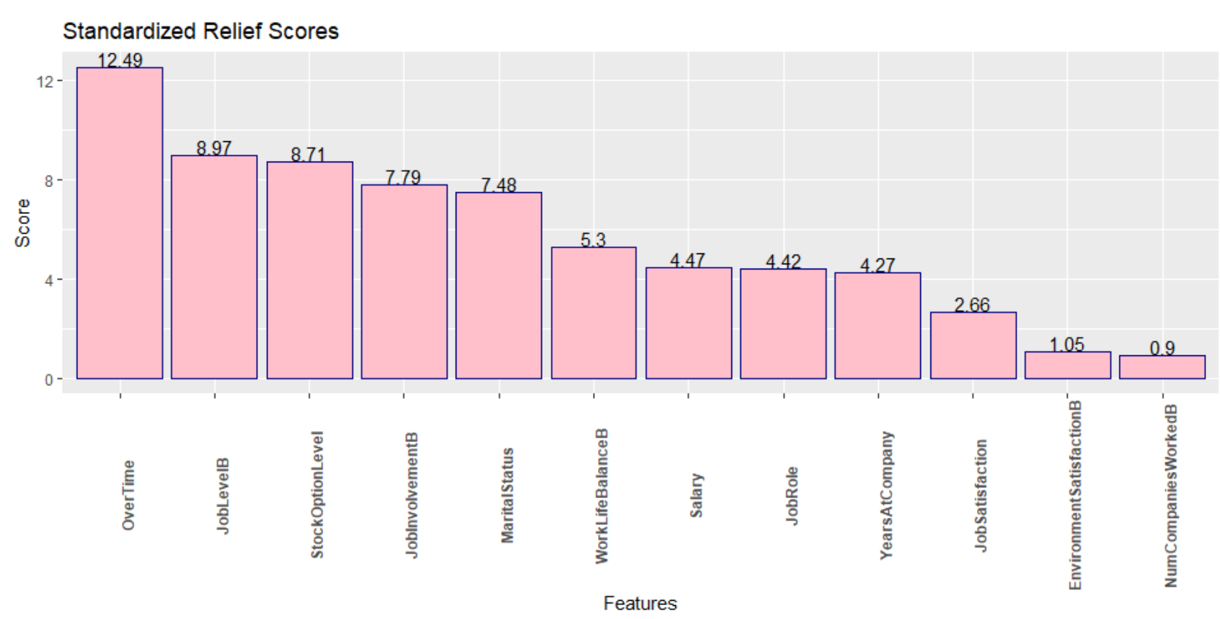
Relief scores
Measures how well a feature can differentiate class members. Looks at nearest “hit” and “miss” to determine the score.
Nearest hit is close by → Increases score. Nearest miss close by → decreases score.

Slide 4
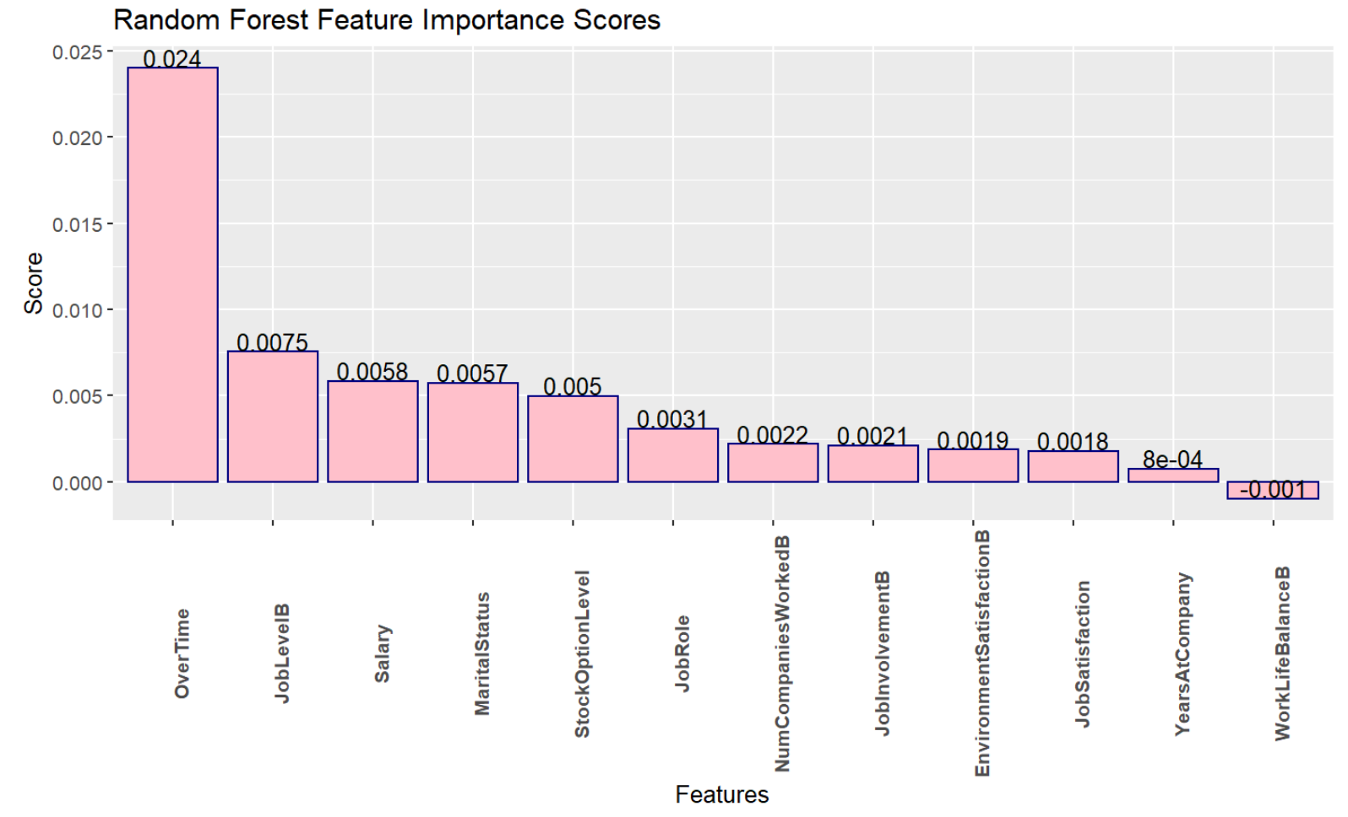
Random forest Feature Importance Scores
Uses the random forest models built in feature selection capability to rank the importance of predictors.

Slide 5
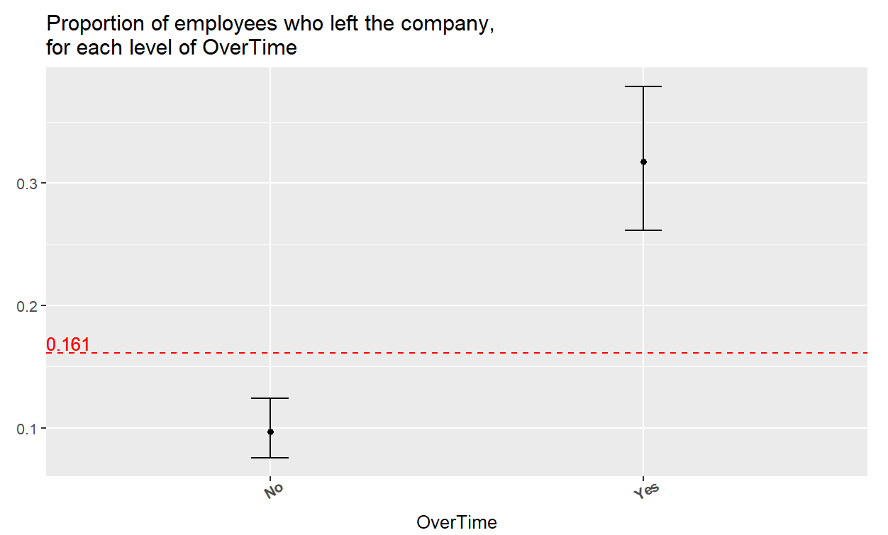
overtime
More than 3x as many people who do overtime work leave the company, as compared to those who do not work overtime.

Slide 6
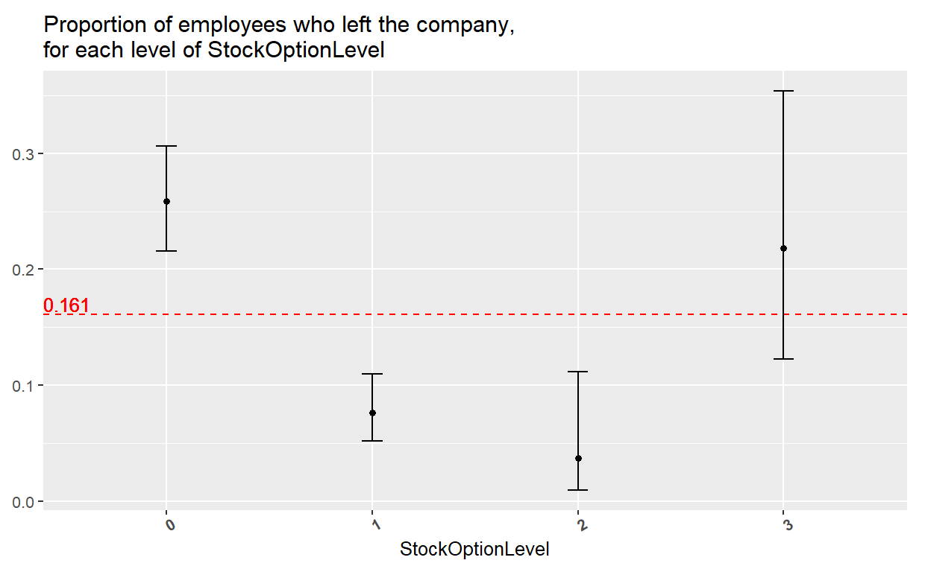
Stock option level
Very powerful feature because it summarizes the career lifecycle.

Slide 7
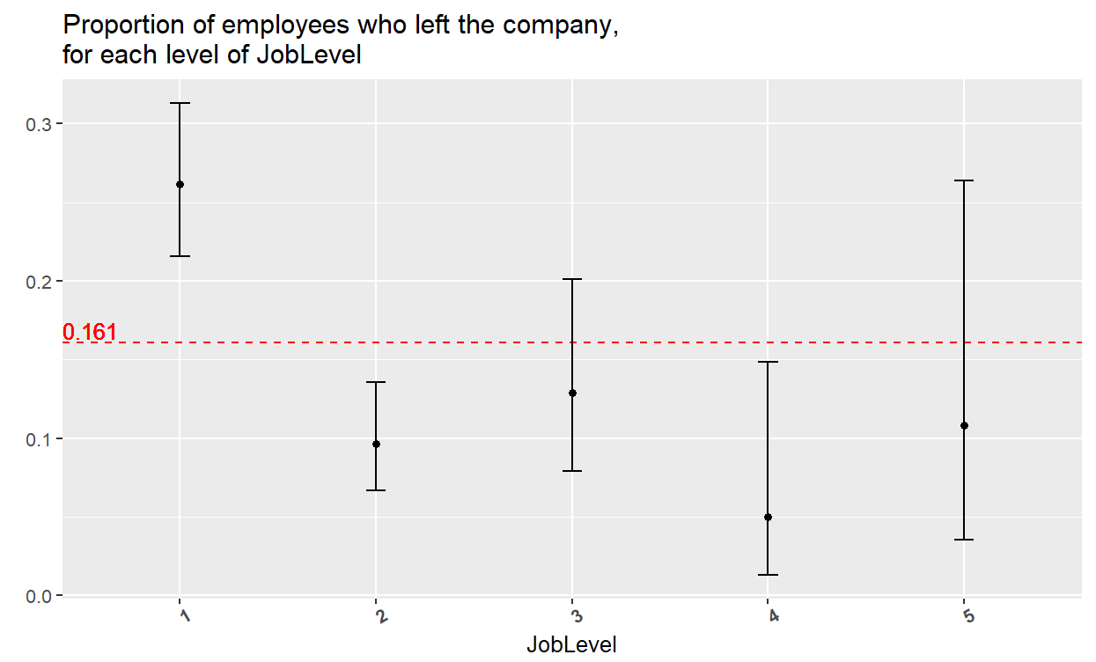
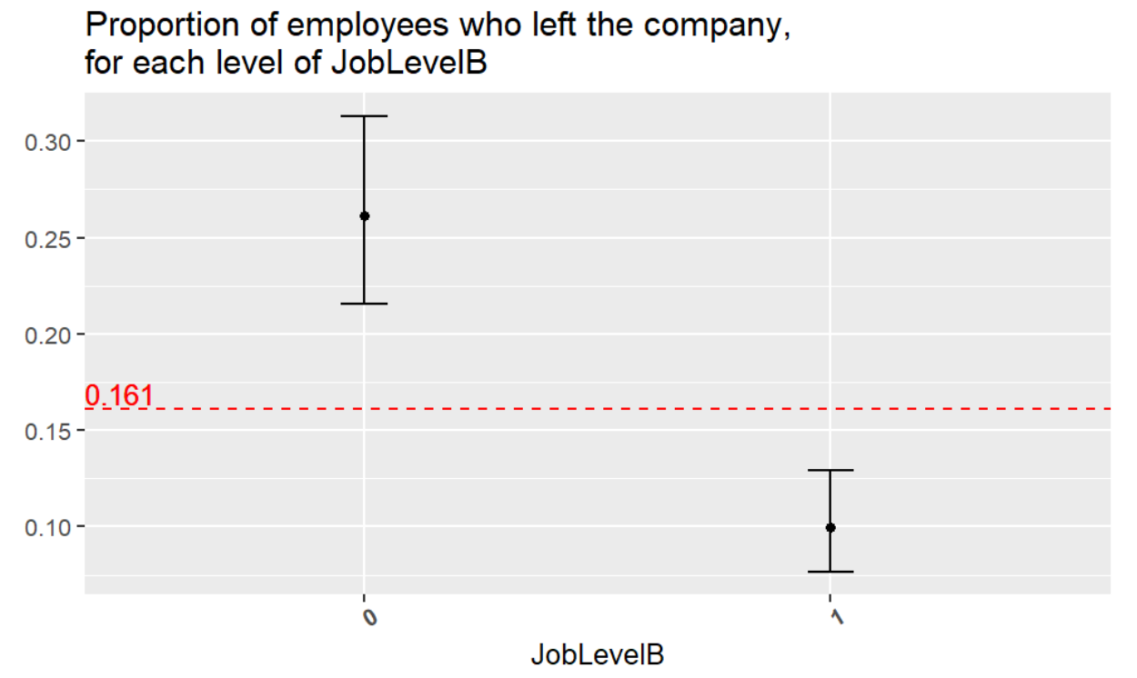
joblevelb
Original Feature
Binned Version
The proportion of attrition is more than twice as high for individuals with a job level of 1 than it is for the combined population of all other possible job levels.
Binning is beneficial because it:
Reduces the complexity of the relationship we seek to model.
Pooling similar categories allows us to get better estimates (tighter confidence intervals).

Slide 8
Model | Training Accuracy | Training Specificity | Training Sensitivity | Test Accuracy | Test Specificity | Test Sensitivity | Model Parameters | Features Used
Naïve Bayes | 0.8648 | 0.5595 | 0.9234 | 0.8586 | 0.5500 | 0.9178 | N/A | 12 Predictors OverTime JobLevelB Salary MaritalStatus StockOptionLevel JobRole NumCompaniesWorkedB JobInvolvementB YearsAtCompany WorkLifeBalanceB EducationField Gender
KNN | 0.9114 | 0.5928 | 0.9726 | 0.8436 | 0.3857 | 0.9315 | k=1 | Six Predictors OverTime StockOptionLevel JobLevelB MaritalStatus JobSatisfaction Education
Support Vector Machine | 0.8781 | 0.60 | 0.9315 | 0.7954 | 0.4857 | 0.8547 | - Polynomial Kernel - Degree 3 - Cost = 7.720323 - Gamma = 10.39 | Eight Predictors OverTime JobLevelB StockOptionLevel JobInvolvementB MaritalStatus WorkLifeBalanceB Salary JobRole

Slide 9
Predicting monthly income with linear regression
Evaluation Method:
Repeated 10 fold cross validation, with 3 repeats.
Predictors
Evaluation Metrics
1) Education
Training RMSE = 1020.05
2) JobLevel
Test RMSE = 1021.53
3) JobRole
4) Age
Agreement between the training and test metrics indicates this model likely does not suffer from overfitting, and should generalize well to new observations from the same population.

Slide 10
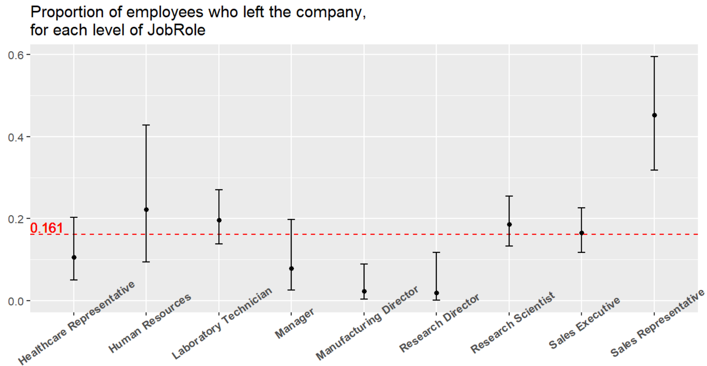
JOB ROLE SPECIFIC TRENDS
Sales Representatives have the highest proportion of attrition of all job roles.

Slide 11
Thank you for your time
Any questions?

Slide 12
Back-up slides

Slide 13
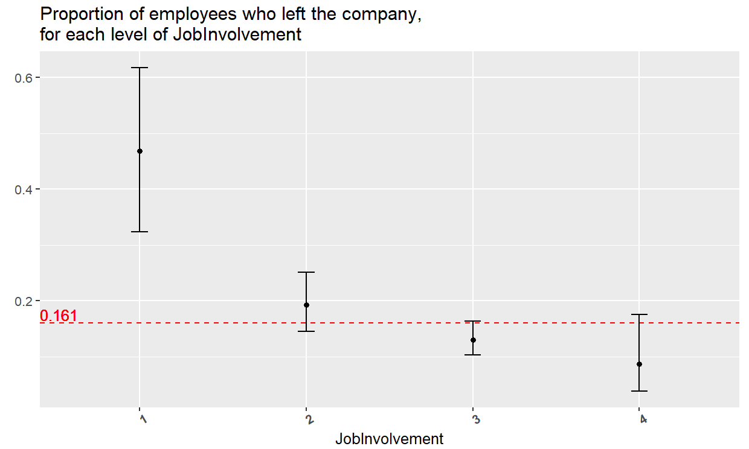
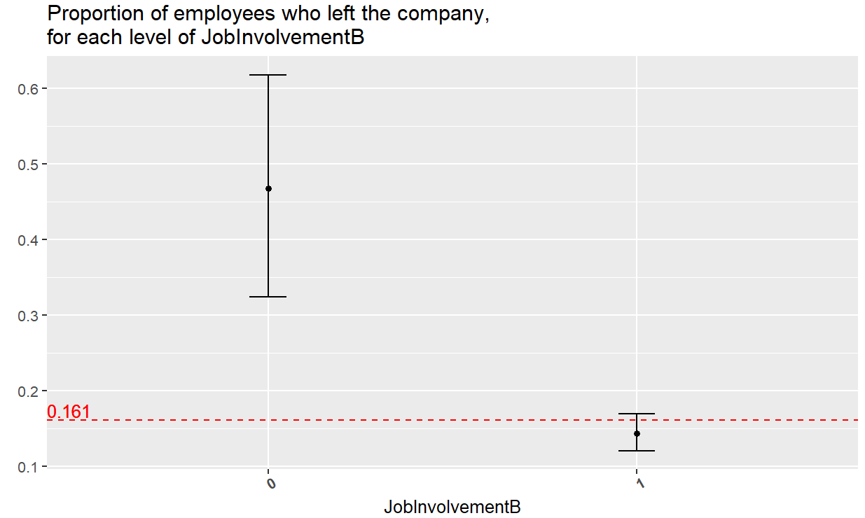
jobinvolvementb
Original Feature
Binned Version
The proportion of Attrition is more then 3x higher for individuals with a job involvement score of 1 than all other possible scores combined.

Slide 14
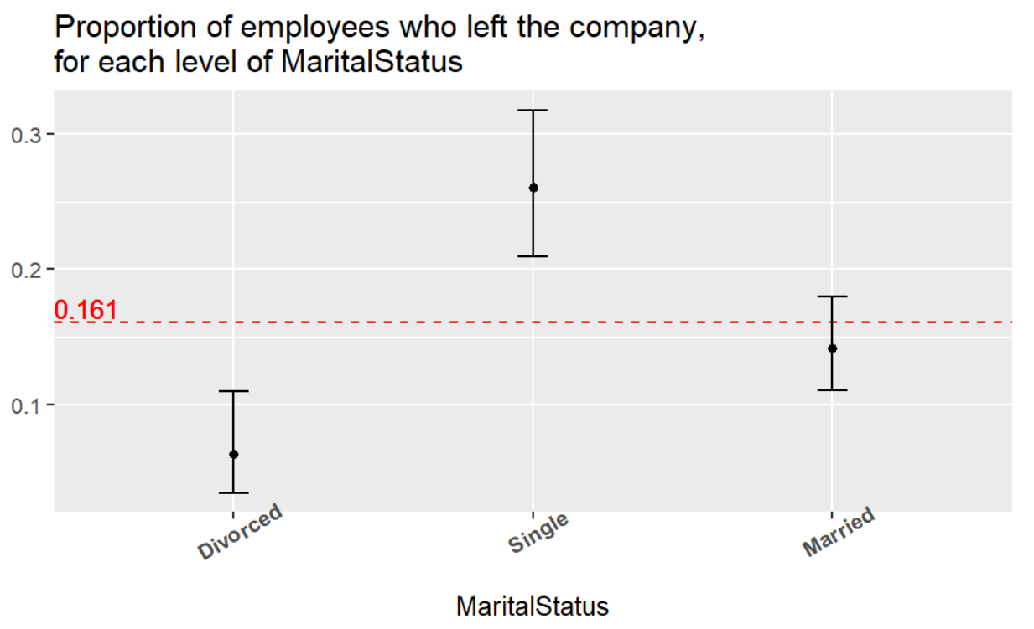
Marital status
Groups with least attrition → most attrition
Divorced individuals → Married Individuals → Single Individuals

Slide 15
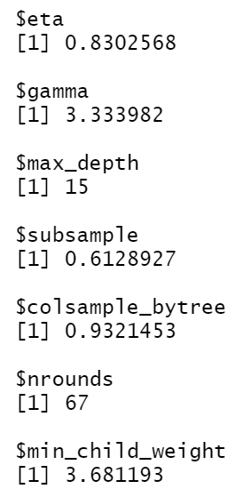
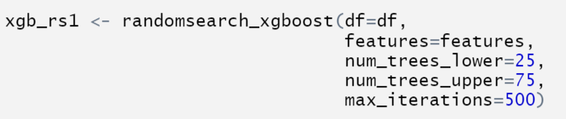
Xgboost random search 1

Slide 16
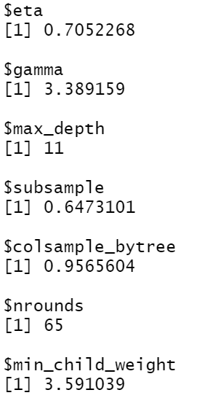
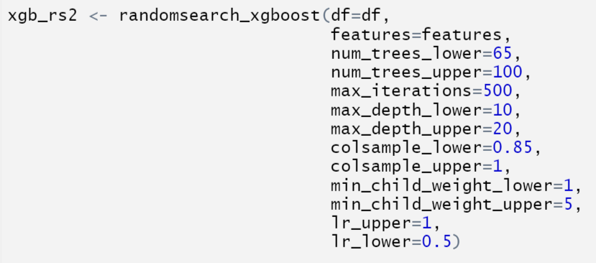
Xgboost random search 2

Slide 17
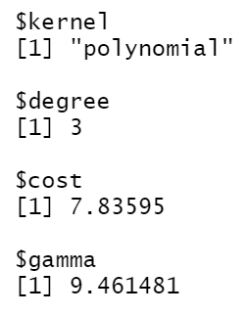
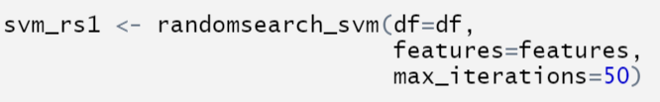

Svm 1

Slide 18
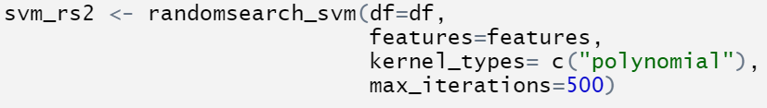
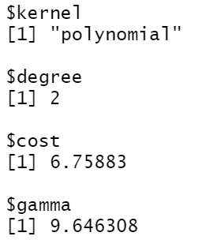
Svm 2

Slide 19
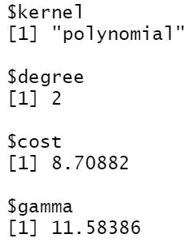
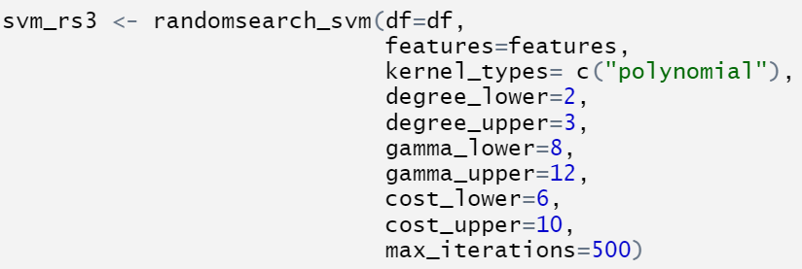
Svm 3

Slide 20
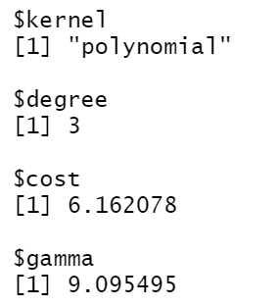
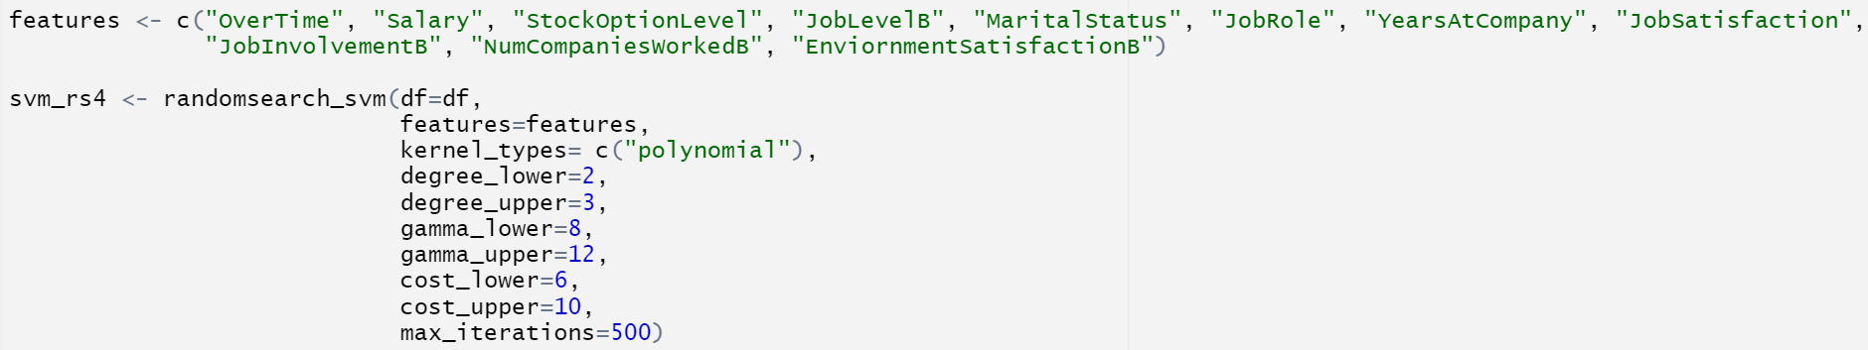

Svm 4

Slide 21
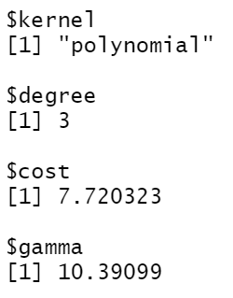
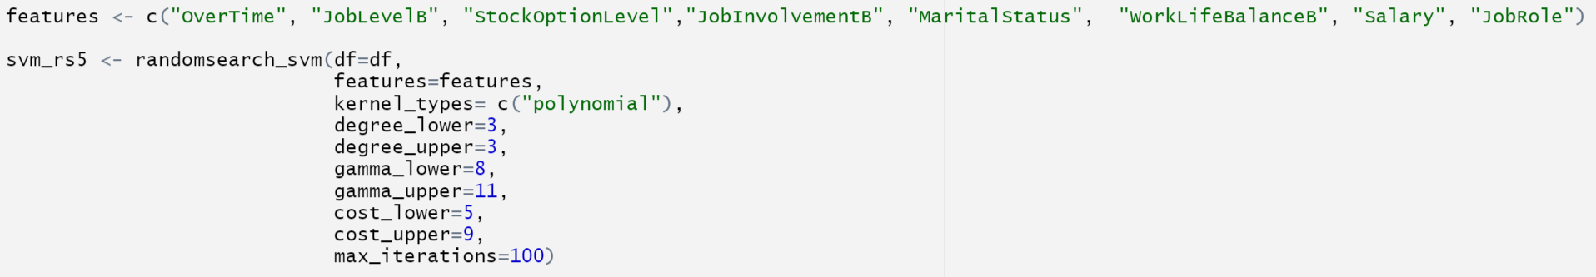
Svm 5

Slide 22
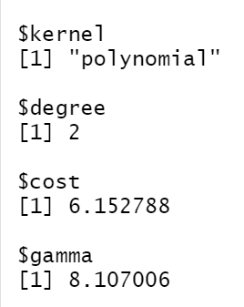
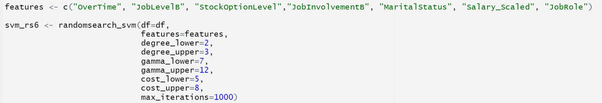
Svm 6

Slide 23
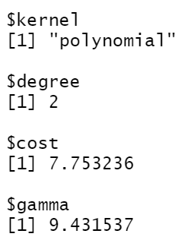
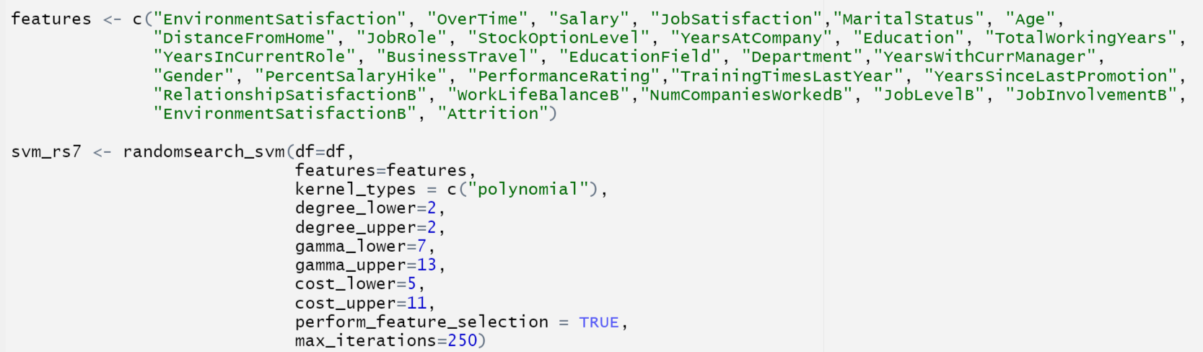
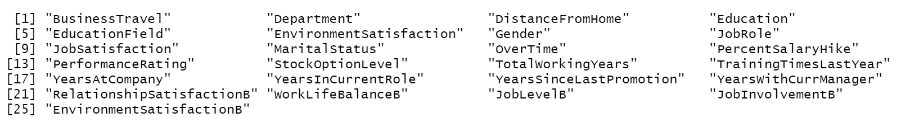

Svm 7

Slide 24
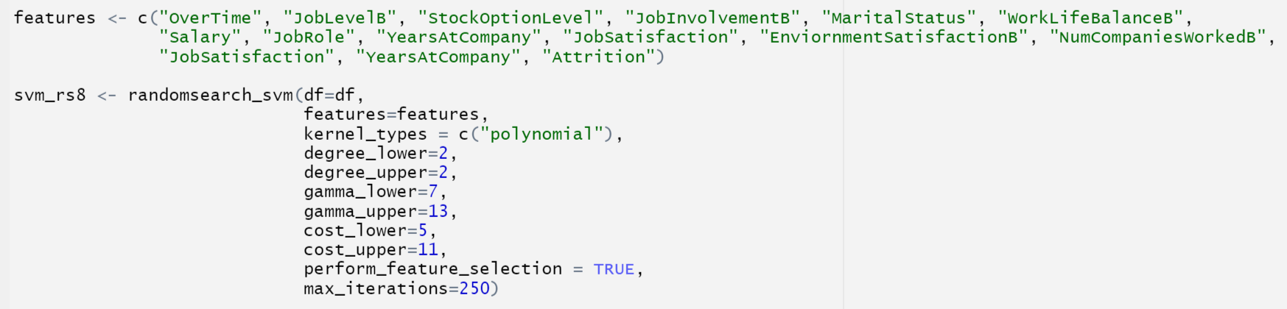
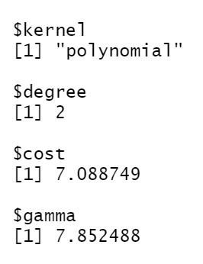
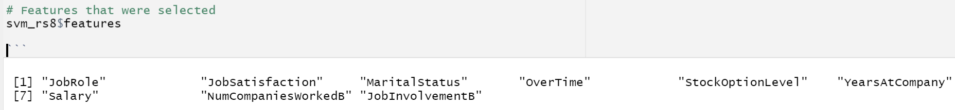
Svm 8

