Slide 1
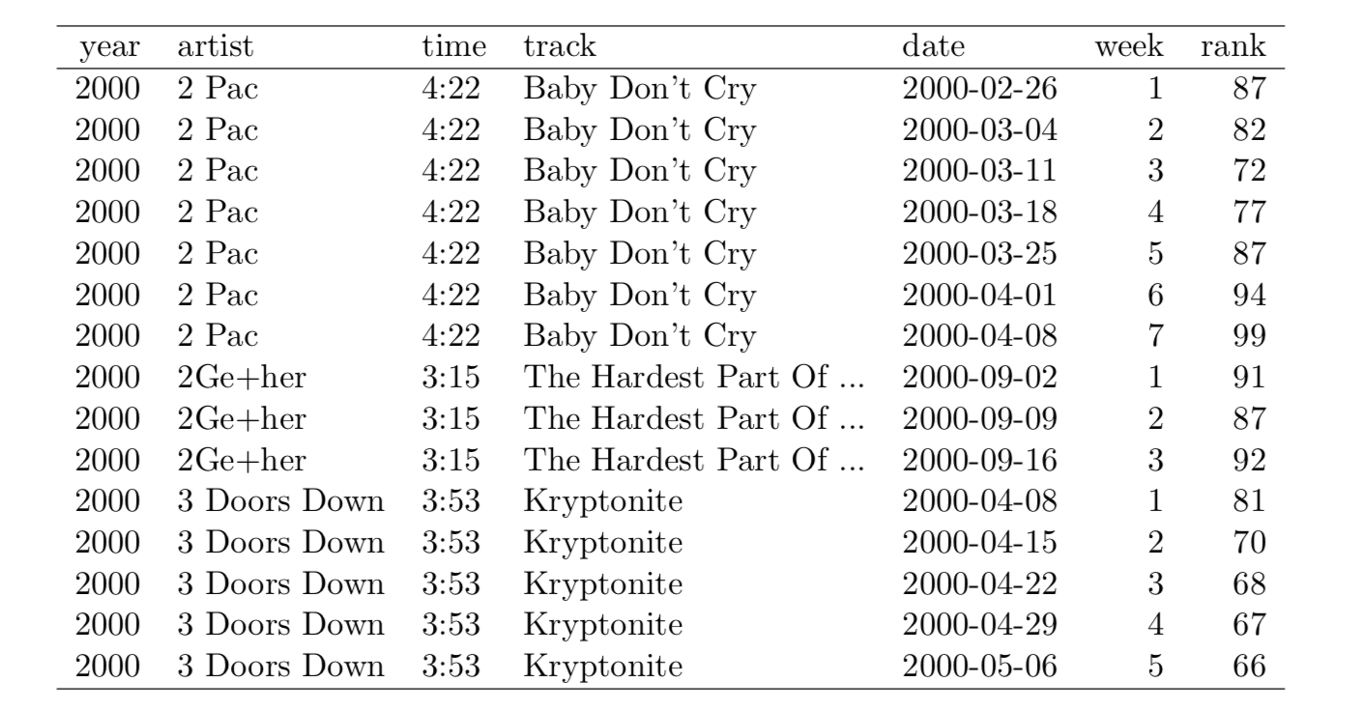
R likes tidy data
Wickham 2014

Slide 2
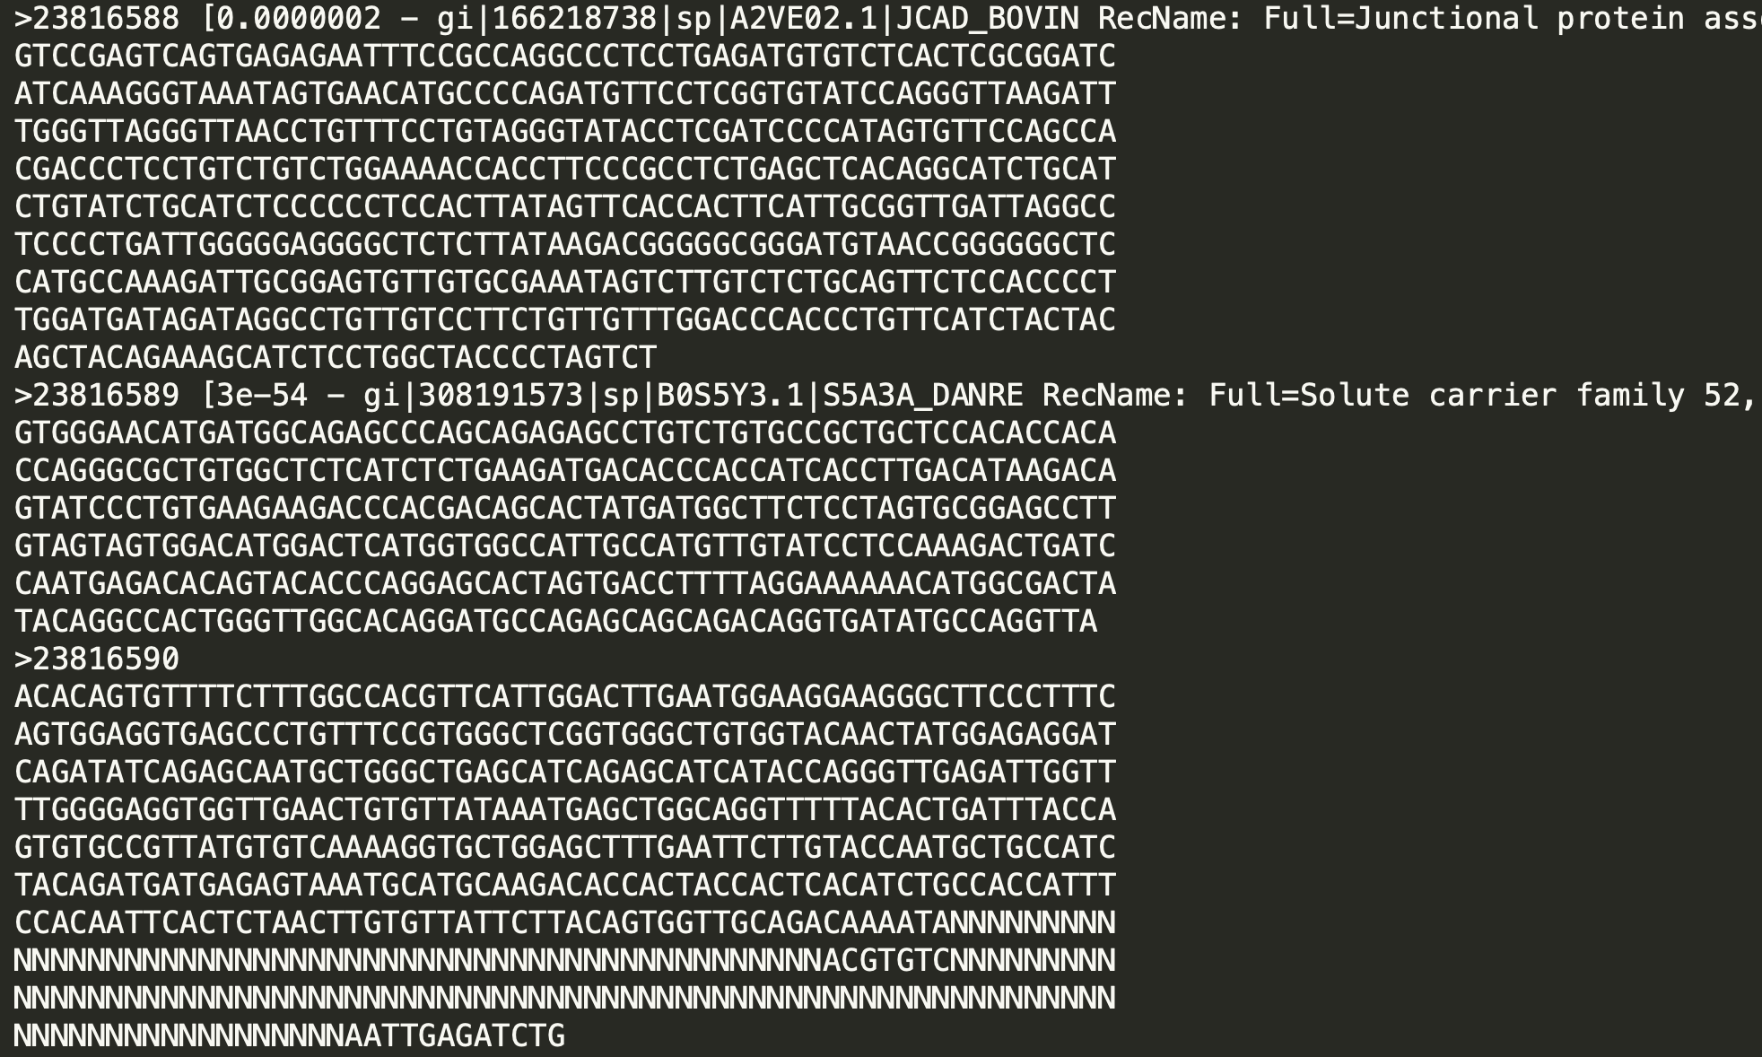
Most real life data is not tidy

Slide 3
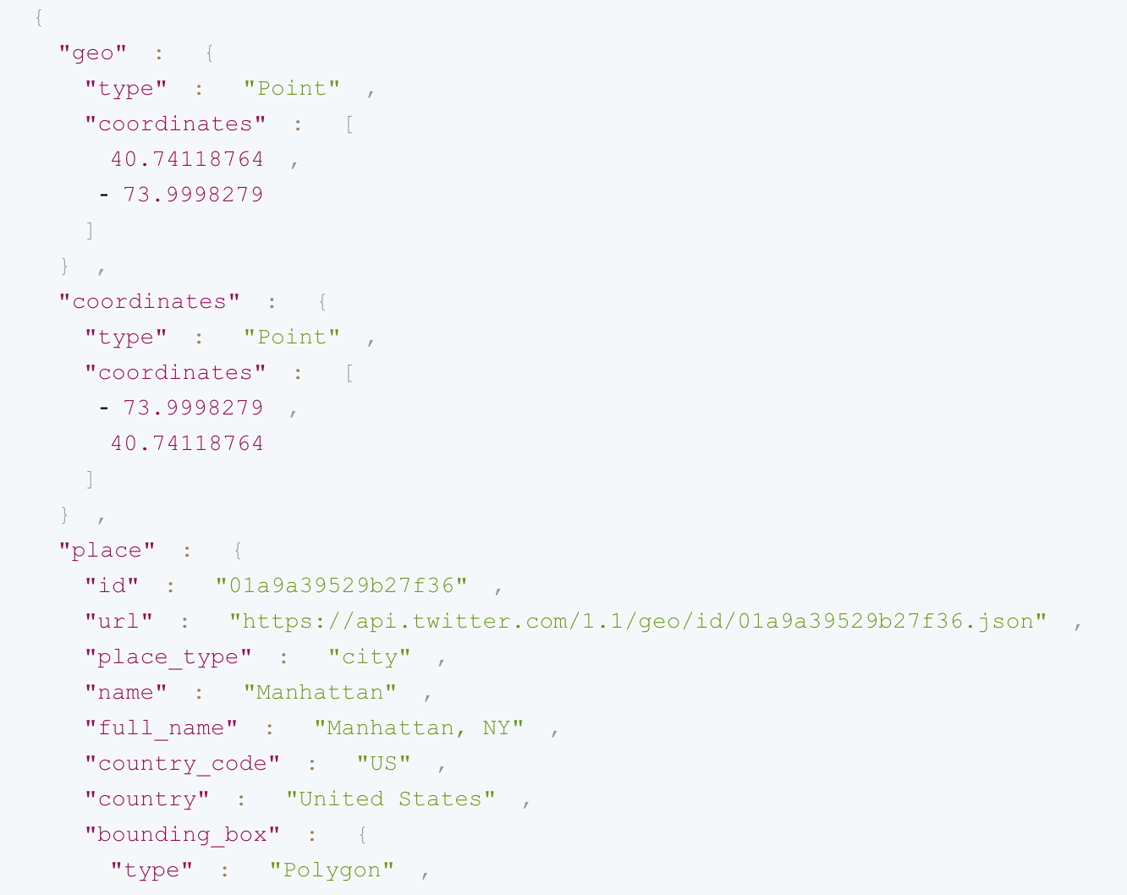
Most real life data is not tidy
JSON Data
structured,
not tidy

Slide 4
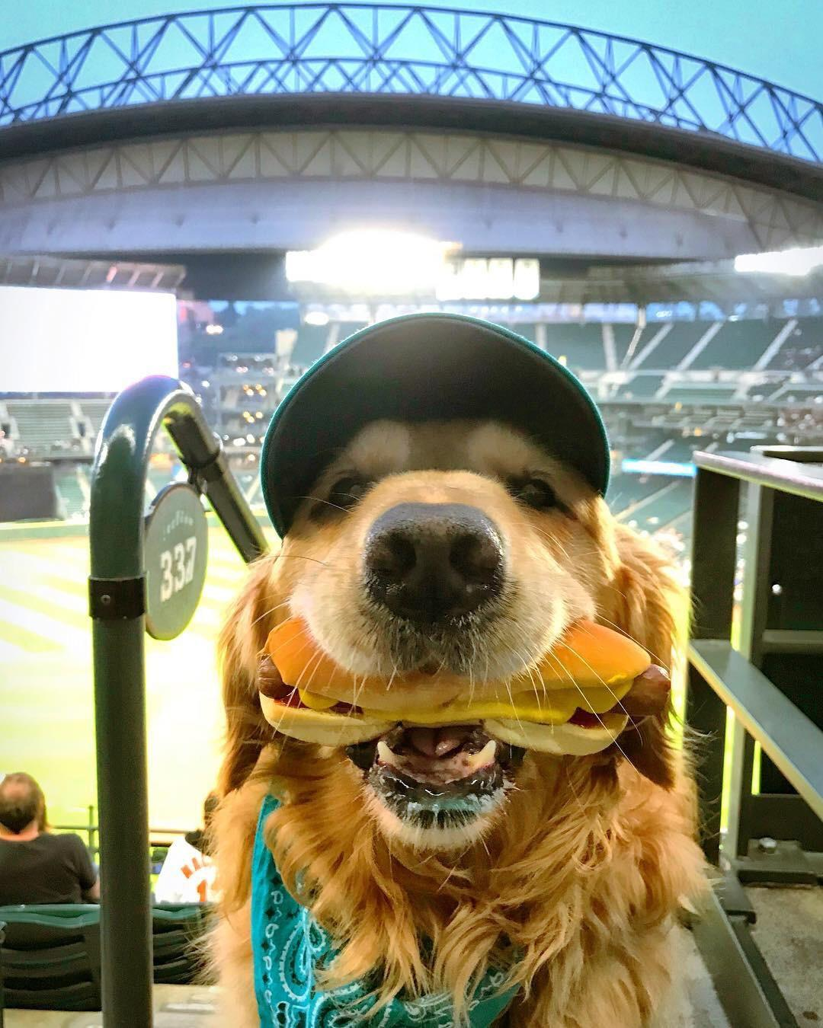
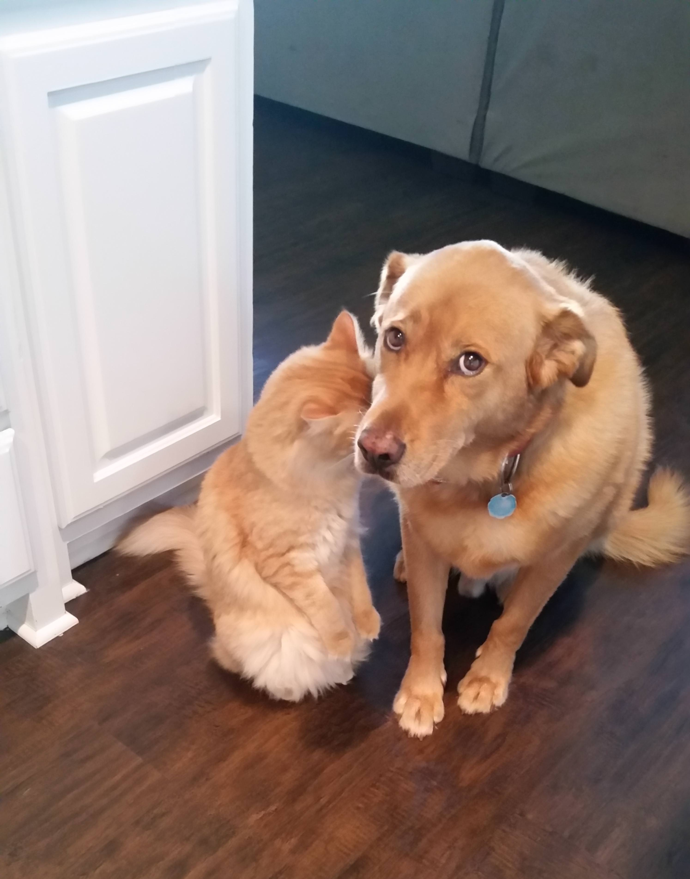
Most real life data is not tidy

Slide 5
Todays topics
Reading messy data into R
“String manipulation”
c(“String”, “manipulation”)
Constructing tidy data from scratch
Using functions to simplify the above

Slide 6
R basic data types
Character (aka String): “1” or “words”
Logical (aka Boolean): TRUE/FALSE or 1/0
Try this: TRUE == 1 && FALSE == 0
Integer: 1, 1138
Double (aka floating point): 1.0, 17.38

