Slide 1
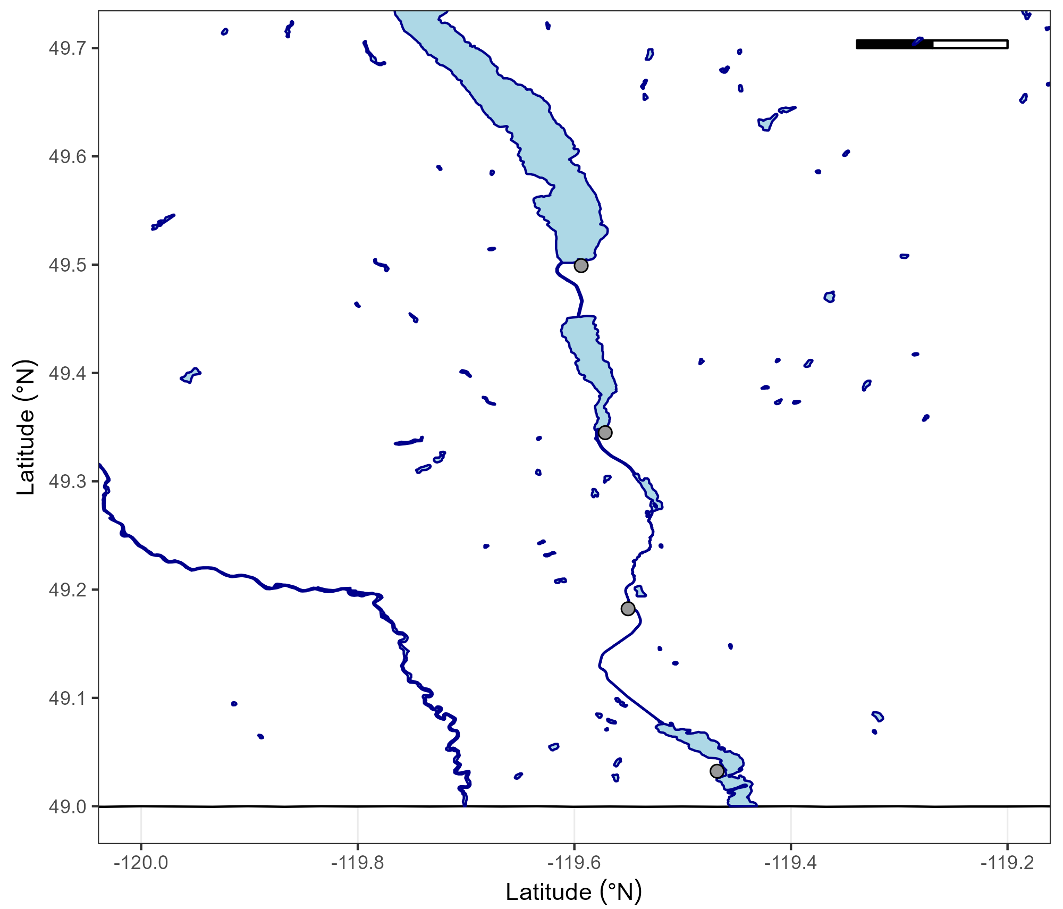
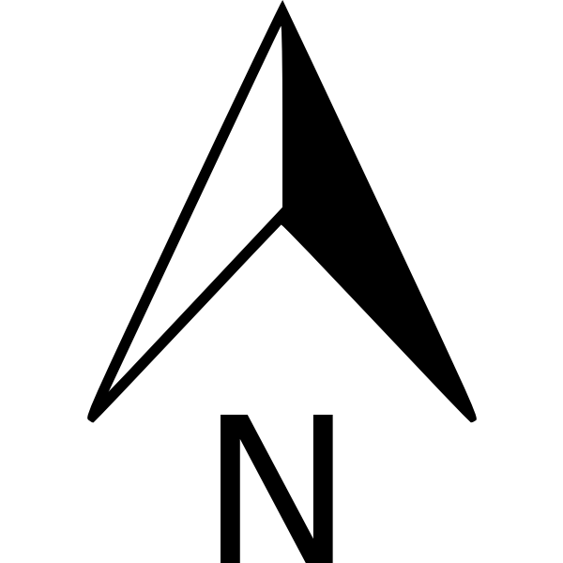
50km
Okanagan Lake
Penticton
Skaha Lake
Skaha Lake
Okanagan Falls
Vaseaux Lake
Oliver
Similkameen River
Okanagan River
Osoyoos
Osoyoos Lake

Slide 2
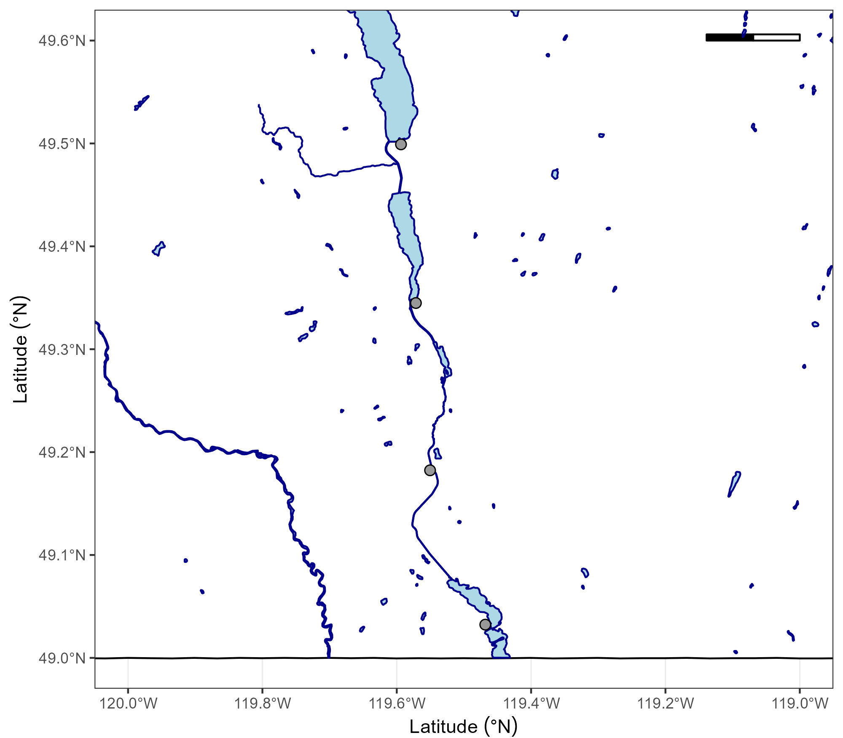
Okanagan Lake
50km
Shingle Creek
Penticton
Skaha Lake
Okanagan Falls
Vaseaux Lake
Oliver
Okanagan River
Similkameen River
Osoyoos
Osoyoos Lake

Slide 3
Okanagan Lake
50km
Penticton
Shingle Creek
Skaha Lake
Okanagan Falls
Vaseaux Lake
Okanagan River
Oliver
Similkameen River
Osoyoos
Osoyoos Lake

Slide 4
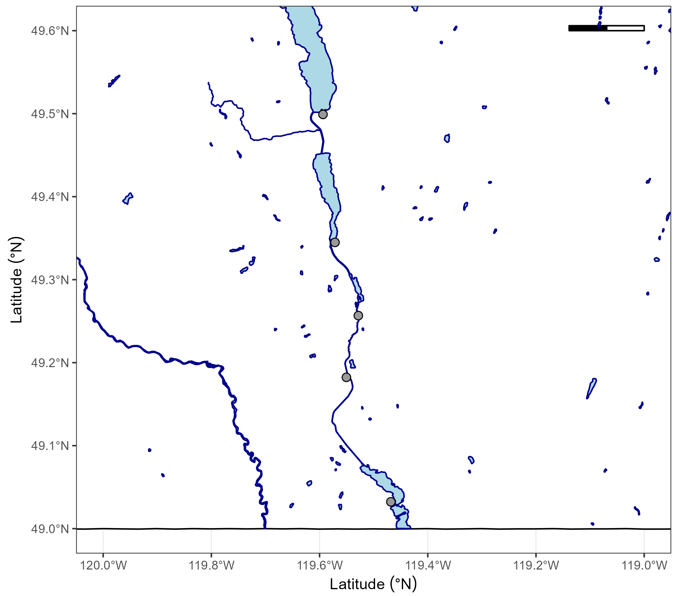
Okanagan Lake
50km
Penticton
Shingle Creek
Upper Okanagan
Skaha Lake
Okanagan Falls
Middle Okanagan
Vaseaux Lake
McIntyre Dam
Okanagan River
Naturalized
Lower Okanagan
Oliver
Channelized
Similkameen River
Osoyoos
Osoyoos Lake

