Slide 1
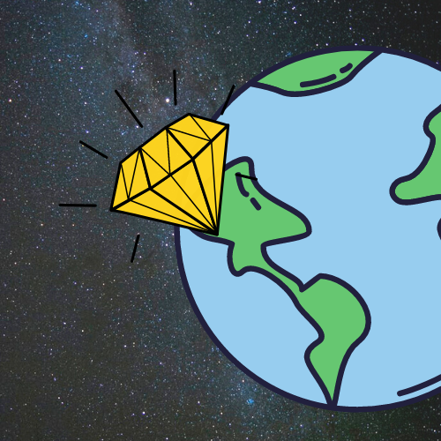
Gemma
The Furious Five
(Rebecca DiCosola, Grace Jung, Eleanor Lee, Oscar Schott, and Braden Weber)
Notes:
Eleanor kicks off

Slide 2
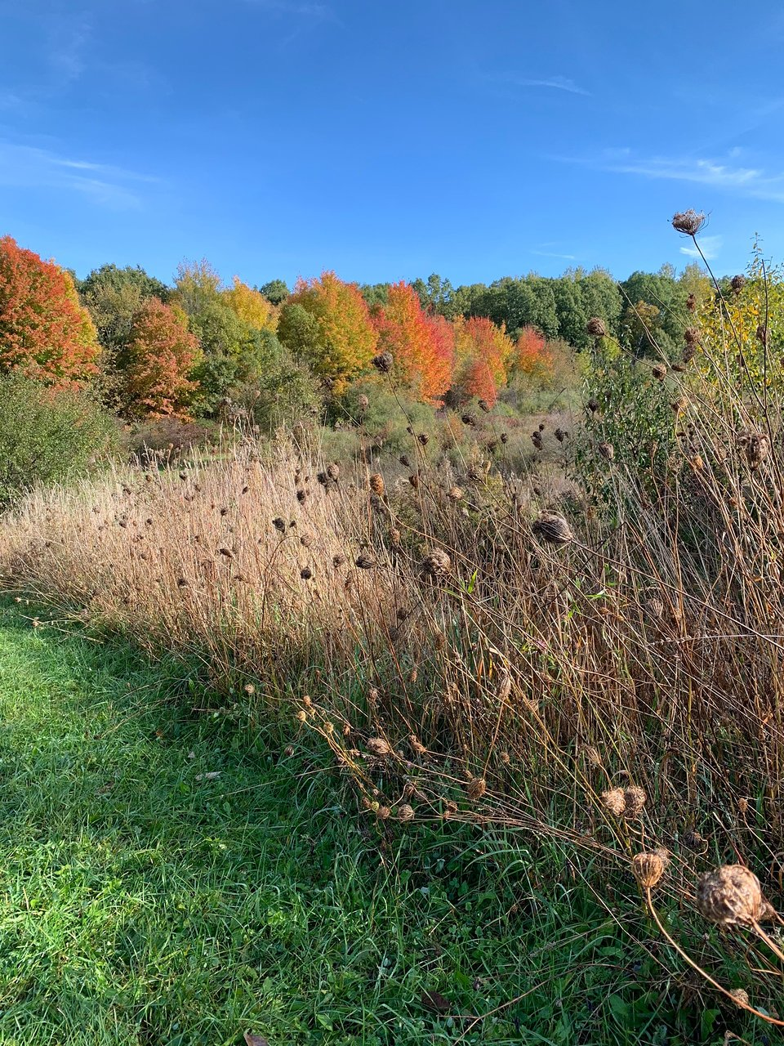
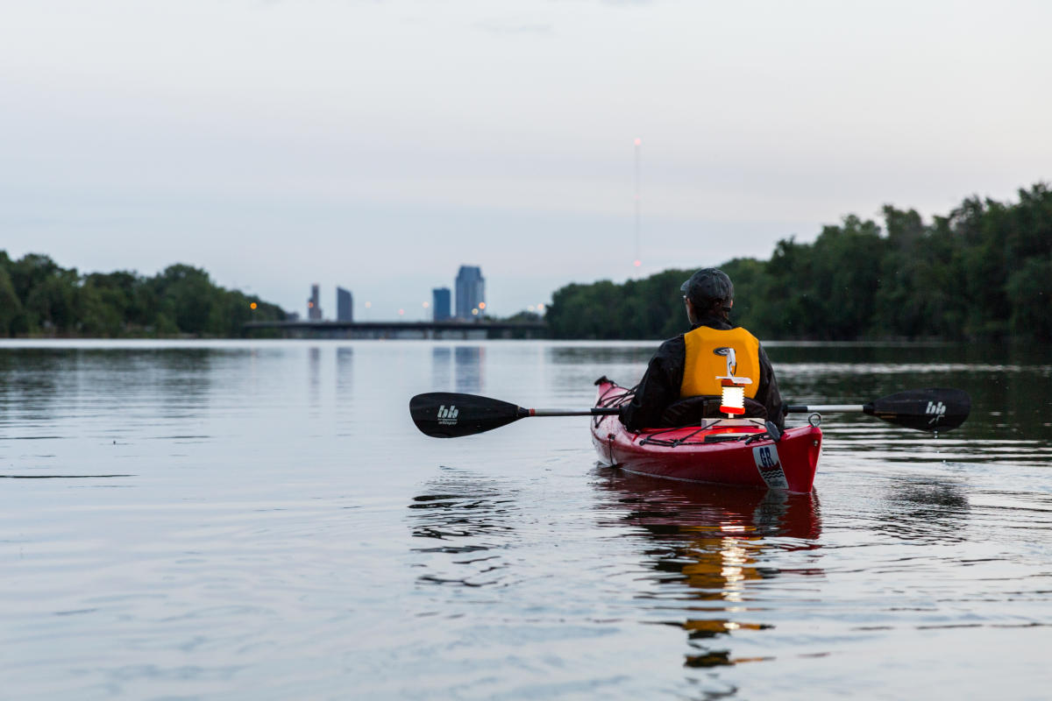
Vision
Outside!
What are your favorite outdoorsy activities?
Enter Gemma...
TripAdvisor
Experience Grand Rapids
Notes:
- Eleanor does opening: Who here likes the outdoors?
- In this day and age, it's more important than ever to soak in the peace of nature
- What do you like to do outdoors?
- How do you decide where to go to watch birds, hike, ski, etc.?
- I like the outdoors, too, but whenever I want to go somewhere... it takes me an hour of Googling/tabs/research
- Our go-to map apps take us to buildings, cities, and roads; they don't help us leave those things behind
- That's why we're making Gemma

Slide 3



What's Gemma?
Geolocation tool
Say what?
Demo time!
Notes:
Gemma is a geolocator app for the outdoorsperson in all of us. It's for hardcore hikers, campers, rock climbers, skateboarders... people who enjoy a nice walk to see the sunset.
How does it work?
Braden demos user story – pin placing, board search

Slide 4
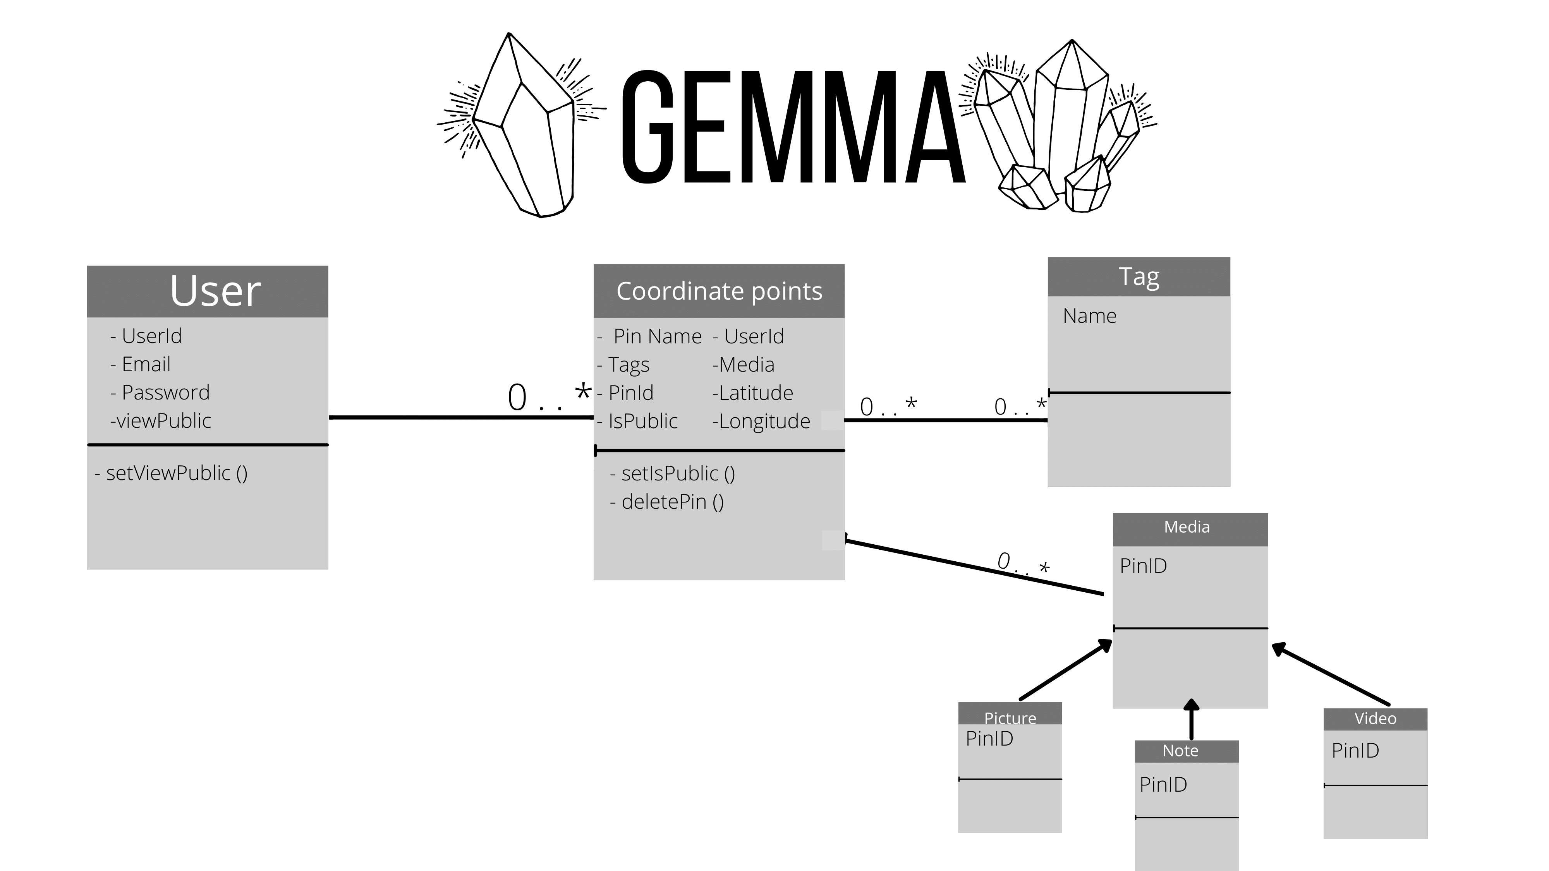
Wow! How'd you do that?
0 . . 1
0 . . 1
Notes:
- We're so glad you asked!
- Rebecca presents Domain model in context of information systems (what's stored where? How does the app access it?)
- technologies used: React Native (free, easy to use, runs on Android and iOS)
- GitHub for code management (free, pretty fire)
- ElephantSQL for data service (free, works well)
- Adobe illustrator, Figma for Domain/UI models (we had them, or they're free, and they're really cool)

Slide 5

Information Systems
AUser(UserID, emailAddress, passphrase, viewPublic)
Coordinates(UserID, pinID, pinName, longitude, latitude)
Tag(tagID, tagName, pinID)
Media(pinID)
Notes:
Grace presents Information Systems

Slide 6
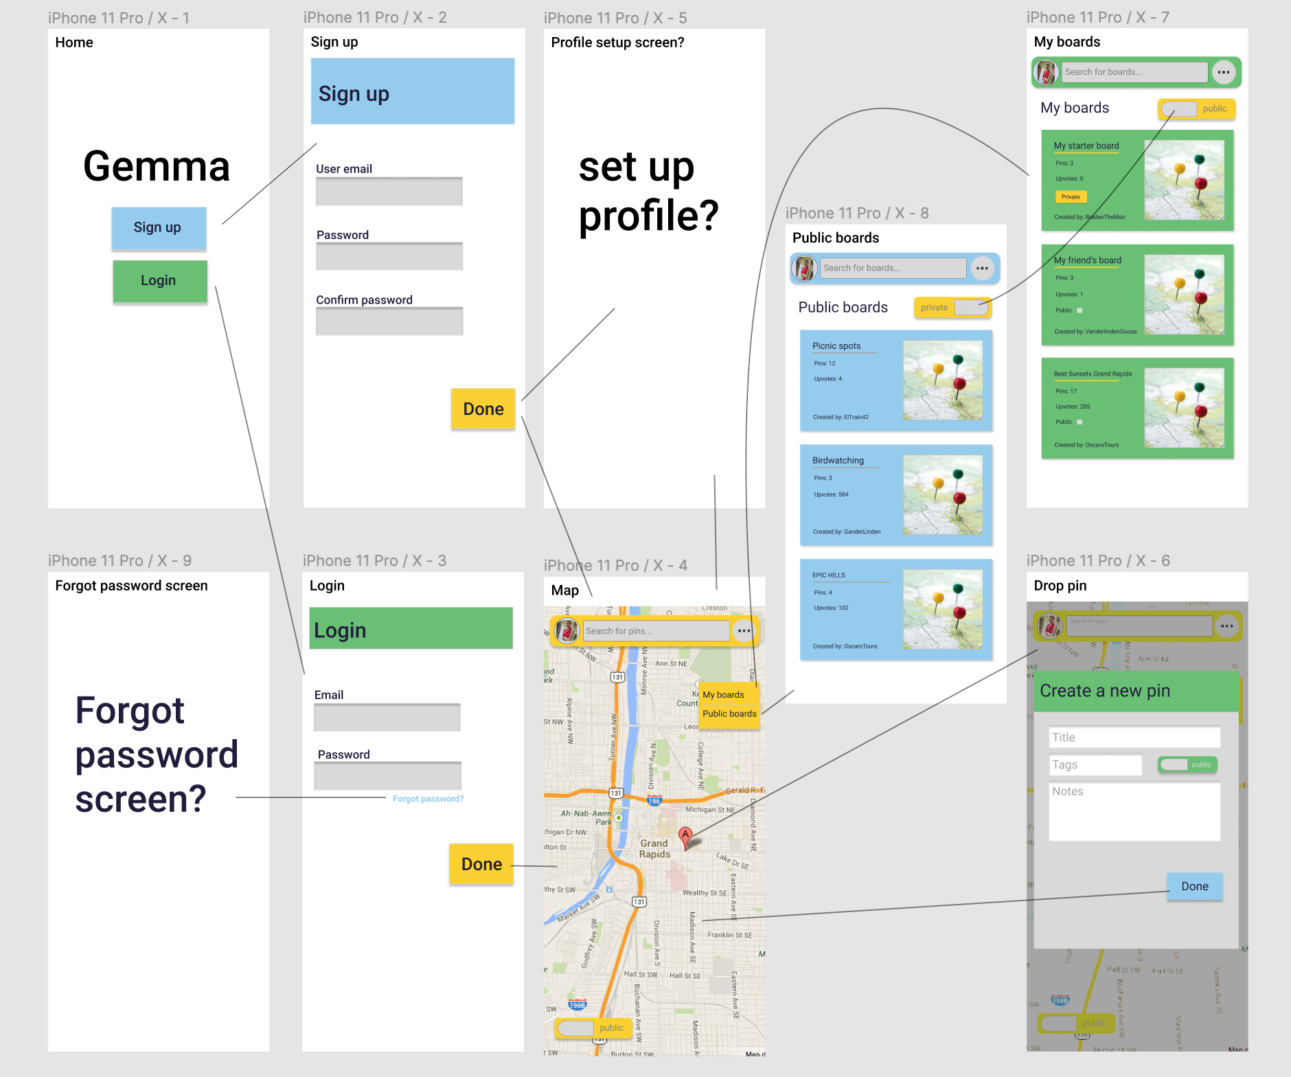

UI Design
Notes:
- mention color palette
- missing profile/forgot password screens: things we've now added in
- boards: not yet added in

Slide 7

Moving forward?
Integrate client and server!
Enable pin sharing & searching
Store pins together as "boards"
Notes:
Oscar?

Slide 8
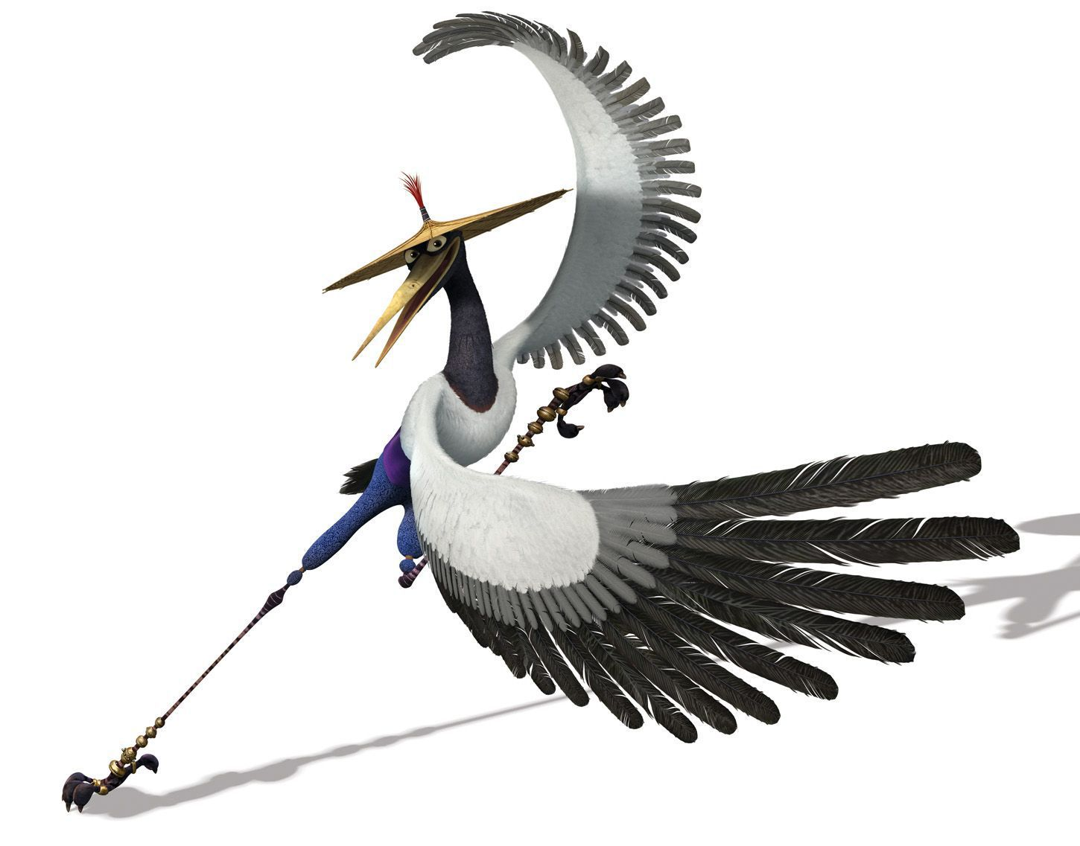
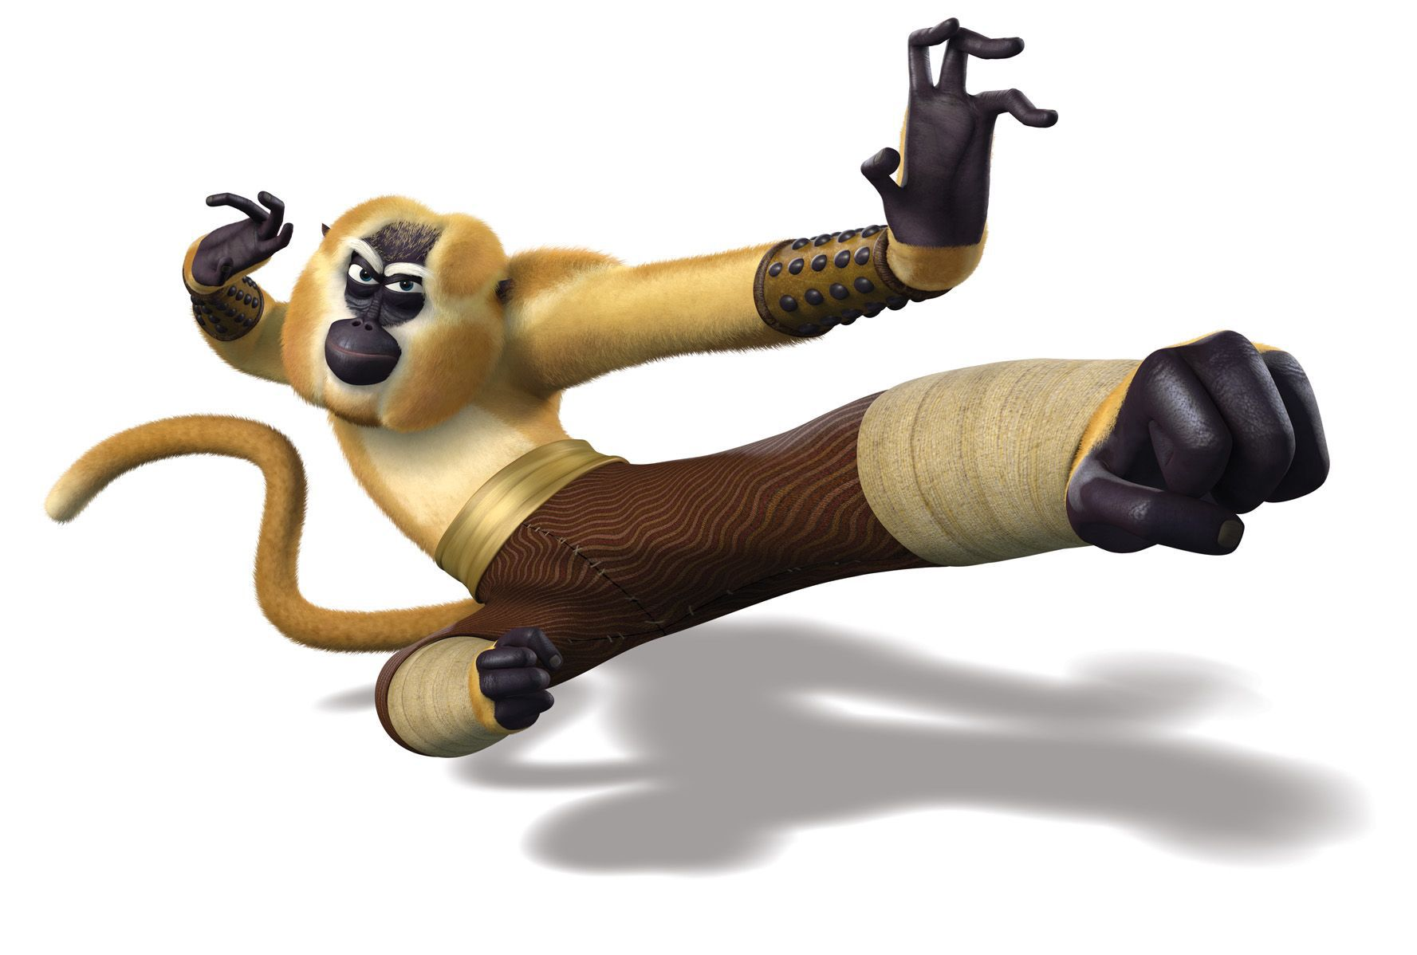



Thanks for listening!
Y'all are real gems ;)
-The Furious Five

Slide 9
Questions?
Notes:
Oscar moderates?

