Slide 1







DESIGNING USER INTERFACES AND WORKING WITH DATABASE
Abdulhameed Yunusa
Lecturer in Computer Science

Slide 2
Outline
Introduction to Package Managers (NPM and PIP)
Designing User Interfaces
Introduction to ‘Streamlit’ for UI design
Setting up your ‘Dev Environment’
Working with Database
Integrating database with code
Introduction to REST APIs

Slide 3

Get started Clone the repository
Repository URL
https://github.com/Bradford-College/Desigining-User-Interfaces-and-Working-with-Databases

Slide 4

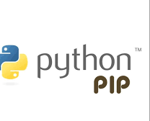
Introduction to Package Managers (NPM and PIP)
A package manager is a tool that automates the process of installing, upgrading, configuring, and removing software packages.
NPM (Node Package Manager) is the default package manager for JavaScript/Node.js, while PIP (Python Package Installer) is used for Python.

Slide 5
Python Package Installer (PIP)
Language: Python.
Usage: Manages Python packages (libraries, frameworks, etc.), ensuring smooth Python environment setups.
Commands: pip install <package>: Installs a package.
pip freeze: Lists installed packages.

Slide 6
Example of Python Package Installer (PIP)
Streamlit, a Python package, can be installed via PIP:
pip install streamlit
Streamlit allows rapid UI creation for data apps in Python, using minimal code and integrating seamlessly with other Python libraries.

Slide 7
Designing User Interfaces
UI Design Principles:
Clarity: Make the interface intuitive and self-explanatory.
Consistency: Ensure elements behave consistently to avoid user confusion.
User-Centricity: Design with the end user in mind, focusing on usability and accessibility.

Slide 8
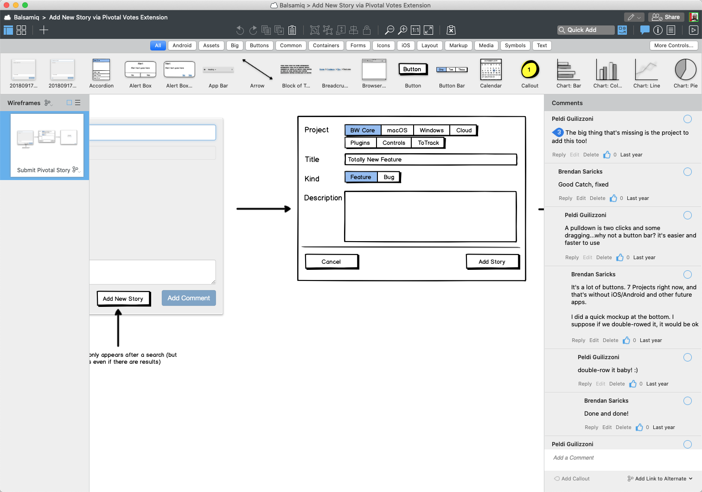
Types of Mockups
Low Fidelity Mockups:
Rough representations focusing on the overall structure and layout.
Tools: Balsamiq (easy drag-and-drop interface).
Purpose: Early-stage designs for discussing concepts.

Slide 9
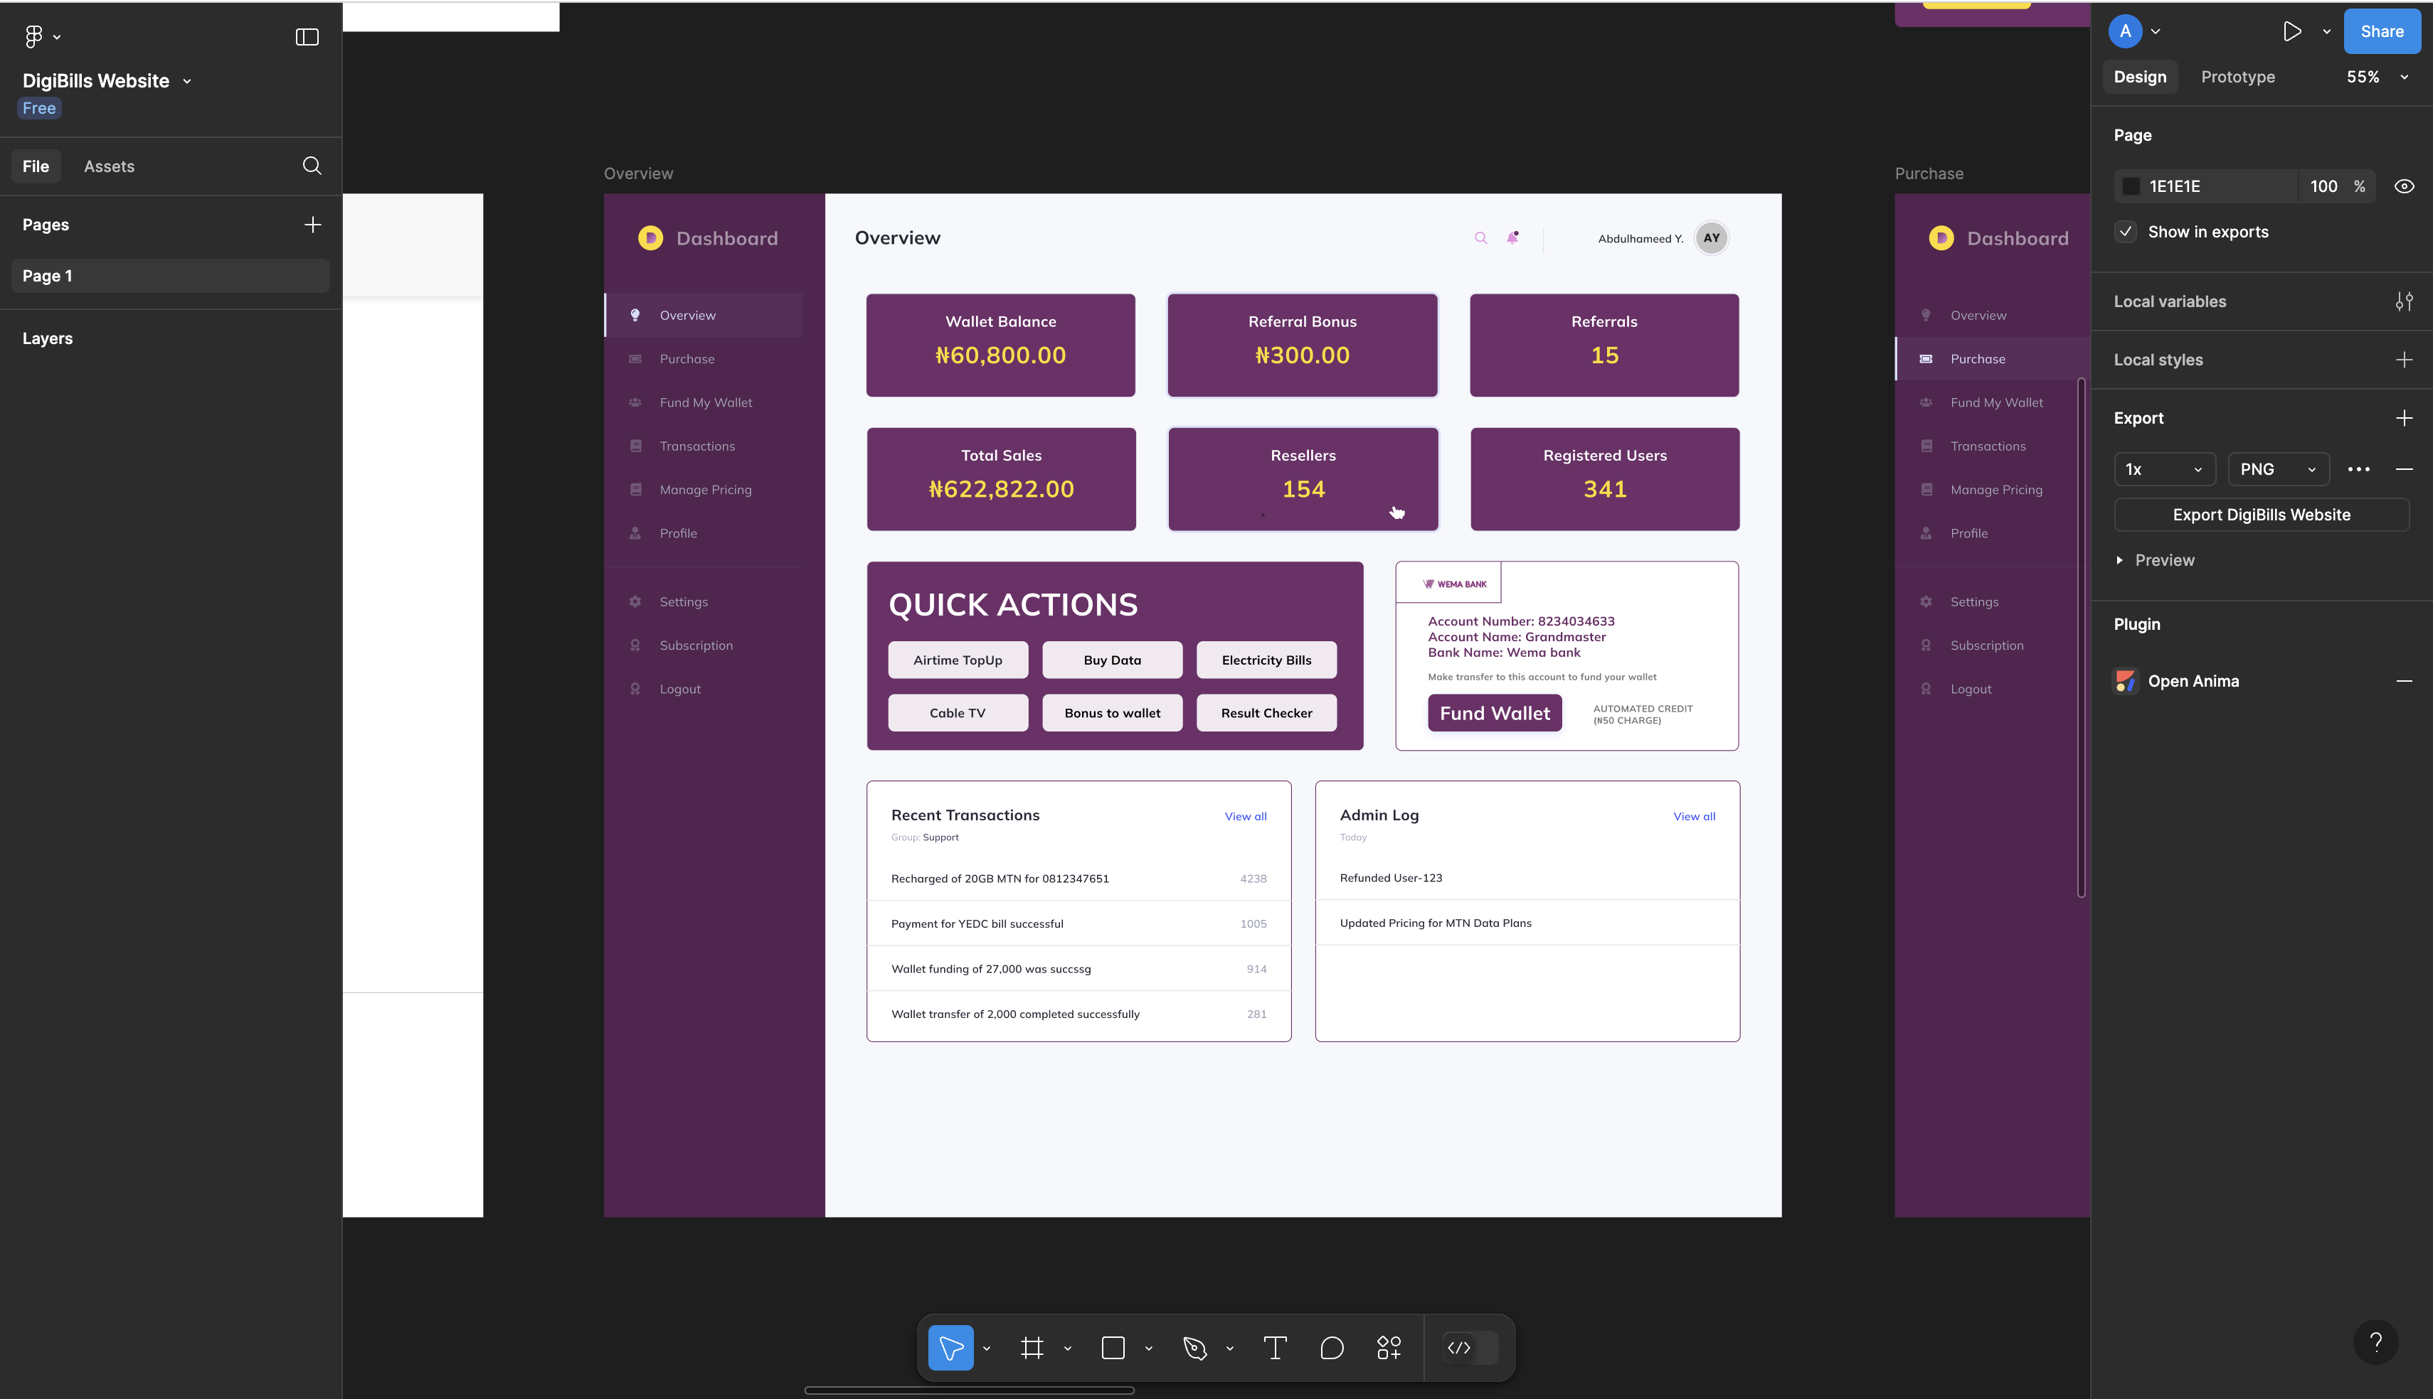
Types of Mockups
High Fidelity Mockups:
Detailed and polished, closely resembling the final product.
Tools: Figma (collaborative design tool).
Purpose: Fine-tuning details, making final adjustments before development.

Slide 10
Best Practices
Keep navigation simple and intuitive.
Ensure responsiveness for various devices (mobile, tablet, desktop).
Use visual hierarchy to direct user attention to key elements.
Maintain consistency with colors, fonts, and buttons throughout the application.

Slide 11

Introduction to
What is Streamlit?
Streamlit is an open-source Python library that allows you to create beautiful, custom web apps for data science and machine learning projects quickly and easily.
Ideal for building interactive applications with just Python code.

Slide 12
Features of
Interactive widgets: Buttons, sliders, checkboxes, etc.
Data visualization: Integrates with libraries like Matplotlib, Plotly, and Altair.
Real-time updates: Streamlit apps can update in real-time as users interact with them.

Slide 13
Advantages of
No need for front-end skills (HTML/CSS/JS).
Quick prototyping for data-driven applications.
Ideal for data science, machine learning, and business intelligence dashboards.

Slide 14
The ‘Dev’ Environment
The development environment is a collection of tools required to build your project.
To use Streamlit, your dev environment should include:
An IDE (e.g., VSCode).
The Python interpreter installed.
The Streamlit Python package installed.
Python is required to install PIP, which allows us to install Streamlit.

Slide 15
The App Structure
Widgets: Interactive elements like sliders, buttons, etc.
Sidebar: For organizing controls.
Main area: For displaying data and visuals.

Slide 16
Running a Streamlit App
Install Streamlit:
pip install streamlit
Create a Python script:
Example: app.py
Run your app:
streamlit run app.py

Slide 17
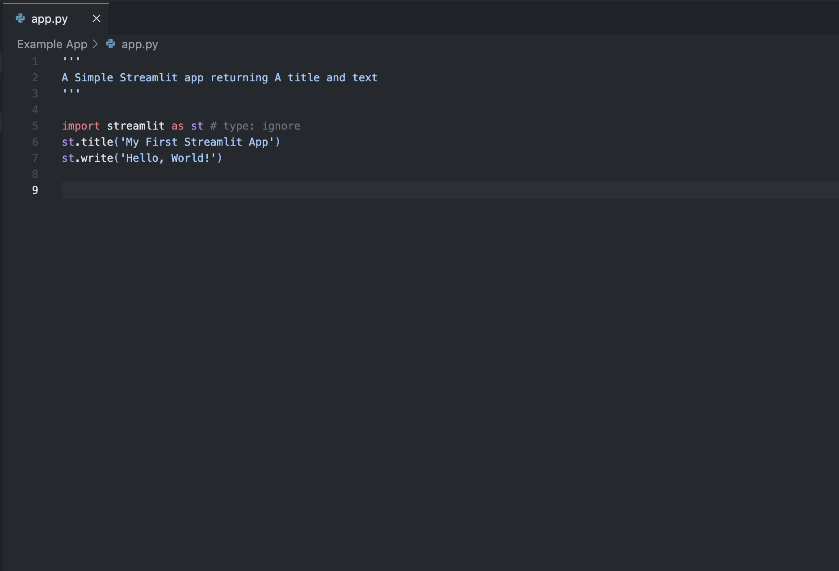
Code

Slide 18
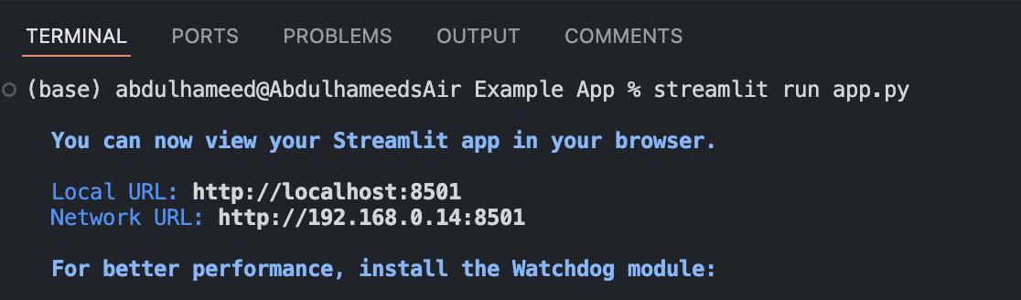
Running the Code
You can also run your app with the command
python –m streamlit run filename.py

Slide 19
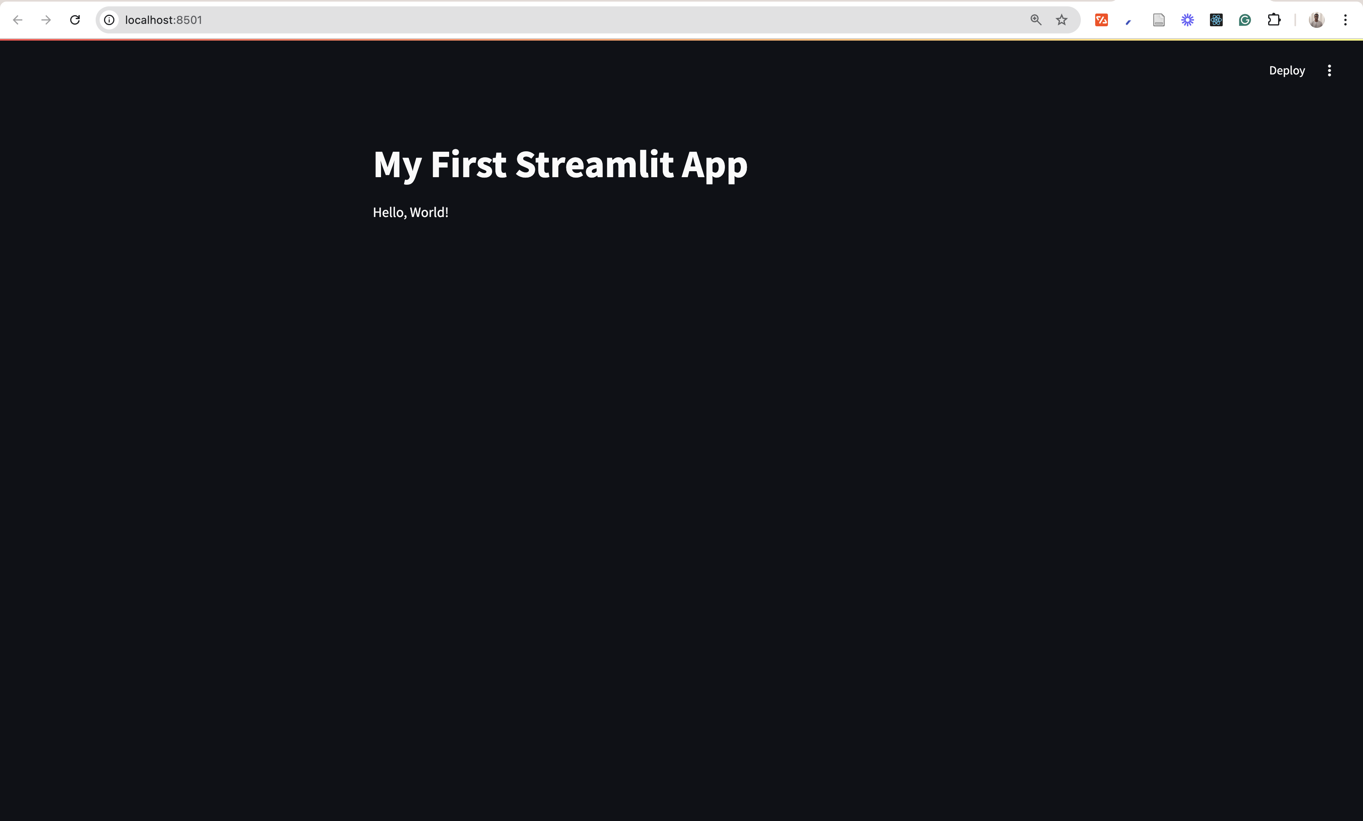
The Output
The Code runs on the web server

Slide 20
Streamlit Tags and Usage: Text Elements
st.title(): Displays the main title of the app.
Example: st.title('Welcome to My App')
st.header(): Adds a header, useful for section titles.
Example: st.header('Data Overview')
st.subheader(): Sub-section within a section.
Example: st.subheader('Summary Statistics')
st.text(): Displays simple text.
Example: st.text('This is a basic text element.')
st.markdown(): Allows formatting with Markdown syntax.
Example: st.markdown('**Bold Text** or *Italicized Text*')

Slide 21
Input Widgets
File Uploads: st.file_uploader()
Used for uploading files like CSV, images, etc.
Allows users to upload files and interact with the content (e.g., processing CSV files).
Text Inputs: st.text_input()
Accepts user input as text.
Text Area: st.text_area()
For multi-line text input.

Slide 22
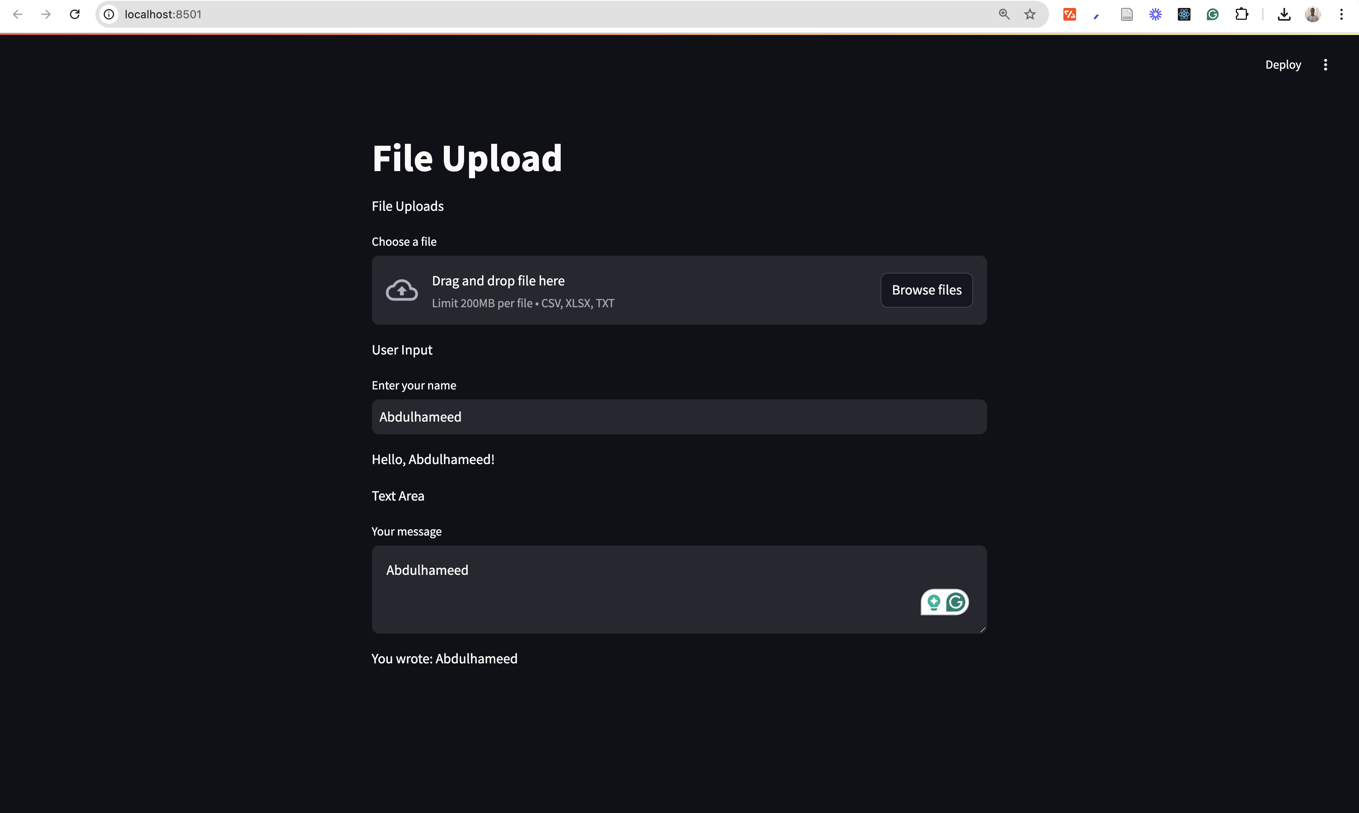
The Output
The Code runs on the web server

Slide 23
Output Elements
Data Display: st.write()
Displays various types of outputs, including text, data frames, charts, and more.
Tables: st.table()
Renders a static table for displaying tabular data.
Charts: st.line_chart(), st.bar_chart()
Used for visualizing data.

Slide 24
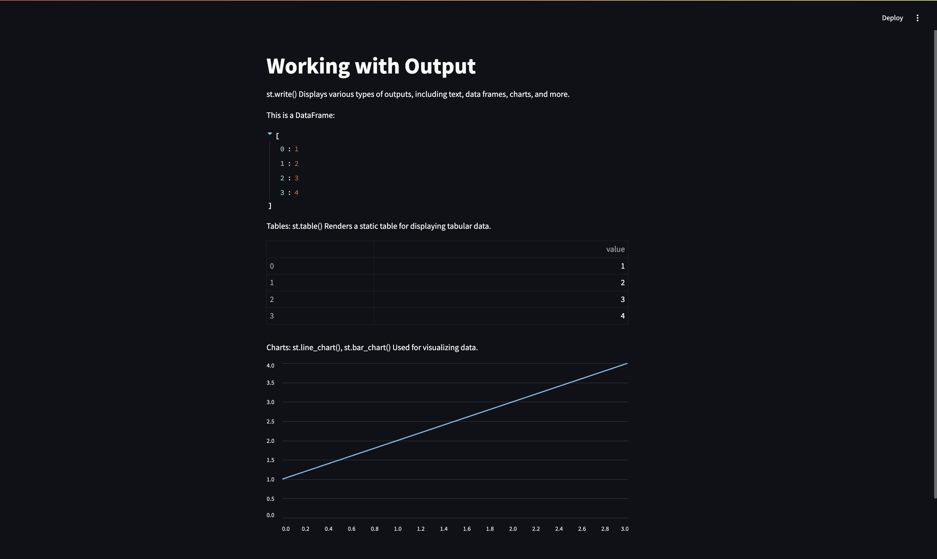
The Output
The Code runs on the web server

Slide 25
Sidebar Elements
Sidebar Elements
st.sidebar.title() and st.sidebar.header()Add elements in a collapsible sidebar for navigation or organizing controls.
Sidebar Input Widgets
Same as main content, but in the sidebar:
Text Input: st.sidebar.text_input()
Sliders: st.sidebar.slider()

Slide 26
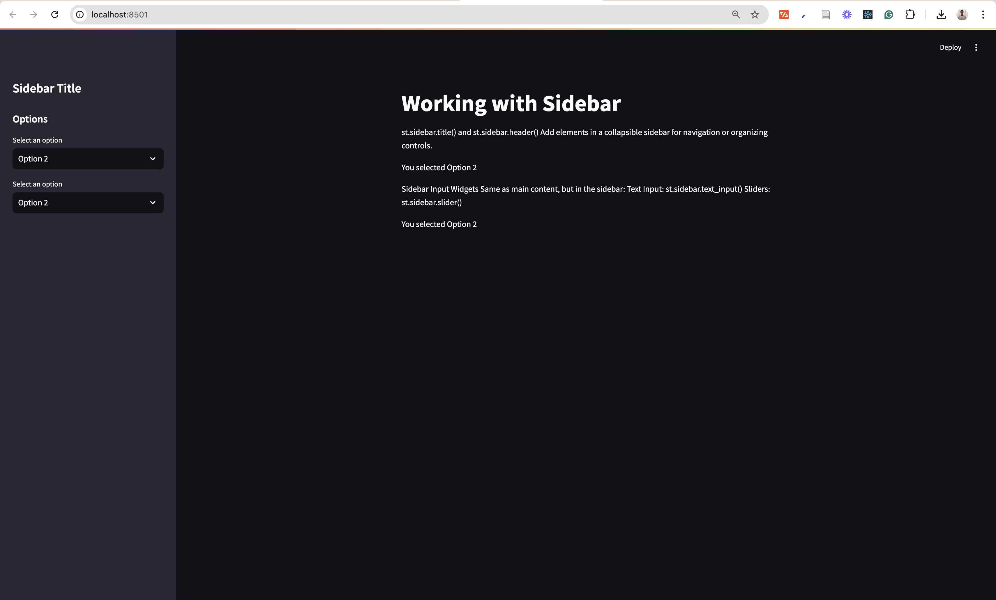
The Output
The Code runs on the web server

Slide 27
Navigation
Navigation
Multi-page apps: Streamlit doesn’t have built-in multi-page support, but you can simulate it using sidebars, radio buttons, or custom navigation.

Slide 28
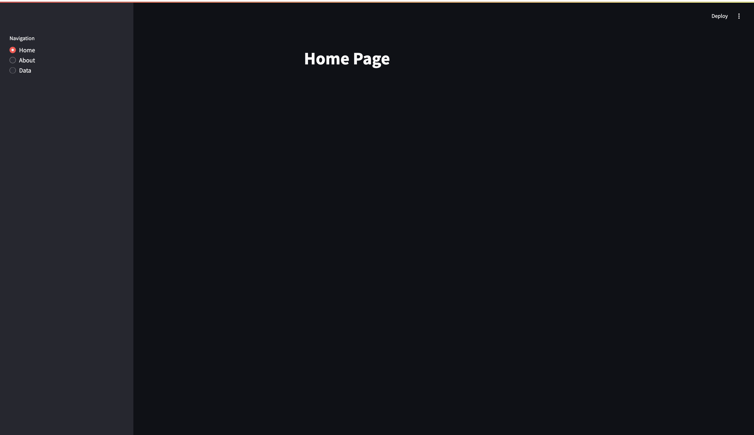
The Output
The Code runs on the web server

Slide 29
Class Activity
Objective:
By the end of this activity, you will:
Gain experience using Streamlit to build interactive web applications.
Learn how to accept user input (e.g., text, sliders, or file uploads) and use it to control the app's behavior.
Understand how to display dynamic content in Streamlit.
Open the Class Activity Folder to get started.

Slide 30
Working with Database
Definition: A database is an organized collection of structured information or data, typically stored electronically in a computer system.
Purpose: Databases are used to manage, store, and retrieve data efficiently.
Importance:
Facilitate data management.
Ensure data integrity and security.
Support complex queries and data analysis.

Slide 31
Types of Database
1. Relational Databases (RDBMS)
Examples: MySQL, PostgreSQL, Oracle Database.
Features: Structured data with defined schemas, support for SQL queries.
2. NoSQL Databases
Examples: MongoDB, Cassandra, Couchbase.
Features: Flexible schemas, unstructured data, high scalability.
3. In-Memory Databases
Examples: Redis, Memcached.
Features: Data stored in RAM for fast access, often used for caching.
4. Graph Databases
Examples: Neo4j, ArangoDB.
Features: Data represented as nodes and edges, ideal for complex relationships.

Slide 32
Reasons for choosing a DB
Data Integrity: Ensures accuracy and consistency of data over its lifecycle.
Scalability: Ability to handle increasing amounts of data and user load.
Performance: Optimized for fast data retrieval and processing.
Security: Protects sensitive data through authentication and authorization.
Flexibility: Supports various data models and structures, adapting to different application needs.

Slide 33
CRUD Operations Overview
Definition: CRUD stands for Create, Read, Update, and Delete—basic operations for managing data in a database.

Slide 34
SQL
Work in progress

Slide 35
Summary
Summary:
Understanding different types of databases and their purposes is crucial for effective data management.
Mastering CRUD operations is fundamental for interacting with databases.
Next Steps:
Explore database management systems (DBMS) for hands-on practice.
Implement CRUD operations in a project.

Slide 36
Introduction to RESTAPI
Definition:
REST (Representational State Transfer) API is an architectural style that uses HTTP requests to access and manipulate data.
Key Features:
Stateless: Each API call is independent and contains all the necessary information.
Client-Server Architecture: Separation of client and server for improved scalability and flexibility.
Use of Standard HTTP Methods: Typically uses methods such as GET, POST, PUT, DELETE.
Common Use Cases:
Web services, mobile applications, microservices communication.

Slide 37
Key components of RESTAPI
1. Endpoints:
URLs that represent resources (e.g., https://reqres.in/api/users').
2. HTTP Methods:
GET: Retrieve data from a resource.
POST: Create a new resource.
PUT: Update an existing resource.
DELETE: Remove a resource.

Slide 38
Key components of RESTAPI
Request and Response Format:
Typically uses JSON or XML for data interchange.
Example:
Request: GET https://reqres.in/api/users'

Slide 39
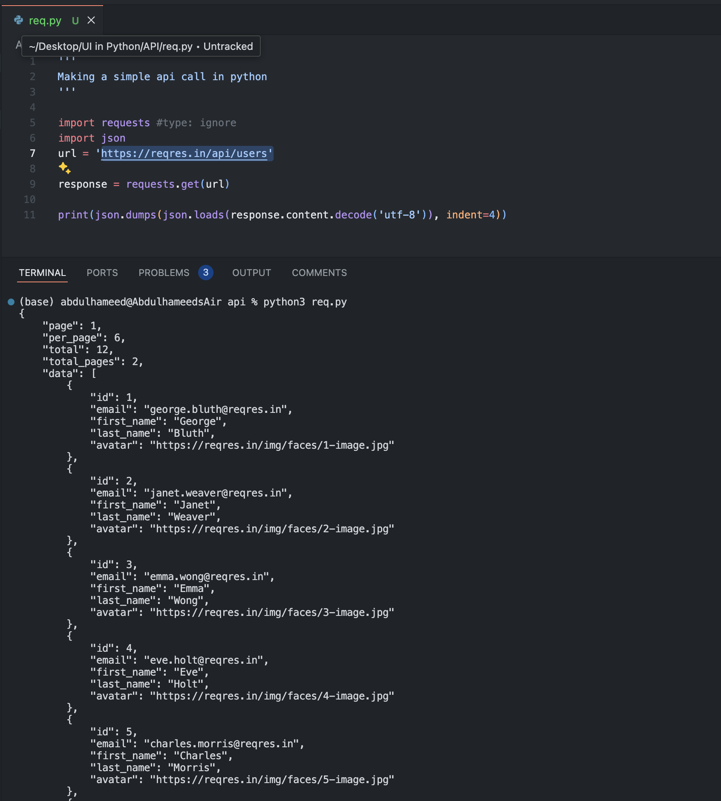
The Output

