Slide 1

File Handling
Unit Tutor: Abdulhameed Yunusa
Email: a.yunusa@bradfordcollege.ac.uk

Slide 2


Introduction to File Handling
Files are used to store data permanently.
Two main types of files:
Text files (.txt) and JSON files (.json).
File handling allows reading from and writing to files.
This Photo by Unknown Author is licensed under CC BY-SA
This Photo by Unknown Author is licensed under CC BY-SA-NC

Slide 3
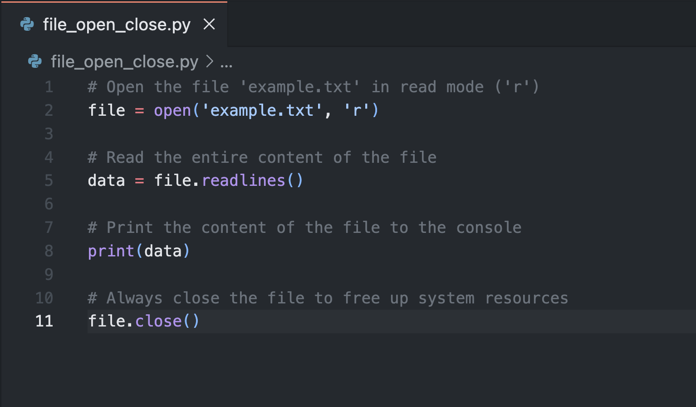
File Operations: Open & Close
open() function: Opens a file.
Modes:
'r': Read
'w': Write (overwrites)
'a': Append (adds to the end)
'r+': Read and write.
Close() function: Closes the file.

Slide 4
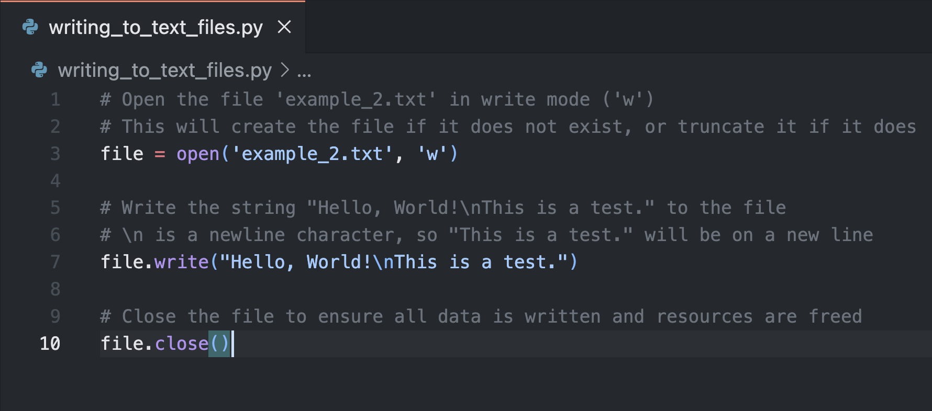
Writing to a Text File
Use 'w' or 'a' mode to write data.
Writing will overwrite existing content in 'w' mode.

Slide 5
JSON (JavaScript Object Notation
JSON (JavaScript Object Notation) is widely used in modern applications for storing and exchanging data in a lightweight, human-readable format.
It is commonly used in web APIs to transmit data between a client (browser or mobile app) and a server, making it easy to share structured information such as user profiles, product details, or messages.
JSON is also used in configuration files for applications, allowing developers to define settings or options in a simple and flexible format.
Additionally, many databases, like MongoDB, store data in JSON-like documents, facilitating data manipulation and retrieval.

Slide 6
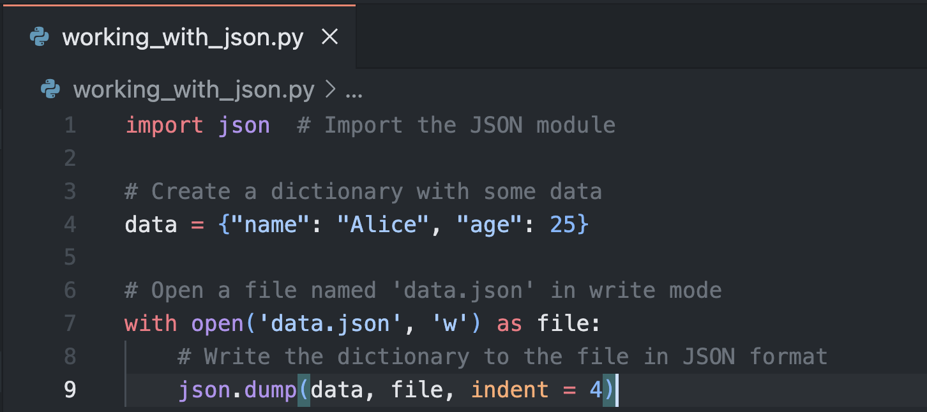
Working with json
A format for storing structured data (key-value pairs).
Python uses the json module to read/write JSON files.

Slide 7
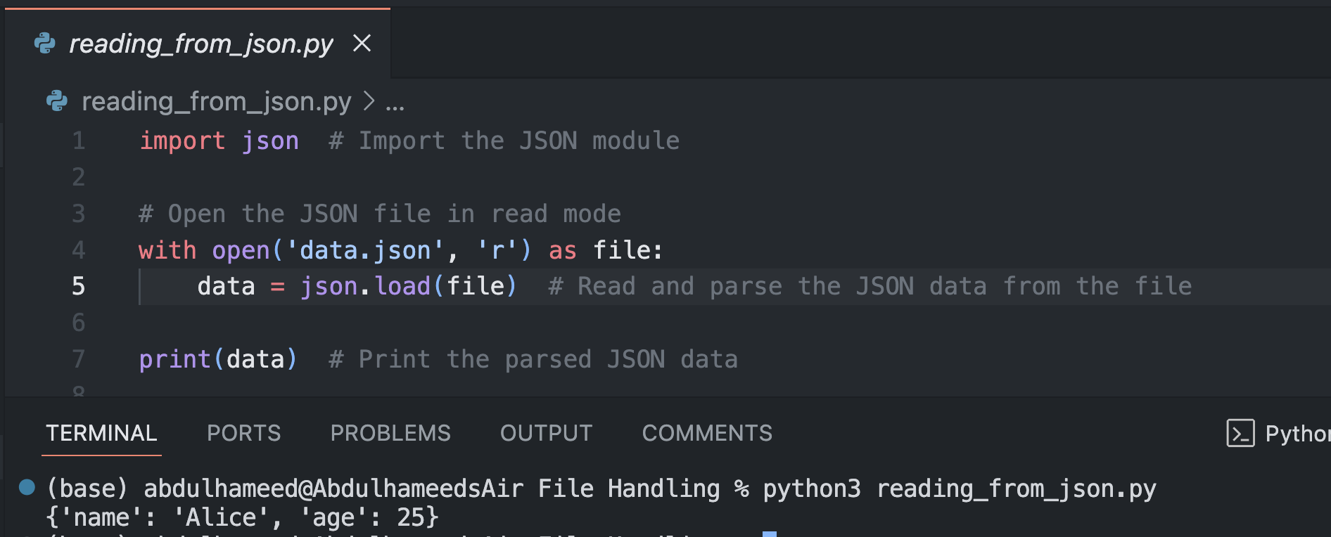
Reading from a json file
Use json.load() to read data from a JSON file.

Slide 8
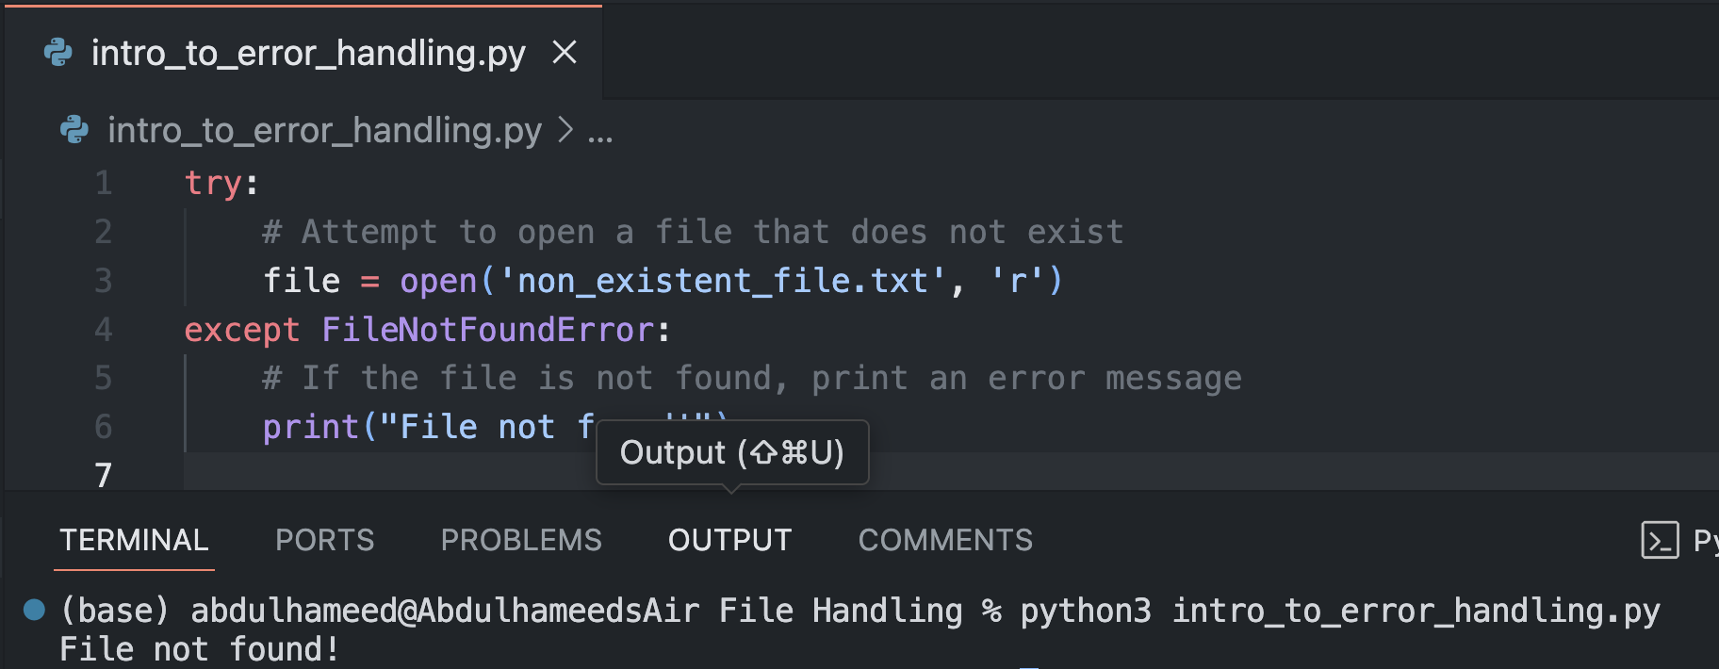
Introduction to Exception Handling
Exceptions occur when errors happen in a program.
try-except block is used to handle errors.

Slide 9
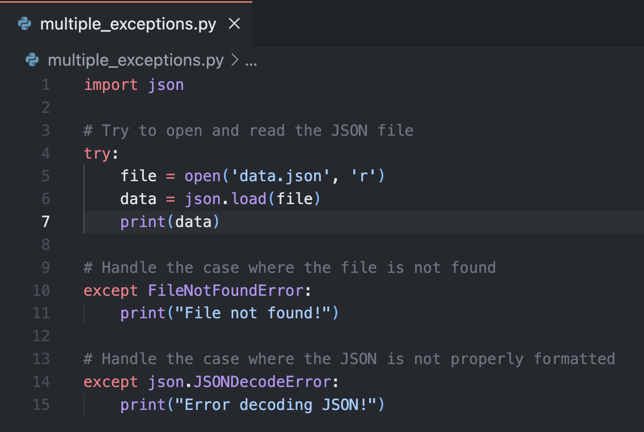
Handling Multiple Exception Handling
Use multiple except blocks to catch different types of errors.

Slide 10
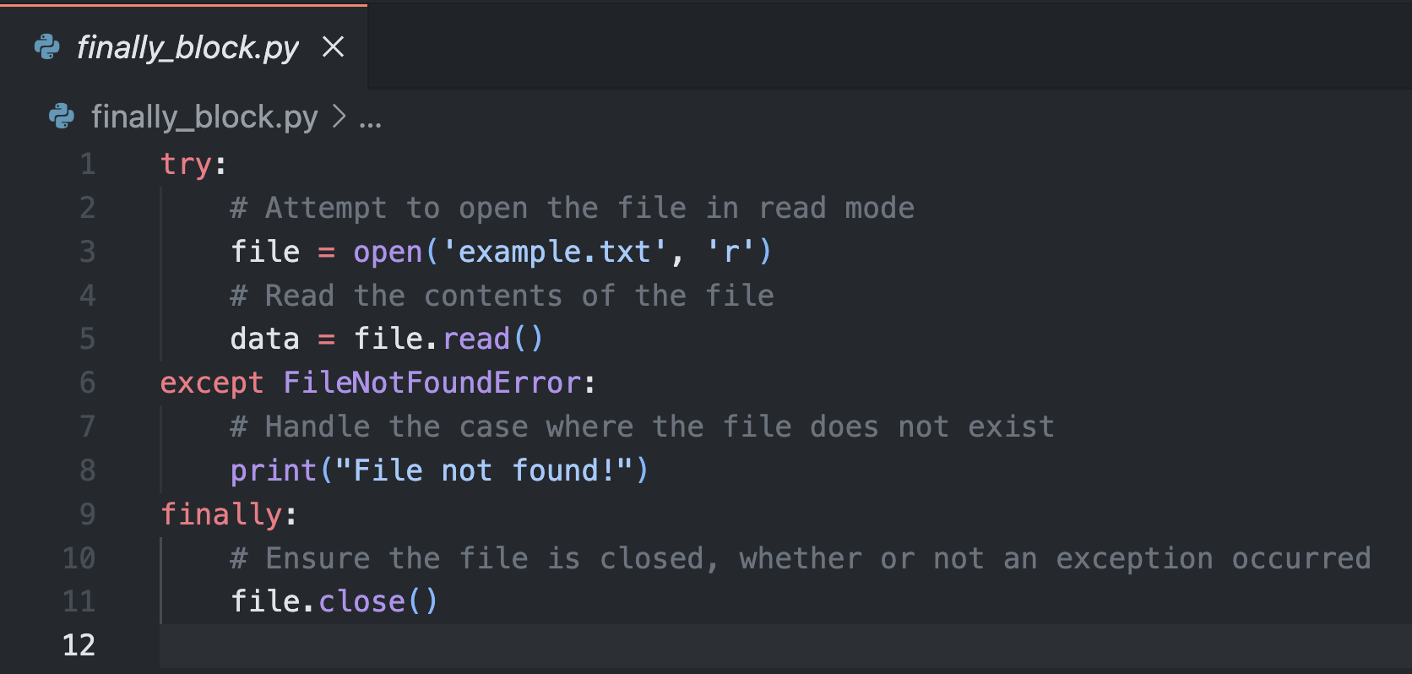
The finally block
The finally block always executes, regardless of whether an exception occurred.

Slide 11
Class Activity

Slide 12
Class activity
Write a Python program that:
Reads content from a text file.
Writes data to a JSON file.
Implements exception handling to manage potential errors.

Slide 13
Thank you!
Questions?

