Slide 1

Testing
Computer Science @ JTHS
Notes:
Matrix soundtrack +progress presents boy wonder …….. Best songs

Slide 2
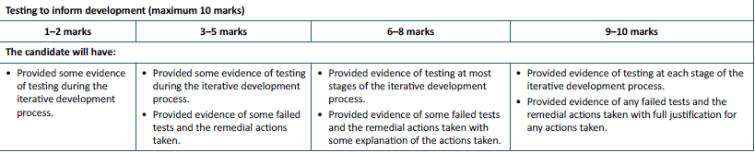
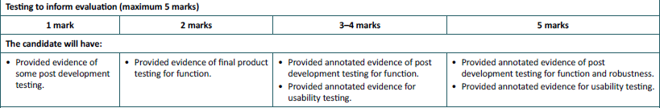
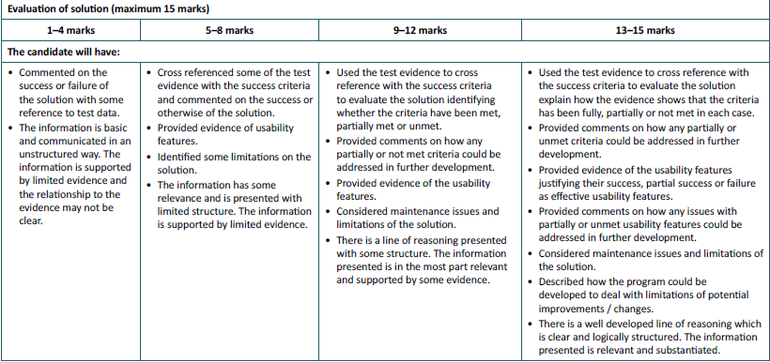

Slide 3
Testing
Split into 3 key areas :
Testing during development: A test plan for each “module” once it has been completed, showing detailed testing (erroneous, normal, borderline). Full evidence of testing (screenshots).
Testing to inform evaluation: Focussing on functionality and robustness – ie does it work as a whole?
Usability testing : Checking that users feel the system is genuinely helpful.

Slide 4
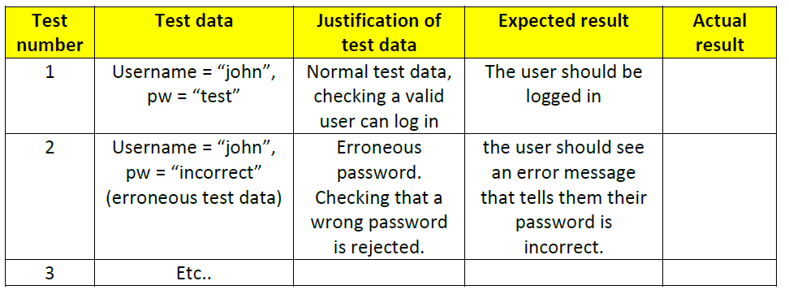
Test plans
Test as many routes through the system as possible.

Slide 5
Evidence
I expect evidence of tests working or not working.
This is most clearly done using screenshots and notes, although other methods may be more appropriate (video?)
Testing evidence is most certainly the largest (in terms of pages) section in the project

Slide 6
Usability testing
Requires real users
How can you get this information from them? Survey / questionnaire? Record comments?
Your analysis of what they say is most important.

