Slide 1
Baseball Trajectory Simulation
Bradley Canty
2026/06/25

Slide 2
Outline
Simulation Overview
Projectile Motion in a Vacuum
Projectile Motion through Air
Program Flow Diagram
Program Inputs
Program Outputs

Slide 3
Simulation Overview
User inputs:
Batted Ball Speed [mph]
Launch angle [degrees]
Time step size
Outputs:
To console…
Newton drag trajectory time of flight, horizontal range, maximum height, and Reynolds Number range
Vacuum trajectory time of flight, horizontal range, and maximum height
Plots of…
Drag coefficient vs Reynolds Number data points and piecewise linear curve fit of points
Baseball trajectory, both within vacuum (air density = 0) and within the atmosphere
The vacuum trajectory has an exact solution
The Newton drag trajectory requires solving a system of Ordinary Differential Equations

Slide 4
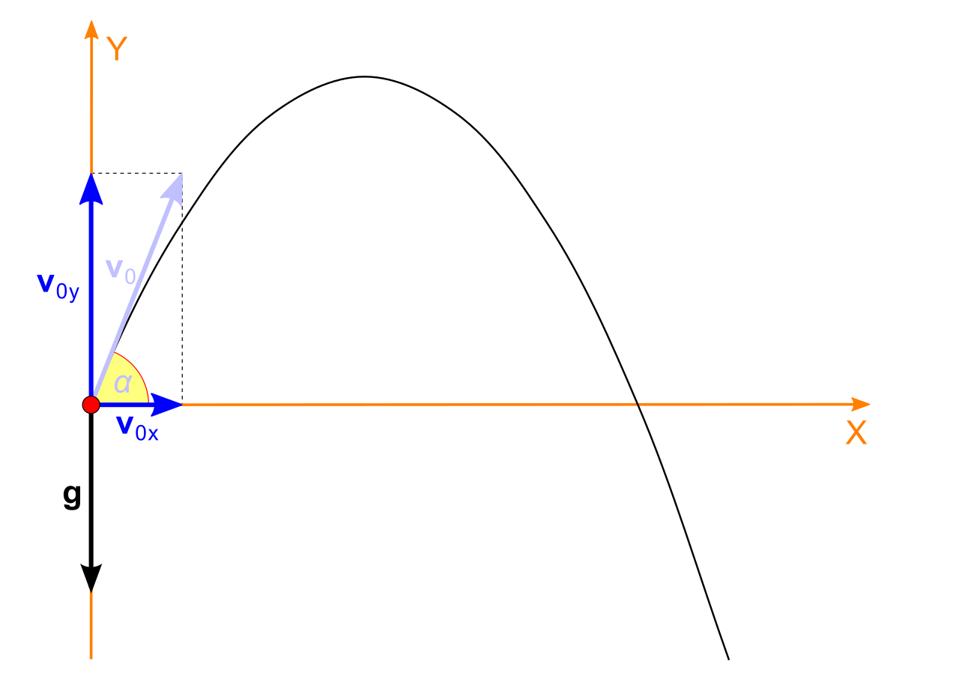
Projectile Motion in a Vacuum
Projectile motion through a vacuum (air density is zero) and in a homogenous gravity field (gravity always pointing downward) has an analytical solution, specifically, the trajectory is a parabola
The solution requires an initial launch speed and an initial launch angle
Free body diagram:

Slide 5
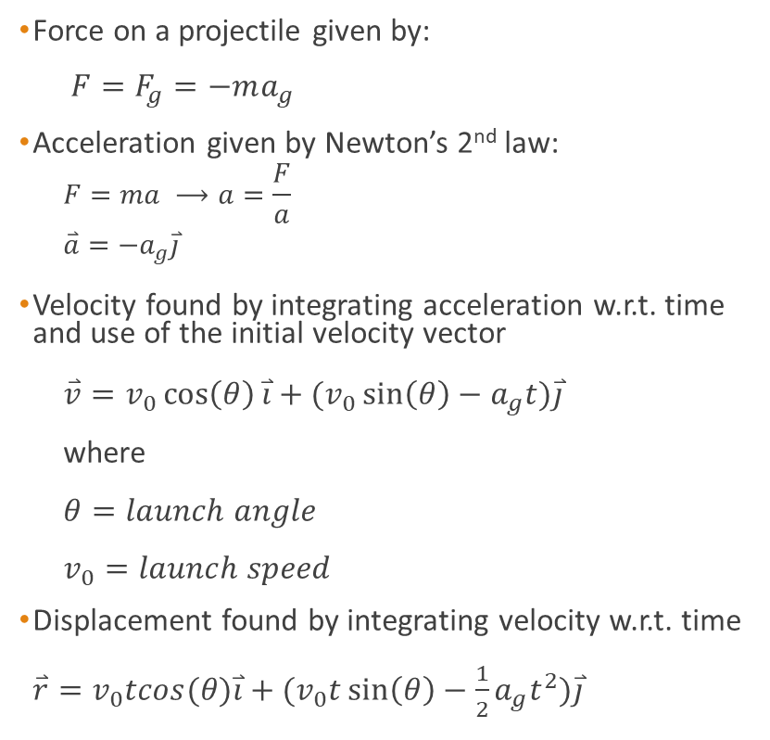
Projectile Motion in a Vacuum
Force on a projectile given by:
$F=F_{g}=−ma_{g}$
Acceleration given by Newton’s 2nd law:
$$F=ma ⟶a=\frac{F}{a}$$
$$\overset{⃑}{a}=−a_{g}\overset{⃑}{j}$$
Velocity found by integrating acceleration w.r.t. time and use of the initial velocity vector
$\overset{⃑}{v}=v_{0}\cos\left(θ\right)\overset{⃑}{i}+(v_{0}\sin\left(θ\right)−a_{g}t)\overset{⃑}{j}$
where
$θ=launch angle$
$v_{0}=launch speed$
Displacement found by integrating velocity w.r.t. time
$\overset{⃑}{r}=v_{0}tcos(θ)\overset{⃑}{i}+(v_{0}t\sin\left(θ\right)−\frac{1}{2}a_{g}t^{2})\overset{⃑}{j}$
Free body diagram:

Slide 6







Projectile Motion through Air
As an object moves through the air, the air resists the motion of the object.
This resistance is called aerodynamic drag, and is the component of the aerodynamic force that is aligned and opposite to the flight direction:
Free body diagram:
$$\overset{⃑}{v}$$
$$y$$
$$\overset{⃑}{F_{d}}$$
$$\hat{j}$$
$$\overset{⃑}{F_{g}}=m{\overset{⃑}{a}}_{g}$$
$$\hat{i}$$
$$x$$

Slide 7



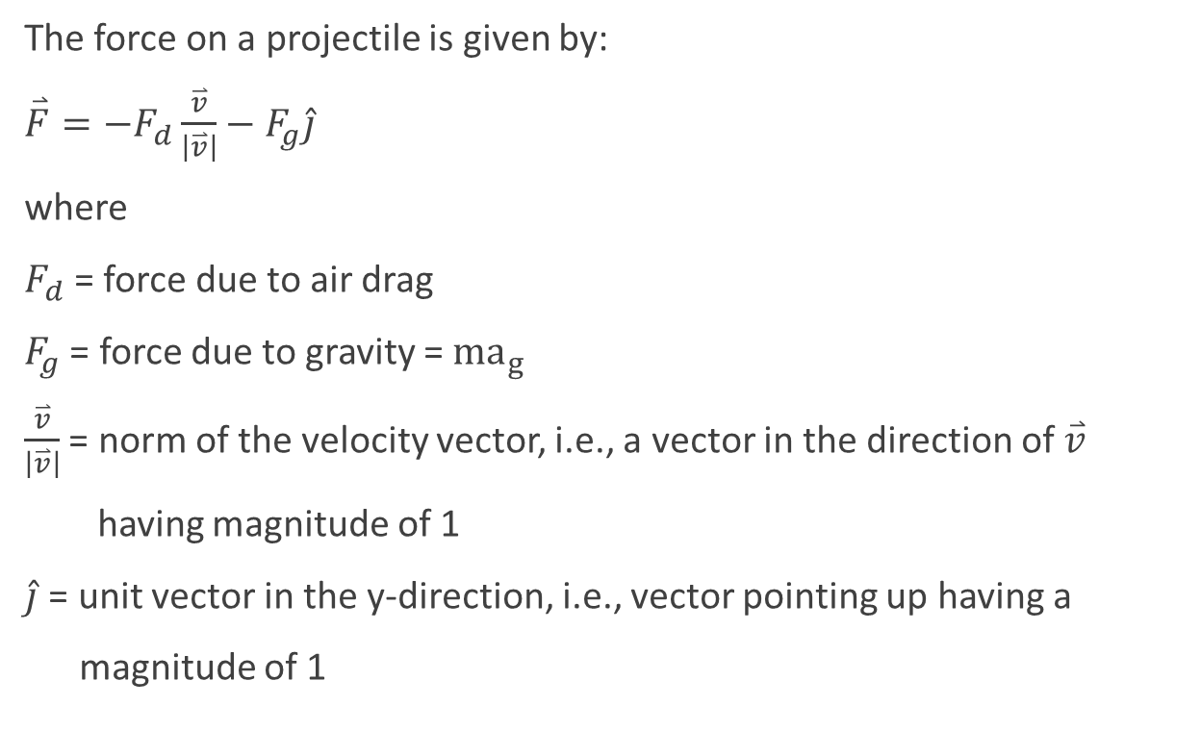




Projectile Motion through Air
The force on a projectile is given by:
$\overset{⃑}{F}=−F_{d}\frac{\overset{⃑}{v}}{\left|\overset{⃑}{v}\right|}−F_{g}\hat{j}$
where
$F_{d}$= force due to air drag
$F_{g}$ = force due to gravity = ${ma}_{g}$
$\frac{\overset{⃑}{v}}{\left|\overset{⃑}{v}\right|}$ = norm of the velocity vector, i.e., a vector in the direction of $\overset{⃑}{v}$
having magnitude of 1
$\hat{j}$ = unit vector in the y-direction, i.e., vector pointing up having a
magnitude of 1
Free body diagram:
$$\overset{⃑}{v}$$
$$y$$
$$\overset{⃑}{F_{d}}$$
$$\hat{j}$$
$$\overset{⃑}{F_{g}}=m{\overset{⃑}{a}}_{g}$$
$$\hat{i}$$
$$x$$

Slide 8
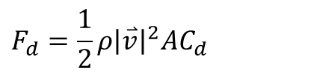
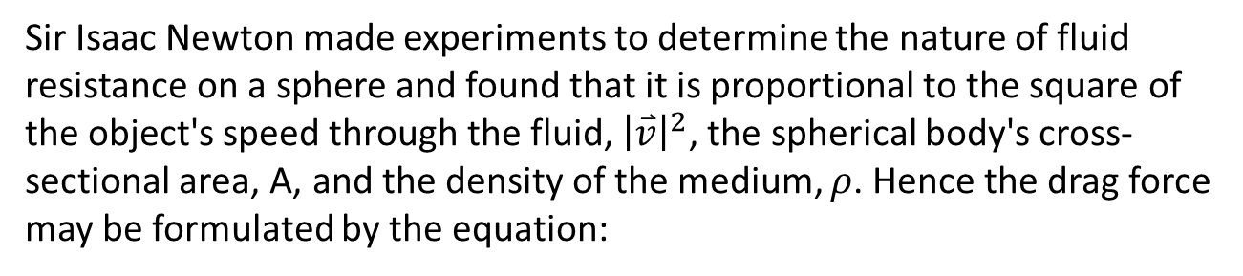
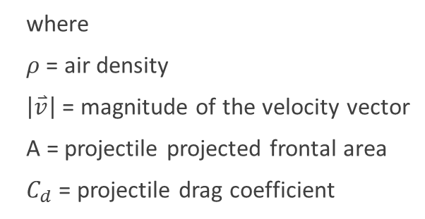
Projectile Motion through Air
Sir Isaac Newton made experiments to determine the nature of fluid resistance on a sphere and found that it is proportional to the square of the object's speed through the fluid, ${\left|\overset{⃑}{v}\right|}^{2}$, the spherical body's cross-sectional area, A, and the density of the medium, $ρ$. Hence the drag force may be formulated by the equation:
$$F_{d}=\frac{1}{2}ρ{\left|\overset{⃑}{v}\right|}^{2}AC_{d}$$
where
$ρ$ = air density
$\left|\overset{⃑}{v}\right|$= magnitude of the velocity vector
A = projectile projected frontal area
$C_{d}$ = projectile drag coefficient
Newton experiments yielded the first accurate measurements of fluid drag forces. He measured the drag coefficient of a sphere to be 0.5, in good agreement with currently accepted value of 0.44 to 0.47 for low speed drag on a smooth sphere.

Slide 9
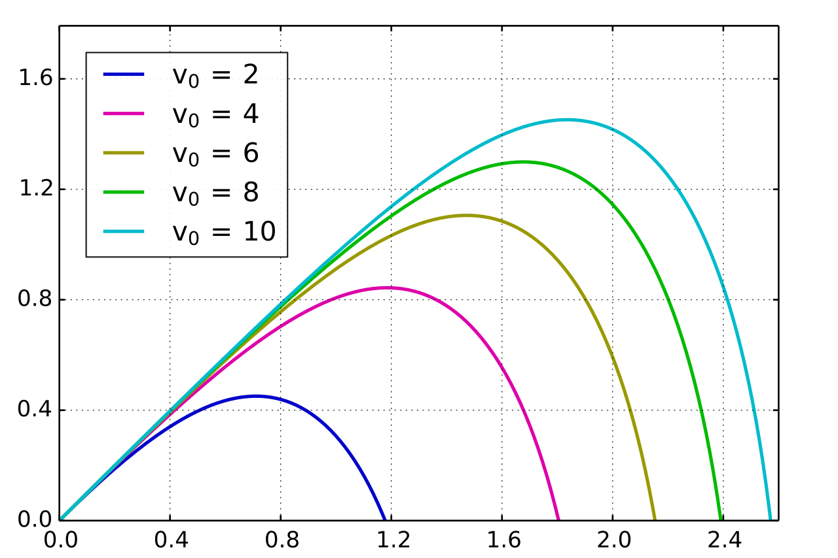

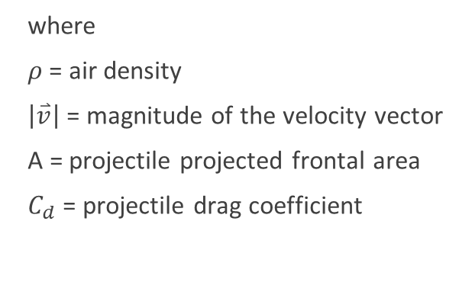


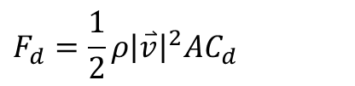


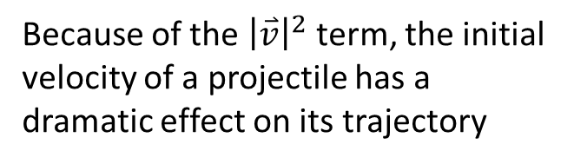


Projectile Motion through Air
Free body diagram:
Again, the equation of drag force is given by:
$$\overset{⃑}{v}$$
$$F_{d}=\frac{1}{2}ρ{\left|\overset{⃑}{v}\right|}^{2}AC_{d}$$
$$\overset{⃑}{F_{d}}$$
$$y$$
where
$ρ$ = air density
$\left|\overset{⃑}{v}\right|$= magnitude of the velocity vector
A = projectile projected frontal area
$C_{d}$ = projectile drag coefficient
$$\hat{j}$$
$$\overset{⃑}{F_{g}}=m{\overset{⃑}{a}}_{g}$$
$$\hat{i}$$
$$x$$
Because of the ${\left|\overset{⃑}{v}\right|}^{2}$ term, the initial velocity of a projectile has a dramatic effect on its trajectory

Slide 10
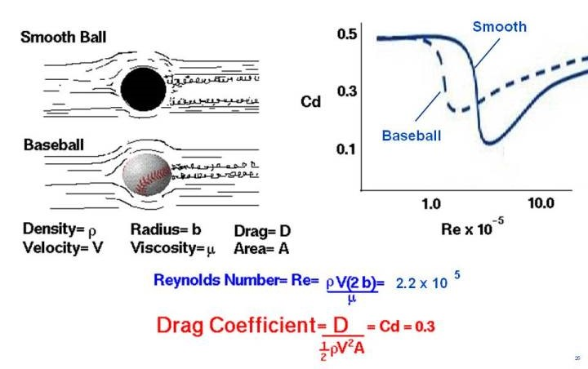







Projectile Motion through Air
As mentioned previously, Newton measured the drag coefficient, Cd, of a sphere to be 0.5. However, the drag coefficient is a nonlinear function of Reynolds number, Re, and surface roughness:
$$\overset{⃑}{v}$$
$$\overset{⃑}{v}$$
$$Reynolds number= Re= \frac{ρvD}{μ}$$
$$ρ=air density$$
$$v=velocity magnitude$$
$$D=sphere diameter$$
$$μ=dynamic viscosity$$

Slide 11
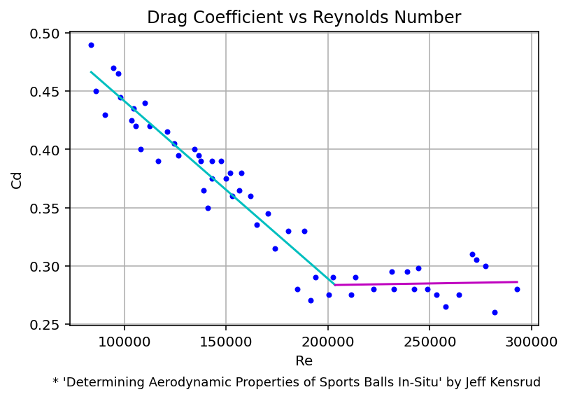
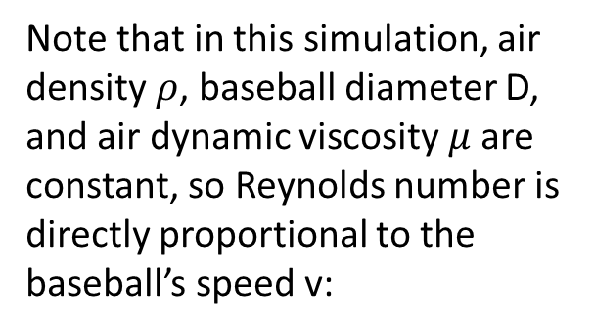



Projectile Motion through Air
Using drag coefficient versus Reynolds number data for airflow over a baseball (Ref.: Kensrud), a linear least-squares curve fit was used to fit the data to a two-line piecewise continuous function:
when Re < 200000: $Cd=Re∗\text{−1.52664361}\text{e}\text{−06 + 0.59416069 }$
when Re ≥ 200000: $Cd=Re\text{ ∗ }\text{2.83876989}\text{e}\text{−08 + 0.2776702}$
$$Reynolds number= Re= \frac{ρvD}{μ}$$
Note that in this simulation, air density $ρ$, baseball diameter D, and air dynamic viscosity $μ$are constant, so Reynolds number is directly proportional to the baseball’s speed v:
$$Re=Const ∗v$$

Slide 12

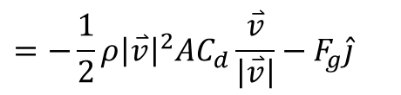

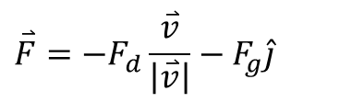




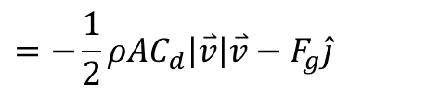

Projectile Motion through Air
Using the drag force equation, the total force vector on the projectile is given by:
Free body diagram:
$$\overset{⃑}{v}$$
$$\overset{⃑}{F}=−F_{d}\frac{\overset{⃑}{v}}{\left|\overset{⃑}{v}\right|}−F_{g}\hat{j}$$
$$y$$
$$\overset{⃑}{F_{d}}$$
$$\hat{j}$$
$$\overset{⃑}{F_{g}}=m{\overset{⃑}{a}}_{g}$$
$$=−\frac{1}{2}ρ{\left|\overset{⃑}{v}\right|}^{2}AC_{d}\frac{\overset{⃑}{v}}{\left|\overset{⃑}{v}\right|}−F_{g}\hat{j}$$
$$x$$
$$\hat{i}$$
$$=−\frac{1}{2}ρAC_{d}\left|\overset{⃑}{v}\right|\overset{⃑}{v}−F_{g}\hat{j}$$

Slide 13
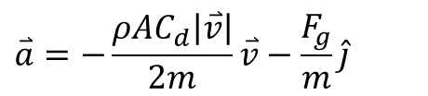

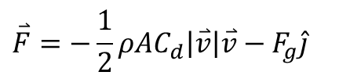

Projectile Motion through Air
$$\overset{⃑}{F}=−\frac{1}{2}ρAC_{d}\left|\overset{⃑}{v}\right|\overset{⃑}{v}−F_{g}\hat{j}$$
To find the acceleration vector acting on the projectile, apply Newton’s second law:
$$F=ma ⟶a=F/m$$
Thus, acceleration of projectile given by:
$$\overset{⃑}{a}=−\frac{ρAC_{d}\left|\overset{⃑}{v}\right|}{2m}\overset{⃑}{v}−\frac{F_{g}}{m}\hat{j}$$
$$=−\frac{ρAC_{d}\left|\overset{⃑}{v}\right|}{2m}\overset{⃑}{v}−a_{g}\hat{j}$$

Slide 14

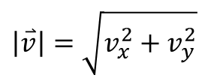

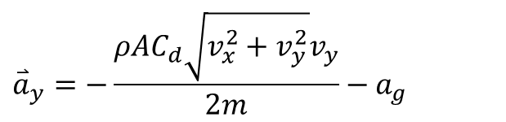
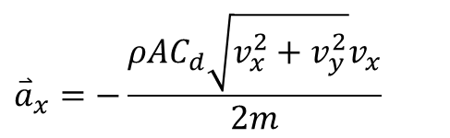
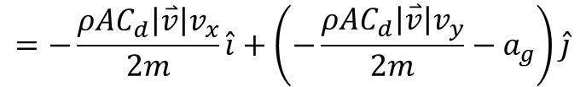
Projectile Motion through Air
Decompose $\overset{⃑}{a}$ into its components:
$$\overset{⃑}{a}=a_{x}\hat{i}+a_{y}\hat{j}$$
$$=−\frac{ρAC_{d}\left|\overset{⃑}{v}\right|v_{x}}{2m}\hat{i}+\left(−\frac{ρAC_{d}\left|\overset{⃑}{v}\right|v_{y}}{2m}−a_{g}\right)\hat{j}$$
where
$$\left|\overset{⃑}{v}\right|=\sqrt{v_{x}^{2}+v_{y}^{2}}$$
Thus,
$${\overset{⃑}{a}}_{x}=−\frac{ρAC_{d}\sqrt{v_{x}^{2}+v_{y}^{2}}v_{x}}{2m}$$
$${\overset{⃑}{a}}_{y}=−\frac{ρAC_{d}\sqrt{v_{x}^{2}+v_{y}^{2}}v_{y}}{2m}−a_{g}$$

Slide 15
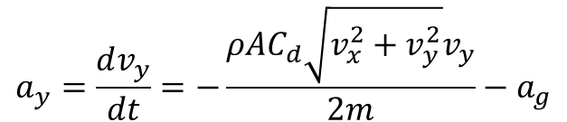
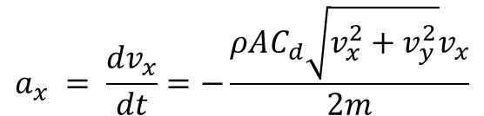
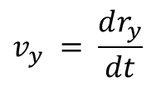
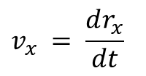
Projectile Motion through Air
Acceleration of projectile in terms of velocity given by:
$$a_{x} = \frac{dv_{x}}{dt}=−\frac{ρAC_{d}\sqrt{v_{x}^{2}+v_{y}^{2}}v_{x}}{2m}$$
$$a_{y}=\frac{dv_{y}}{dt}=−\frac{ρAC_{d}\sqrt{v_{x}^{2}+v_{y}^{2}}v_{y}}{2m}−a_{g}$$
These equations cannot be integrated to yield velocity components because they are nonlinear and coupled, so all we can say about the velocity of the projectile in terms of position is that…
$$v_{x} = \frac{dr_{x}}{dt}$$
$$v_{y} = \frac{dr_{y}}{dt}$$

Slide 16
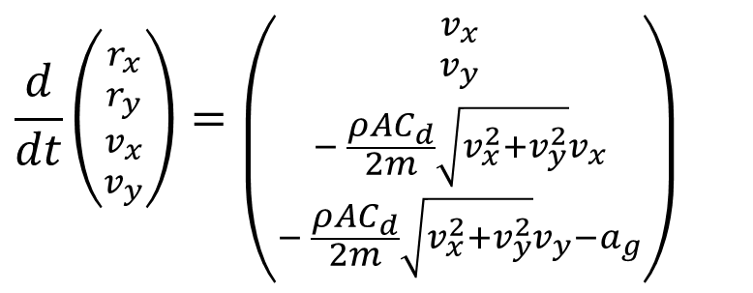
Projectile Motion through Air
Thus, to solve for the position and velocity of the projectile throughout its trajectory, we must solve the nonlinear system of ordinary differential equations:
$$\frac{d}{dt}\left({{r_{x} \atop r_{y}} \atop {v_{x} \atop v_{y}}}\right)=\left({{v_{x} \atop v_{y}} \atop {− \frac{ρAC_{d}}{2m}\sqrt{v_{x}^{2}+v_{y}^{2}}v_{x} \atop − \frac{ρAC_{d}}{2m}\sqrt{v_{x}^{2}+v_{y}^{2}}v_{y}−a_{g}}}\right)$$

Slide 17
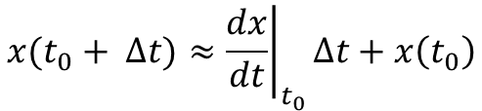
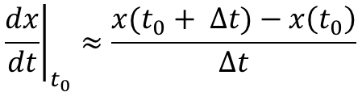

Projectile Motion through Air
Euler (Tangential) Method for solving ordinary diff. eqns.:
Consider the function
$$\frac{dx}{dt}=f(t,x)$$
First, approximate the derivative of x using a forward finite difference
$${\left.\frac{dx}{dt}\right|}_{t_{0}}≈\frac{x(t_{0}+ Δt)−x\left(t_{0}\right)}{∆t}$$
Then, rearrange to solve for f at the next time step
$$x(t_{0}+ Δt)≈{\left.\frac{dx}{dt}\right|}_{t_{0}}∆t+x\left(t_{0}\right)$$
One can integrate the solution:
Start with an initial value
Compute the derivative
Find the next value

Slide 18


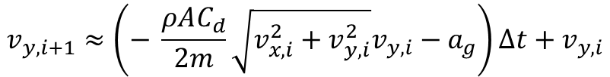
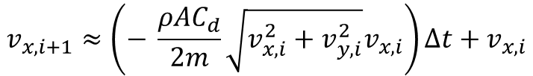
Projectile Motion through Air
Applying Euler method to our system of equations, we have:
$$r_{x,i+1}≈v_{x,i}∆t+r_{x,i}$$
$$r_{y,i+1}≈v_{y,i}∆t+r_{y,i}$$
$$v_{x,i+1}≈\left(− \frac{ρAC_{d}}{2m}\sqrt{v_{x,i}^{2}+v_{y,i}^{2}}v_{x,i}\right)∆t+v_{x,i}$$
$$v_{y,i+1}≈\left(− \frac{ρAC_{d}}{2m}\sqrt{v_{x,i}^{2}+v_{y,i}^{2}}v_{y,i}−a_{g}\right)∆t+v_{y,i}$$
Such that i = 0 corresponds to the initial state. In this way we can solve for all positions and velocities in the trajectory.
Other numerical integration methods implemented are:
Midpoint method: slope evaluated at two points per time step
4th order Runge-Kutta method: slope evaluated at four points per time step

Slide 19
Program Flow Diagram
Take batted ball speed, launch angle, and time step as input
Compute vacuum trajectory using analytical solution
Compute t_{peak} of Newton drag trajectory using secant method to find when v_{y} = 0, which itself uses a numerical integration method and t_{peak} guesses of 0 and 1 seconds
Compute t_{impact} of Newton drag trajectory using secant method to find when y = 0, which itself uses a numerical integration method and t_{impact} guesses of 2* t_{peak} and 2* t_{peak} +1 seconds
Compute Newton drag trajectory using a numerical integration method and time span of 0 to t_{impact}
Generate plots and output text to console

Slide 20

Program Inputs to Console

Slide 21
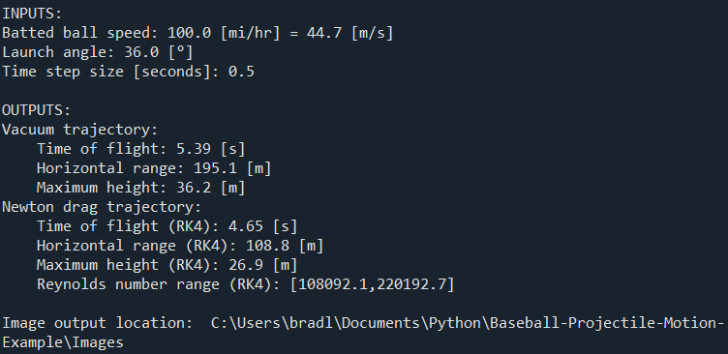
Program Outputs to Console

Slide 22
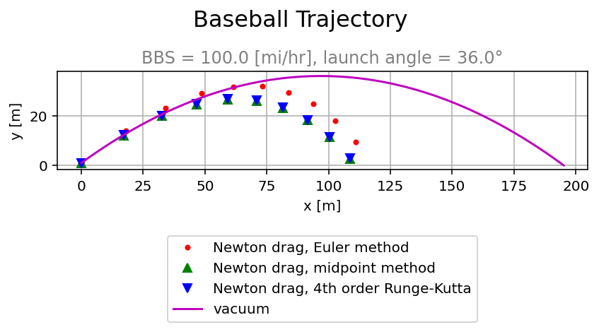
Program Output Plot 1

Slide 23
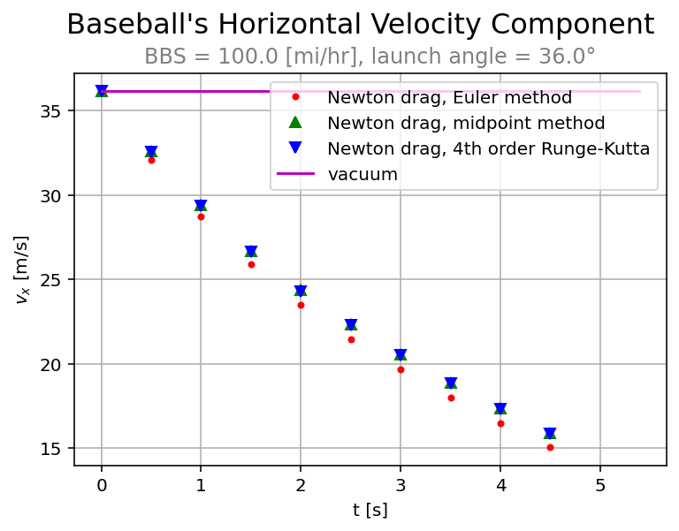
Program Output Plot 2

Slide 24
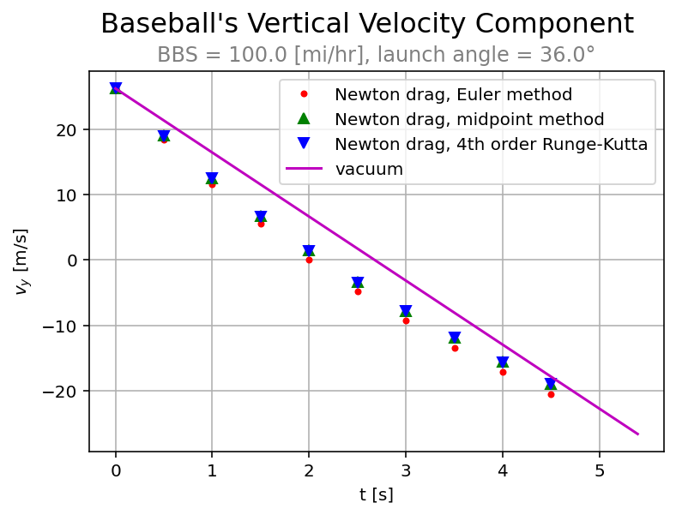
Program Output Plot 3

Slide 25
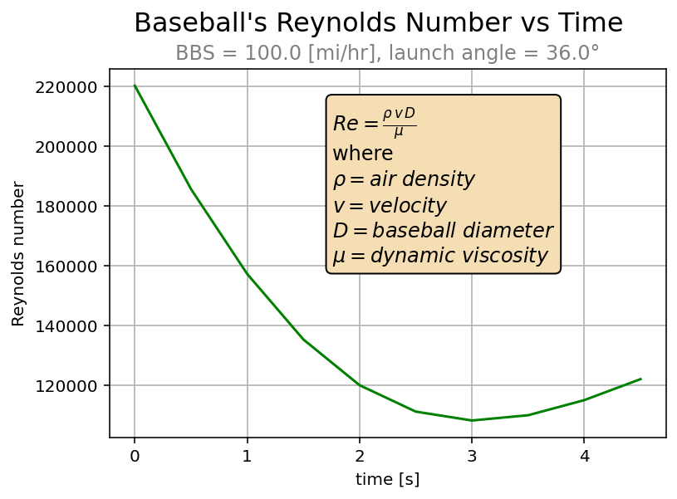
Program Output Plot 4

Slide 26
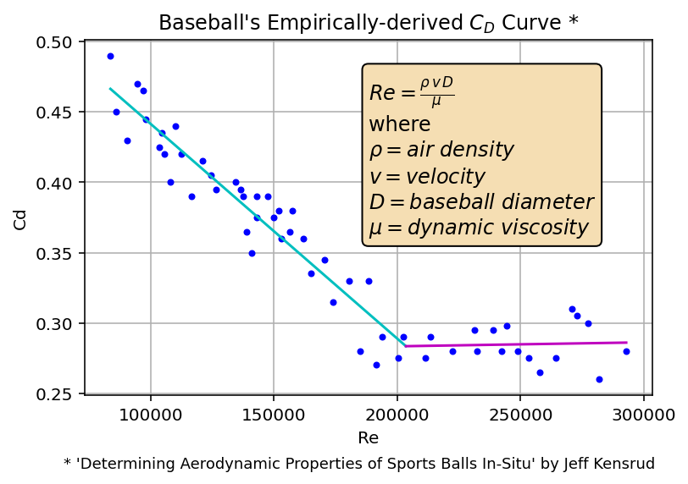
Program Output Plot 5

Slide 27
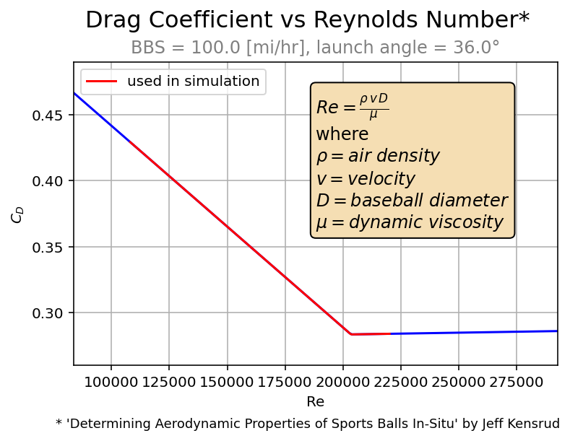
Program Output Plot 6

Slide 28
References
http://baseball.physics.illinois.edu/PointC.html
http://baseball.physics.illinois.edu/DragTPTMay2014.pdf
https://en.wikipedia.org/wiki/Projectile_motion
https://baseballaero.com/2019/05/03/baseball-drag-crisis/
http://baseball.physics.illinois.edu/KensrudThesis.pdf

