Slide 1
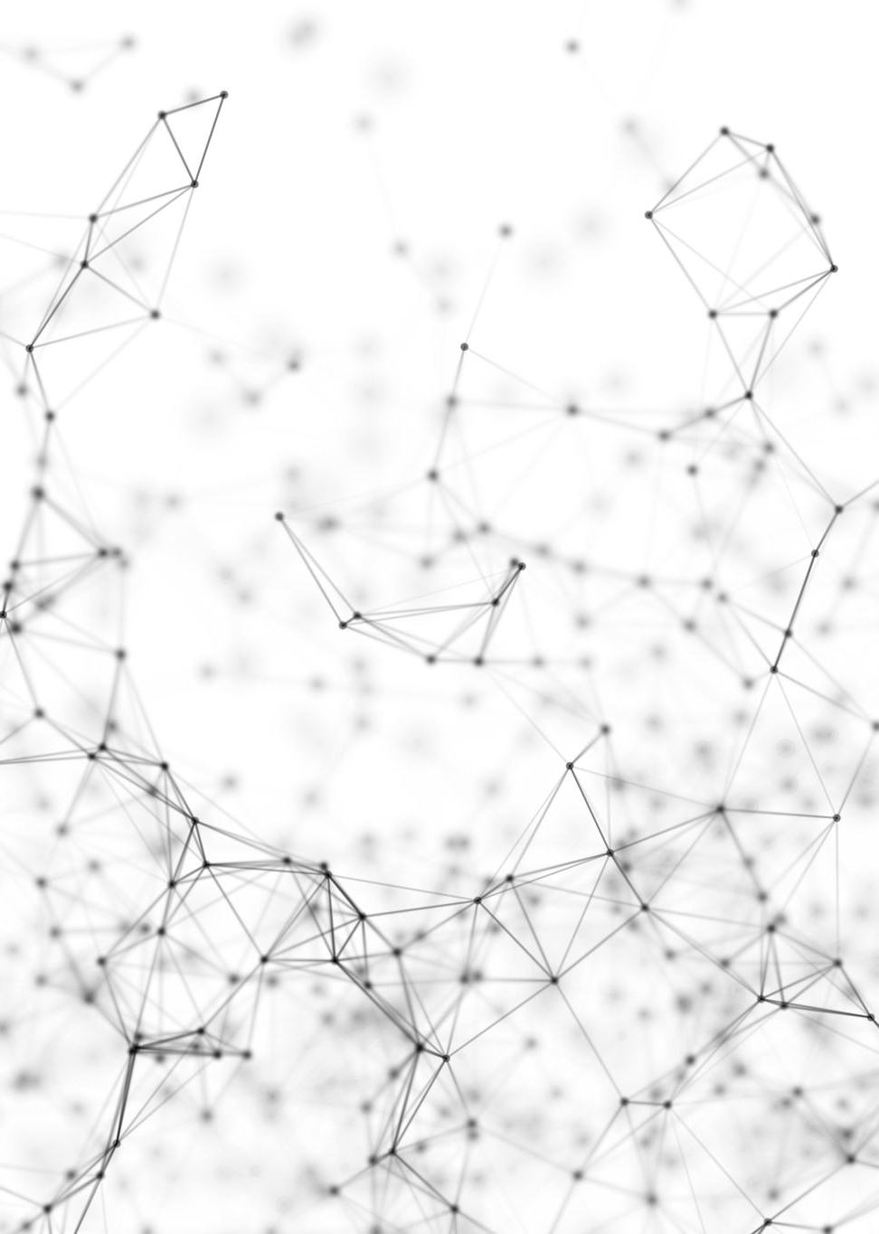
Semi-supervised Learning on Graphs with Generative Adversarial Nets
graphsgan
Nashash David
Feitsvaig Bradley

Slide 2
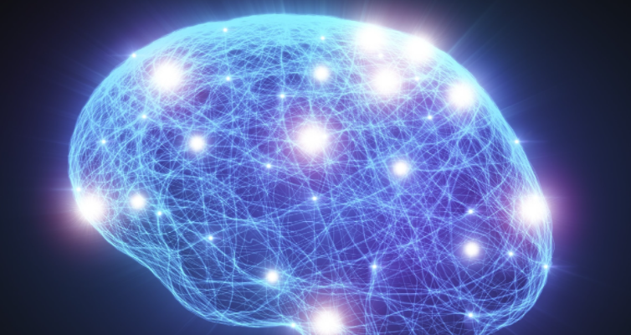
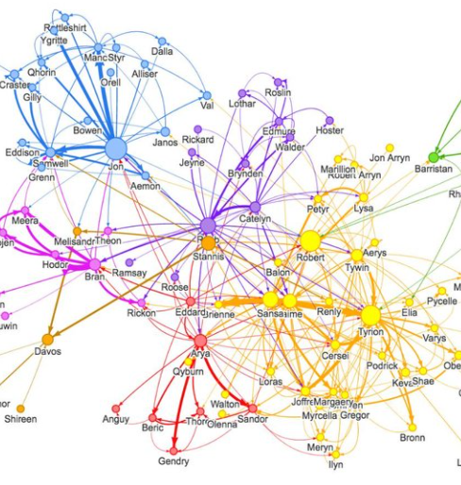
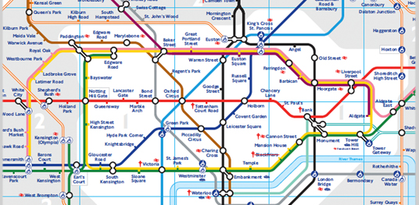

Slide 3
Semi-supervised learning on graphs
We are given a graph comprised of a small set of labeled nodes and a large set of unlabeled nodes.
The goal is to learn a model that can predict label of the unlabeled nodes

Slide 4
GANs in Semi-supervised learning on graphs
Using GAN directly on graph learning is impractical. Because it does not take into account the graph structure.
GAN is used to weaken the effect of propagation across density gaps.

Slide 5
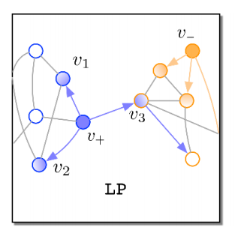
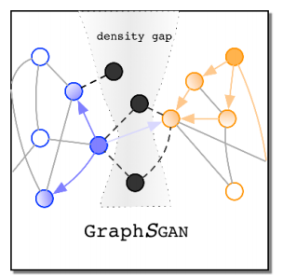
GANs in Semi-supervised learning on graphs
Generator generates fakes samples into density gap areas.
Discriminator discriminate fake samples from real before classifying them into different classes.
This method weakens the propagation across density gaps.

Slide 6
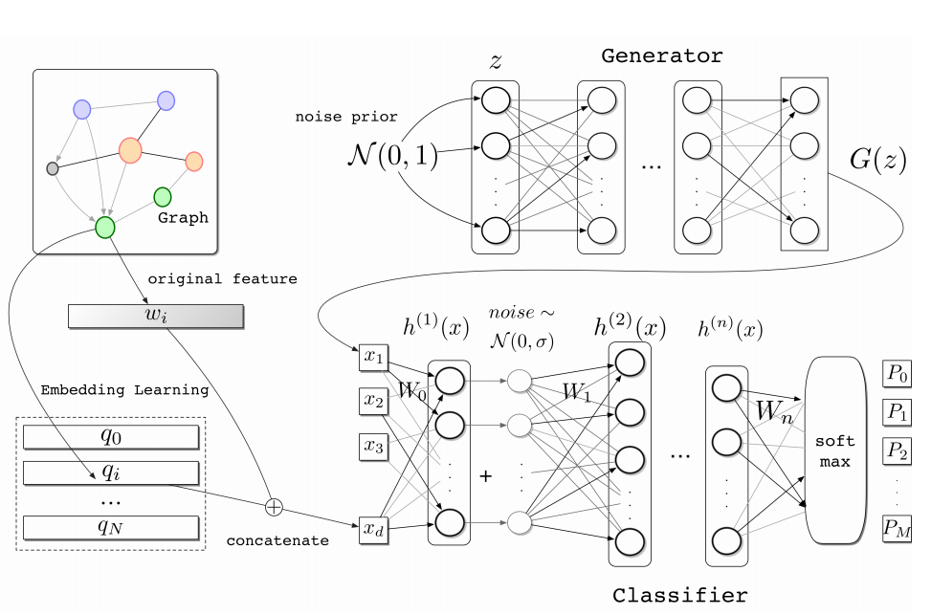
Graphsgan Architecture

Slide 7
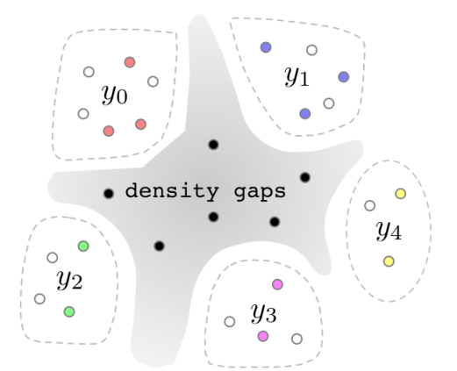
Learning process
Traditionally, in equilibrium GAN mimicking real data.
In graphSGAN, the generator would generate fake samples into density gaps.
graphSGAN is expected to generate samples in density gaps as in the figure.

Slide 8


discriminator
Generator

Slide 9
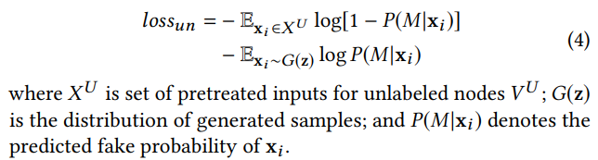

discriminator
Four conditions for discriminator to reach equilibrium:
Map nodes from different classes into different clusters. Achievable by using cross entropy loss on labelled nodes:
$x^{L}$ is the set of inputs for labeled nodes.
Real nodes should not be mapped into the central area in order to expose the density gap.
Achievable by using original GAN loss:

Slide 10

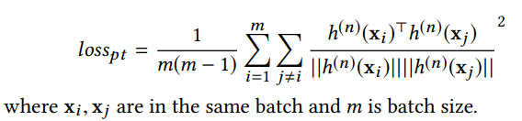
discriminator
Every unlabeled node should be mapped into one cluster Achievable by adding an entropy regularization term:
Clusters should be distant each other as much as possible to help classification.
Achievable by using pull-away loss:

Slide 11

Generator
Two conditions for Generator to reach equilibrium:
Map fake samples into central area. Achievable by using feature matching loss – minimize the distance from centroid:
Fake samples should not overfit centroid.
Achievable by using pull-away loss:

Slide 12
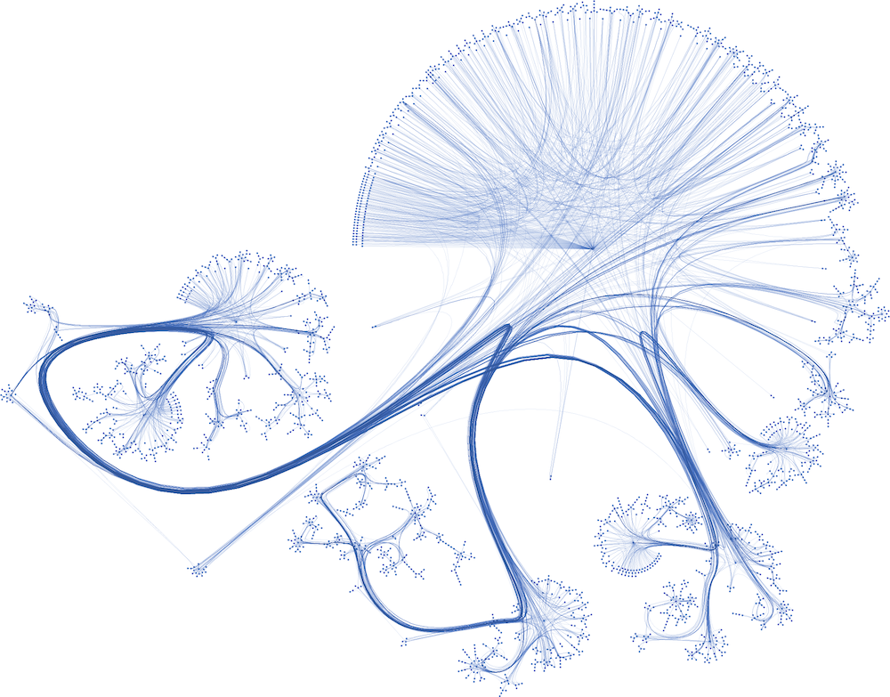
Cora dataset
consists of 2708 scientific publications
classified into one of seven classes
The citation network consists of 5429 links

Slide 13
test_batch clusters

Slide 14
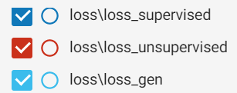
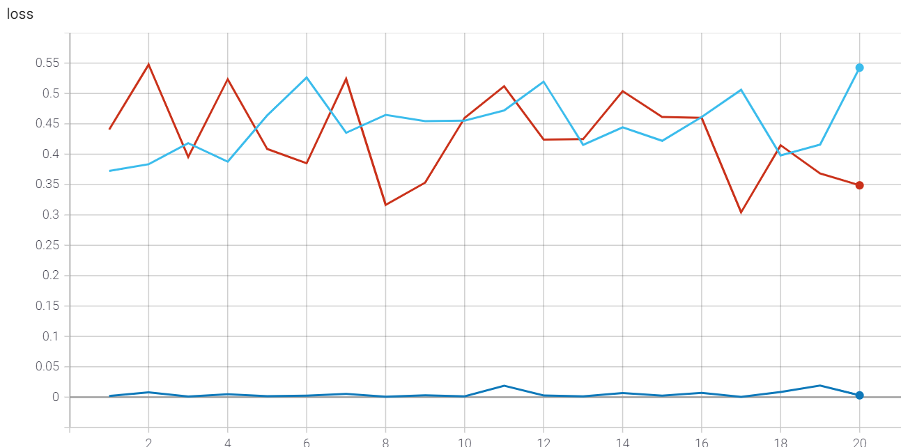

Slide 15
references
Paper: Semi-supervised Learning on Graphs with Generative Adversarial Nets; Ming Ding, Jie Tang, Jie Zhang
CODE : THUDM/GraphSGAN: Implementation of "GraphSGAN", a GAN-based semi-supervised learning algorithm for graph data. (github.com)
Cora dataset explanation : The Cora dataset - Graphs and Networks

