Slide 1
Algorithm Design and Analysis
Welcome to
Bowu Zhang
Department of Computer Science
Marist College

Slide 2
Contact
Bowu Zhang
B.S in Electrical Engineering,
Univ. of Sci. & Tech. of China,
China
Ph.D in Computer Science,
George Washington University, Washington, D.C., US
Research Interests
  Distributed Systems
  Machine Learning
  Mobile Health
Contact Information
  Office: Hancock 3014
  Office Hours:
  Monday: 10:00 a.m. to 12:00 p.m.
  Tuesday: 1:30 pm to 2:30 pm
  Wednesday: 10:00 a.m. to 11:00 p.m.
  Thursday: 1:30 pm to 2:30 pm
  Email: bowu.zhang@marist.edu

Slide 3
Course Description
Algorithms are:
methods for solving a problem.
We will learn algorithms for solving typical problems:
  Greedy
  Sorting
  Searching
  Graphs
  etc.
We will focus on design techniques and analysis.

Slide 4
Prerequisites
Discrete Maths
Software Dev I
Working knowledge of Java

Slide 5
Course Information
The class webpage:
  ilearn.marist.edu
No paper handout
All slides, assignments and solutions will be updated on iLearn

Slide 6
Textbook
Recommended:
Introduction to Algorithms.
Third Edition.
Cormen, Leirserson, Rivest & Stein.
Cambridge, MA: MIT Press, 2009
ISBN-10: 0262033844
ISBN-13: 978-0262033848

Slide 7
Course Procedures
Two lectures every week
  Tuesdays and Thursdays, 11:00 am to 12:15 pm
  Slides and demonstrations, and hands-on exercises

Slide 8
Course Work
Assignments: 35%
In-class Exercises: 10%
In-class Presentation: 5%
Quizzes: 10%
Midterm Exam: 20% -- cheat sheet allowed
Final Exam: 20% -- cheat sheet allowed

Slide 9
Assignments
A number of assignments
  Solutions must be submitted to iLearn before the due date provided
  For each day your assignment is late, 10% will be deducted from your score.
  Assignments will NOT be accepted after one week.
  You are not permitted to work together on these assignments.

Slide 10
In-class Exercises
Hands-on exercises every lecture
  You need to show results to the instructor before you leave the classroom

Slide 11
In-class Presentation
Two/Three presentations every lecture
  Throughout the semester, each student will do ONE in-class presentation to the entire class on assigned topics
  Presenters are picked by the instructor randomly
  Topics are assigned by the instructor, from what have been discussed in the previous class

Slide 12
Quizzes
A number of quizzes
  related to the lecture
  time will be notified in advance
  (usually) at the beginning of the class

Slide 13
Exams
Two Written Exams (Midterm, Final)
  Individual, written exams
  Cheat sheet allowed

Slide 14
Programming Load
We will introduce you to algorithmic concepts with a strong focus on implementation
  You will need a working knowledge of objects in Java to handle the programming assignments.
  You will need the skill-level that comes with completing CMPT 120, CMPT 220, CMPT 221.

Slide 15
Collaboration
You are encouraged to form study groups and to discuss the course material with your classmates.
Do not, under any circumstances, copy another person's program/solution.

Slide 16
How to Do Well in This Class?
Keep up with the exercises/assignments/quizzes
  The course material is cumulative
  Start early!
If you don’t understand something, ask questions (especially “WHY?”)
  Everything can be explained!

Slide 17
Course Overview

Slide 18
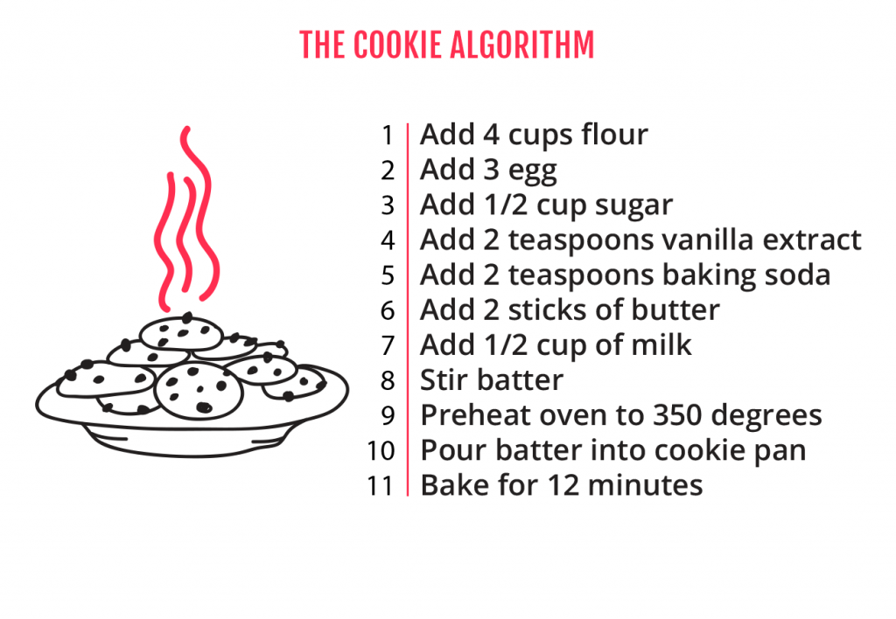
What is Algorithm?
Based on some input, an algorithm specifies a series of steps to generate output.

Slide 19
What is Algorithm? (cont.)
Algorithms are described in pseudocode.
Algorithms are analyzed for speed independent of machine/language.

Slide 20
Algorithm Design and Analysis
We will do all these:
  come up with solutions for a problem
  prove that it is correct
  analyze its running time

Slide 21

Example
Input: an array of numbers.
Output: two numbers whose absolute difference is largest, and their absolute difference.

Slide 22
Algorithm Design and Analysis
We will do all these:
  come up with solutions for a problem
  prove that it is correct
  analyze its running time

Slide 23
One Solution (Pseudcode)
Input double[] A
x = A[0], y = A[1], max =abs(x - y);
for i in [0,size(A)-1]
for j in [i+1, size(A)-1]
if( max < abs(A[i]-A[j]) )
x = A[i]
y = A[j]
max = abs(A[i]-A[j])
end if
end for
end for
Output x, y, max

Slide 24
How Does Algorithm1 Work?
Example:

Slide 25
In-class Exercise
How many comparisons are made by algorithm1?

Slide 26
In-class Exercise
How many comparisons are made by algorithm1 with an array of n elements?

Slide 27
Another Solution (Pseudocode)
Input double[] A
x = A[0], y = A[0]; // x represents the maximum number in A, while y represents the minimum number in A
for i in [0,size(A)-1]
if( x < A[i])
x = A[i]
end if
if(y > A[i])
y = A[j]
end if
end for
max = x - y
Output x, y, max

Slide 28
How Does Algorithm2 Work?

Slide 29
In-class Exercise
How many comparisons are made by algorithm2?

Slide 30
In-class Exercise
How many comparisons are made by algorithm2 with an array of n elements?

Slide 31
Pseudocode
A description of an algorithm : similar to a real program, BUT
  without the syntax and semantics of a specific programming language
  without variable declarations or data-types (implied or left to the reader)
  not all methods/functions are shown, especially when the meaning is obvious

Slide 32
English Description
Example for Algorithm1:
1. Scan through all possible pairs of numbers in the array.
2. For each such pair, compute the absolute difference.
3. Record the largest such difference.

Slide 33
Pseudocode
Example for Algorithm1:
Input double[] A
x = A[0], y = A[1], max =abs(x - y);
for i in [0,size(A)-1]
for j in [i+1, size(A)-1]
if( max < abs(A[i]-A[j]) )
x = A[i]
y = A[j]
max = abs(A[i]-A[j])
end if
end for
end for
Output x, y, max

Slide 34
In-class Exercise
Design an algorithm and write pseudocode for:
Given an array of numbers, check if there are more 3s than 4s

Slide 35
Algorithm Design and Analysis
We will do all these:
  come up with solutions for a problem
  prove that it is correct
  analyze its running time

Slide 36
Correctness
Algorithm 1: Proof by contradiction
  Assume max = abs(x-y) returned by our algorithm is not the largest absolute difference.
  Then there should exist a pair of elements A[m] (not equal to x), A[n] (not equal to y) in array A that abs(A[m] - A[n]) > abs(x-y)
  Not possible, because we have checked all the possible pairs in our algorithm.
  If there exists such a pair A[m], A[n], then x must be equal to A[m], and y must be equal to A[n] --> Contradiction
  abs(x-y) must be the largest absolute difference

Slide 37
Correctness
Algorithm 2: Proof by contradiction
  Assume max = abs(x-y) returned by our algorithm is not the largest absolute difference.
  Then there should exist a pair of elements A[m] (not equal to x), A[n] (not equal to y) in array A that abs(A[m] - A[n]) > abs(x-y)
    case 1: A[m] - A[n] >= 0, x - y >=0
    case 2: A[m] - A[n] < 0, x - y >=0
  If there exists such a pair A[m], A[n], then x must be equal to A[m], and y must be equal to A[n] --> Contradiction
  abs(x-y) must be the largest absolute difference

Slide 38
Comparison
Both Algorithm1 and Algorithm2 are correct
Which one is better?
  We need to look at the resource use of the algorithm
    main memory
    bandwidth
    running time

Slide 39
Algorithm Design and Analysis
We will do all these:
  come up with solutions for a problem
  prove that it is correct
  analyze its running time

Slide 40
How to Measure Running Time
Use wall-clock time?
  We need to first implement the algorithm in Java/C/...
  Then use System.currentTimeMillis()
  long startTime = System.currentTimeMillis();
  your algorithm ...
  long stopTime = System.currentTimeMillis();
  long elapsedTime = stopTime - startTime;

Slide 41
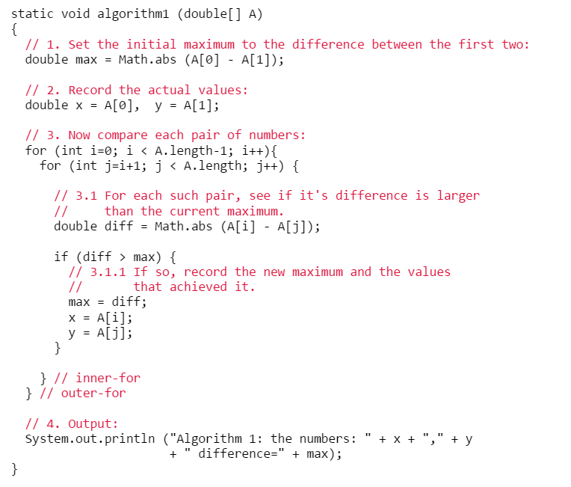
Algorithm1 (Java Code)

Slide 42
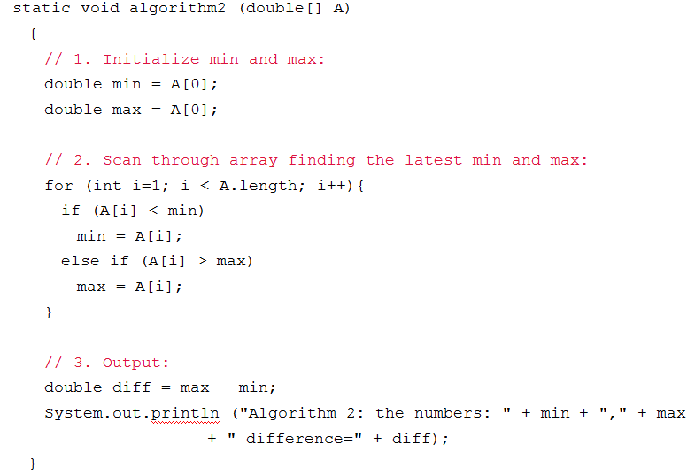
Algorithm2 (Java Code)

Slide 43
Actual Running Time
Compare Algorithm1 with Algorithm2
Array size | Algorithm1 (Java) | Algorithm2 (Java)
7000 | 3031 | 47
8000 | 3962 | 49
9000 | 5020 | 51
10000 | 6247 | 56

Slide 44
Bad Idea
Comparing algorithms by their actual running time is a bad idea
  takes time to implement the algorithm
  highly depends on computer details (CPU speed, disk, memory, etc.)
Array size | My Laptop | My Office Desktop
7000 | 3031 | 2670
8000 | 3962 | 3490
9000 | 5020 | 4430
10000 | 6247 | 5490

Slide 45
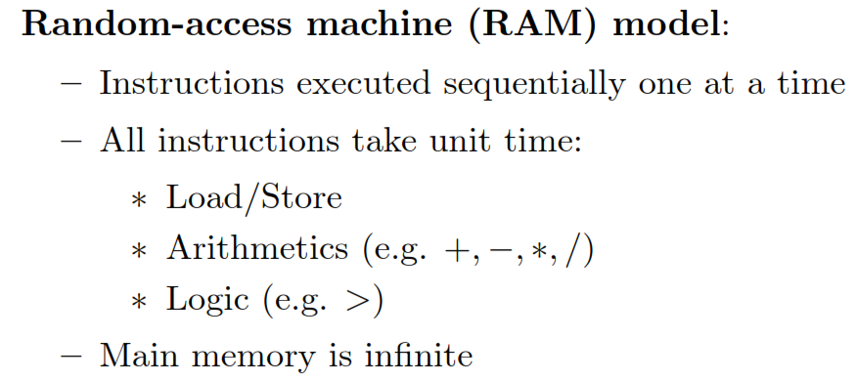
Predict the Running Time

Slide 46
RAM Model
RAM model not completely realistic
  main memory not inﬁnite
  not all memory accesses take same time
  not all arithmetic operations take same time
  instruction pipelining

Slide 47
Running Time ≈ The Number of Instructions
The number of instructions (running time) of an algorithm depends on
  How big the input size is
  How the input is distributed (within a certain range? purely random?)
  etc.

Slide 48
Running Time is a Function of Input Size
Array size | My Laptop | My Office Desktop
7000 | 3031 | 2670
8000 | 3962 | 3490
9000 | 5020 | 4430
10000 | 6247 | 5490
The running time of an algorithm grows as the input size grows.

Slide 49
Input Size
Size of input = n
Input: an array of numbers --> input size: the size of the array
Output: the two numbers whose absolute difference is largest, and the absolute difference.

Slide 50
Example
What is the input size?
  Q1: We search for a number in an array
  Q2: We merge 2 arrays

Slide 51
Therefore,
  The Running Time ≈ The number of instructions
  The Running Time is a function of input size

Slide 52
Predict Running Time

Slide 53
Analyzing Running Time
1. For each line in an algorithm, count the number of primitive operations in it.
  "primitive"
    arithmetic: +, -, *, /, %, ...
    logic: <, >, ==, ...
    load, store
  A method call such as "sorting an array" is not primitive
    A method running time = running time of statements inside the method's body
2. Multiply this count by the number of times this line is executed.
3. Sum up over all lines.
Assume the input size is n
The result must be a function of n

Slide 54
Example
Input double[] A
x = A[0], y = A[1], max =abs(x - y);
for i in [0,size(A)-1]
for j in [i+1, size(A)-1]
if( max < abs(A[i]-A[j]) )
x = A[i]
y = A[j]
max = abs(A[i]-A[j])
end if
end for
end for
Output x, y, max

Slide 55
Example
Input double[] A
x = A[0], y = A[0]; // x represents the maximum number in A, while y represents the minimum number in A
for i in [0,size(A)-1]
if( x < A[i])
x = A[i]
end if
if(y > A[i])
y = A[j]
end if
end for
max = x - y
Output x, y, max

Slide 56
Example
input: int[] A
total = sum(A);
if(total < 100)
too small, ask for another A
end if
public static int sum(int[] values)
{
int result = 0;
for(int i = 0; i < values.length; i++)
{
result += values[i];
}
return result;
}

Slide 57
In-class Exercise
input: double[][] rhs
numRows = rhs.length;
numCols = rhs[0].length;
double sum = new double[numRows()][numCols];
for(int row = 0; row < numRows(); row++)
{
for(int col = 0; col < numCols(); col++)
{
sum[row][col] = 1- rhs[row][col];
}
}
output: sum

Slide 58
In-class Exercise
input: int[] A
result = member(10, A);
if result
A contains 10
else
A does not contain 10
end if
output: result
public static boolean member(int x, int[] a) {
int n = a.length;
for (int i = 0; i < n; i++) {
if (x == a[i])
return true;
}
return false;
}

Slide 59
Compare Running Time

Slide 60
Asymptotic Analysis
Assume n is big enough, then the running time of an algorithm:
  dominated by the highest order of n
  ignoring constants in front of it, lower order terms

Slide 61
Why the Highest-Order?
R = x² + 3x + 5:
  x = 0 x² = 0 3x = 0 5 = 5 R = 5
  x = 10 x² = 100 3x = 30 5 = 5 R = 135
  x = 100 x² = 10000 3x = 300 5 = 5 R = 10,305
  x = 1000 x² = 1000000 3x = 3000 5 = 5 R = 1,003,005
  x = 10,000 x² = 10⁸ 3x = 3*10⁴ 5 = 5 R = 100,030,005
  x = 100,000 x² = 10¹⁰ 3x = 3*10⁵ 5 = 5 R = 10,000,300,005

Slide 62
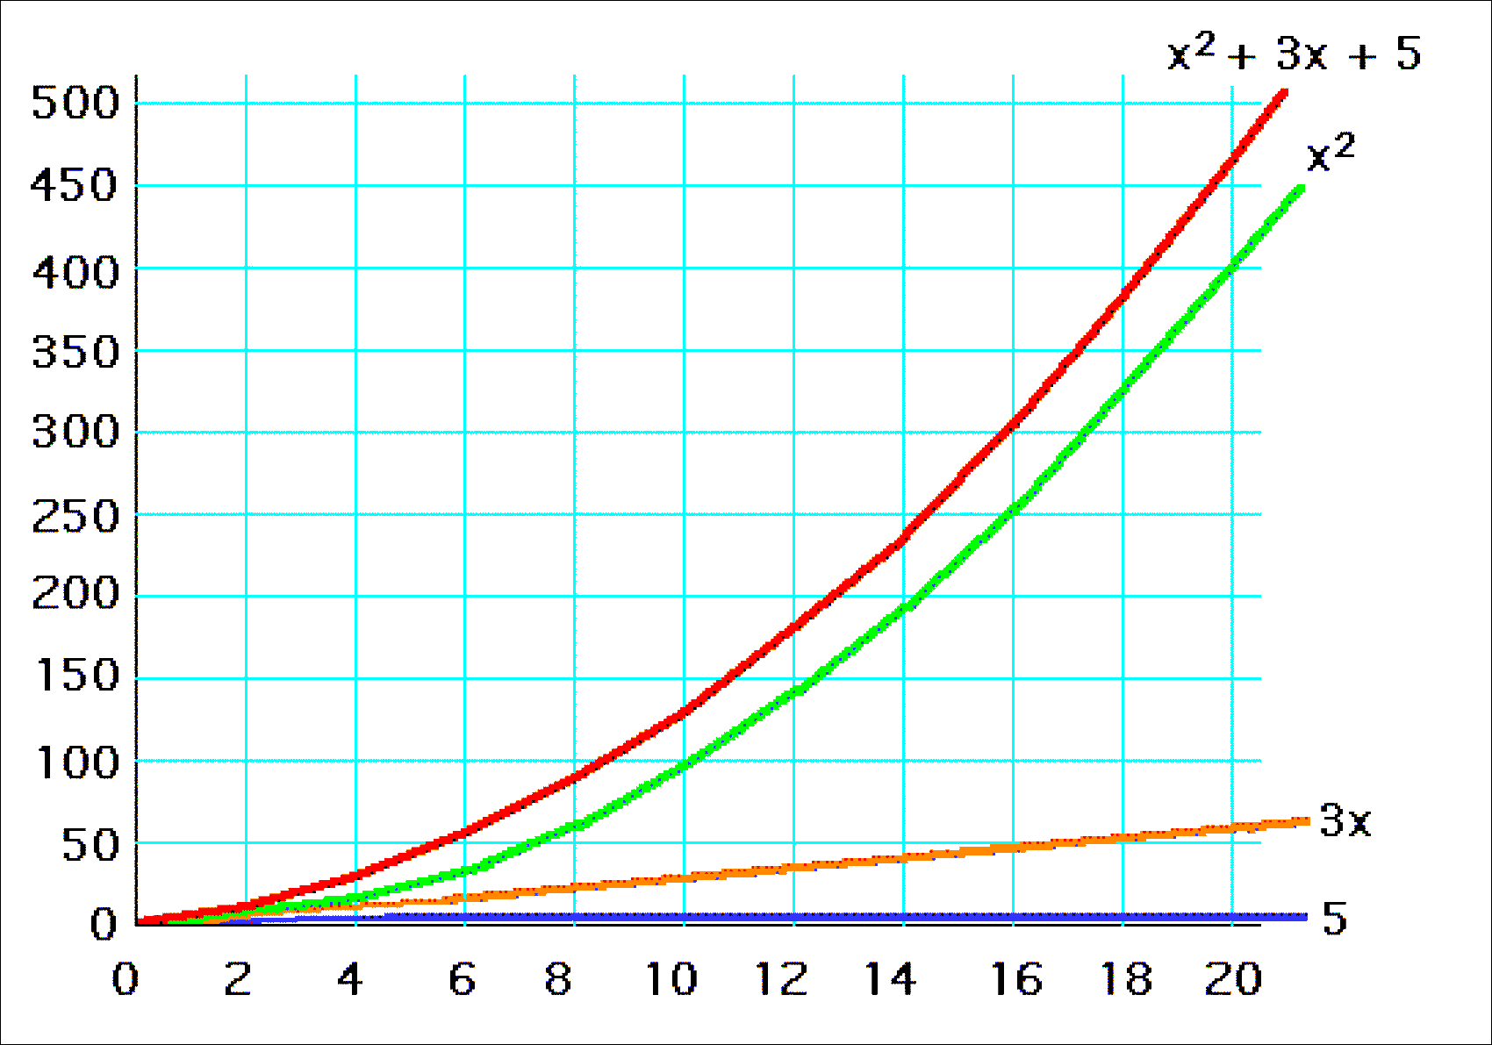
R = x² + 3x + 5, for x in [1,20]

Slide 63

Aymptotic Analysis: Big O
A function f(n) is O(g(n))
if there exist positive constants c and n₀ that makes
f(n) ≤ cg(n) for n ≥ n₀
  f(n) ∈ O(g(n)) : f(n) ≤ g(n)
  O(.) is upper bound of f(n)

Slide 64
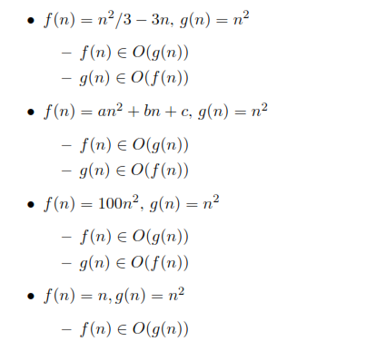
Example

Slide 65
In-class Exercise
7n-2 is O(n), O(n²), O(n³)?
3n³ + 20n² + 5 is O(n), O(n²), O(n³), O(n⁴)?
3 nlog n + n + 5 is O(n), O(nlogn), O(n²), O(n³)?

Slide 66
Why Big O?
Big-O notation gives a good first guess for deciding which algorithms are faster.
The Big O notation gives an upper bound on the growth rate of a function
Big O notation: rank functions according to their growth rate

Slide 67
Big O Ranking
BETTER
WORSE
O(1) constant time
O(log n) log time
O(n) linear time
O(n log n) log linear time
O(n²) quadratic time
O(n³) cubic time
O(n^{k}), k>3 polynomial time
O(2^{n}) exponential time

Slide 68
Example
Which one is bigger?
  n! ? a^{n}?

Slide 69

In-class Exercise
Arrange the following functions in ascending order of Big O

Slide 70

Tight Bound
Normally, we use the tightest possible bound:
  tightest possible bound ≈ the highest order in f(n)
    “2n is O(n)” to “2n is O(n²)”

Slide 71
Unless we specify otherwise, we want a tight bound
  Drop lower-order terms
  Drop constant factors
  Keep the highest order term

Slide 72
Example
If an algorithm takes 12n³+4n²+8n+35 time
  We say the algorithm requires O(n³) time
  Bottom line: Keep the Highest Order Term!

Slide 73
Example
If an algorithms execution time is n² + n + 3
  Preferred: O(n²)
  Yes, but not recommmended: O(n³), ...
Algorithmic Analysis

Slide 74
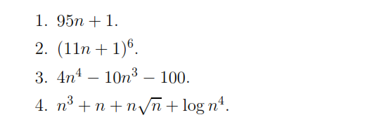
In-class Exercise
Find the tight bound.

Slide 75
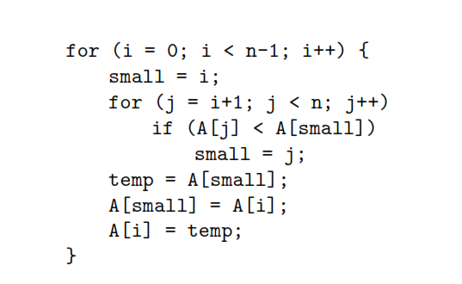
In-class Exercise

Slide 76
Remark
3n ³ + 5n ² – 9 = O (n ³)
Doesn’t mean
“3n ³ + 5n ² – 9 equals the function O (n³)”
Which actually means
“3n³+5n ² –9 is dominated by n³”
Read as: “3n³+5n² –9 is big-Oh of n ³”

Slide 77
Example
Input double[] A
x = A[0], y = A[1], max =abs(x - y);
for i in [0,size(A)-1]
for j in [i+1, size(A)-1]
if( max < abs(A[i]-A[j]) )
x = A[i]
y = A[j]
max = abs(A[i]-A[j])
end if
end for
end for
Output x, y, max

Slide 78
Example
Input double[] A
x = A[0], y = A[0]; // x represents the maximum number in A, while y represents the minimum number in A
for i in [0,size(A)-1]
if( x < A[i])
x = A[i]
end if
if(y > A[i])
y = A[j]
end if
end for
max = x - y
Output x, y, max

Slide 79
Tight Bound Big O
O(.) is expressed as a function of the highest order in f(n)
  Drop lower-order terms
  Drop constant factors
  Use the tightest possible bound ≈ the highest order in f(n)
    Prefer “2n is O(n)” to “2n is O(n²)”

Slide 80
Worst Case, Average Case, Best Case

Slide 81
Review: Running Time ≈ The Number of Instructions
The number of instructions (running time) of an algorithm depends on
  How big the input size is
  How the input is distributed (within a certain range? purely random?)
  etc.

Slide 82
Worst Case
The longest running time
  The algorithm will never be slower than this.
  The worst possible input

Slide 83
Best Case
The shortest running time
  The algorithm will never be faster than this.

Slide 84
Average Case
Be careful: average over what? Must assume an input distribution.
  I ran the algorithm a large number of times with different sets of data what would the average amount of work be for those runs?

Slide 85
Example
public static boolean member(int x, int[] a) {
  int n = a.length;
  boolean flag = false;
  for (int i = 0; i < n; i++) {
      if (x == a[i])
      {
        flag = true;
        break;
      }
      }
      return flag; }

Slide 86
Example
Worst Case:
If x is not in a, the loop executes N times (O(N)), where
N = a.length
Average Case:
If x is in a, the loop executes N/2 times on average (Still O(N))
Best Case:
If x is in a, as the first element, the loop executes one time

Slide 87
In-class Exercise
public static double minimum(double[] values, int numValues)
{ int n = numValues;
double minValue = values[0];
for(int i = 1; i < n; i++)
if(values[i] < minValue)
minValue = values[i];
return minValue;
}
Best case? Worst Case? Average Case?

Slide 88
Relatives of Big O
big-Omega
  f(n) is Ω(g(n)) if there is a constant c > 0
  and an integer constant n₀ ≥ 1 such that
  f(n) ≥ c•g(n) for n ≥ n₀
big-Theta
  f(n) is Θ(g(n)) if there are constants c’ > 0 and c’’ > 0 and an integer constant n₀ ≥ 1 such that c’•g(n) ≤ f(n) ≤ c’’•g(n) for n ≥ n₀

Slide 89


Relations Between Θ, O, Ω

Slide 90
Useful Math

Slide 91
Exponentiation
xª x^{b} = x^{a+b}
xª / x^{b} = x^{a-b}
(xª)^{b} = x^{ab}

Slide 92
log
Definition: y = log_{a}(x) if a^{y} = x
Example: What is log₂(256)?
2? = 256?
2⁸ = 256
Thus, log₂(256) = 8.

Slide 93
log (cont.)
What do logarithms have to do with algorithms? (e.g., searching)
  Consider an algorithm to search a data set of size n.
  Break up the data into two pieces (size n/2 each).
  Figure out (quickly) which piece has the data.
  Continue the search with data set of size n/2.
  Repeat the above procedure.
How long does this procedure take?
How many times can you recursively break up the data into two pieces?
  Ans: log(n) times.

Slide 94
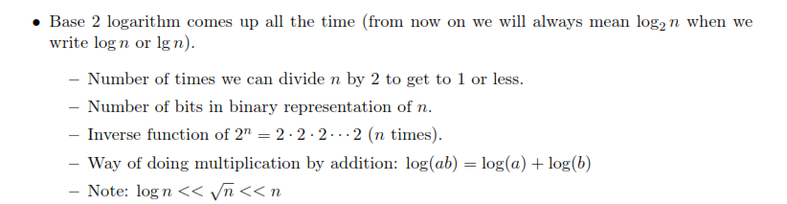
log (cont.)

Slide 95
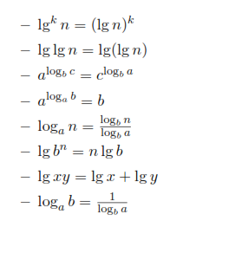
log (cont.)

Slide 96
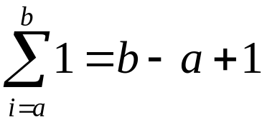
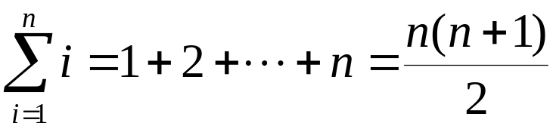
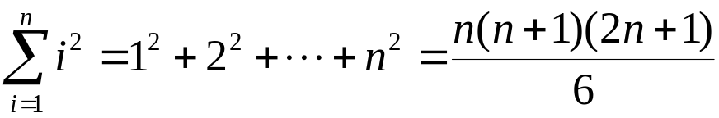
Summations
Constant Series: For integers a and b, a ≤ b,
Linear Series (Arithmetic Series): For n ≥ 0,
Quadratic Series: For n ≥ 0,

Slide 97
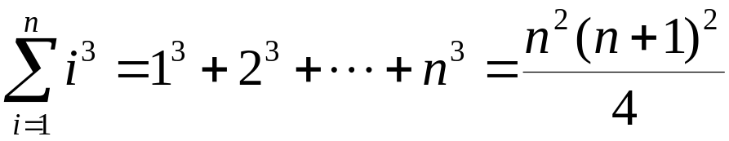
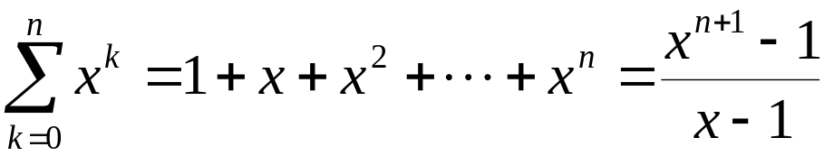
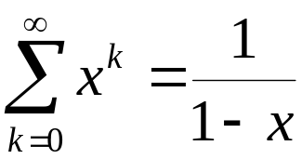
Summations
Cubic Series: For n ≥ 0,
Geometric Series: For real x ≠ 1,
For |x| < 1,

Slide 98
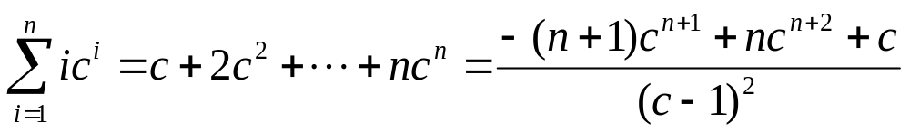
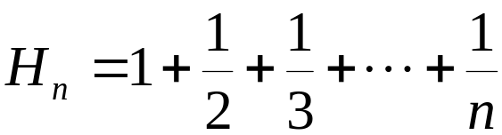
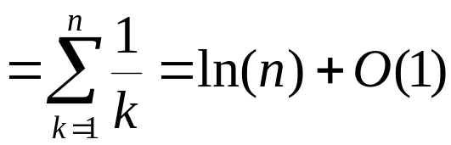
Summations
Linear-Geometric Series: For n ≥ 0, real c ≠ 1,
Harmonic Series: nth harmonic number, n∈I⁺,

