Slide 1
Business intelligence

Slide 2
Business Intelligence
Business intelligence = looking for patterns, relationships, and clusters of information in data

Slide 3
Business Intelligence (BI) Tools
Computer programs used as BI tools:
  Reporting
  Data mining
  Knowledge management

Slide 4
Data Mining
Applying statistical techniques to find patterns and relationships among data
Primary purpose: making predictions

Slide 5
Data “Sorting”
SPSS
Excel pivot tables
Algorithms

Slide 6

Fisher, Lauria, & Matheus (2009)

Slide 7
Data Mining
Data mining
  Cluster analysis: identifying groups with similar characteristics
  Regression analysis
Market-based (regression) analyses
  Technique for determining sales patterns
Decision Trees

Slide 8
Cluster Analysis and Customer Groups
Characteristics of Group A:
  Average age 33, owns 3 iPhones, owns high-end home-entertainment system, drives BMW M5, buys expensive children’s play equipment
Characteristics of Group B:
  Average age 64, owns vacation properties, plays golf, buys expensive wine
Cluster analysis findings: both groups buy designer children’s clothing
  Why are such different groups buying the same products?

Slide 9

Regression Analyses
Basic regression: using multiple IV’s to predict a DV

Slide 10
Market-based Regression Analyses
Example:
  Marketing experts in a communication company think cell phone usage on weekends is determined by customer age and length of time customer has owned the phone
  Run analysis to estimate the impact of customer age and account age on weekend cell use

Slide 11

Decision Trees
A tool that uses tree-like graphs of decisions and possible consequences
Calculate conditional probabilities
Decision rules use If…Then… format

Slide 12
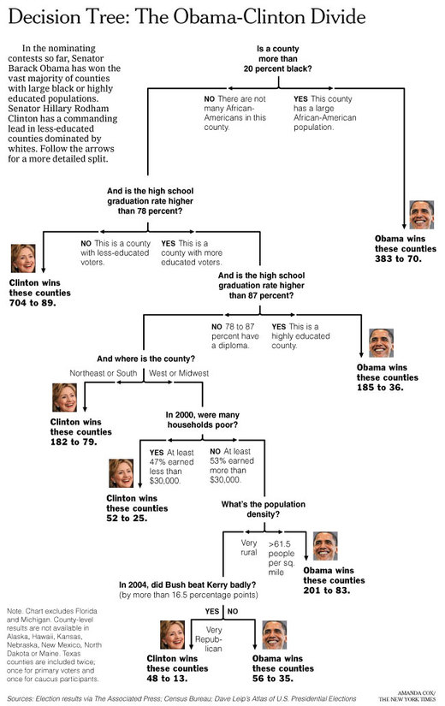
Decision Tree: Clinton vs. Obama (2008)

Slide 13
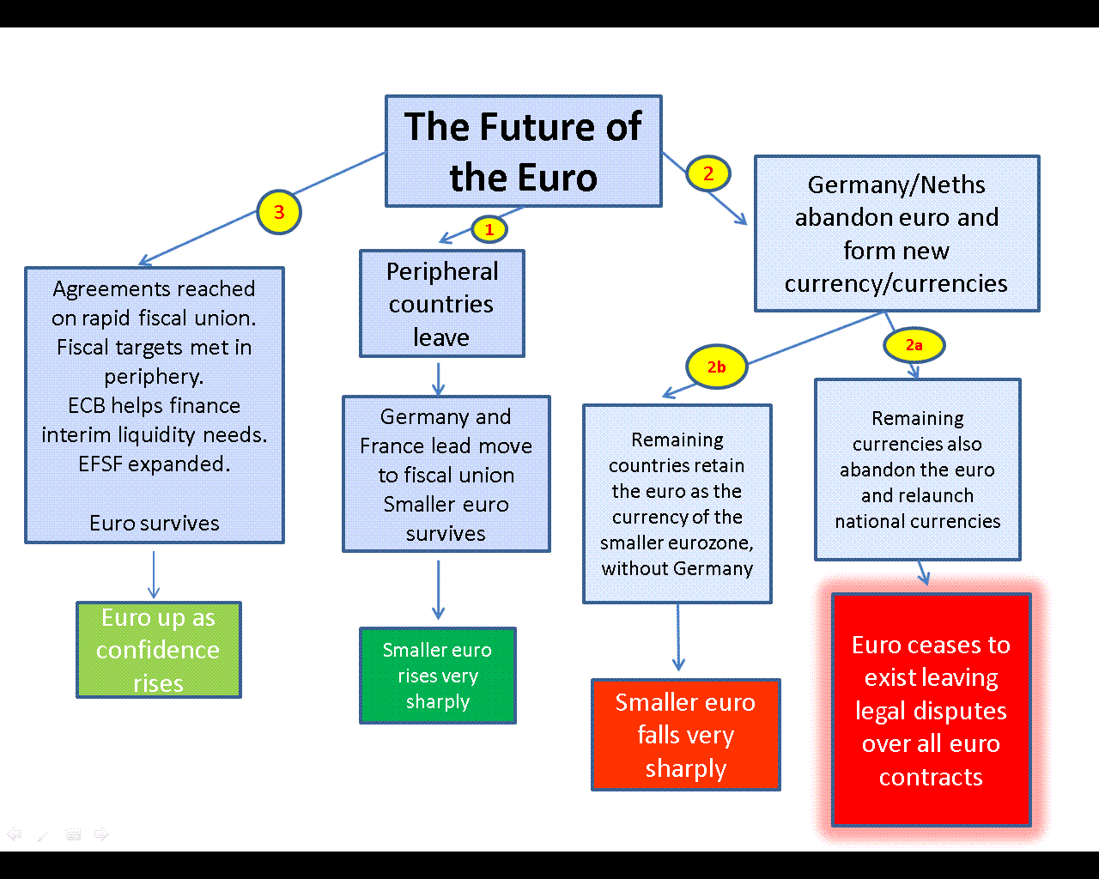
Decision Trees and €

Slide 14
Big Data
What is big data?
How do we work with big data?
  Hadoop

Slide 15
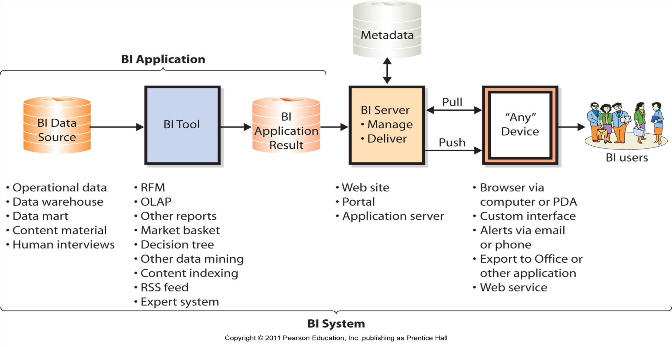
Components of a BI System
A data source is processed by a BI tool to produce application results. A BI application server delivers results in different formats to devices for BI users.
Notes:
*A data source is processed by a BI tool to produce application results
*BI application servers deliver results to devices for use by BI users

