Slide 1
Who should we call first?
A stroke-risk model to prioritise prevention outreach
[Your name] · [Date]
Notes:
Introduce yourself and the goal: help care coordinators decide who to contact first for stroke-prevention outreach, given limited capacity. Mention you'll cover the data, the model, a recommendation, and what you'd do next.

Slide 2
A ranking problem: put the highest-risk patients first
1
Explore & clean
Understand the data, find and fix quality issues
How success is measured
2
Baseline model
Coordinators can only call a small share of patients each month
So what matters is how many real high-risk patients sit near the top of the list
Assumption: outreach targets adults (18+)
Simple, interpretable logistic regression
3
Stronger models
Random forest and gradient boosting, compared fairly
4
Decide
Choose a call volume and estimate the impact
5
Recommend
Advice for the outreach team, plus next steps
Notes:
Frame the problem: limited capacity means we need to rank, not just classify. Walk through the five steps briefly. Call out the adults-only assumption: the brief says to make reasonable assumptions and write them down.

Slide 3
Strokes are rare, and the data needed cleaning
Issue | Decision
BMI missing (201) | Keep + 'missing' flag; fill with training median
Smoking "Unknown" (30%) | Keep as a category (mostly children)
BMI over 60 (13) | Cap at 60, likely entry errors
Gender "Other" (1) | Remove; can't learn from one case
Under-18s (856, 2 strokes) | Exclude; outside adult outreach
Duplicates | Checked: none found
4.9%
of 5,110 patients had a stroke
An "always no" model would be 95% accurate and find nobody, so accuracy is the wrong measure.
Notes:
Lead with the 4.9% and why accuracy is misleading. Then the cleaning log: each decision has a reason. Mention missing BMI was filled inside the pipeline using the training data only, to avoid leakage. After cleaning: 4,253 adults, 247 strokes (5.8%).

Slide 4
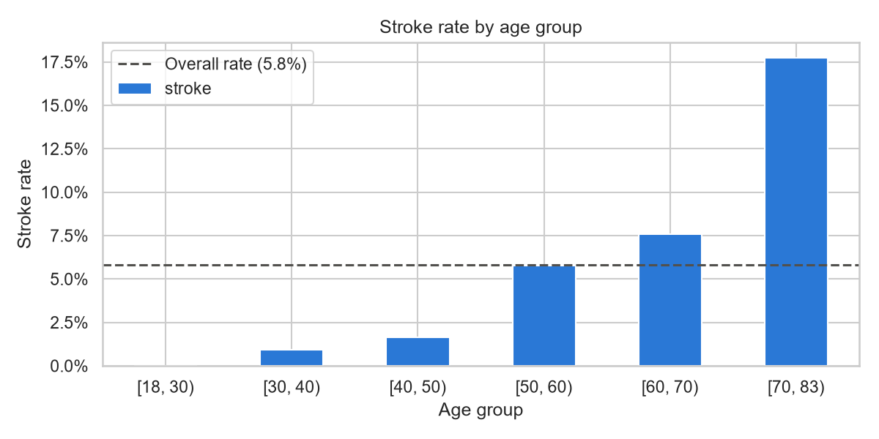
Age is the strongest driver of stroke risk
~18%
stroke rate for patients aged 70+
3×
the adult average of 5.8%
73% of all strokes are in patients aged 60+.
Notes:
Stroke rate rises steadily with age and jumps sharply in the 70+ group. Distinguish rate (how risky a group is) from count (where most cases are): 181 of 247 strokes are in the 60+ group.

Slide 5
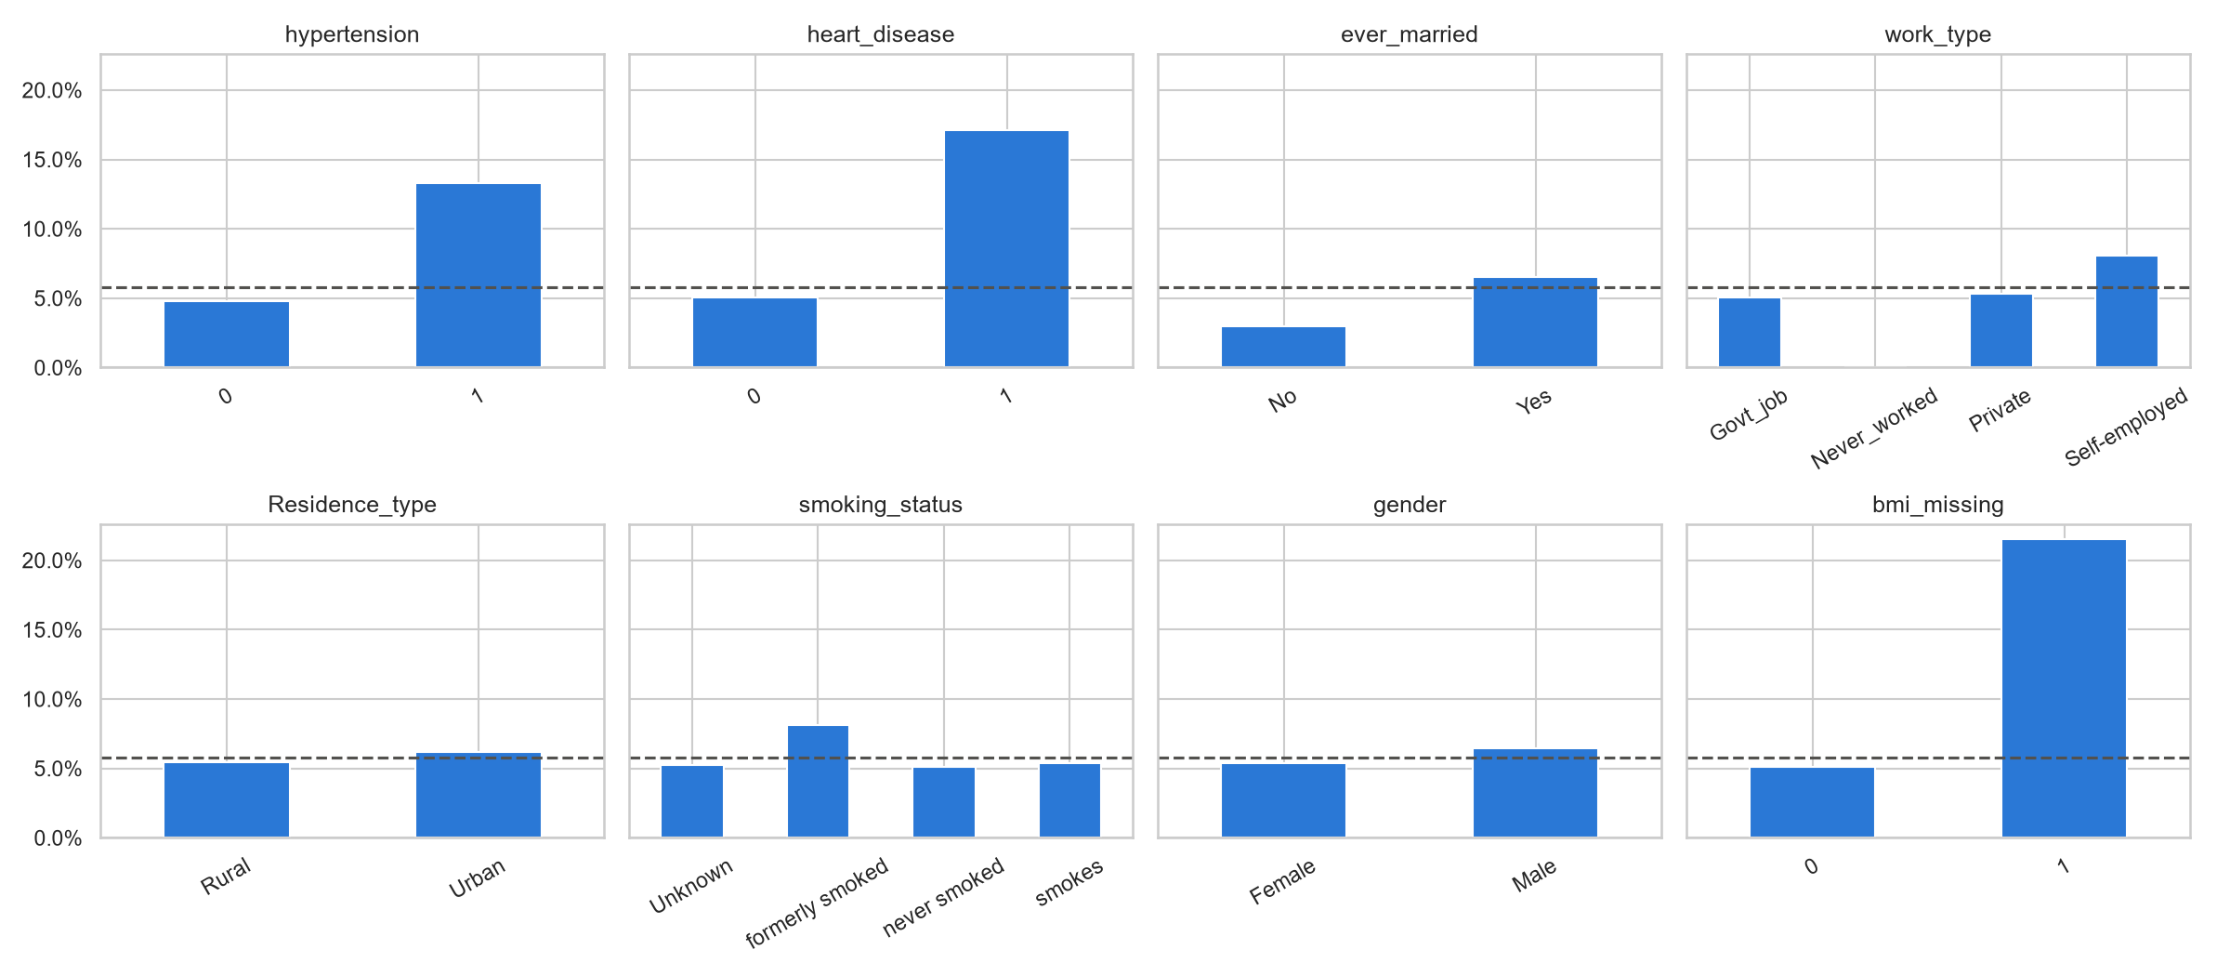
Health conditions matter; some patterns are just age
Hypertension, heart disease, high glucose: 2–3× the rate
Missing BMI: 20% stroke rate vs 4%
Gender, residence, smoking: little difference
"Married" and "self-employed" look risky only because they're older (confounding)
Dashed line = overall stroke rate
Notes:
Hypertension, heart disease and missing BMI stand out. Explain confounding with ever_married: married adults have a median age of 54 vs 28. Smoking showing little effect is surprising medically; likely age confounding plus limited data (30% unknown, no amount). Never_worked has only 5 adults, too few to read anything into.

Slide 6
More complex models didn't beat the simple one
Differences are smaller than the noise between folds: a tie
Compared with 5-fold cross-validation; test set kept sealed
Default random forest overfit: 1.00 on training vs 0.77 on new patients
Three different model types hitting the same ceiling suggests the limit is the data
PR AUC: 0.23 / 0.22 / 0.23 (random = 0.06)
Notes:
Explain cross-validation in one line: five rounds of train-on-most, test-on-the-rest, on training data only. The gaps between models (about 0.01) are smaller than the fold-to-fold spread (about 0.02), so it's a tie. Mention overfitting: the default forest memorised the training patients. Constraining it helped but it still didn't win.

Slide 7
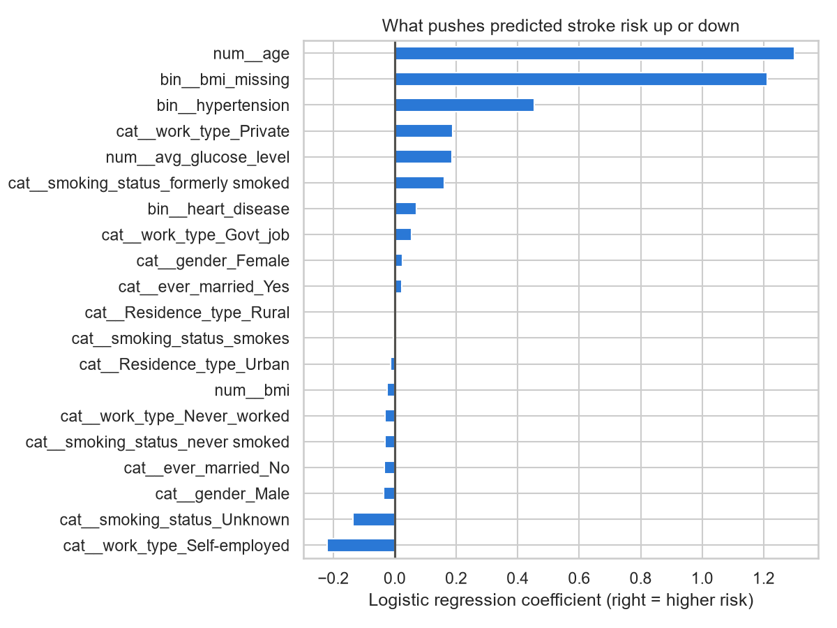
Recommended model: logistic regression
0.82
4×
ROC AUC on unseen test patients
better than random (PR AUC 0.23 vs 0.06)
Top drivers: age, missing BMI, hypertension, glucose
Coordinators can see why a patient is flagged
Simple to run monthly and to maintain
Notes:
These test-set numbers come from the one time we used the sealed test set. Right = pushes risk up. Note ever_married is now near zero: once age is in the model it doesn't matter, which confirms the confounding finding. Coefficient sizes aren't directly comparable between 0/1 flags and scaled numbers. Age's full effect is about 4x bigger than the missing-BMI flag.

Slide 8
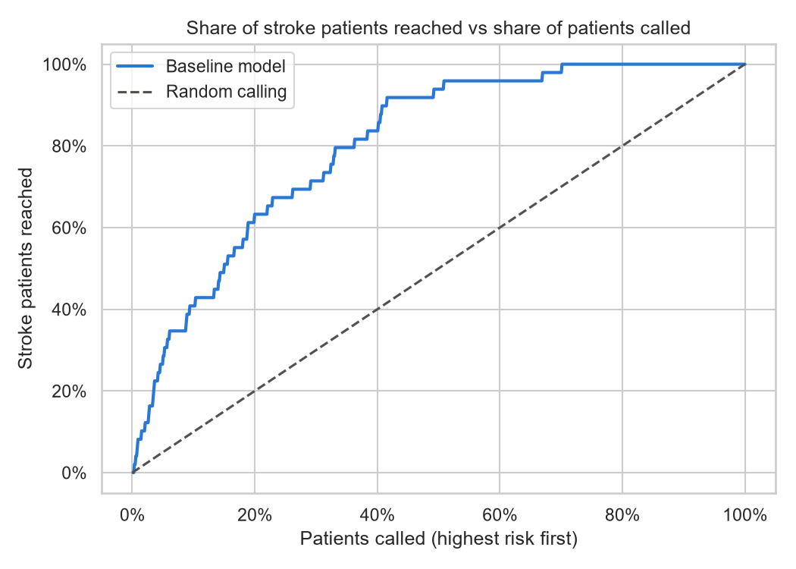
Each extra call finds fewer stroke patients
Beyond the top ~20%, calls hit at the random rate (5.8%).
Notes:
Left: calling the top 20% reaches about 63% of stroke patients; random calling would reach 20%. Right: the trade-off. Each block of calls is less productive than the last. By the 20-30% block, the model is no better than calling at random. That's the natural limit for model-driven outreach.

Slide 9
Call from the top down, up to about 20% of patients
Call the top… | Stroke patients reached | Hit rate | vs random
5% | ~29% | 1 in 3 | ~6×
10% | ~41% | 1 in 4 | ~4×
20% | ~63% | 1 in 5–6 | ~3×
30% | ~71% | 1 in 7 | ~2×
The recommendation
Score all adult patients monthly
Call from the top down as far as capacity allows
Stop around the top 20%, where the model stops adding value
If capacity changes, move the cutoff. No retraining needed
Based on 49 test-set strokes, so treat these as approximate.
Notes:
Example to say out loud: if the team can reach about 10% of patients a month, they'd reach roughly 4 in 10 stroke-risk patients, with about 1 in 4 calls being to someone who had a stroke. That's 4x better than random. The threshold is set by capacity; the matching probability cutoffs are about 0.20 (top 5%), 0.15 (10%) and 0.09 (20%). Trade-off: more calls reach more patients but each call is less likely to be useful.

Slide 10
Risks to check before launch
1
2
3
Possible leakage
Timing of the data
Risk ≠ prevention
BMI may be missing because of a stroke admission. Tested: without the flag, scores barely change (CV PR AUC 0.23 → 0.20).
The target is "had a stroke". We don't know whether features were recorded before or after it.
The model finds high-risk patients. It doesn't prove that outreach prevents strokes.
Notes:
Be upfront: these are the questions I'd take to the data owner first. The leakage check is a strong point: the model doesn't depend on the flag. If in doubt, deploy the version without it.

Slide 11
Parking lot: what I'd do with more time
Richer clinical data
Confirm timing
Predict the future
BP readings, atrial fibrillation, cholesterol, prior mini-strokes
Ask the data owner how BMI and other features are recorded
Rebuild the target as "stroke in the next X years"
Fairness check
Calibration
Pilot & monitor
Compare reach by gender, residence and age band
Check risk %s before showing them to clinicians
Measure whether outreach reduces strokes; watch for drift
Notes:
Lead with richer data: three model types all hit about 0.82, which points to a data ceiling, not a model one. More tuning would give diminishing returns. The full parking lot, with what/why/how for each item, is in parking_lot.md.

