Slide 1

What is OpenRefine and why should it be used?
Benjamin Winter & Wolfgang Müller 2020

Slide 2
What is OpenRefine
Ex GoogleRefine, ex Freebase Gridworks
Intended for
  Cleaning messy data
  Transformation of data
  Parsing data from web sites
  Aligning to Wikidata
  More features with specialised forks and extensions
  see https://openrefine.org/download.html

Slide 3
For us the most interesting
Use for cleaning data
  Find what may be written wrong
  Search and replace on steroid
Reproducible transformation
  Create trace of transformations used
  Reuse next time with little effort

Slide 4
Facets

Slide 5
Facets visualisation
find parts of the data by a facet
some Data
find data by combining facets
or only the intersection?
or by difference?
you can also invert the selection at any point

Slide 6
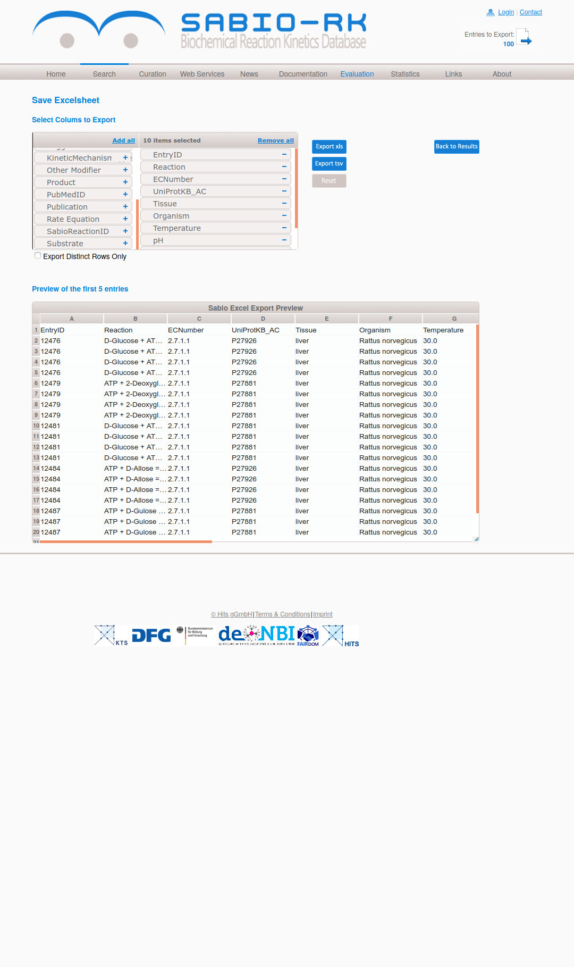

Slide 7
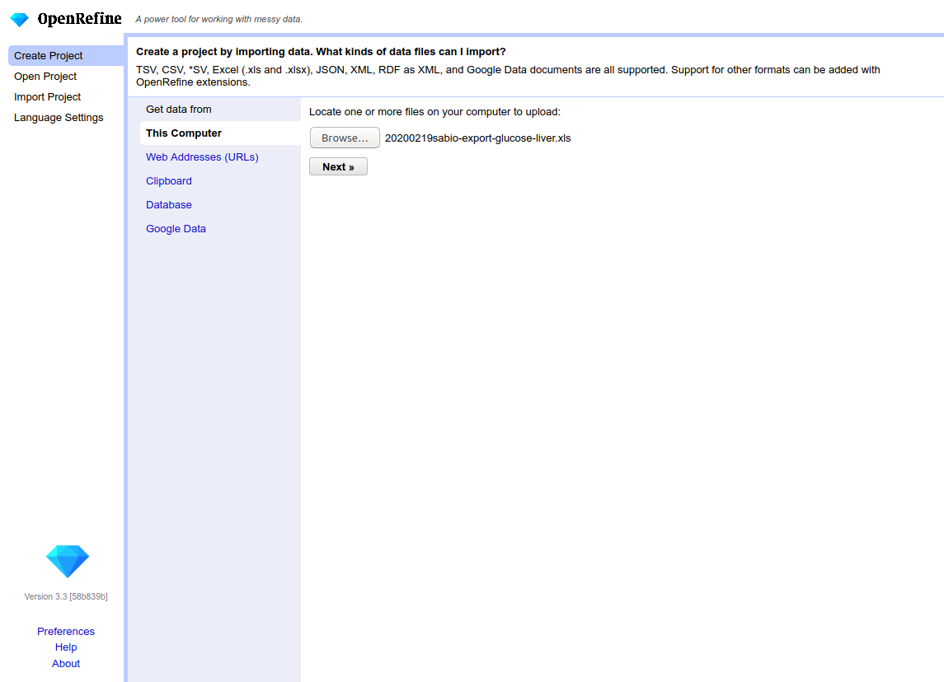

Slide 8
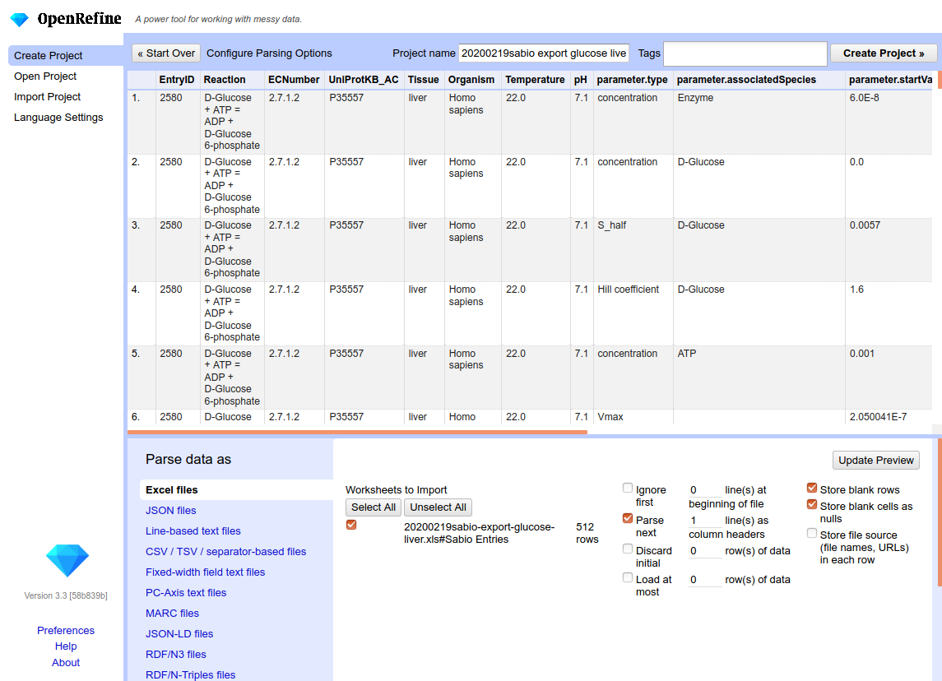

Slide 9
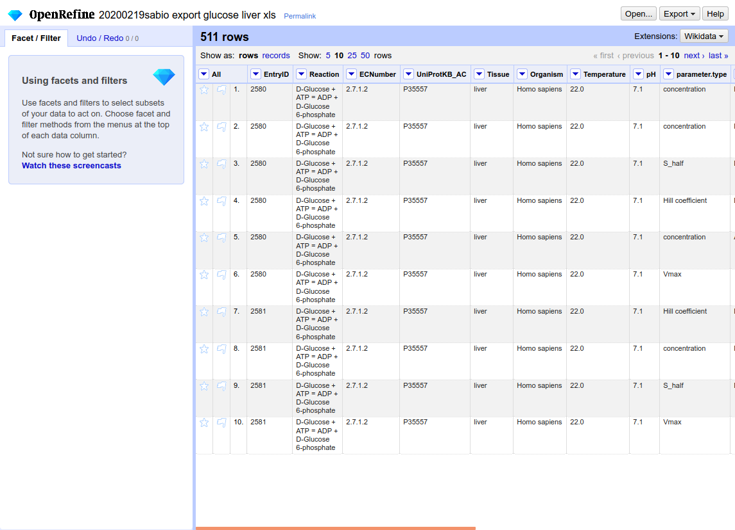

Slide 10
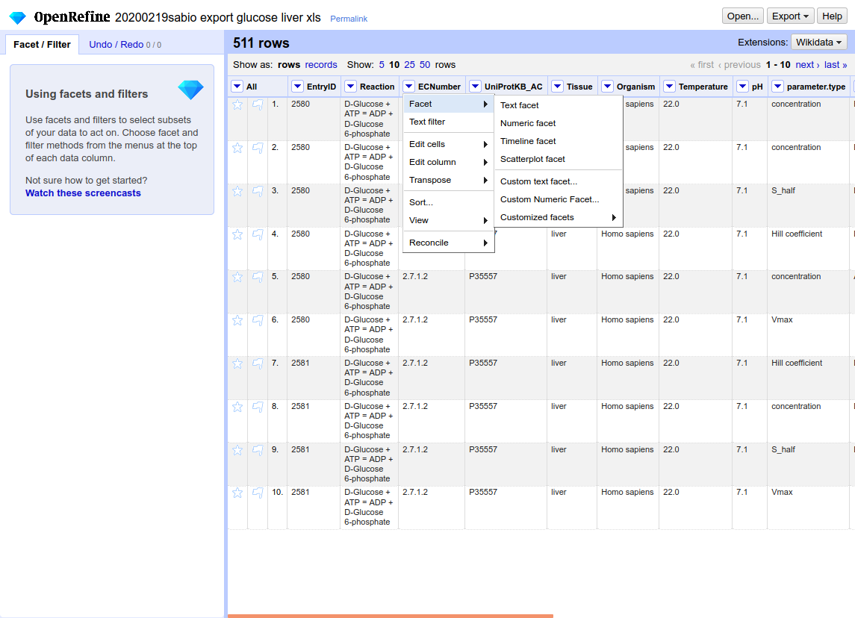
create new Text facet

Slide 11
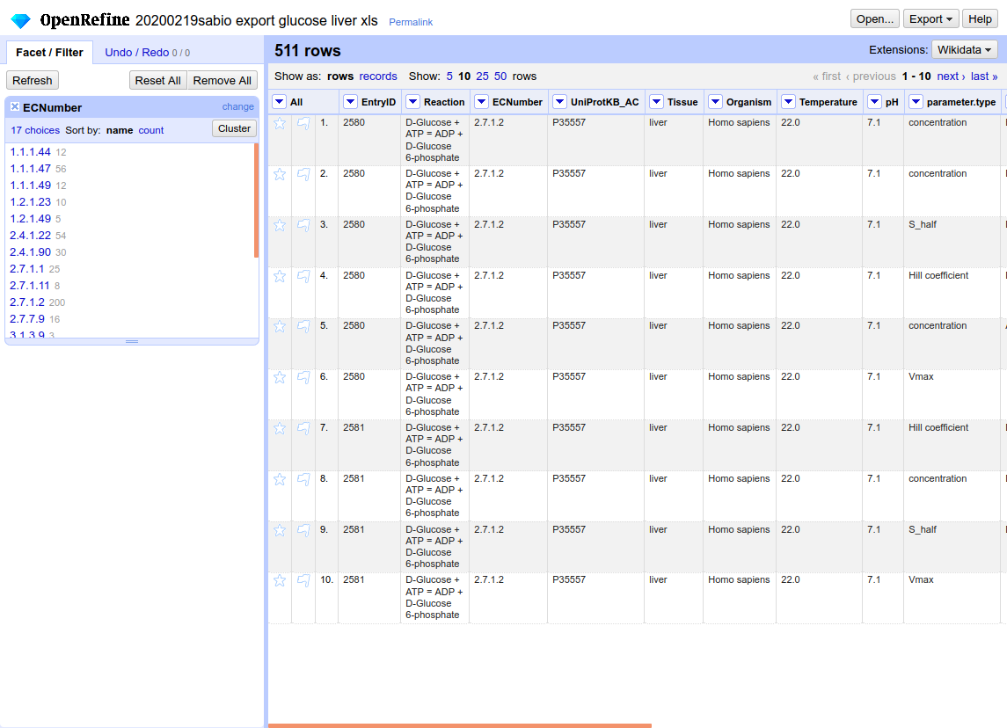

Slide 12
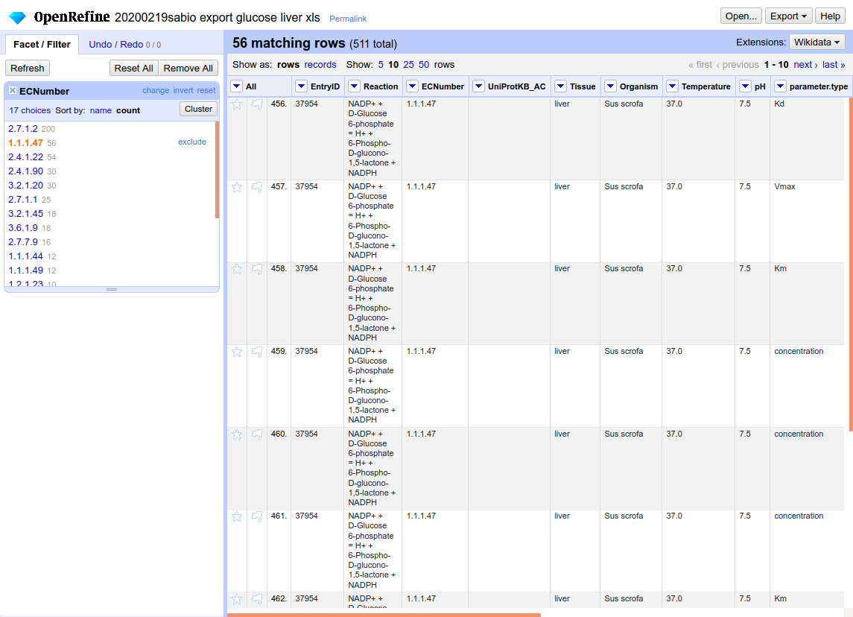
sort by count
select data by ECNumber

Slide 13
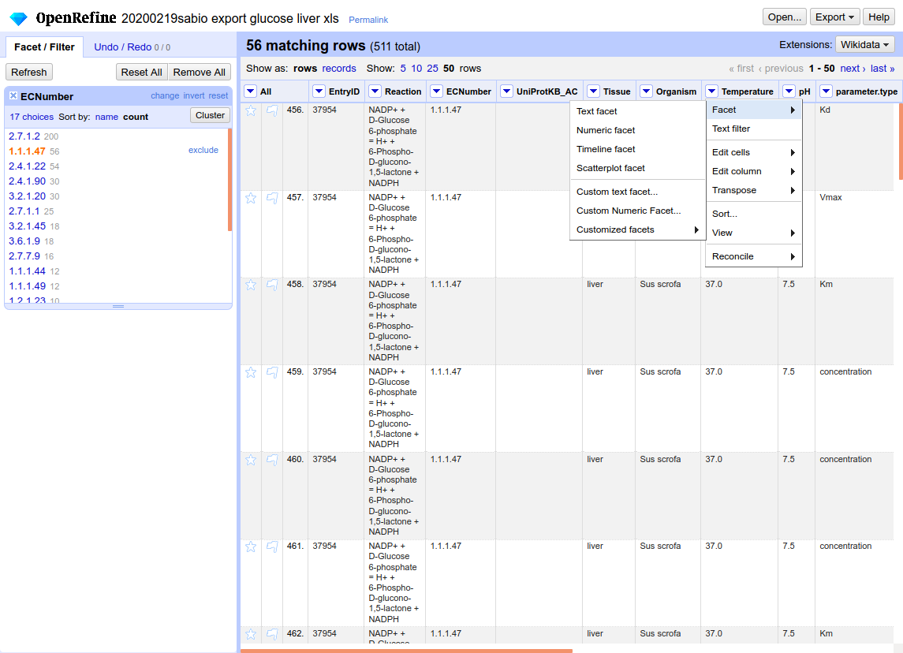
if you try to create a numeric facet
on a text column like temperature

Slide 14
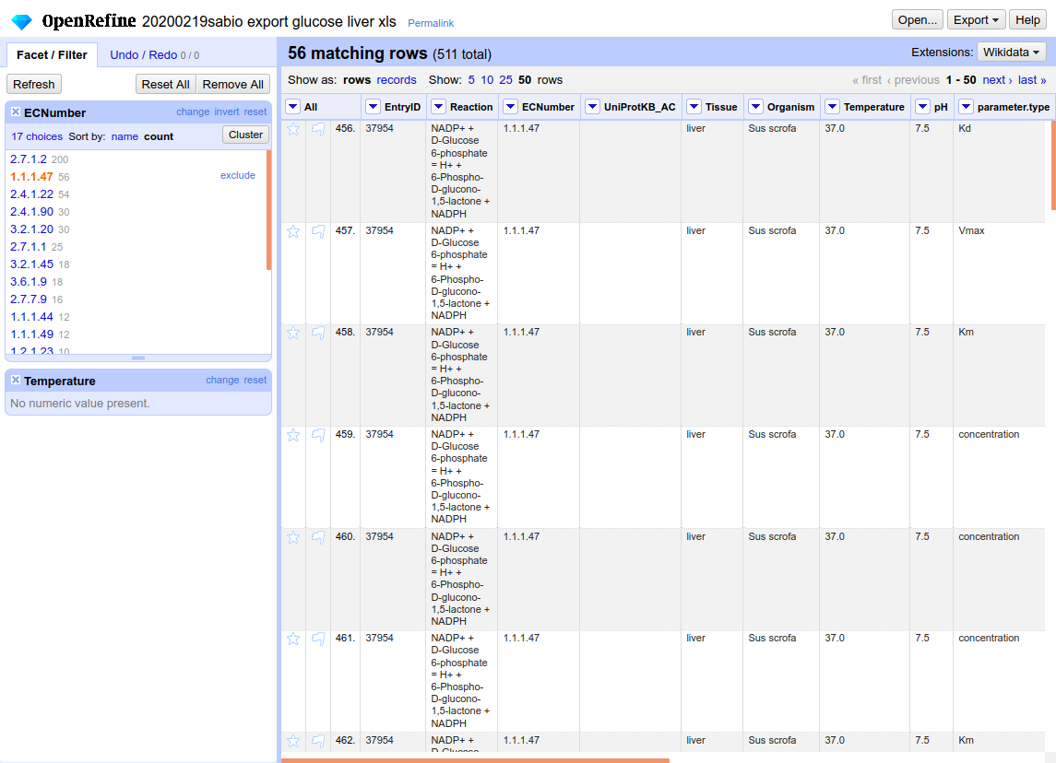
it will not work, so…

Slide 15
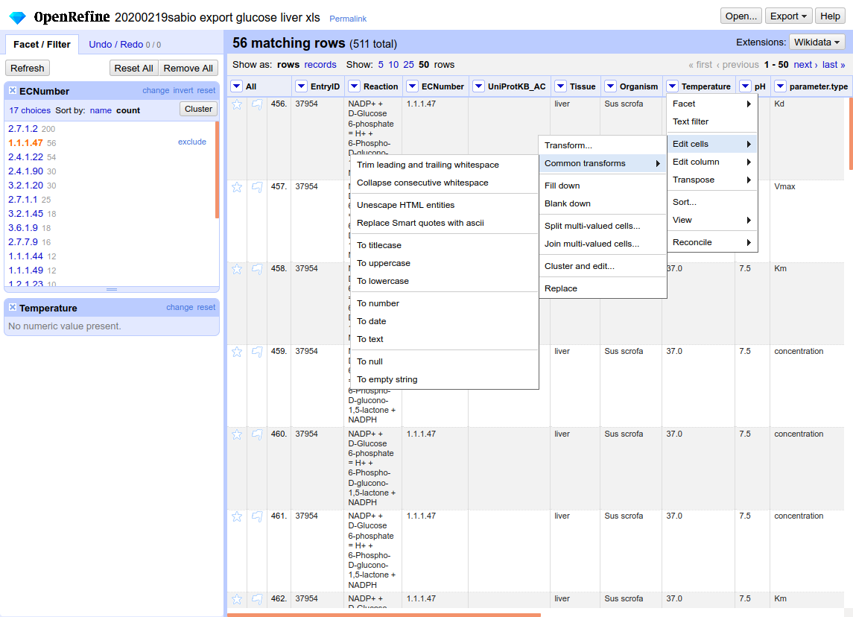
transform the column type!

Slide 16
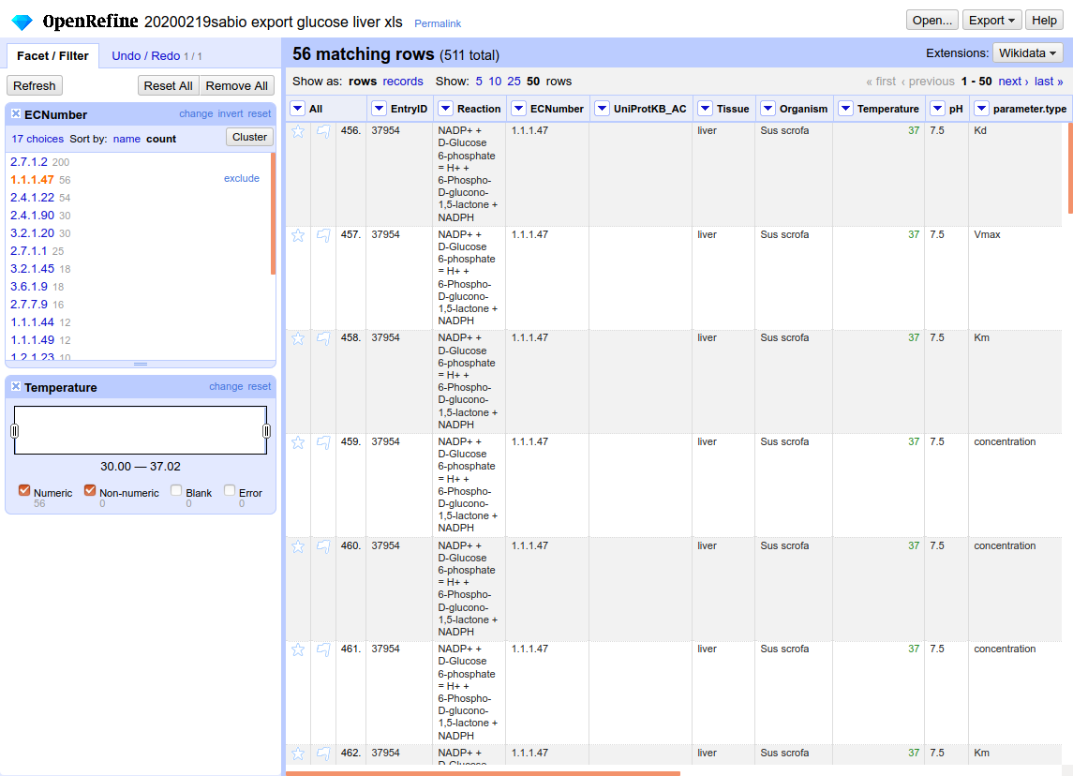
you can also transform the type
of more then one column in one step,
try All → Transform → enter value.toNumber()
then select the columns

Slide 17
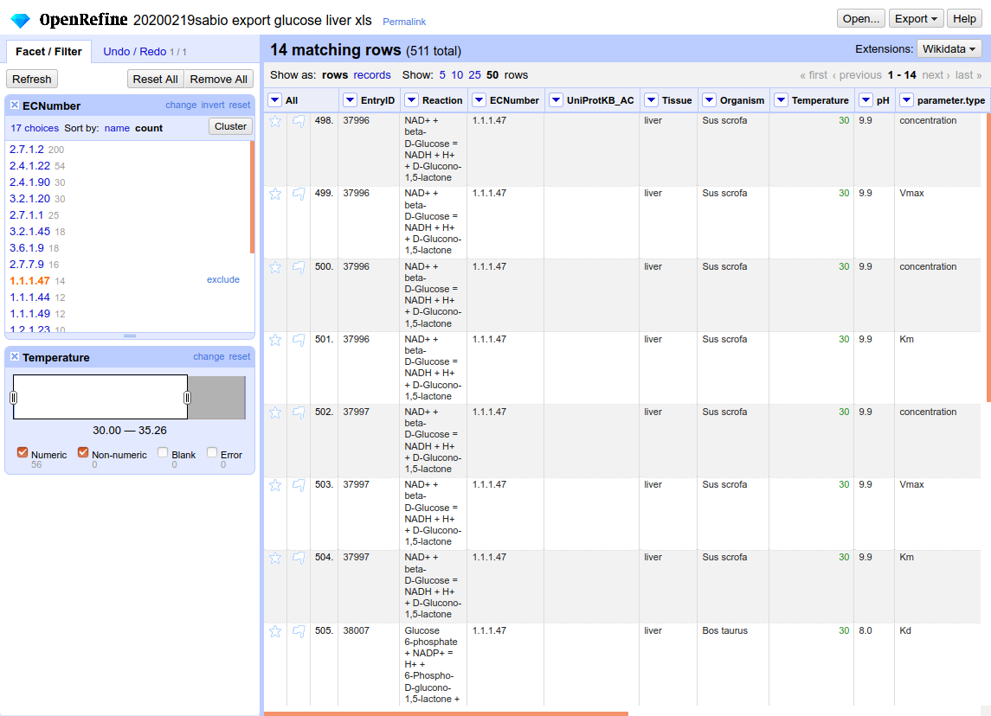
all the facets are working together
the data is filtered by the selected ranged/values

Slide 18
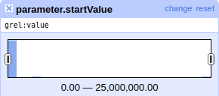
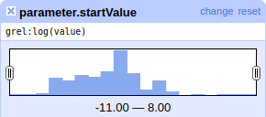
add facets as you like, fiddle around
find the exclude option
find the invert option
create a numeric facet for parameter.startValue
  linear scale doesn't fit here
  click change in the facet
  change value to log(value)

Slide 19
Modifying values

Slide 20
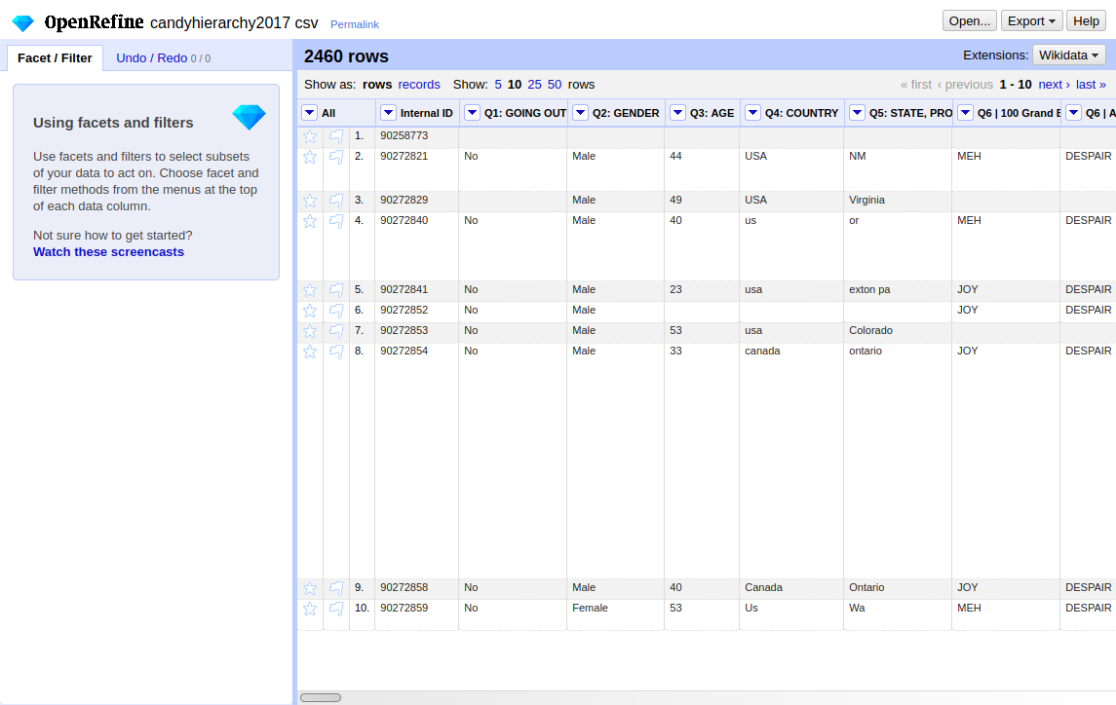
load candyhierarchy2017.csv

Slide 21
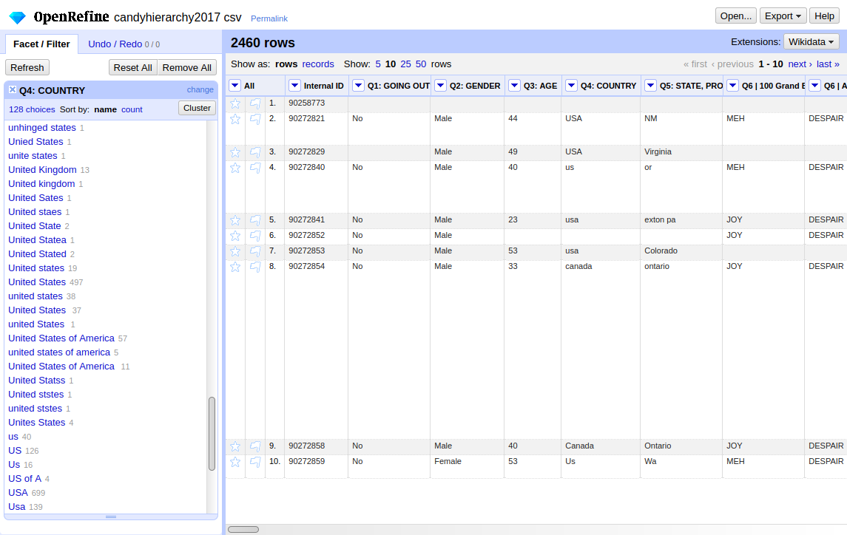
Text-facet the “Q4: COUNTRY”
manually entered data in the Country-Field makes analysis very hard here
try that one

Slide 22
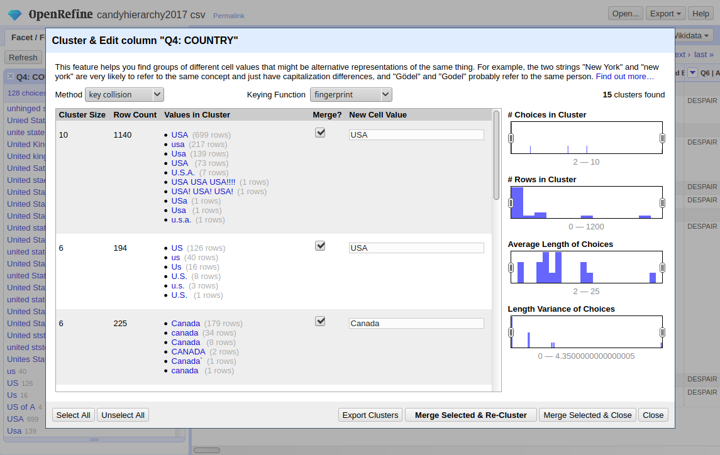
Study the Cluster-Dialogue
tick
enter new name
merge!

Slide 23
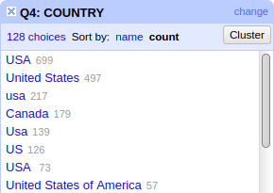
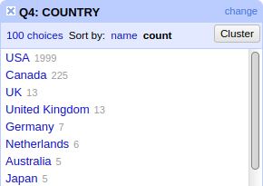
Compare result

Slide 24
Find meaning in your data

Slide 25
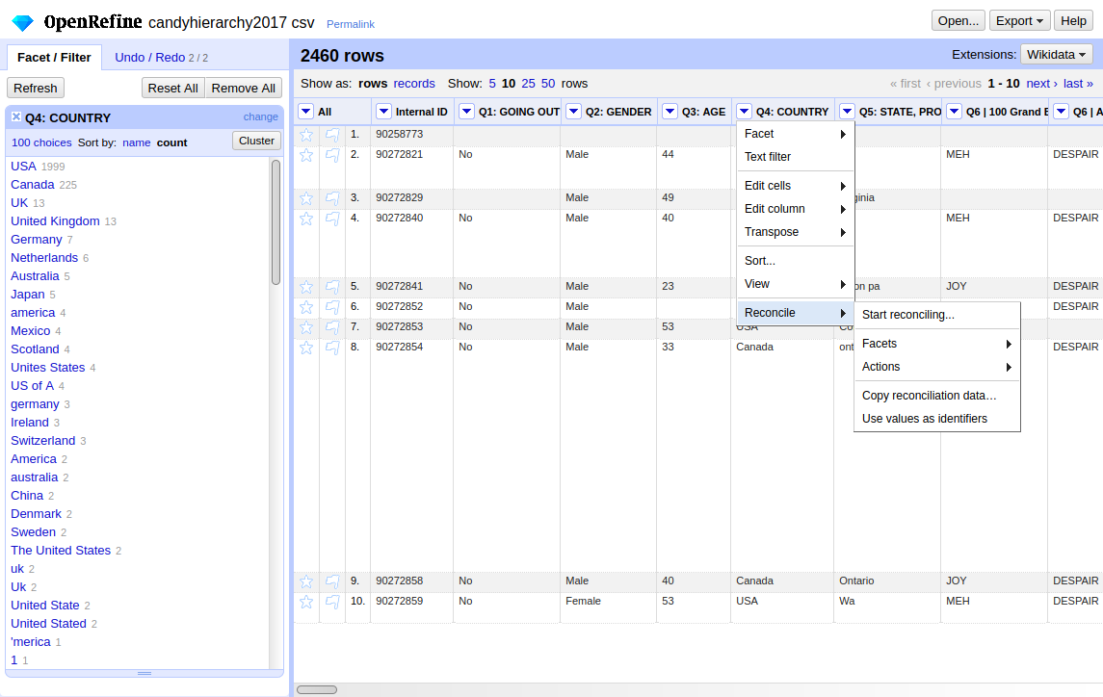
“Country” could mean something…
reconcile

Slide 26
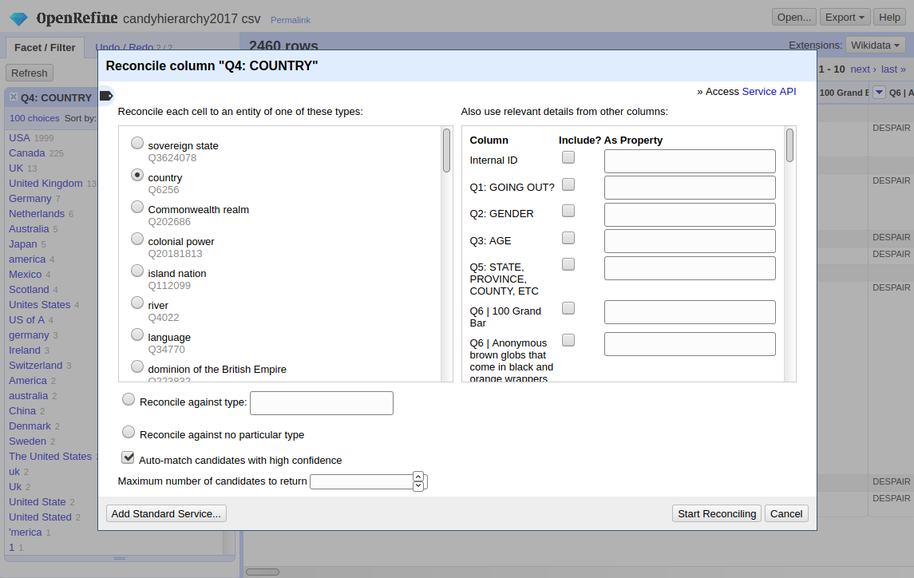
use WikiData to add meaning
select the right
property
start here but beware
100 Countries will take up to 5 Minutes

Slide 27
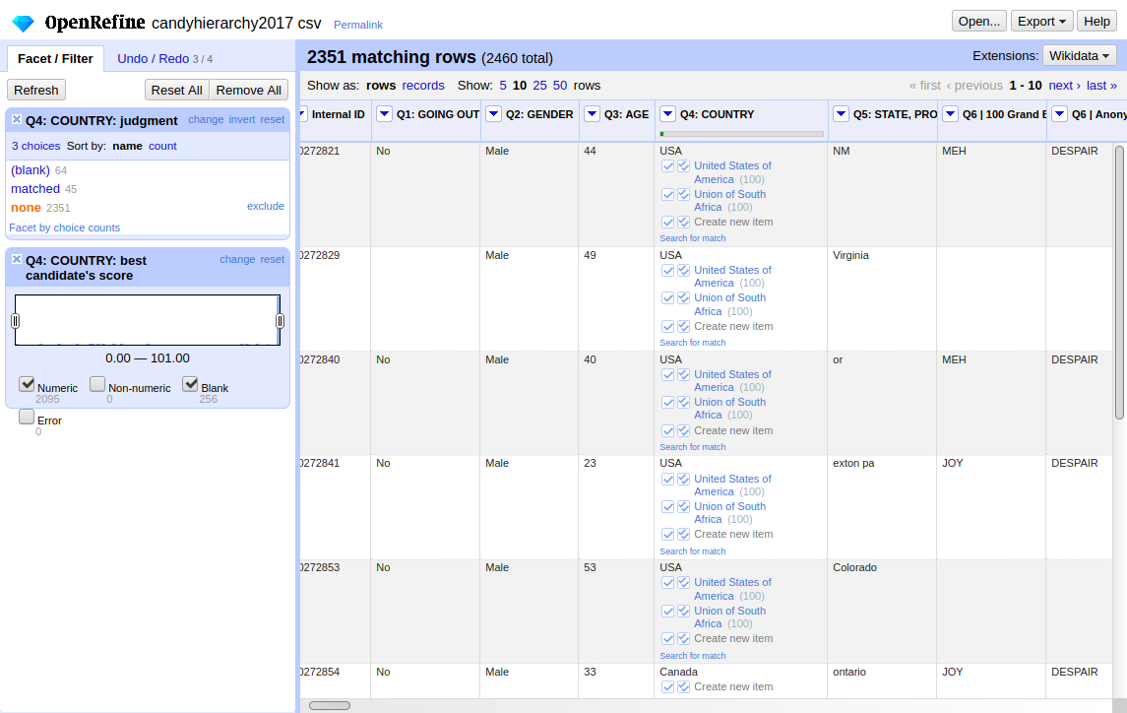
The new column provides new data
this is the overview,
how many matches are found
only select the
non-matched
submit the right match
for all cells
with the same content

Slide 28
Transforming content

Slide 29
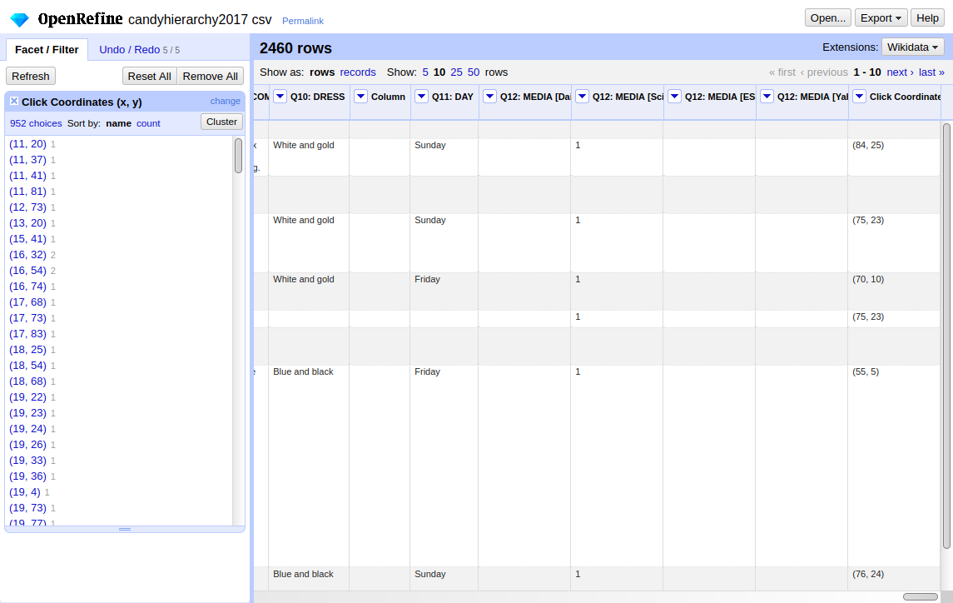
How to split a column?
Coordinates!

Slide 30
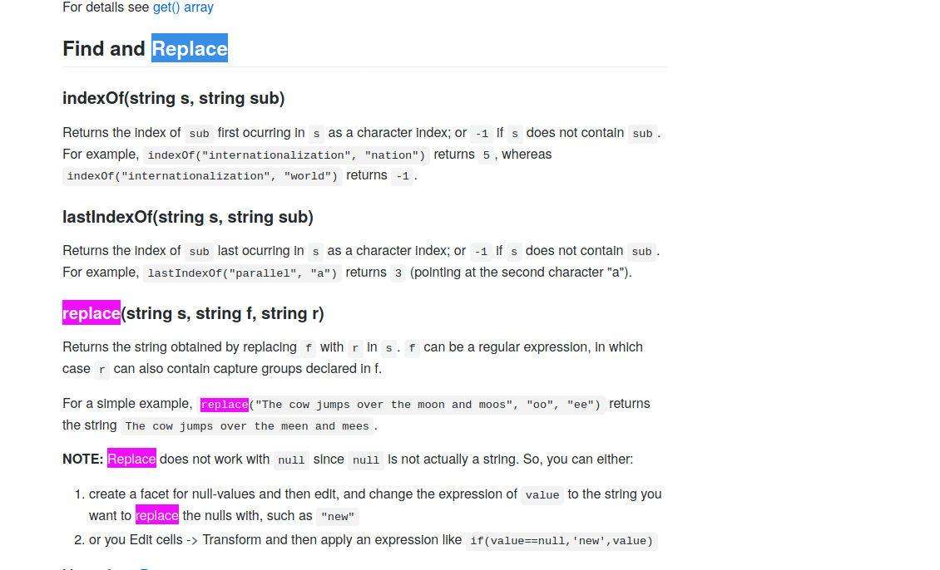
1. delete the braces
GREL is a script language for OpenRefine
  simple String/Array/Math/…-Operations
see https://github.com/OpenRefine/OpenRefine/wiki/GREL-Functions
go for String Functions
search “replace”

Slide 31
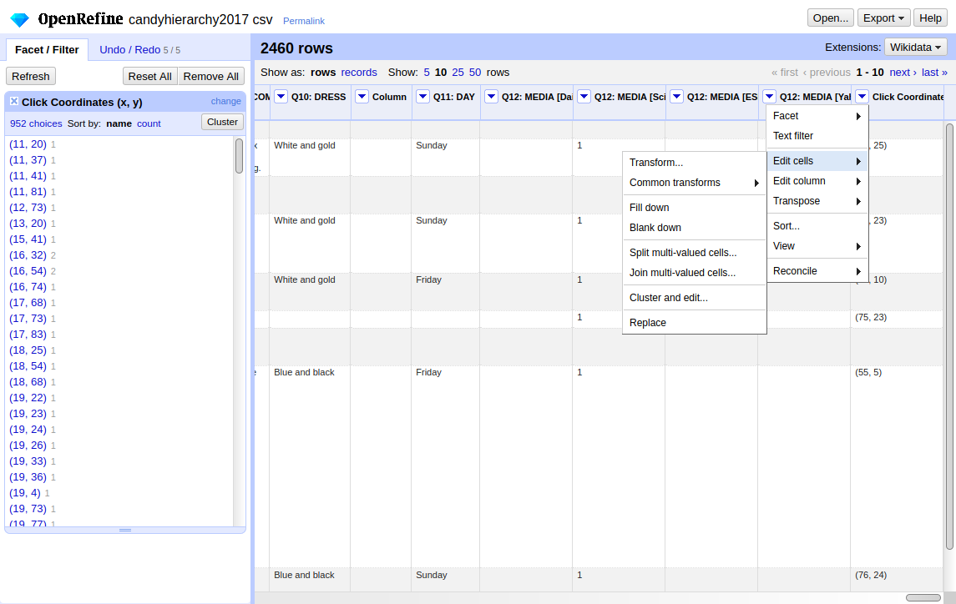
1. delete the braces
Transform cells

Slide 32
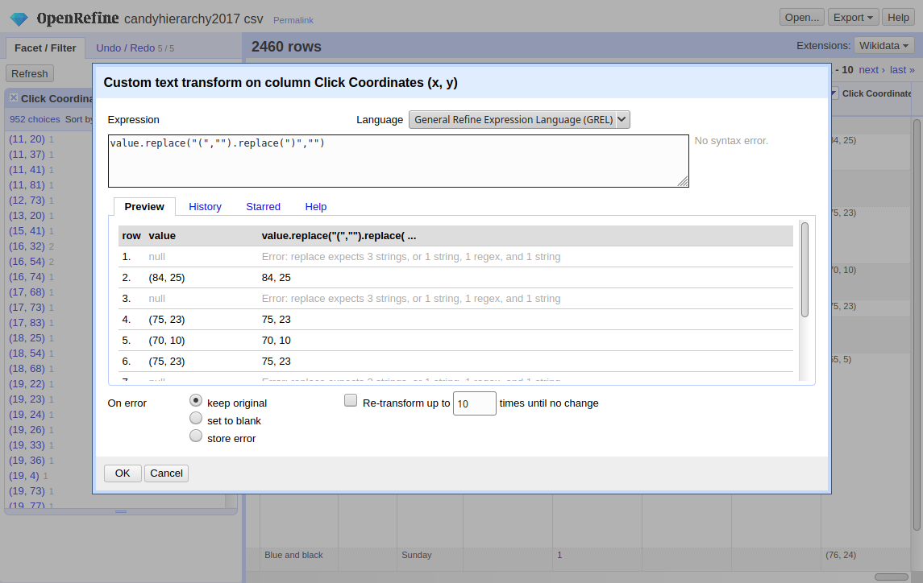
1. delete the braces
enter
formula
see
preview

Slide 33
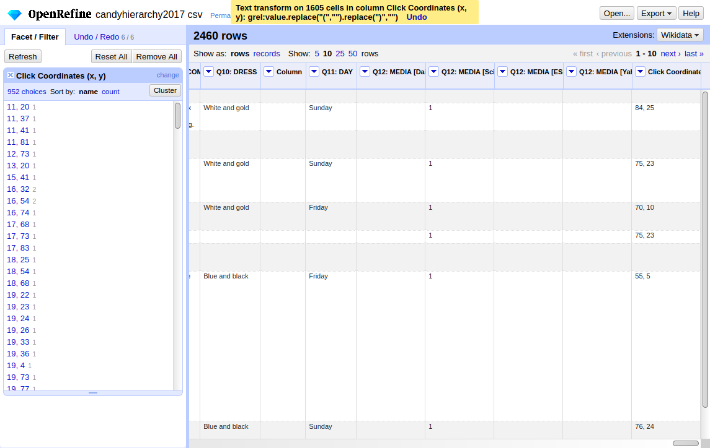
2. split column
braces gone!
now split by “,”

Slide 34
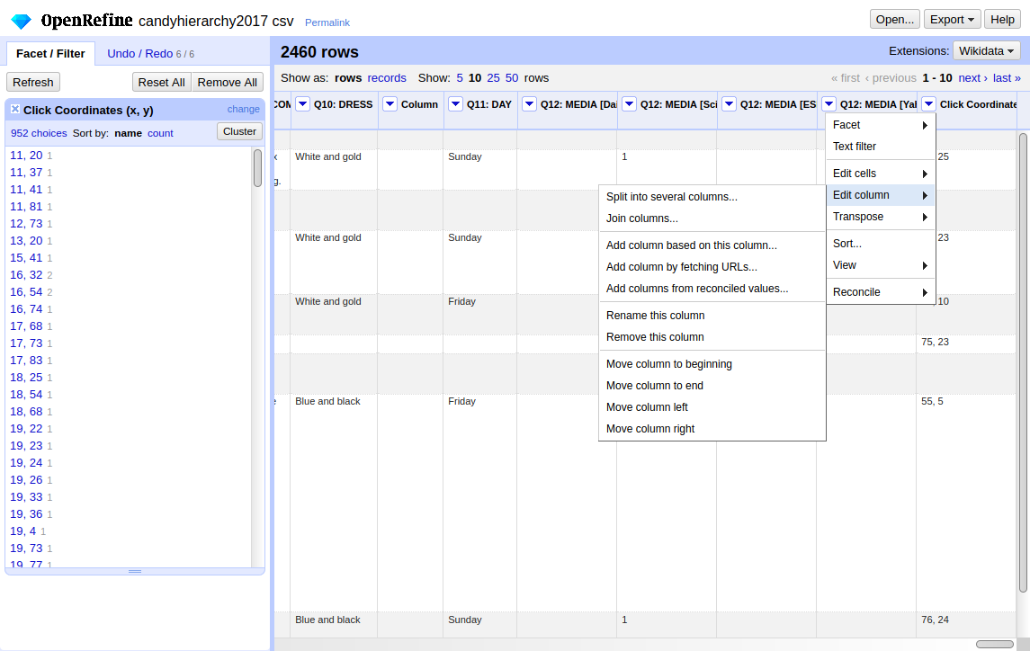
2. split column
split into several columns

Slide 35
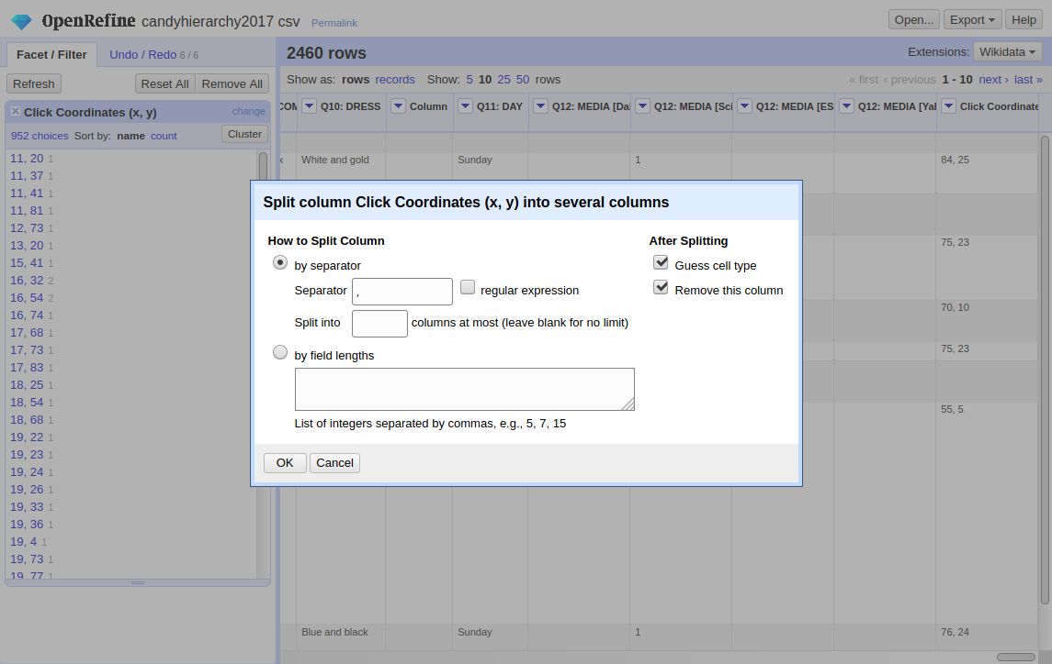
2. split column

Slide 36
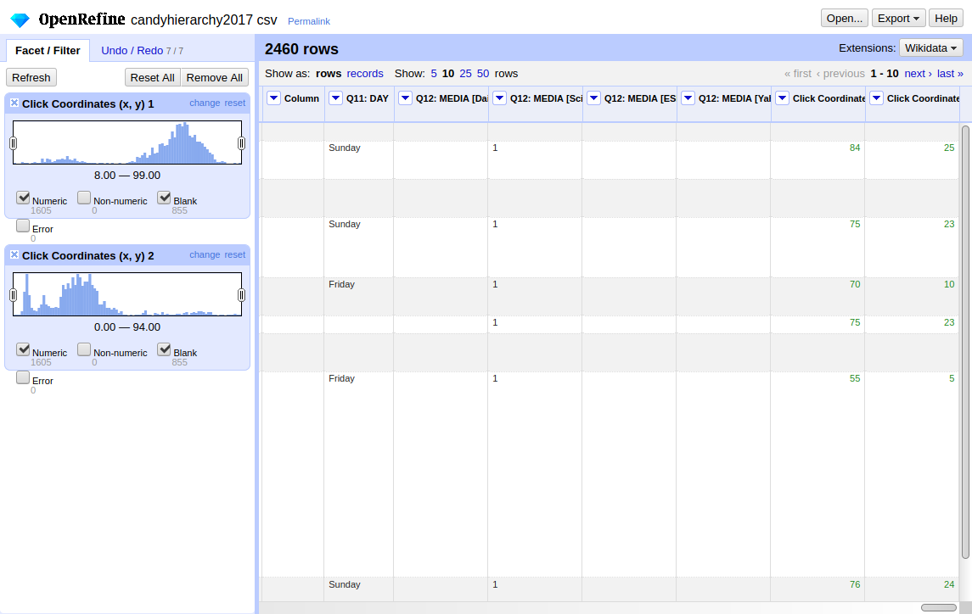
Done!
but look at the numeric facets
is there some kind of meaning in the data?!

Slide 37
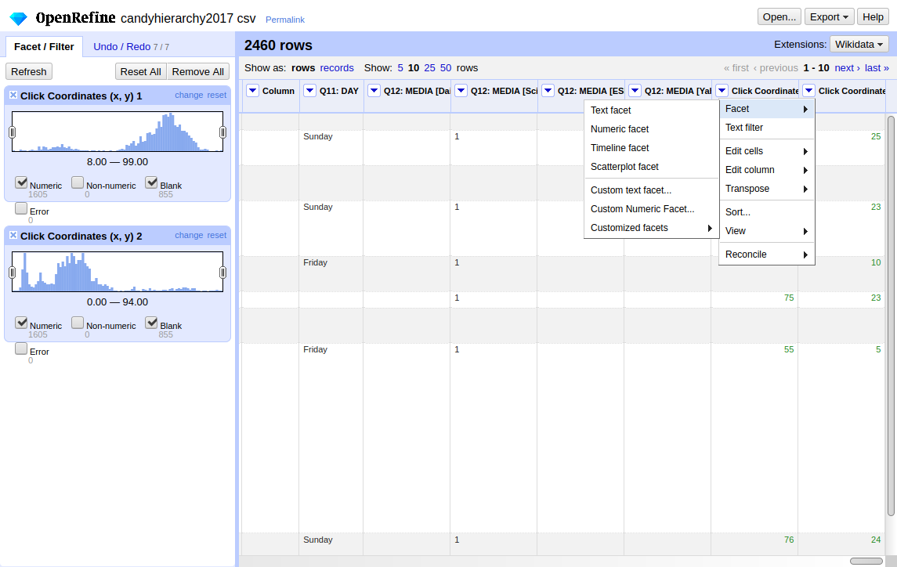
Scatterlplot data
try the scatterplot
facet to view correlations

Slide 38
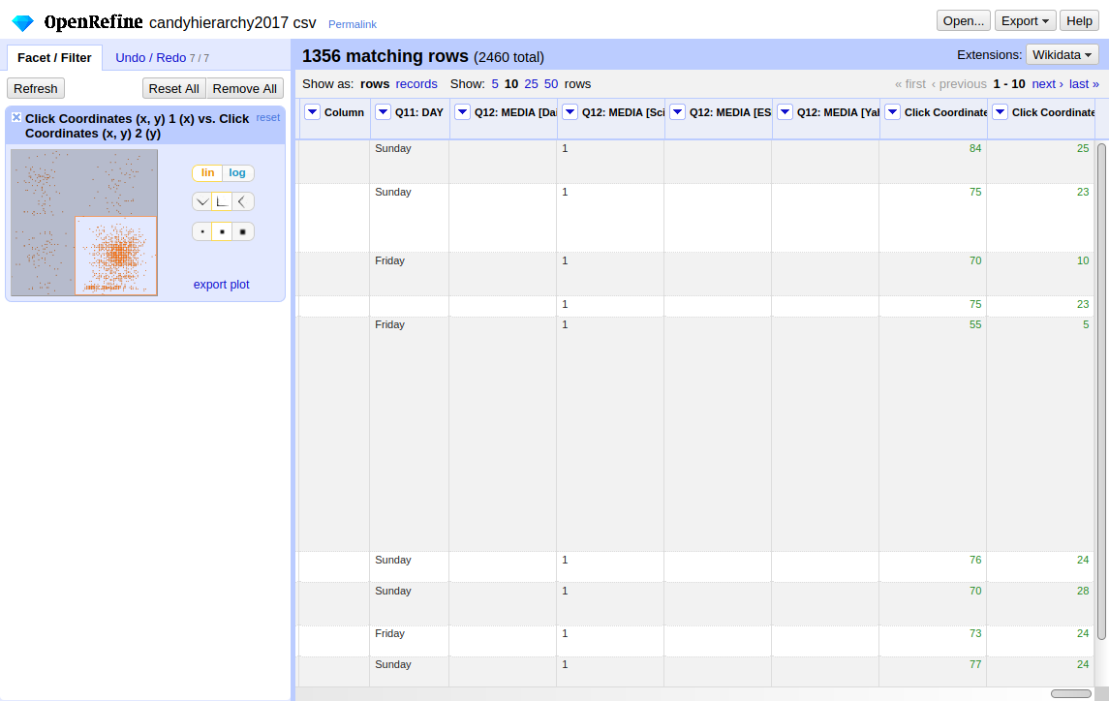
Scatterlplot data
you can also use the scatterplot facet as input
i.e. to only use data from Q4 here

Slide 39
Meaning
the X/Y Coordinates were collected on an advertising block
see https://github.com/riinuots/candihierarchy
you will find the advertisement picture with the clicks as overlay

Slide 40
Keep a trace

Slide 41
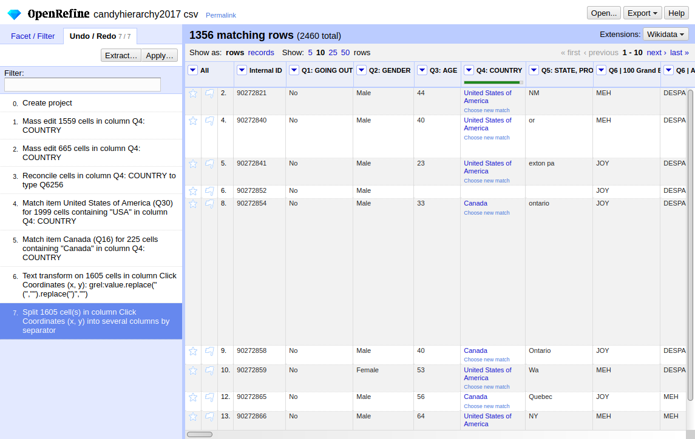
OpenRefine works non-destructive
find the history here
jump back to any point
Extract → Export rules
Apply → Import rules

Slide 42
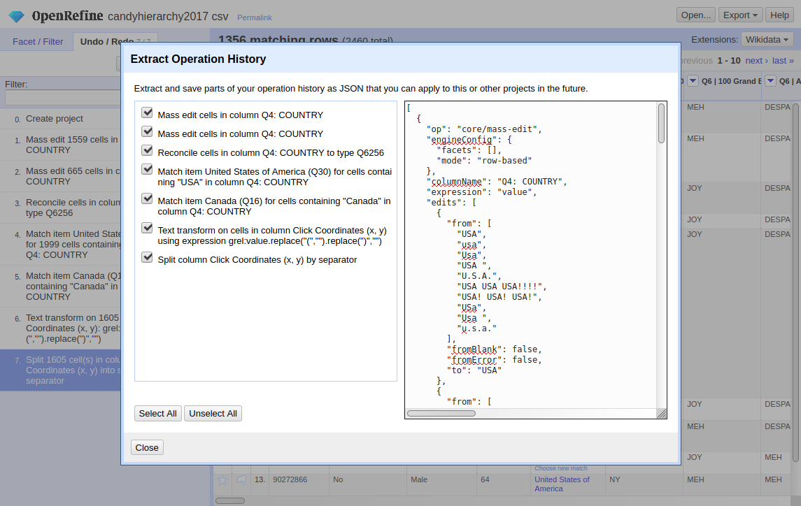
Extract (Export rules) dialogue

Slide 43
Re-using rules
Save your history (or part of it) to re-use it!
Batch Processing
  Created a rule set and want to apply it to several data tables?
    have a look at p3-batchrefine
    http://openrefine.org/download.html#other-distributions

Slide 44
Other Options
Export/Import Project (i.e. when using Docker)
  Save as tar.gz (OpenRefine project)
  Export as TSV, CSV, HTML-table, XLS, ODF, SQL
Language Setting
  you can switch the language,
  but beware of
  “Kein Weltraum links auf dem Gerät” ^{(no space left on device)}

Slide 45
Keep up the quality!
Thanks :)

