Slide 1
All Locations
File created on: 9/5/24 4:18:55 PM EDT

Slide 2
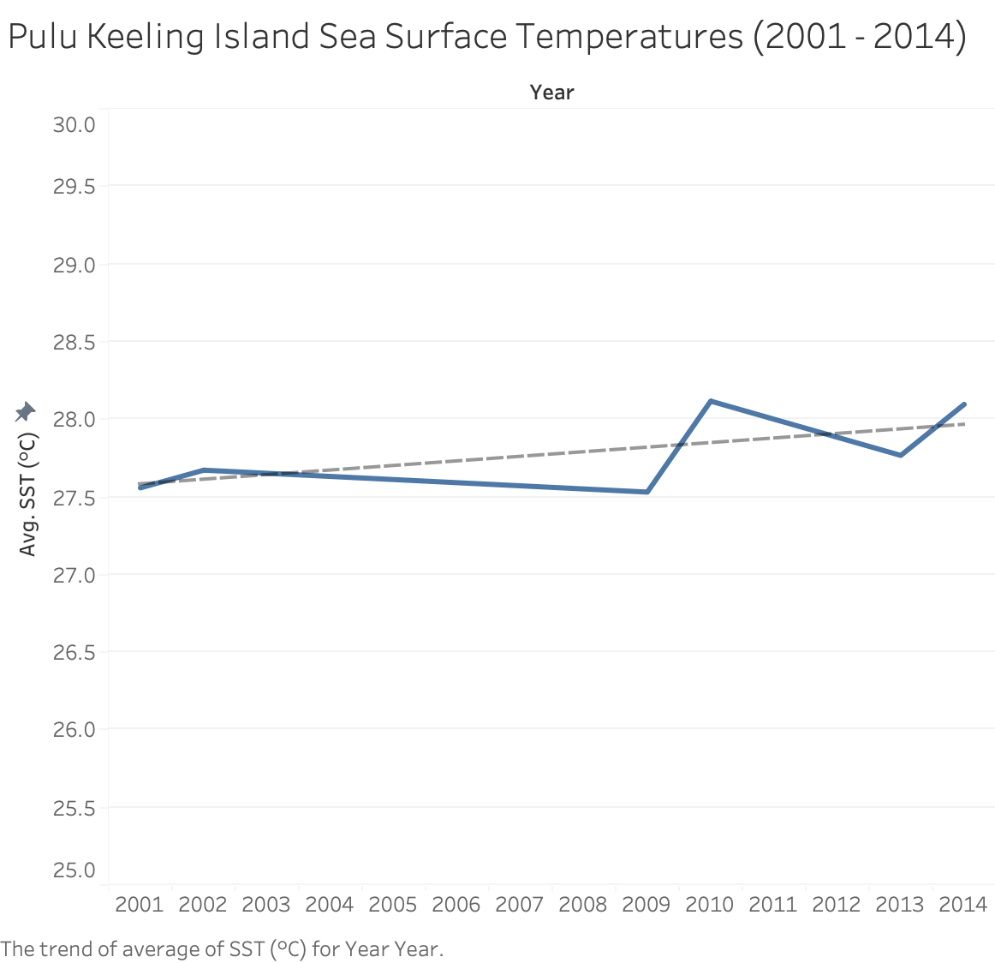

Slide 3
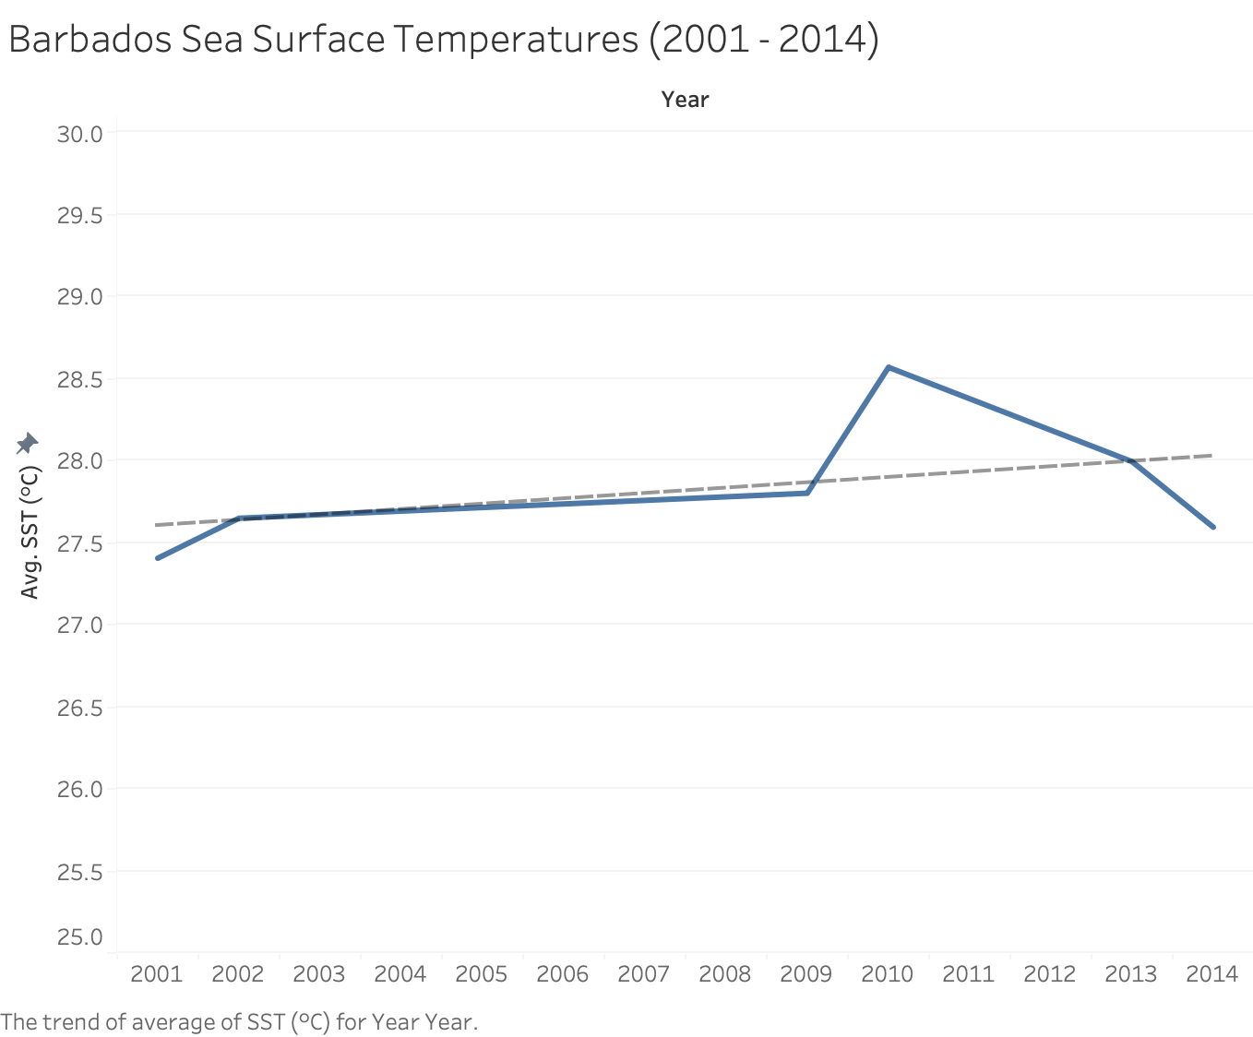

Slide 4
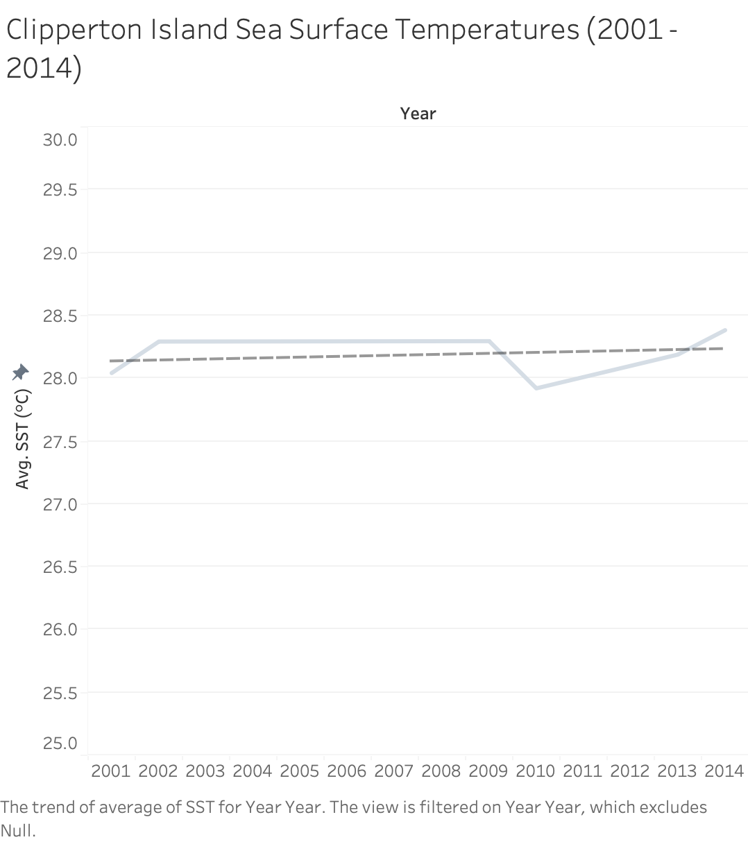

Slide 5
