Slide 1
Book1
File created on: 9/5/24 3:06:36 PM EDT

Slide 2
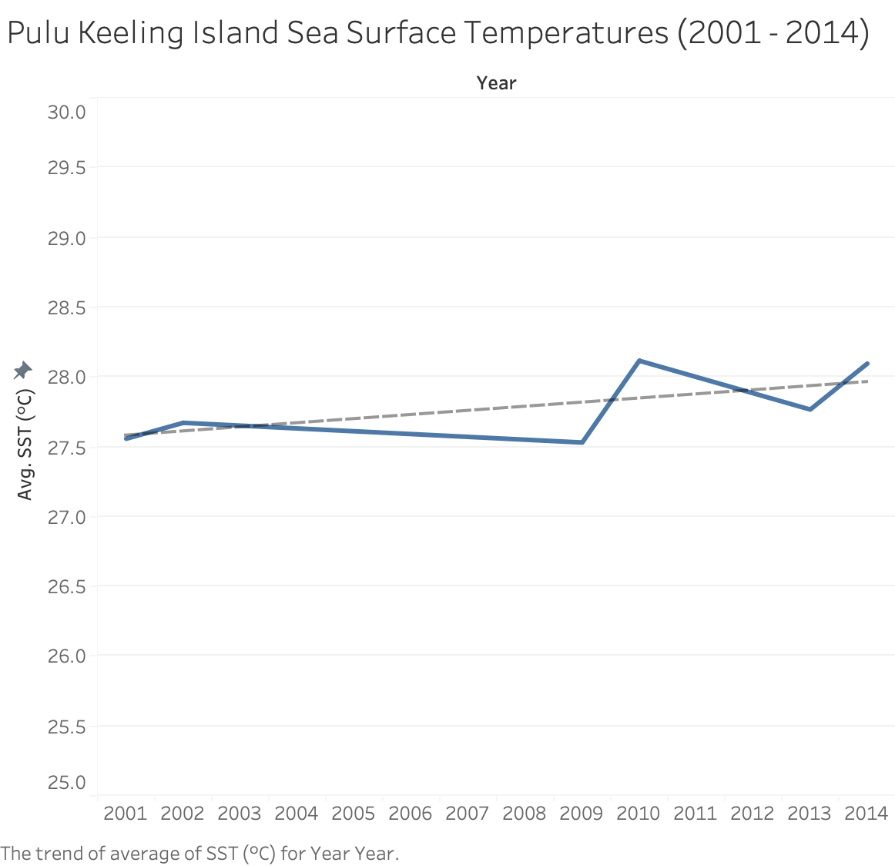

Slide 3
