Slide 1
NYC_APS_Safety
File created on: 9/16/24 3:46:40 PM EDT

Slide 2
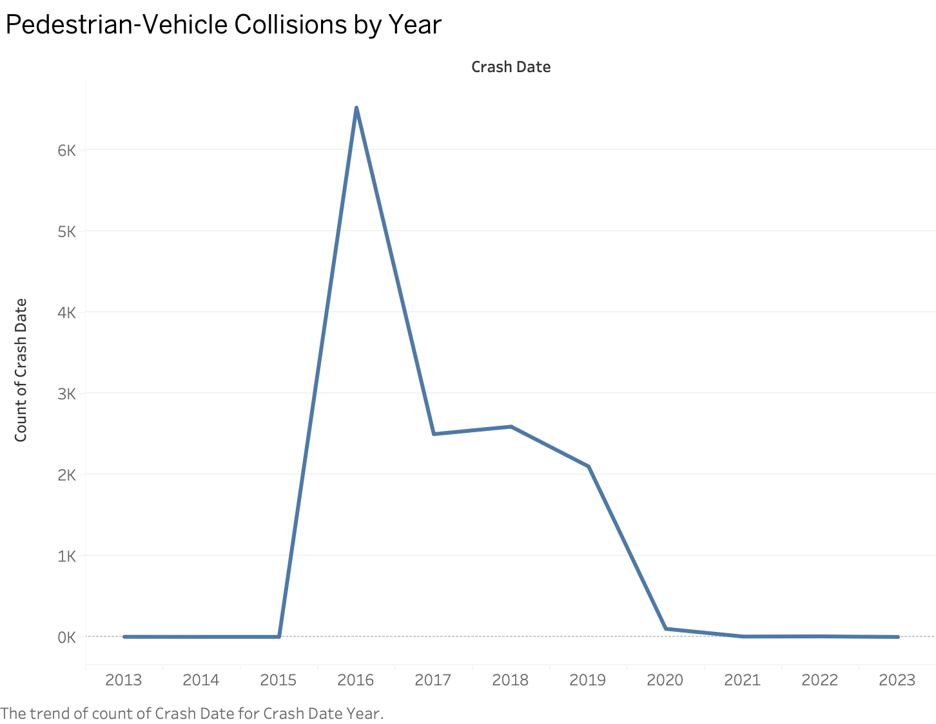

Slide 3
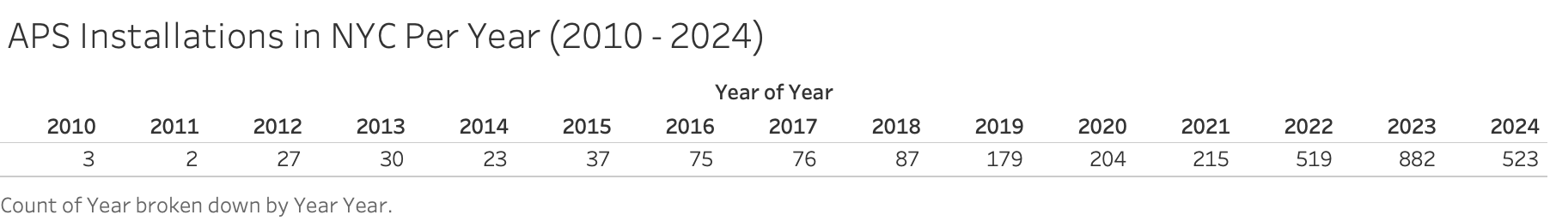

Slide 4
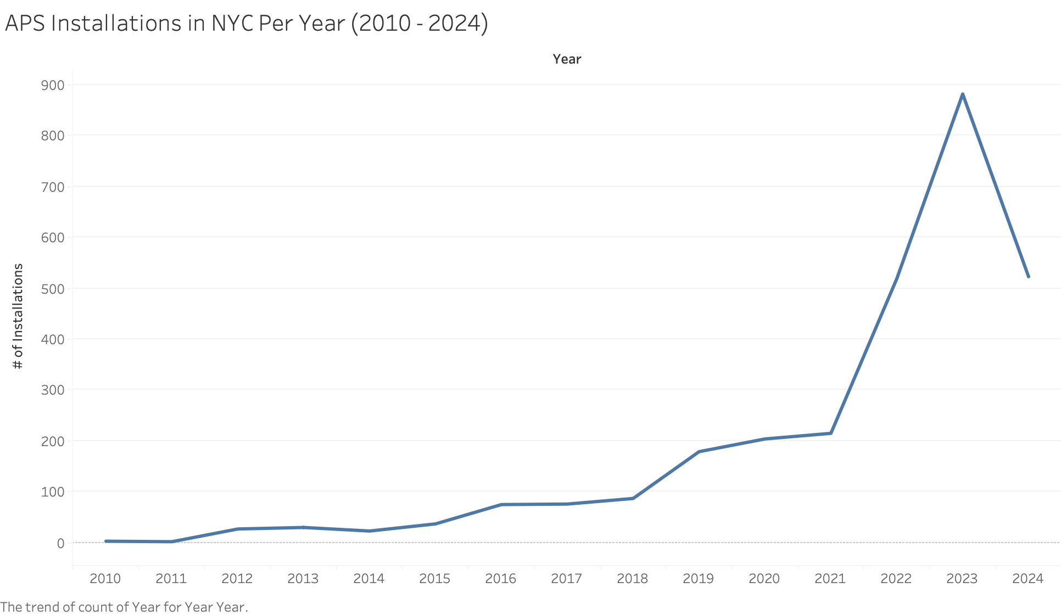

Slide 5
