Slide 1
NYC_APS_Safety
File created on: 9/16/24 9:25:13 PM EDT

Slide 2
Note: Upon reviewing the pedestrian-vehicle collisions data from OpenData with SQL, significant inconsistencies were identified, which may impact the accuracy of the analysis.
Nevertheless, exploring these datasets still offers valuable insights into the safety impacts of APS.

Slide 3
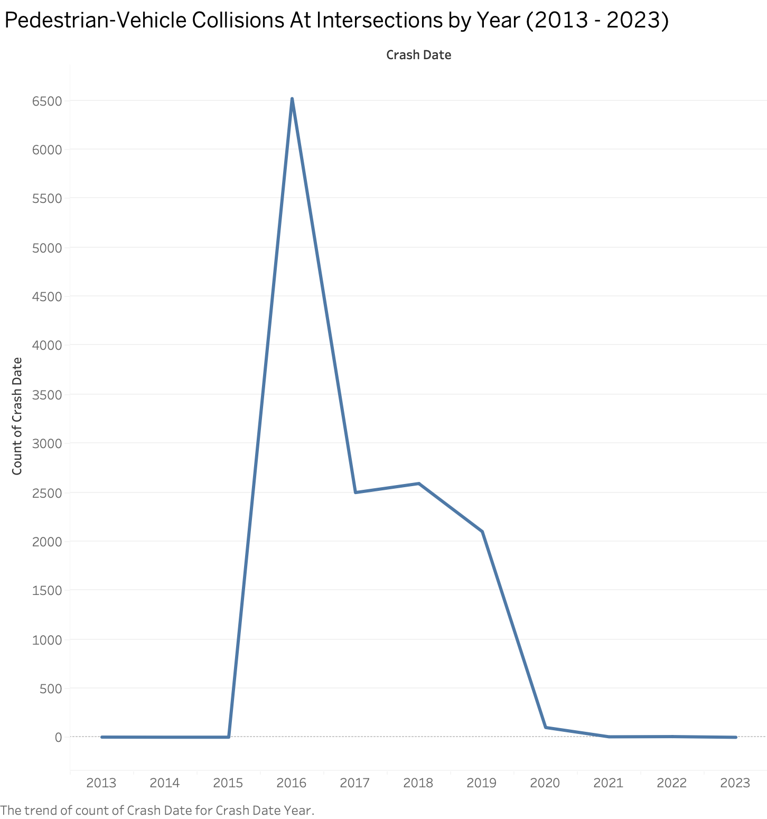

Slide 4
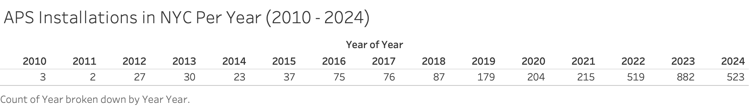

Slide 5
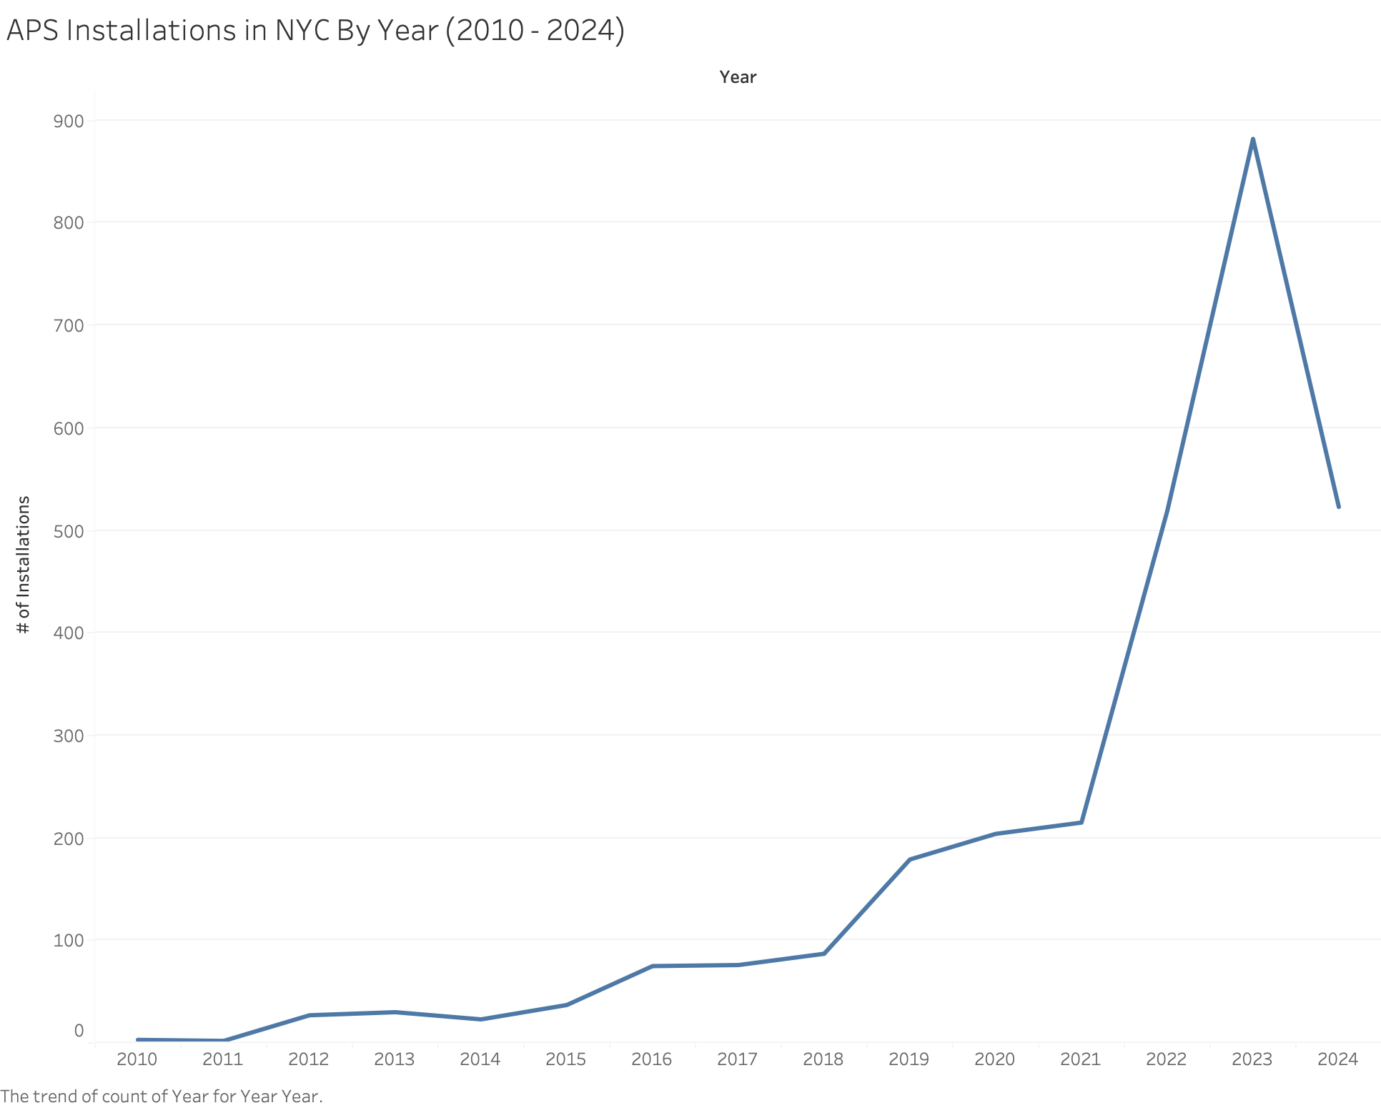

Slide 6
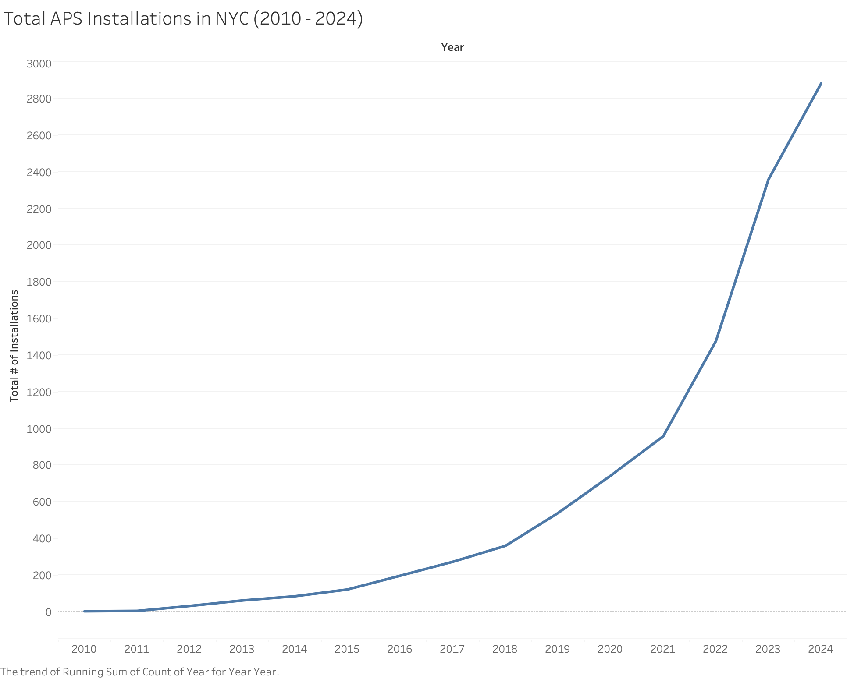

Slide 7
