Slide 1





















































Titanium Sponsors
Platinum
Sponsors
Gold
Sponsors
Friends of KCDC
Other Awesome Organizations

Slide 2
Notes:
Cold open follows: restore the self-accusation.

Slide 3
The incident, three ways
Lock-wait timeout — row contention
Runtime error — an implicit data contract violated
Timestamp gaps — slow queries
Notes:
PagerDuty goes off on slow ingestion; queue depth in the tens of thousands. The logs say one of these three.

Slide 4
The incident, three ways
Lock-wait timeout — row contention
Runtime error — an implicit data contract violated
Timestamp gaps — slow queries
All three lead to the same result: a potential customer facing outage
Notes:
PagerDuty goes off on slow ingestion; queue depth in the tens of thousands. The logs say one of these three.

Slide 5
AI Assisted Legacy Refactors
Brad Boggs
Notes:
Cold open follows: restore the self-accusation.

Slide 6
One application
At the epicenter of nearly every on-call incident.
Notes:
At a company where I've done a lot of work over the last couple of years.

Slide 7
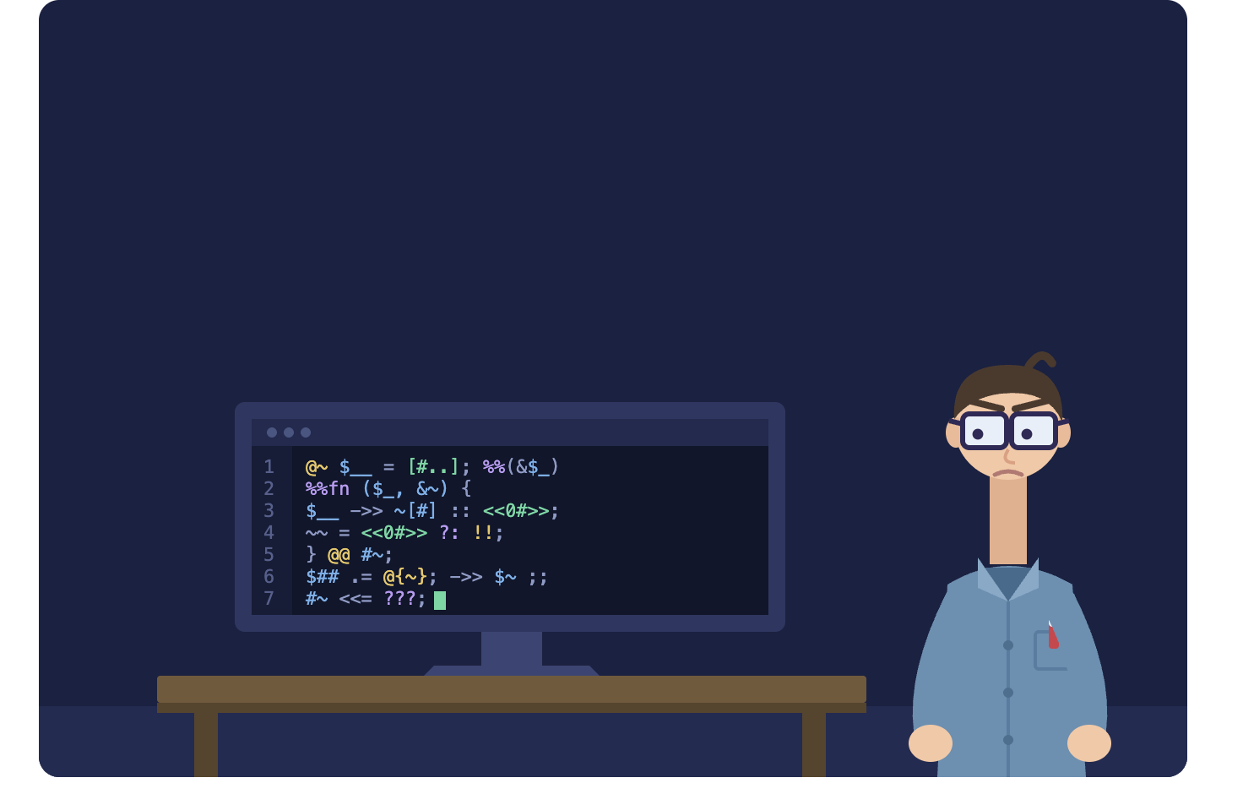
Notes:
The hotfix incantation. Never say the values. This is the piece of specification that lived in a person, not in the code — it comes back later.

Slide 8
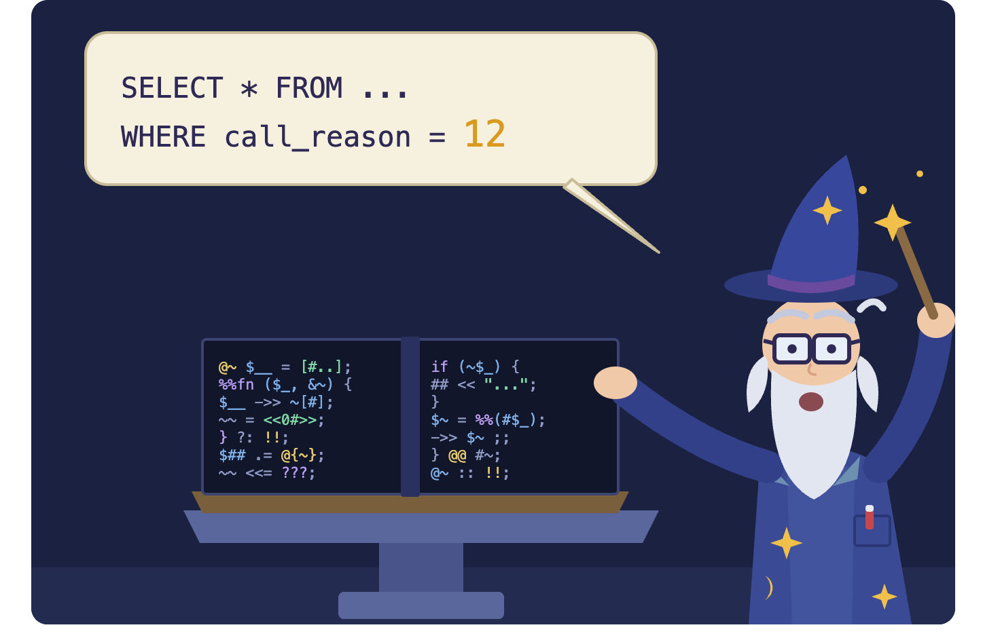
Notes:
The hotfix incantation. Never say the values. This is the piece of specification that lived in a person, not in the code — it comes back later.

Slide 9
A rewrite was attempted. And aborted.
Notes:
I wasn't part of the effort. I've talked to two people who were.

Slide 10
Two blockers
01
A third-party library detail caused a performance regression.
Specific. Manageable. A fix was found later, and left unimplemented.
Notes:
According to the guy who was the team lead at the time. The engineer ranked the first; the manager ranked the second. The disagreement is the evidence.

Slide 11
“We weren't 100% confident in how we were going to test and approve the new version.”
Notes:
APPROVED WORDING — do not tighten. Read it, then land on the word: approve. You can test without a spec; you cannot approve without one. Attribute out loud only: the current engineering manager.

Slide 12
Two blockers
01
02
A third-party library detail caused a performance regression.
No way to test and approve the new version.
Specific. Manageable. A fix was found later, and left unimplemented.
Which is why the first one was never fixed.
Notes:
According to the guy who was the team lead at the time. The engineer ranked the first; the manager ranked the second. The disagreement is the evidence.

Slide 13
Why legacy resists change
No understanding of the system
Notes:
Three reasons, and the third is the one that turns fear into a budget line.

Slide 14
Why legacy resists change
No understanding of the system
No tests to protect us in its absence
Notes:
Three reasons, and the third is the one that turns fear into a budget line.

Slide 15
Why legacy resists change
No understanding of the system
No tests to protect us in its absence
Real business cost when we get it wrong
Notes:
Three reasons, and the third is the one that turns fear into a budget line.

Slide 16
2004
“to me, legacy code is simply code without tests”
Michael Feathers
Notes:
The slide people photograph. The years are doing argumentative work: 2004 and 2018 are what make 'reading was expensive back then' credible later. Pause here.

Slide 17
2022
“Legacy code is code that delivers more in value than it costs to maintain.”
Brad Ediger
Notes:
The slide people photograph. The years are doing argumentative work: 2004 and 2018 are what make 'reading was expensive back then' credible later. Pause here.

Slide 18
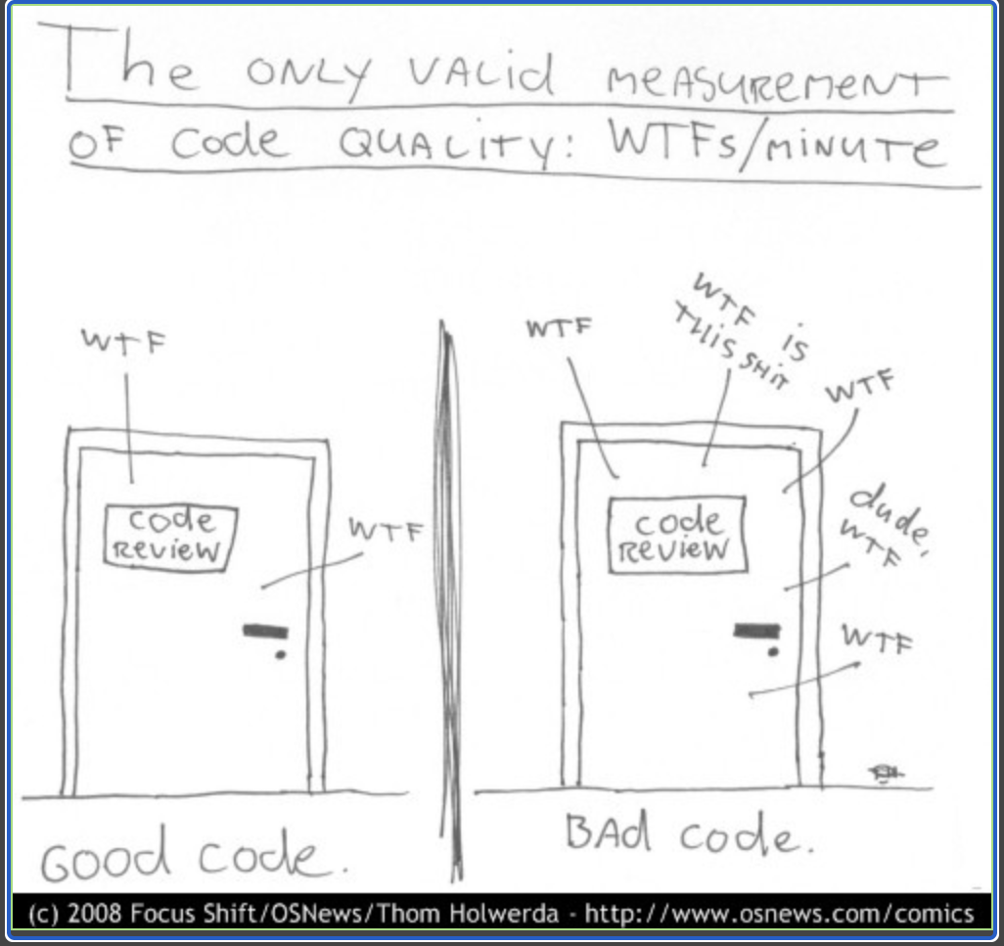
Notes:
The slide people photograph. The years are doing argumentative work: 2004 and 2018 are what make 'reading was expensive back then' credible later. Pause here.

Slide 19
“We weren't 100% confident in how we were going to test and approve the new version.”
Notes:
Second and last showing. Same asset. Nobody was careless — the definition they were working from has an unresolved word in it. Decide in the dry run whether you talk over this or stay silent. Not both.

Slide 20
technical specification
Translates approved needs into an implementable and verifiable description of a system.
Interfaces. Data. Constraints. Engineering decisions.
Notes:
Adapted from ISO/IEC/IEEE 29148:2018 — say that out loud; it is adapted, not quoted.

Slide 21
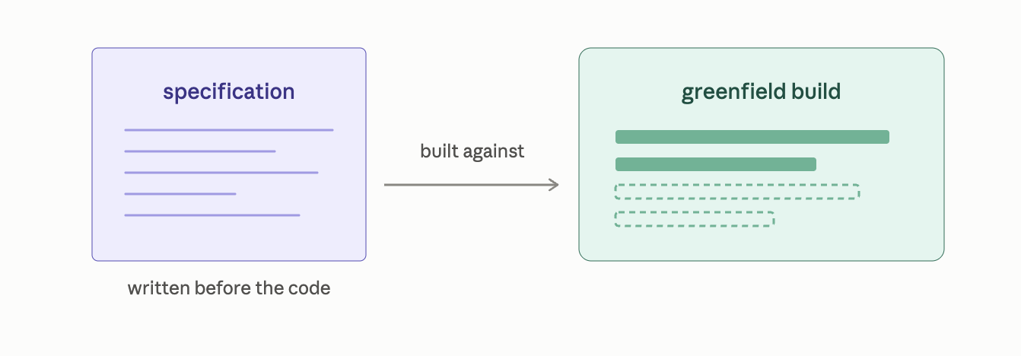
Notes:
Adapted from ISO/IEC/IEEE 29148:2018 — say that out loud; it is adapted, not quoted.

Slide 22
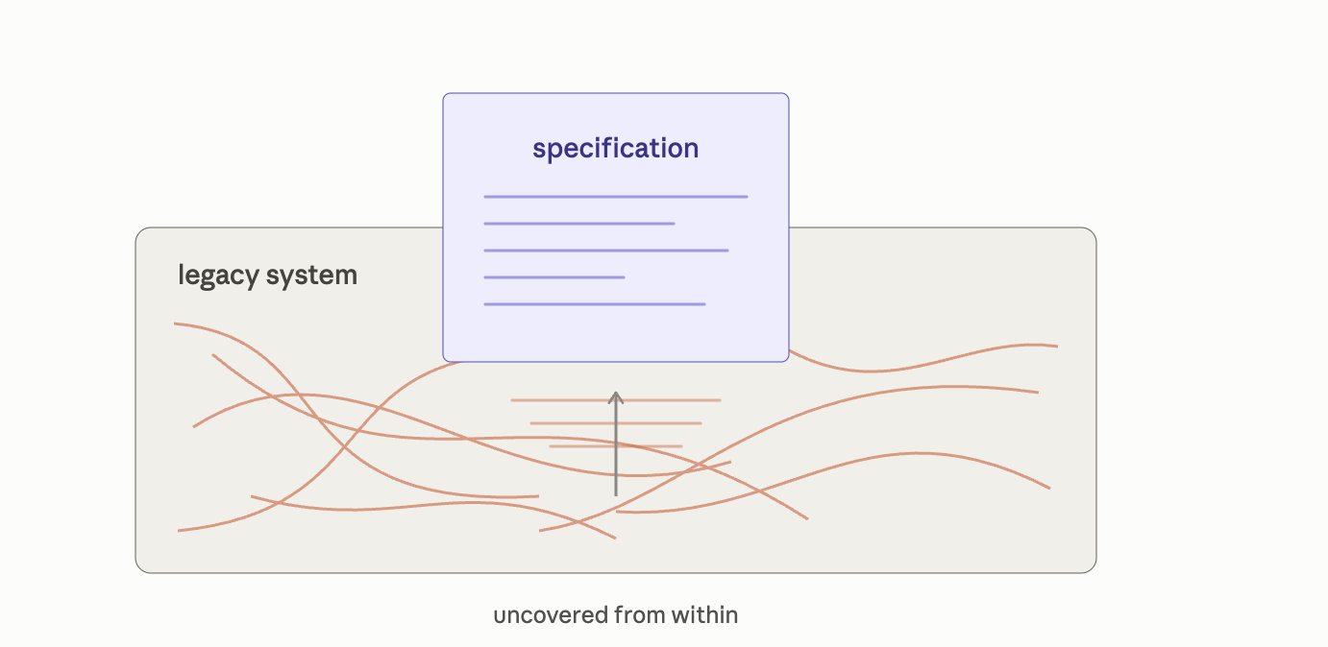
Notes:
Adapted from ISO/IEC/IEEE 29148:2018 — say that out loud; it is adapted, not quoted.

Slide 23
The definition of what should be collapses to a subset of what is.
Notes:
In a greenfield app we're handed a definition of correct. In a legacy app the external spec has been stale for years, so getting to it is archaeology.

Slide 24
“With a sufficient number of users of an API, it does not matter what you promise in the contract: all observable behaviors of your system will be depended on by somebody.”
Notes:
Say 'Hyrum's Law' out loud and stop there. Usage quietly promotes your implementation into your interface. You will never have the list of who is standing on what.

Slide 25
legacy system specification
What must remain true at the edges no matter what else changes
Notes:
Adapted from ISO/IEC/IEEE 29148:2018 — say that out loud; it is adapted, not quoted.

Slide 26
On Call Incident # 2
Notes:
Adapted from ISO/IEC/IEEE 29148:2018 — say that out loud; it is adapted, not quoted.

Slide 27
One method, measured
1,489
lines in one method
92%
of it covered by a single transaction
1
synchronous HTTP call inside that transaction
23
writes
4
reads
464
lines, median distance from writing a value to reading it back
48
local variables live at once at the deepest point
Notes:
Show the whole list at once. Say three. End on 48 and stop — that number is the handoff. Never say the magic-integer values.

Slide 28
2–6
48
chunks in human short-term memory
local variables live at once
Lack of knowledge · lack of information · lack of processing power
Felienne Hermans, The Programmer's Brain, 2021
Notes:
Hermans, The Programmer's Brain, 2021. Three confusions: lack of knowledge, lack of information, lack of processing power. Mine was the third, with the second underneath it — a 464-line median is information that isn't in front of you. Do NOT say I didn't have an issue with the first two. Thirty seconds, then move.

Slide 29
A context window problem
Notes:
Hermans, The Programmer's Brain, 2021. Three confusions: lack of knowledge, lack of information, lack of processing power. Mine was the third, with the second underneath it — a 464-line median is information that isn't in front of you. Do NOT say I didn't have an issue with the first two. Thirty seconds, then move.

Slide 30
A probabilistic tool is a bad way to produce something you have to trust.
It is a very good way to produce a candidate you are going to check .
Notes:
I like determinism. LLMs are probabilistic. So how do you get high-quality code out of one — wrong question. I wasn't asking it to write production code. I was asking it to read code.

Slide 31
Planning for the remodel is greenlit.
With a clear path to testing and approving what replaces it.
Notes:
The honest claim: planning, not tickets, not started. It is smaller than the room expects and saying so is the credibility play. The confidence brought the greenlight — not the artifacts.

Slide 32
Workflow Demo
Notes:
The honest claim: planning, not tickets, not started. It is smaller than the room expects and saying so is the credibility play. The confidence brought the greenlight — not the artifacts.

Slide 33
CHARACTERIZATION TESTS
They pin current behavior as-is.
They make no claim that it is correct.
On their own they pin everything equally. The edges tell you which of it counts.
Notes:
Feathers' term. What changed since 2004 is that we can prompt our way there. Q&A backstop: a characterization test records everything the code does; the spec is the part somebody else is standing on.

Slide 34
Find the edges. Generate characterization tests at the edges. Generate and evaluate the spec from the characterization tests, and finally make the change.
Module · whole app · interconnected systems
Notes:
This codebase is small and these changes are small — but I've used this at greater scale across much larger cross-cutting codebases. Is AI the silver bullet? No. It took the most expensive step in the canon and made it affordable.

Slide 35
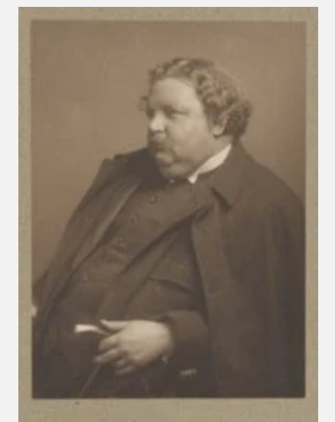
hyrumslaw.com
hyrumslaw.com
G. K. Chesterton
Notes:
This codebase is small and these changes are small — but I've used this at greater scale across much larger cross-cutting codebases. Is AI the silver bullet? No. It took the most expensive step in the canon and made it affordable.

Slide 36
“There exists in such a case a certain institution or law; let us say, for the sake of simplicity, a fence or gate erected across a road. The more modern type of reformer goes gaily up to it and says, ‘I don't see the use of this; let us clear it away.’ To which the more intelligent type of reformer will do well to answer: ‘If you don't see the use of it, I certainly won't let you clear it away. Go away and think. Then, when you can come back and tell me that you do see the use of it, I may allow you to destroy it.’”
G. K. Chesterton, The Thing, 1929
Notes:
NOT WRITTEN. Do not improvise this on the day. The last slide is the one that gets photographed and quoted.

Slide 37
“We weren't 100% confident in how we were going to test and approve the new version.”
Notes:
Second and last showing. Same asset. Nobody was careless — the definition they were working from has an unresolved word in it. Decide in the dry run whether you talk over this or stay silent. Not both.

Slide 38
legacy system specification
What must remain true at the edges no matter what else changes
Notes:
Adapted from ISO/IEC/IEEE 29148:2018 — say that out loud; it is adapted, not quoted.

Slide 39

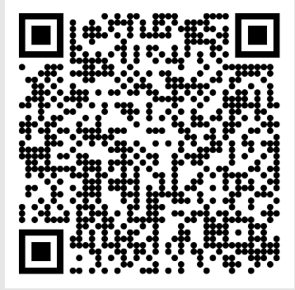
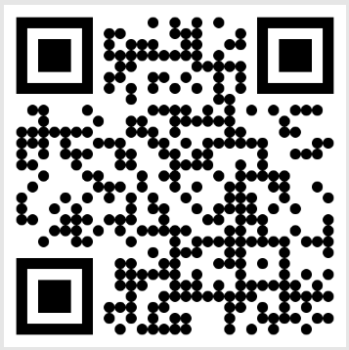



Provide Feedback on the talk
Talk materials Github Repo
Part-time consulting available
Notes:
Takeaway plus QR is the last thing on screen. No thank-you slide, no questions slide.

