Slide 1
Personal Desktop Agent
System Study Guide
Multimodal accessibility desktop control · iPad sensor hub + RTX 5090 inference
Architecture · 4-gate routing · 12 state machines · 42-table data model · 2026-06-13

Slide 2
Agenda
Overview
1
Project Overview
What it is, the end-to-end pipeline, 4-gate routing, models, the agent kernel
2
State Machines
12 machines — iPad sensors/UI (5) + PC agent kernel (7)
3
Data Model
Two-tier storage + 42-table agent.db grouped into 5 ER views
Study this deck top-to-bottom; each section's diagrams map 1:1 to source files
Personal Desktop Agent

Slide 3
SECTION 1
Project Overview
The mission, the pipeline, and how a command is routed

Slide 4
What Is This?
Overview
▸ Multimodal accessibility desktop control for a single user with rheumatoid arthritis
– An iPad Pro is the sensor hub + primary touch surface; a Windows PC + RTX 5090 runs inference and executes desktop actions
▸ Four control surfaces, one vocabulary
– Voice · hand gesture · iPad tilt · direct touch → a 16-verb action vocabulary
▸ Local-first, privacy-first
– 100% local inference (Ollama → vLLM); cloud (Anthropic API) only as an escalation fallback
– Gate 0 forces sensitive input local; every tool call lands in an append-only, hash-chained audit log
▸ Scale of the system today
– 16 action verbs · 6-level sensor fusion @ 60 Hz · 42-table operational DB · ~1,440 tests
CLAUDE.md · .kiro/specs/ipad-sensor-focus/requirements.md
Personal Desktop Agent

Slide 5
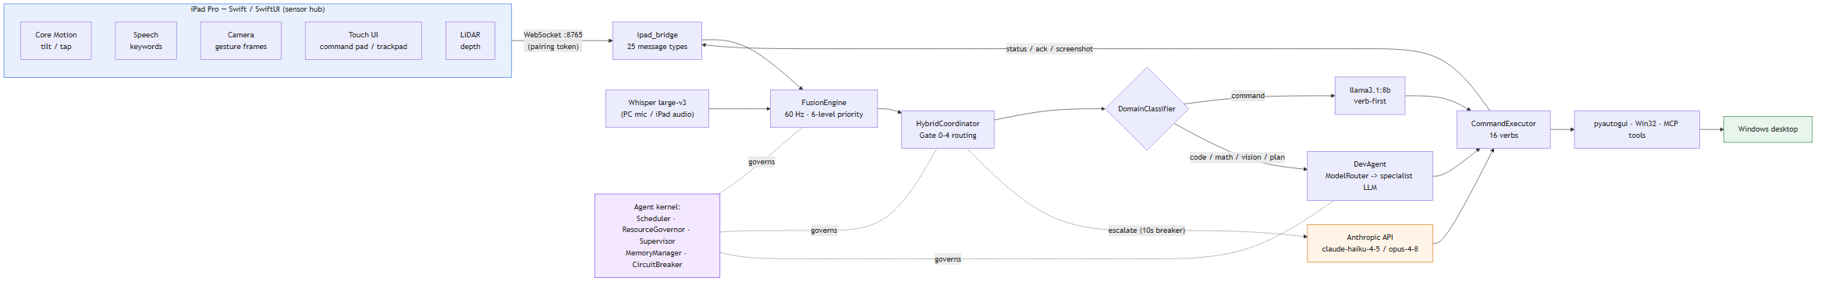
End-to-End Architecture
Overview
iPad sensors stream over WebSocket → fused at 60 Hz → routed → executed on the Windows desktop
core/ipad_bridge.py · core/fusion_engine.py · core/hybrid_coordinator.py · core/command_executor.py
Personal Desktop Agent

Slide 6
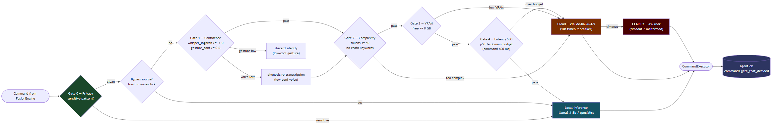
How a Command Is Routed — 4 Gates
Overview
Each command passes privacy → confidence → complexity → VRAM → latency gates; the deciding gate is logged
core/hybrid_coordinator.py
Personal Desktop Agent

Slide 7
Inference Tiers
Overview
Domain | Model | Notes
Command | llama3.1:8b (4.6 GB) | verb-first; ~190 ms warm p50
Code / Plan | qwen3-coder:30b | thinking ON; DevAgent specialist
Math | deepseek-r1:8b | chain-of-thought retained
Vision | qwen3-vl:30b | UI target → pixel grounding
General | gemma3:27b / gemma4:12b | resident slot, no eviction churn
Cloud fallback | claude-haiku-4-5 / opus-4-8 | command / dev; 10 s breaker
inference/local_inference.py · inference/model_router.py · RTX 5090 · 32 GB VRAM
Personal Desktop Agent

Slide 8
Action Vocabulary — 16 Verbs
Overview
11 ACCESSIBILITY VERBS (iPad sensor pipeline)
▸ CLICK · MOUSEDOWN · MOUSEUP
▸ SCROLL · TYPE · DICTATE
▸ OPEN · CLOSE · HOTKEY
▸ CLARIFY · SCREENSHOT
– Verb-first format from llama3.1:8b
5 DEV-AGENT VERBS (specialist models)
▸ WRITE_FILE · RUN_TERMINAL
▸ EXPLAIN · SEARCH_WEB
▸ READ_SCREEN
– Free-form; emitted via DevAgent
– DomainClassifier picks the pipeline; CommandExecutor handles all 16
core/command_executor.py · core/domain_classifier.py
Personal Desktop Agent

Slide 9
The Agent Kernel — AIOS Primitives
Overview
▸ AccessibilityScheduler — priority queue, 5 tiers; accessibility/voice/gesture run concurrently, dev/background are semaphore-gated so they never starve the user
▸ ResourceGovernor — pain-aware; on a flare it evicts heavy models, pauses the indexer + dev admission, and relaxes sensor thresholds (hysteresis 0.6 / 0.4)
▸ Supervisor — one-for-one liveness watchdog; restarts dead loops under a bounded budget, latches FAILED and degrades gracefully (TTS warning)
▸ CircuitBreaker — latches a down inference backend so it fast-fails instead of costing a full timeout per call
▸ MemoryManager — a syscall façade over agent.db + SemanticMemory with schema-validated writes
▸ Saga + goal_queue — durable, idempotent, rollback-safe autonomous execution
→ Each of these is a state machine. The next section diagrams them.
core/scheduler.py · resource_governor.py · supervisor.py · circuit_breaker.py · storage/memory_manager.py
Personal Desktop Agent

Slide 10
SECTION 2
State Machines
12 machines — how each subsystem behaves over time

Slide 11
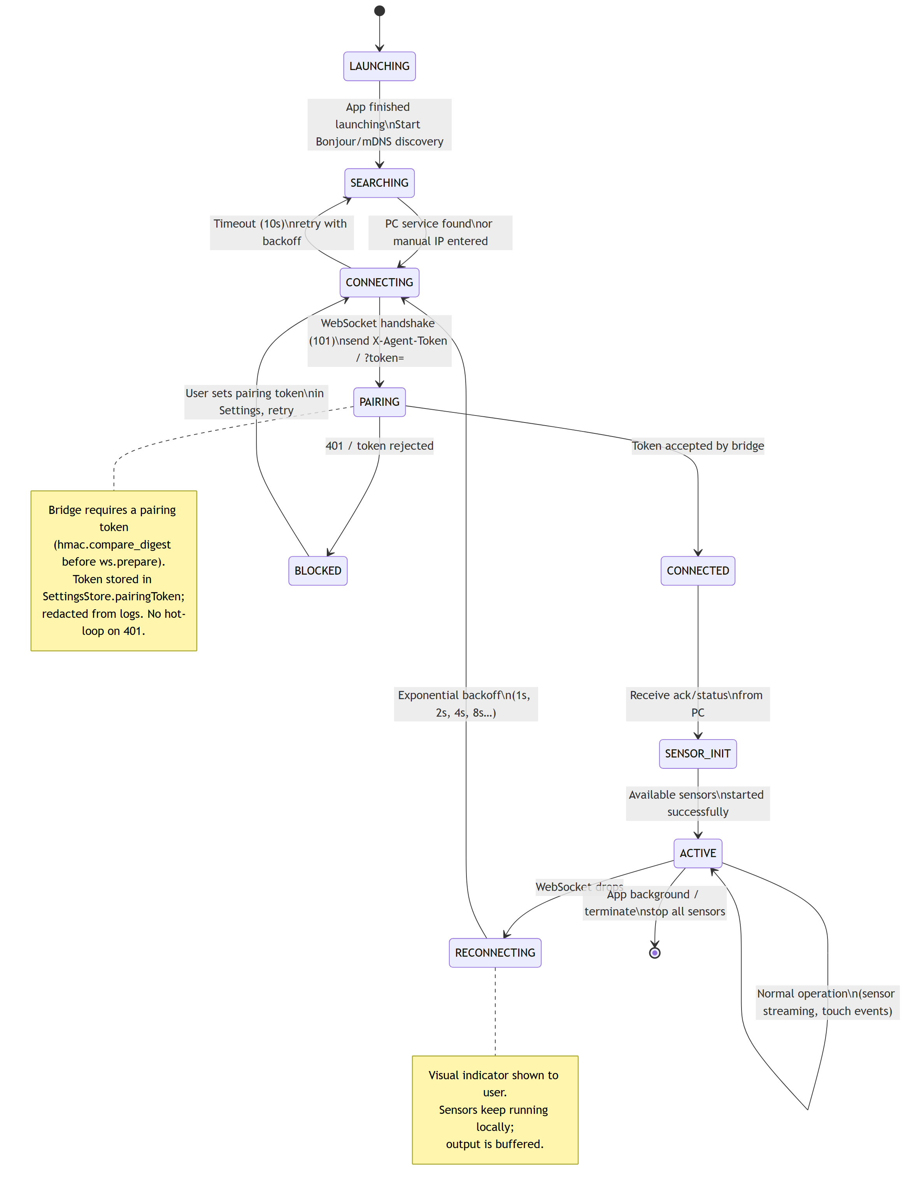
App Top-Level Lifecycle
iPad · Swift 1/5
Source: DesktopAgentApp · SensorManager
Personal Desktop Agent

Slide 12
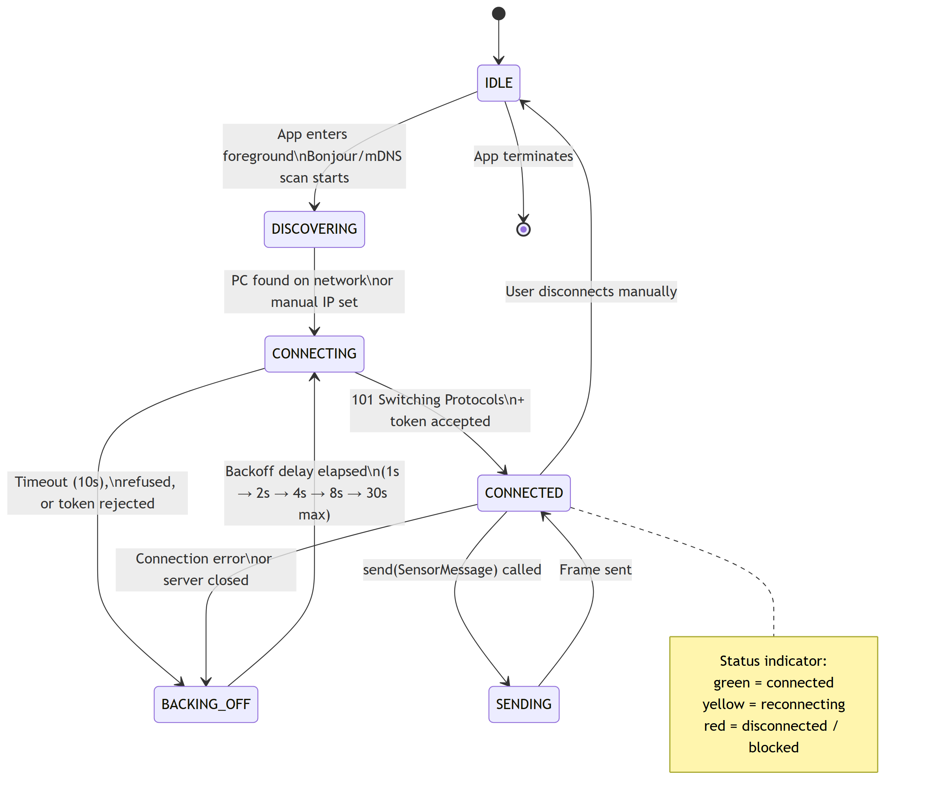
WebSocket Connection
iPad · Swift 2/5
Source: WebSocketManager.swift
Personal Desktop Agent

Slide 13
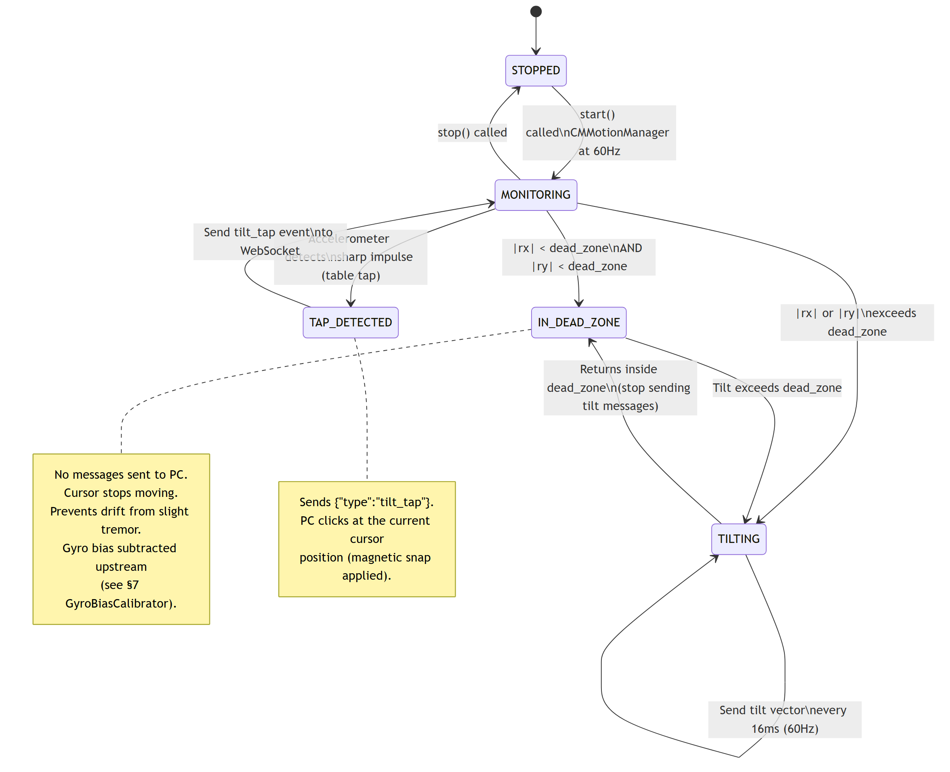
Tilt Navigation
iPad · Swift 3/5
Source: TiltSensor.swift (Core Motion)
Personal Desktop Agent

Slide 14
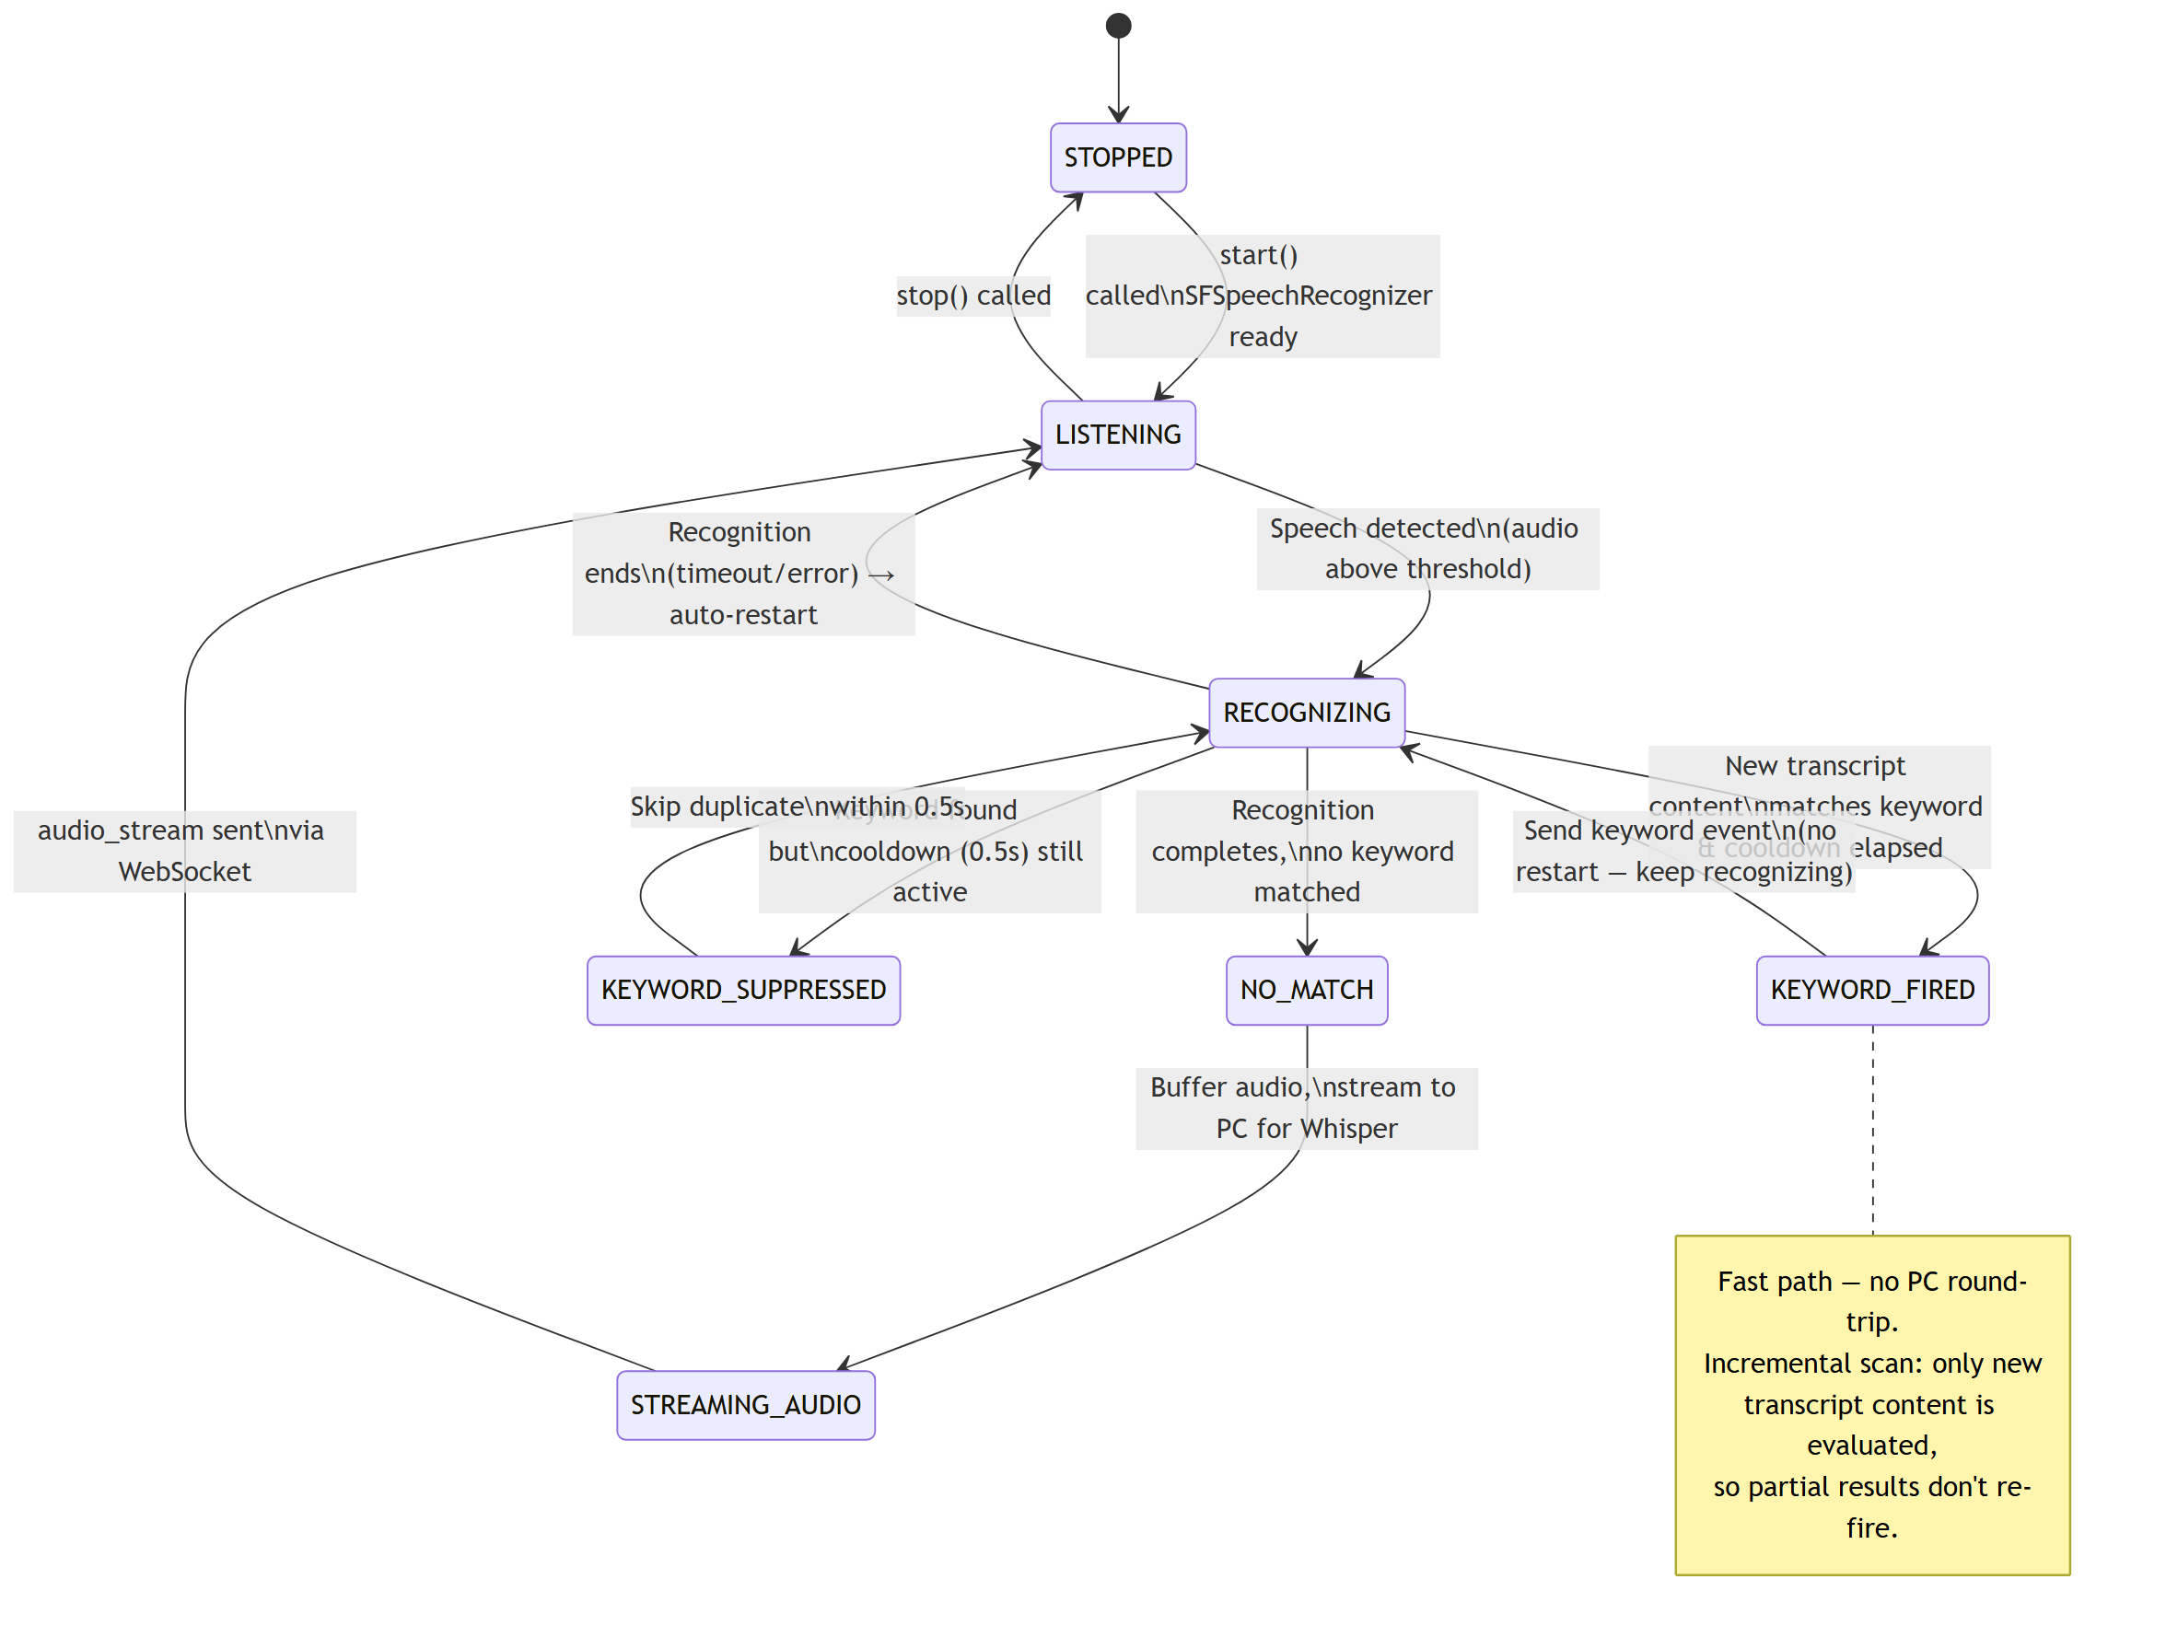
Keyword Listener
iPad · Swift 4/5
Source: KeywordListener.swift (Speech)
Personal Desktop Agent

Slide 15
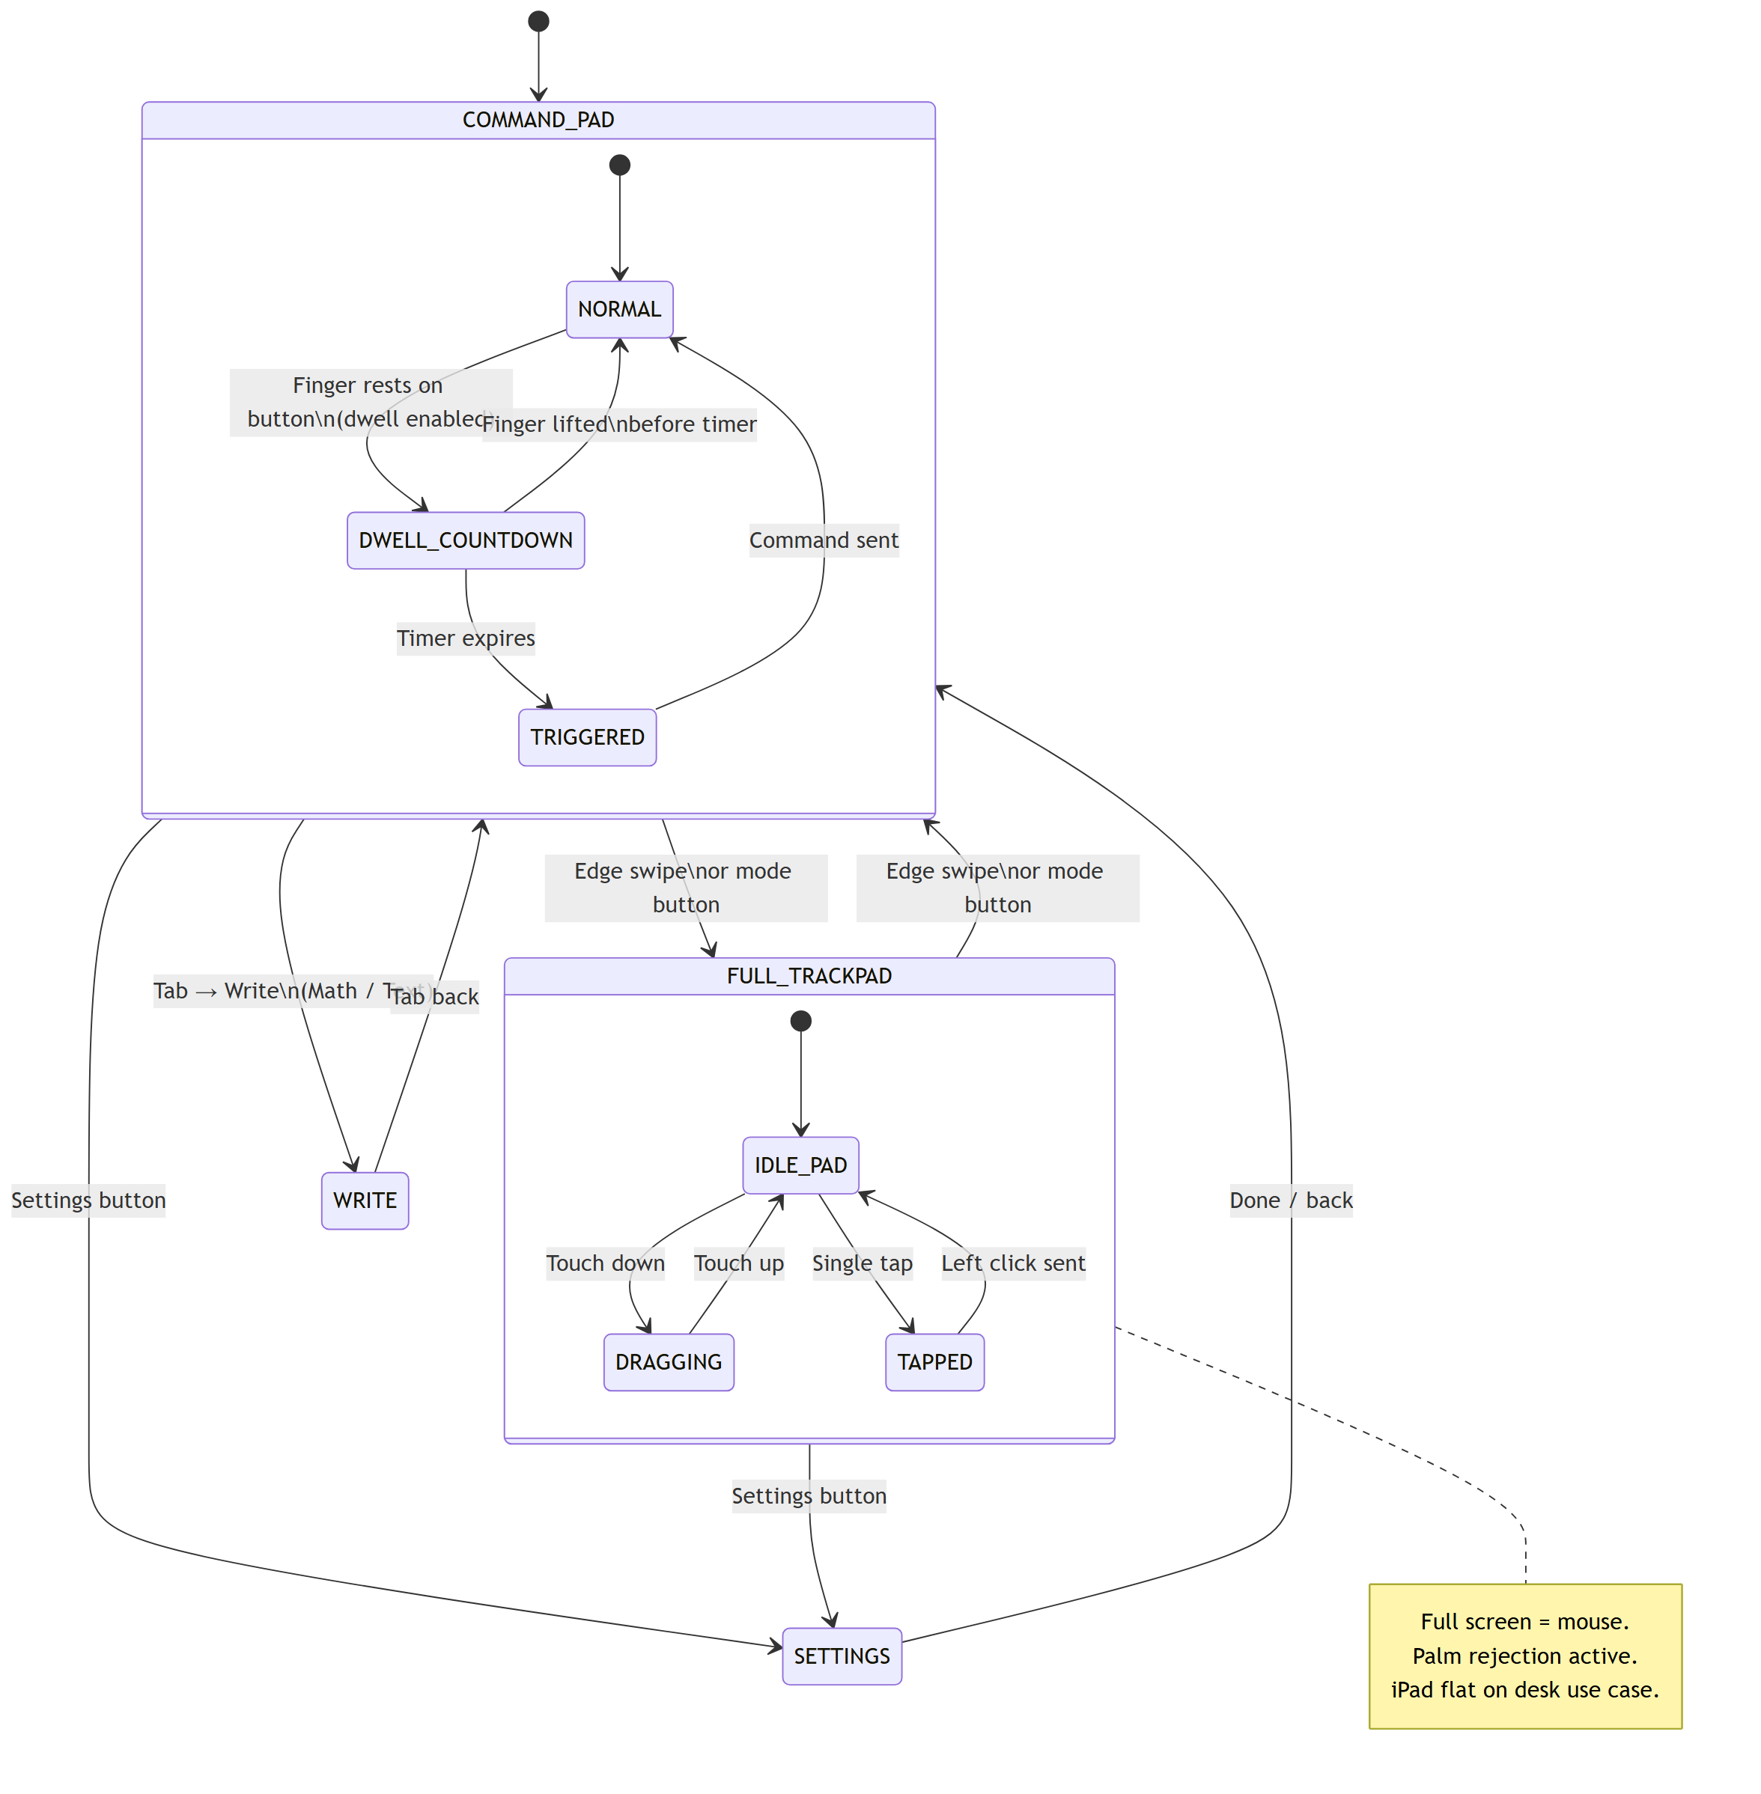
UI View Mode
iPad · Swift 5/5
Source: SwiftUI views
Personal Desktop Agent

Slide 16
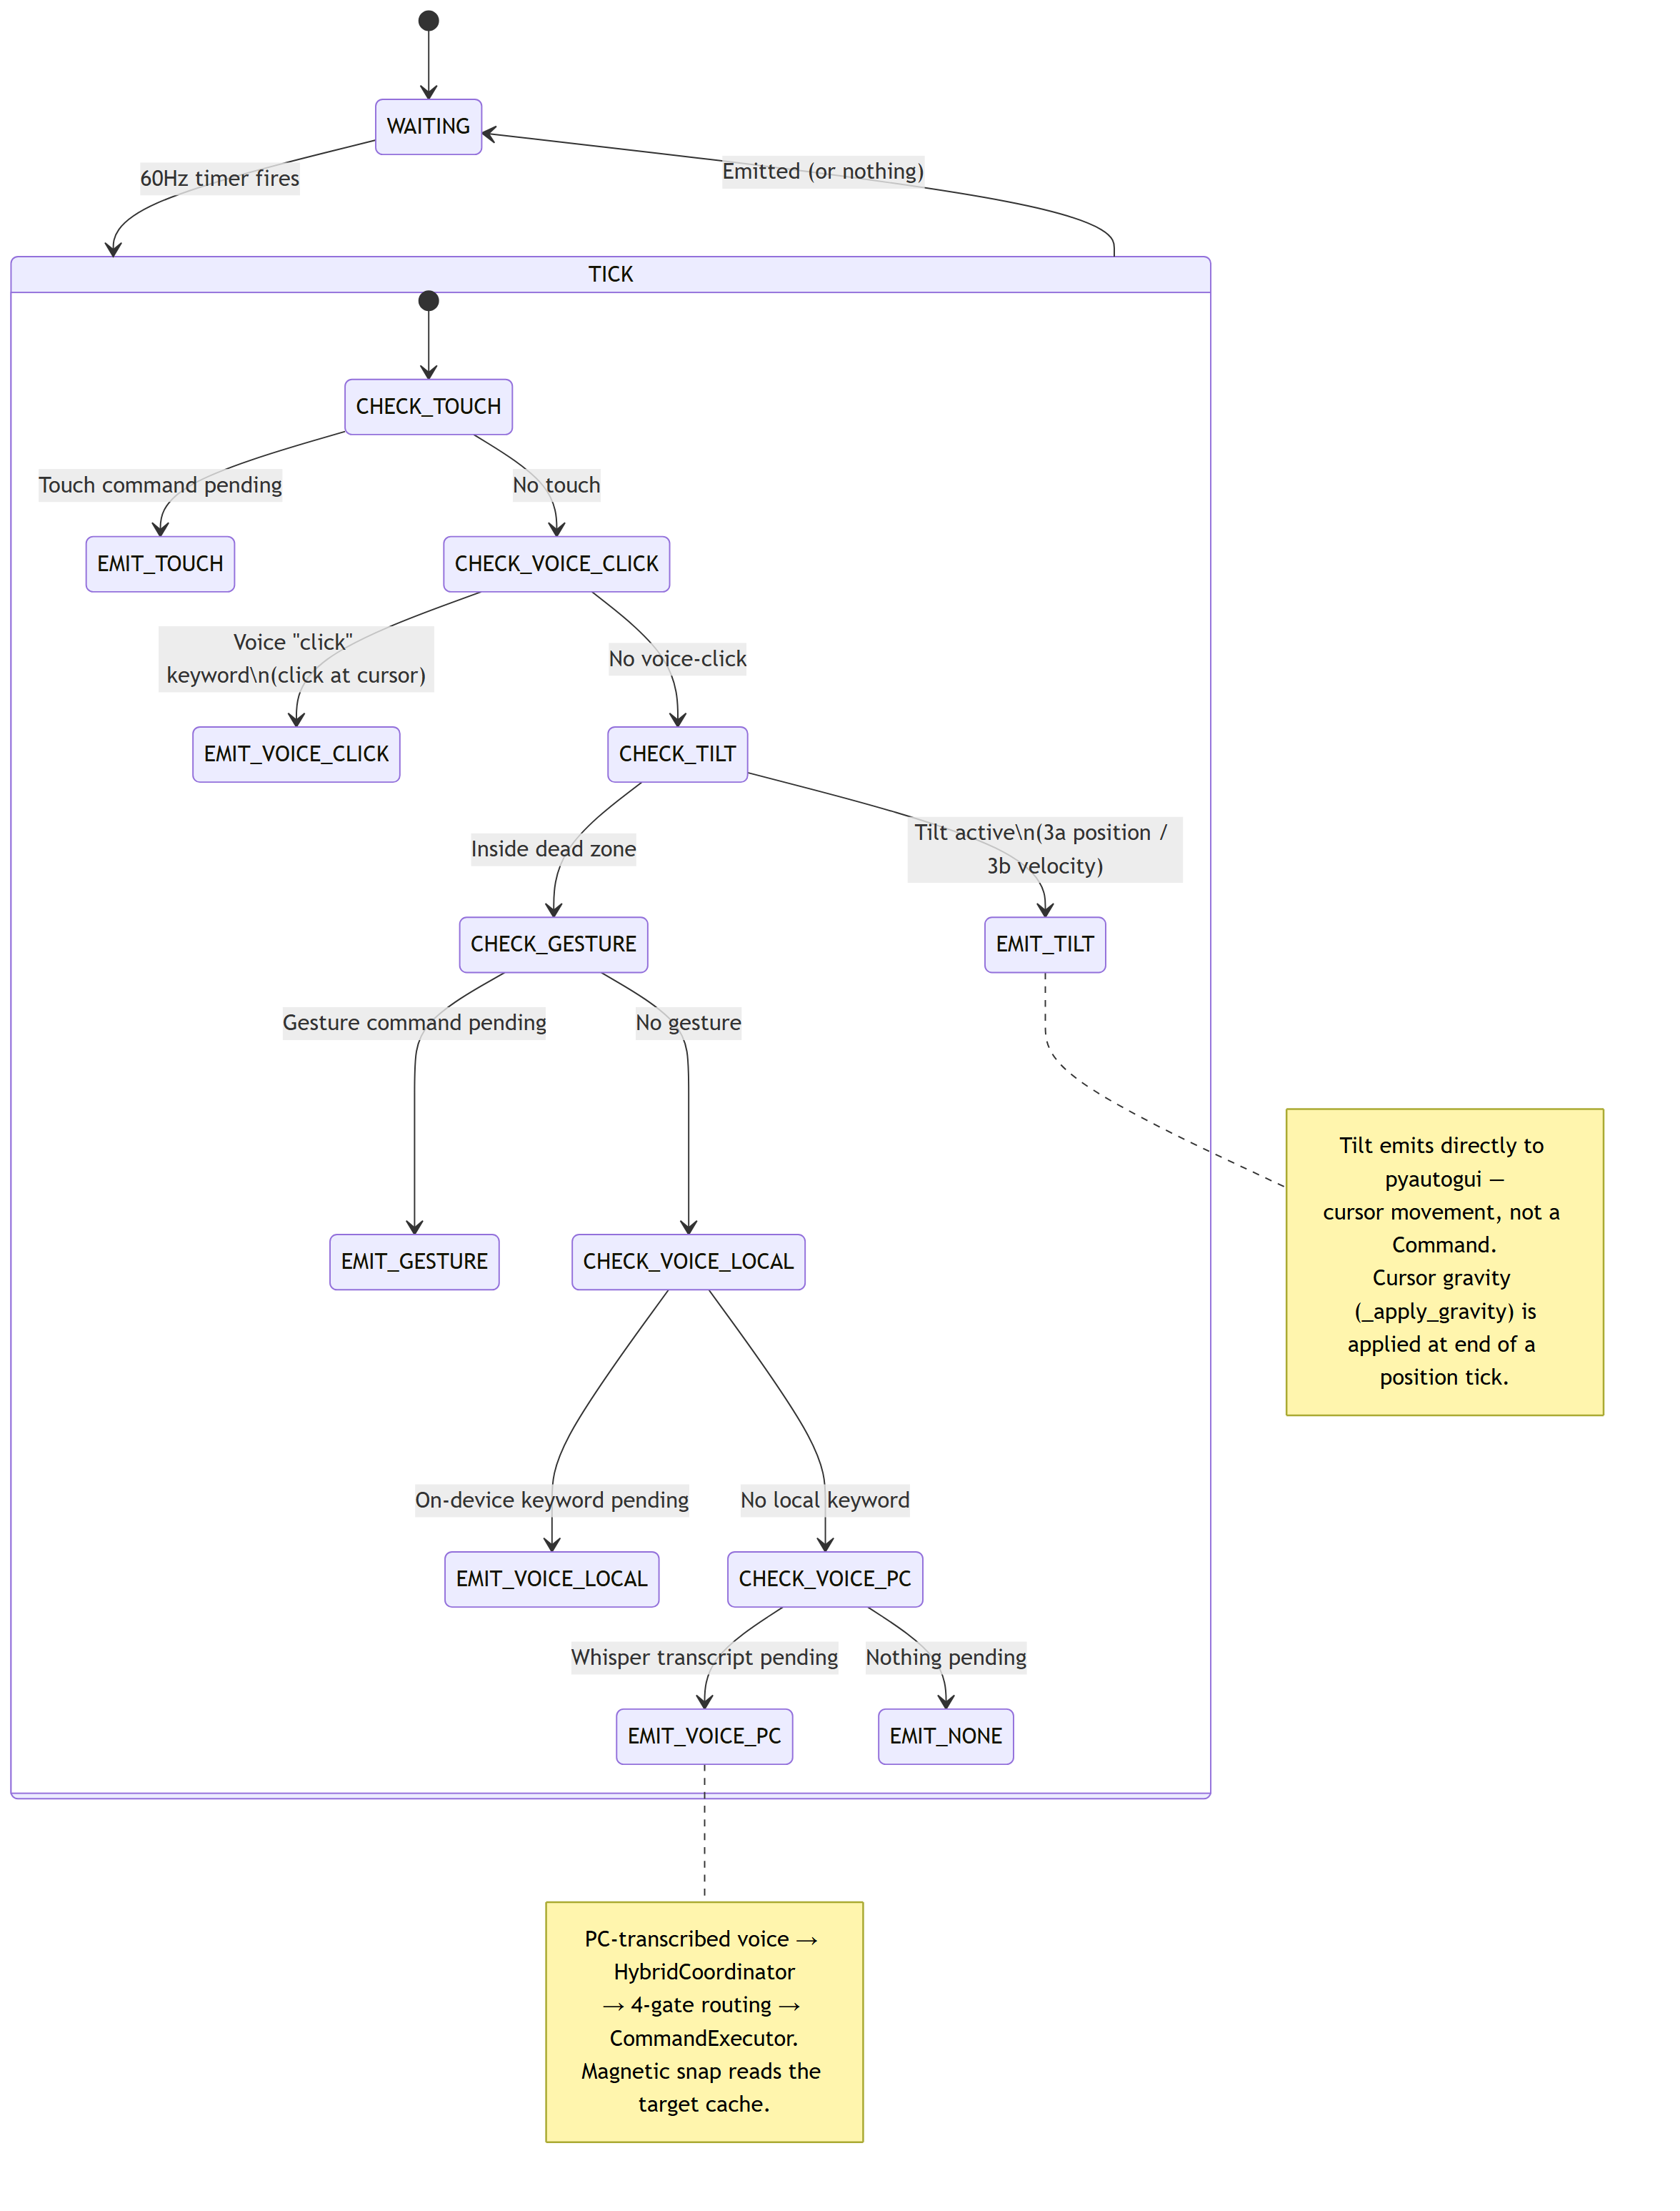
FusionEngine — 6-Level Tick
PC Backend 1/7
Source: core/fusion_engine.py
Personal Desktop Agent

Slide 17
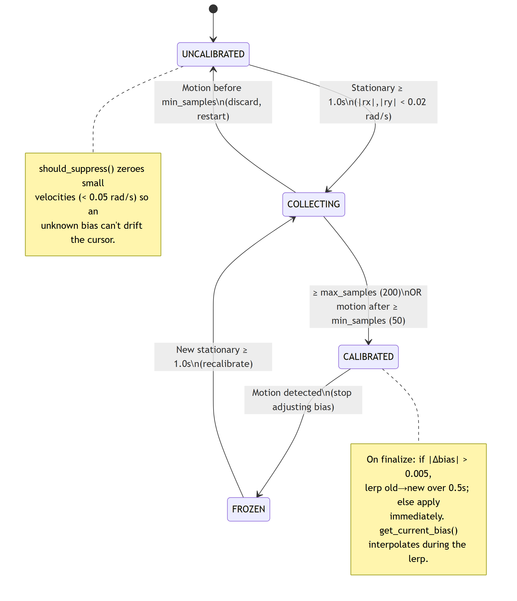
Gyro Bias Calibrator
PC Backend 2/7
Source: calibration/gyro_bias_calibrator.py
Personal Desktop Agent

Slide 18
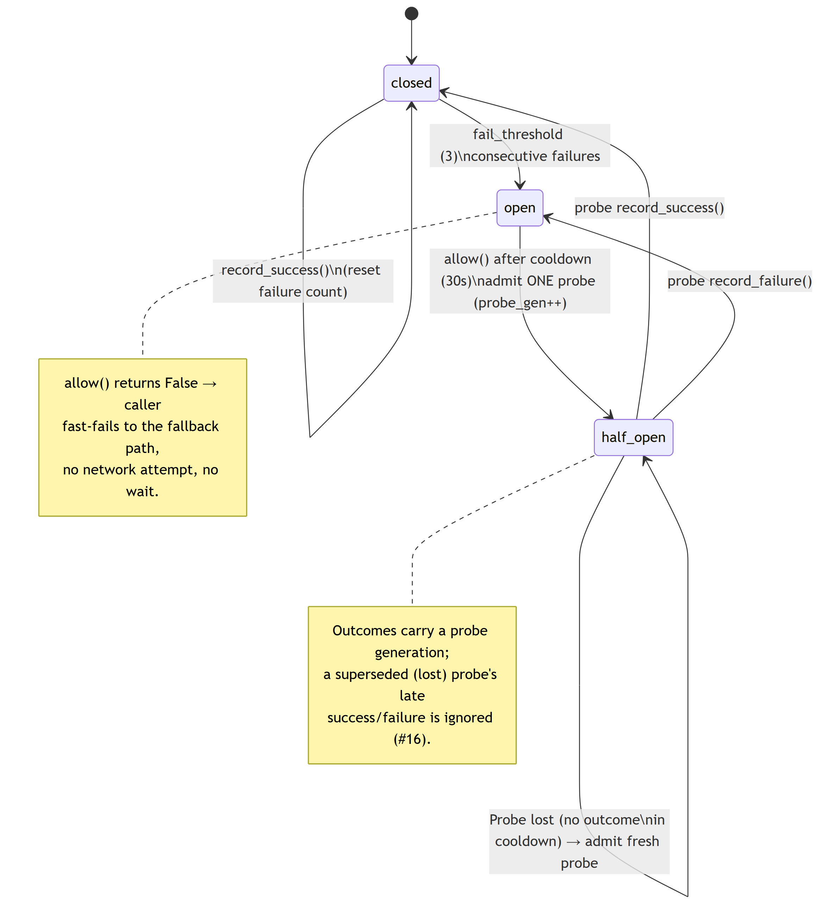
Circuit Breaker
PC Backend 3/7
Source: core/circuit_breaker.py
Personal Desktop Agent

Slide 19
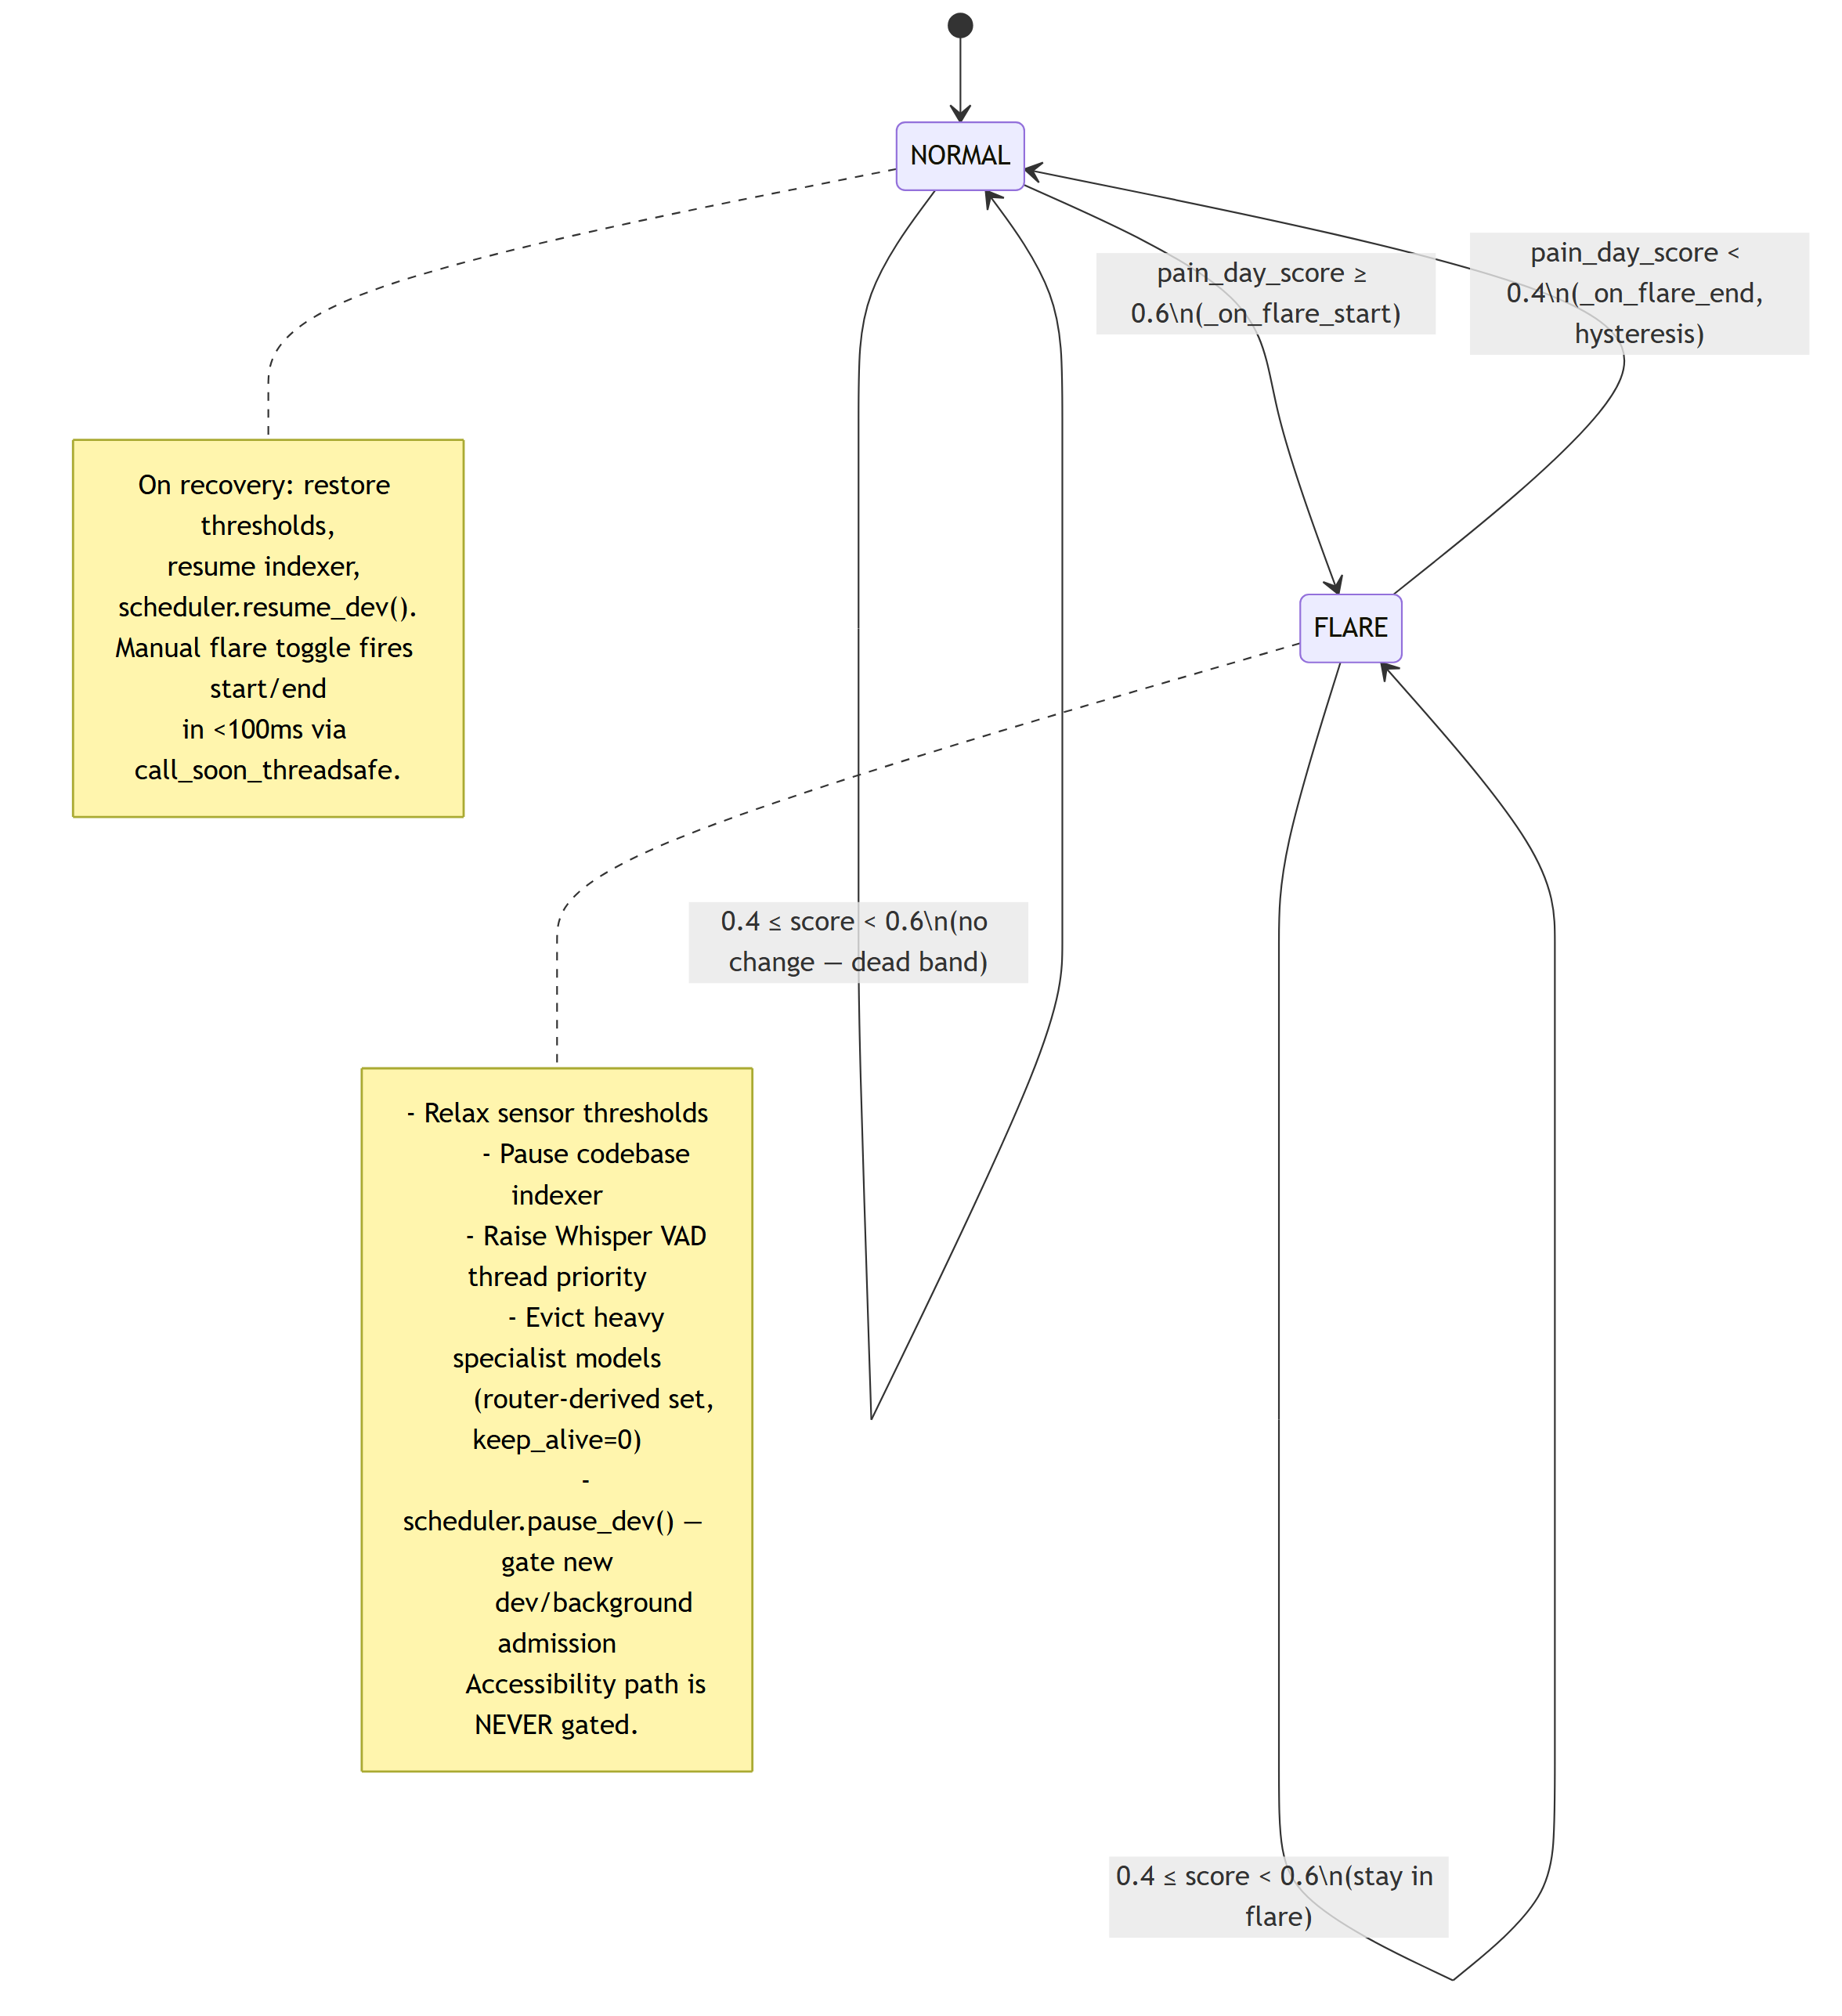
Resource Governor (Flare)
PC Backend 4/7
Source: core/resource_governor.py
Personal Desktop Agent

Slide 20
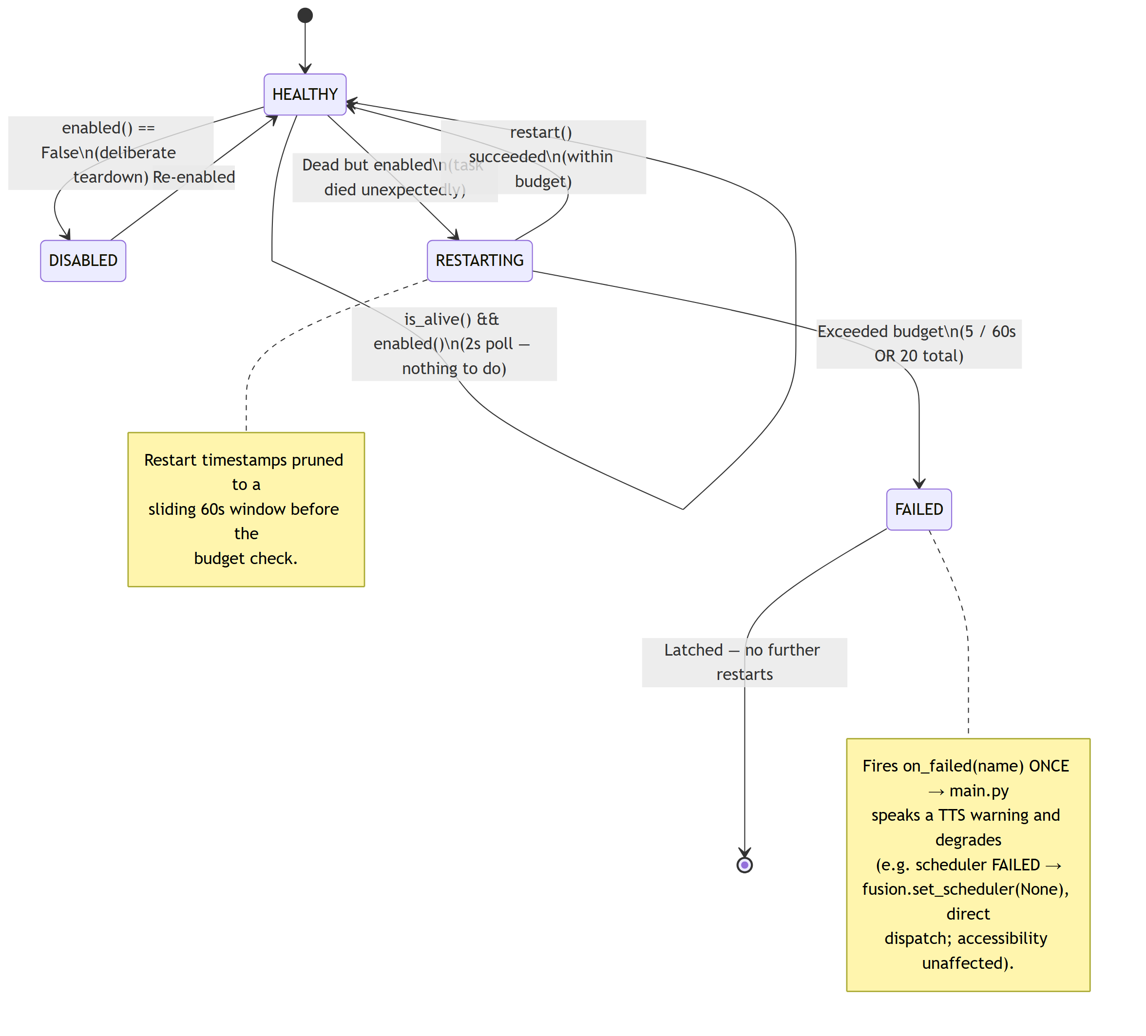
Supervisor Restart Policy
PC Backend 5/7
Source: core/supervisor.py
Personal Desktop Agent

Slide 21
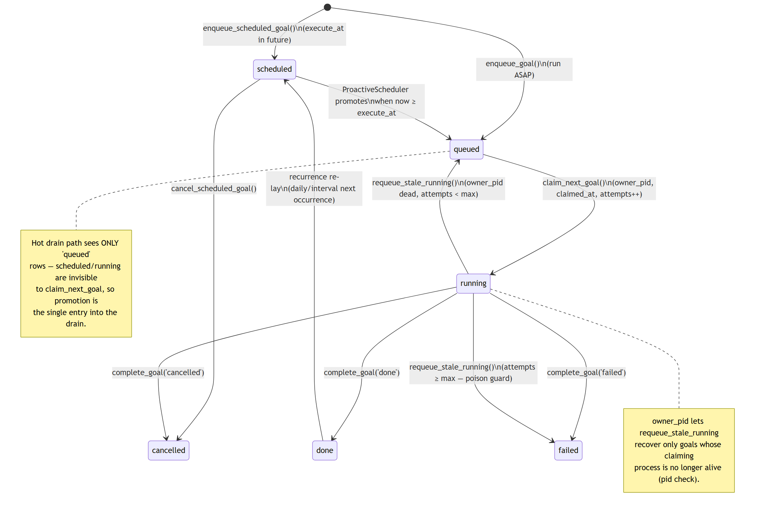
Goal-Queue Row Lifecycle
PC Backend 6/7
Source: storage/db.py · goal_queue
Personal Desktop Agent

Slide 22
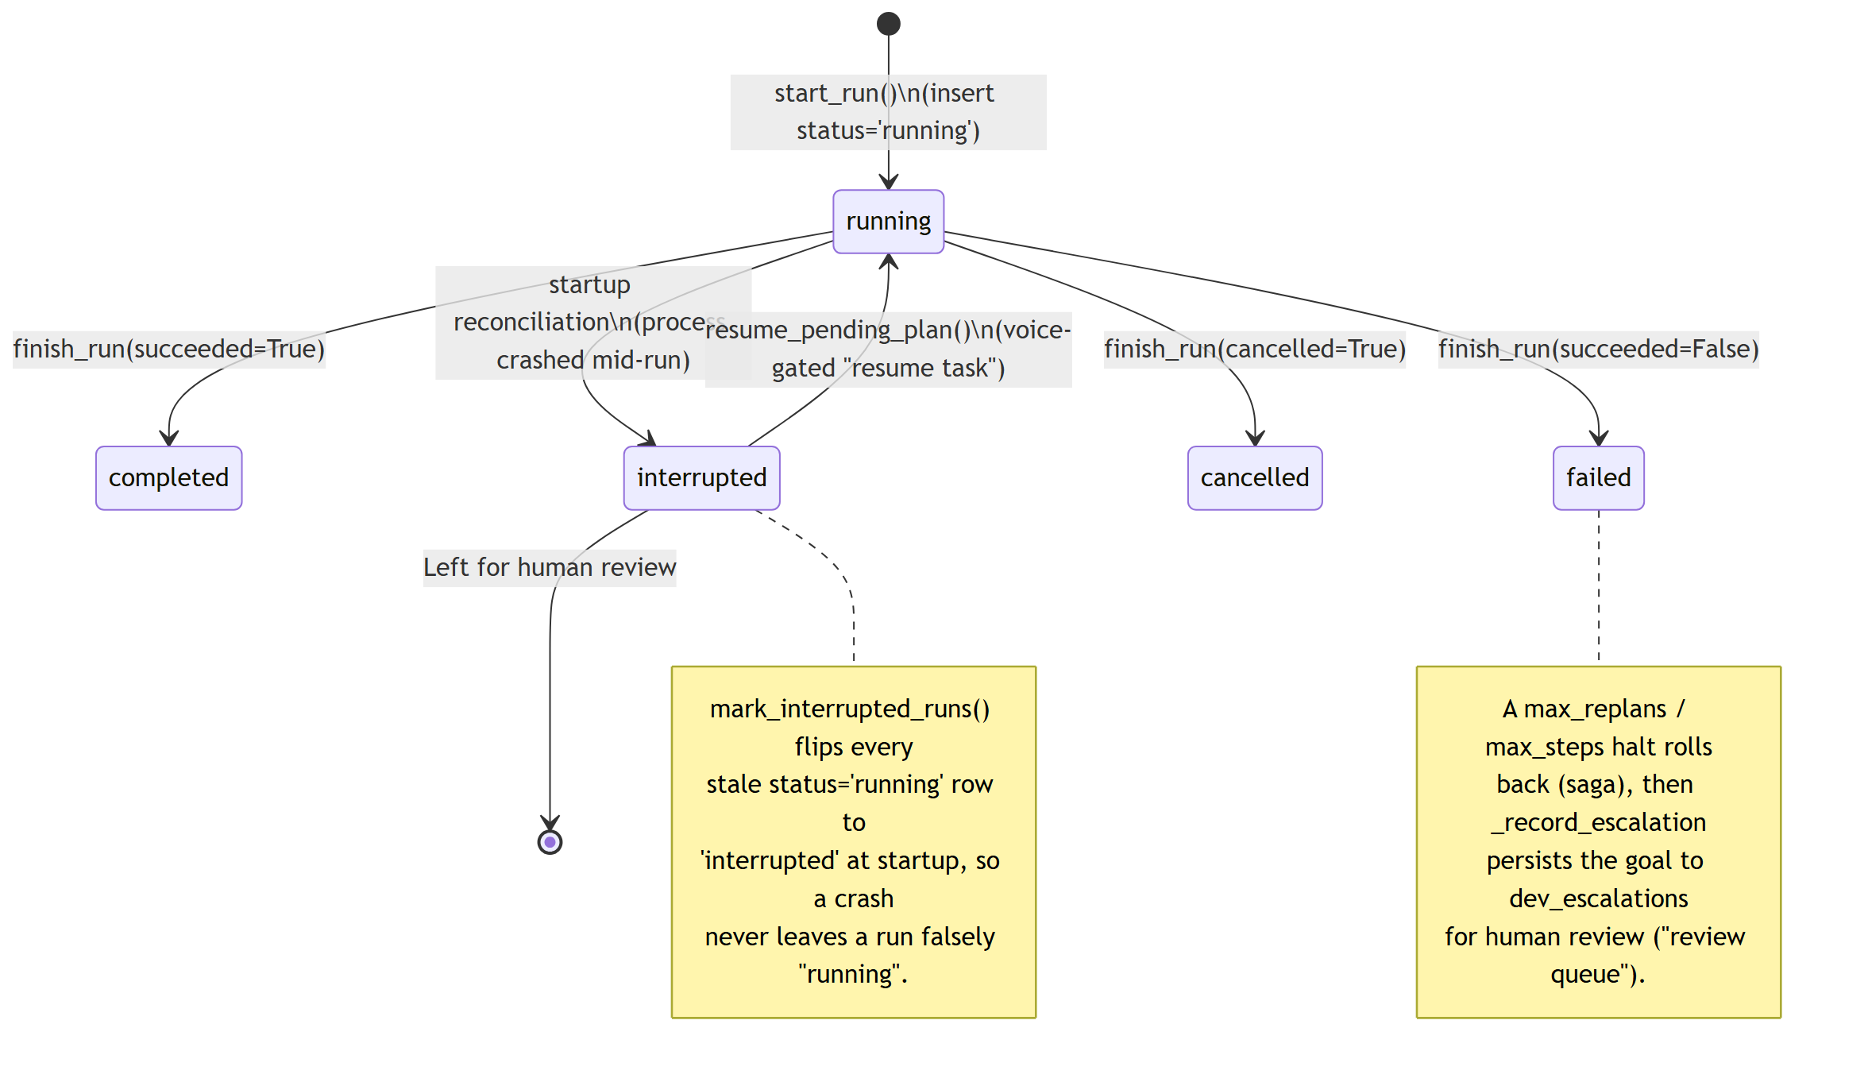
Agent-Run Lifecycle
PC Backend 7/7
Source: storage/db.py · agent_runs
Personal Desktop Agent

Slide 23
SECTION 3
Data Model
Two-tier storage and the 42-table operational schema

Slide 24
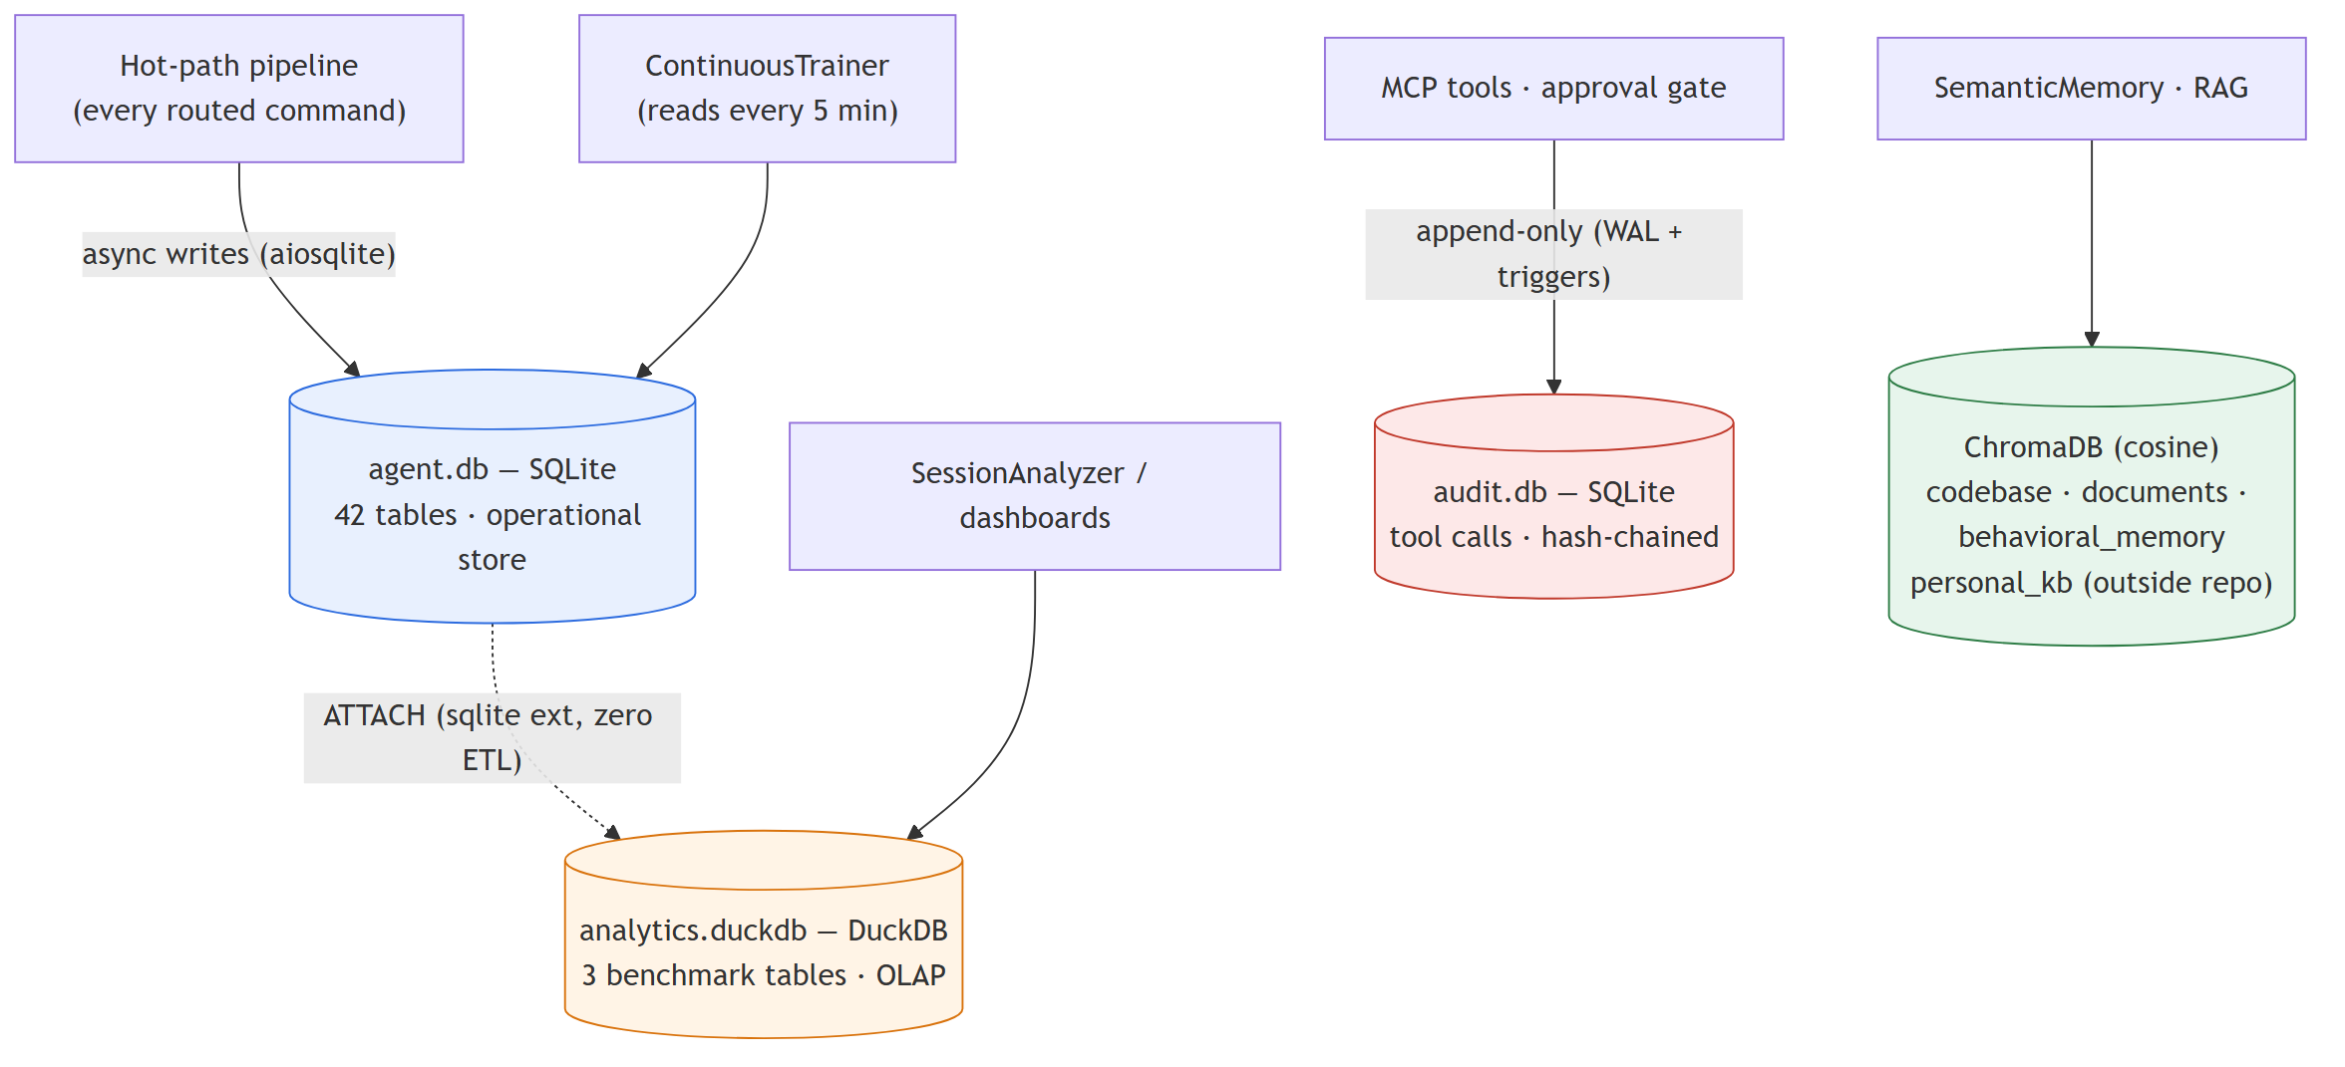
Two-Tier Storage
Data Model
SQLite on the hot path, DuckDB for analytics (zero-ETL attach), ChromaDB for RAG, append-only audit.db
storage/db.py · storage/audit_log.py · storage/semantic_memory.py
Personal Desktop Agent

Slide 25
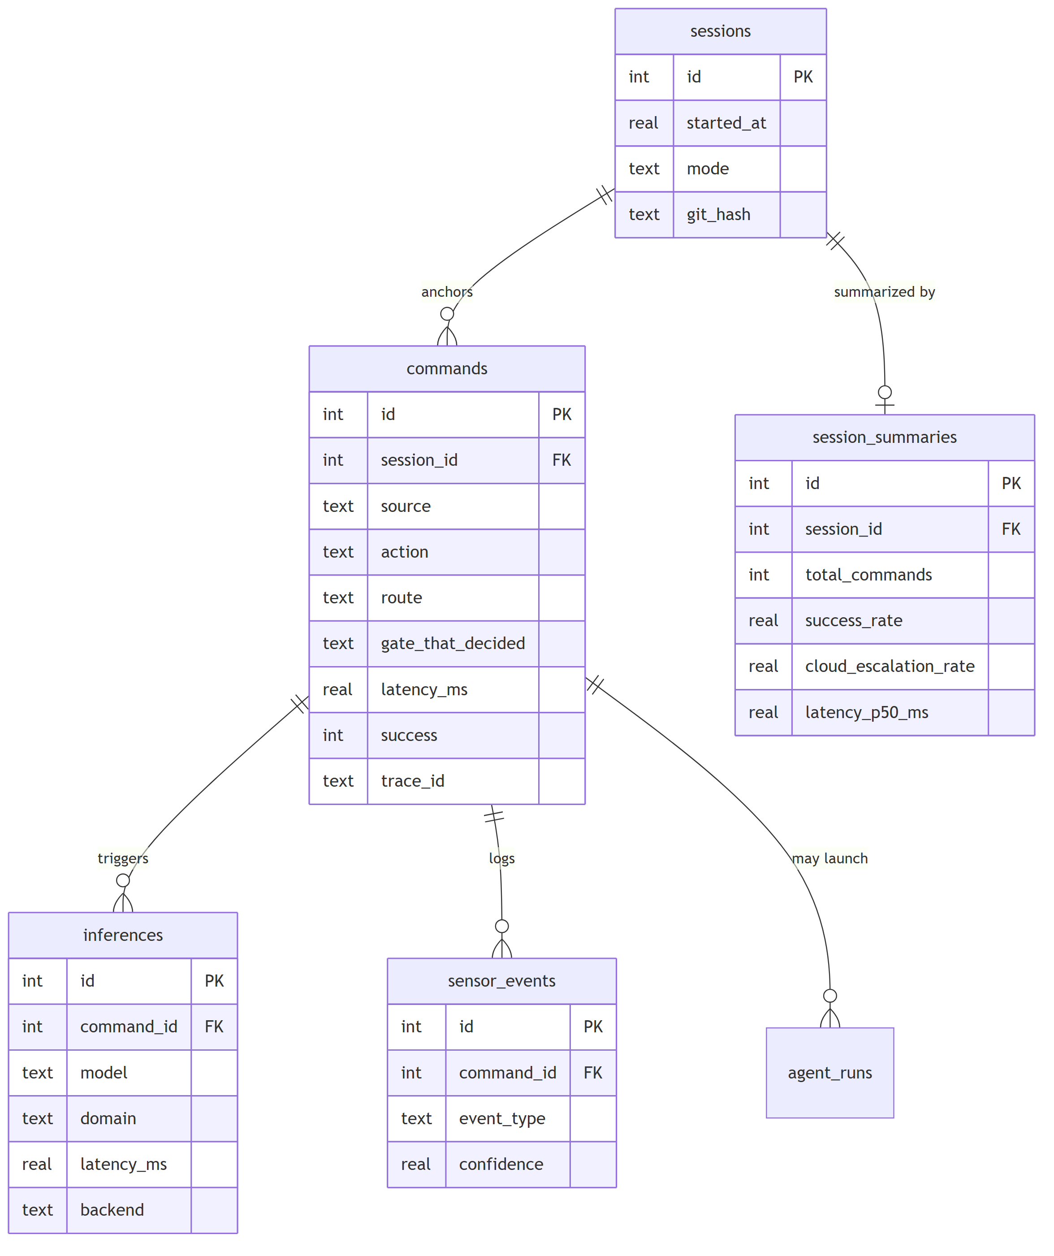
Core Star Schema
Data Model
commands is the central fact table; sessions is the anchor
storage/db.py — sessions · commands · inferences · sensor_events · session_summaries
Personal Desktop Agent

Slide 26
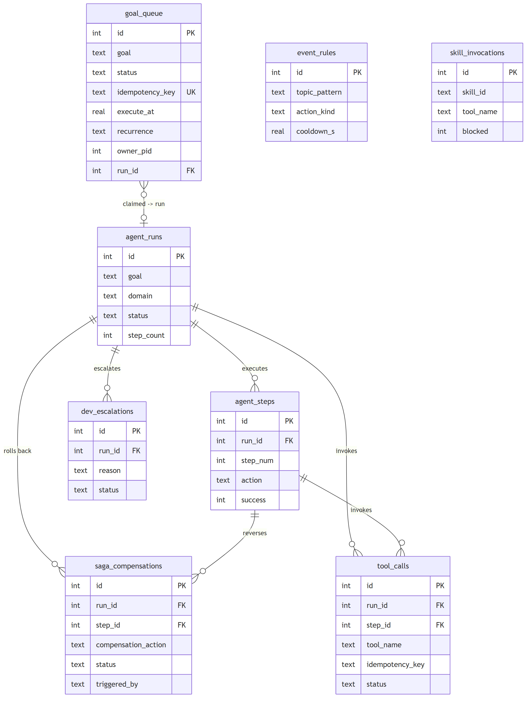
Dev-Agent Orchestration
Data Model
Durable goal queue → runs → steps, with saga rollback + escalation
storage/db.py — goal_queue · agent_runs · agent_steps · saga_compensations · dev_escalations · tool_calls
Personal Desktop Agent

Slide 27
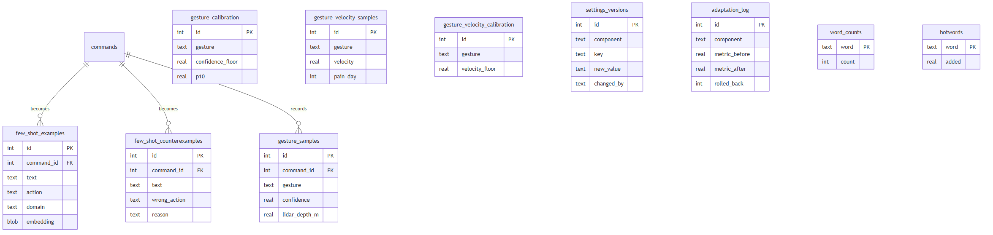
Learning & Adaptation
Data Model
Few-shot examples/counterexamples, gesture calibration, threshold history
storage/db.py — few_shot_* · gesture_* · settings_versions · adaptation_log
Personal Desktop Agent

Slide 28
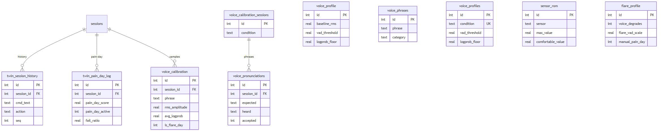
Behavioral Twin & Voice
Data Model
Pain-day signals, session history, and per-condition voice calibration
storage/db.py — twin_* · voice_* · sensor_rom · flare_profile
Personal Desktop Agent

Slide 29
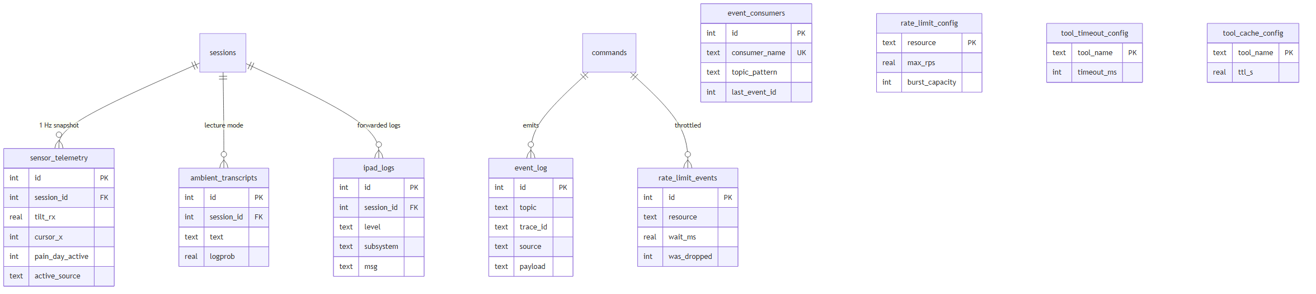
Telemetry, Events & Limits
Data Model
1 Hz sensor snapshots, the event bus, and rate-limit/observability config
storage/db.py — sensor_telemetry · event_log · event_consumers · rate_limit_* · tool_*_config
Personal Desktop Agent

Slide 30
Where Everything Lives
Diagrams (Mermaid source + PNG): docs/diagrams/{state,overview,db}/
State-machine spec: .kiro/specs/ipad-sensor-focus/diagrams/04-state-machines.md
DB design rationale: docs/architecture/database-design.md
Project orientation: CLAUDE.md (status, key files, conventions)
Rebuild this deck: python docs/diagrams/build_deck.py

