Slide 1
Personal Desktop Agent
State Machine Reference
Multimodal accessibility desktop control · iPad sensor hub + RTX 5090 inference
12 machines · iPad app (5) + PC agent kernel (7) · refreshed 2026-06-13

Slide 2
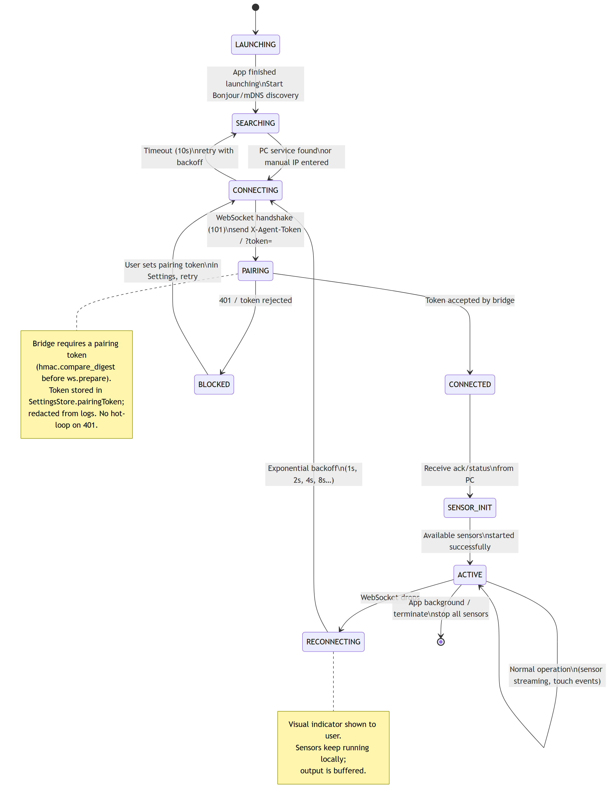
App Top-Level Lifecycle
iPad · Swift 1/5
Source: DesktopAgentApp · SensorManager
Personal Desktop Agent

Slide 3
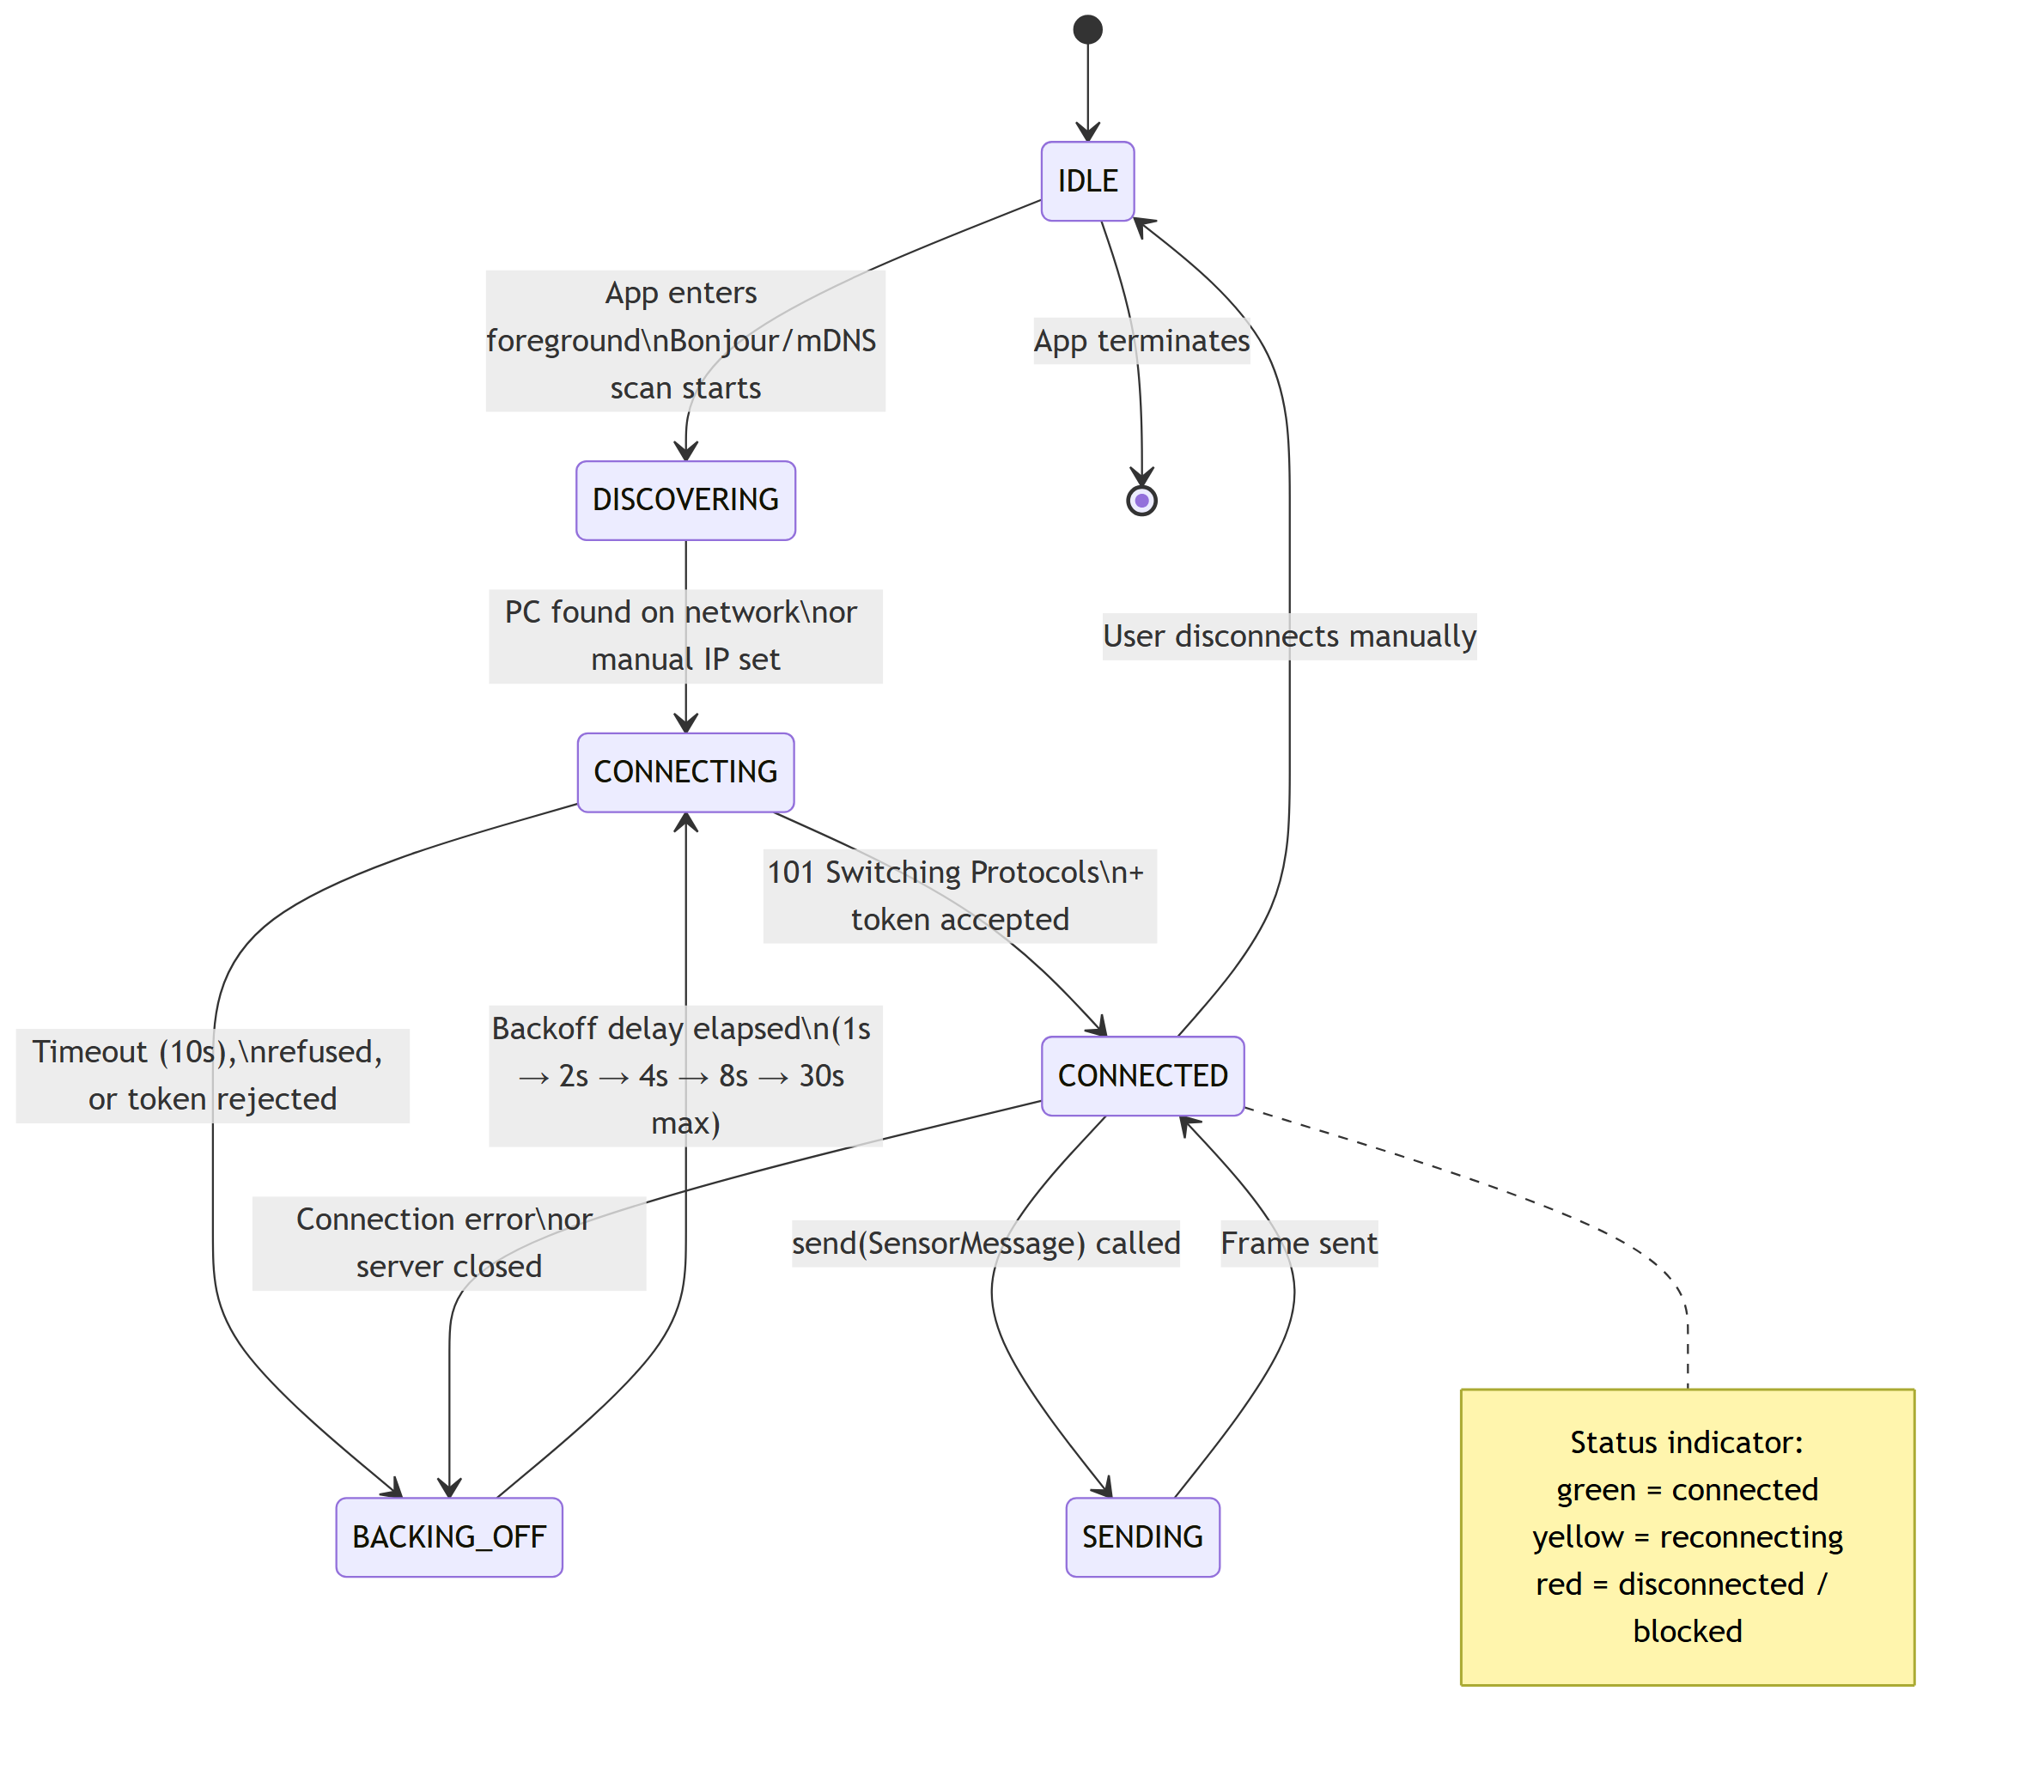
WebSocket Connection
iPad · Swift 2/5
Source: WebSocketManager.swift
Personal Desktop Agent

Slide 4
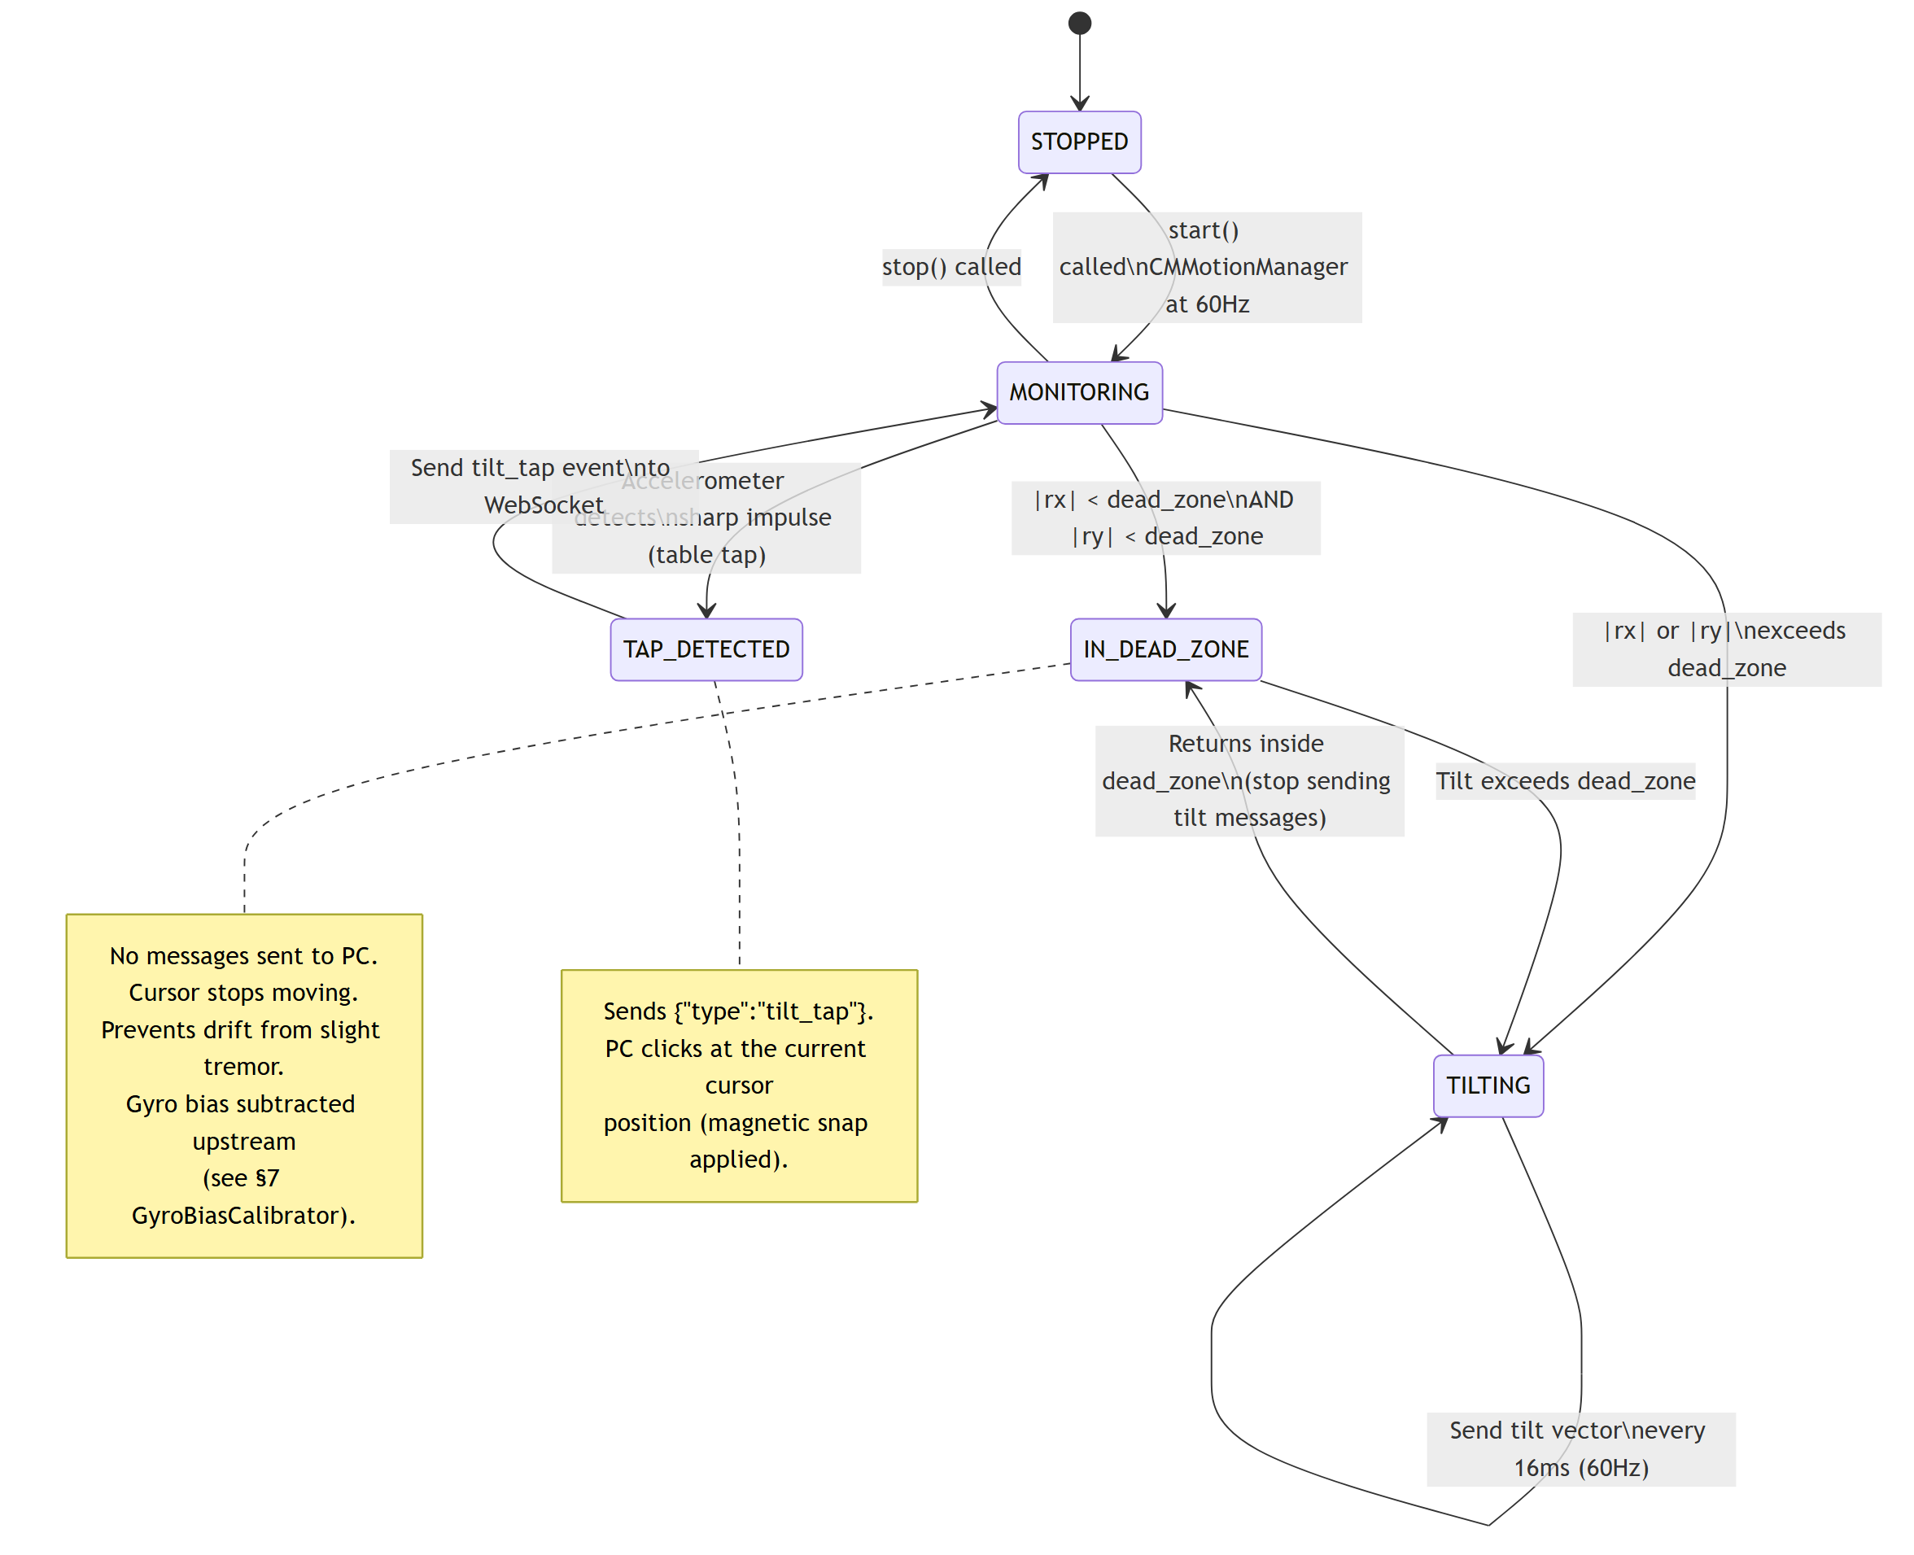
Tilt Navigation
iPad · Swift 3/5
Source: TiltSensor.swift (Core Motion)
Personal Desktop Agent

Slide 5
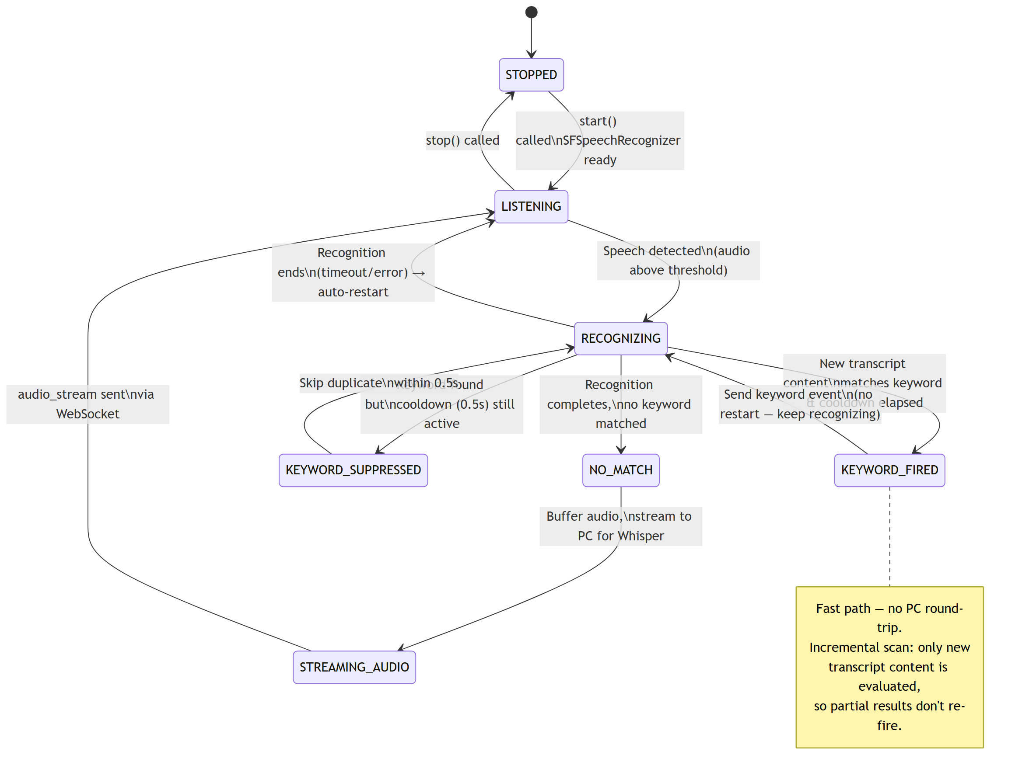
Keyword Listener
iPad · Swift 4/5
Source: KeywordListener.swift (Speech)
Personal Desktop Agent

Slide 6
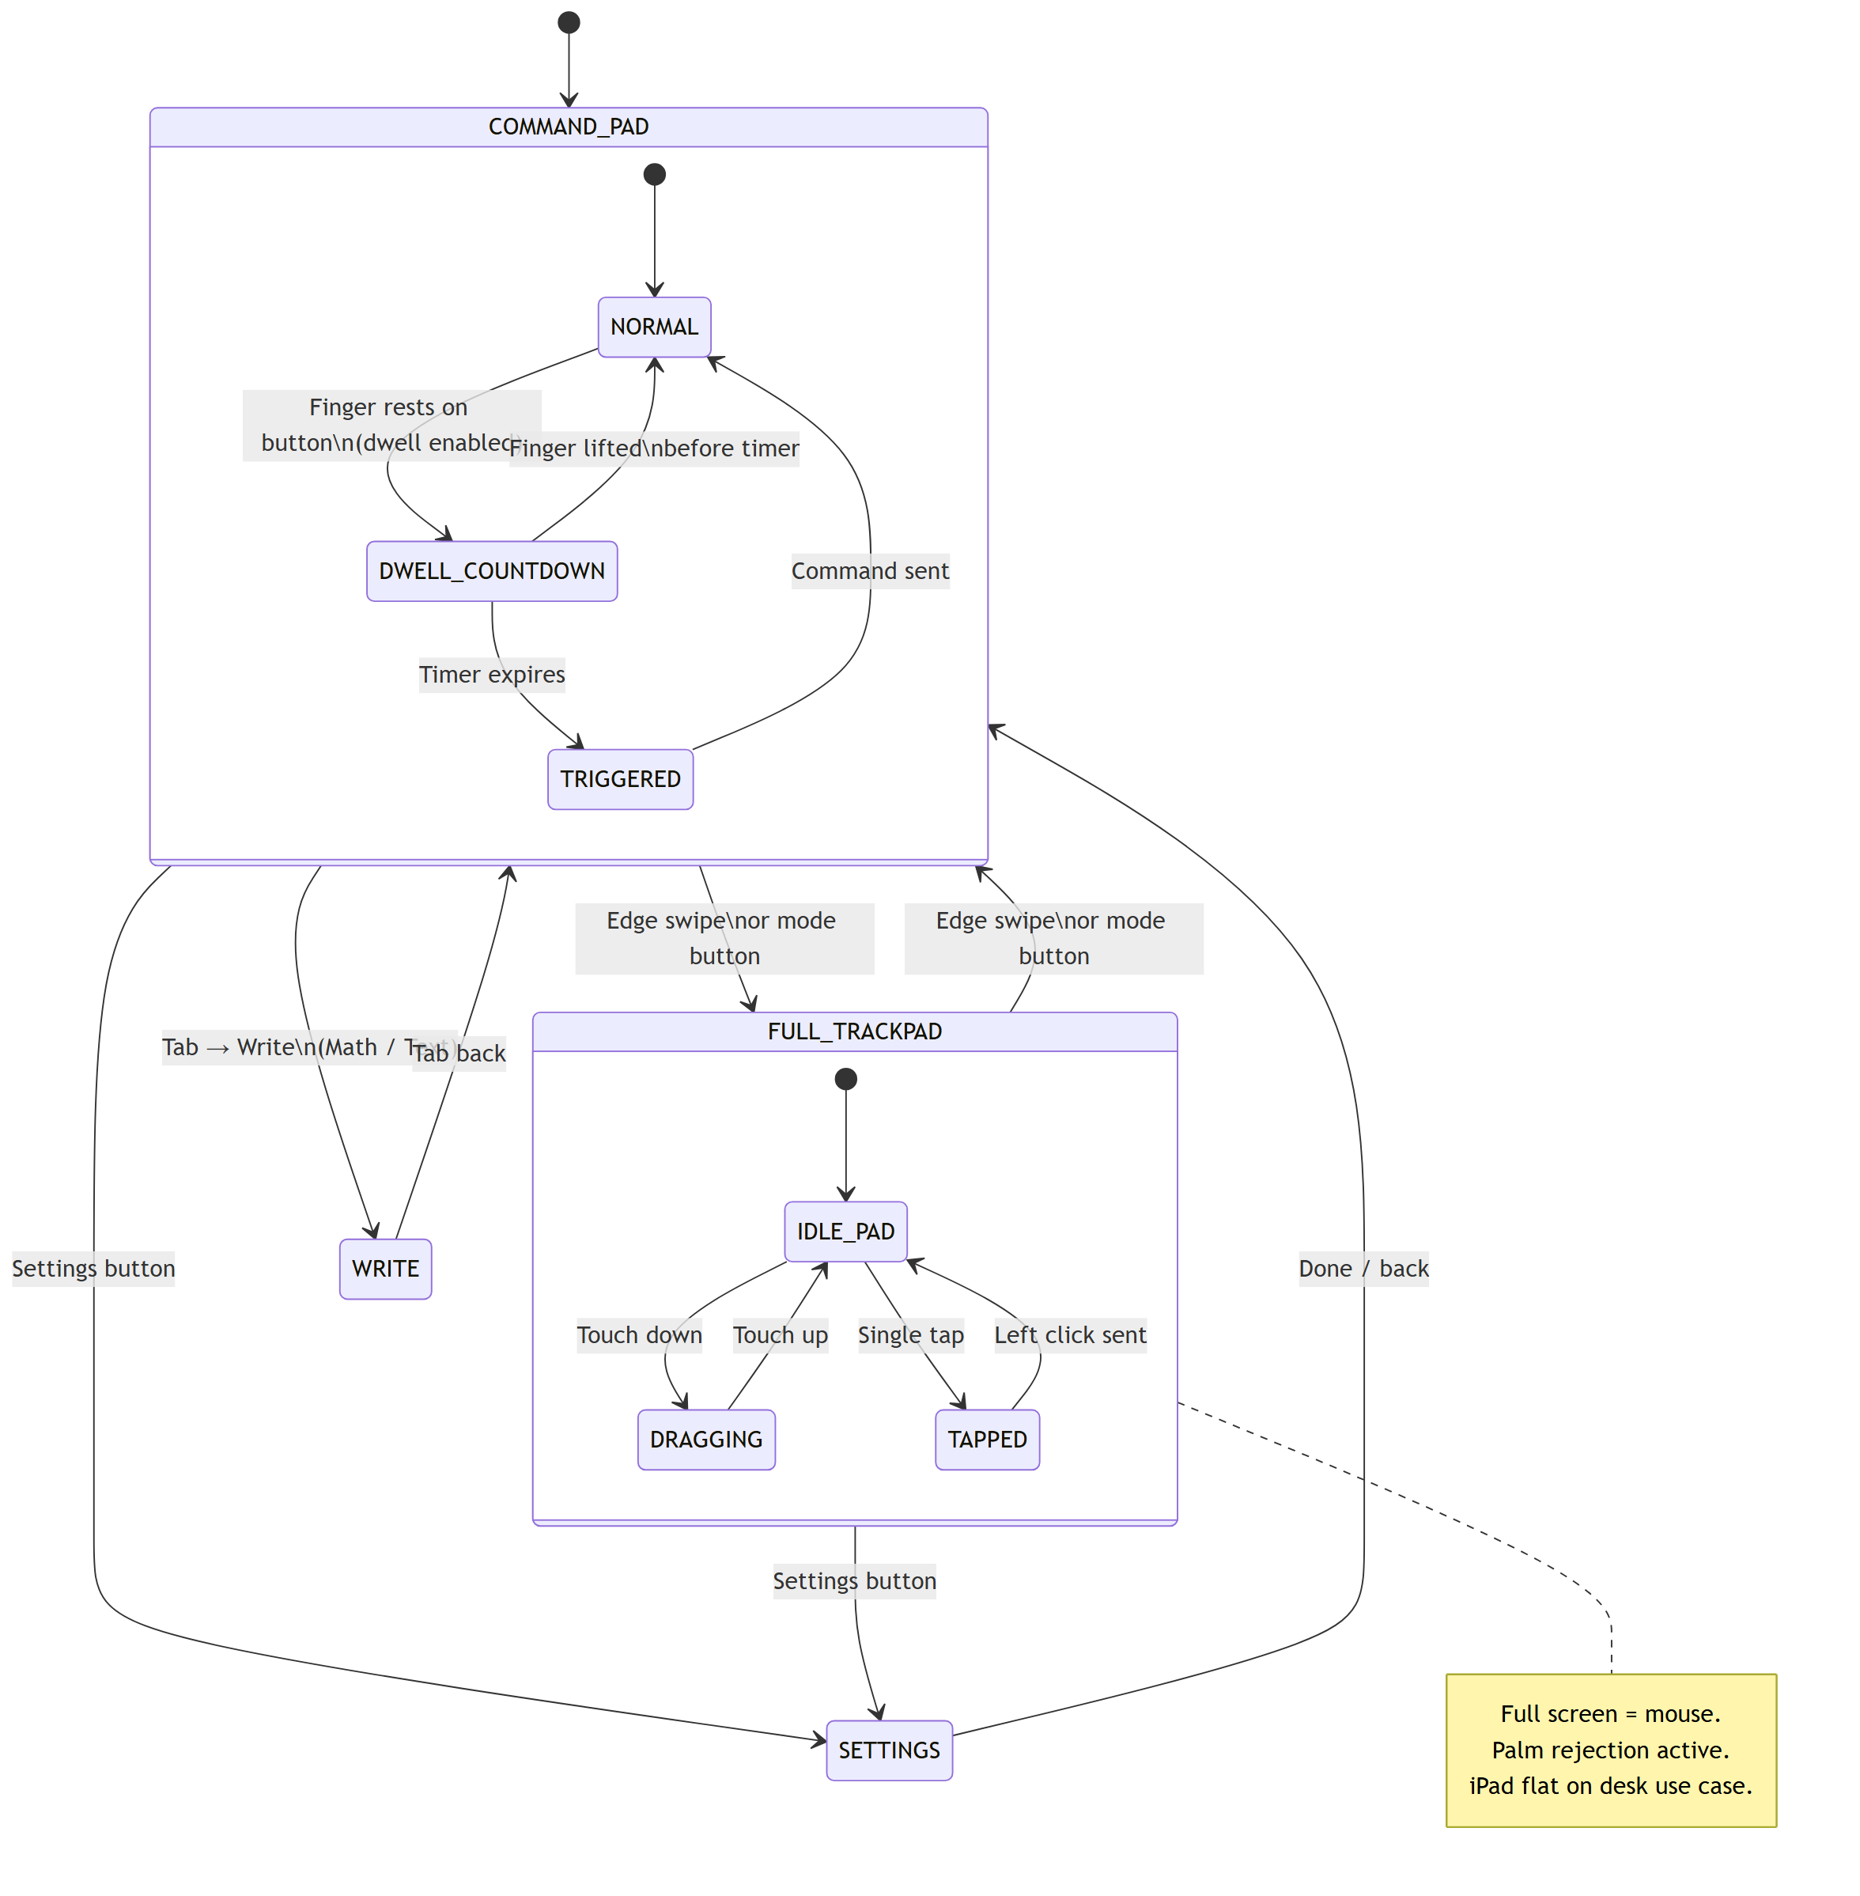
UI View Mode
iPad · Swift 5/5
Source: SwiftUI views
Personal Desktop Agent

Slide 7
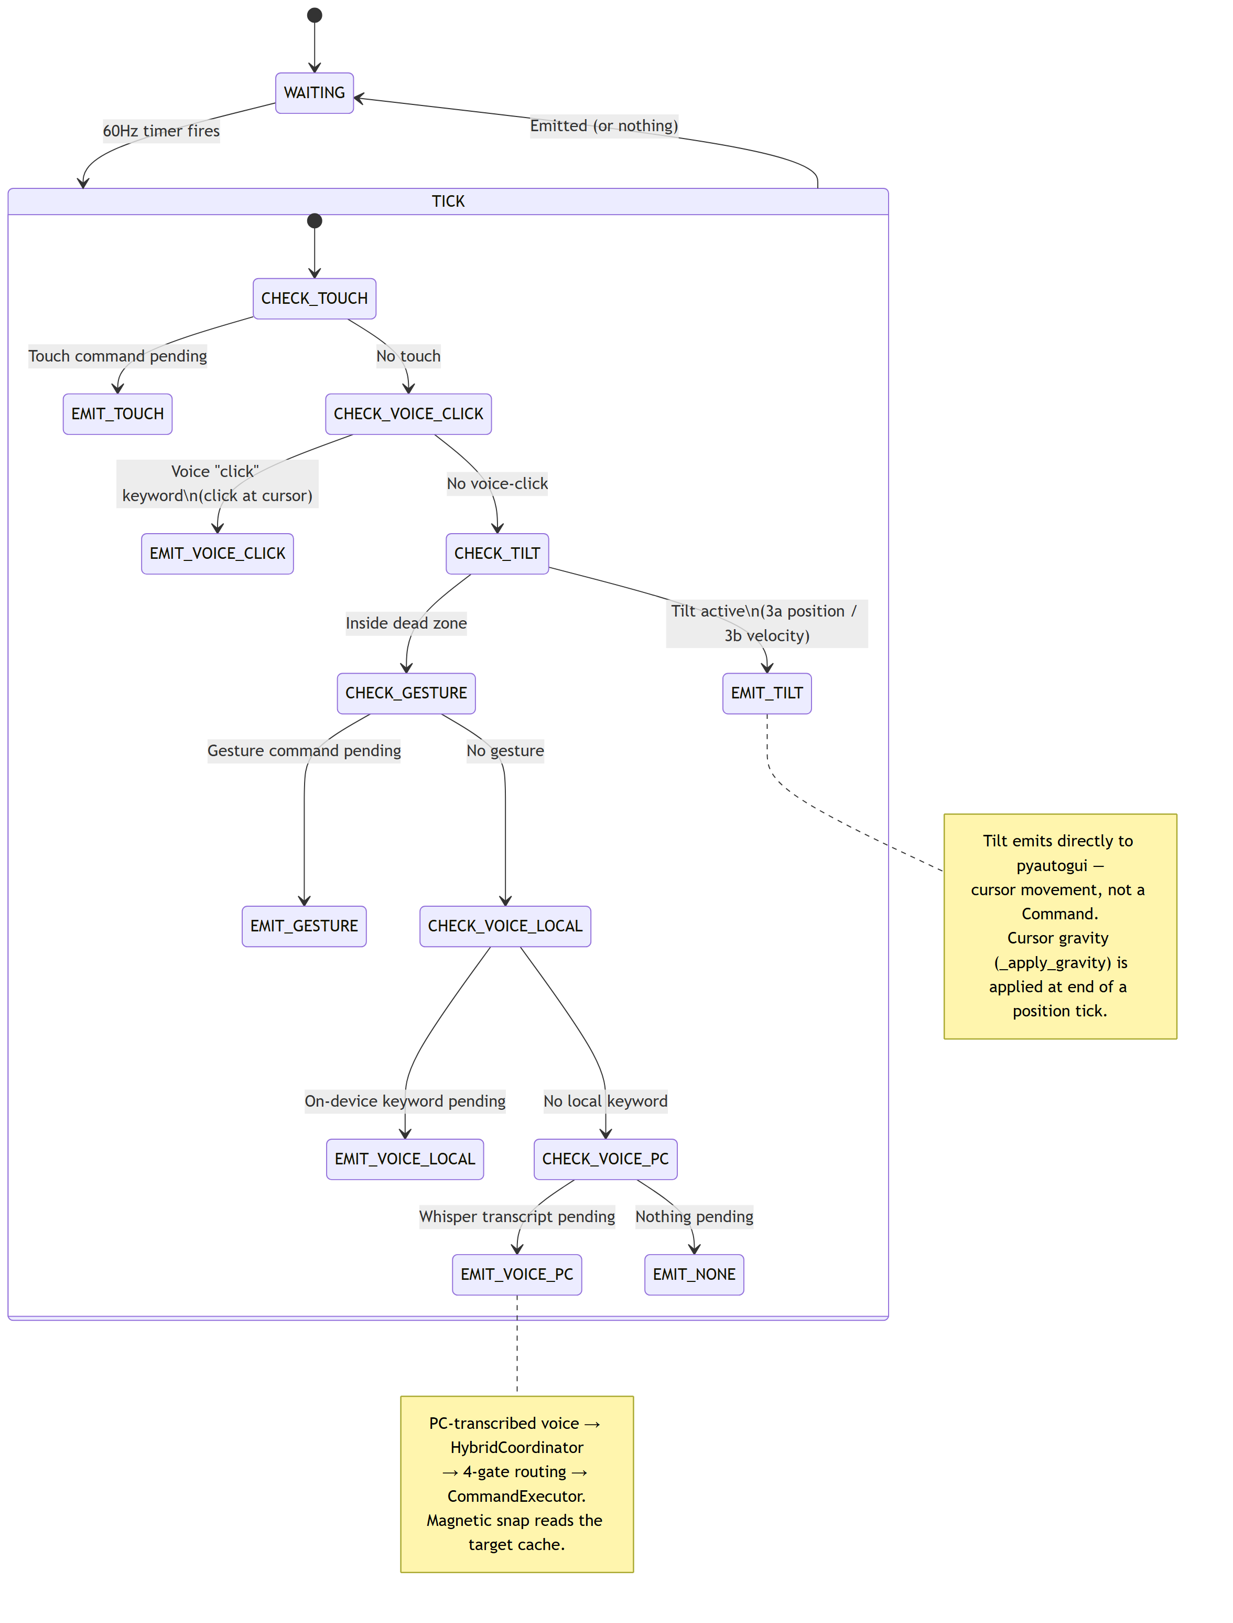
FusionEngine — 6-Level Tick
PC Backend · Python 1/7
Source: core/fusion_engine.py
Personal Desktop Agent

Slide 8
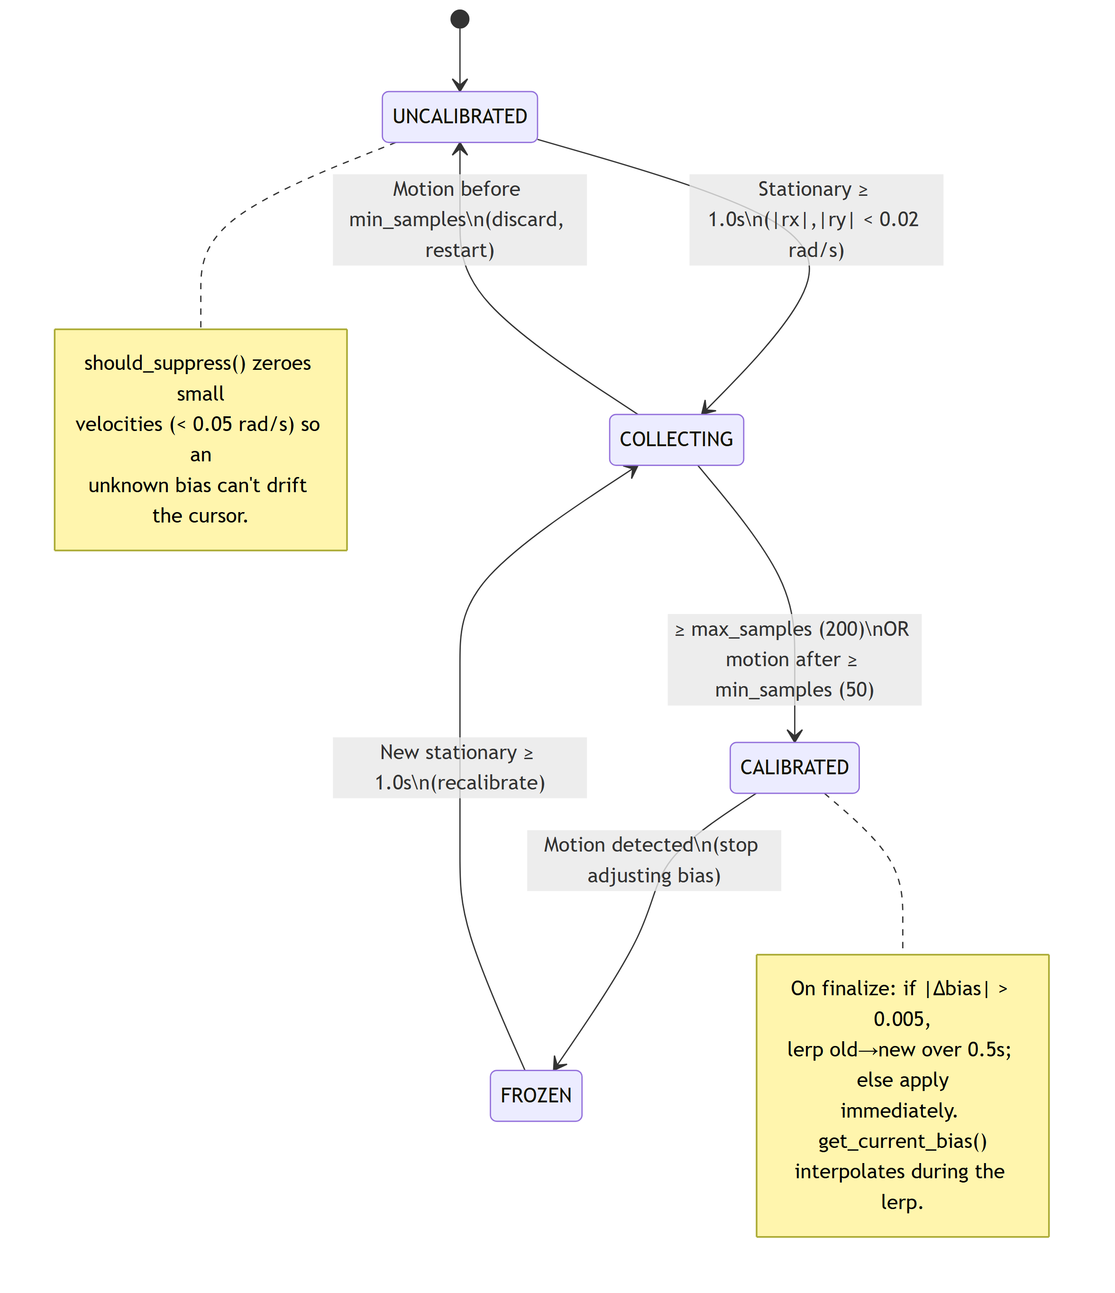
Gyro Bias Calibrator
PC Backend · Python 2/7
Source: calibration/gyro_bias_calibrator.py
Personal Desktop Agent

Slide 9
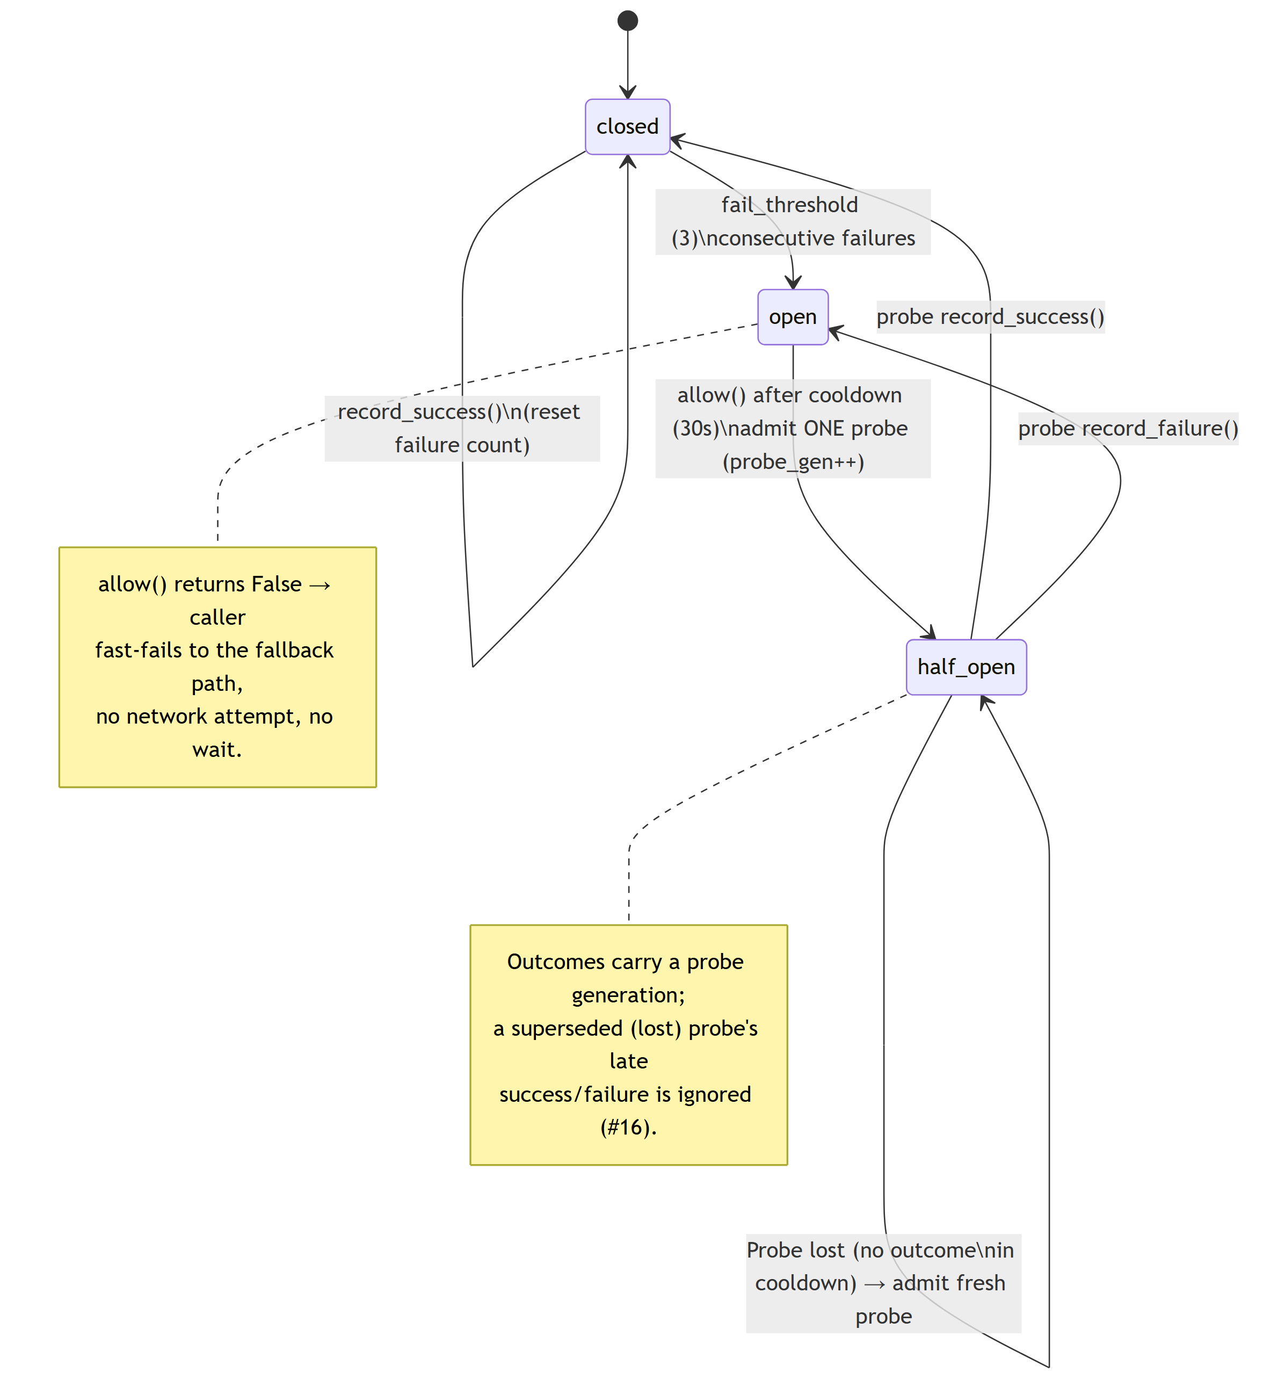
Circuit Breaker
PC Backend · Python 3/7
Source: core/circuit_breaker.py
Personal Desktop Agent

Slide 10
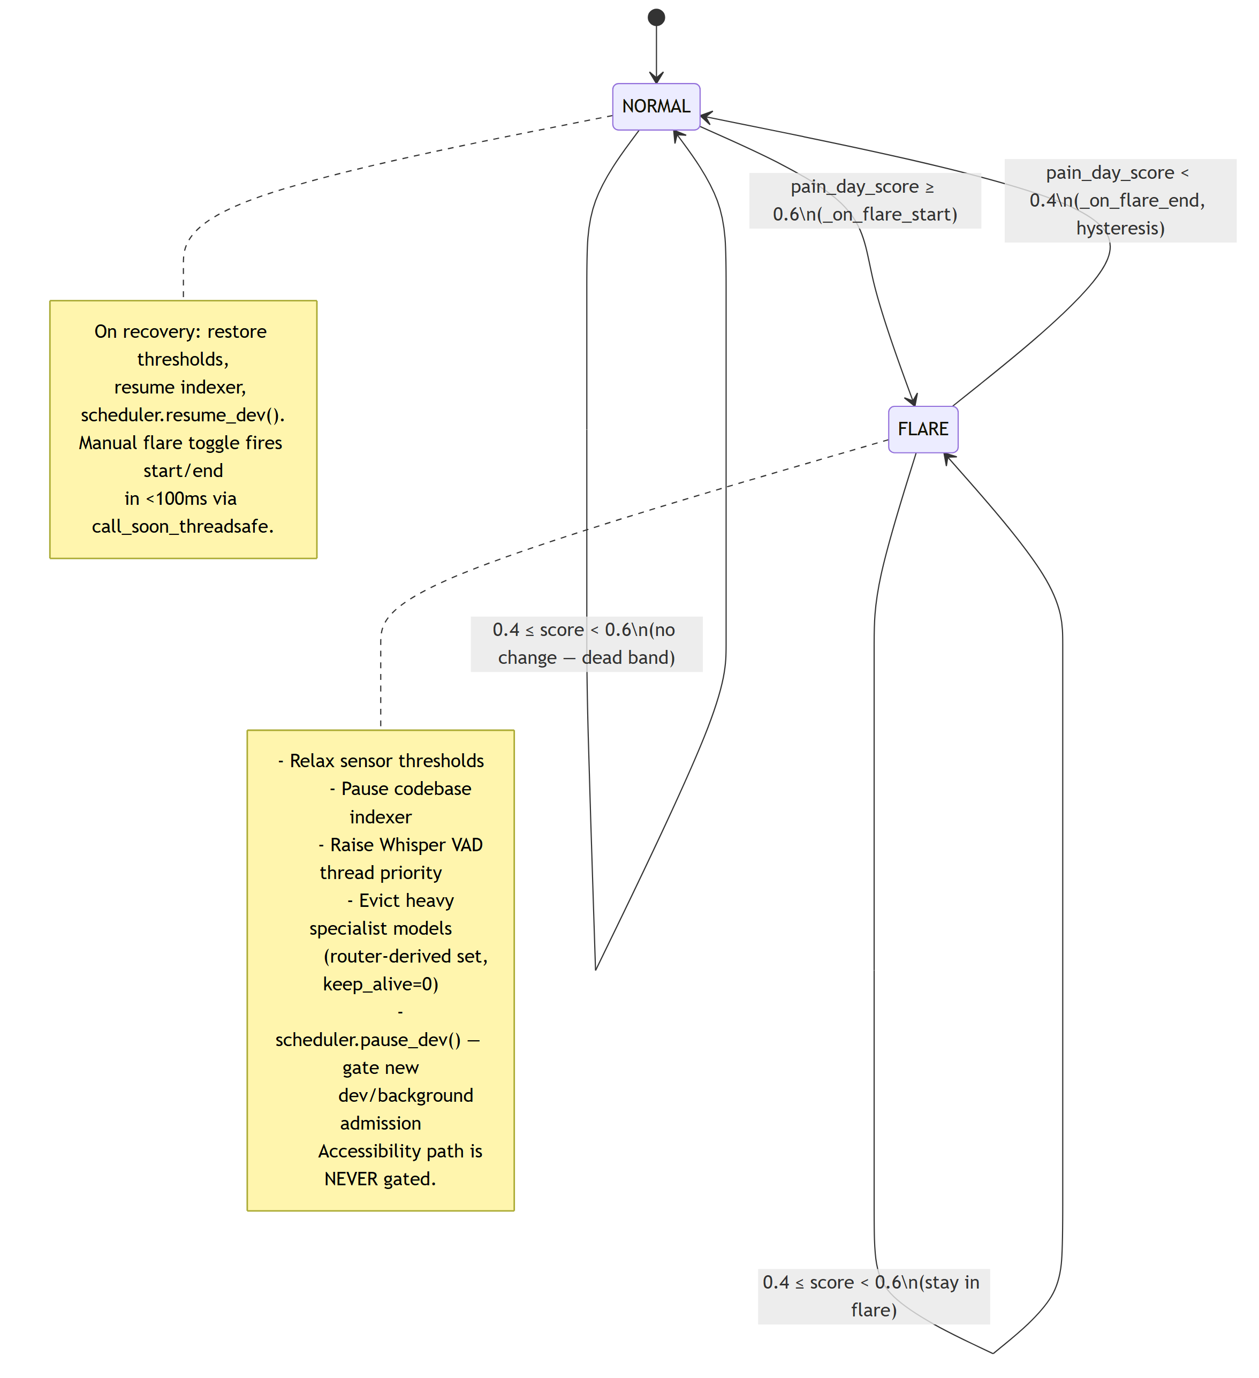
Resource Governor (Flare)
PC Backend · Python 4/7
Source: core/resource_governor.py
Personal Desktop Agent

Slide 11
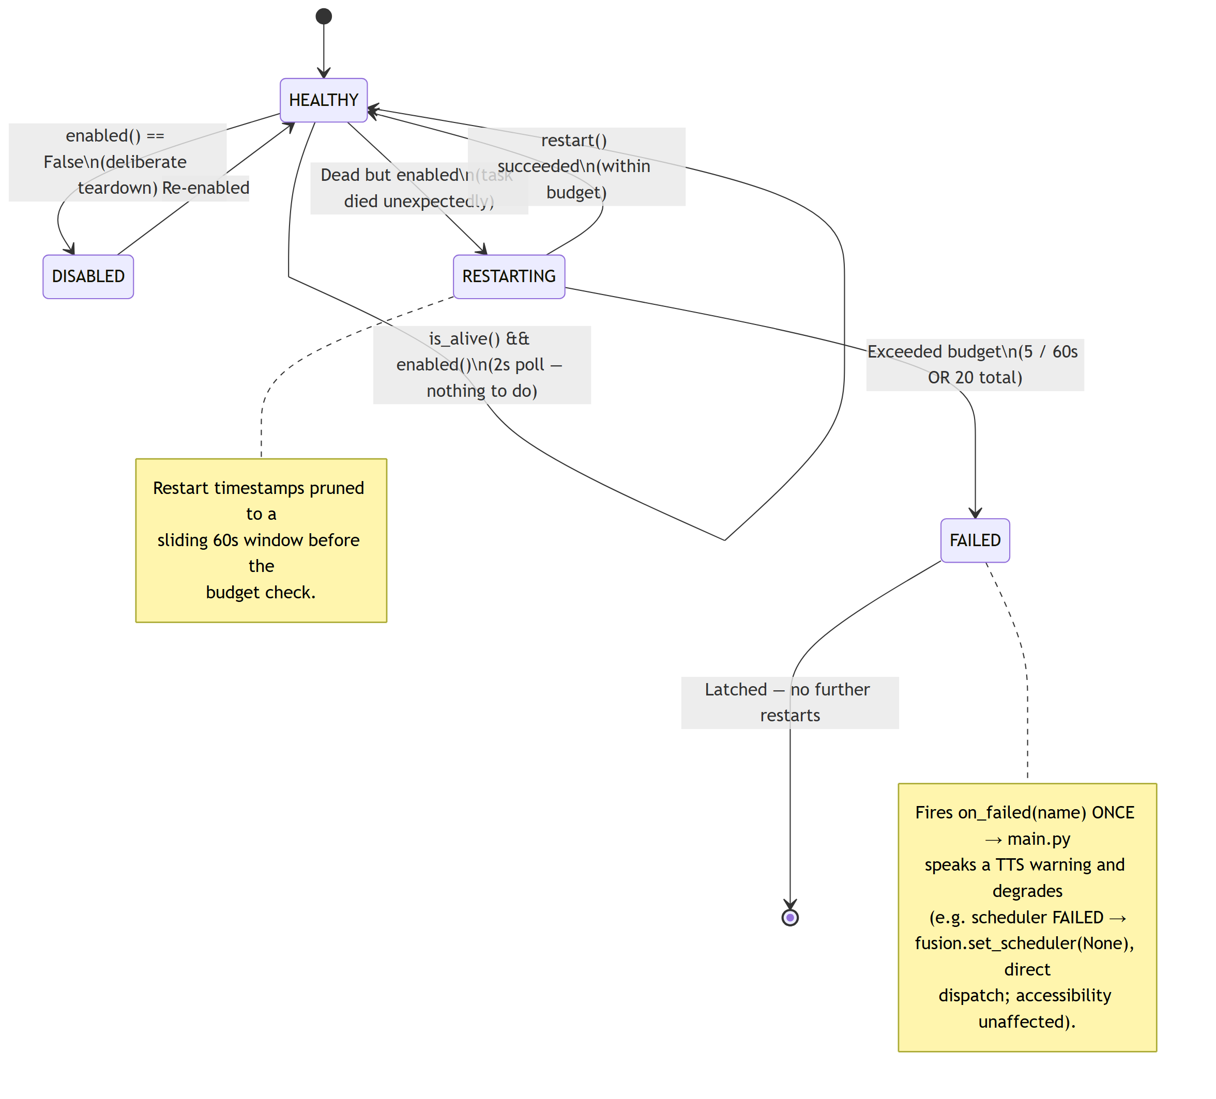
Supervisor Restart Policy
PC Backend · Python 5/7
Source: core/supervisor.py
Personal Desktop Agent

Slide 12
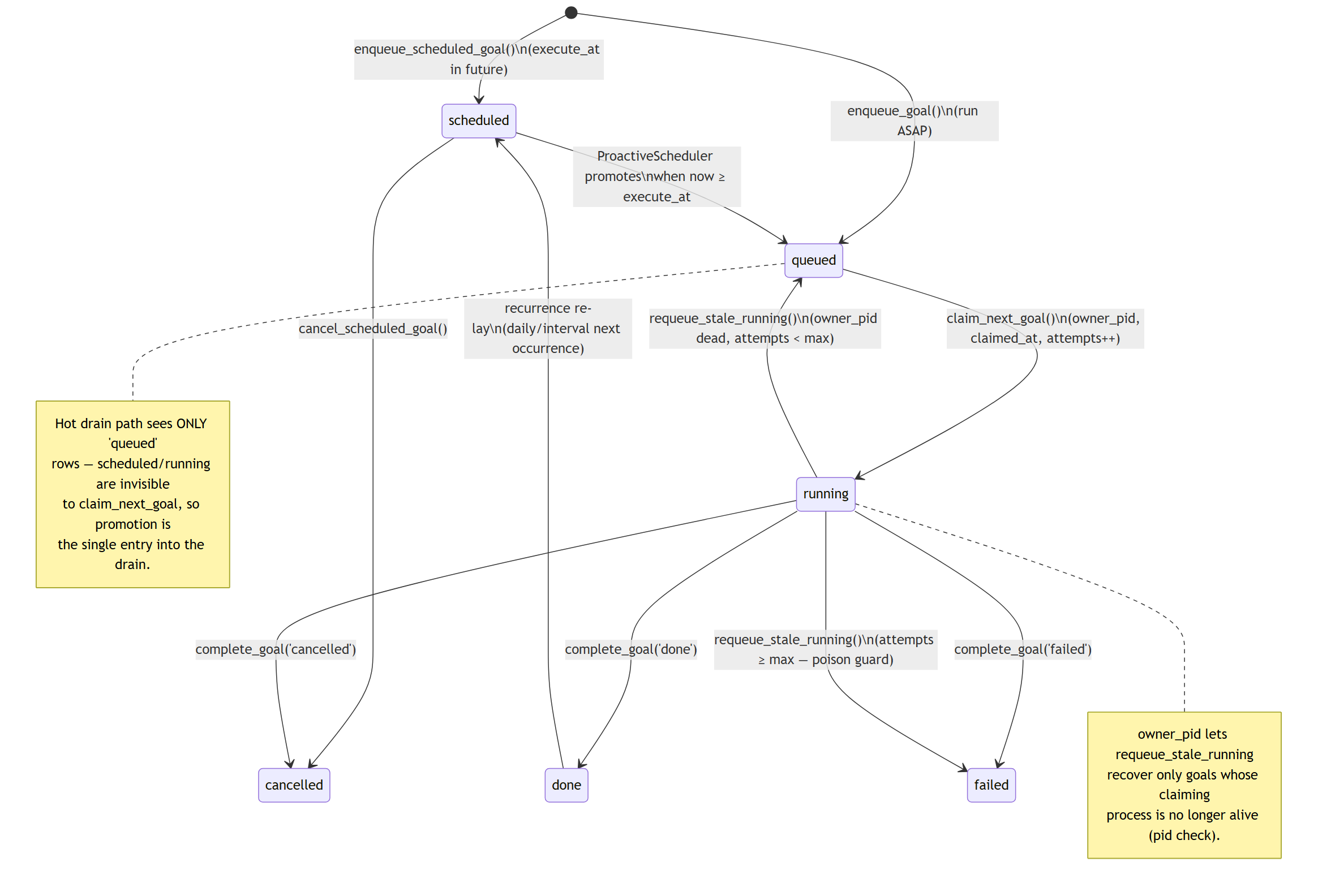
Goal-Queue Row Lifecycle
PC Backend · Python 6/7
Source: storage/db.py · goal_queue
Personal Desktop Agent

Slide 13
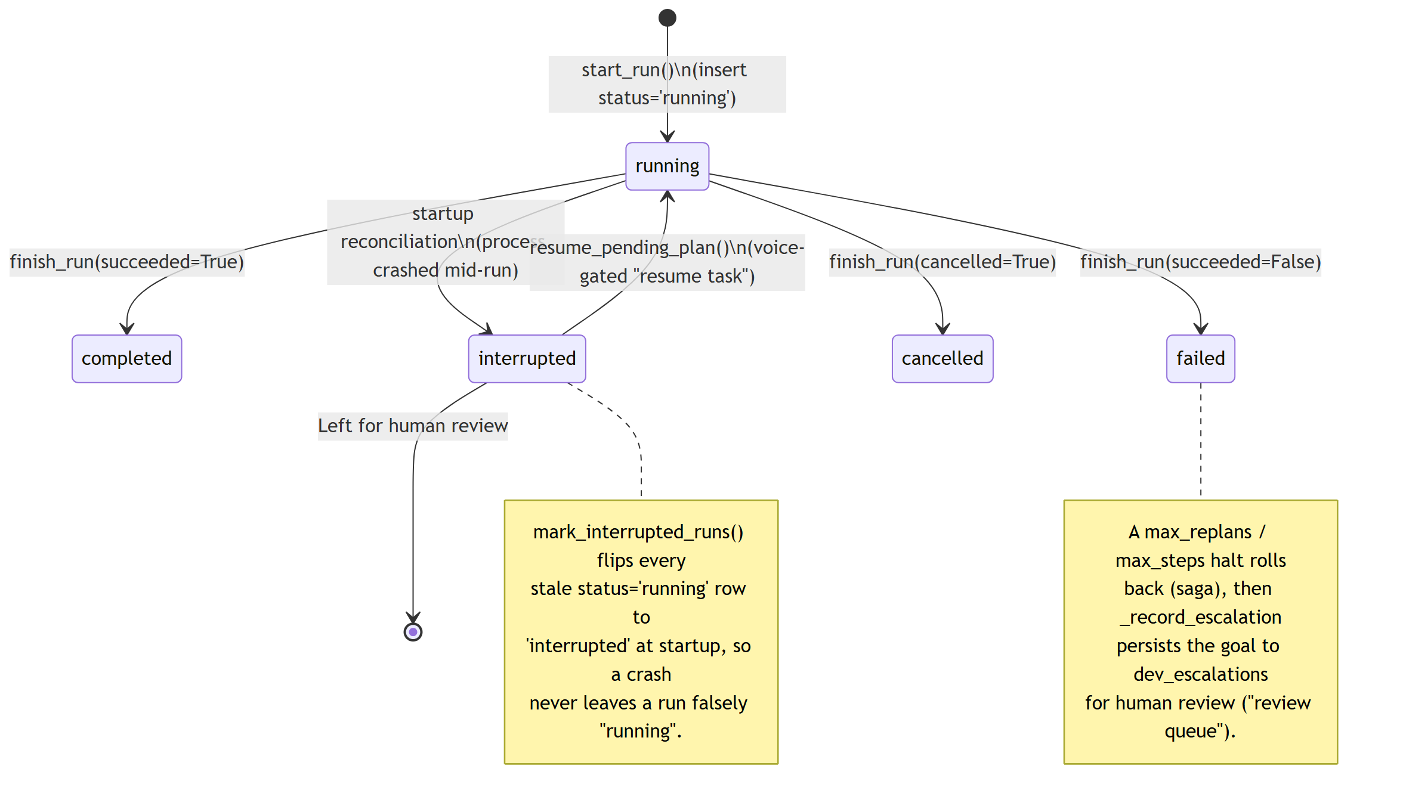
Agent-Run Lifecycle
PC Backend · Python 7/7
Source: storage/db.py · agent_runs
Personal Desktop Agent

