Slide 1
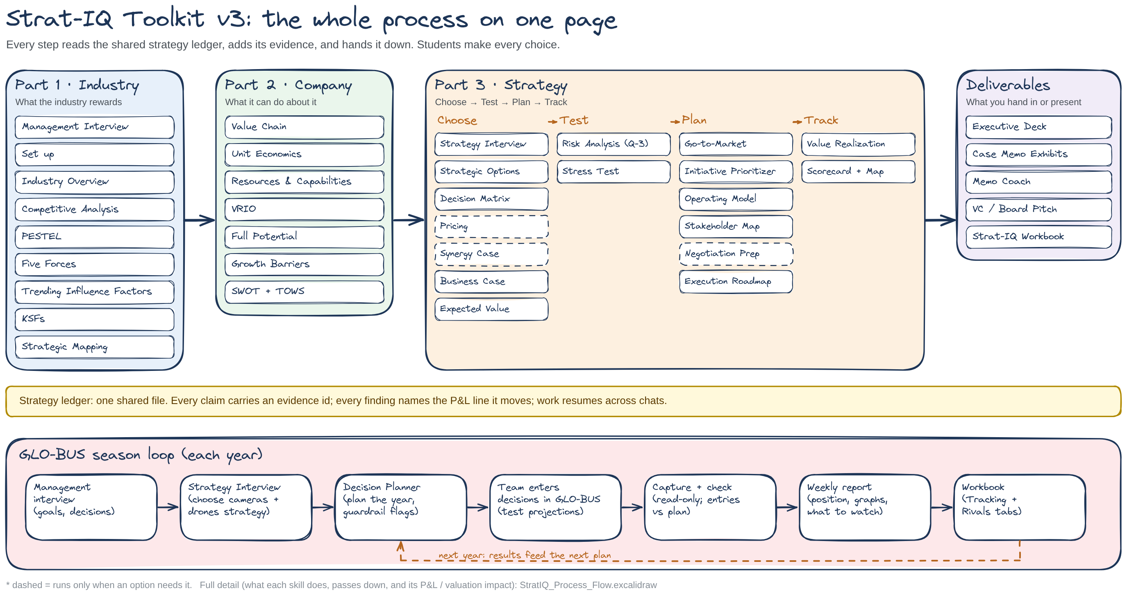
MGT4850 · NORTHEASTERN UNIVERSITY · FALL 2026
Strat-IQ Toolkit v3: The Complete Process
How every skill connects, from industry evidence to a chosen, tested, funded and tracked strategy, plus the GLO-BUS season loop
Created by G. Bradley Scheller
Notes:
Welcome. In this video I'm going to walk you through the complete process, version 3, from end to end. First, a new name: StratOS is now the Strat-IQ Toolkit. Same tools, new name, and I'll show you how to switch over at the end. Over the last few weeks we've added a lot: Part 2, Part 3, new GLO-BUS tools, and an Excel workbook. It's easy to lose sight of how the pieces fit together, so this video is the map.
I'll use one diagram throughout. It shows every skill in order, what each one does, what information it passes to the next step, and how it reaches the P&L or the value of the company. I'm posting that diagram with this video as an Excalidraw file, with instructions, so you can zoom in and follow along.
We'll go part by part: the industry, the company, then making the strategy work, including new statistical tools for testing a decision. Along the way I'll stop for nine short live demos, so you can see each piece working on real screens. Then the GLO-BUS loop, the workbook, how to install version 3, and a few prompts to try this week.

Slide 2
The whole process on one page
Notes:
Here is the whole process on one page. Read it left to right. Part 1 reads the industry: what it rewards. Part 2 reads the company: what it can actually do about it. Part 3 makes the strategy work in four moves: choose, test, plan and track. On the far right are the deliverables you hand in or present.
Underneath everything is the strategy ledger. That's one shared file. Every step reads it, adds its evidence, and passes it down, so nothing is lost between chats and every claim can be traced back to a source.
At the bottom is the GLO-BUS season loop. It runs once a year in the game: choose your strategy, plan the year, enter your decisions yourself, check your entries, get feedback, and track the results.
Dashed boxes run only when an option needs them. Pricing, for example, only runs when price is actually a lever.

Slide 3
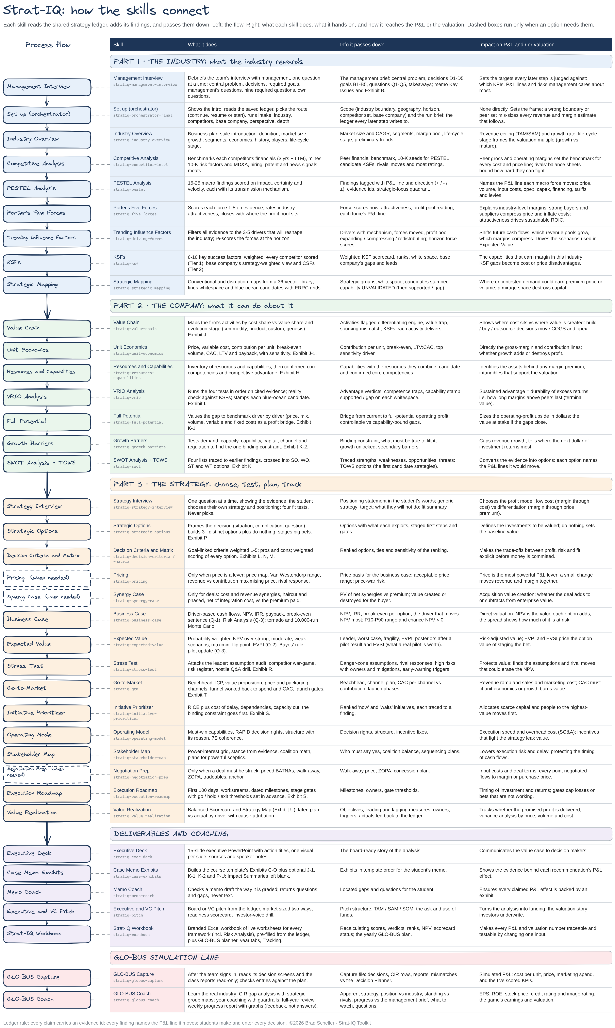
How to read the detailed process map
1
The flow
The left column runs top to bottom in the order Strat-IQ runs the skills. Arrows show the hand-off.
2
The table
Four columns for every skill: its name, what it does, the information it passes down, and its impact on the P&L or valuation.
3
Dashed boxes
Pricing, Synergy Case and Negotiation Prep run only when an option needs them.
4
Get the file
Download StratIQ_Process_Flow.excalidraw (posted with this video) and open it at excalidraw.com to zoom in.
Notes:
This is the detailed version of the map, and it's the file I'm posting with this video. Let me show you how to read it.
The left column is the flow. It runs top to bottom in the same order Strat-IQ runs the skills, and the arrows show each hand-off.
To the right of every box is a row in the table with four columns: the skill's name, what it does, the information it passes down to the next steps, and its impact on the P&L or on the company's valuation. That last column is the point of the whole toolkit: every piece of analysis should end up touching revenue, cost, investment, risk or how long an advantage lasts.
Dashed boxes are the tools that run only when needed. And the file itself opens free in your browser at excalidraw.com, so you can zoom into any row while you watch.

Slide 4
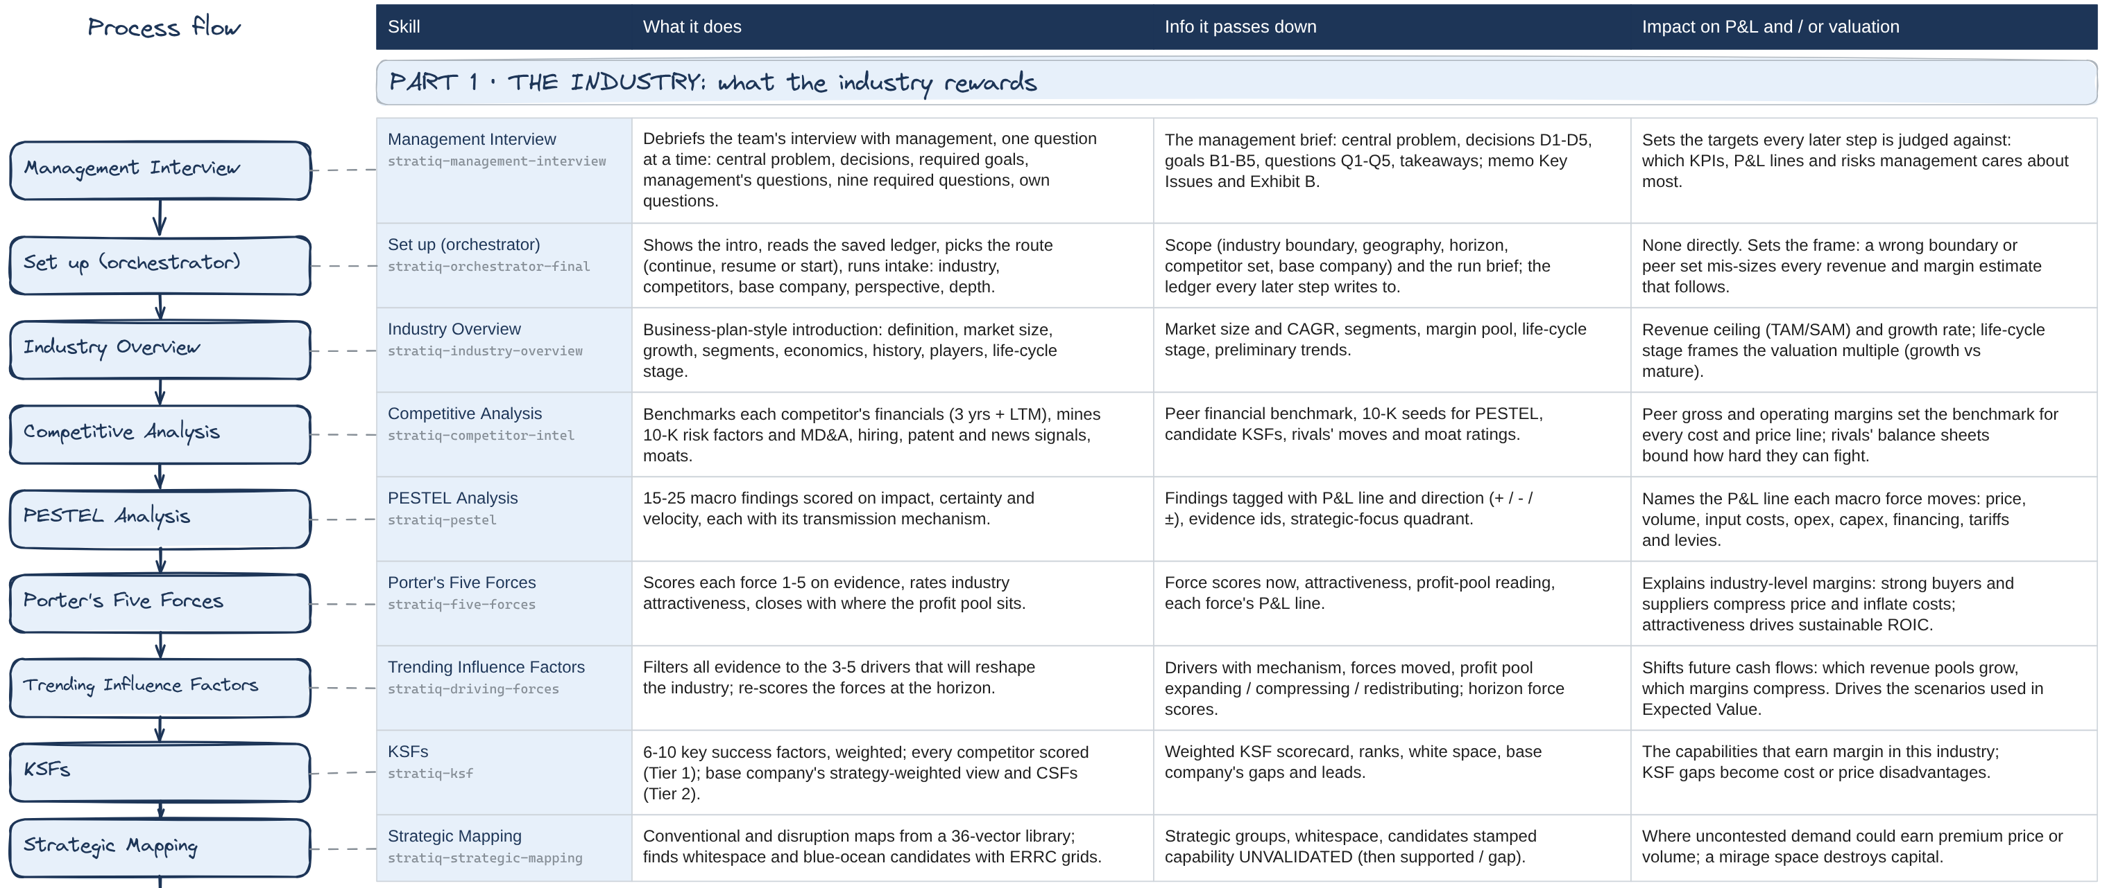
Part 1 reads the industry: evidence before opinion
Part 1 · 9 steps
Competitors' 10-Ks are mined before PESTEL: primary evidence first
Every finding names the P&L line it moves and in which direction
Maps re-plot rivals on new axes to find space nobody occupies
Notes:
Everything starts with the new Management Interview debrief. After your team interviews management, Strat-IQ asks you, one question at a time, what they said: the decision they need made, the goals you must reach, and the questions they want answered. That becomes your memo's Key Issues and Exhibit B, and every later step is checked against it.
Part 1 then reads the industry. It starts with setup: the industry boundary, the competitors and your base company. Then the Industry Overview sizes the market and its growth, which sets the revenue ceiling.
Competitive Analysis comes before PESTEL on purpose. Your competitors' annual reports, their risk factors and management discussion, are primary evidence of what threatens the business. PESTEL then turns macro trends into findings, and each one names the P&L line it moves: price, volume, input costs, opex, capex or financing.
Five Forces explains why margins in this industry are what they are. Trending Influence Factors picks the three to five drivers that will change those margins. KSFs score every competitor on what it takes to win.
Strategic Mapping closes Part 1 by finding empty space. Look at the right-hand column: this is where the evidence first becomes a story about profit.

Slide 5
Pick up where you left off
Live demo 1
Type this
Run Strat-IQ
What to watch
Screen recording: demo 1
Insert → Video → This Device, then size it to this box
1
Strat-IQ finds the saved ledger in the Project: BYD, global EVs
2
It reports what's done: Parts 1 and 2 complete, Part 3 partly done, no strategy statement yet
3
It offers to continue from the gap, not to start over
Clip: about 2 minutes · Demo files: strategy-ledger-ev-demo.json in the Project
Notes:
Let me show you what that looks like in practice. This is a Claude Project with one file in it: a saved Strat-IQ ledger for the electric vehicle industry, with BYD as the base company. It's demo data, so don't cite it, but it's built exactly the way yours will be.
I open a new chat and type two words: Run Strat-IQ.
Watch what it does first. It doesn't start over. It reads the ledger, checks what's already done, and tells me: Part 1 and Part 2 are complete, Part 3 is partly done, and the strategy statement is missing.
Then it offers to pick up exactly there. That's the ledger doing its job. Your work survives between chats, between weeks, and between teammates, as long as the latest ledger is saved in your Project.

Slide 6
Same industry, different company
Live demo 2
Type this
Make Xiaomi the base company.
What to watch
Screen recording: demo 2
Insert → Video → This Device, then size it to this box
1
Part 1 is kept as it is: the industry hasn't changed
2
Part 2 reruns for Xiaomi: strong on software, weak on local production
3
A different company finds different white space and a different SWOT
Clip: about 2 minutes · Demo files: same Project
Notes:
Here's a quick one that shows why Part 1 and Part 2 are separate. I'll type: Make Xiaomi the base company.
Strat-IQ keeps all of Part 1. The industry, the forces, the trends and the KSFs haven't changed just because we're looking at a different company.
What it reruns is Part 2. Look at the KSF scorecard. Xiaomi scores a five on software and user experience, but a one on local production footprint. BYD was the opposite: a five on battery cost, a two on local production.
Same evidence, different company, and so a different strategy. When you analyse a case, this is how you can test a competitor's position quickly: make them the base company for a moment, then switch back.

Slide 7
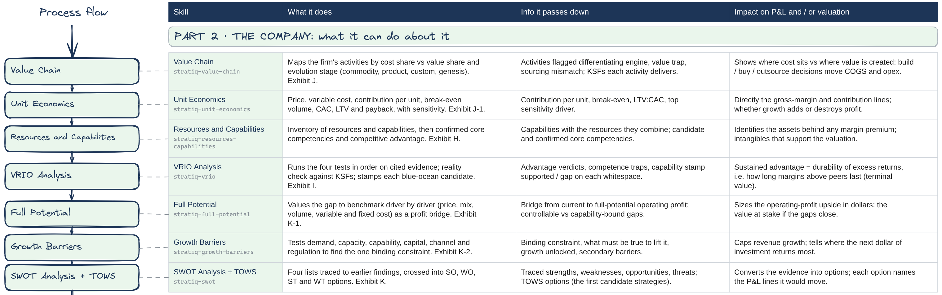
Part 2 reads the company: what it can actually do
Part 2 · 7 steps
Unit Economics: does one more unit make money, and what does a customer cost?
VRIO stamps each empty space 'supported' or 'gap'
Growth Barriers names the one binding constraint
Notes:
Part 2 turns from the industry to your company. The Value Chain shows where cost sits and where value is created. Unit Economics asks the simplest and most important question: does one more unit make money? It gives contribution per unit, break-even volume, and what it costs to win a customer.
Resources and Capabilities lists what the company owns and does well. VRIO tests whether those advantages are valuable, rare, hard to copy and organised. It also stamps each empty space from Part 1 as supported or a gap, so you don't chase a market you can't serve.
Full Potential sizes the profit gap to the best peers, driver by driver. Growth Barriers finds the one binding constraint that caps growth right now. SWOT and TOWS pull it all together and turn it into the first candidate strategies.

Slide 8
Can we actually serve that white space?
Live demo 3
Type this
Which of the white spaces on our strategic map can BYD actually serve?
Screen recording: demo 3
Insert → Video → This Device, then size it to this box
What to watch
1
Two empty spaces from the strategic map, each stamped by VRIO
2
Sub-€25k EU compact: supported, because battery integration passes all four tests
Clip: about 1.5 minutes · Demo files: same Project (base company BYD)
3
Premium software subscription: a gap, because BYD's software isn't rare
Notes:
One of the most common mistakes in strategy is falling in love with an empty space on a map. So let me ask Strat-IQ directly: which of the white spaces on our strategic map can BYD actually serve?
There are two. The first is a European compact car under twenty-five thousand euros with good software. VRIO stamps that one supported. BYD's vertical battery integration passes all four tests, valuable, rare, hard to copy and organised, and it's what makes that price point possible.
The second is a premium software subscription layer. That one is stamped a gap. BYD's in-car software fails the rarity test, and Tesla and Xiaomi lead on that KSF.
An empty space isn't an opportunity until you can show you have what it takes to win there. That's the hand-off from Part 2 to Part 3.

Slide 9
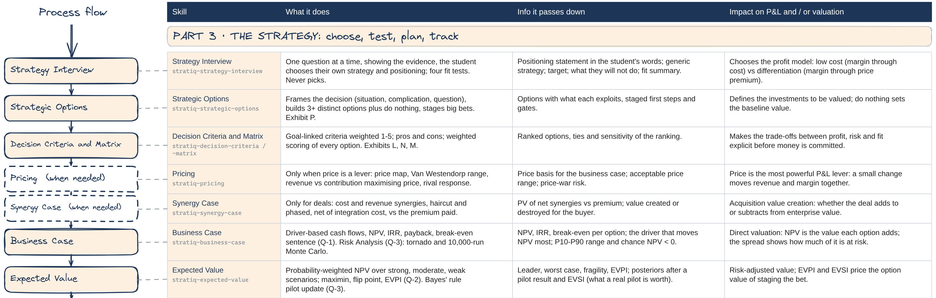
Choose: you pick the strategy, the numbers test it
Part 3 · Choose
The Strategy Interview asks, one question at a time; it never picks for you
'Do nothing' is always an option: every alternative must beat it
NPV, IRR, expected value, and what a pilot is worth
Notes:
Part 3 starts with Choose, and it starts with you. The Strategy Interview is new. It asks one question at a time and shows you the evidence behind each one: the maps, the trends, your KSF scores, your VRIO results. Where is the opportunity? Can you win there? Which strategy fits? Then you write the strategy in your own words. It never picks for you.
Strategic Options turns your choice into real alternatives, always including do nothing. The decision matrix ranks them against your criteria. The Business Case puts money on each one: NPV, IRR, payback and the break-even sentence. Pricing and Synergy Case run only when price or a deal is involved.
Expected Value adds uncertainty: strong, moderate and weak scenarios, the worst case, the point where the ranking flips, and what it's worth to learn more before you commit. In a moment I'll show you the new statistics that go one step further.

Slide 10
The Strategy Interview: you choose
Live demo 4
Type this
Run the Strategy Interview for BYD.
Screen recording: demo 4
Insert → Video → This Device, then size it to this box
What to watch
1
One question at a time, each shown with its evidence: map, KSFs, VRIO
2
Short answers are fine; it checks each one for fit and asks a follow-up
Clip: about 3-4 minutes · Demo files: same Project
3
It ends with a strategy statement in your words, saved to the ledger
Notes:
Now the new Strategy Interview. I'll type: Run the Strategy Interview for BYD.
Notice the pace. One question at a time, and each one comes with the evidence behind it. Where is the opportunity? It shows me the map. I answer: the sub-25k compact segment in Europe.
Can BYD win there? It shows the KSF scores and the VRIO results. I answer: yes on cost, because of the batteries, but not yet on brand trust. It pushes back on that, which is exactly what it should do.
Which generic strategy? I say best-cost provider: good-enough software at a lower price. And what will BYD not do? Chase premium software subscriptions.
At the end, it writes the strategy statement in my words and saves it to the ledger. If I ask it to pick for me, it hands the question back. The choice is yours.

Slide 11
How sure are you? Statistics that test the choice
Part 3 · Exhibit Q-3
87%
of simulated futures lose money
−$366M
median NPV vs −$35M at plan
$53M
what the pilot is worth (EVSI)
Tornado: which assumption to test first
Monte Carlo: how often the case loses money
Bayes' rule: what a real, imperfect pilot is worth
Notes:
Version 3 adds a set of statistical tools, because a single NPV hides how uncertain it is. They go in a new optional memo exhibit, Q-3, Risk Analysis.
On the left is a tornado chart for the EU plant option. You set a low, likely and high value for each driver. The chart moves one driver at a time and sorts them by how far NPV swings. Units sit on top, so that's the assumption to test first, and the one the Stress Test will attack.
On the right is a Monte Carlo simulation: ten thousand futures, with every driver drawn from your ranges at once. At plan, this option is close to break-even. But because these ranges have more downside than upside, the median outcome is far below plan, and most futures lose money.
Finally, Bayes' rule. Expected value already told us what perfect information is worth. Real pilots aren't perfect, so Strat-IQ now prices the pilot you could actually run: how it would update your probabilities, whether either result would change your choice, and what that's worth against its cost.

Slide 12
Put numbers on the bet, then price the pilot
Live demo 5
Type this
Run the business case for Option A from the ledger, then the risk analysis using the ranges in the ledger.
Screen recording: demo 5
Insert → Video → This Device, then size it to this box
Now run expected value for all three options, and tell me whether the 12-month EU import test is worth its $25M cost.
What to watch
1
NPV −$34.5M at plan; break-even needs revenue 0.5% above plan
Clip: about 3-4 minutes · Demo files: same Project
2
Units top the tornado; NPV is below zero in 87% of 10,000 runs
3
Partnering leads on expected value ($86M); the pilot is worth $53M, more than its cost
Notes:
Let's run those tools on the demo. First the business case and the risk analysis for Option A, the EU plant.
At plan, the NPV is minus 34.5 million and the IRR is just under the ten percent hurdle. The break-even sentence says it plainly: the case holds only if revenue beats plan by half a percent.
The tornado puts units on top. And the simulation shows why the plan is optimistic: with these ranges the median NPV is around minus 366 million, and NPV is negative in 87 percent of the runs.
Now expected value across all three options. Partnering leads at 86 million, the plant at 60 and a half. Do nothing is the maximin choice, because it never loses.
And the pilot: a positive result would switch the choice to the plant, a negative one keeps the partnership. That's why the pilot is worth about 53 million, more than its 25 million cost. The numbers don't decide; they show you exactly what you're betting on.

Slide 13
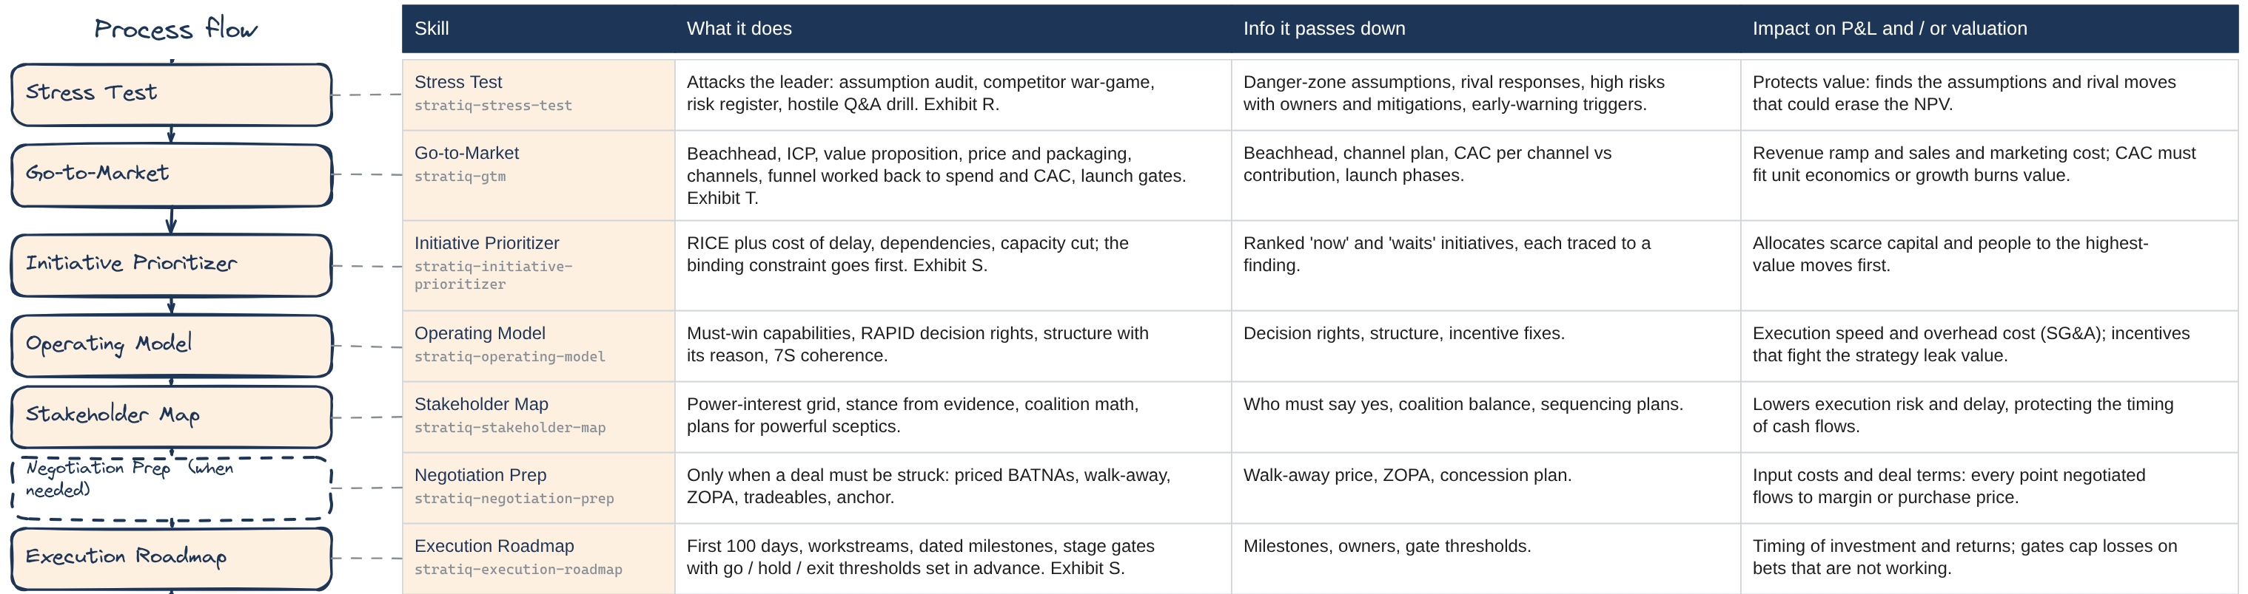
Test before anyone plans; plan only what traces back
Test · Plan
Test: risk analysis for the numbers, the Stress Test for the arguments
Go-to-Market: one named beachhead; CAC must fit unit economics
Every initiative, milestone and gate traces to a finding
Notes:
Next comes Test, now in two steps. The Risk Analysis you just saw tests the numbers. Then the Stress Test attacks the argument for your leading option before anyone starts planning. It audits the assumptions the case rests on, war-games how each rival will respond, builds a risk register where every big risk has an owner, and runs a hostile question drill.
Then Plan. Go-to-Market picks one named beachhead customer and works backwards from the business case to the cost of winning each customer, which has to fit your unit economics. The Initiative Prioritizer ranks what to do first, and the binding constraint goes to the top. The Operating Model and Stakeholder Map cover who decides and who has to say yes. Negotiation Prep runs only when a deal must be struck. The Execution Roadmap sets the first hundred days and the stage gates.
The discipline: nothing new appears in the plan. Everything traces back.

Slide 14
Practise the defence before anyone attacks it
Live demo 6
Type this
Run the hostile Q&A drill on my recommendation: Option B, partner with a European OEM. Ask as the professor.
Screen recording: demo 6
Insert → Video → This Device, then size it to this box
What to watch
1
One hard question at a time, in the professor's voice
2
A weak answer gets named, with the exhibit it should have cited
Clip: about 2-3 minutes · Demo files: same Project
3
Type 'score me' for the scorecard and your weakest answer
Notes:
Here's the Stress Test's hostile Q and A drill. I'll ask it to question my recommendation, Option B, partnering with a European carmaker, in the voice of the professor.
It asks one question at a time. I'll answer the first one properly, citing the expected value exhibit. For the second, I'll give a weak answer on purpose: because it's less risky.
Watch the feedback. It doesn't answer for me. It tells me the answer was a claim without evidence, and which exhibit I should have used: the risk analysis, or the maximin row of the expected value table.
When I type score me, I get a scorecard and my weakest answer. Do this before your memo is due, and before any presentation. It's far better to meet these questions here than in the room.

Slide 15
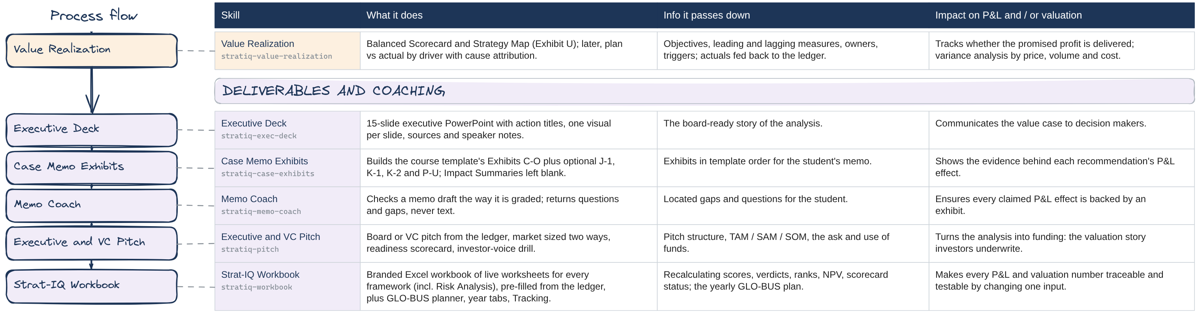
Track it, then hand it in or pitch it
Track · Deliver
Balanced Scorecard and Strategy Map: four perspectives, leading and lagging
Memo Coach returns questions, never text
The Workbook makes every number traceable in Excel
Notes:
Track closes the loop. Value Realization now builds a Balanced Scorecard and a Strategy Map. You set objectives in four perspectives: financial, customer, internal process, and learning and growth. The map links them cause to effect, and the scorecard sets leading and lagging measures with owners and triggers. Later, it compares actual results with the plan, driver by driver.
Then the deliverables. The Executive Deck tells the story. Case Memo Exhibits builds your exhibits in template order and leaves every Impact Summary for you; the updated memo template lists the new optional exhibits, including Q-3, Risk Analysis. The Memo Coach checks your draft and returns questions, never rewritten text. The Pitch builds a board or investor version.
And the Strat-IQ Workbook puts the whole analysis into live Excel worksheets, so you can change an input and watch the scores, ranks and NPV update.

Slide 16
The Memo Coach: questions, not rewrites
Live demo 7
Type this
Coach my memo.
What to watch
Screen recording: demo 7
Insert → Video → This Device, then size it to this box
1
Planted problems found and located: answer buried, 'we believe', predictions as fact
2
The memo's NPV (+$120M) contradicts Exhibit Q-1 (−$34.5M); it recommends A while M and Q-2 favour B
3
Ask it to rewrite a paragraph: it declines and offers the check instead
Clip: about 2-3 minutes · Demo files: memo-draft-weak.docx (attach it)
Notes:
Now the Memo Coach. I've written a deliberately weak memo draft, and I'll attach it and type: Coach my memo.
Look at what it finds, each one located by paragraph. The recommendation is buried in the third paragraph, after a history of the company. There's 'we believe', 'I think' and 'we feel'. There are predictions stated as fact, with no source.
Then the serious ones. The memo says the NPV is plus 120 million, but Exhibit Q-1 says minus 34.5. And it recommends the plant, while the decision matrix and the expected value both favour the partnership, with no explanation.
Every finding comes back as a question for me to answer. And when I ask it to rewrite my recommendation, it declines. Your memo is graded as your work, and the coach is built to keep it that way. The updated memo template, with the new optional exhibits, is posted with this video.

Slide 17
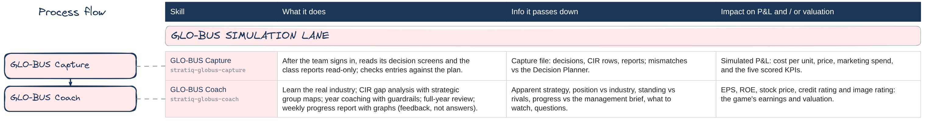
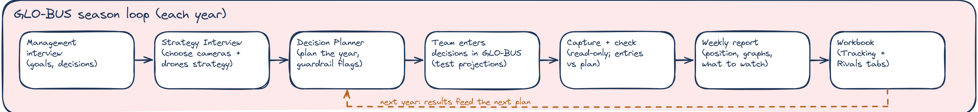
GLO-BUS: a season loop that starts with management
GLO-BUS
Start with the management interview; capture is read-only, after you sign in
You enter every decision; the check catches typos
Every week: a memo and a short deck on your position, progress and rivals
Notes:
Many of you have told me GLO-BUS is hard to read, so this lane is built for it. Two skills do the work. GLO-BUS Capture runs in your own Chrome after you sign in yourself. It reads your decision screens and the class reports, read-only. It never sees your password and never changes a decision. GLO-BUS Coach learns the real camera and drone industries with you, analyses the competitor report, coaches your yearly decisions, and reviews a captured year.
Underneath is the season loop. It starts with the management interview: what management wants decides what success means. Choose your strategy with the Strategy Interview. Plan the year in the Decision Planner, which flags big swings and any year you cut price and advertising together. Enter the decisions in GLO-BUS yourself and test them. Then capture and check your entries against the plan. Then the weekly review: a short memo and a deck, like an executive briefing, that show the position your inputs reveal, your progress in graphs, where you stand against the other companies from the class reports, how you're doing against management's goals, and what to watch next round. Feedback, not answers. The workbook keeps every year on one tab.

Slide 18
GLO-BUS: read the field, then catch the typo
Live demo 8
Type this
Analyse this competitor report for company C: strategic groups and white space for cameras and drones.
Screen recording: demo 8
Insert → Video → This Device, then size it to this box
Check our Year 8 entries against the plan.
What to watch
1
Company C leads cameras as a value leader, but sits with the low-cost group in Latin America
Clip: about 2-3 minutes · Demo files: globus/cir-Y7.csv, then the demo workbook and the Year 8 capture
2
In drones C is a premium differentiator everywhere; low-cost rivals lead two regions
3
The plan check: North America camera price planned $239, entered $293
Notes:
Two GLO-BUS demos in one clip. First I attach a Year 7 competitor report and ask for the strategic groups and white space.
The groups chart shows company C as the camera value leader in three regions, but in Latin America its prices put it in the low-cost group. That's a drift from the best-cost strategy the team chose, and exactly the kind of thing the coach raises as a question, not an instruction.
Second, the plan check. I attach the workbook with our Year 8 plan and the screens we captured after entering our decisions, and ask: check our Year 8 entries against the plan.
Six decisions match. One doesn't: the North America camera price was planned at 239 and entered as 293. Two digits swapped. Strat-IQ never touches the game; we fix it ourselves. That one-minute check could save a whole year.

Slide 19
Following the money: where each step reaches P&L and value
Revenue
price · volume · mix
Industry Overview · Strategic Mapping · Pricing · Go-to-Market
Cost of goods
inputs · labour
Five Forces (suppliers) · Value Chain · Unit Economics · Negotiation Prep
Operating expenses
SG&A · R&D
Full Potential · Operating Model · Go-to-Market (CAC)
Investment
capex · working capital
Business Case · Initiative Prioritizer · Execution Roadmap gates
Risk
cost of capital
Risk Analysis · Expected Value · Stress Test · Stakeholder Map
Durability
terminal value
KSFs · VRIO · Value Realization
Notes:
Here's why the right-hand column of the diagram matters. Every Strat-IQ step should end up in one of these six places.
Revenue: the market size, the empty space you target, your price and your go-to-market plan. Cost of goods: supplier power, your value chain, your unit economics and the deals you negotiate. Operating expenses: the gap to the best peers, your operating model, and what it costs to win a customer. Investment: the business case, which initiatives get funded first, and the gates that stop bad bets.
Then the two that drive valuation beyond this year's P&L. Risk: the risk analysis, expected value and the stress test change what the cash flows are worth. Durability: KSFs and VRIO tell you how long an advantage lasts, and that's most of a company's terminal value.
When you write your memo, use this as a test. If an exhibit doesn't reach one of these six, ask why it's there.

Slide 20
The Strat-IQ Workbook: the analysis in live Excel
Part 1 · Industry
Management Interviews · Industry Overview · Competitive Analysis · PESTEL · Five Forces · Trending Factors · KSFs · Strategic Mapping
Part 2 · Company
Value Chain · Unit Economics · Resources & Capabilities · VRIO · Full Potential · Growth Barriers · SWOT-TOWS
Part 3 · Strategy
Positioning · Options · Decision Matrix · Business Case · Expected Value · Risk · Pricing · Stress Test · Go-to-Market · Initiatives · Operating Model · Roadmap · Scorecard · Strategy Map
GLO-BUS
CIR · Planner · Season by Year · Competition by Year · KPI Charts · Findings & Questions
Every grey cell is a formula: change an input and the scores, ranks, NPV and charts update.
Notes:
The Strat-IQ Workbook is the same analysis in Excel, with one sheet for every step of the process, in the same order as the map. It's built from your saved ledger, so most sheets arrive filled in.
After the Management Interviews sheet, Part 1 runs from the Industry Overview, with a growth calculator and concentration measures, through Competitive Analysis, PESTEL, Five Forces, the trending factors with their four tests, the KSF scorecard and a strategic map you can re-plot. Part 2 covers the value chain, unit economics with lifetime value and payback, resources and capabilities, VRIO, full potential, growth barriers and SWOT. Part 3 runs from your positioning and options through the business case, expected value and risk analysis to the stress test, go-to-market, initiatives, operating model, roadmap and scorecard.
And GLO-BUS. The Management Interviews sheet comes right after the start page. Then the competitor report with strategic groups and the Decision Planner. At the end, Season by Year puts every decision and result for every year on one tab, each year followed by its change, with the labels frozen so you can scroll right. Competition by Year compares every company on the measures that decide the contest. KPI Charts graphs how you're doing, like this EPS chart, and Findings and Questions keeps the watch items and questions from each weekly review, with your team's response.
Everything grey is a formula. Change one input and watch what moves. That's the fastest way to understand which assumptions really matter.

Slide 21
The workbook: change one input, watch it move
Live demo 9
Type this
Build our Strat-IQ workbook from the ledger with our Year 6 and Year 7 GLO-BUS captures.
Screen recording: demo 9
Insert → Video → This Device, then size it to this box
What to watch
1
Risk Analysis: change Units low from −20% to −10%; the bar shrinks and the chance of a loss falls
2
Expected Value: raise the pilot cost from 25 to 60; its net value turns negative
Clip: about 2-3 minutes · Demo files: StratIQ_Workbook_demo.xlsx (prebuilt)
3
Tracking: EPS rose to $2.10 but stayed under the investor expectation
Notes:
Last demo: the workbook. I asked Strat-IQ to build it from the ledger with two years of GLO-BUS captures, and here it is in Excel.
On the Risk Analysis sheet, the tornado and the simulation are live formulas. I'll change the low case for units from minus twenty percent to minus ten. The units bar shrinks, and the chance of losing money drops. Press F9 and the simulation draws again; the numbers move a little, which is what a simulation does.
On the Expected Value sheet, I'll raise the pilot's cost from 25 to 60 million. Its net value turns negative: at that price, the test isn't worth running.
And on the Tracking tab: EPS rose from 1.85 to 2.10, but it stayed just under what investors expected both years. That's the conversation for the next decision round.

Slide 22
Four rules that keep the work yours
1
You choose the strategy
The interview asks and tests; it never picks. Options Claude adds are marked SUGGESTED.
2
You enter every decision
In GLO-BUS, Strat-IQ plans, checks and reviews. It never enters or submits anything.
3
Your memo stays yours
Exhibits leave every Impact Summary blank; the Memo Coach returns questions, not text.
4
Evidence or it doesn't count
Every claim carries a source; missing facts are marked, never invented.
Notes:
Before you start, four rules. They're built into every skill, and they're how I'll read your work.
One: you choose the strategy. The Strategy Interview asks questions and tests your reasoning, but it never picks. If Claude adds an option, it's marked suggested.
Two: you enter every GLO-BUS decision. Strat-IQ helps you plan, checks your entries against your plan, and reviews your results. It never enters or submits anything.
Three: your memo stays yours. The exhibits leave every Impact Summary blank, and the Memo Coach gives you questions, not text.
Four: evidence or it doesn't count. Every claim carries a source, and a missing fact is marked as missing, never invented. That's what makes the analysis worth defending.

Slide 23
Install the Strat-IQ Toolkit in about fifteen minutes
Release v3.1.0
1
Delete the old skills StratOS is now the Strat-IQ Toolkit. Delete every skill whose name starts with stratos-.
2
Download GitHub → Releases → latest → stratiq-toolkit-skills.zip. Unzip once: 40 skill zips inside. Don't unzip those.
3
Upload all 40 Settings → Capabilities → Skills → Upload skill, once per zip. You should see 40 Strat-IQ skills on.
4
Update the Project Replace industries.json with version 2 (cameras and drones) and keep your latest ledger there.
5
Start Open a new chat in the Project and type: Run Strat-IQ. Teams start with the management interview.
Notes:
Installing takes about fifteen minutes. One thing has changed: StratOS is now the Strat-IQ Toolkit, and every skill has a new name.
One: in Settings, Capabilities, Skills, delete every skill whose name starts with stratos, the old names. Your saved ledger and your Project files keep working.
Two: on the GitHub page, open Releases, choose the latest, and download stratiq-toolkit-skills.zip. Unzip it once. Inside are forty smaller zips, one for each skill in Parts 1 to 3. Leave those zipped.
Three: upload all forty. You should see forty Strat-IQ skills switched on. Four: in your Project, replace industries.json with version 2, which adds cameras and drones, and keep your latest ledger there.
Five: open a new chat in the Project and type: Run Strat-IQ. If your team hasn't done the management interview debrief yet, that's where it starts.

Slide 24
Open the process map yourself
Download
StratIQ_Process_Flow.excalidraw (detail) and StratIQ_Process_Overview.excalidraw (one page), posted with this video.
Open
Go to excalidraw.com, then Menu → Open, or drag the file onto the page. Free, no account needed.
Explore
Scroll to zoom, drag the canvas to move. Find a skill's row to see what it does and passes down.
A PNG of each diagram is posted too, if you'd rather not open the file.
Keep a copy
Menu → Export image saves a PNG. Your edits stay on your computer.
Notes:
Alongside this video I'm posting two Excalidraw files and instructions. StratIQ_Process_Overview is the one-page map we started with. StratIQ_Process_Flow is the detailed one, with the table for every skill.
To open one, go to excalidraw.com in your browser, open the menu and choose Open, or simply drag the file onto the page. It's free and you don't need an account.
Scroll to zoom in and drag the canvas to move around. Find the skill you're working on and read across its row: what it does, what it passes down, and how it reaches the P&L or valuation.
If you want to keep a picture, use Export image from the menu. Anything you change stays on your own computer. And if you'd rather not open the file at all, PNG images of both diagrams are posted too.

Slide 25
Try these this week
Run Strat-IQ and make the strategy work.
Part 3, mode D
Run a risk analysis on my business case.
Exhibit Q-3
Run the Strategy Interview for our GLO-BUS company.
Choose your strategy
Build our Strat-IQ workbook with the GLO-BUS planner.
Plan the year
Check our GLO-BUS entries against the plan.
Catch typos
Rebuild our workbook with all our GLO-BUS captures.
Results and trends
Notes:
Here are six prompts to try this week, roughly in the order you'll need them.
Run Strat-IQ and make the strategy work: that's Part 3 from your saved ledger. Once you have a business case, run a risk analysis on it. Run the Strategy Interview for our GLO-BUS company: take the time to answer the questions as a team, because the strategy you write becomes the anchor for every year that follows.
Build our Strat-IQ workbook with the GLO-BUS planner: plan the year before you enter anything. After you enter your decisions: check our GLO-BUS entries against the plan. It takes a minute and it catches the typo that would cost you a year.
And after each round: rebuild our workbook with all our GLO-BUS captures, to add the new year's results tab and update the trend charts.

Slide 26
Strategy is one argument, built from evidence, that ends in a decision.
Industry → Company → Strategy → Results, then back again as evidence.
Thursday Zoom Sync: bring your strategy statement, your GLO-BUS plan and your toughest question (link on Canvas).
Notes:
That's the complete Strat-IQ process. Part 1 tells you what the industry rewards. Part 2 tells you what your company can do about it. Part 3 helps you choose, test, plan and track the strategy. And the results come back in as evidence for the next run, or the next year of GLO-BUS.
Keep the process map open while you work. When you're unsure what a step is for, find its row and read the last column: how does this reach the P&L or the value of the company?
Bring your strategy statement, your GLO-BUS plan for next year, and your toughest question to the Thursday Zoom Sync. The link is on Canvas. See you there.

