Slide 1
STRATOS GLO-BUS WEEKLY REVIEW
Company C after Year 7: rank 2 of 8 — is the position paying off?
Company C · Year 7 results · Cameras and drones, four regions
Feedback, not recommendations: every decision is the team's
Source: GLO-BUS captures, Years 6–7 (company reports, class scoreboard, Competitive Intelligence Report); StratOS weekly_report.py
Notes:
Purpose: a ten-minute read of how Company C did in Year 7, the position its inputs show, where it stands against the other companies, and what to watch before the Year 8 decisions.
Everything comes from the team's own captured screens and the class-wide reports every team can see. Nothing here tells the team what to enter; it names the pattern and asks the questions.
Likely question: why no recommended numbers? Answer: the course rule is that the team decides; the review is feedback on the strategy the inputs reveal.

Slide 2
Rank 2 of 8 with a best-cost provider position in both products; drones have drifted from the strategy you chose
Scorecard
1 of 5 scored measures met investor expectations in Year 7; EPS fell short ($2.10 vs $2.15)
1
Position
Cameras read as best-cost provider (as chosen); drones have drifted toward best-cost provider
2
Contest
Rank 2 of 8, 2 points behind Company D; Company F moved most in drones
3
Watch first
Drones: the position your inputs show differs from the strategy you chose
4
Source: GLO-BUS captures, Years 6–7 (company reports, class scoreboard, Competitive Intelligence Report); StratOS weekly_report.py
Notes:
This is the one-slide summary. Read the four points top to bottom: how you scored, what position your inputs show, where you stand, and the one thing to watch most.
Likely question: which point matters most this round? Answer: the position. If the inputs have drifted from the strategy you chose, this is the round to decide whether that drift is deliberate.

Slide 3
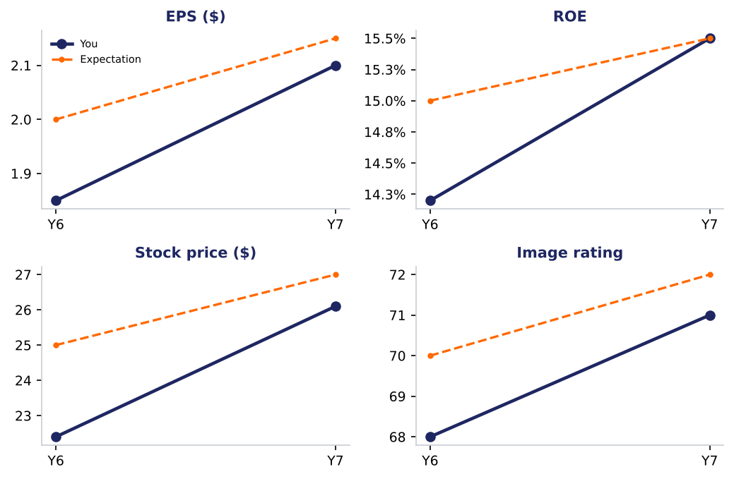
1 of 5 scored measures met investor expectations in Year 7; EPS fell short ($2.10 vs $2.15)
Scored measure | You | Expectation
EPS | $2.10 | $2.15 | Below
ROE | 15.5% | 15.5% | Met
Stock price | $26.10 | $27.00 | Below
Credit rating | BB- | BB | Below
Image rating | 71 | 72 | Below
Source: GLO-BUS captures, Years 6–7 (company reports, class scoreboard, Competitive Intelligence Report); StratOS weekly_report.py
Notes:
The five scored measures against investor expectations, this year and the trend since the first round.
Rank 2 of 8, overall score 84 (rank 3 last year). Leader: Company D at 86.
Likely question: why did a measure miss when we improved? Answer: expectations rise each year; improvement that does not keep pace still shows as a miss.

Slide 4
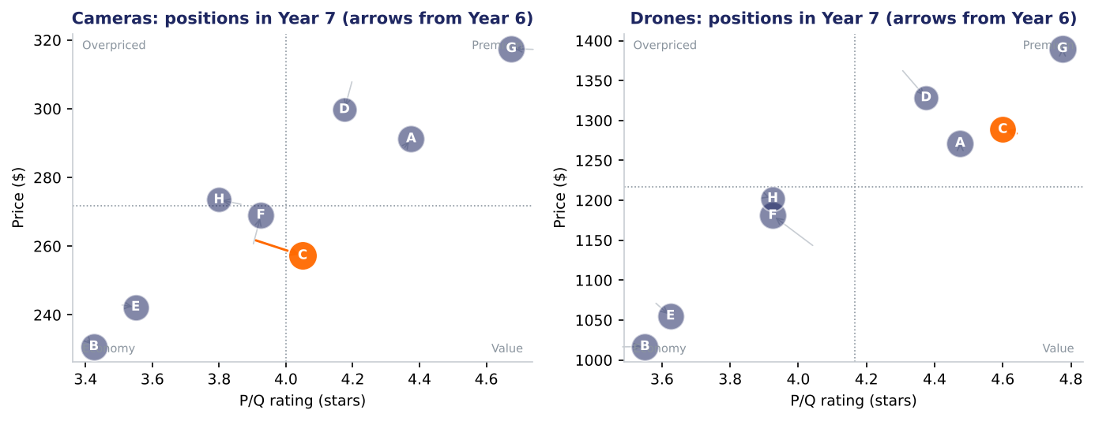
Cameras read as best-cost provider (as chosen); drones have drifted toward best-cost provider
Source: GLO-BUS captures, Years 6–7 (company reports, class scoreboard, Competitive Intelligence Report); StratOS weekly_report.py
Notes:
Cameras: your inputs look like a **best-cost provider** position (mixed). Price -4.4% vs the industry, P/Q +0.1 stars, cost per unit -4.3%. On the competitor report you sit in the value leader group. That matches the strategy you chose. Best-cost providers offer above-average quality at an average or slightly lower price, so costs must stay tightly controlled to fund both.
Drones: your inputs look like a **best-cost provider** position (mixed). Price +3.5% vs the industry, P/Q +0.2 stars, cost per unit +0.6%. On the competitor report you sit in the premium differentiator group. You chose differentiation. Best-cost providers offer above-average quality at an average or slightly lower price, so costs must stay tightly controlled to fund both.
Likely question: is the label fixed? Answer: no. It reads the pattern of price, P/Q and cost against the industry this year; it moves when the inputs move.

Slide 5
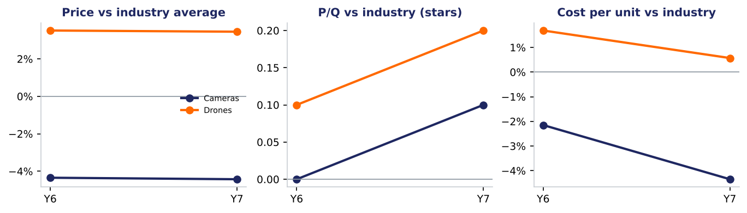
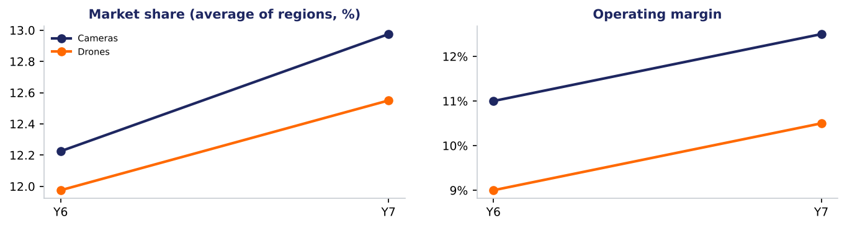
Cost per unit vs the industry: cameras -4.3%, drones +0.6% — the number that decides whether the position pays
Source: GLO-BUS captures, Years 6–7 (company reports, class scoreboard, Competitive Intelligence Report); StratOS weekly_report.py
Notes:
Three lines per product against the industry average: price premium, P/Q lead and cost per unit gap. A strategy pays when the gaps line up with it: a low-cost provider needs a negative cost gap, a differentiator needs a price premium that covers its cost gap.
Likely question: which line matters most? Answer: the cost gap, because it decides whether the price you charge earns a margin.

Slide 6
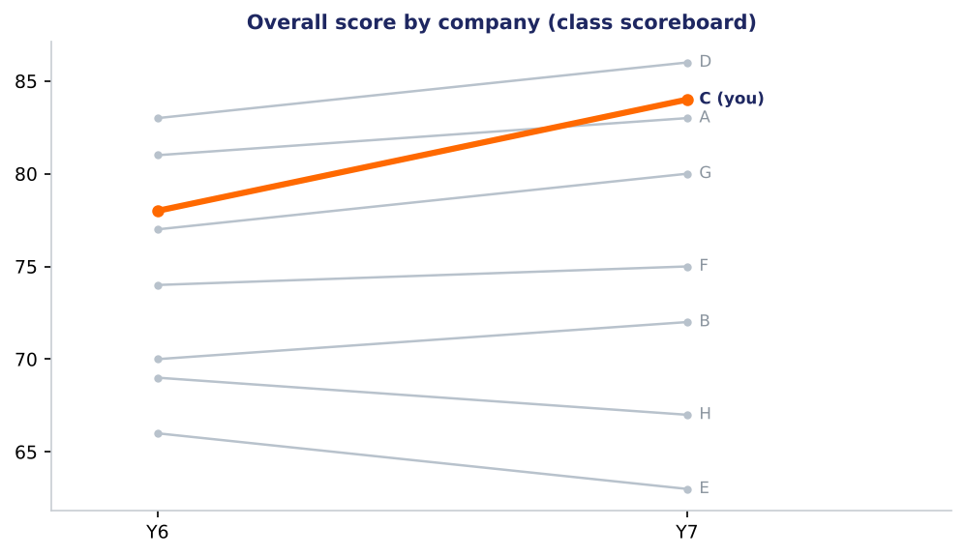
Rank 2 of 8, 2 points behind Company D; Company F moved most in drones
What rivals changed
Company F (drones): price +3.5%, P/Q -0.1 stars, share +0.3 points; now in the low-cost / economy group.
Company D (drones): price -2.7%, P/Q +0.1 stars, share +1.3 points; now in the premium differentiator group.
Company F (cameras): price +3.6%, P/Q +0.0 stars, share +0.4 points; now in the low-cost / economy group.
Company D (cameras): price -2.9%, P/Q -0.0 stars, share +0.3 points; now in the premium differentiator group.
Source: GLO-BUS captures, Years 6–7 (company reports, class scoreboard, Competitive Intelligence Report); StratOS weekly_report.py
Notes:
Every company's overall score from the class scoreboard, year by year, with your line highlighted, and the biggest moves rivals made on the competitor report.
Likely question: did we use other teams' data? Answer: only what the class-wide reports show every team.

Slide 7
3 of 3 goals from your management interview missed this round
Goal | Measure | This round | Target | Status
B1. Beat investor expectations for EPS | EPS | 2.1 | investor expectation 2.15 | missed
B2. Hold a credit rating of BB or better | Credit rating | BB- | BB | missed
B3. Keep the image rating at or above expectations | Image rating | 71 | investor expectation 72 | missed
Takeaways you hold yourselves to
Protect the credit rating: no growth that needs new debt
Cameras compete on value, drones on quality
Source: GLO-BUS captures, Years 6–7 (company reports, class scoreboard, Competitive Intelligence Report); StratOS weekly_report.py
Notes:
The goals and takeaways from your management interview, checked against this round's results. A miss is information: the question is whether your position can still reach the goal.
Likely question: can we change a goal? Answer: only management can; you can explain why your strategy departs from it.

Slide 8
4 things to watch before the Year 8 decisions
Drones: the position your inputs show differs from the strategy you chose
You chose differentiation; price +3.5% vs the industry and P/Q +0.2 stars put you closer to best-cost provider.
Teams that drift between positions usually pay for both and get credit for neither. Decide whether the drift is deliberate.
Management goal B1 missed: Beat investor expectations for EPS
EPS: 2.1 against investor expectation 2.15. This goal came from your management interview.
EPS reflects price, cost and volume together; look for which of the three moved against you.
Management goal B2 missed: Hold a credit rating of BB or better
Credit rating: BB- against BB. This goal came from your management interview.
Credit rating follows debt, interest coverage and cash; it also sets borrowing costs.
Management goal B3 missed: Keep the image rating at or above expectations
Image rating: 71 against investor expectation 72. This goal came from your management interview.
Image rating builds slowly from P/Q, models, warranty, advertising and CSR.
Source: GLO-BUS captures, Years 6–7 (company reports, class scoreboard, Competitive Intelligence Report); StratOS weekly_report.py
Notes:
Each watch item names the evidence and a general lesson for the position you hold. None of them is an instruction; together they are the agenda for the team's next decision meeting.
Likely question: which one first? Answer: the one that threatens the goal management cares about most.

Slide 9
Questions for the team before Year 8
1
Is the drones position your inputs now show the one you meant to build?
2
Which input did you change most this year, and did the result move the way the projections said?
Source: GLO-BUS captures, Years 6–7 (company reports, class scoreboard, Competitive Intelligence Report); StratOS weekly_report.py
Notes:
Close the review with these questions. Discuss them as a team before you open the decision screens, then use the Decision Planner and the plan check.
Likely question: where do we record the answers? Answer: the workbook's Findings & Questions tab, in the 'Our response' column.

