Slide 1
Forecasting Solar Activity for Solar Cycles 25 & 26 􀂱􀀃an indication for future solar minimum
Forecasting Solar Activity for Solar Cycles 25 & 26 - an indication for future solar minimum
Ashok K. Singh and Asheesh Bhargawa
Department of Physics, University of Lucknow, Lucknow – 226007 (U.P.)
Email: aksphys@gmail.com

Slide 2
OUTLINE
Introduction
Significance of the Solar Cycle
Why we predict solar activity
Predictions for Solar Cycle 25 and 26
Methodology and data analysis
Results and discussion
Conclusions

Slide 3
Significance of the solar cycle

Slide 4
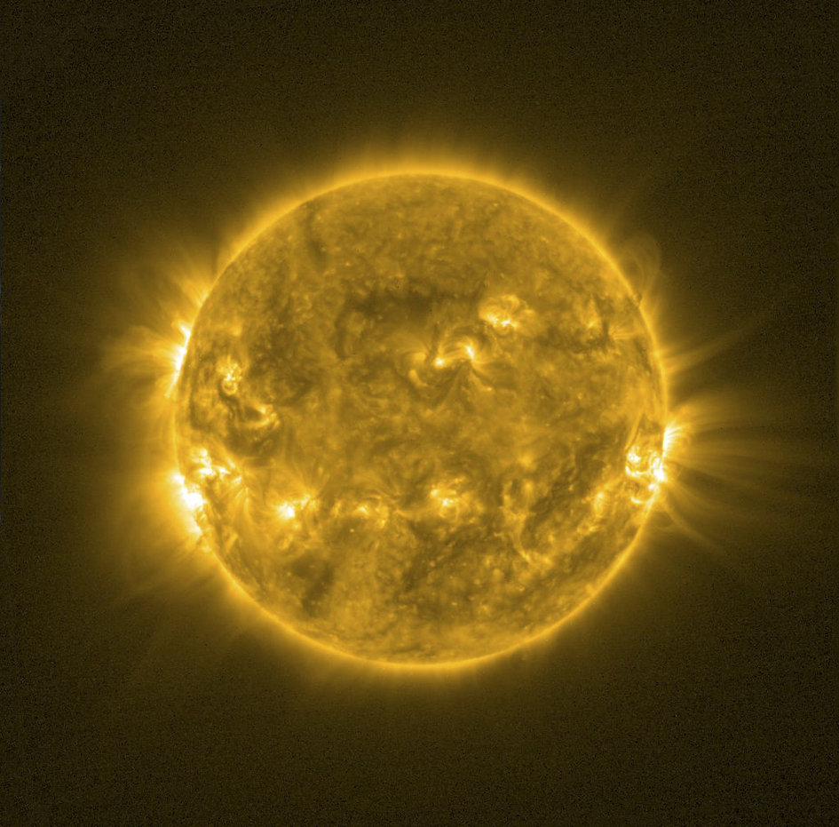
Solar Activity
The sun varies over a period of approximately 11 years. More accurately the lengths of the cycles we have observed have been between 9.0 and 13.6 years. During the course of each cycle the activity of the sun varies and is best observed from the number of sunspots which waxes and wanes through the cycle.
Solar activity (including: flares, prominence eruptions, coronal mass ejections, solar energetic particle events, and high-speed solar wind streams from coronal holes) varies in frequency with the solar cycle.

Slide 5
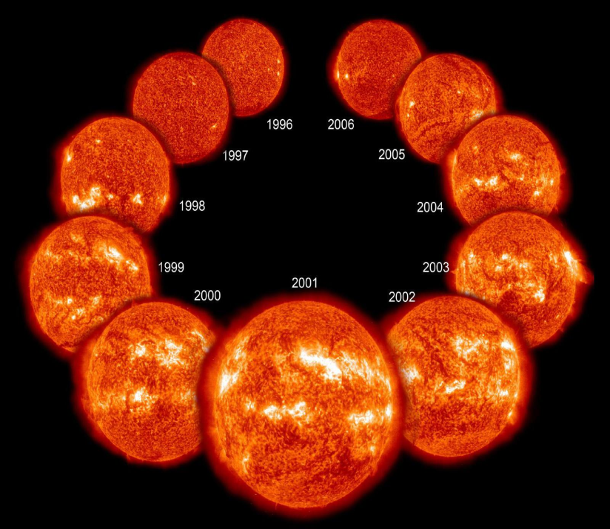
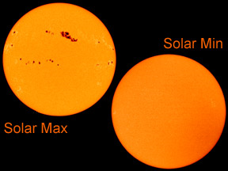
It seems that in terms of the total amount of energy coming from the sun there is only a very small variation due to the changing level of solar activity during a single cycle. Apparently there is a variation from top to bottom of each cycle of only 0.01% of the total. However it may be that the change in length of a cycle creates a bigger difference in average energy delivered during each day, week, month or year of the particular cycle.
Forecasting of solar activities has greater importance for scientific as well as for social concern and various methods have been developed in the past for the same.
Since, the best representation of solar activity is the variation in solar parameters on the time scale therefore we have analyzed and predicted some solar parameters for future solar cycles 25 and 26.

Slide 6
Forecasting the solar cycle 25 and 26

Slide 7
Introduction
Study of variations in solar activity parameters has its importance in understanding the underlying mechanisms of space weather phenomena and space climate variability.
We have used the already observed data of solar parameters viz. sunspot numbers, F10.7 cm index and Lyman alpha index recorded for last seventy years (1947–2017).
In this study we have used three major statistical methods-
1) Rescaled range analysis
2) Hodrick Prescott filtering
3) Simplex projection analysis

Slide 8
The understanding of solar activity and solar related events is important for scientific, social, and economic reasons. Our Sun is the epicenter of all solar activities and associated phenomena and plays a pivotal role in space weather concerns and global climate studies.
In recent past, the space observations have greatly expanded our ability to look into the Sun, the interplanetary space, and the near surroundings of the Earth.
The solar activity variations take place within a period of about 11 years and are the major cause of changes in interplanetary and the near Earth space conditions.
This also makes prediction requirements so important to know about the level of solar activity in advance and ultimately about the solar cycles and terrestrial climate

Slide 9
Some previous works on solar activity predictions
Various tools and methods have been adopted, in the past, for the predictions of solar activities. Statistical methods, spectral analysis and predictions by an extrapolation of the significant periodicities present in solar activity cycles have been already reported (Cohen and Lintz 1974;DeMeyer 1981; Kane and Trivedi 1985).
Quassim et al. (2007) have applied neuro-fuzzy approach for the prediction of sunspot numbers for solar cycles 24 and 25.
Hamid and Galal (2013) have used precursor technique to forecast the maximum amplitude and the time of rise for 25th solar cycle.

Slide 10
data sources
we have used the observed data of the sunspot numbers, the F10.7 cm index and the Lyman alpha index recorded for the period 1947–2017 (mid of solar cycle 18 to present solar cycle 24) as an input to regenerate the data for future solar cycles 25 and 26.
The monthly data of the sunspot numbers was obtained from the website http://www.sidc.be/silso/.
F10.7 cm index data was obtained from the website http://www.wdcb.ru/stp/solar/solar_activity.html
the data of Lyman alpha index was acquired from the website http://lasp.colorado.edu/lisird/data/historical_tsi/

Slide 11
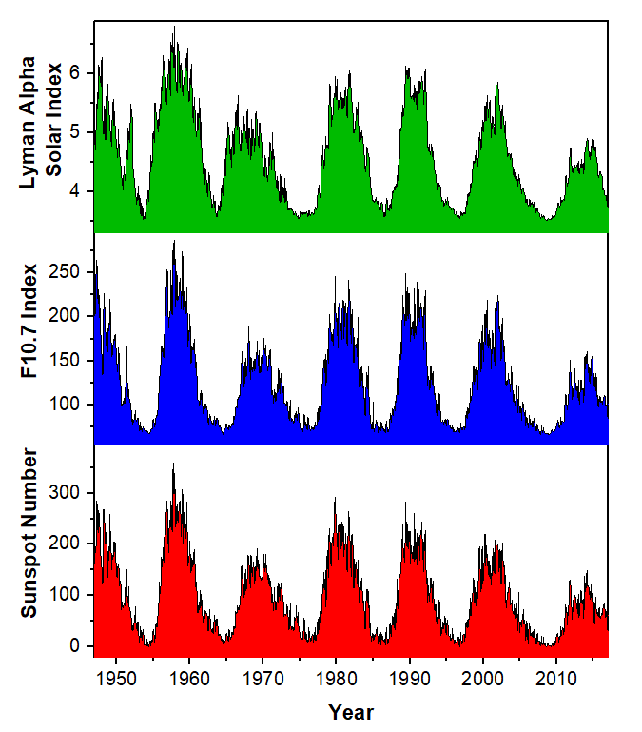
Fig. 1 Monthly variations of sunspot numbers, F10.7 cm index and Lyman alpha index for the period 1947 to 2017

Slide 12
Methodology
The time series data was detrended using the Hodrick and Prescott filter to obtain cyclical residual component (periodic component) and trend component. Actually this filter separates a time series into trend and cyclical components.
Here in the present analysis, we were concerned with the cyclical component for analysis of persistence because it provided better understanding of persistence in the time series and the trend component was used for prediction part. Therefore Rescaled range analysis was used to evaluated the level of persistence for each parameter.
Further the simplex projection method was applied on the trend data to obtain future points of various solar parameters of time series data and prediction was made with greater accuracy.

Slide 13
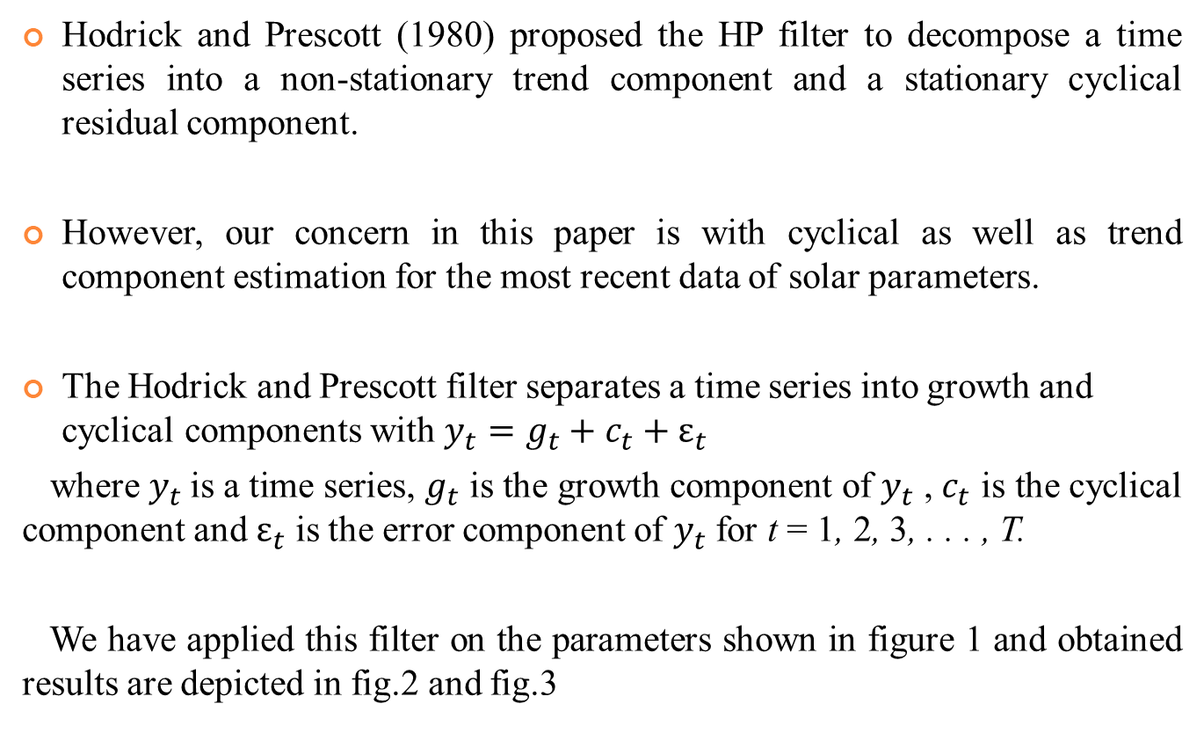
Hodrick and Prescott filter
Hodrick and Prescott (1980) proposed the HP filter to decompose a time series into a non-stationary trend component and a stationary cyclical residual component.
However, our concern in this paper is with cyclical as well as trend component estimation for the most recent data of solar parameters.
The Hodrick and Prescott filter separates a time series into growth and cyclical components with $y_{t}=g_{t}+c_{t}+ε_{t}$
where $y_{t}$is a time series, $g_{t}$is the growth component of $y_{t}$,$c_{t}$is the cyclical component and $ε_{t}$is the error component of $y_{t}$for t = 1, 2, 3, . . . , T.
We have applied this filter on the parameters shown in figure 1 and obtained results are depicted in fig.2 and fig.3

Slide 14
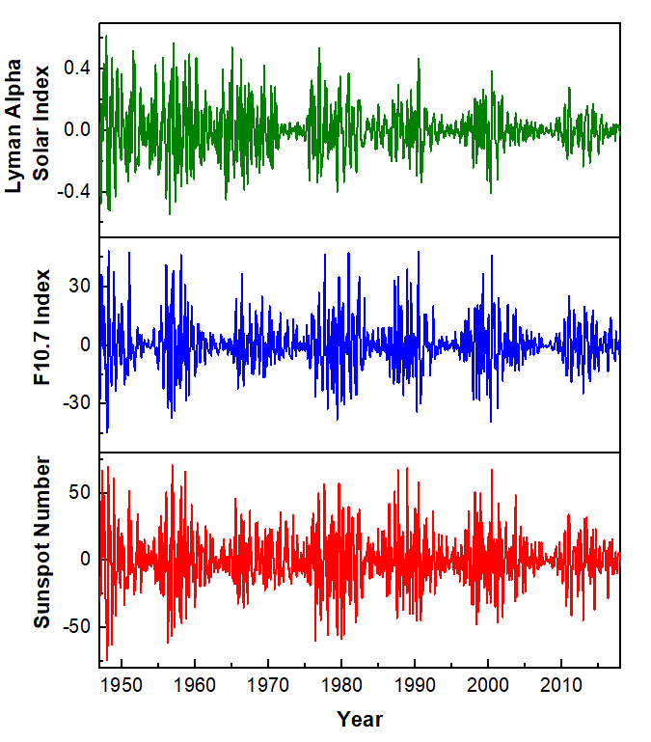
Fig. 2 Detrended variations (cyclic component) of sunspot numbers, F10.7 cm index and Lyman alpha index from 1947 to 2017

Slide 15
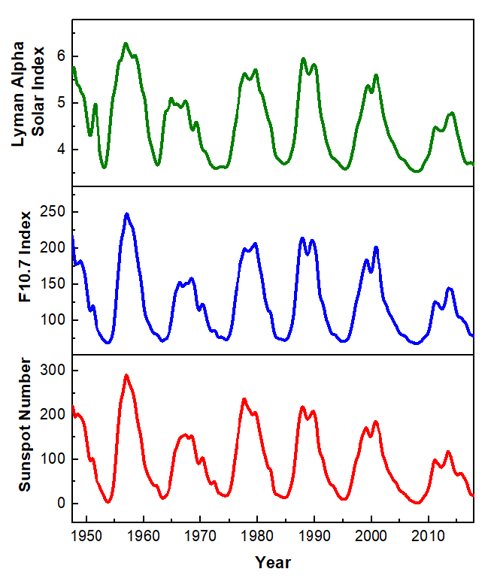
Fig. 3 The trend component of sunspot numbers, F10.7 cm index and Lyman alpha index from 1947 to 2017

Slide 16
the rescaled range analysis
It is a classical methodology for the calculation of the Hurst exponent.
In this paper we have used the rescaled range analysis for the calculation of the Hurst exponent (Singh and Bhargawa 2017).
Based on the previous work of Hurst (1951), classical test for estimation of the Hurst exponent was proposed by Mandelbrot (1972).
It has been widely used by other workers for measure of long term memory and persistence in time series (Oliver and Ballester 1996; Adams et al. 1997).
The Hurst exponent provides a measure for long term memory of a time series. Since it is robust with few assumptions about underlying system, it has broad applicability for time series analysis.
The values of the Hurst exponent range between 0 and 1. The strength of persistence increases as H approaches 1.

Slide 17
Why we calculate Hurst exponent
In the time series forecasting, the first question we want to answer is whether the time series under study is predictable.
If the time series is random, all methods are expected to fail.
We want to identify and study those time series having at least some degree of predictability.
We know that a time series with a larger H value has strong trend, thus it’s natural to believe that such time series are more predictable.

Slide 18
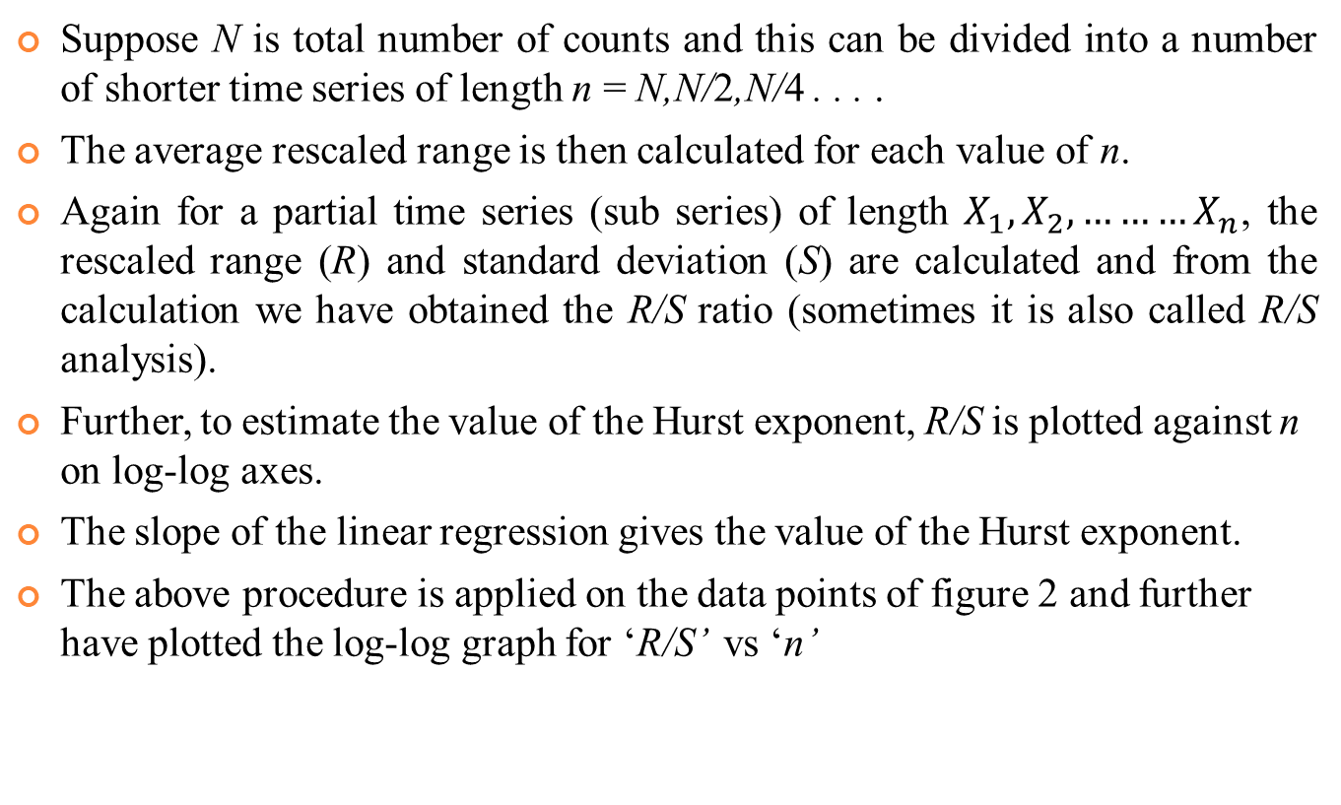
Calculating Hurst exponent
Suppose N is total number of counts and this can be divided into a number of shorter time series of length n = N,N/2,N/4 . . . .
The average rescaled range is then calculated for each value of n.
Again for a partial time series (sub series) of length $X_{1}, X_{2},………X_{n}$, the rescaled range (R) and standard deviation (S) are calculated and from the calculation we have obtained the R/S ratio (sometimes it is also called R/S analysis).
Further, to estimate the value of the Hurst exponent, R/S is plotted against n on log-log axes.
The slope of the linear regression gives the value of the Hurst exponent.
The above procedure is applied on the data points of figure 2 and further have plotted the log-log graph for ‘R/S’ vs‘n’

Slide 19
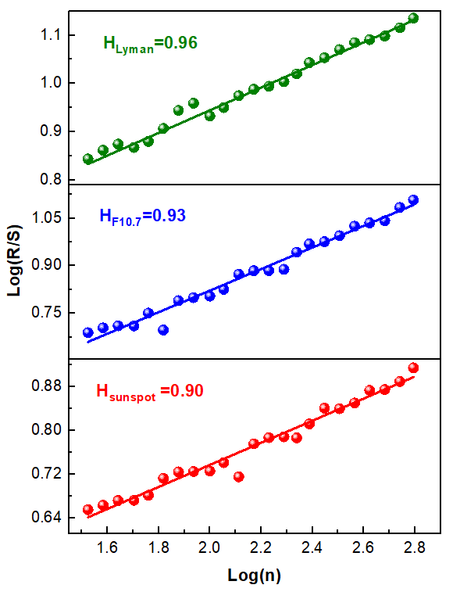
Fig. 4 Obtained values of the Hurst exponent (after detrending) of sunspot numbers, F10.7 cm index and Lyman alpha index

Slide 20
Simplex projection Analysis
Simplex projection, originally proposed by George Sugihara and Bob May in 1990 is a powerful tool for detecting patterns (chaos).
Moreover, it also tells how complicated this pattern is, and then predict the future, often with far greater accuracy than any other technique.
This technique has widely been used in fields as diverse as epidemiology, cardiology, neuroscience, atmospheric science, finance, engineering (Narisma and Teresa 1997; Narisma and Villarin 2000), ecology and fisheries.
Rozelot (1994) used this method to analyse the behaviour of solar activity.
The simplex projection is a nearest-neighbour forecasting algorithm that involves tracking the forward evolution of nearby points.
This algorithm compares a library of (known) past patterns to patterns seen later in the real time series. Thus, similar past events are used to forecast the future.

Slide 21
Now we apply this approach on the trend part of the time series shown in fig.3
Using the sunspots, the F10.7 cm index and the Lyman alpha index data available for the period 1976–2017, we have obtained the data points for the prediction of next solar cycles 25 and 26 by adopting the simplex projection analysis.

Slide 22
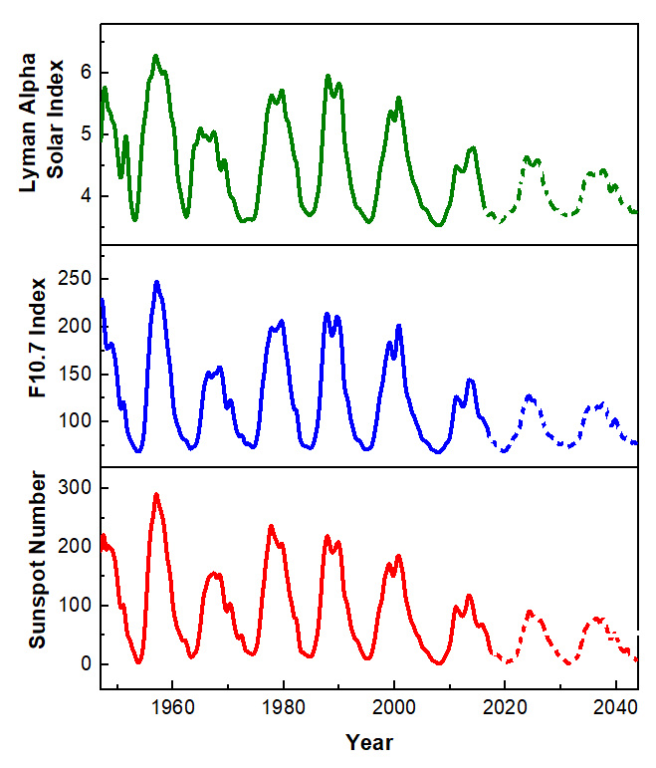
Fig. 5 Monthly variations of the observed and predicted (dotted) values of the sunspot numbers, F10.7 cm index and Lyman alpha index

Slide 23
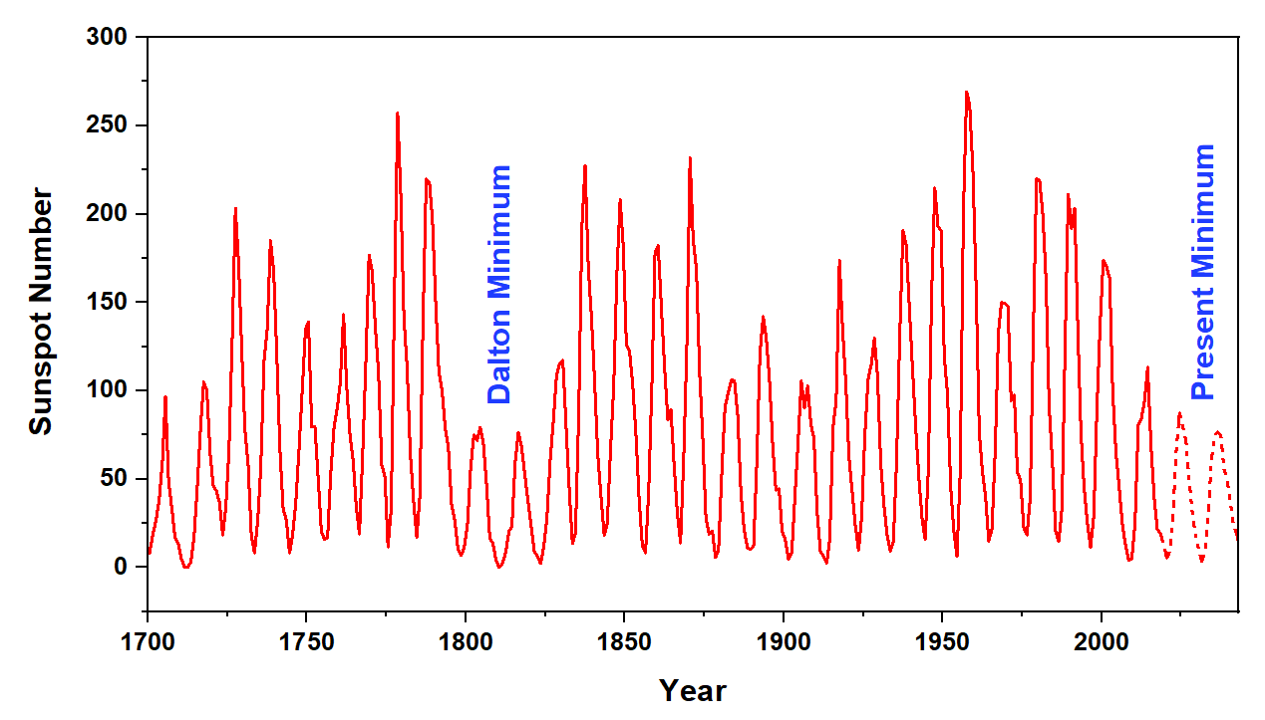
Fig. 6 Yearly average numbers of sunspots (SSN) from the year 1700 to the present and the predicted values.

Slide 24
Figure 6 has showed the long term (1700–2043) variations of observed and predicted sunspot numbers.
The figure has indicated that the solar cycles 25 and 26 will have lower solar activity and very much comparable to solar cycles 5 and 6.
But the nature of solar cycles 25 and 26 would be different in comparison to Dalton minima (cycles 5 and 6) because cycles 25 and 26 have showed a continuous trend of decreasing solar activity since last four solar cycles while the Dalton minima was observed in between high solar activity cycles.

Slide 25
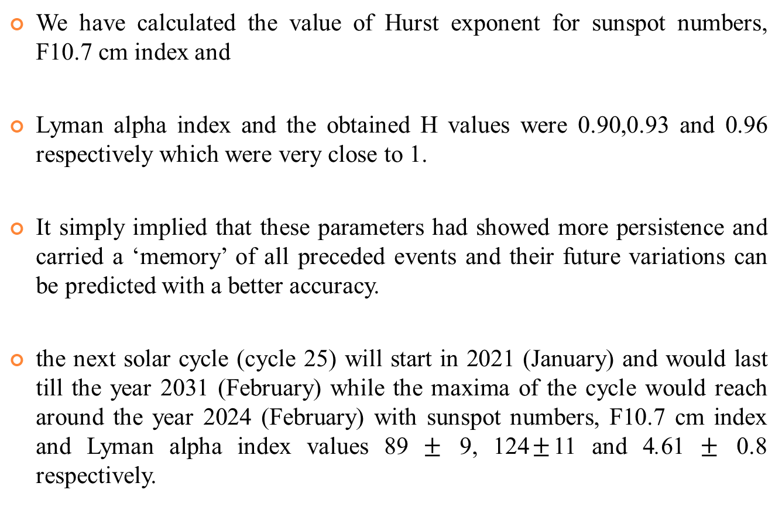
Results and conclusions
We have calculated the value of Hurst exponent for sunspot numbers, F10.7 cm index and
Lyman alpha index and the obtained H values were 0.90,0.93 and 0.96 respectively which were very close to 1.
It simply implied that these parameters had showed more persistence and carried a ‘memory’ of all preceded events and their future variations can be predicted with a better accuracy.
the next solar cycle (cycle 25) will start in 2021 (January) and would last till the year 2031 (February) while the maxima of the cycle would reach around the year 2024 (February) with sunspot numbers, F10.7 cm index and Lyman alpha index values 89 $±$ 9, 124$±$11 and 4.61 $±$ 0.8 respectively.

Slide 26
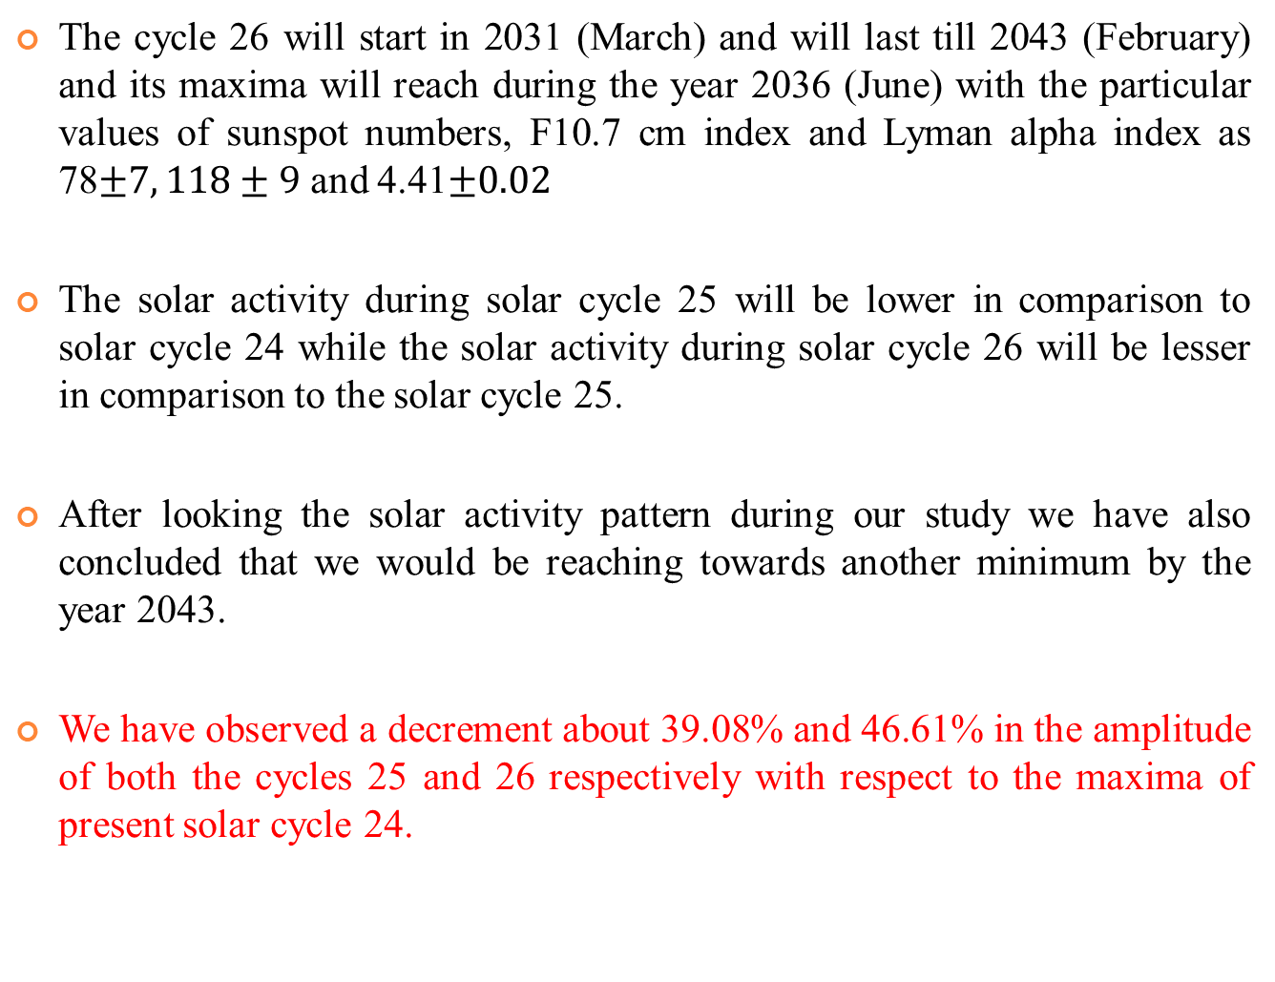
The cycle 26 will start in 2031 (March) and will last till 2043 (February) and its maxima will reach during the year 2036 (June) with the particular values of sunspot numbers, F10.7 cm index and Lyman alpha index as 78$±7, 118±9$and 4.41$±0.02$
The solar activity during solar cycle 25 will be lower in comparison to solar cycle 24 while the solar activity during solar cycle 26 will be lesser in comparison to the solar cycle 25.
After looking the solar activity pattern during our study we have also concluded that we would be reaching towards another minimum by the year 2043.
We have observed a decrement about 39.08%and 46.61% in the amplitude of both the cycles 25 and 26 respectively with respect to the maxima of present solar cycle 24.

Slide 27
Hathway and Upton (2016) used Advective Flux Transport (AFT) code for the simulation of the evolution of the Sun’s polar magnetic fields from early 2016 to the end of 2019—near the expected time of cycle 24/25 minimum. This AFT code assumes that the strength of the Sun’s polar fields near the time of a sunspot cycle minimum determines the strength of the following solar activity cycle. They found that the average strength of the polar fields near the end of cycle 24 will be similar to that measured near the end of cycle 23, indicating that cycle 25 will be similar(or slightly smaller than) in strength to the current cycle.

Slide 28


