Slide 1

MyCUCalendar
Brady Auen, Andy Chuong, Will Vardell

Slide 2
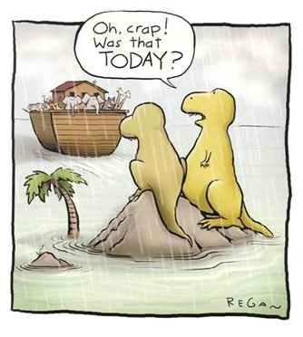
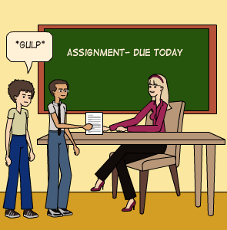
Due Dates are a nightmare
Students struggle often to remember due dates and keep a planner
Moodle holds some of your due dates, D2L holds others
Some due dates don’t even show up on moodle (written work)
Class Manager: Mobile app with alerts/reminders, we like the alerts, we don’t think there’s enough of them, what if we want multiple ones? Also not automated
myHomework: Multiplatform app, Great platform support and multiple device syncing, but doesn’t automatically update
Moodle Calendar: Good foundation, no alerts/reminders, can’t add things manually, no D2L integration

Slide 3
Our Solution
At it’s base, we want a calendar that pulls information from D2L and moodle to automatically update
Capable of accepting manual additions in case of written work or work not listed with a due date on the website
User managed textboxes corresponding with assignments that allow the user to takes notes and save them
Stretch goal: With little understanding of it, we’d like to have notifications/reminders
Stretch goal: Multiple platforms

