Slide 1
Java: Type Speed Game
By
Brady Auen
Nick Nocella
and Peter Huynh

Slide 2

Video Demo

Slide 3
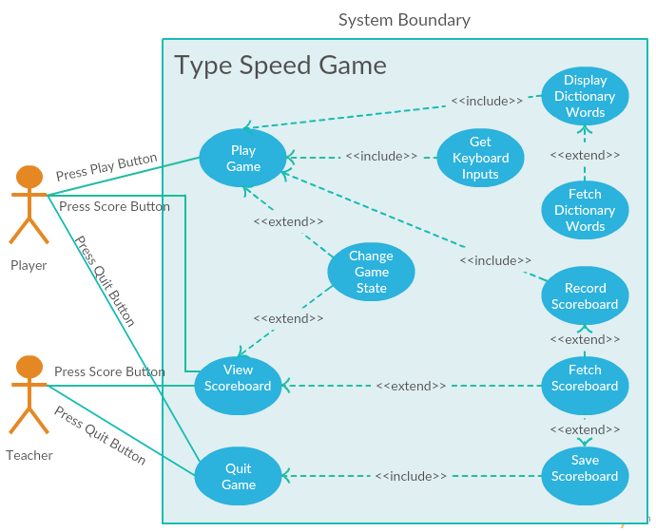
Use Case Diagram
Three Main interactions
Play Game
Starts main game state
View Scoreboard
Starts leaderboard state
Quit Game
Exits program and saves score

Slide 4
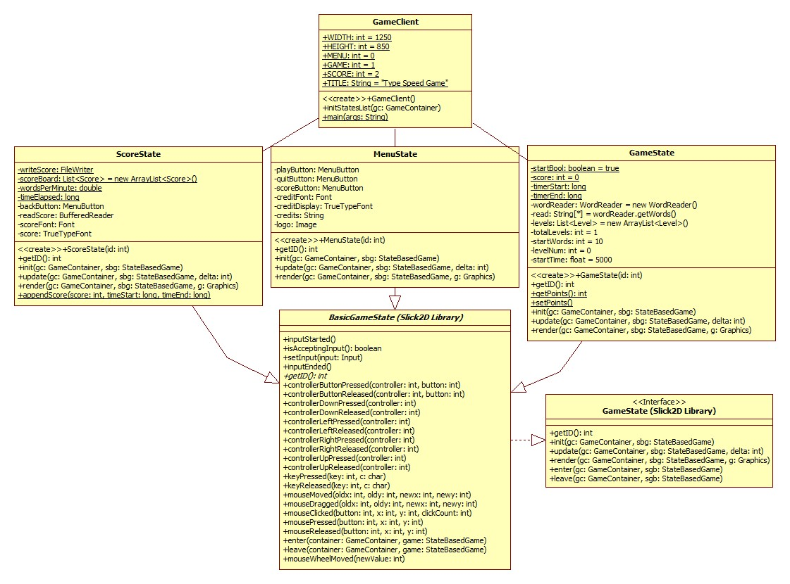
Design Patterns
State Design Pattern
One-To-Many Dependencies between objects.
When one object changes state, all its dependents are notified and updated.

