Slide 1
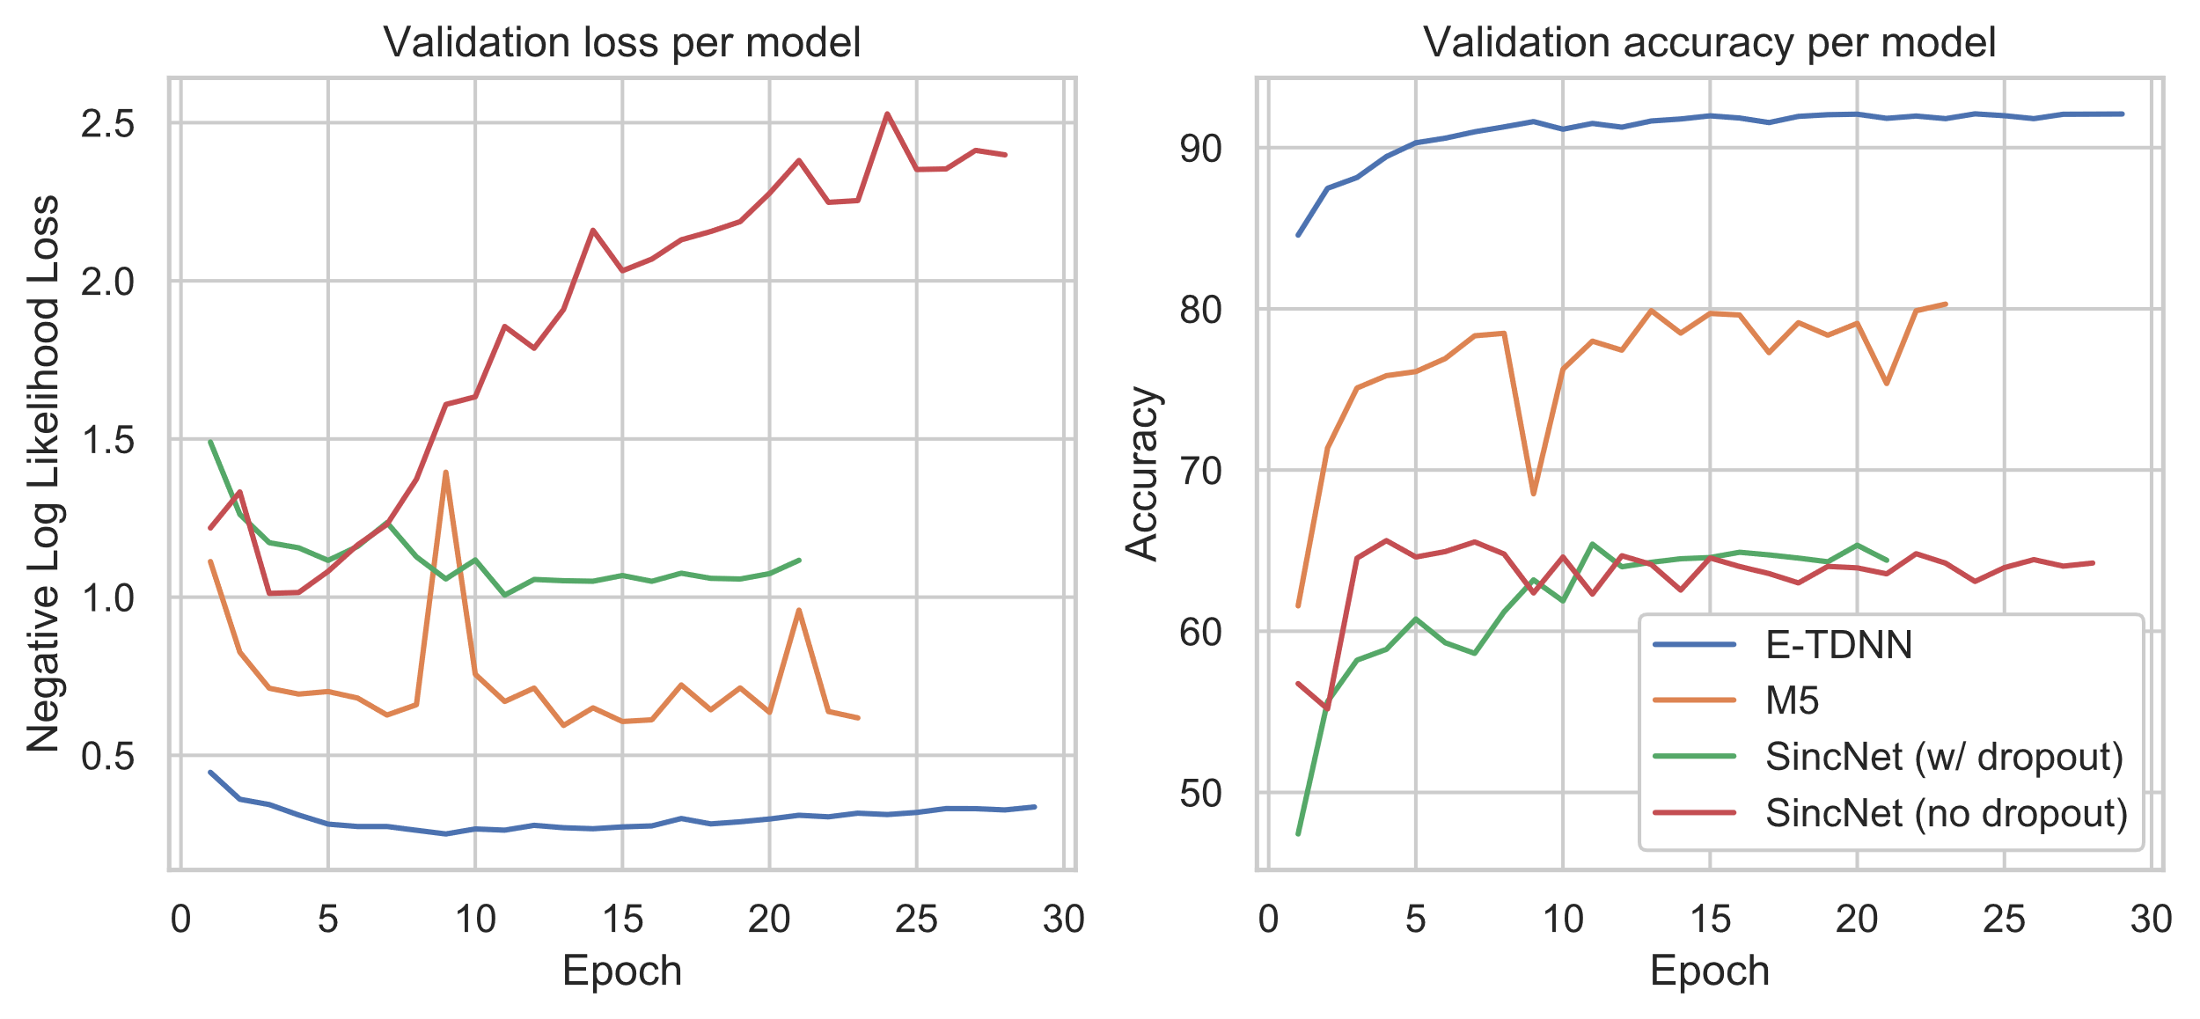
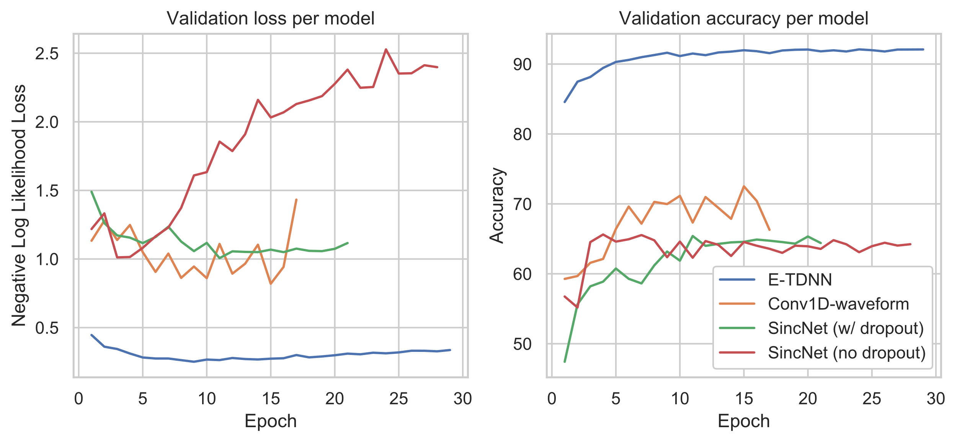
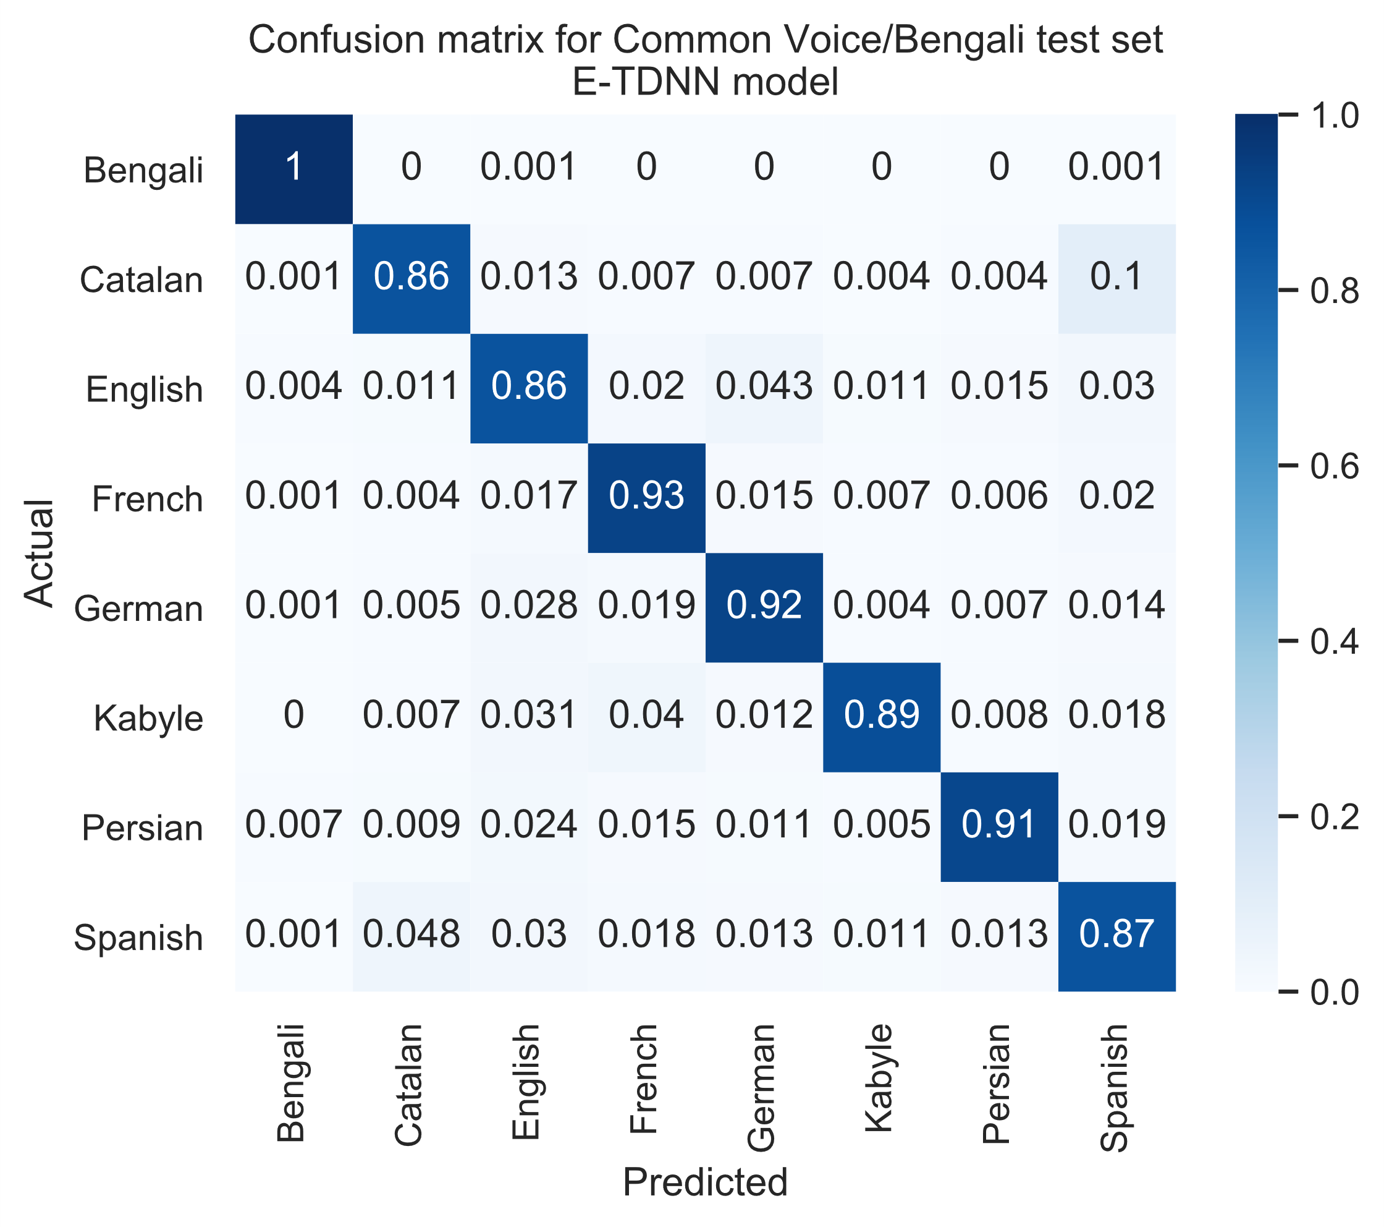
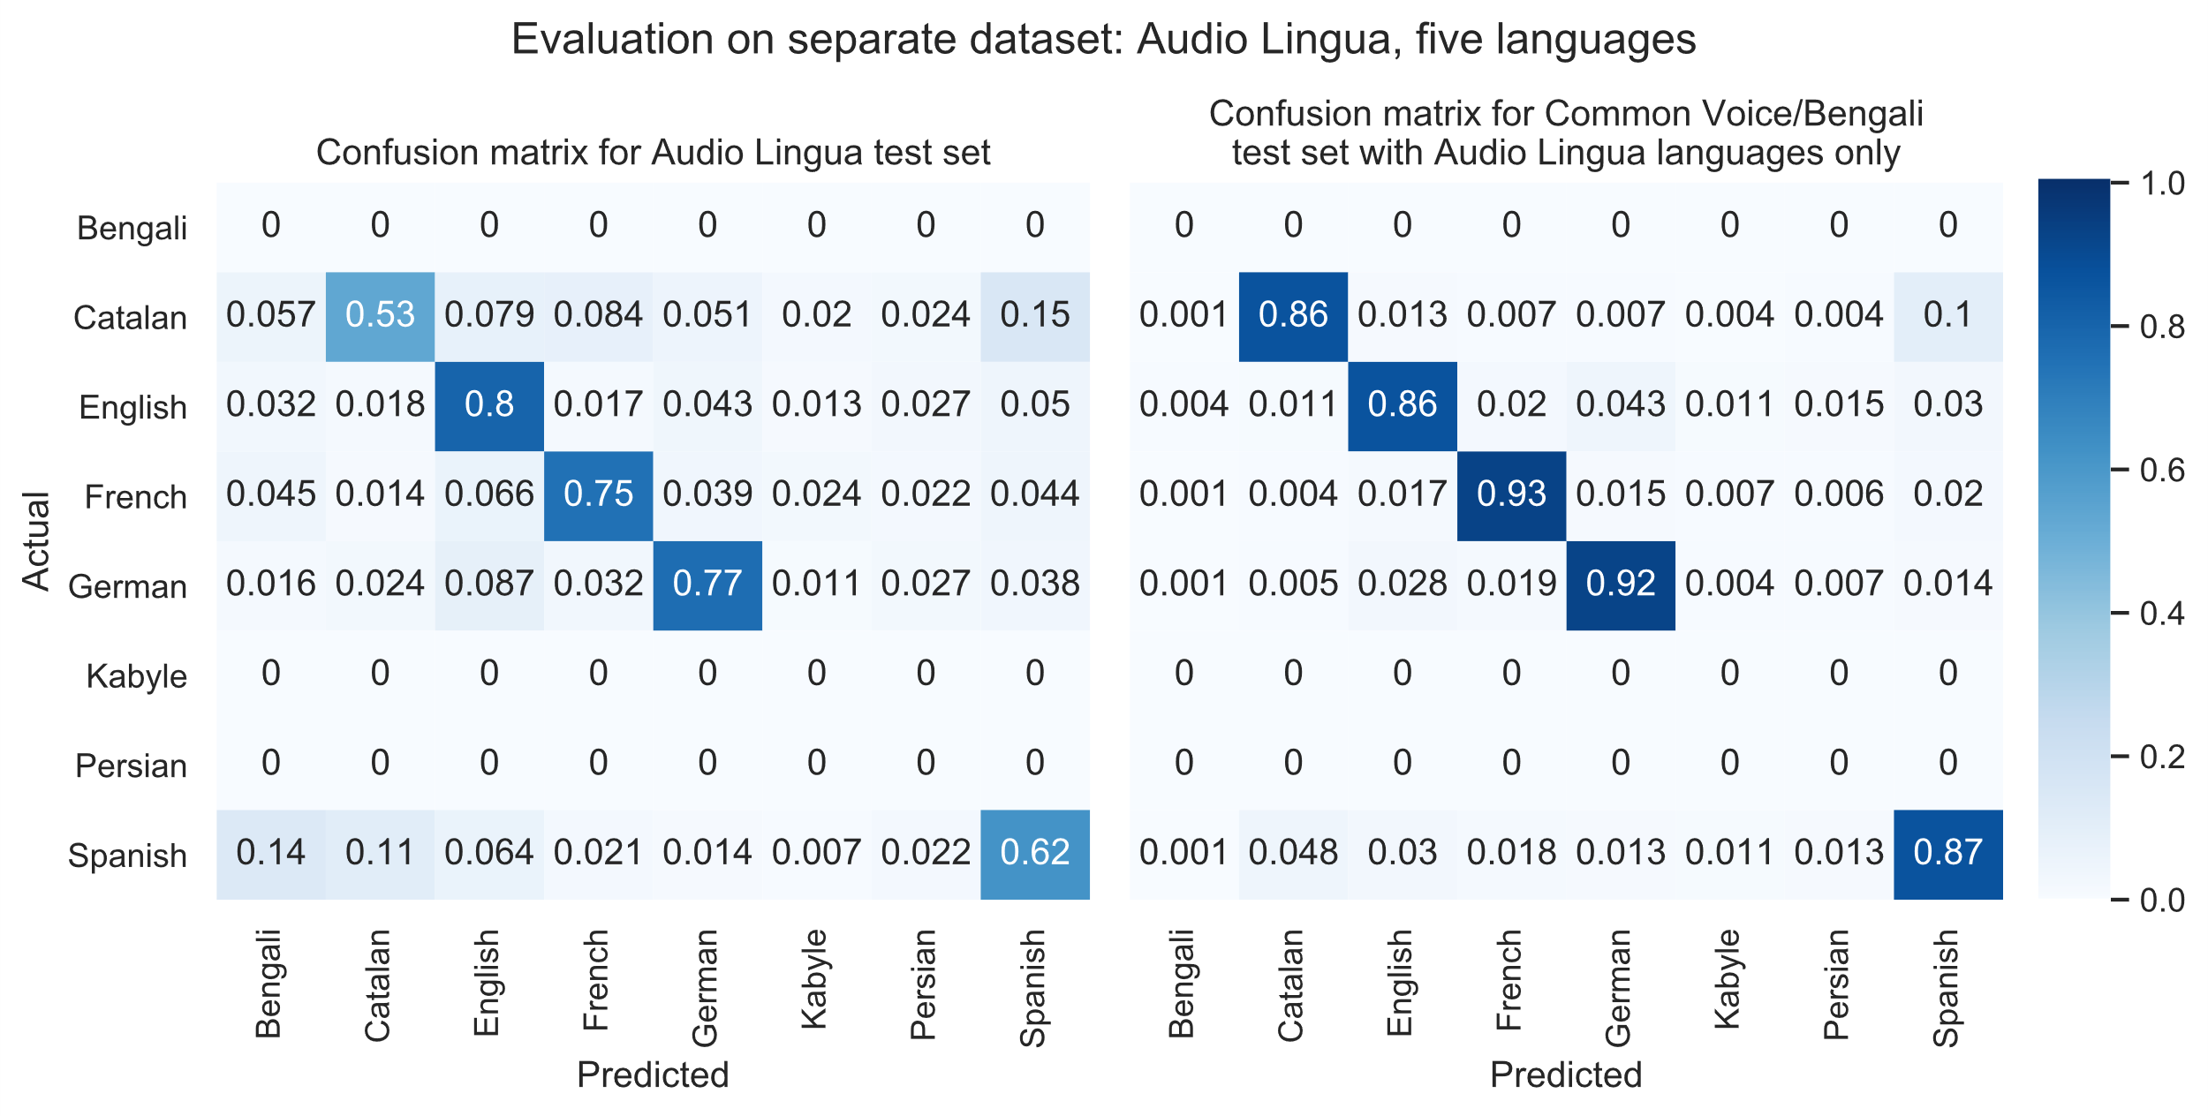
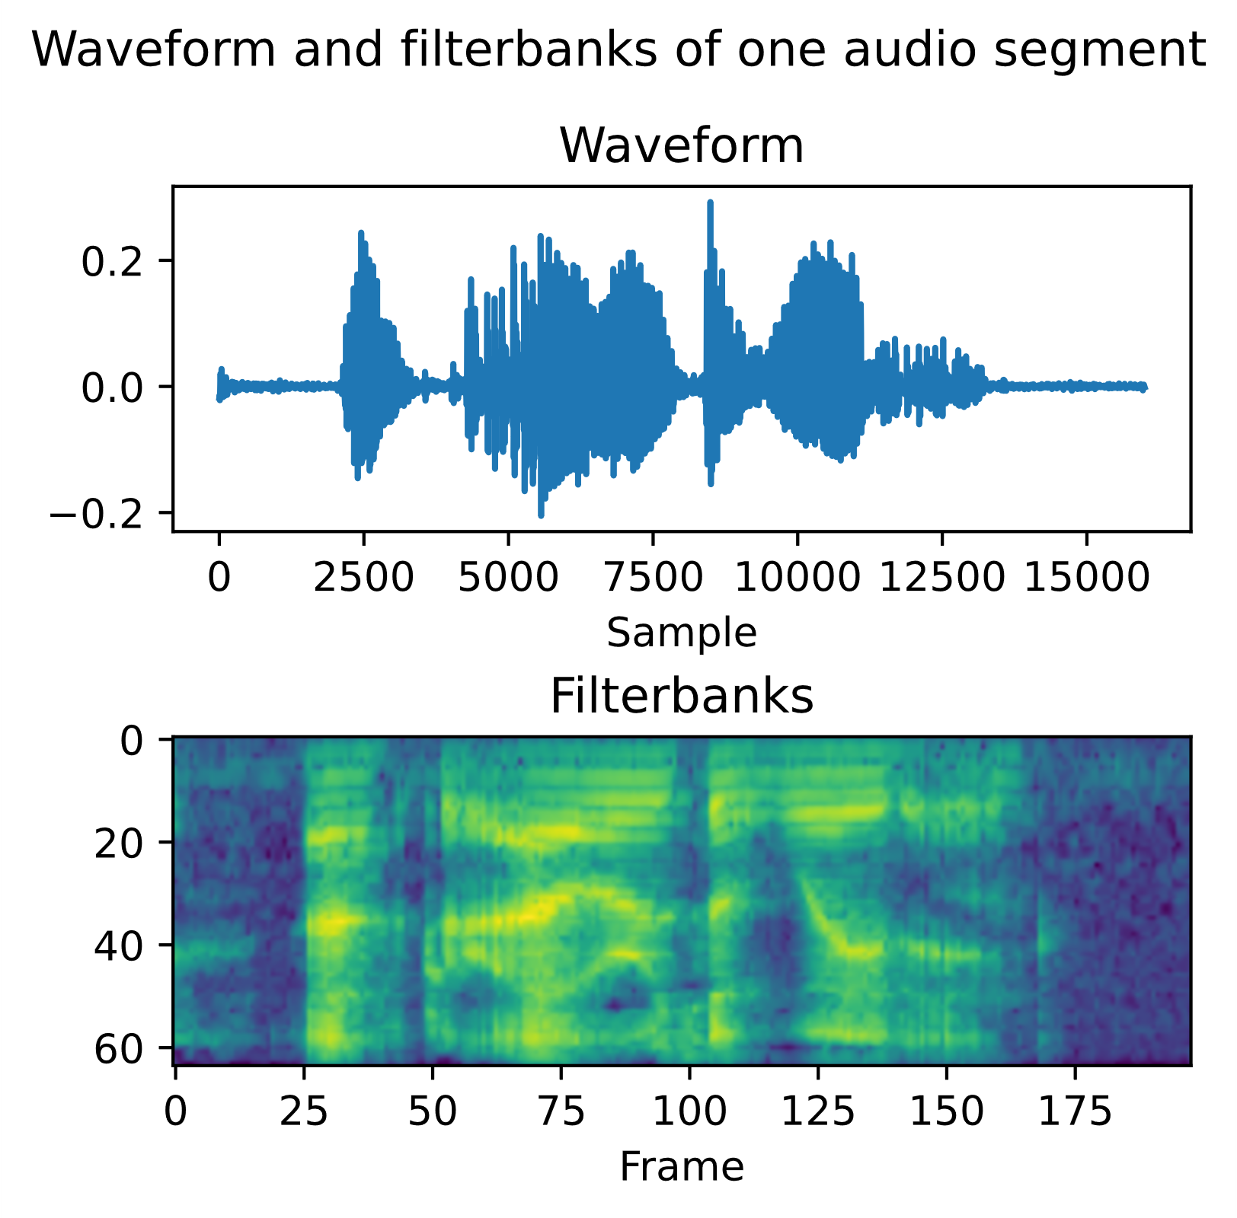

Spoken Language Recognition on Open-Source Datasets
Brady Arendale, Samira Zarandioon, Ryan Goodwin, and Douglas Reynolds
Master of Science in Data Science
Southern Methodist University, Dallas, TX 75275, USA
Introduction
E-TDNN model
We wanted to know if we could automatically classify a spoken language from speech audio
Previous studies have been very successful but are limited to private or expensive datasets
We collected data from various freely available data sources and compared several state-of-the-art deep learning models
E-TDNN: composed of several time-delay neural network layers (aka 1D convolutional layers) that uses filterbanks as input.
4 1D convolutional layers (512 filters) with increasing dilation and constant kernel size
Average + standard deviation pooling (dim 3072)
2 dense layers (dim 512)
1 dense layer with softmax activation to output probabilities for each language (dim 8)
Data collection
We gathered data from three sources containing a total of eight languages
Mozilla Common Voice: Catalan, English, French, German, Kabyle, Persian (Farsi), Spanish
Google Bengali: Bengali
Audio Lingua (used as separate test set): Catalan, English, French, German, Spanish
Other models
Model | Test accuracy | Test accuracy (Audio Lingua)
E-TDNN | 90.5% | 74.8%
M5 | 77.5% | 49.7%
SincNet (w/ dropout) | 63.0% | 35.5%
SincNet (no dropout) | 62.1% | 31.5%
M5: 4 1D convolutional layers with increasing number of filters, each followed by batch normalization and max pooling, then a global average pooling layer and two dense layers
SincNet: a 1D convolutional architecture that attempts to learn more meaningful filterbanks using bandpass filters. We trained SincNet both without dropout and with dropout to avoid overfitting.
Feature extraction
Audio files were split into two-second chunks
We extracted raw waveforms (measure of amplitude over time) and filterbanks (aka log mel spectrogram, a measure of the frequencies that make up a wave over time)
We trained models on either waveforms or filterbanks
Results
E-TDNN performed much better than the other models with a test accuracy of 90.5%. It also performed fairly well on the separate Audio Lingua set with a 74.8% accuracy.
The waveform models performed quite a bit worse and did not generalize to the Audio Lingua dataset as well. The simple Conv1D model outperformed SincNet.
Audio features visualized
Here are the waveform and filterbanks from the same two-second English audio clip
Note that filterbanks are calculated over a window of several samples, known as a speech frame
Conclusions
Although these models were created using private datasets, they perform well when trained on free datasets such as Common Voice as well.
Generalization to separate datasets not used for training is a problem. Solutions include training on a larger variety of datasets as well as data augmentation techniques such as adding background noise.

