Slide 1
Investing on LendingClub with proven models
Brady Arendale

Slide 2
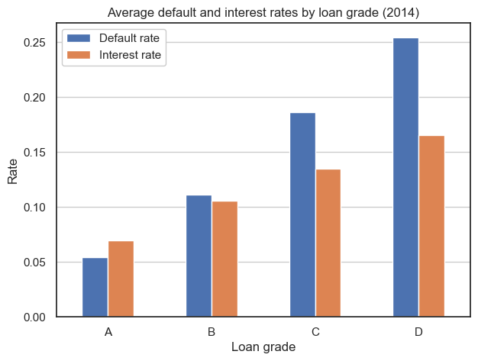
What is LendingClub?
LendingClub is a peer-to-peer lending company. Customers can apply for loans, and then investors can choose which loans to invest in based on factors such as income, credit score, and amount of debt
LendingClub assigns grades to each loan based on its own evaluation of these metrics, with worse-graded loans typically having higher interest rates

Slide 3
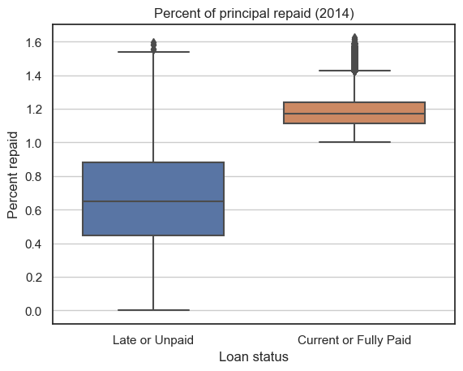
Why add Lending Club to your portfolio?
LendingClub loans can be a low-risk investment. The average default rate on 2014 loans was 15.5%, with grade A loans at 5.4%
The average amount repaid above principal was 10.9%. For current or fully paid loans, that number jumps to 19%

Slide 4
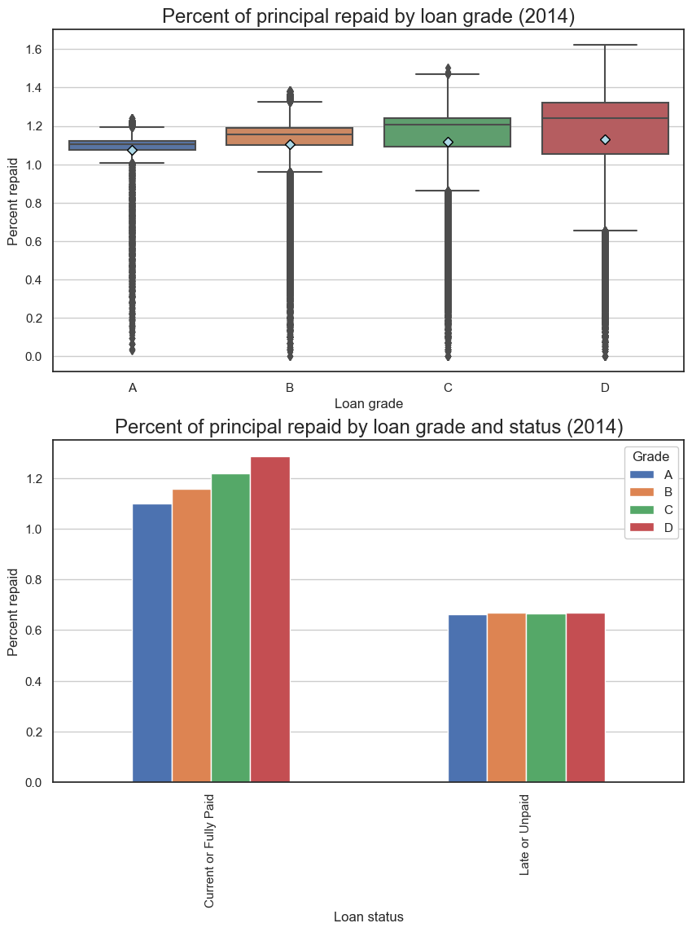
What are the risks and rewards?
Investing in risker loans has the potential for large payoffs. Loans graded D earn 2.9 times more interest on average than A loans when fully paid, and 1.7 times overall
However, grade D loans are 4.7 times more likely to default than those rated A

Slide 5
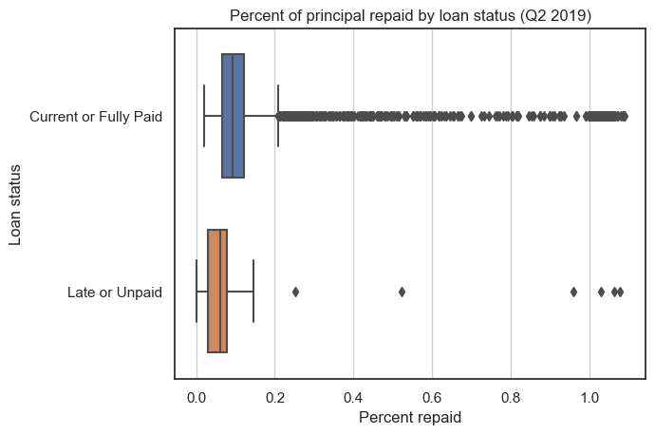
Why use our model?
Our model is trained on the latest data available from Q2 2019, allowing us to keep up with market trends
Our model achieves a 54.5% recall (ratio of predicted defaults to all defaults) using a cutting-edge elastic net model

Slide 6
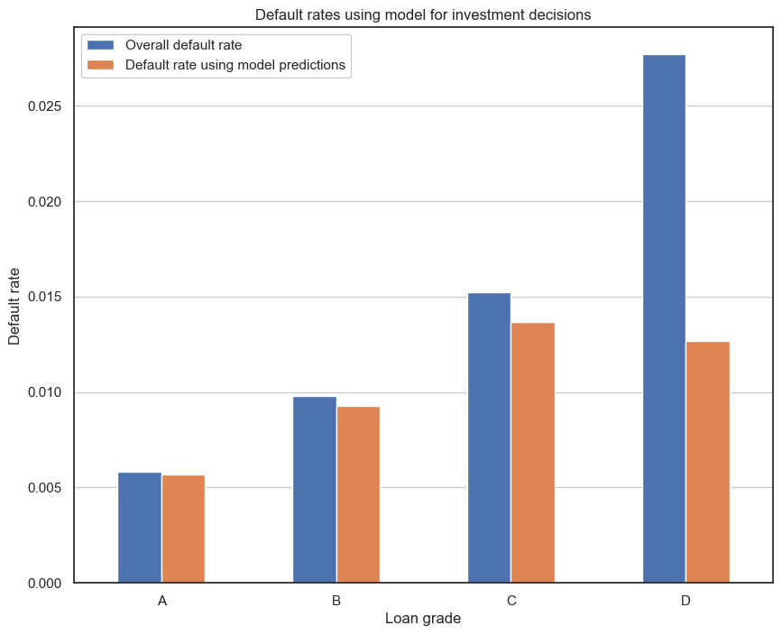
Why use our model?
For Q2 2019, the current default rate is 1.2%. Our model achieves a default rate of 0.83% when investing only in loans it predicts not to default (also known as the false omission rate), an improvement of 32.8%
For loans graded D, our model achieves an improvement in default rate of 54.2% (2.8% vs. 1.3%)

Slide 7
Customizing decision thresholds to manage risk

Slide 8
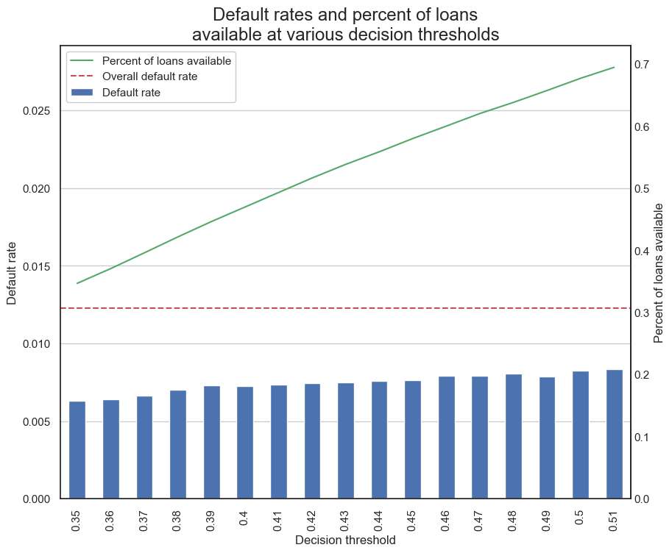
Customizing decision thresholds
Our model allows for customizing decision thresholds – i.e., how certain the model is that a particular loan will default
Lower decision thresholds may be chosen to mitigate risk, but this will also cause more good loans to be predicted to default, lowering the total amount of loans available to invest in

Slide 9
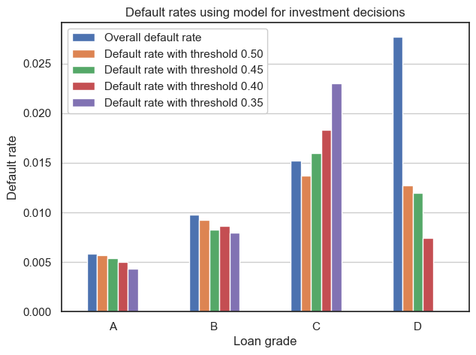
Customizing decision thresholds
Using decision thresholds is an effective way to achieve the higher ROI from riskier loans without incurring significantly greater risk
For loans of grade D, choosing a threshold of 0.40 lowers the default rate from 1.3% to 0.74%, an improvement over the base model of 41.6%, and 3.7 times lower than the overall default rate for grade D loans
The default rate for grade D loans using the 0.40 decision threshold is only 30.5% greater than that of grade A for the base model, compared to 4.7 times greater overall

Slide 10
Conclusion
LendingClub is a great investment choice for your portfolio due to relatively low risk and potential for high ROI
Using our model to invest on LendingClub can significantly limit risk and provide greater returns than using loan grades alone
The customizability of our model allows you to more effectively serve your clients based on their own personal needs and goals

