Slide 1
Intelligent Authorship Verification
Matthew Sobocinski and Brady Sheehan

Slide 2
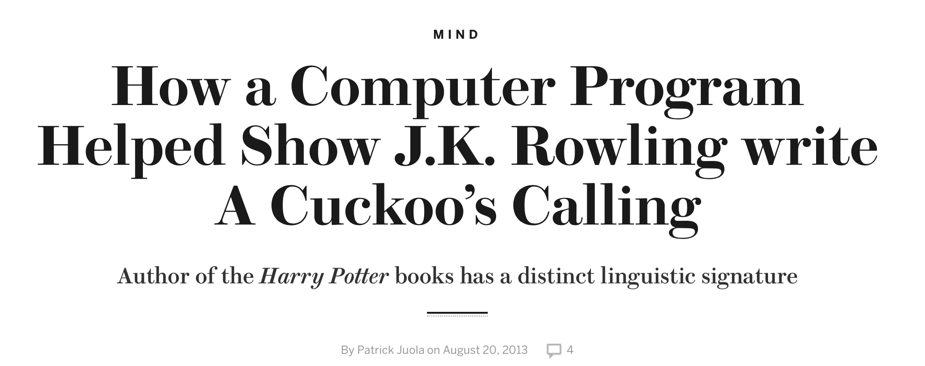
Motivation
Identifying Individuals in cyber bullying
Recognizing plagiarism
Catching Terrorists
“Who wrote the ransom note in the Jon Benét Ramsey case?”
Notes:
http://nsm.uh.edu/news-events/stories/2016/0322-authorship-attribution.php
http://www.scientificamerican.com/article/how-a-computer-program-helped-show-jk-rowling-write-a-cuckoos-calling/
https://www.brooklaw.edu/intellectuallife/centerforlawlanguageandcognition/authorattributionsite

Slide 3
Authorship Verification
“Authorship verification is a branch of forensic authorship analysis addressing the following task: Given a number of sample documents of an author A and a document allegedly written by A , the task is to decide whether the author of the latter document is truly A or not. “
Oren Halvani, Christian Winter, Anika Pflug in Authorship verification for different languages, genres and topics, 2016.

Slide 4
Overview
Corpus
Inputs
Neural Network
Authors
Documents
Feature vector
Features
Input Pair
Classification
Feature vector

Slide 5
Data Collection

Slide 6
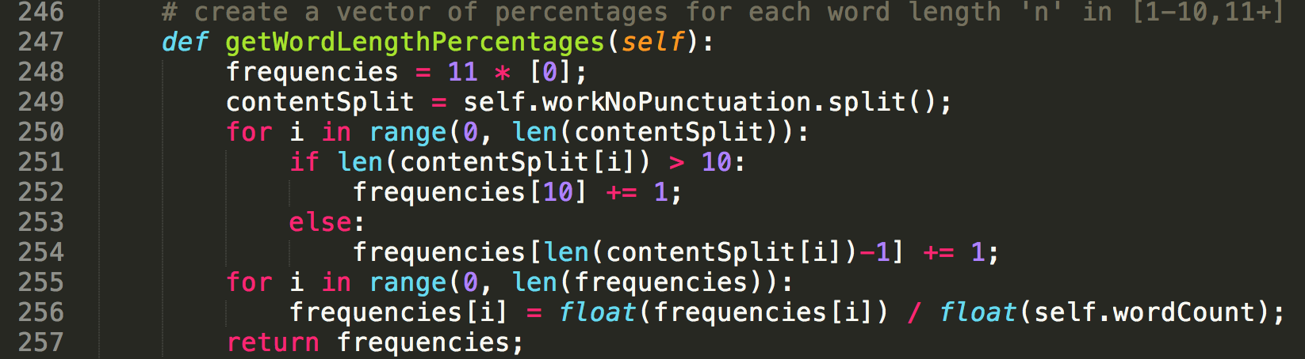
Feature Extraction

Slide 7
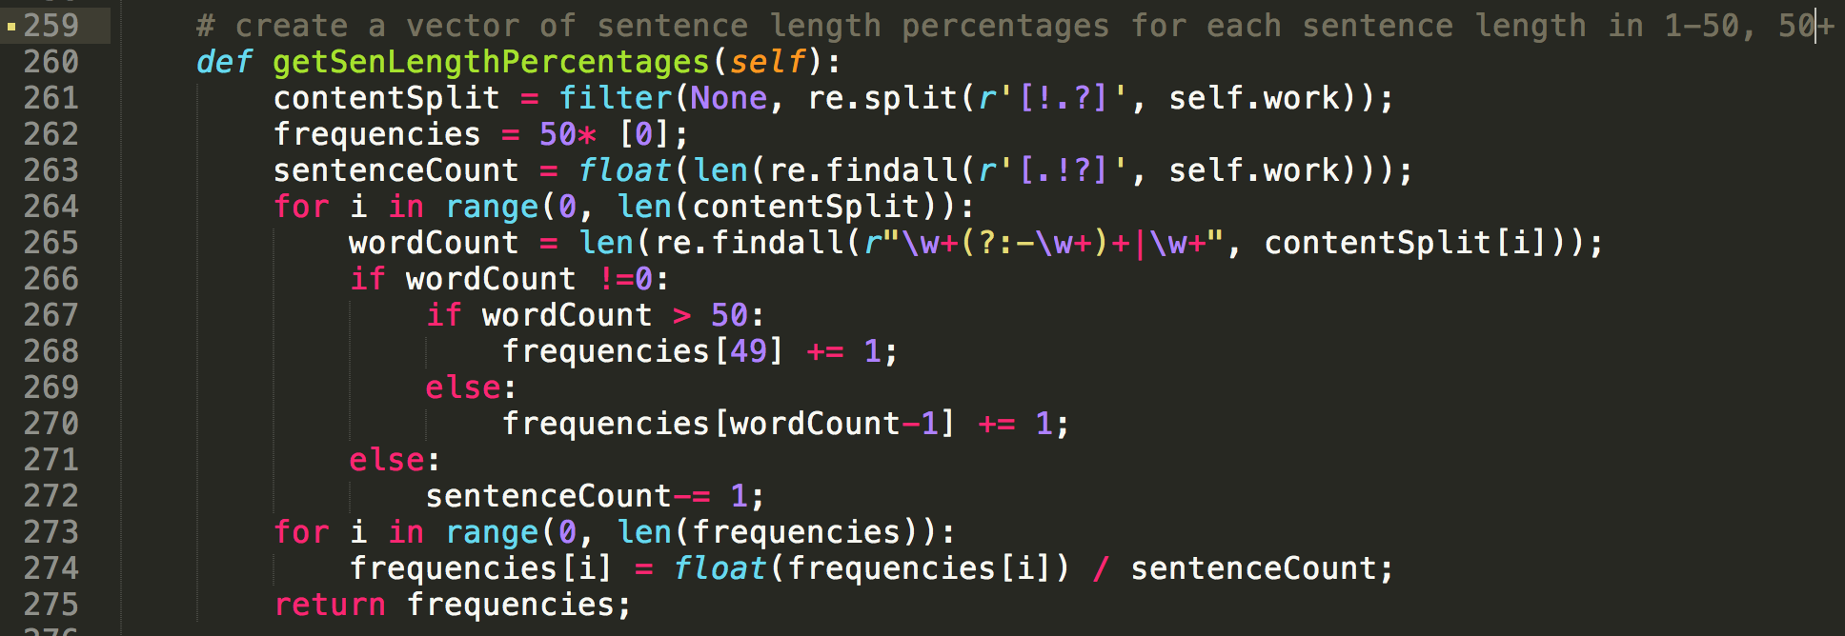
Feature Extraction

Slide 8
Neural Networks

Slide 9
Results
Include table from paper maybe?

Slide 10
Any Questions?

Slide 11
References
*Juola, Patrick. Authorship Attribution. Hanover, MA: Now Publishers Inc., 2008. Print.
MATLAB and Neural Network Toolbox Release 2015a, The MathWorks, Inc., Natick, Massachusetts, United States.
*We would like to thank Dr. Patrick Juola for helpful discussions while working on this project and for giving us data to use for training and testing.

