Slide 1
Intelligent Authorship Verification
Matthew Sobocinski and Brady Sheehan

Slide 2
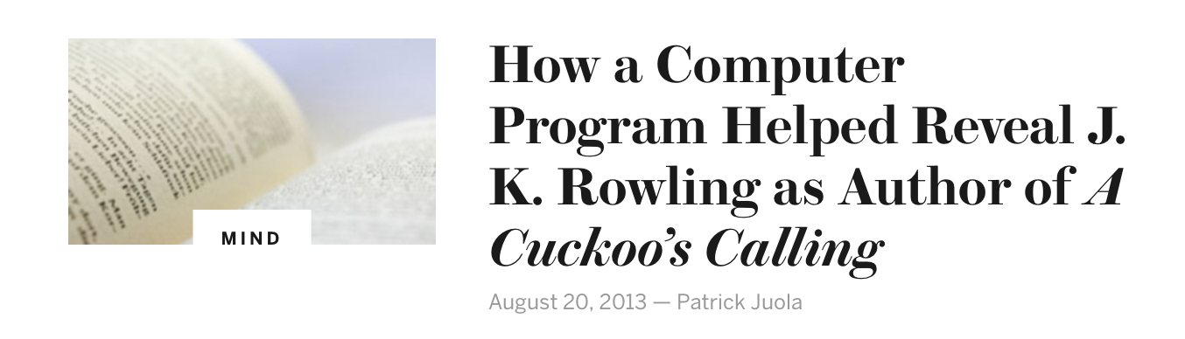
Motivation
Identifying Individuals in cyber bullying
Recognizing plagiarism
Catching Terrorists
“Who wrote the ransom note in the Jon Benét Ramsey case?”
Notes:
http://nsm.uh.edu/news-events/stories/2016/0322-authorship-attribution.php
http://www.scientificamerican.com/article/how-a-computer-program-helped-show-jk-rowling-write-a-cuckoos-calling/
https://www.brooklaw.edu/intellectuallife/centerforlawlanguageandcognition/authorattributionsite
Brady here

Slide 3
Authorship Verification
“Authorship verification is a branch of forensic authorship analysis addressing the following task: Given a number of sample documents of an author A and a document allegedly written by A , the task is to decide whether the author of the latter document is truly A or not. “
Oren Halvani, Christian Winter, Anika Pflug in Authorship verification for different languages, genres and topics, 2016.
Notes:
Matt here

Slide 4
Overview
Corpus
Inputs
Neural Network
Authors
Documents
Feature vector
Features
Input Pair
Classification
Feature vector

Slide 5
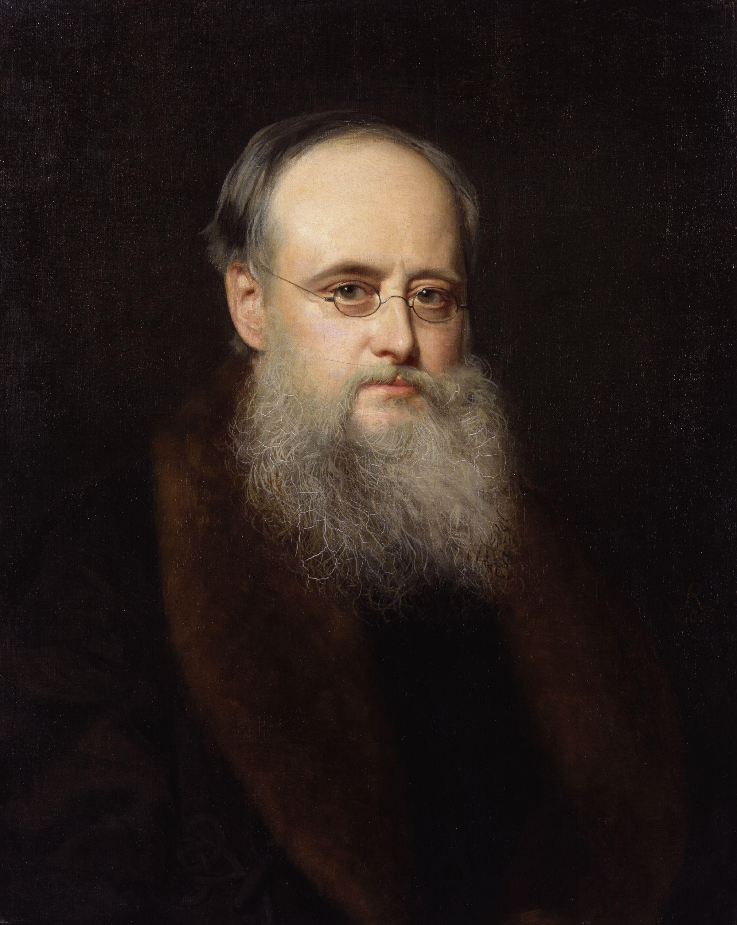
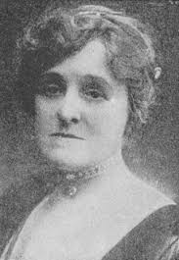

Data Collection*
Victorian Era works (~84 MB of plain text)
Over 100 works written by 12 different authors
Individual vs. Combined
Authors:
Charlotte Bronte
Wilkie Collins
Charles Dickens
George Elliot (Real Name: Mary Ann Evans)
Thomas Hardy
Henry James
Sarah Orne Jewett
George Meredith
David Graham Phillips
William Makepeace Thackeray
Anthony Trollope
Edith Wharton
Wilkie Collins
Edith Wharton

Slide 6
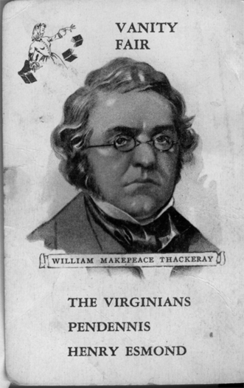
Data Grouping
Partitioned data into three groups:
Training dataset
Various authors and works
In-group dataset
Works by authors who have other works in the training dataset
Out-group dataset
Works by authors not included in either dataset

Slide 7
Expectations
Expectations of results:
Training dataset
Much better than random
In-group dataset
Better than random
Out-group dataset
About random
“There are books of which the backs and covers are by far the best parts.”
― Charles Dickens, Oliver Twist

Slide 8
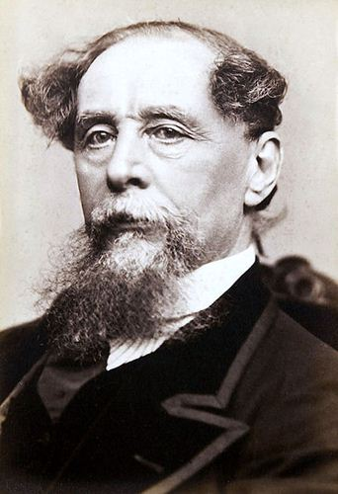
Feature Selection
average word length
average sentence length
most unique words
most common words
most common first word
sentence length frequencies
word length frequencies
character and word n-grams of various lengths
Charles Dickens
Notes:
brady

Slide 9
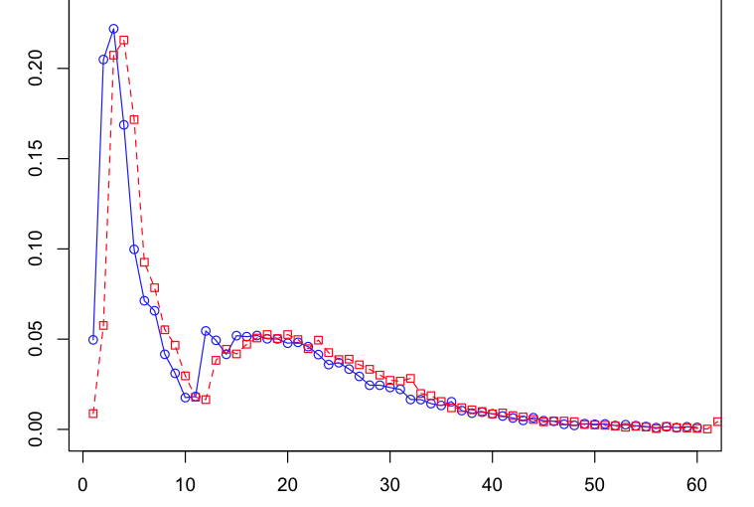
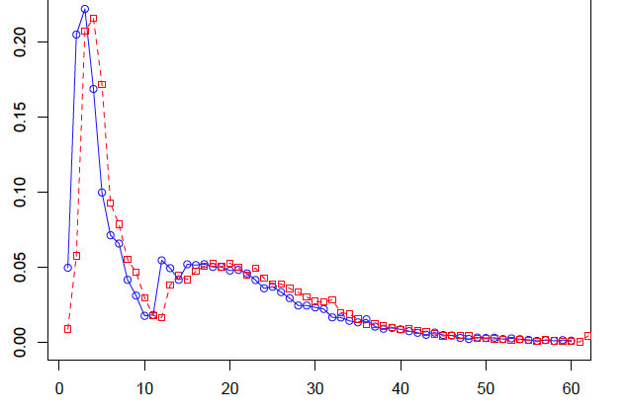
Feature Selection
average word length
average sentence length
most unique words
most common words
most common first word
sentence length frequencies
word length frequencies
character and word n-grams of various lengths
Same Author & Different Work
Different Authors & Different Works
Notes:
matt

Slide 10
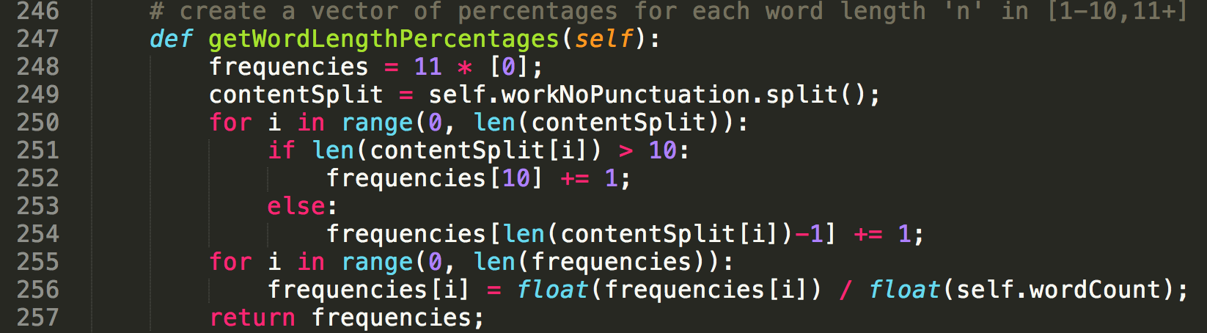
Feature Extraction
Notes:
me

Slide 11
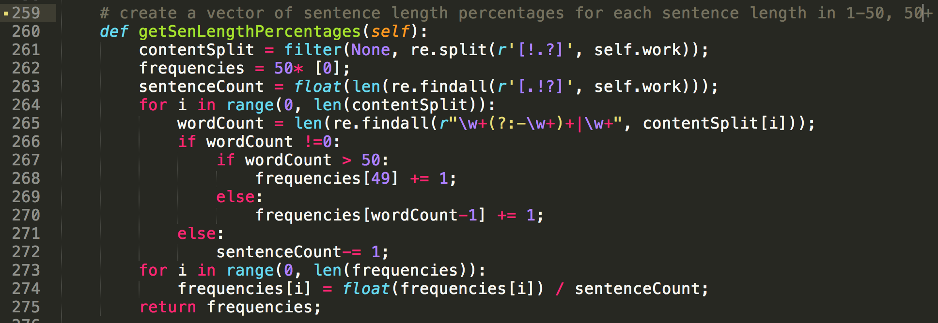
Feature Extraction
Notes:
matt

Slide 12
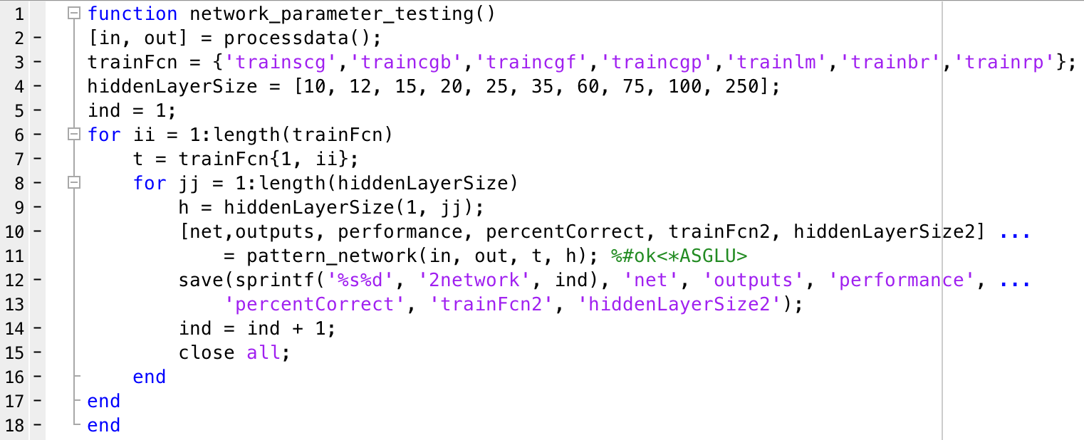
Neural Network
Tested neural networks from the Neural Network Toolbox in MATLAB with various network configurations
Notes:
me

Slide 13
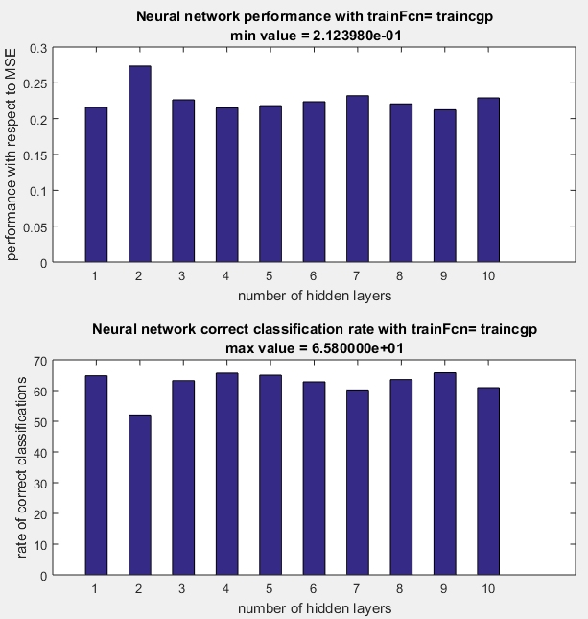
Neural Network
Generated plots with network_parameter_plots() function
Used for selecting optimal neural network configurations for testing
Hidden layer sizes:
[10, 12, 15, 20, 25, 35, 60, 75, 100, 250]
Notes:
matt

Slide 14
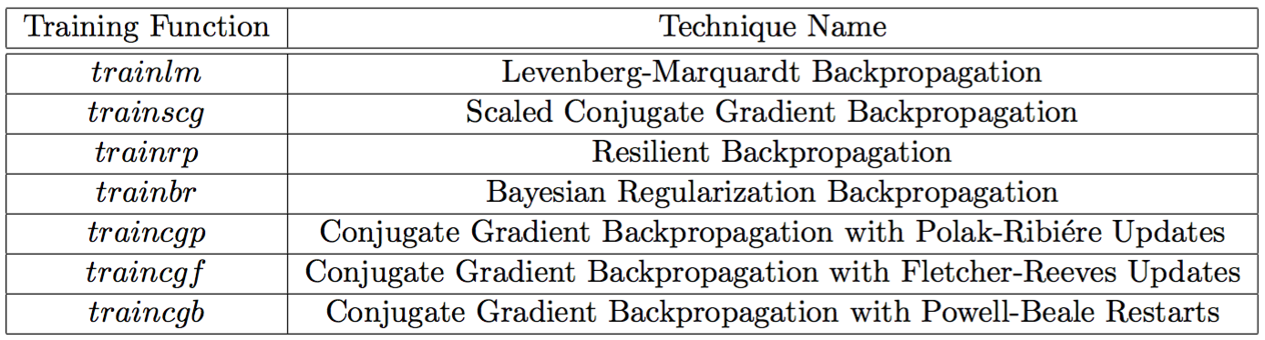
Training Functions
Notes:
me

Slide 15
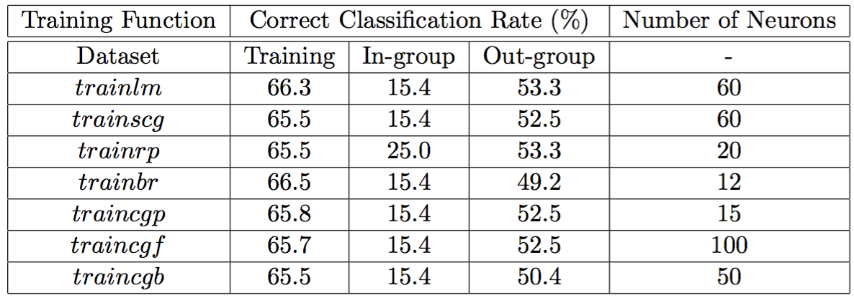
Results
Notes:
matt

Slide 16
Conclusion
We will not be able to stop terrorism…
But:
Tests show our neural network approach is feasible but could likely be improved by
discovering and extracting more meaningful features
testing the feasibility of different neural network configurations
investigating the significance of corpus size.
Notes:
me

Slide 17
Any Questions?

Slide 18
References
Hoorn, J.F., Frank, S.L., Kowalczyk, W., and Ham, F.V.D. (1999). “Neural network identification of poets using letter sequences''. Literary and Linguistic Computing, 14(3), 311–338.
Juola, Patrick. “Authorship Attribution”. Hanover, MA: Now Publishers Inc., 2008. Print.
MATLAB and Neural Network Toolbox Release 2015a, The MathWorks, Inc., Natick, Massachusetts, United States.
Oren, H., Christian, W., and Anika, P. (2016). “Authorship verification for different languages, genres and topics''. The International Journal of Digital Forensics and Incident Response archive, 16(2), S33-S43.
*We would like to thank Dr. Patrick Juola for helpful discussions while working on this project and for giving us data to use for training and testing.

