Slide 1
Optimality Bounds for Recovering Geometric Information in Images
By Brady Sheehan
Advised by Stacey Levine, Ph.D.
April 20th, 2017
Notes:
My project is all about finding a theoretical bound on the performance of a certain type of image processing algorithm.

Slide 2
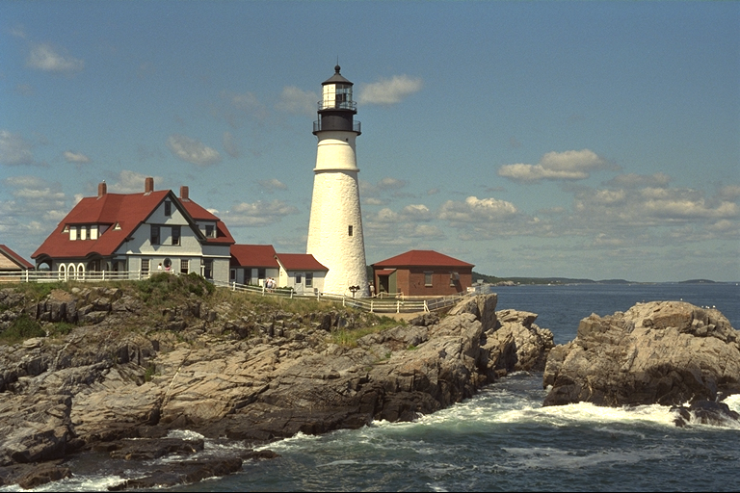

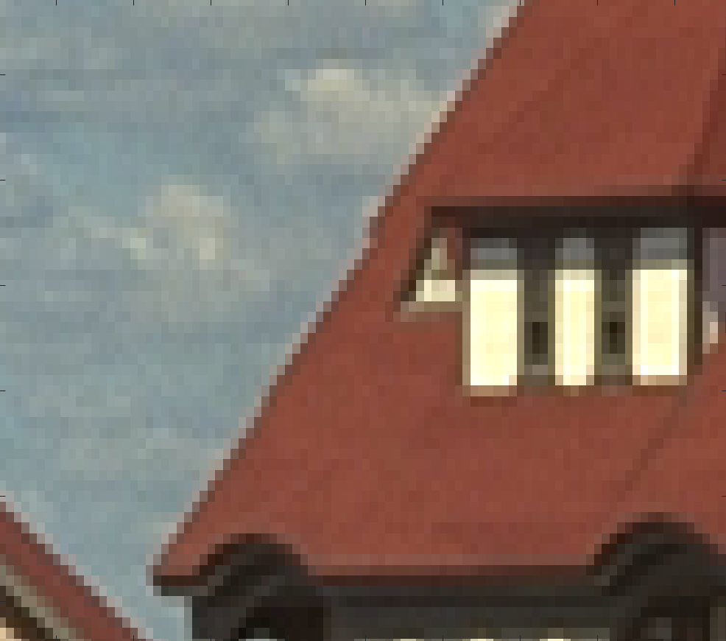

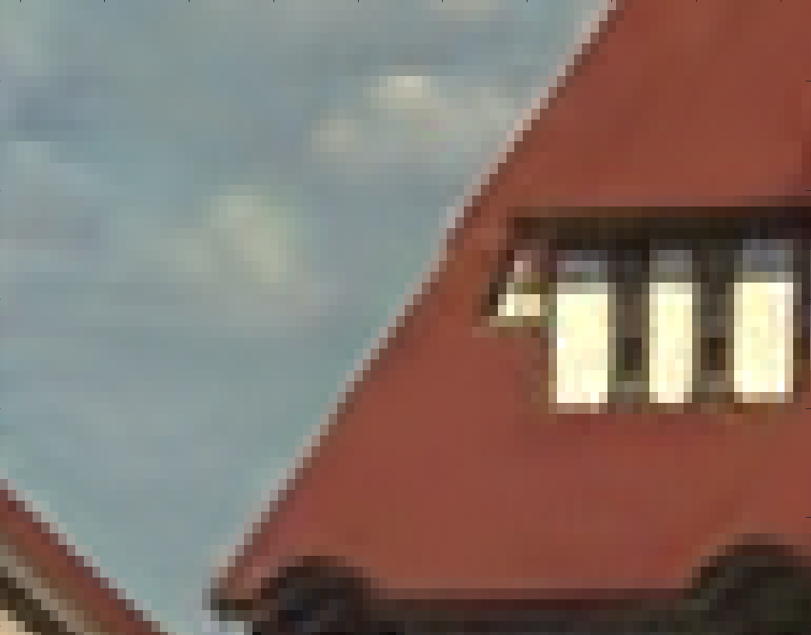
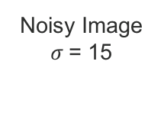
State of the Art Denoising Method: BM3D
Original image
BM3D Result
Original Image
Original image
Noisy Image $σ$= 15
BM3D Result
Images credit: http://r0k.us/graphics/kodak/ Algorithm credit: http://demo.ipol.im/demo/l_bm3d/
Notes:
What is noise? Any unwanted data/signal in our image. Noise appears as a result of the image capture process or through post processing.
We want to remove noise to get nicer and more clear and accurate images.
So, one question one might ask is how well can we currently denoise images?
BM3D is one algorithm in a specific class of algorithms for image denoising and it's good.
An example of an assumed clean image, of an image with simulated noise, and the result after running this state of the art denoising algorithm is shown.
It turns out that BM3D is about as close to as good as this type of denoising algorithms can get when considering only the image itself.
This algorithm, despite being best in class, has room for improvement. If you look at the zoomed images on the right, you will see
where the BM3D result has lost detail in the shudders on the roof and the clouds in the sky

Slide 3
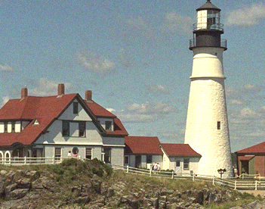

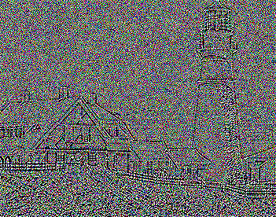
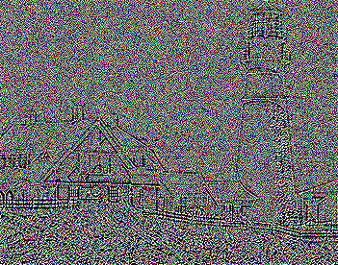

Research Question: How well can we denoise curvature data?
Noisy
Result after application of a denoising method
$$κ_{noisy}$$
Images credit: http://r0k.us/graphics/kodak/ Algorithm credit: http://demo.ipol.im/demo/l_bm3d/
Notes:
One goal is to do better than this state of the art algorithm. However, The question we want to answer is,
if we consider this other type of data called curvature data, could we outperform BM3D by denoising curvature information ?
On the top you see the lighthouse image and below it is the curvature of its level lines, we don’t have the right background to
discuss all the different ways that one can compute curvature but know that it is an open research problem.
Researchers at MIT and the weizman institute of science were able to determine bounds for the best possible result for denoising algorithms in the same class of algorithms as BM3D.
However, we are not aware of such bounds for curvature based image denoising.
My hypothesis is that curvature based denoising has the potential to outperform natural based image denoising because of some nice properties of the curvature data

Slide 4
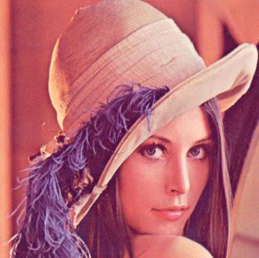
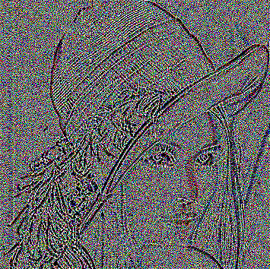

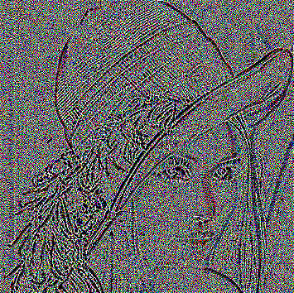




Curvature Denoising Framework
1. Input: $y$
2. $κ\left(y\right)$
3. $K_{den}$
4. Reconstructed Image, $\hat{y}$
Notes:
So what does curvature denoising look like?
This is how we denoise images when we talk about curvature.
The basic idea is to consider a noisy image y
Denoise the curvature of the level lines, $k(y)$, to obtain $K_{den}$
Then reconstruct a clean image by Generating a new image whose level line curvature matches $K_{den}$ and level line contrast matches the noisy image $y$
So what did I do for this project? I took the method developed by the researches who bounded natural image denoising and adapted it for curvature imagery.
I then implemented the mathematical formulation in computer code and ran experiments to determine the upper/lower bound on curvature based image denoising.
Challenge: I haven’t been able to run the experiment for a large enough sample size to get a statistically significant result. I just need access to a computing cluster
Or super computer to run my experiment to get an answer. However preliminary results on a small sample size show promise.
Alright, =so why is my project important?
This result is important because finding bounds on curvature denoising could be impactful to the larger image processing community.
If the theoretical bounds demonstrate that it is possible to recover more information from a noisy
curvature image than a noisy natural image, then it could give researchers ideas for developing better
denoising algorithms.
On the other hand, if the bounds on curvature denoising demonstrate that it
is not possible to recover as much information from a noisy curvature image then researchers know
to look for other frameworks for denoising images.
Hopefully it will not be long before we can run the full scale experiment.
Thank you for being attentive and a special thanks to Dr. Kern for the help with the statistics involved in my project
As well as a special thank you to Dr. Levine for advising me.

