Slide 1
Chapter 1
A Modern View of the Universe

Slide 2
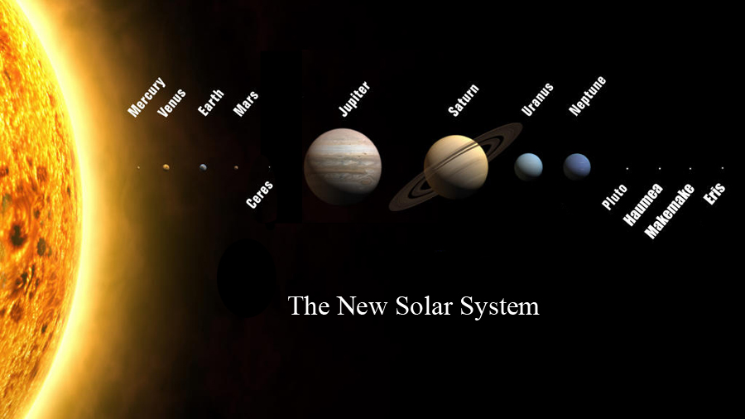

Slide 3
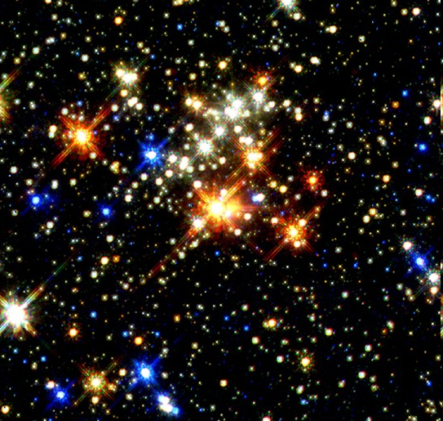
Stars
Many different types of stars in the sky
Stars have long lifetimes
Study many stars to learn about the full lifecycle of a star

Slide 4
We are Stardust
Our bodies contain many types of atoms
Except for the hydrogen in water (H₂O) and other molecules, all of our atoms were made in stars
Stars generate energy by making heavier elements out of light ones
They eject the material into space when they die
New stars and planets (and humans) form out of the ejected material

Slide 5
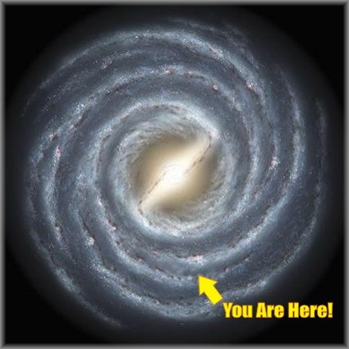
Galaxies
Stars are grouped together in systems called galaxies
Stars orbit galaxy center

Slide 6
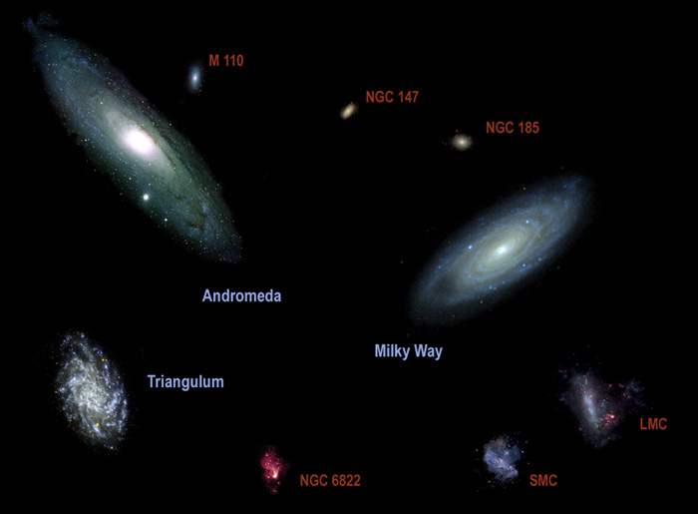
The Local Group

Slide 7
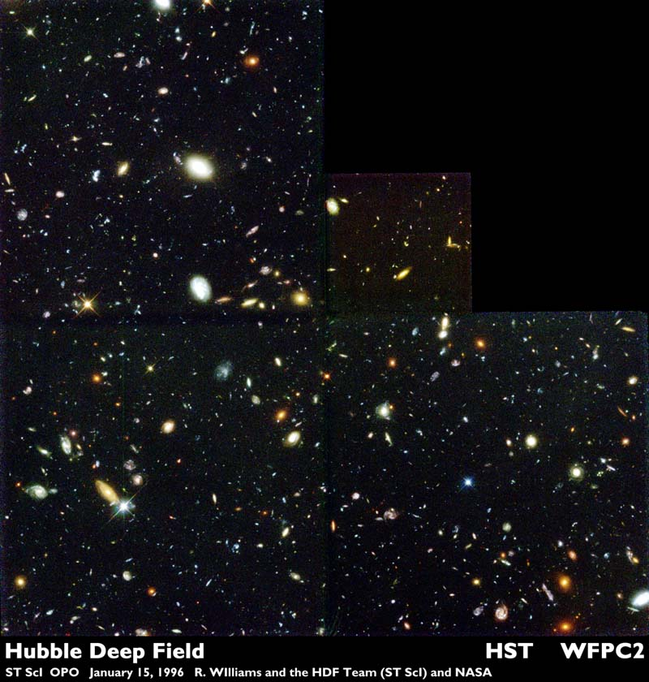
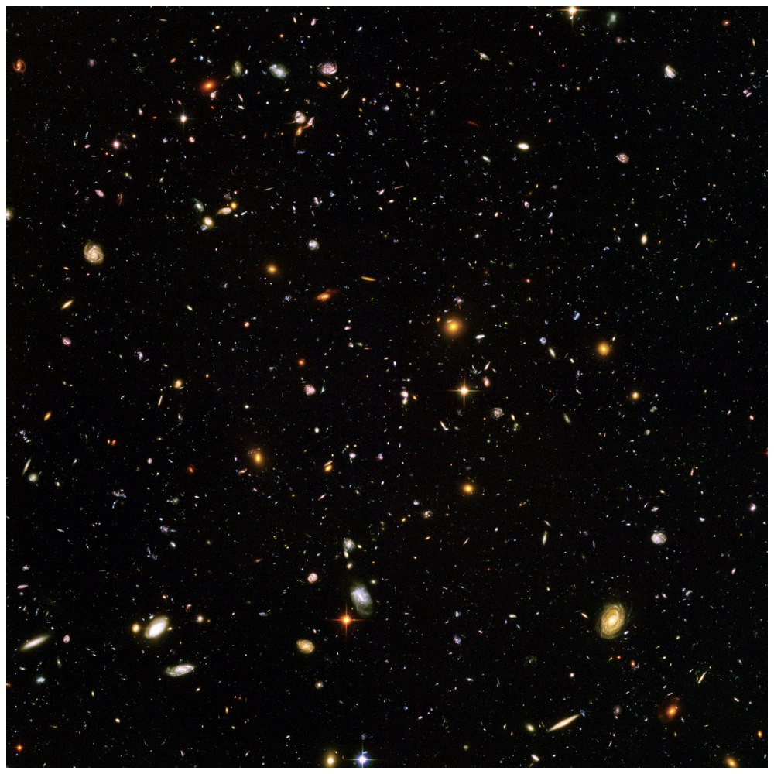
We learn from galaxies that…
NASA/ESA/S. Beckwith (STScI) and the HUDF Team
the Universe is 13.8 billion
years old.

Slide 8
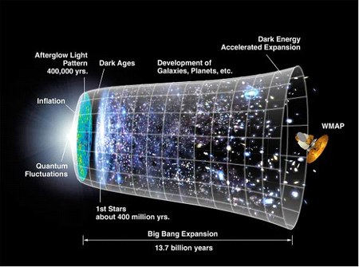
The Universe is Everything
The Universe began with the Big Bang
We don’t know what happened before the Big Bang
The Universe has been expanding since then
Galaxies and stars have formed within the Universe

Slide 9
Space is Big
Scientific notation
Powers of Ten: Large Numbers
  10³ = 1,000
  10⁹ = 1,000,000,000
Powers of Ten: Small Numbers
  10⁻³ = 1/1,000 = 0.001
  10⁻⁹ = 1/1,000,000,000 = 0.000000001

Slide 10
Powers of 10 (SI Units)
10¹² = 1,000,000,000,000 = trillion = tera
10⁹ =1,000,000,000 = billion = giga
10⁶ = 1,000,000 = million = mega
10³ = 1000 = thousand = kilo
10⁻² = 0.01 = hundreth = centi
10⁻³ = 0.001 = thousandth = mili
10⁻⁶ = 0.000001 = millionth = micro
10⁻⁹ = 0.000000001 = billionth = nano
10⁻¹² = 0.000000000001 = trillionth = pico
10⁻¹⁰ = 0.0000000001 = Angstrom = Å
  (only used for distances: 10 Å = 1 nanometer )

Slide 11
New Distance Units: AU
Astronomical Unit (AU)
  average distance between Earth and Sun
  1.496 x 10⁸ km
  92.96 million miles
Distances in our solar system
  5 AU between Jupiter and the Sun
  30 AU between Sun and Neptune (the furthest planet from the Sun)

Slide 12
Light Years
The speed of light: 300,000 km/s
  760 million miles/h
  186 thousand miles/s
light year
  Distance light travels in one year
  About 6 trillion miles
The farther away a light-emitting object is, the farther the light has had to travel to us
The light is older - we are looking back in time

Slide 13
Traveling at about 186,000 miles/s, light takes:
1¼ seconds to arrive from the Moon
8.3 minutes to arrive from the Sun
5.5 hours to get to Pluto from the Sun
4.24 years to get to the nearest star
100,000 years to cross the galaxy
2.5 million years to get to the nearest big galaxy
10 billion years to come from distant galaxies

