Slide 1
Lecture 1: Introduction to CS/ECE 3992 Sr. Project Design
Dr. Tsung-Wei Huang
Department of Electrical and Computer Engineering
University of Utah, Salt Lake City, UT
Notes:
Good morning, everyone. Welcome to CS 3992 Computer Engineering Senior Project Design. I am the course instructor Tsung-Wei Huang, and you can just call me TW, which is much easier to remember.
I am faculty member at the ECE department and my research helps parallel programming easier to handle. And, thanks for taking this course and I believe everyone is forced to do that.
I believe it is quite challenging this semester because I know many of you are suffering from the difficult situations due to COVID-19. The course is going to be in-person because we need you to be here to know each other so you can form teams. Its very difficult to find a team member without sitting in a room to know each other.
Keep in mind, we will need to follow the COVID-19 policy imposed by the university. This means, you need to wear masks and keep social distance.

Slide 2
Class Logistics
Staff
Instructor: Dr. Tsung-Wei Huang (tsung-wei.huang@utah.edu)
TA: Yasin Zamani (yasin.zamani@gmail.com)
Main class
11:50 AM – 13:10 PM Wed/Fri (excluding holiday)
In person + individual project meeting
Office hour
By appointment
Web: https://github.com/tsung-wei-huang/cs3992
Announcement and assignment in Canvas
Notes:
class logistics. We have only one instructor and that is me. We will have one TA, Yasin; Yasin, would you please say hello to everyone and introduce yourself? I have put down our emails so you can reach out to us if you have any questions.
The main class takes place twice weekly. We will not have lectures all the week but in the first several weeks when I need to introduce the ideas of the course, ask you to give elevator pitch to let other students know you more, and present your proposal.
Most of the time will be offline and scheduled individual group meeting for me to understand your progress and give you advice.
You can find me at my office MEB 2124, pretty much every day I will be there. You can also email me to schedule an appointment so we can meet in person or do it virtually through zoom.
Webpage. We will use GitHub to manage the class. You can go visit the page or find the link at the my website. You can check out the class materials from the repository. We use GitHub because it allows everybody to easily keep track of all changes and updates to the class materials.

Slide 3

Watch the GitHub Repository
https://github.com/tsung-wei-huang/cs3992
You can receive all updates
New homework
New check-in data
New updates
… (please register for a GitHub account)
You will need to turn in assignments via Canvas!
Notes:
I kindly ask everyone of you to register for a GitHub account. Once you register for a GitHub account, you can log in your page, go to the class GitHub page, and watch the repository. You will be able to see a link on the top-right page for you to click on to watch the page so you can receive all updates, including ...
It is very important you get familiarized with the GitHub. This is probably the most popular open source repository for you to store your software and hardware project. And GitHub provides many easy access to, for example, keep track of progress, updates, modification, and so on. We will also ask you later on to create personal pages for your resume and set up a project repository in GitHub.
Everything in GitHub is free.
For assignment, you will need to turn in them through Canvas because Canvas requires log in and we can keep many data confidential like your grades.

Slide 4
Scoring
Total 100 points
Engineering Evaluation (10%)
Resume and Elevator Pitch (10%)
Proposal PDF file (30%)
Project Website (15%)
Technical Open House (10%)
Proposal Presentation (15%)
Class Participation (10%)
Recommended textbook
William Strunk and E B White, Elements of Style
Notes:
In terms of scoring, there will be a total of 100 points going to assignment. Since this is a project-driven course, all the assignments are designed to be eventually helping you complete the project. Most of them are discussion-based, and I don’t think there is a way or a necessity to cheat.
We have totally seven items to your final grade.

Slide 5
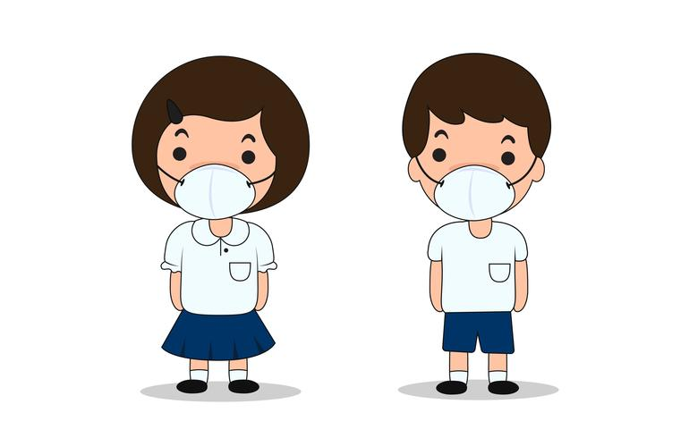
Please Wear Your MASK in Class
Notes:
To avoid contributing to the spreading of COVID-19, we request everyone of you to wear a mask, or you will not be allowed to participate in the LAB.

Slide 6
Class Philosophy
Focus on team work
You need to form a team of 3-4 members
Write a good resume and build your website
Elevator pitch
Work on a real project that matters
Why is it important?
Why should I care?
Write a proposal for what you plan to do in CS/ECE 4992
A contract between you and me
My role is “supervisor”
Collaborate, collaborate, collaborate, …
Notes:
Philosophy of the class. This class is going to focus on team work a lot. And this is really important. You may have a very good technical skill, for example, you can design a hardware system in just a few hours or you can write an AI program in just a few minutes, but, if you are not able to collaborate with others people in a team, most likely you won’t have a good promotion in your career. This is really important in today’s job market. You need to be able to collaborate with other people and this is one of the main themes in the course.
To complete the project, you need to form a team. Each team has about 3-4 members, not smaller, not larger. Form a team of 3-4 members. Beyond that, some people will easily become free rider, below that, the overload is too much.
The project has to be real. It has to be something that matters. Something you create to become useful for your career. For example, why is your project important? Why should I care? You need to be able to answer these two questions.
At the end of this class, you need to turn in a final proposal to outline what you plan to accomplish in the project. This final report has to summarize your implementation ideas in detail. (explore … )

Slide 7
To this end …
Class is organized in three parts
Lectures
Teaming
Project meeting
Notes:
So, …

Slide 8
Let’s Look from the Outcome
Projects from the previous semesters
https://github.com/tsung-wei-huang/cs3992
Notes:
The best way to understand what you need to accomplish in this two-semester-long course is to look at the outcome from previous students.

Slide 9
Assignment 1: Engineering Evaluation
This assignment lets you understand the course goal
Part 1
Identify a daily problem to improve
Provide a solution as a “computer engineer”
Part 2
Watch the videos of previous projects
Write your comments for three projects
Due 11:59 PM on 1/27
Notes:
Now, I would like to explain briefly each assignment in the following slides. Keep in mind, each assignment is designed to help you more understand what you need to do and give you enough equipment and power to accomplish your senior design project.
Assignment 1: Engineering evaluation, due next Wed 11:59 pm. This assignment has two parts, part 1 is to identiy …
The idea is: Engineers improve the life of those in the world around them by improving interfaces, adding capabilities, and fixing things that are broken. For this assignment you will observe the every day world around you and determine what you, as a computer engineer, could do to improve it. Carry a note pad or cell phone and make notes of all the things that you observe over the next week. Turn in a report of identifying the improvement and sketch out your initial thoughts on how you would engineer a solution. The solutions should be realistic and feasible. Practice problem solving at a high level of abstraction and general project planning.
You will be graded on the problems set you identify, the problems having engineering solutions that you can identify, and your ability to define a reasonable project solution approach and effort estimate.

Slide 10
Assignment 2: Resume and Pitch
This assignment lets others know about you
Part 1
Prepare you resume and a personal webpage
Part 2
Stand up to the stage and give a pitch
What’s special about yourself?
Why do you need me to be in your team?
In class pitch
Resume due 11:59 PM on 2/5
Notes:
Create a short resume and quick elevator speech (no slides) that describe why other students in the senior project section would want to "hire" you into their team. Include the engineering skills that you enjoy and that you feel you excel at. You may also want to include areas where you have interest in growth and learning. List any time or accessibility constraints you might have. These would include that you already have a team and your project is half done, you have a work schedule that limits availability, etc. Also, provide a quick overview of interesting design ideas that you are keen to pursue.

Slide 11
Assignment 3: Project Website
Create a project website to include the following:
Project title
Team members
Project abstract (what’s in it and why is it important?)
Proposed methods
Timetable of project-related activities
V1 due 11:59 PM on 2/26
V2 due 11:59 PM on 3/12
V3 due 11:59 PM on 3/26
Notes:
We ask you to use GitHub page to highlight your team, project ideas, and implementation progress. This page must be visible online to all members of your project plus the instructor and the TA. We understand during the project execution, things change quickly and you may switch to another team (though not recommended). So, this assignment has three dues, and each due must be different from the other and the next due should contain more progress than the previous one.
At a minimum, your project page should contain the following:
Project title
Team members
Project abstract (what is your project and why is it important?)
Proposed methods
how are you going to deal with the problem?
what resources do you need to reach the goal?
what are the potential risks involved? any mitigation/contingency plan?
how long does each method take?
what is the job distribution plan for each team member?
Timetable of project-related activities starting from 2/26 (inclusive)

Slide 12
Assignment 4: Engineering Open House
Attend one session of EE technical open house
Write a report on selected projects
What’s unique about the project?
What’s important in the project?
What’s solved by the project?
Due: TBD

Slide 13
Assignment 5: Final Proposal
5-10 pages proposal to identify:
Identify the key idea of the project
Identify the proposed methods in details
How are you going to implement the idea?
How are you going to mitigate the risk?
How are you going to demo the result
Analyze the potential risk is of paramount importance!
Due: 11:59 PM 4/23
Notes:
This document will consist of a 5 to 10 page draft of your final proposal. This draft will clearly identify the key idea of your project, why it is interesting, and add substantial detail on how it will be implemented. The draft will contain relatively complete and polished versions of the following sections: abstract, introduction, background and bibliography for sources used in these sections. A draft of the proposed work, schedule, and required resources need to be included. Be sure to include a risk assessment as part of the proposed work.

