Slide 1
Lecture 3: Building a Personal Website
Dr. Tsung-Wei Huang
Department of Electrical and Computer Engineering
University of Utah, Salt Lake City, UT
Notes:
Good morning, everyone. Today we are going to continue on our journey on senior project design. We are going to talk about team work and resume.
Some of you email me that you are registering for this class under the thesis track, and in this case, do I still need to form team? The answer is no, you don’t need to form a team; however, you need to find an advisor, a faculty member from either ECE or CS who can advisor you on a research project; other than that, everything is the same, you need to turn in all the assignments, give elevator pitch next next week, turn in a final project proposal and of course this project proposal is the research project you are doing with the advisor.

Slide 2
Why Do I Need a Web-based Resume?
Can be “Major” advantage in your job search
So, what is a web-based resume?
Created with a programming language called HTML
Set up in a http server so everyone can view it online
Sometimes, this makes a big difference
Would you prefer to open a file or a web page?
Also, career fair is coming!
https://employment.utah.edu/jobfairs/
Give your resume a try – summer internship or full time
Of course, this is part of assignment #2
Notes:
Every job-seeker today needs a formatted "print" resume for sending to employers as an e-mail attachment (according to the employer's instructions) and using for interviews, job fairs, and general networking, as well as a text-based electronic resume to use for submitting to online job sites and sending in the body of e-mail messages.
Another resume variation that every job-seeker should consider for his or her toolbox is the Web-ready or HTML resume.
What is a Web-ready resume? It's one created with a programming language called Hypertext Markup Language or HTML (or similar Web-based coding). A number of tools are available to help you create a Web-ready resume without having to learn HTML.
Once you have your resume online, employers can access your resume 24/7. If you're networking on the phone with an employer in another city who wants to see a copy of your resume, you can simply refer the employer to the Web address where your resume resides.
That is very convenient, especially for those who are looking job in big companies. There is a lot of you. It does not make a difference without you. It is really important if you can catch up their eyes as soon as possible.

Slide 3
HTML
Hyper Text Markup Language (HTML)
The de-facto programming language for web
HTML elements are building blocks of HTML pages
Represented by a pair of <> tags
Different tags represent different elements
Heading element
Paragraph element
Table element …
https://www.w3schools.com/

Slide 4
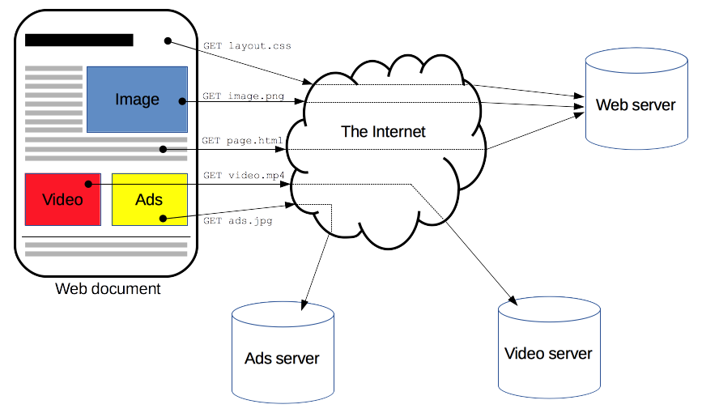
How Does it Work online?
Notes:
Now, suppose I have my html pages ready, the next step is to put it online, put it into the web world so everybody can see it. This means “internet”.
The diagram looks like this. You have your html pages over here, and it contains …,; now these pages sit in a web sever, and a web server is nothing but a machine that maintain your pages, web links, firewalls, proxies, and many other internet-specific things, and more importantly the server tells people how to access your pages, when a person access a link to your page.
For example, when you open a browser and hit a link, the web server starts sending a bunch of data requested by your browser, for example, google chrome or safari. This means, the browser start talking with the server and the browser will visualize the pages for you. At the same time, you can also send requests through the browser, such as, I want to download this data I want to fetch this image. The server will handle this for you.
So the browser is like an agent; it process your requests indirectly. And the web server is like the manager; it handles all the requests from the client.

Slide 5
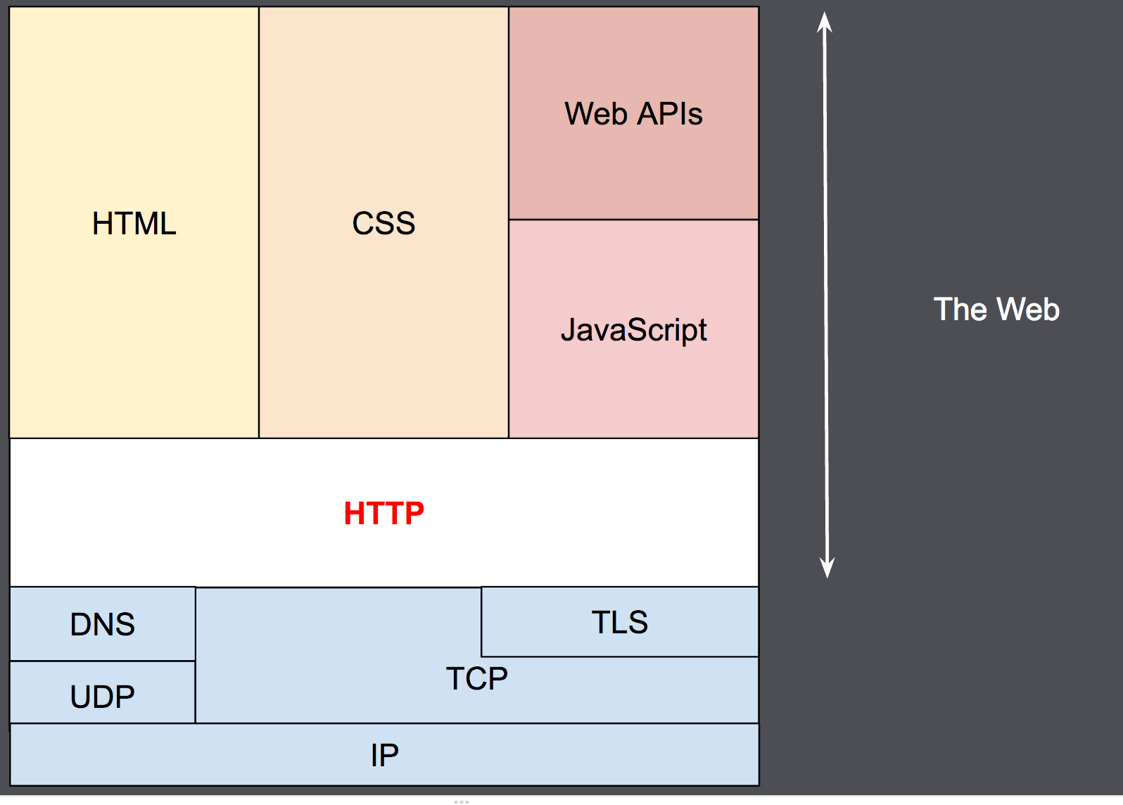
How Does Client Talk to Server?
HTTP: hyper text transfer protocol
Notes:
HTTP is a protocol which allows the fetching of resources, such as HTML documents. It is the foundation of any data exchange on the Web and it is a client-server protocol, which means requests are initiated by the recipient, usually the Web browser.
Typically a complete HTML page is broken into different sub-documents, and the client can fetch each individual part, apparently for speed and dependency purpose, for instance, text, layout, layout description, images, videos, scripts, and more.
The stack looks like this. (explore…)
Clients and servers communicate by exchanging individual messages. The messages sent by the client, again, usually a Web browser, are called requests and the messages sent by the server as an answer are called responses.
I send you a request and you give me a response. I request to see this video, and you send me the video content. That’s the idea.

Slide 6
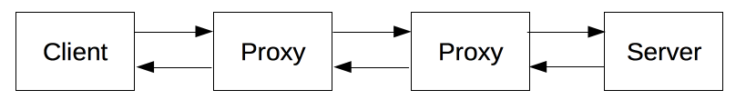
Internet is Very Complex Indeed …
The underlying structure is often many layers
We will use GitHub pages as our web server
https://pages.github.com/
We will provide you a template
https://github.com/tsung-wei-huang/cs3992/tree/main/website
Notes:
Internet is very complex. It’s so complex that Xfinity has outages many times. You know, I didn’t have internet for two days. It’s so unreliable. These days, you realize you become a useless person without internet. What can you do without internet?
Each individual request is sent to a server, which handles it and provides an answer, called the response. Between the client and the server there are numerous entities, typically called proxies, which perform different operations and act as gateways or caches, for example. It is just so complex.
So, the question here is do I need to know all the things? Actually no, there are many free cloud service that provide already nice infrastructure for their customers or users to set up their website in a simple form. What I mean by simple form is, the website is static, typically has only HTML components without access to any dynamic database. But, for our class, this is quite enough.

Slide 7

Let’s get started
Create a file “index.html” with a favorite text editor
Notes:
Let’s get started with your first website. In the rest of today’s lecture, I am going to give you hands-on programming experience in building a website using html. We will start with a simple hello world example, visualize it on your favorite browser (except Microsoft), use github pages to set up a server for you page, and then you can access the weblink to see your page.
Then, we will spend a bit of time talking about css, how to use existing css templates, bootstrap, from twitter, so you can quickly dress up your website with eye-catching components.
The first step is to create a file, with the file name “index.html”, and open it up with your favorite text editor. In my case, I use vim. Vim is the best for learning programming, btw.

