Slide 1
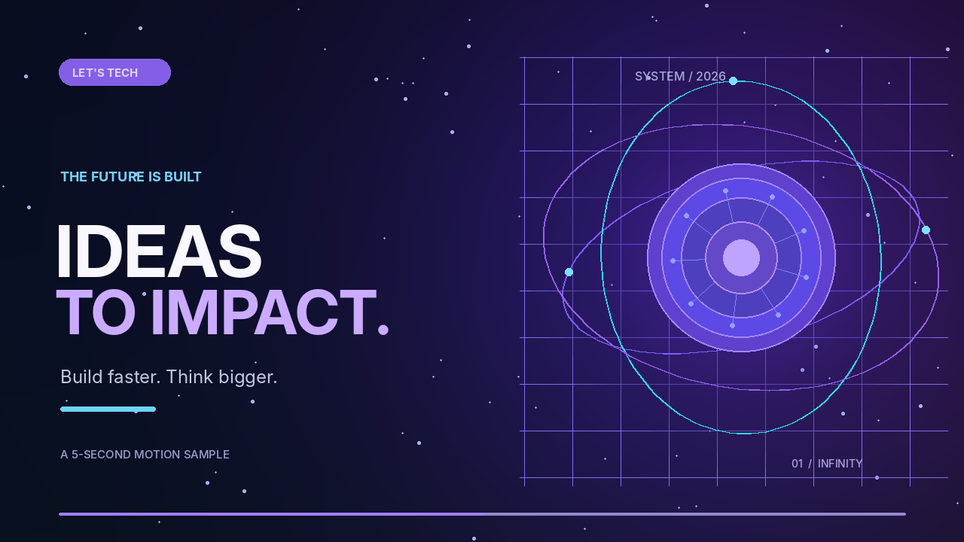

Slide 2

LET'S TECH / MINI DECK
02 / 03
3 WAYS AI CREATES
LEVERAGE
Not just better answers. Better ways of working.
01
02
03
THINK FASTER
CREATE MORE
AUTOMATE WORK
Turn rough questions into plans,
insights, and next steps.
Move from an idea to a first
draft or prototype.
Give repetitive steps to tools
and focus on decisions.
AI is most powerful when it strengthens a real workflow.

Slide 3
LET'S TECH / MINI DECK
03 / 03
FROM IDEA TO
REAL IMPACT.
Small experiments compound into serious skills.
01
02
03
DEFINE
PROTOTYPE
IMPROVE
Pick one specific
problem to solve.
Build the smallest
useful version.
Get feedback. Refine.
Share what worked.
START WITH ONE REAL PROBLEM THIS WEEK →

