Slide 1

PRESENTATION ON PROJECT
NAME-BRAHAMDEEP SINGH
ROLL NO.-22303045
FIELD-NODE.JS EXPRESS.JS AND MONGODB
UNIVERSITY-SBSSU, GURDASPUR,PUNJAB, INDIA
COMPANY-NOVEM CONTROLS, MOHALI

Slide 2
CHAPTERS OVERVIEW:
This Presentation is structured into well-defined chapters to provide a clear and logical flow of information:
Chapter I: Introduction
Describes the background, necessity, objectives, and theme of the training, along with the structure of the report.
Chapter II: Literature Survey Related to Training
Presents the theoretical background and research on technologies used — Node.js, Express.js, MongoDB — and their roles in modern web development.
Chapter III: Training Work
Describes the hands-on work performed during the training period, including daily activities, technologies practiced, challenges faced, and solutions implemented. Also includes details of the capstone project.
Chapter IV: Evaluation of Training
Analyzes the outcome of the training, comparison of planned vs. actual output, skill enhancement, and overall learning experience.
Chapter V: Conclusion and Future Scope
Summarizes the learnings and outcomes of the training and discusses potential future improvements and real-world applications of the project work.

Slide 3
CHAPTER 1: INTRODUCTION
Introduction:
A E-Commerce is a web-based application designed to manage products, orders, and add to cart functionality.
Built using the Nodejs, MongoDB to ensure modern, scalable, and responsive functionality.
Helps Vendors streamline operations digitally.
Necessity of the System:
Enables seamless online buying and selling of products.
Reduces manual work for sellers and improves efficiency.
Provides a platform for secure transactions and data management.
Enhances customer experience with easy product search and orders.
Supports business growth through wider reach and 24/7 availability.

Slide 4
Objectives:
Develop a full-stack web app using MongoDB, Express, Node.
Implement CRUD operations and secure user authentication.
Ensure smooth client-server data flow.
Manage media using Cloudinary.
Apply MVC and modular routing for clean code structure.
Gain real-world project experience and improve coding skills.
Organization:
Chapter I – Introduction
Chapter II – Literature Survey
Chapter III – Training Work
Chapter IV – Evaluation
Chapter V – Conclusions & Future Scope

Slide 5
CHAPTER II – LITERATURE SURVEY
Literature Survey Overview:
Study of existing e-commerce systems like Amazon, Flipkart etc.
Analysis of backend frameworks and database integration.
Review of research on RESTful APIs and scalable architectures.
Focus on authentication, CRUD operations, and media management.
Findings from Literature Survey:
E-commerce systems enhance shopping efficiency and reach.
MERN is widely used due to its scalability and JavaScript-only workflow.
Backend frameworks like Node.js and Express.js simplify server-side development.
NoSQL databases like MongoDB handle dynamic product and user efficiently.
Secure authentication and role-based access are essential for user safety.

Slide 6
CHAPTER III – TRAINING WORK
Training Module Development:
Modules learned and implemented:
Frontend (HTML/CSS + JS)
  User and Vendor Interfaces.
  Forms for registration , login , product management.
Backend (NodeJS + ExpressJS)
  REST APIs
  Authentication with JWT
Database (MongoDB)
  Users, Vendor, Products, AddtoCart, Orders collections
Integration
  API communication, Fetch, CORS

Slide 7
Development Methods Used:
Computational: Writing backend logic, CRUD operation, API request handling.
Experimental: Testing user/vendor interactions, cart, and other workflows.
Mathematical: Managing pricing calculations, and order summaries.
Statistical: Analyzing products orders and user activity.
Conceptual: Designing system architecture, database schemas, API structure.
System Architecture:
Frontend(HTML/CSS + JS) communicates with
Express/Node REST API, which connects to
MongoDB database storing all users, vendors, products, and orders.

Slide 8
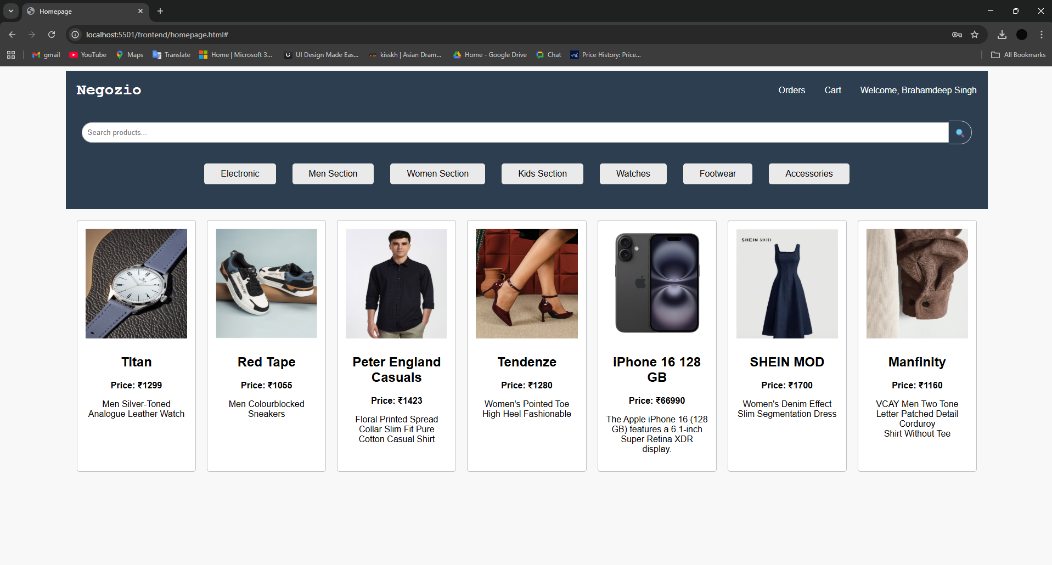
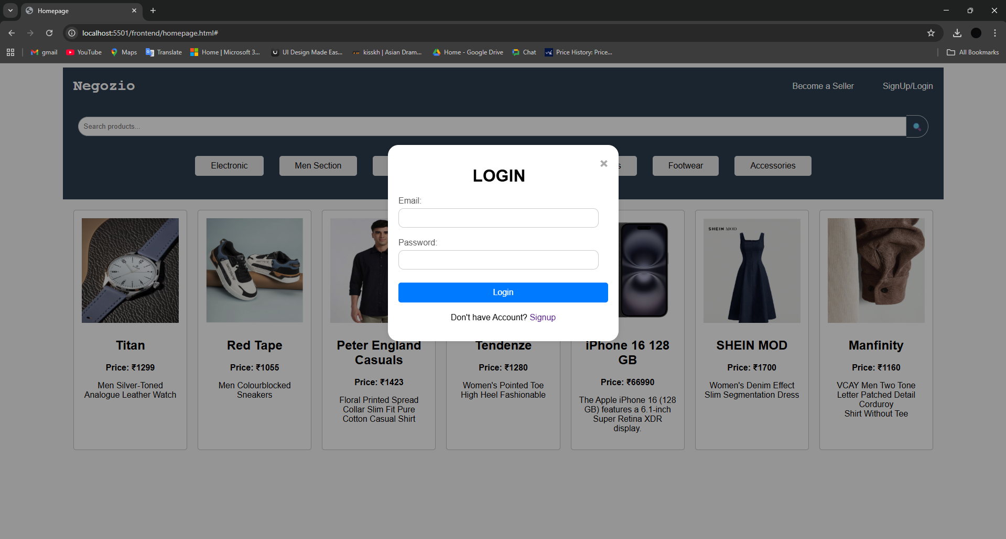
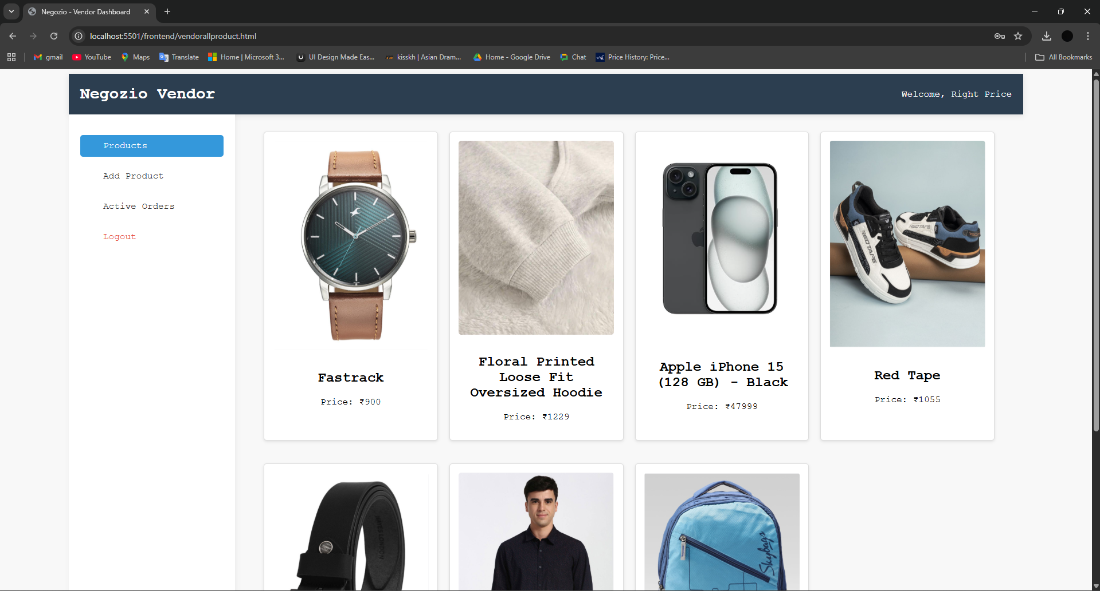
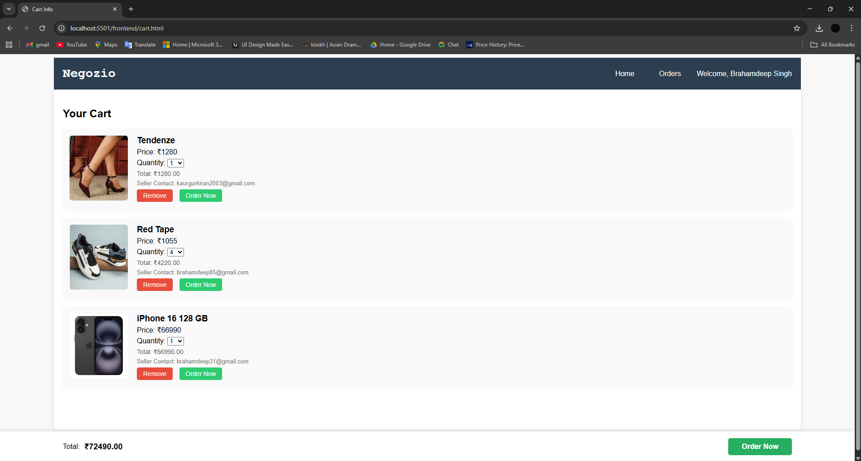
Some Project Screenshots:

Slide 9
CHAPTER IV – EVALUATION OF TRAINING
Evaluation Methods:
Evaluation based on:
Functionality testing of all features
API performance and response times
User/Vendor Interface responsiveness
Database operations and efficiency
Error handling and security measures

Slide 10
Analysis of Work Completed:
Developed all major modules (users, vendors, products, orders).
Implemented signup/login using JWT authentication and password hashing.
Connected frontend to backend using REST APIs.
Created dashboards for users & vendors.
Tested cart, orders and product management workflows.
Output at Various Stages:
Stage 1: Basic UI pages for users and vendors.
Stage 2: Backend server and API developed.
Stage 3: Database collections & relationships created.
Stage 4: Frontend-backend Integration & real-time data flow achieved.
Stage 5: Fully functional, deployment-ready e-commerce system.

Slide 11
CHAPTER V – CONCLUSIONS & FUTURE SCOPE
Conclusions:
Negozio successfully automates e-commerce operations for users and vendors.
Node.js, Express.js, and MongoDB enabled a scalable, modern backend system.
Digital system reduces errors and dependence on manual processes.
Enhances accessibility and management of products, orders, and user data.
Future Scope:
Integrate secure payment gateways.
Advanced search, filters, and product recommendations.
Mobile apps for Android and iOS.
Enhanced security with multi-factor authentication and encryption.
Clod deployment for scalability.

Slide 12
Applications:
E-commerce stores
Online marketplaces
Retail businesses
Inventory management systems
Vendor-customer platforms

