Slide 1
Op-Amp ECG Heartbeat Detector
Precision rectifier · peak detector · Schmitt comparator
Brahiam Alberto Campiño Romero
Instructor: Eng. Rodolfo José Gutiérrez González
Nonlinear Circuits · Universidad de Ibagué · 2026
Notes:
Heartbeat detector overview: the goal is to deliver one clean pulse per QRS complex using only operational amplifiers.

Slide 2
Problem
Design and implement an op-amp-based heartbeat detector powered from ±12 V, able to identify every QRS complex of an ideal 0.5 to 2 Vpp ECG-like signal regardless of its polarity or waveform type, delivering one clean rectangular pulse per beat over a range of 40 to 150 beats per minute.

Slide 3
One pulse per beat, regardless of polarity
Amplifier
×4.9
Rectifier
|Vg|
Peak detector
τ = 100 ms
Schmitt
1.01 / 0.52 V
LED
output
Nonlinear blocks
Why a linear circuit is not enough
The R wave can be positive or negative → rectify
The QRS has several lobes → merge them into one
Design limits: 0.5 to 2 Vpp
Notes:
Each block solves one problem: the rectifier removes the polarity dependence, the peak detector merges the QRS lobes into a single event, and the Schmitt trigger turns the envelope into a clean digital pulse.

Slide 4
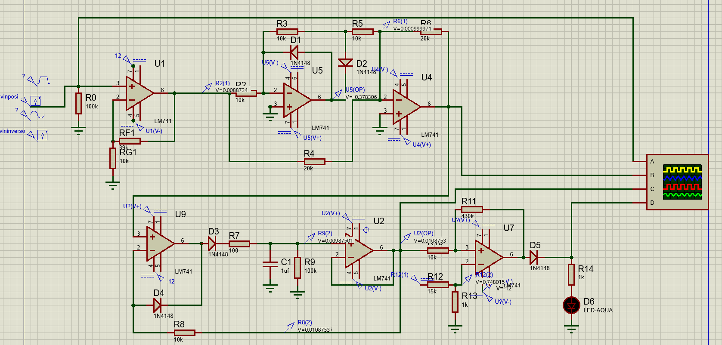
Full circuit: 6 op-amps at ±12 V
Simulated in Proteus with LM741
Notes:
Top row: amplifier, half-wave rectifier and summer. Bottom row: buffered peak detector, Schmitt comparator and LED. The oscilloscope probes input, Vr, Venv and output.

Slide 5
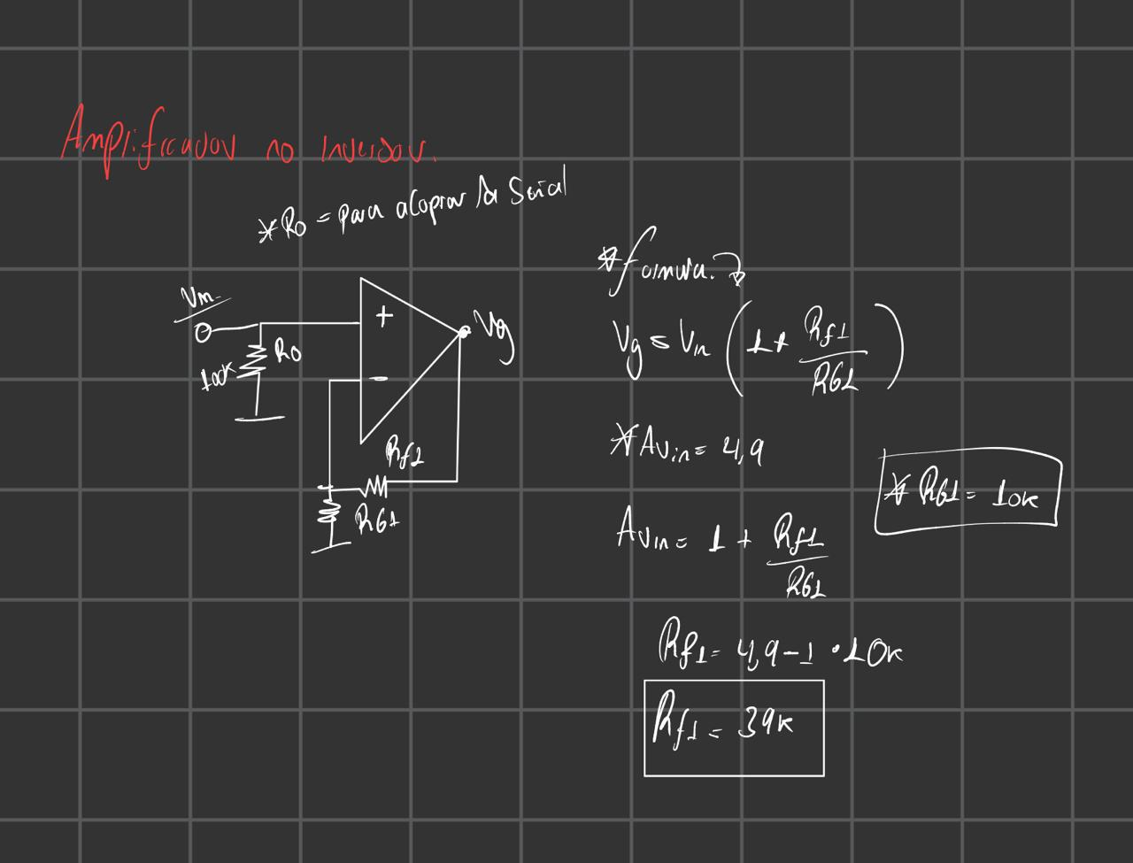
Stage 1 · Non-inverting amplifier
1
Key points
Vg = Vin (1 + Rf1/Rg1)
Av = 4.9
Rg1 = 10 kΩ → Rf1 = 39 kΩ
0.5–2 Vpp → 2.45–9.8 V
Av = 4.9
valid range: 4.04 to 5.25
Notes:
The gain must lie between 4.04 (to clear the threshold with margin) and 5.25 (to avoid saturation). 39 k over 10 k gives 4.9 with standard values.

Slide 6
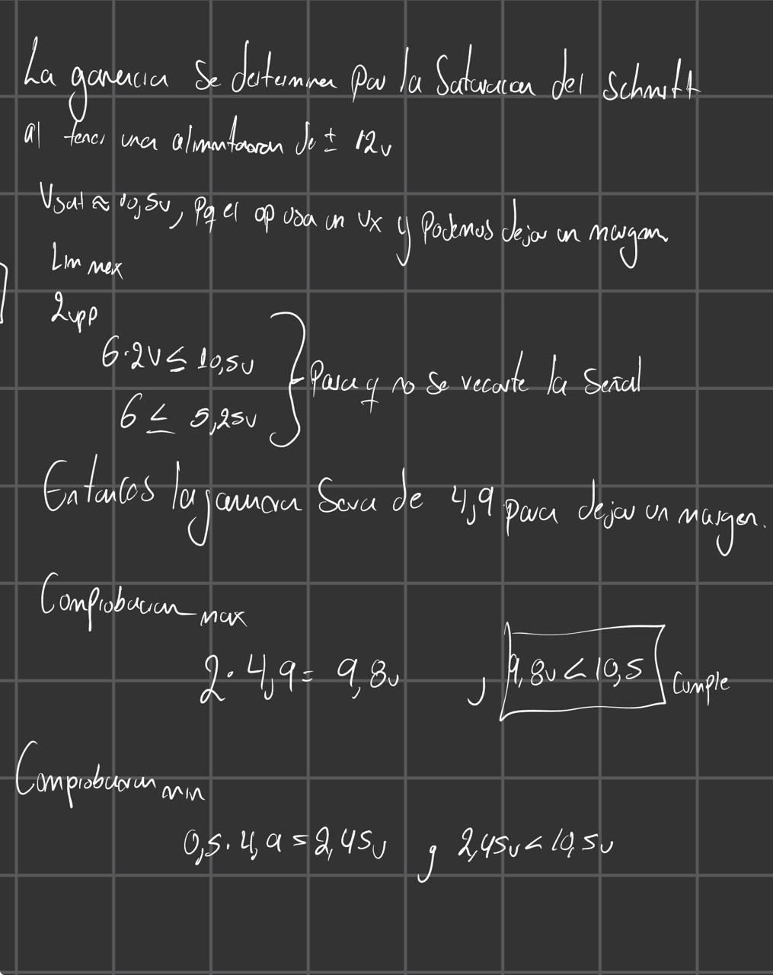

Slide 7
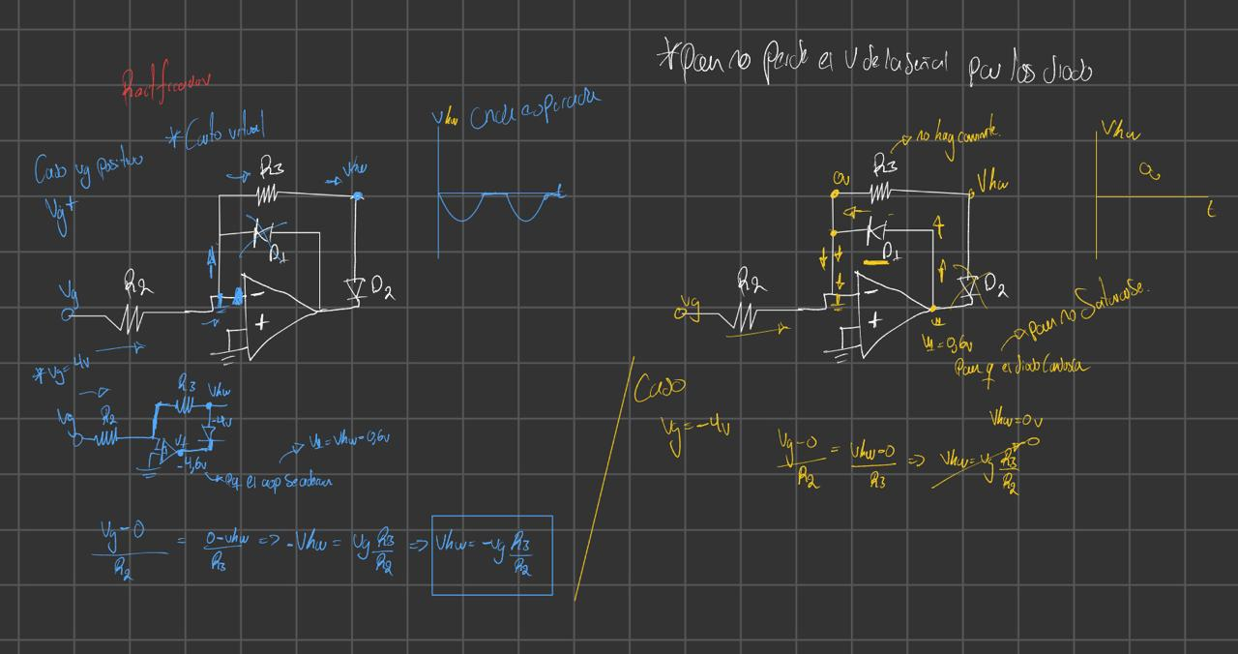
Stage 2 · Precision rectifier
2
Vg > 0
D2 conducts · Vhw = −Vg
Vg < 0
D1 conducts · Vhw = 0
Precision
Dead zone ≈ 3 µV
Notes:
The diode is inside the feedback loop: the op-amp drives its output an extra 0.6 V, so that drop does not appear at Vhw. D1 keeps the op-amp out of saturation on the negative half-cycle.

Slide 8
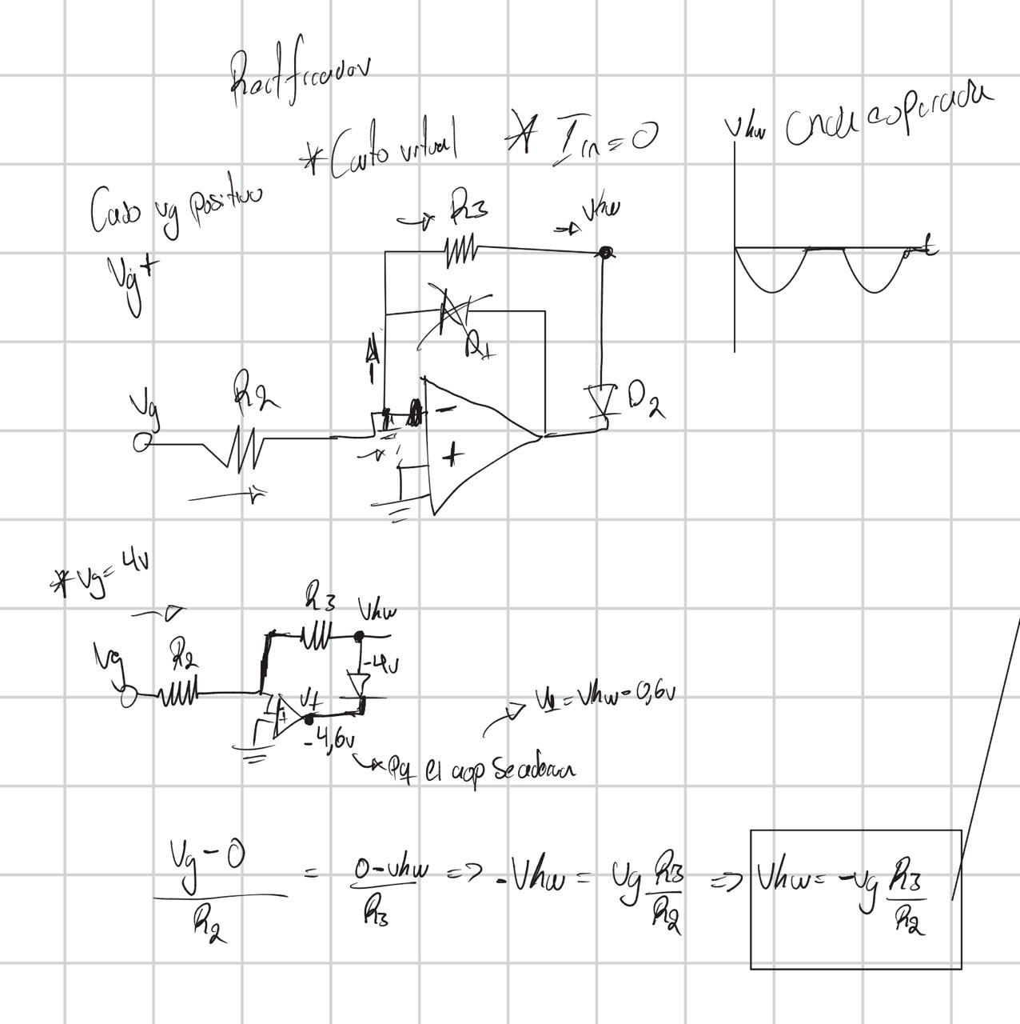
Case 1, Vg +

Slide 9
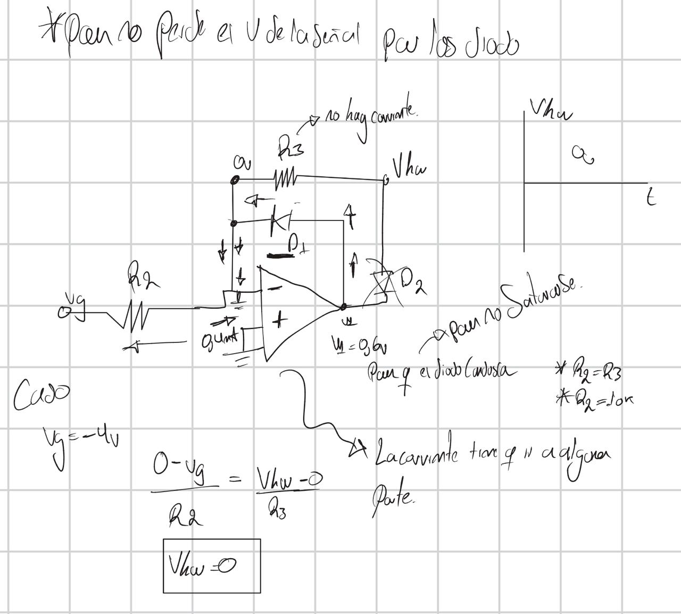
Case 2, Vg -

Slide 10
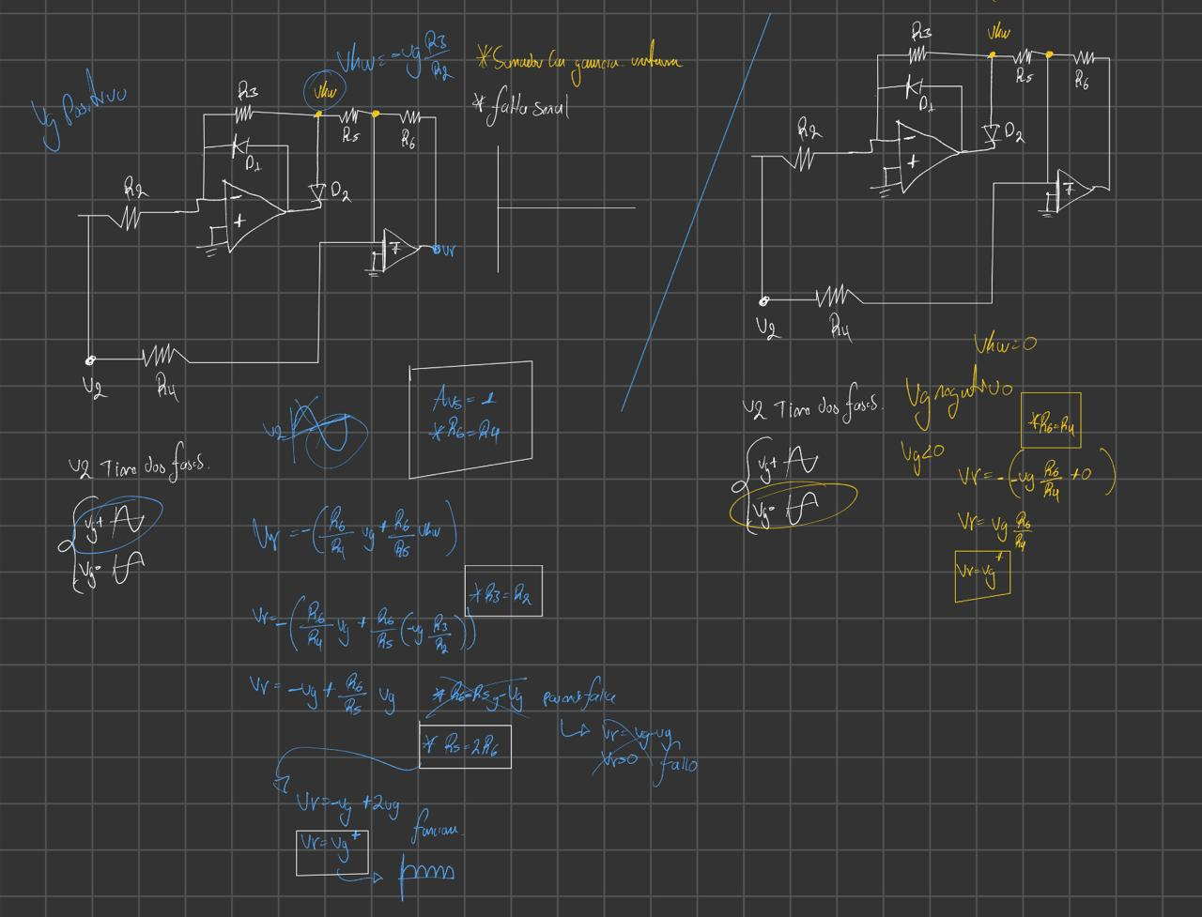
Stage 2 · Summer: from half-wave to |Vg|
2
Key points
Vr = −(Vg + 2·Vhw)
R6 = R4 = 20 kΩ
R6 = 2·R5 (R5 = 10 kΩ)
Result: Vr = |Vg|
1 %
tolerance for R2 to R6
Notes:
R4 feeds the full signal with weight 1 and R5 the half-wave with weight 2. On the positive half-cycle this flips the sign; on the negative one only R4 acts. Resistors must be 1 %.

Slide 11
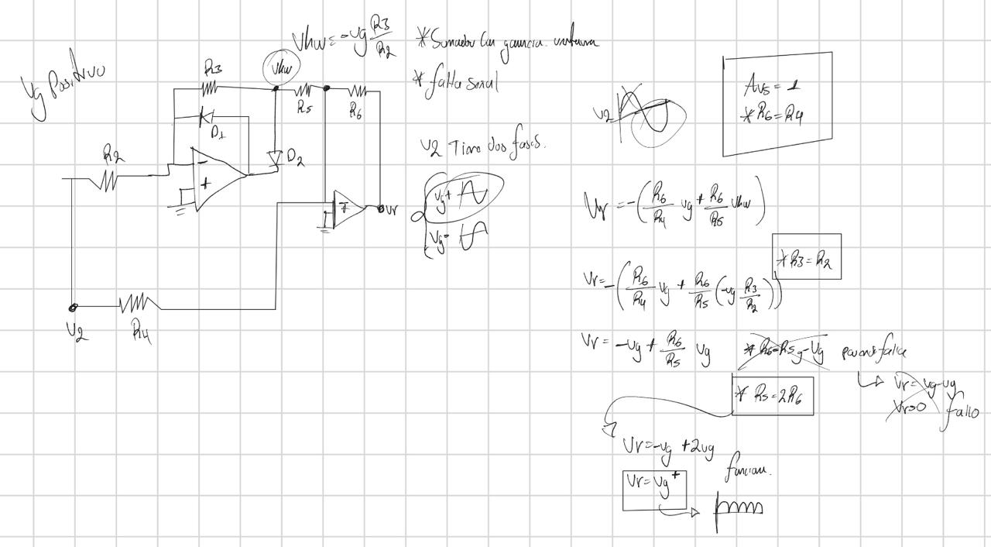

Slide 12
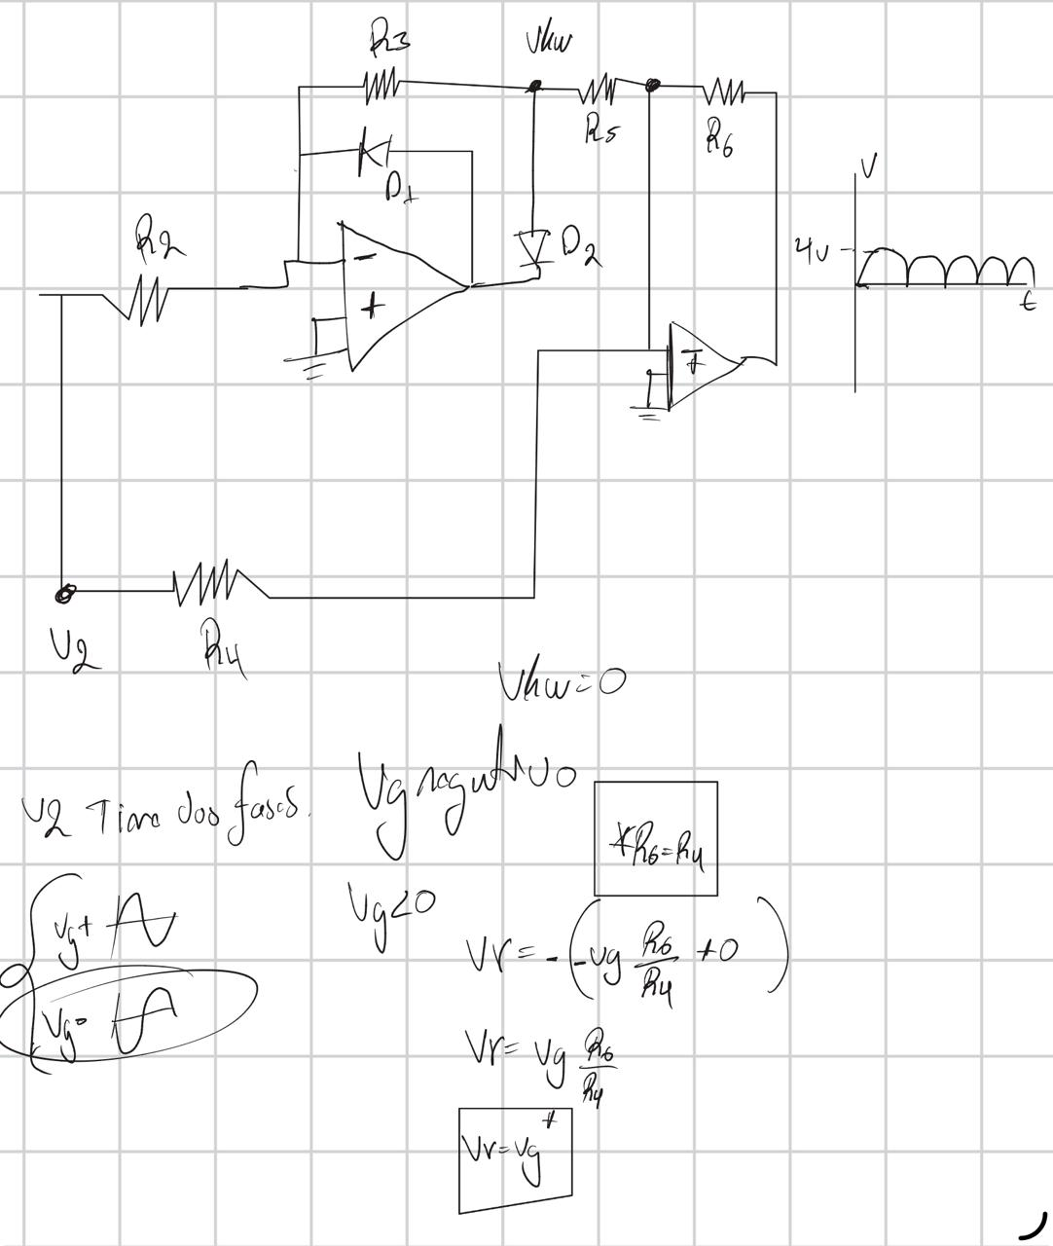

Slide 13
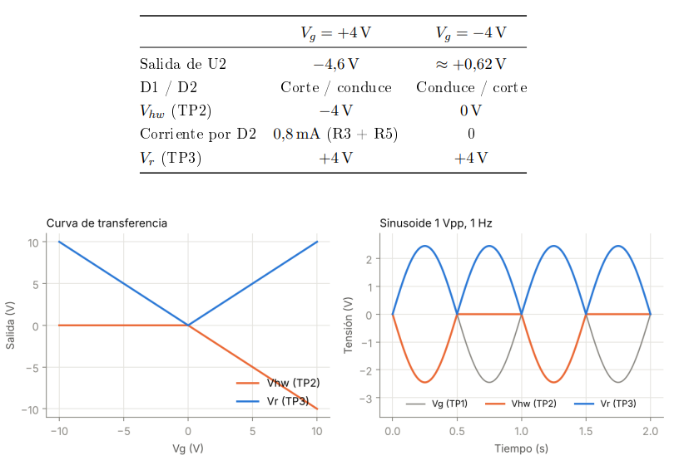

Slide 14
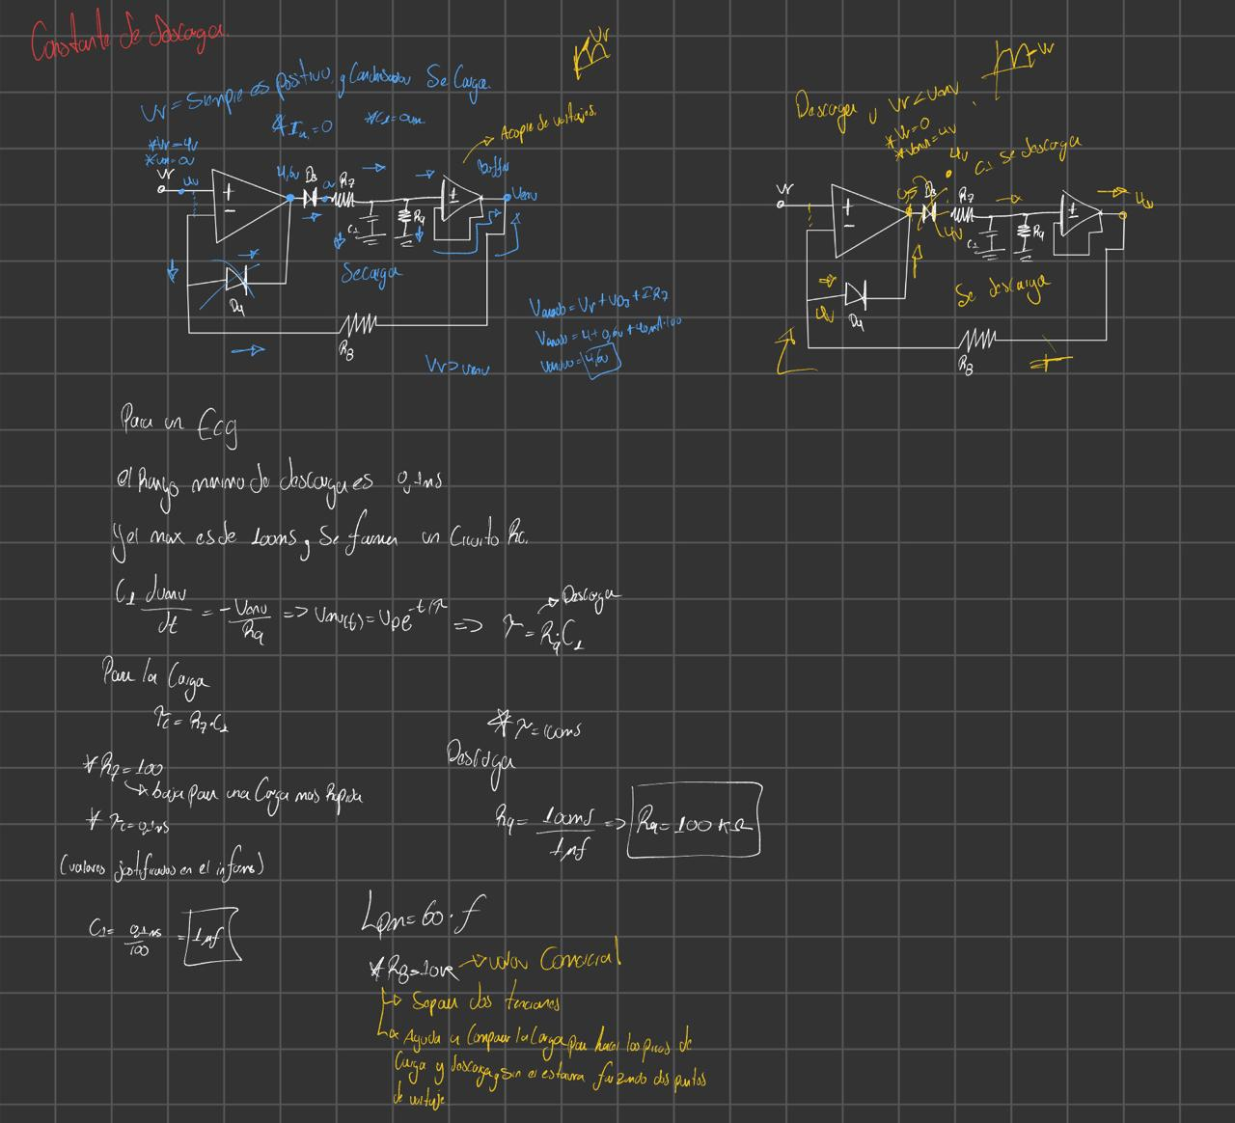
Stage 3 · Peak detector
3
Key points
τ = R9·C1 = 100 kΩ · 1 µF = 100 ms
Valid range: 90–110 ms
Buffer: τ is independent of R8
100 ms
0.1 ms
discharge time constant
charge time constant
Notes:
τ above 90 ms so the beat is not released between QRS lobes; below 110 ms so it releases before the next beat at 150 bpm. The buffer keeps R8 from discharging the capacitor.

Slide 15
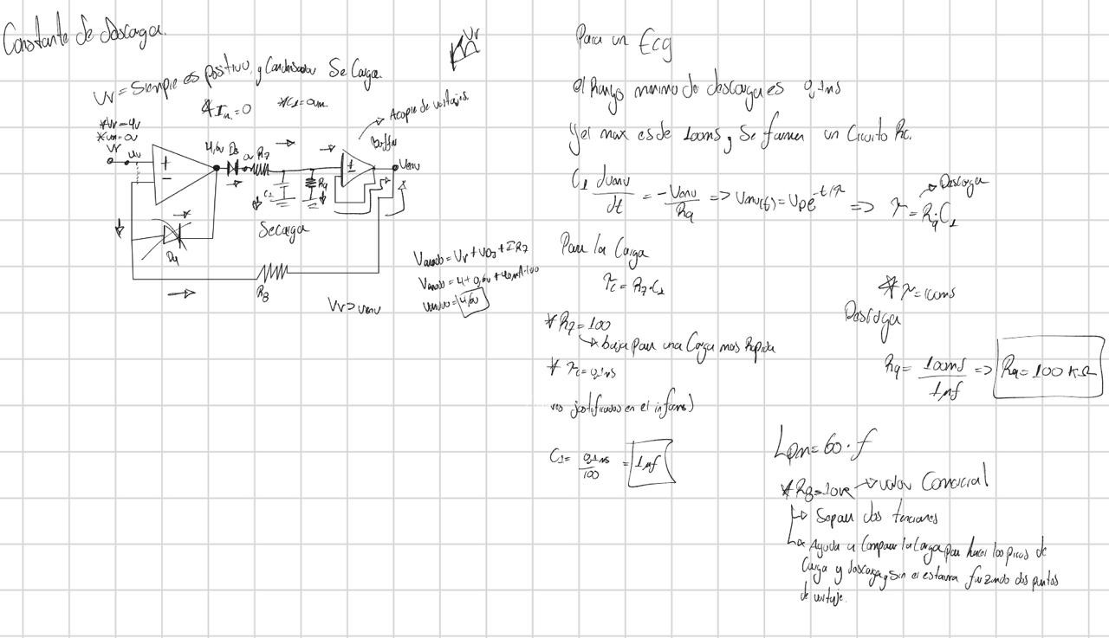

Slide 16
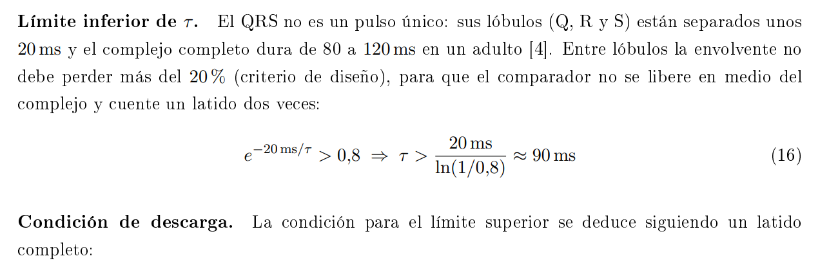
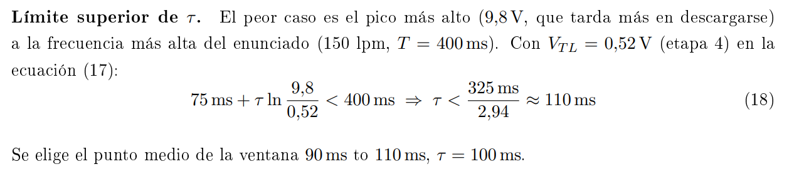

Slide 17
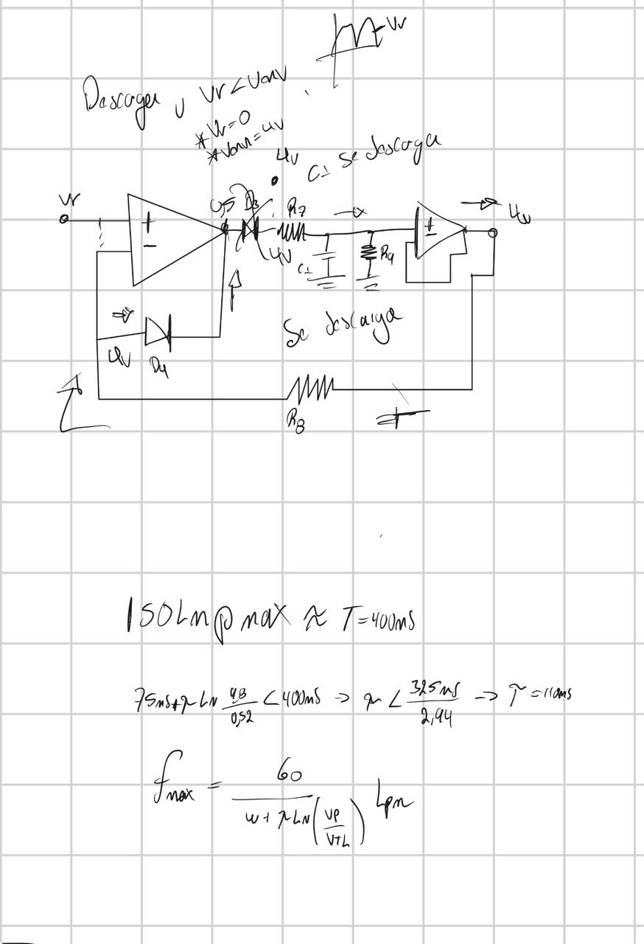

Slide 18
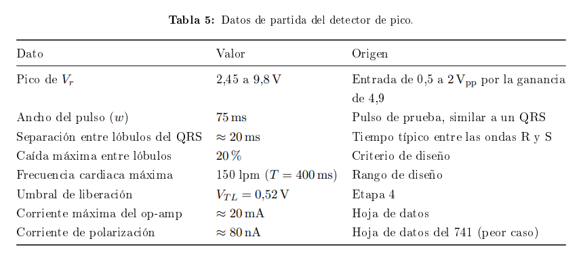

Slide 19

τ sets the maximum heart rate
Formula (taken from the report)
163 bpm
limit at 2 Vpp
Notes:
A larger peak takes longer to discharge, so the limit drops with amplitude. With τ = 100 ms the worst case (2 Vpp) is 163 bpm, above the 150 bpm target. Simulation confirmed that at 180 bpm with 2 Vpp the comparator stays high.

Slide 20
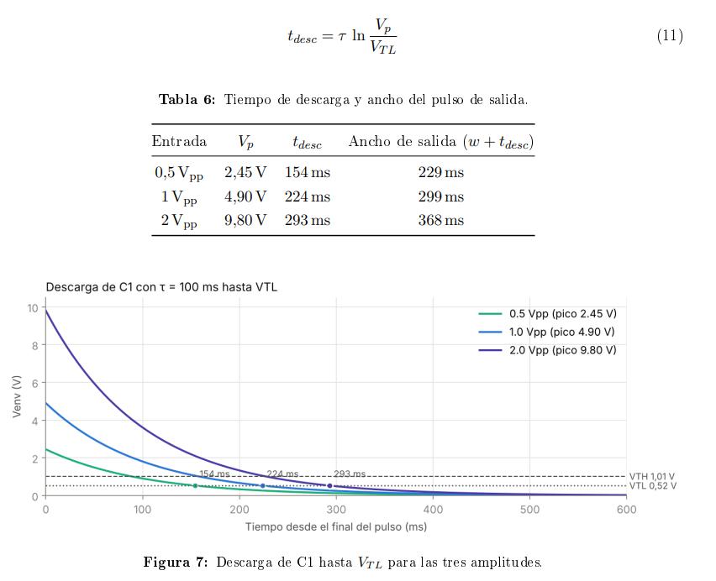

Slide 21
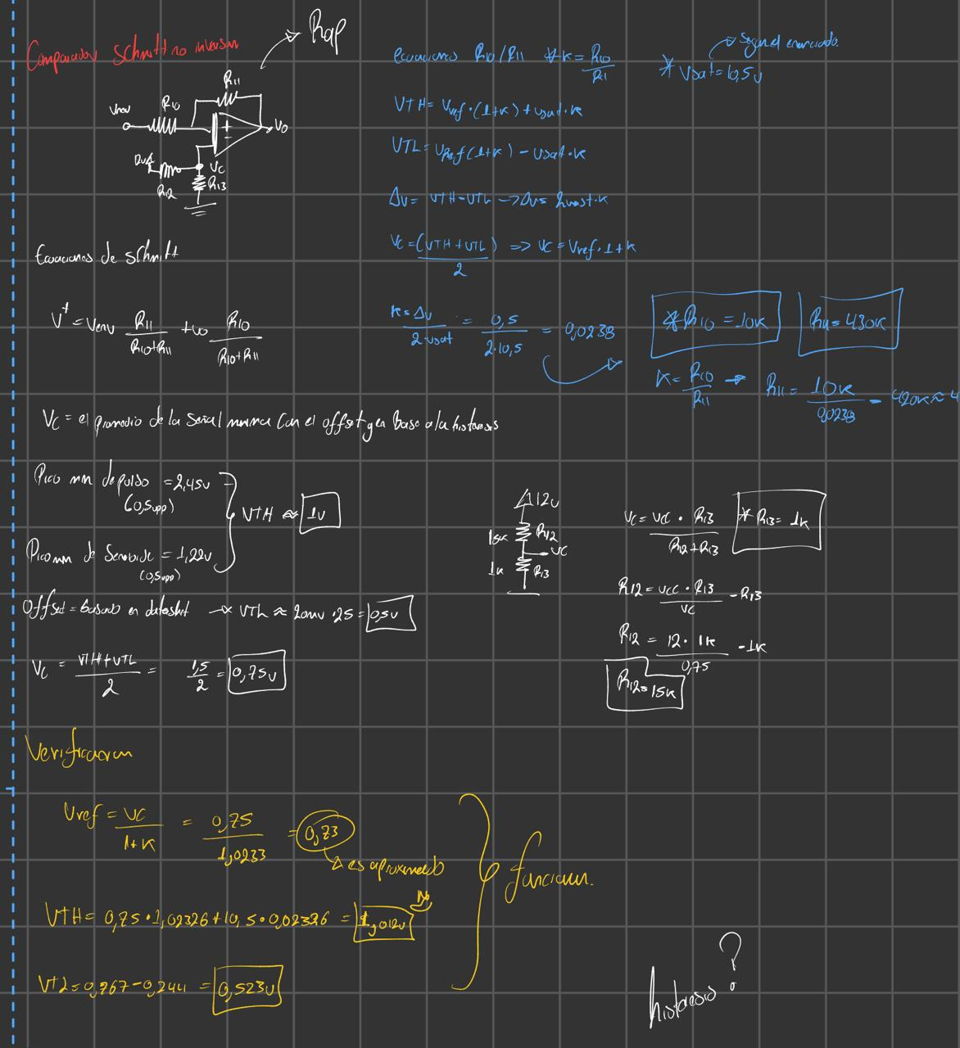
Stage 4 · Schmitt comparator
4
Key points
k = R10/R11 = 0.0233 (430 kΩ)
Vref = 0.75 V (R12 = 15 kΩ, R13 = 1 kΩ)
1.01 V
0.52 V
0.49 V
VTH (trigger)
VTL (release)
hysteresis
Notes:
Positive feedback: there is no virtual short. VTH sits below the minimum peak (1.22 V) and VTL well above the offset. Hysteresis prevents noise-induced chatter.

Slide 22
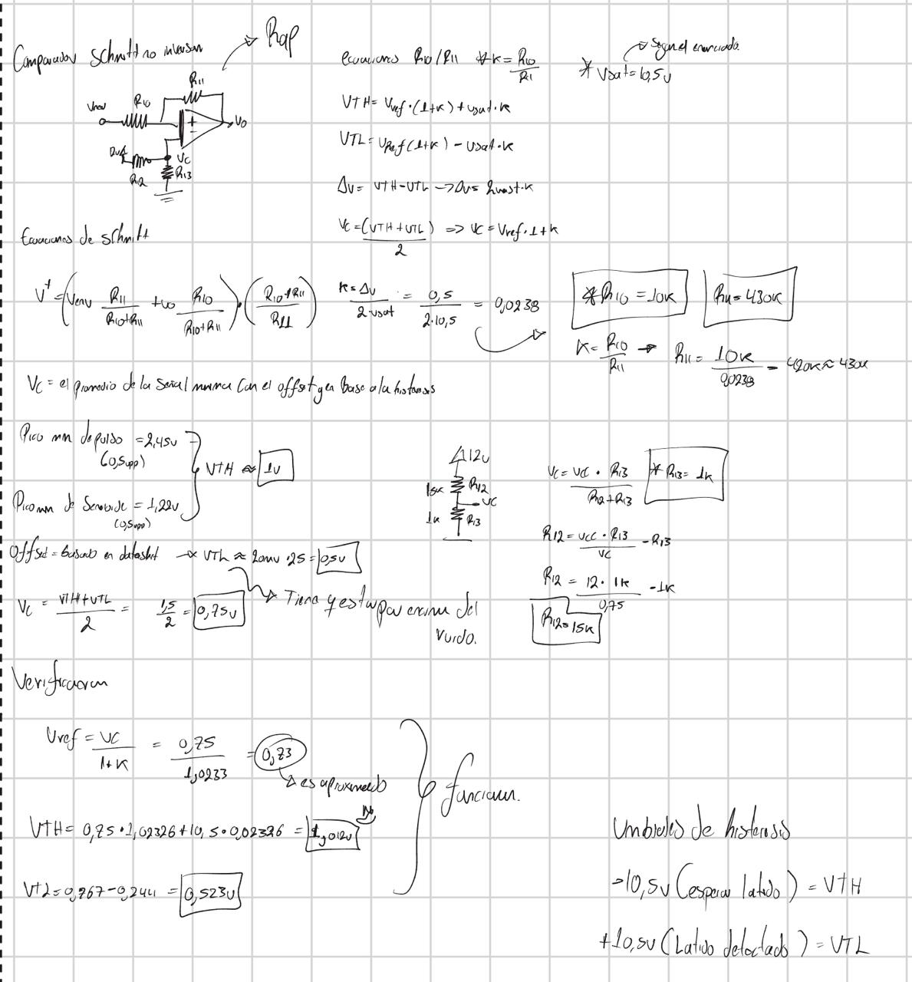

Slide 24
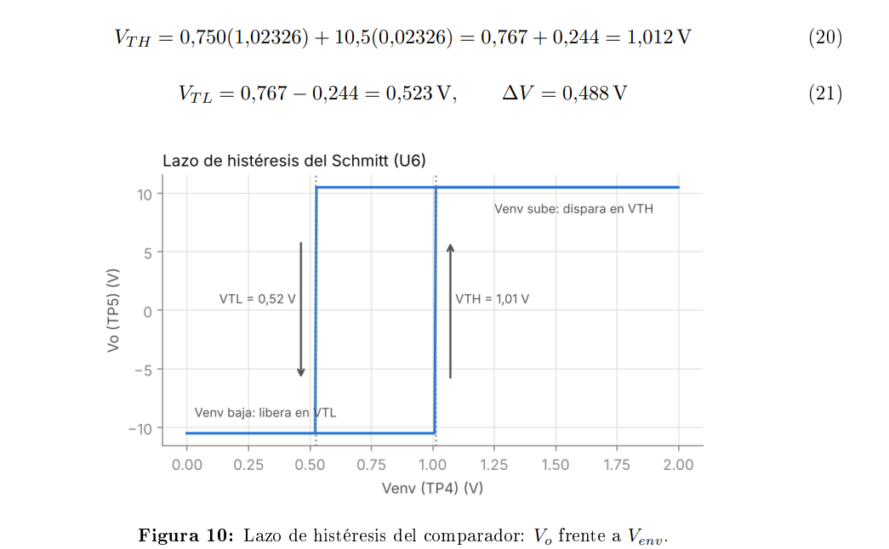

Slide 25
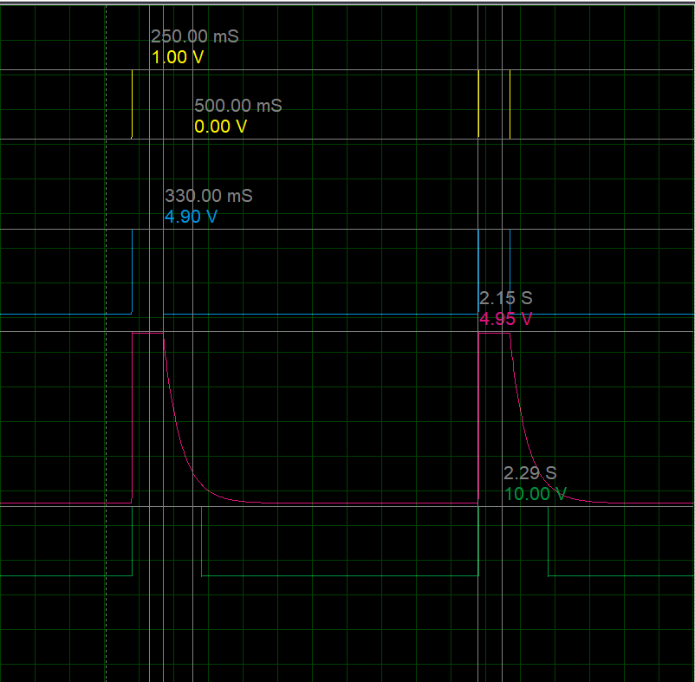
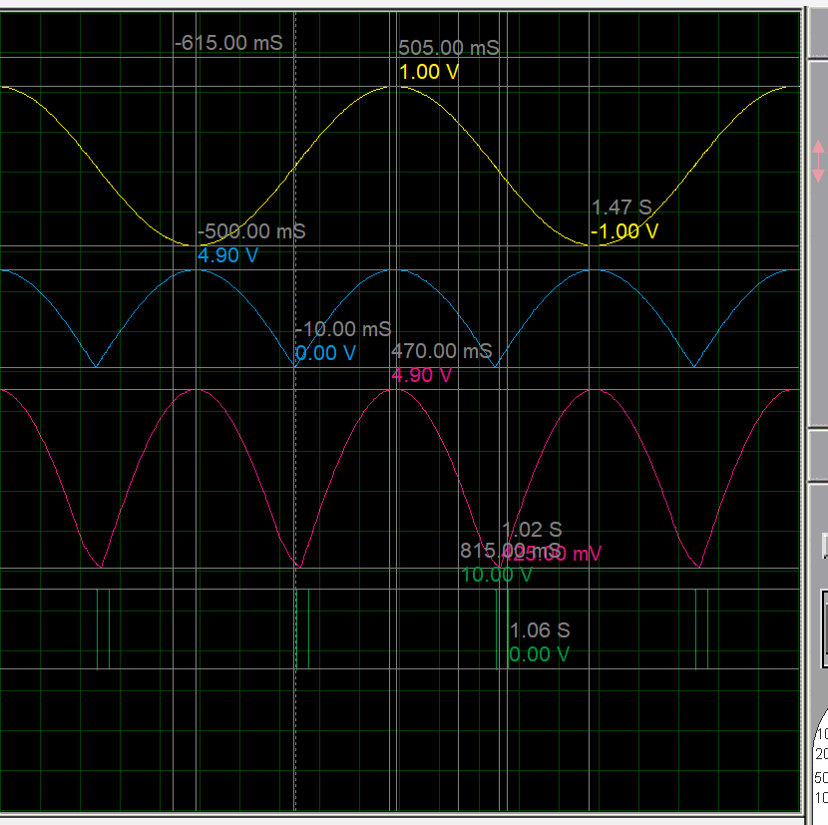
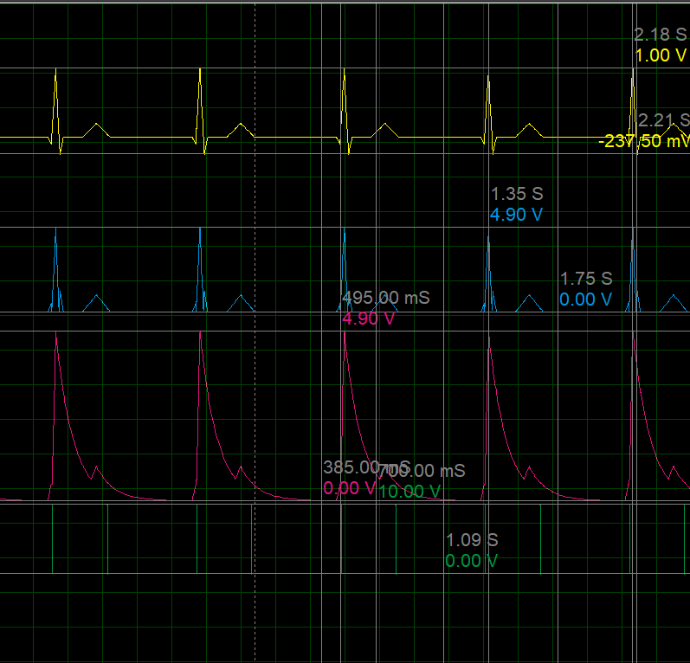
Proteus simulation
1 V pulse · 0.5 Hz
2 Vpp sine · 0.5 Hz
Synthetic heartbeat
Yellow: input · Blue: Vr · Pink: Venv · Green: output
Notes:
Pulse: the envelope holds and decays; the output lasts about 400 ms. Sine: two pulses per cycle, showing both polarities are detected. Synthetic heartbeat: a single pulse per beat despite multiple lobes and the T wave.

Slide 26
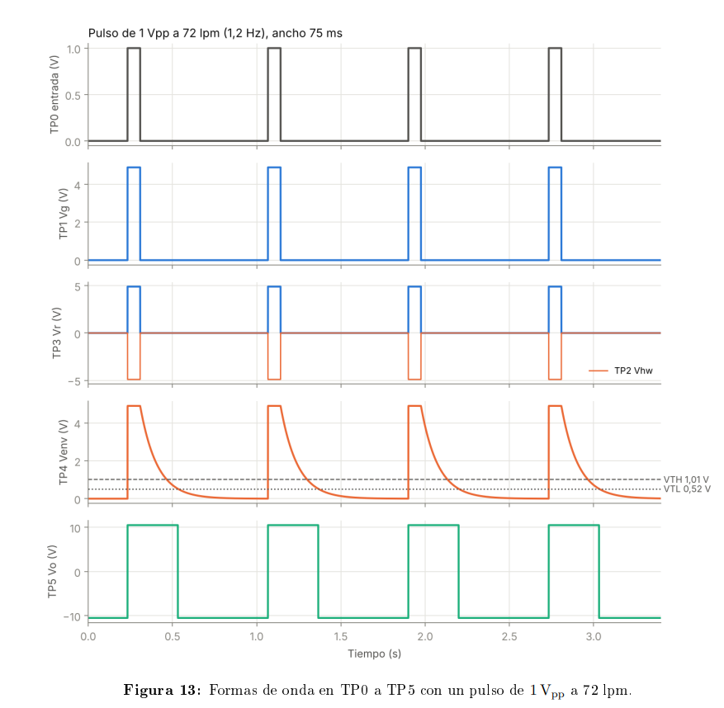
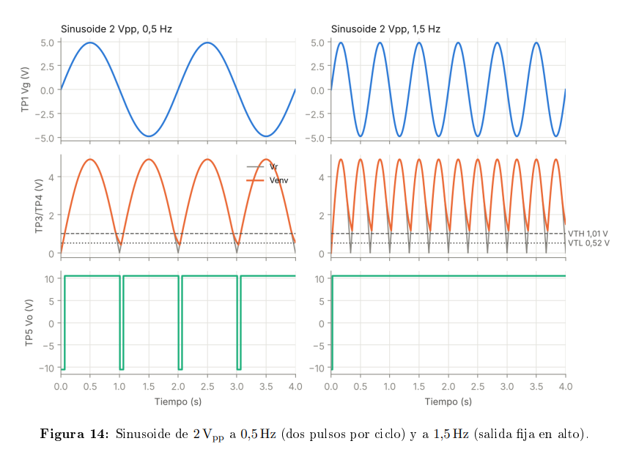

Slide 27
Simulation vs calculation
4.90 V
400 ms
2
≤ 1.6 %
Vr peak (calc. 4.90 V)
output width (calc. 405 ms)
pulses per sine cycle
maximum error
Pending in the lab
Measure τ, VTH, VTL and offset on the real build
Notes:
Proteus values match the calculations with errors of 1.6 % or less. Comparison with bench measurements is still pending.

Slide 28
Conclusions
1
Polarity The precision rectifier detects both positive and negative R waves
2
One pulse The peak detector merges the QRS; τ = 100 ms is the critical parameter
3
No chatter Schmitt hysteresis gives clean transitions
4
Validated Proteus matches the calculation (error ≤ 1.6 %)
Notes:
Possible improvements: instrumentation amplifier with band-pass filter, adaptive threshold, and beat counting with a microcontroller.

Slide 29
References https://github.com/Brahiam18/ecg-heartbeat-detector/tree/main

