Slide 1
GENERATIVE AI TEXT FEATURES
TEAM MEMBERS:
P.SRINADH - 99220041325
P.BRAHMA TEJA - 99220041299
P.TIRUMALESH - 99220041288

Slide 2
PROBLEM STATEMENT
TITLE : GENERATIVE AI TEXT FEATURES :A comprehensive approach using Natural Language Processing Techniques and Machine Learning.
Definition:
The aim of this project is to come up with an intensive generative AI system, incorporating the following four major features of text processing: Text Summarization, Sentiment Analysis, Text Generation, and Language Translation. This will enhance, in turn, the processing and comprehension of huge volumes of text in a most effective manner, finding applications in content creation, customer service, data analytics, and multilingual communication. With the incorporation of sophisticated NLP algorithms and deep learning models, this would sum up text, analyze sentiments, generate contextually relevant content, and translate text across languages-while maintaining accuracy and naturalness that provide valuable insights and enhance communication across diverse domains.

Slide 3
ABSTRACT:
This paper presents a construction of state-of-the-art generative AI models for fully featured integrated text-processing tools: Text Summarization, Sentiment Analysis, Text Generation, and Language Translation. The aim is at a comprehensive system that fosters natural language understanding and generation capabilities, coming in handy across broad application domains: content creation, customer service, data analytics, and multilingual communication. Advanced NLP algorithms will be deployed on this project for summarizing huge amounts of text into concise summaries. The summarization module will extract the most relevant information, maintaining the meaning and key points of the original material. Such a feature can find practical application in news aggregation, research paper synthesis, and simplification of e-mail content. The sentiment analysis component will classify text data by emotional tone into positive, negative, or neutral. This module will provide contextually relevant and human-like text based on either given prompts or partial input

Slide 4
OBJECTIVES :
Develop a Unified NLP Platform
Enhance Text Summarization
Refine Sentiment Analysis
Enable Context-Aware Text Generation
Achieve High-Quality Language Translation
Drive Real-World Application and Adaptation

Slide 5
METHODOLOGIES :
Problem definition involves the identification of a specific task that needs to be achieved, which could be text generation, summarization, or translation, among others. Success metrics are identified and used to gauge the performance of the model. Next is data collection, which is about acquiring volumes of relevant text data; the more diverse the styles, tones, and contexts there are, the more robust the model will be. This dataset is then preprocessed; range cleaning and text tokenization are the preprocessing done on this dataset in order to avoid noise and irrelevant information.
Generative AI models employ a rich blend of techniques across text-based tasks, seamlessly integrating methods from summarization, sentiment analysis, text generation, and translation. For summarization, both extractive and abstractive strategies are used: extractive methods rank and select critical content, while abstractive techniques generate condensed text using transformer-based models that interpret and rewrite content

Slide 6
ADVANTAGES:
Efficiency and Time-Saving
Improved Accuracy and Consistency
Scalability and Flexibility
Cost-Effectiveness
Enhanced Customer Engagement
Continuous Improvement and Adaptation

Slide 7
DISADVANTAGES:
Dependency on Large Datasets
Data Privacy and Security Concerns
Interpretability and Transparency
Cultural and Linguistic Sensitivity
Maintenance and Constant Updates

Slide 8
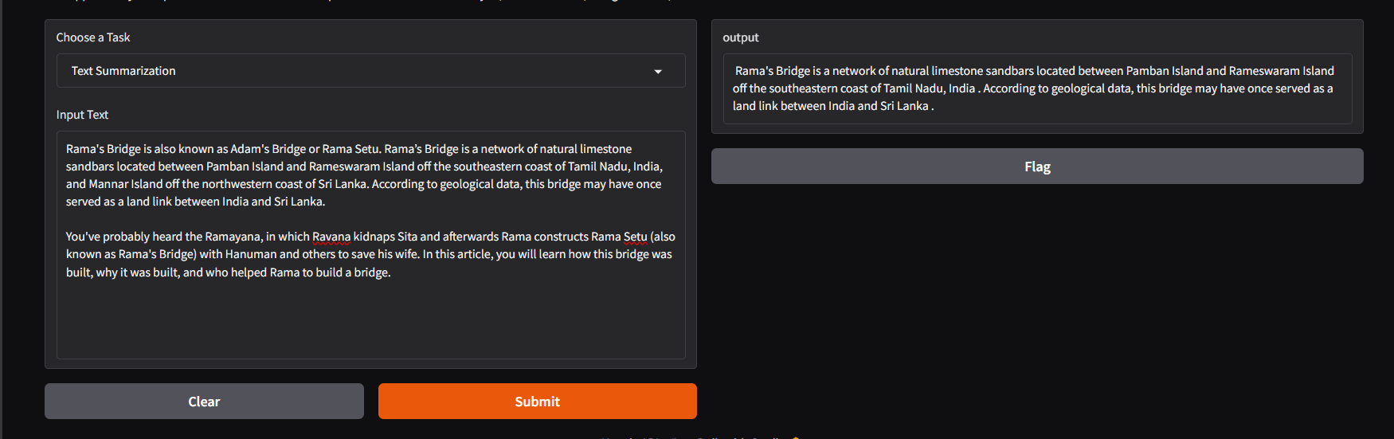
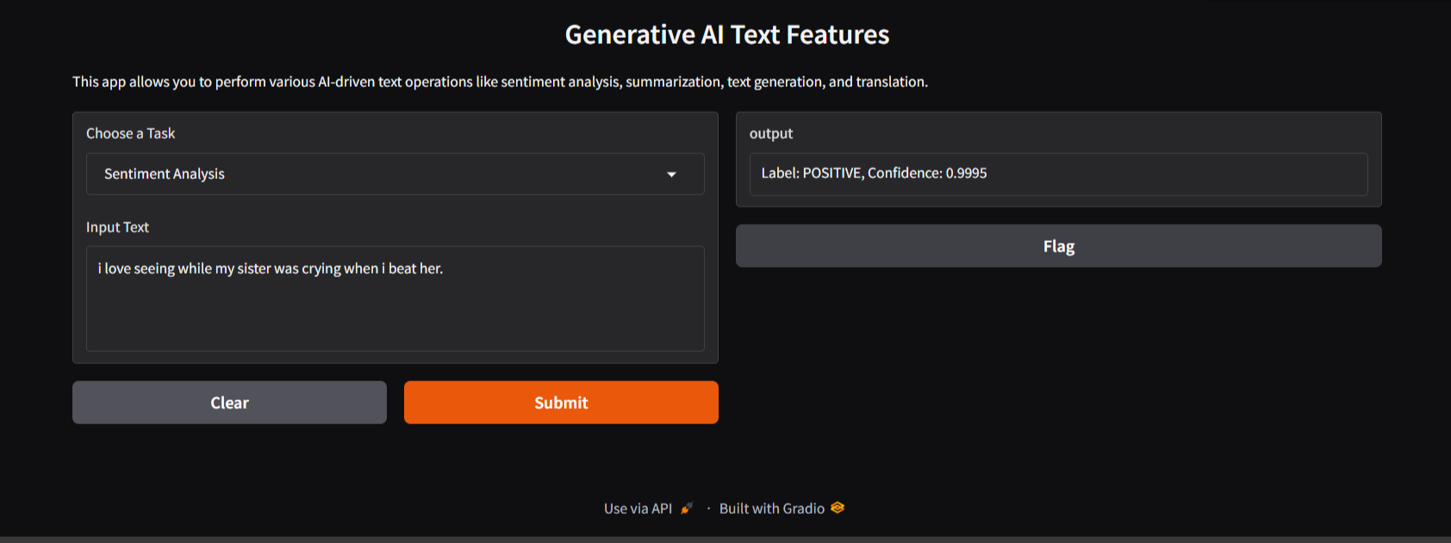
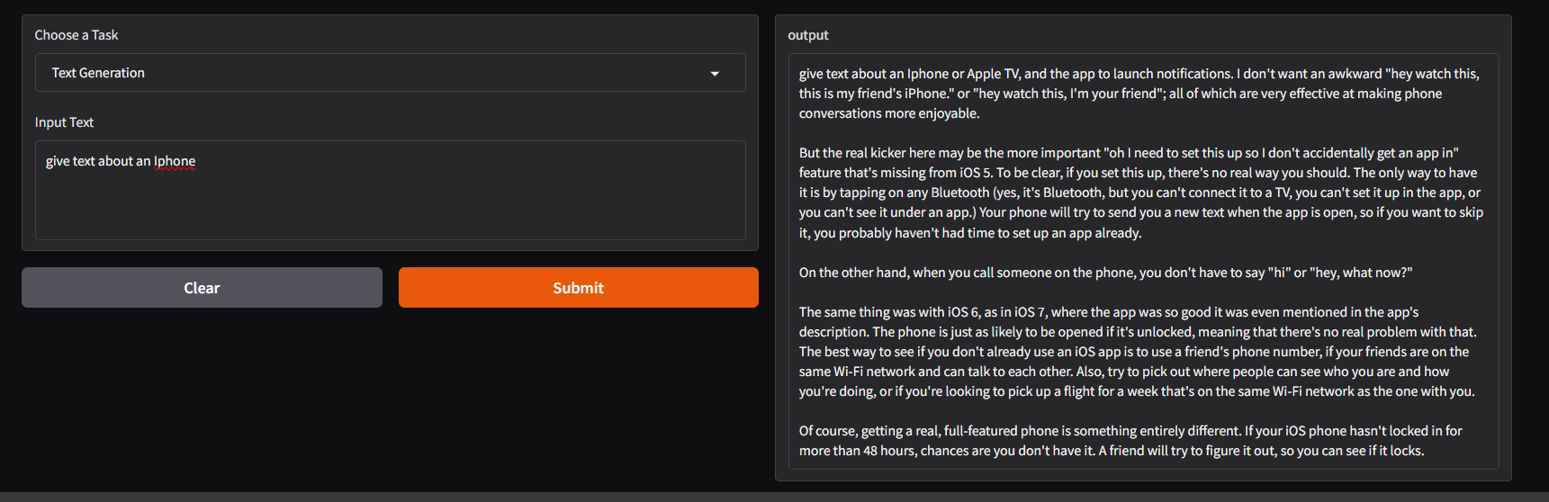
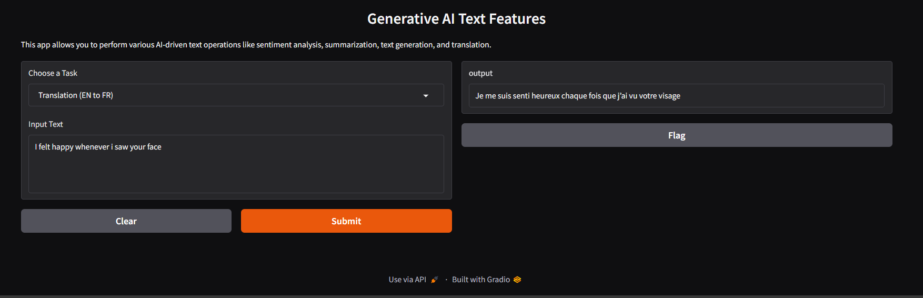
Implementation & output:

Slide 9
Result and discussion:
The integration of Text Summarization, Sentiment Analysis, Text Generation, and Language Translation into generative AI showcases the transformative potential of these technologies across industries. However, for generative AI to reach its full potential, research must address existing limitations, such as contextual understanding, cultural nuances, factual accuracy, and bias mitigation.
The evaluation of generative AI text features—including Text Summarization, Sentiment Analysis, Text Generation, and Language Translation—highlights impressive progress while also bringing to light areas that require continued research and refinement

Slide 10
THANK YOU

