Slide 1


Assessing Public Transit Rider Awareness of Sex Trafficking of Minors
John F. Betak¹, Ankit Sharma¹, and Christie L. Nelson²
¹Collaborative Solutions, LLC, Albuquerque, NM
²Center for Discrete Mathematics and Theoretical Computer Science (DIMACS), Rutgers University
WeArePACT.org

Slide 2

PROJECT BACKGROUND
Notice of Funding Opportunity (NOFO), March 2019
Protect All Children from TraffickingTM (PACT, Formerly ECPAT-USA), May 2019
PACT Notified January 2020
Project Duration – July 2021 Through May 2025

Slide 3
OUR APPROACH
Survivors-Informed Research-Based Social Media Campaign
Six Transit Agencies
Social Media Campaigns on Awareness
Effectiveness of Survivor-Informed, Research-Based, Non-Traditional Anti-Trafficking Social Media Campaigns

Slide 4

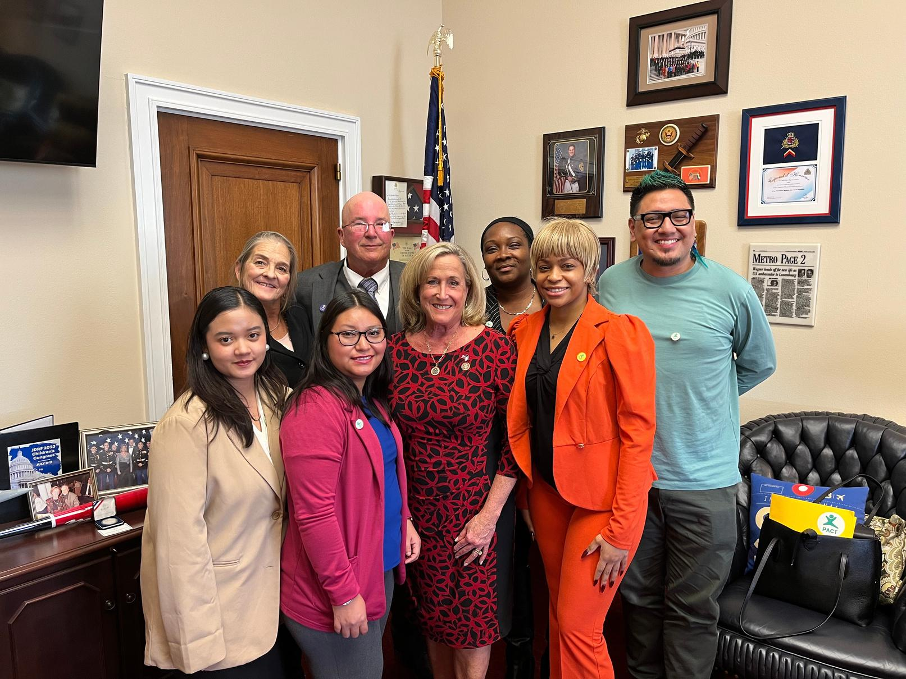
PACT SURVIVORS’ COUNCIL
  Lived-experience experts
  Inform PACT’s programs, curricula, and public awareness efforts
  Consult and provide subject matter expertise to PACT staff during program development and evaluation
  Paid for their contributions in acknowledgment of the value that lived experience brings to our work

Slide 5
LITERATURE REVIEW
260+ Pieces of Literature in Our Search
Categorized 245 Pieces of Literature
210+ Pieces of Literature Specifically Addressed Trafficking, Child Trafficking, & Trafficking on Transit
123 Discussed Child Abuse, Child Trafficking, Child Predators or Related Topics
Limited Academic Literature on the Role of Transportation in Combatting Human Trafficking

Slide 6
TRANSIT AGAINST CHILD TRAFFICKING (TACT) CAMPAIGN
Survivor-informed public awareness campaign deployed across six transit regions.
Multi-channel rollout:
  Transit interiors/exteriors, shelters, station posters
  TV, radio, and digital media
  Social media packages for local partners
Agencies tailored visuals and messaging to local demographics and ridership patterns.
Achieved strong visibility: 18 media placements and widespread station/bus/train coverage.

Slide 7
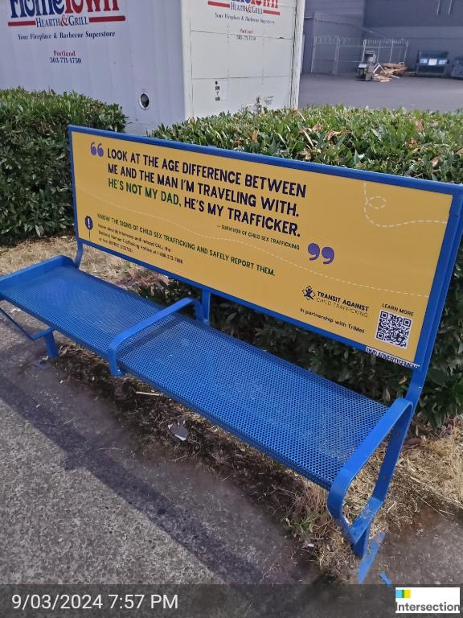
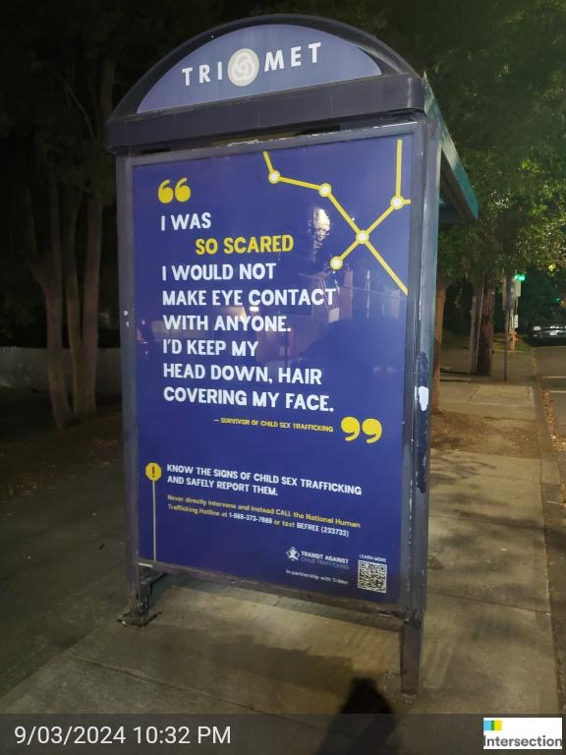
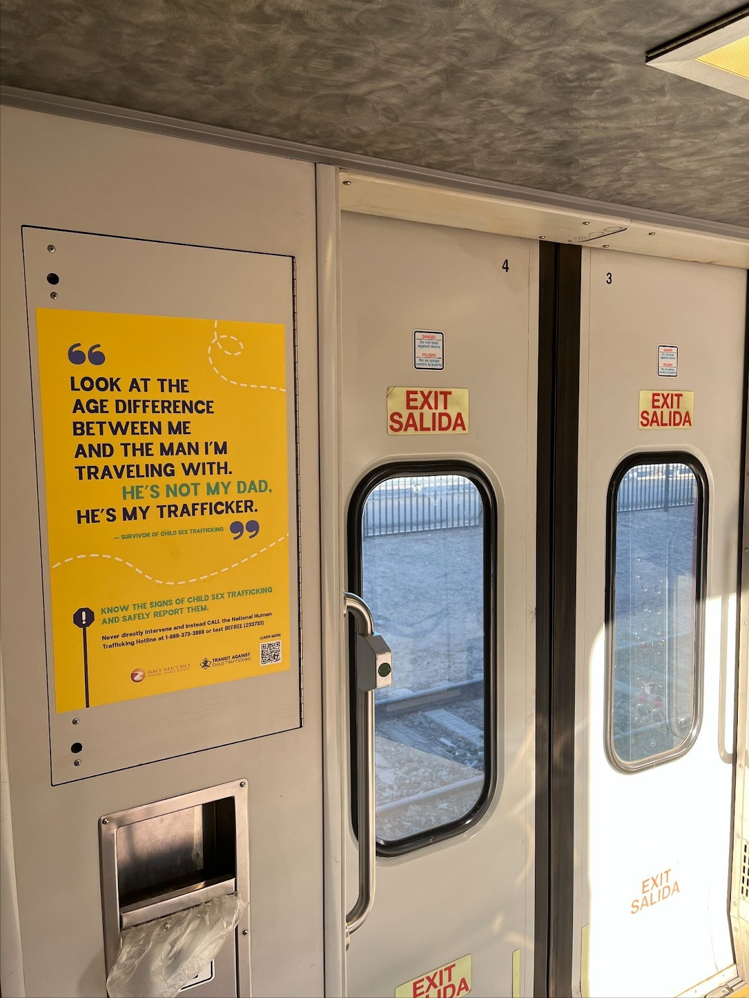
TRANSIT AGAINST CHILD TRAFFICKING (TACT) CAMPAIGN

Slide 8
RESEARCH METHODOLOGY
Social Media Scraping (EDA):
  Collected 603,900 tweets using 260+ trafficking-related keywords/emojis.
  Classified content using multiple ML models.
Quantitative Awareness Assessment (Pre/Post):
  Surveyed riders across six transit agencies.
  Measured knowledge, perceived safety, indicator recognition, and reporting readiness.
Predictive Modeling:
  Built spatial-temporal models using publicly available datasets to forecast likely trafficking-related risk locations.

Slide 9
Social Media Trends & Patterns
Pre-pandemic dominant terms: #nowplaying, escort, sugaring terms.
Post-pandemic dominant terms: #iheartawards, lolita, dateny/datela.
Analysis of 7 major sporting events showed:
  Top hashtags: #massage, #escort, #gfe
  Suspicious tweets:
    +48% year-over-year
    +43% increase during events
Combined keyword–location pairs revealed widespread use of #DateCity codes for escort promotion.

Slide 10
EXAMPLE KEYWORDS & HASHTAGS SCRAPED
Topic | Keyword, Hashtag | Definition | Primary Language (if known)
Child Sex Trafficking, Child Sexual Abuse | boylove | Indicates pedophile’s gender preference | English
Sugaring | PapiDulce | sugar daddy in Spanish | Spanish
Escort, Prostitution, Sex related | transpinay | Filipino trans woman sex worker/entertainer | English
Sex related | Caldo de pollo | Spanish. Translates to soup chicken, which means having sex, or having sex with an older woman | Spanish

Slide 11
Tweet Classification Results
Tested: Baseline, Gaussian NB, Bernoulli NB, Logistic Regression, Random Forest.
Best-performing model: Random Forest
  Accuracy: 0.966
  Precision: 0.956
  Recall: 0.912
Demonstrates feasibility of automated detection of trafficking-related content at scale.

Slide 12
EXAMPLE EMOJIS SCRAPED
Topic | Emoji(s) | Definition | Type
Child Sex Trafficking, Child Sexual Abuse | 💗 | Indicates someone is a minor | Emoji
Grooming or Loneliness | 🥀💔🔪 | loss of loved one, depression or self-harm | Emoji
Child Sex Trafficking, Child Sexual Abuse | 🌹🎥💗✈️👑 | translates to “Pay money to record having sex with an underage person who is being trafficked by a pimp” | Emoji
Child Sex Trafficking, Child Sexual Abuse | 🔞 | Under 18 | Emoji

Slide 13
FOUR METHODS OF DATA TWEET CLASSIFICATION & RESULTS
Model | Accuracy | Precision | Recall | F Score
Baseline | 0.743 | 1.00 | 0.743 | 0.852
Naïve Bayes - Gaussian | 0.949 | 0.977 | 0.816 | 0.889
Naïve Bayes - Bernoulli | 0.948 | 0.917 | 0.881 | 0.898
Logistic Regression | 0.96 | 0.956 | 0.884 | 0.919
Random Forest Regression | 0.966 | 0.956 | 0.912 | 0.934

Slide 14
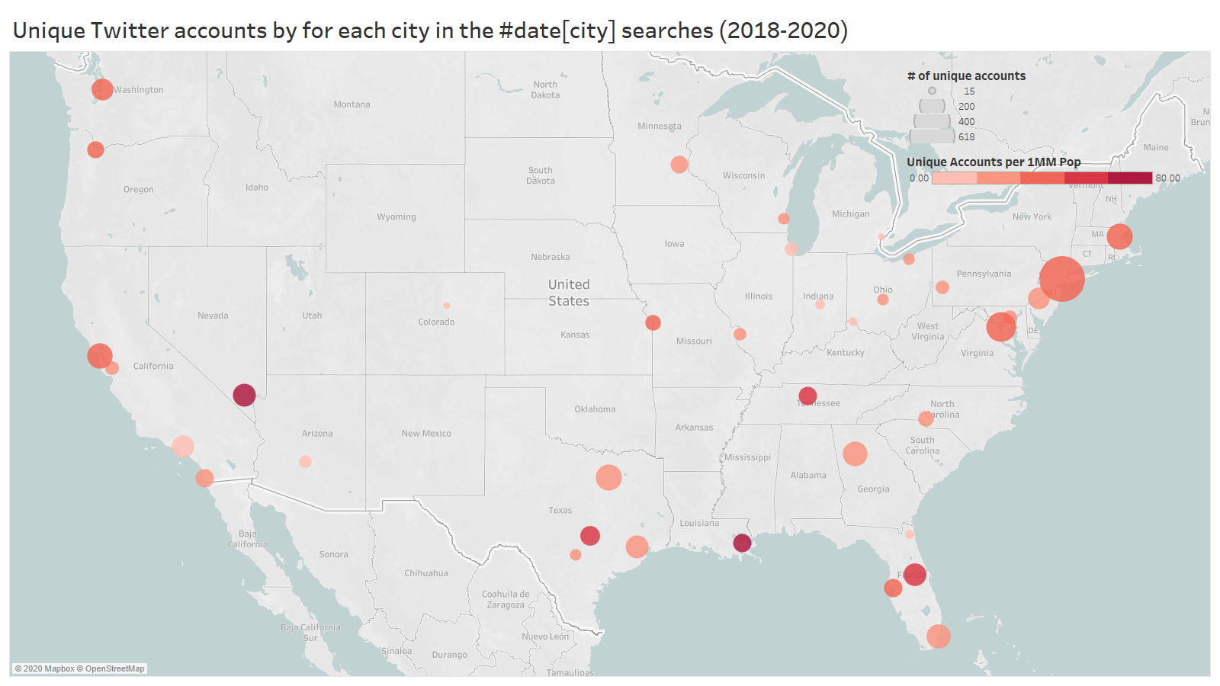
FURTHER SOCIAL MEDIA DATA SCRAPING RESULTS

Slide 15
PUBLICLY AVAILABLE DATA ANALYSES
Integrated multiple publicly available datasets previously linked to trafficking-related activity:
  Crime data
  Socioeconomic indicators
  Health indicators
  Objective: Identify locations where multiple risk factors overlap, signaling potential hotspots or sourcing areas.
Key statistical findings (national-level):
  Poverty and trafficking strongly correlated (p < 0.05)
  STI rates significantly correlated (p < 0.05)
  Mental illness rates not statistically significant

Slide 16
Pre/Post Assessment Findings: Key Outcomes
Pre/Post Awareness Assessment conducted across six U.S. transit agencies: CDTA (Albany, NY), DASH (Alexandria, VA), CapMetro (Austin, TX), CTA (Chicago, IL), TriMet (Portland, OR), Rio Metro (Albuquerque/Santa Fe, NM)
Strong recall of TACT materials via TV, transit ads, and station signage.
Portland & Alexandria showed improved indicator recognition.
Many agencies reported declining perceived crime, suggesting increased feelings of safety.
Digital channel visibility decreased across most systems.

Slide 17
Areas Requiring Improvement :Awareness Gaps Identified
Recognition of vulnerable populations declined in several systems.
Reduced perceived urgency of trafficking issues in the After-phase.
Limited improvements in indicator recognition across most cities.
Significant decline in knowledge of correct reporting actions in Chicago & Albuquerque/Santa Fe.
After-phase respondents skewed older/higher-income, influencing overall results.

Slide 18
PREDICTIVE MODELING
Modeled where & when child sex trafficking–related activity is most likely to occur near public transit.
Integrated publicly available data: crime incidents, hotels/businesses, transit stops, events, neighborhood indicators.
Tested multiple supervised + unsupervised frameworks to identify spatial and temporal hotspots.

Slide 19
Chicago (CTA): Data & Modeling
Data:
8M+ crime records (2001–present) → filtered to 5K trafficking-related cases.
Census + business listings within 0.5 miles of Cicero Avenue.
Models tested: RF, SVM, XGBoost, Logistic Regression, Neural Network.
Features: Lat, Long, Year, Month, Day, Hour.

Slide 20
Chicago (CTA): Key Findings
Neural Network highest accuracy (68.5%) & lowest error (MSE = 1.29).
Clear route-specific clusters near:
Pulaski & 46th Street
Cicero & 72nd Street
Peak risk windows:
8–9 AM
Early August
Indicates consistent spatial-temporal patterns suitable for targeted interventions.

Slide 21
Chicago (CTA): Implications
Data reveals stable, repeated hotspots along specific corridors.
Can inform:
  Operator alerts during peak hours
  Focused patrols
  Placement of awareness materials
Future work: include additional businesses (massage parlors, entertainment hubs) to improve risk correlation.

Slide 22
Portland (TriMet): Data & Objectives
Data: Crime records, hotels, TriMet stops, park-and-ride, massage parlor listings.
45,130 filtered trafficking-relevant offenses.
Objectives:
  Predict high-risk locations/times
  Cluster neighborhoods
  Link spatial factors with crime patterns
  Provide actionable transit-focused insights

Slide 23
Portland (TriMet): Model & EDA Insights
Random Forest classifier achieved 74.7% accuracy using:
  Latitude, Longitude
  Neighborhood
  Month/Year
Key insights:
  Spatial dependency strongest predictor
  Neighborhood context influences risk
  Seasonal variations evident (month significant)
Minority classes challenging due to data imbalance.

Slide 24
Portland (TriMet): Hotspots & Events
K-Means clustering: 10 neighborhood clusters with similar spatial crime profiles.
Crime concentrated within 0.5 km of 6 major TriMet transit centers (~5,200 cases).
Event-driven spikes:
  Festivals (Jazz Festival, Rose Festival, Blues Festival, Winter Light Festival, etc.)
  Event periods show up to 100x higher daily offenses vs non-event days.
Indicates short-term surges layered over long-term hotspots.

Slide 25
Cross-City Comparative Takeaways
Both cities show clear spatial clustering near high-volume transit corridors.
Chicago: Strong temporal regularity (peak hours + seasonal).
Portland: Strong event-driven surges + persistent downtown hotspots.
Predictive models demonstrate:
  Public data can anticipate trafficking risk, not just describe it.
  Transit agencies can adapt operator training, resource allocation, and awareness placement accordingly.

Slide 26
Integrated Conclusions:What the Study Demonstrates
A survivor-informed awareness campaign, paired with rigorous statistical evaluation and predictive analytics, can improve public understanding of human trafficking on transit systems.
The Awareness Assessment Tool captured rider perceptions, recognition of indicators, and readiness to act.
Predictive models revealed consistent spatial and temporal risk structures that can guide campaign placement and operator preparedness.
Together, these approaches provide a multi-dimensional view of trafficking risk—linking public perception with environmental and temporal patterns.

Slide 27
Key Implications for Transit Agencies
Multimodal campaigns (digital, print, vehicle ads, stations) produce stronger retention than single-channel messaging.
Localized tailoring to each city’s demographics and ridership improves engagement and message relevance.
Predictive spatial-temporal models can guide:
  Strategic placement of awareness materials
  Operator vigilance during high-risk hours/events
  Focused outreach around persistent hotspots
Integrating survey analytics + predictive modeling offers a replicable, data-driven framework for early identification, safer reporting, and improved prevention across transit environments.

Slide 28
ACKNOWLEDGEMENTS
Rutgers MBS Externship and Practicum programs
Transit Agencies
  Capital District Transportation Authority - CDTA, Albany, NY
  Rio Metro (Regional Transit), Albuquerque, NM
  CapMetro, Austin, TX
  DASH, Alexandria, VA
  Chicago Transit Authority - CTA, Chicago, IL
  Tri-County Metropolitan Transportation District of Oregon- TriMet , Portland, OR
Fenton Communications
RSG
PACT
  PACT Survivor Council members
  PACT Summer Youth Interns
  Lori Cohen
  Yvonne Chen
  Dr. Christian Toala
  Maressa Jaikumar

Slide 29




THANK YOU
CONTACT US:
+718.935.9192
info@WeArePACT.org
WeArePACT.org
Corresponding Author
John F. Betak, john@collaborativesolutionsllc.com

