Slide 1

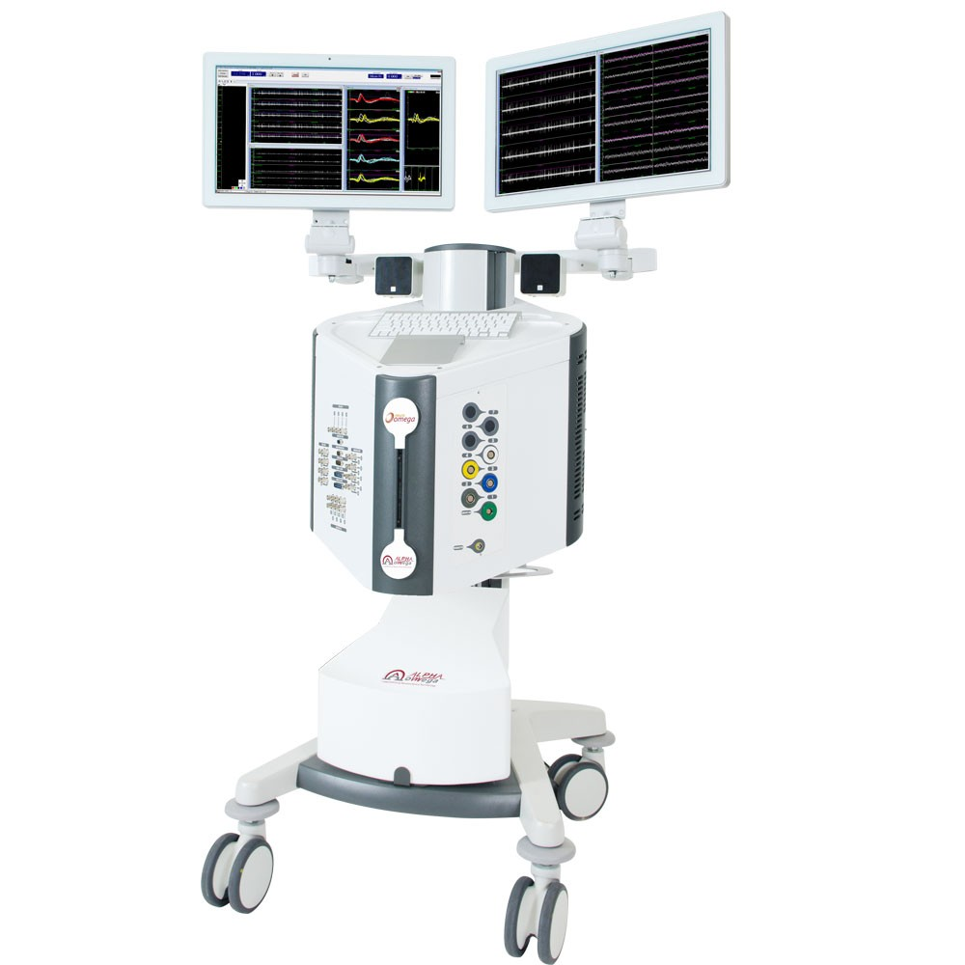
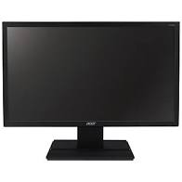
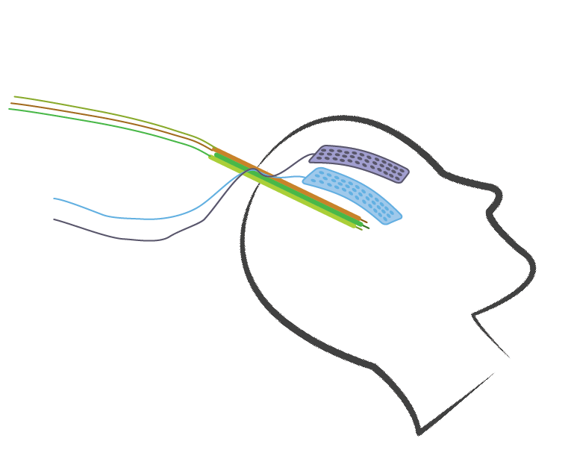
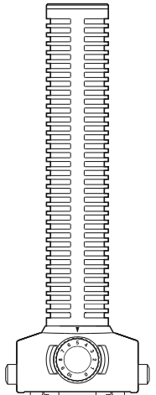
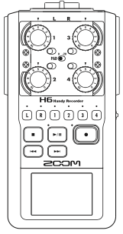
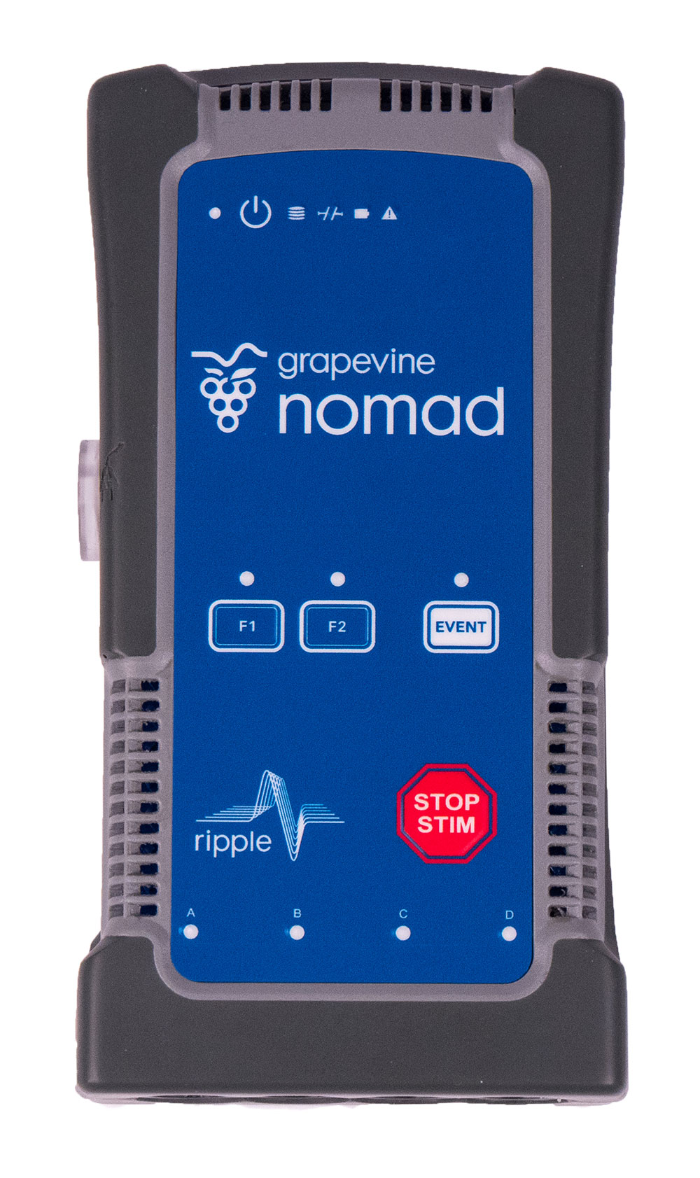
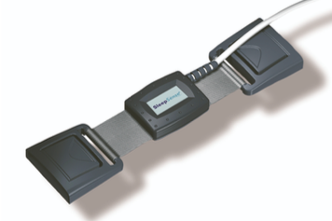
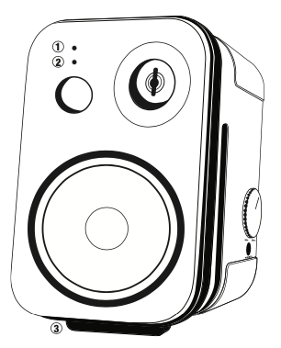
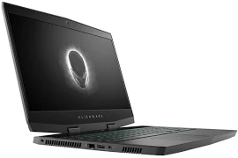
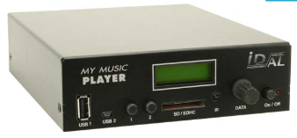

Intraoperative speech research setup
MGH
MER - LFP
ECoG
I/O
Alpha Omega
Zoom H6
Digital
EMG
Neural Data
Respiration
Analog
Produced Audio
I/O
Nomad
Photodiode
Stimulus presentation
Analog sync signal
Task Computer
Psychtoolbox

Slide 2
3.5mm touchproof extension
Respiration Sensor
ISOBOX
Sterile field
In 110V
EMG
Out 6
Lead connector
Out 5
Out 4
Out 3
Out 2
Out 1
ECoG+Stim 5
Monitor Power Cable
Nomad
Port D
ECoG+Stim 4
Cabrio 8
Port C
Cabrio 7
HDMI Cable
Monitor
Port B
ECoG+Stim 3
Octopus 2
Cabrio 6
ECoG Strip 2
O: power
A/D IO
Port A
Cabrio 5
ECoG+Stim 2
Cabrio 4
110V
Power source
Cabrio 3
Ethernet
ECoG+Stim 1
Octopus 1
Cabrio 2
DC power
source
Cabrio 1
ECoG Strip 1
Zoom H6
Directional
Alienware
Shotgun Mic
USB Hub
Ethernet
Analog I/O
Audio in
3.5mm male-male stereo cable 9’
Ambient
USB
3.5mm audio
XLR female-male balanced cable 10’ (2x)
XLR
splitter
USB
Radial USB
XLR female-male balanced cable 3’
Mouse
Keyboard
BNC to SMA
JBL 2P
Studio
Monitor
(Speaker)
DC power
source
BNC to SMA
BNC to SMA
Extension barrel DC power
BNC cable 3’
BNC cable 9’
Vibration Sensor
BNC cable 3’
Monitor Photodiode
HDMI to Display Port
Monitor Power Cable
Sync signal Source
XLR to BNC
Digital I/O
Stimulus Presentation
Monitor
BNC-T
BNC cable 20’
BNC to SMA
BNC cable 20’
AlphaOmega

