Slide 1
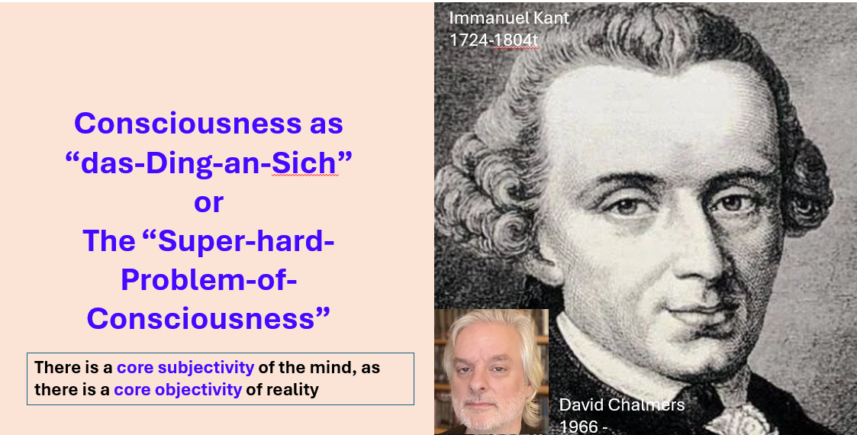
Kenneth Hugdahl, prof. emeritus
Department Biological and Medical Psychology
University of Bergen, Norway

Slide 2
Overview
Some personal reflections (actually speculations) on consciousness
In my presentation I will address three main topics:
1. “What is consciousness” (as I see it)
2. Consciousness, cognition, and the brain
3. Consciousness, AI and intelligence

