Slide 1



Securing Kubernetes Cluster with Kubescape
Speaker: Maxat Akbanov
Date: 14 Aug 2026
Venue: Almaty, Kazakhstan

Slide 2







whoami
👉 maxat-akbanov.com

Slide 3


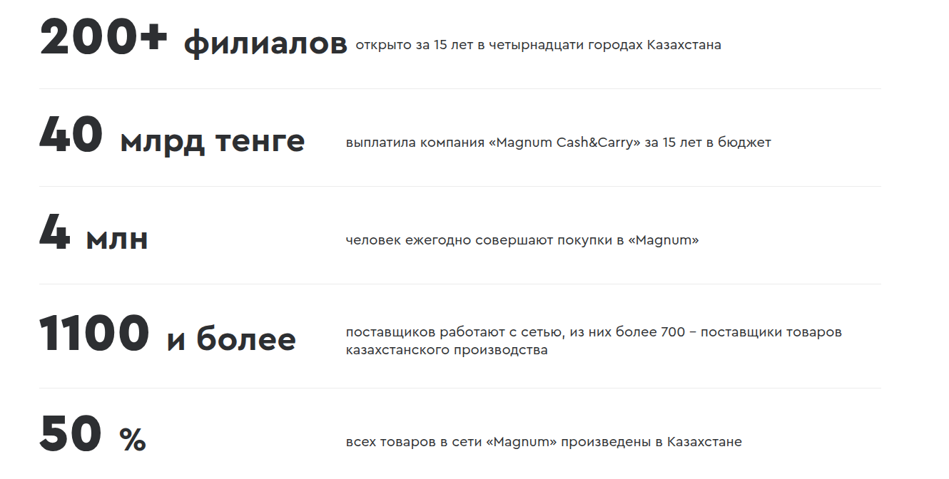
Who we are?

Slide 4




What we needed?
Change Trivy scanner to another security tool (Trivy Security incident 2026-03-19 #10425)
Uses Grype engine under the hood
Open source tool
Able to scan container images, static manifest files and Kubernetes environment
Easy integration with CI/CD pipelines
Easy integration with ArgoCD

Slide 5
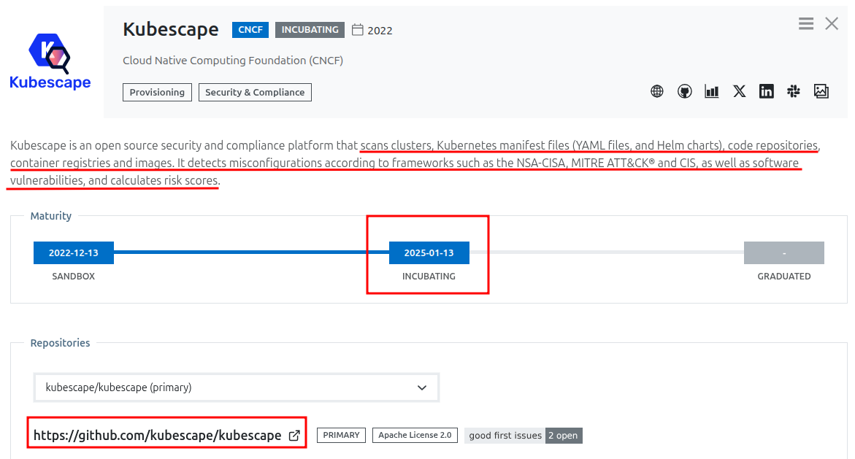

What is Kubescape?
Created & maintained by ARMO
https://landscape.cncf.io/ 👈
ARMO is an Israeli cybersecurity company focused on Kubernetes security
Donated Kubescape to CNCF to ensure vendor-neutral, community-driven development
ARMO remains the primary contributor and offers a commercial SaaS platform on top of the open-source core

Slide 6
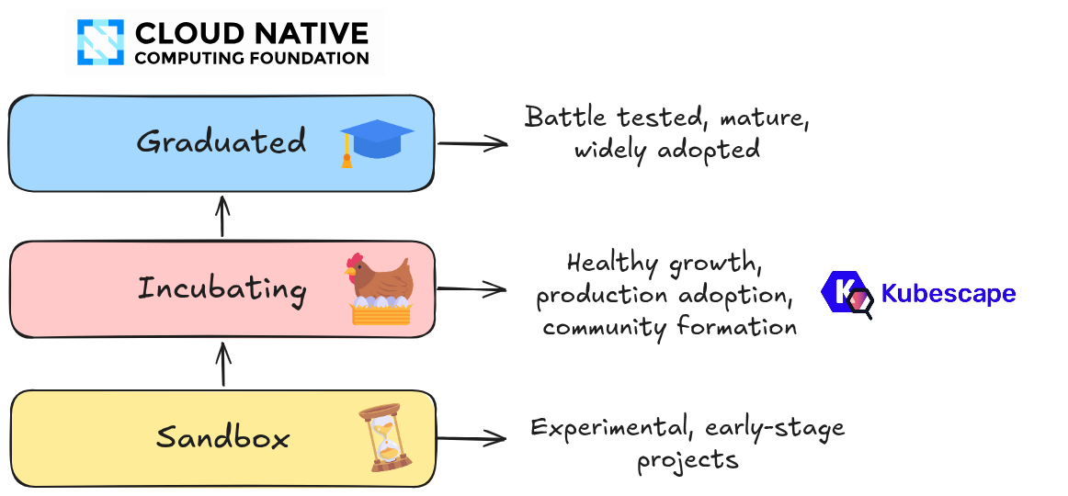
CNCF Maturity Levels

Slide 7
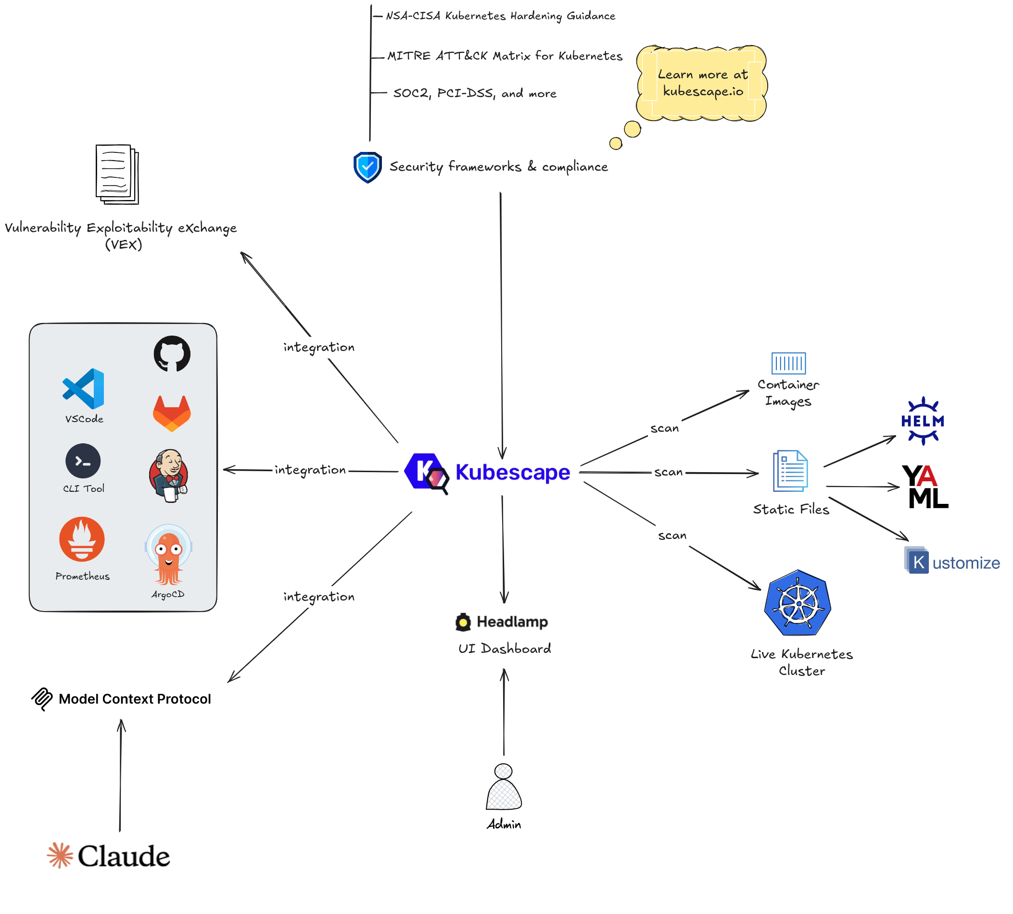
Kubescape Features
Scans: Container Images, Static Files and Live K8s Cluster
Scans against the most popular security frameworks and
custom rules
Integrates with ArgoCD, GitLab, Prometheus, and etc.
Able to provision own MCP server with AI tool connected
Able to provision own UI dashboard with Headlamp
Able to generate VEX formatted documents for security teams
Learn more at kubescape.io

Slide 8
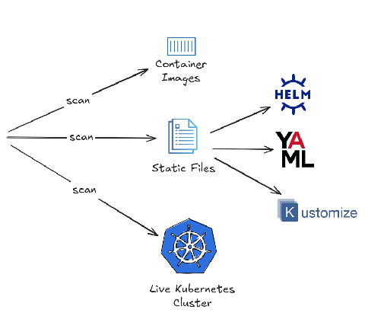
Kubescape Features
Scans: Container Images, Static Files and Live K8s Cluster

Slide 9
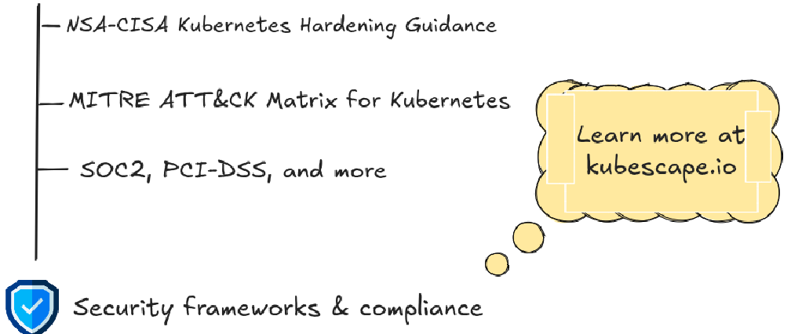
Kubescape Features
Scans against the most popular security frameworks and
custom rules

Slide 10
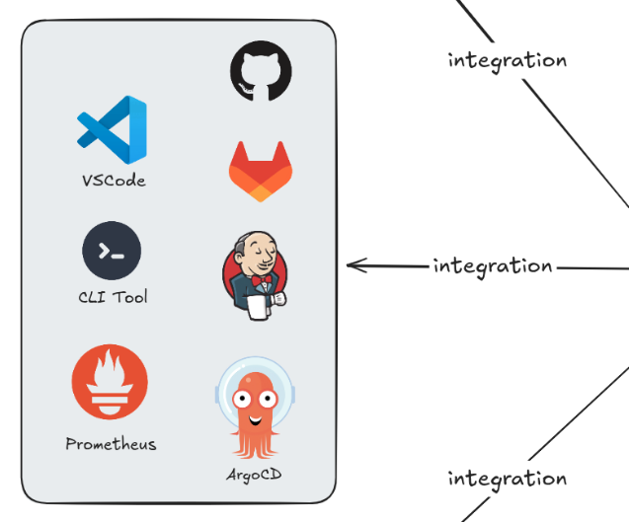
Kubescape Features
Integrates with ArgoCD, GitLab,
Prometheus, and etc.

Slide 11
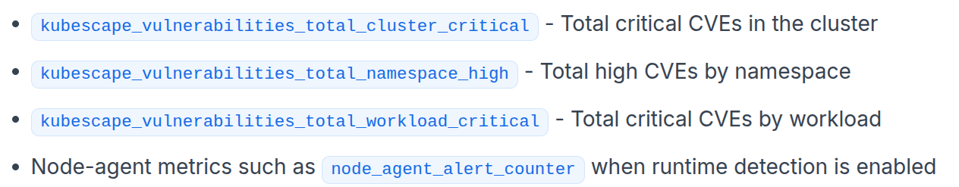
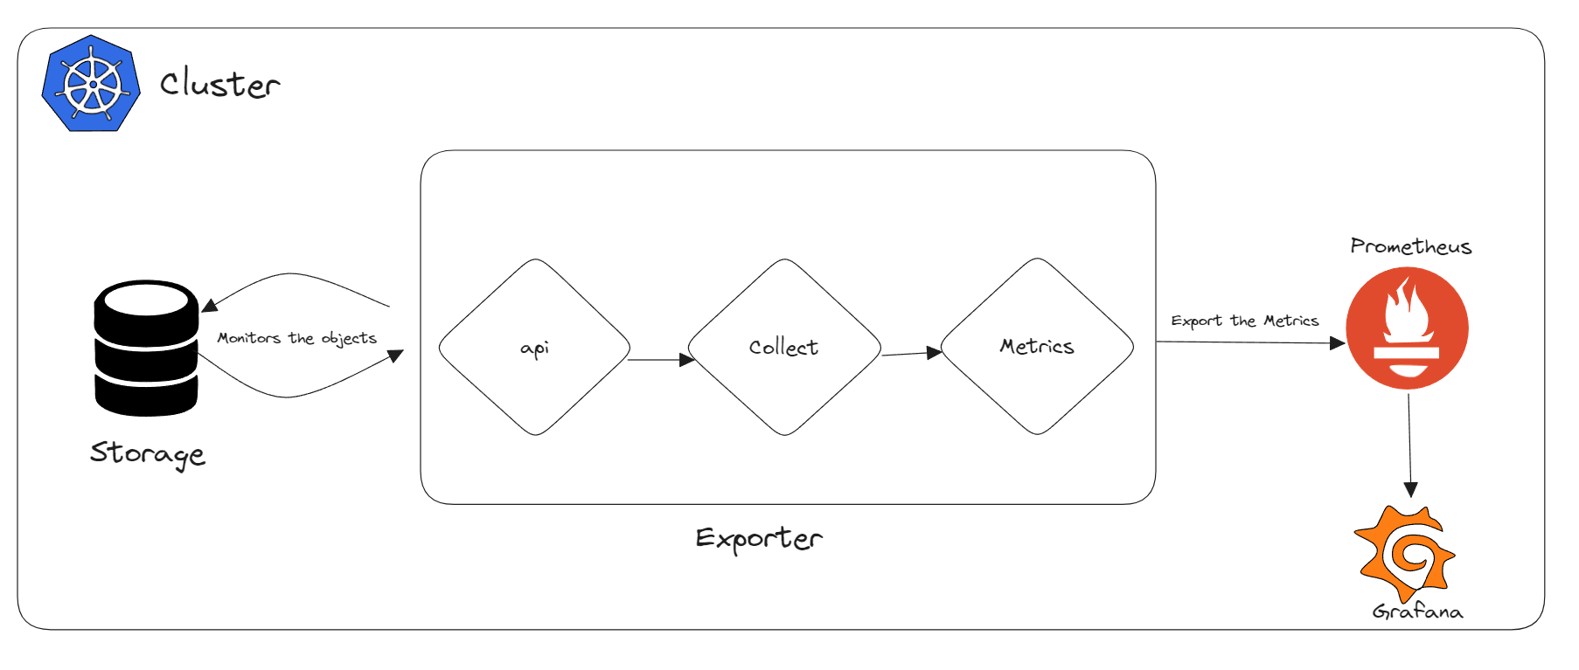
Kubescape Features
Kubescape Prometheus metrics

Slide 12
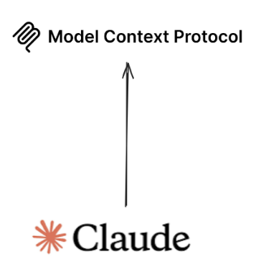
Kubescape Features
Able to provision own MCP server
with AI tool connected

Slide 13
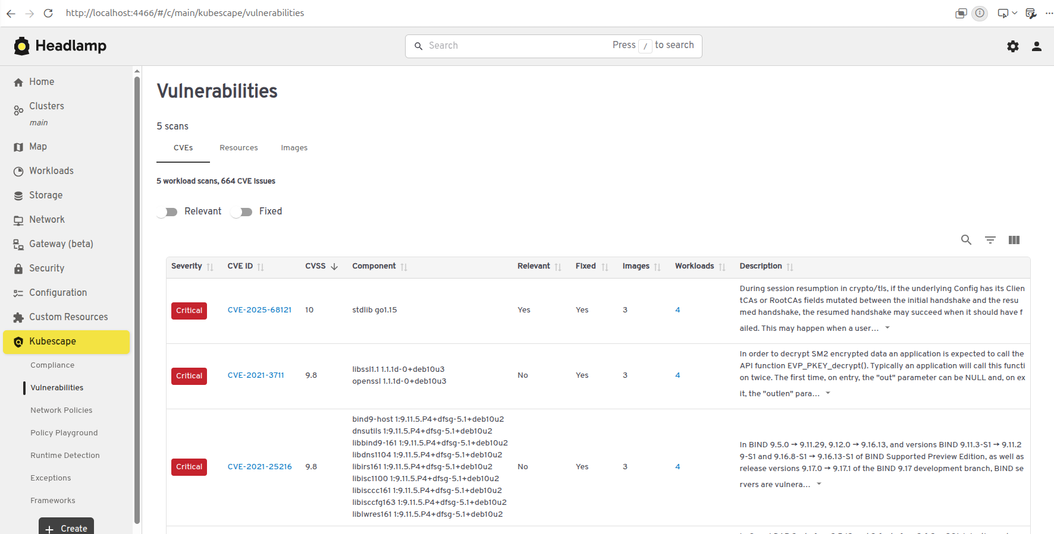
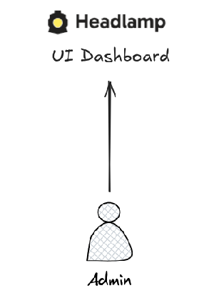
Kubescape Features
Able to provision own UI dashboard with Headlamp

Slide 14
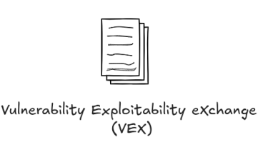
Kubescape Features
Able to generate VEX formatted documents for security teams

Slide 15
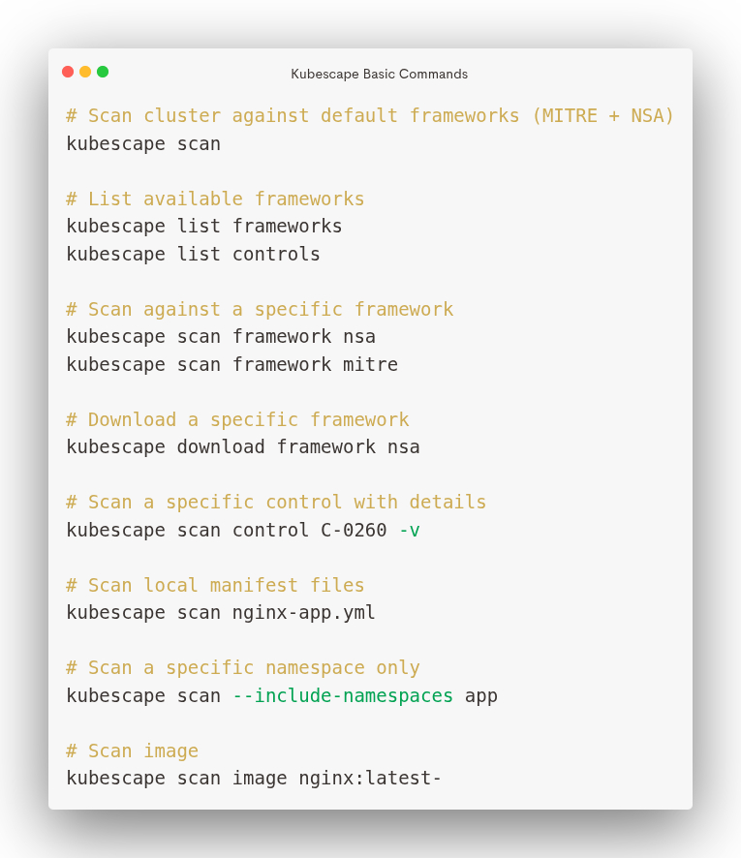
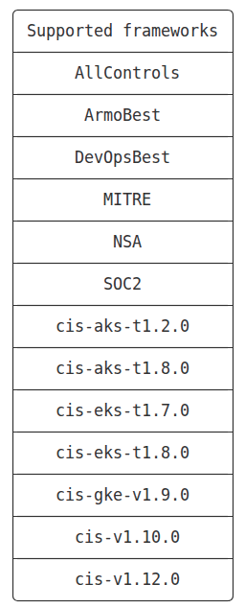
Scan Cluster with Kubescape CLI
V4.0.9

Slide 16
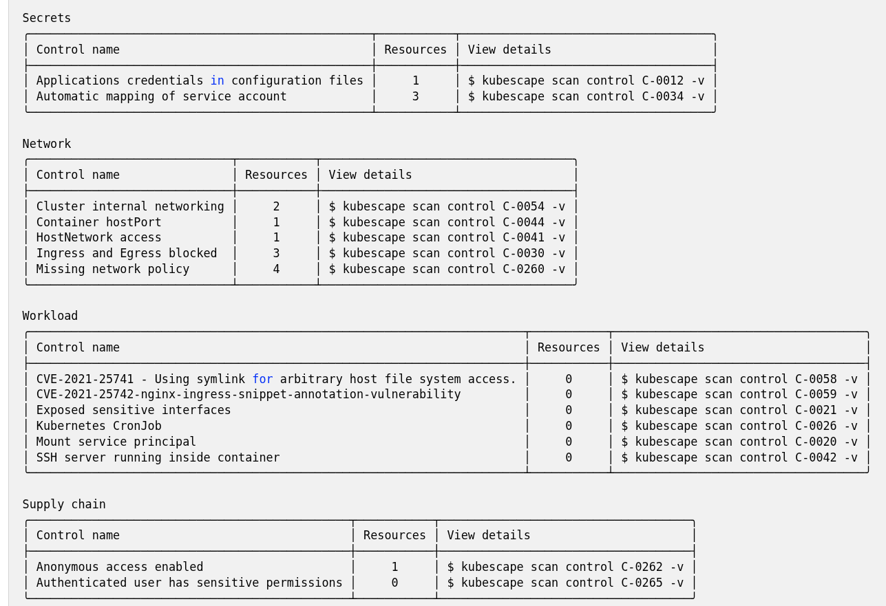
Scan Cluster with Kubescape CLI

Slide 17
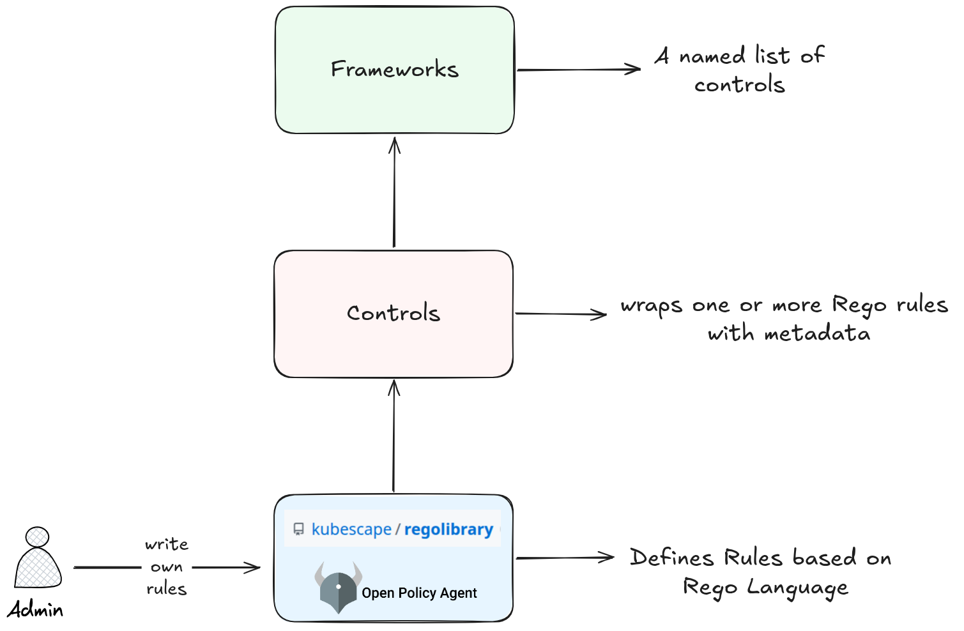
Create Your Own Baseline Framework

Slide 18
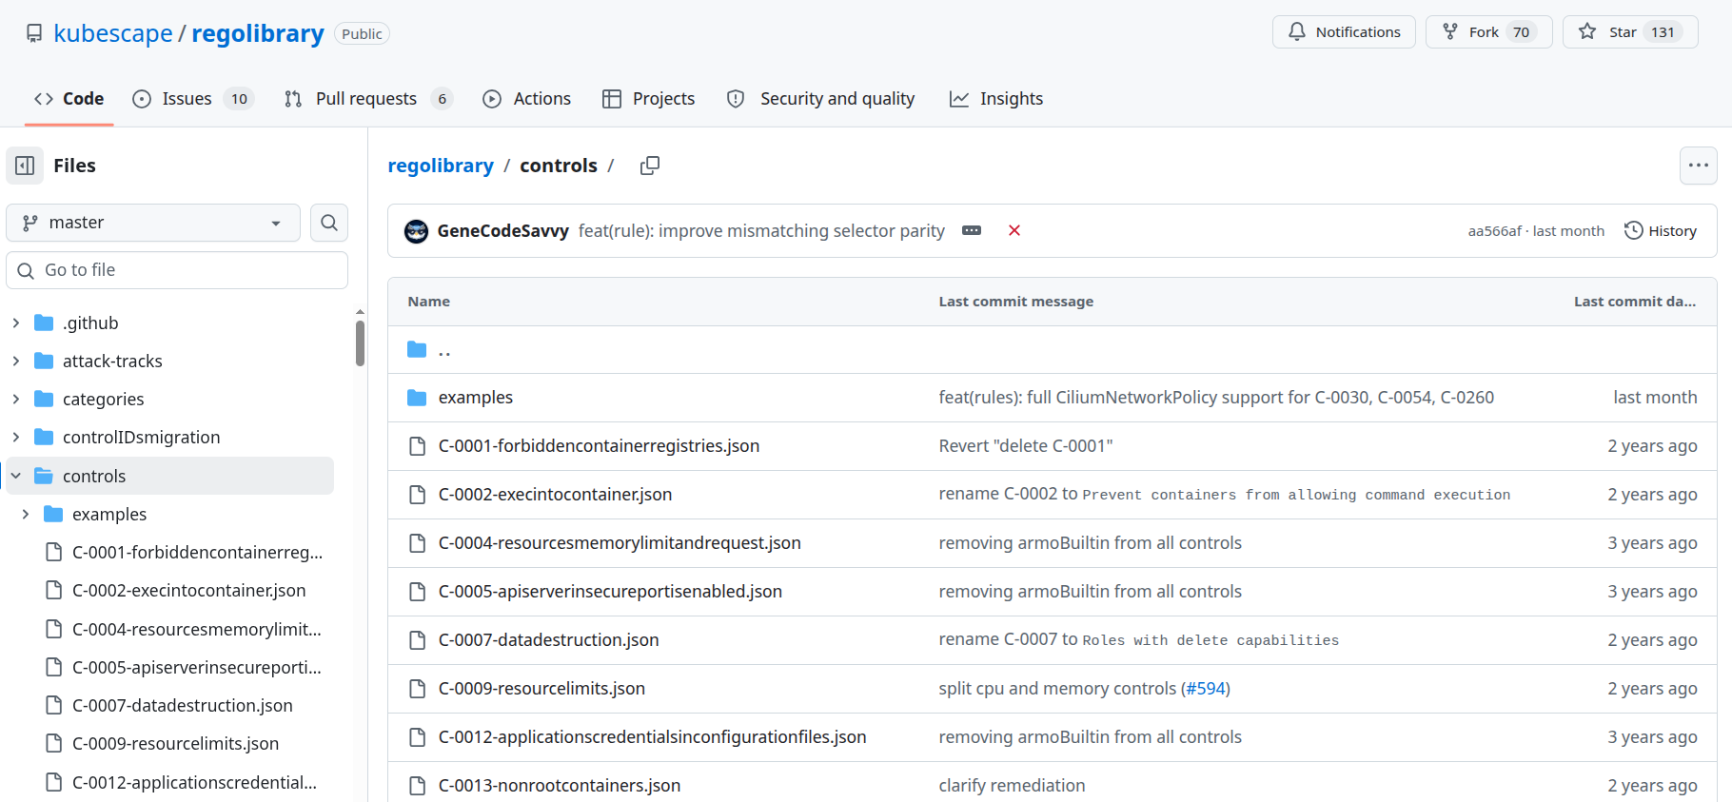
Create Your Own Baseline Framework

Slide 19
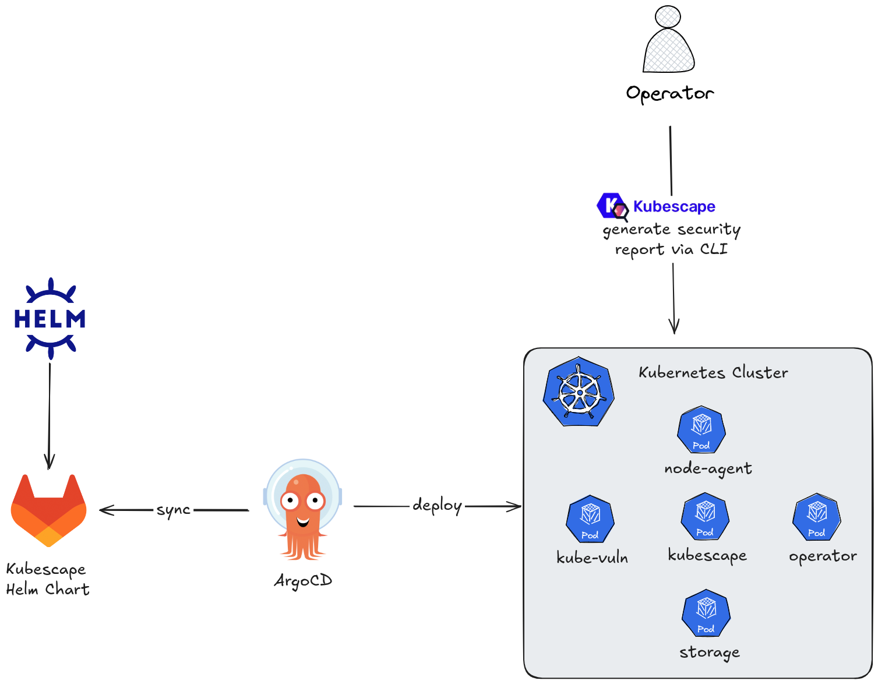
Dynamic Kubescape

Slide 20
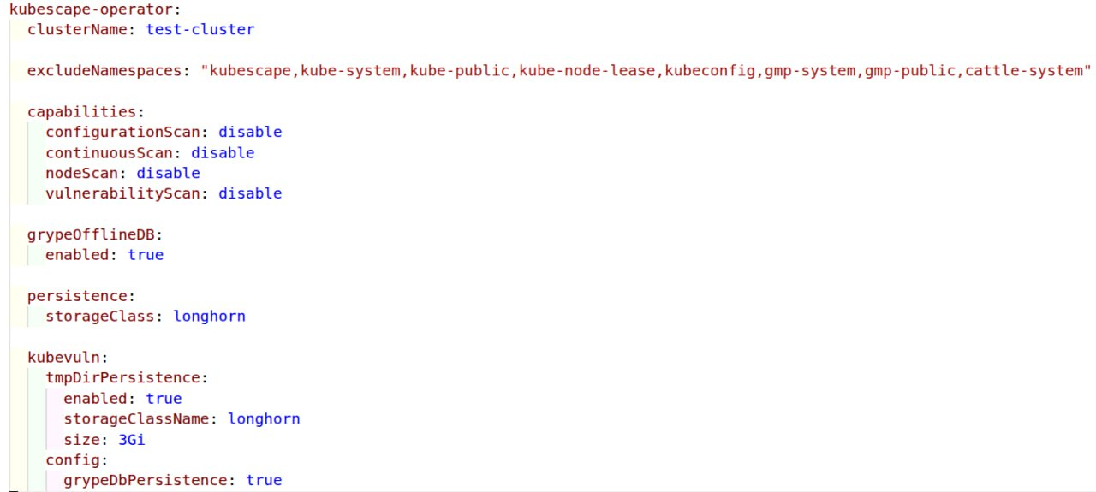
Kubescape Helm Values

Slide 21
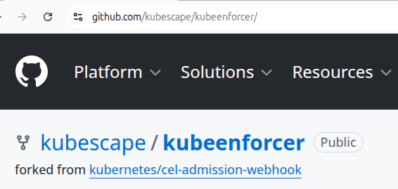
Kubeenforcer for Alermanager

Slide 22
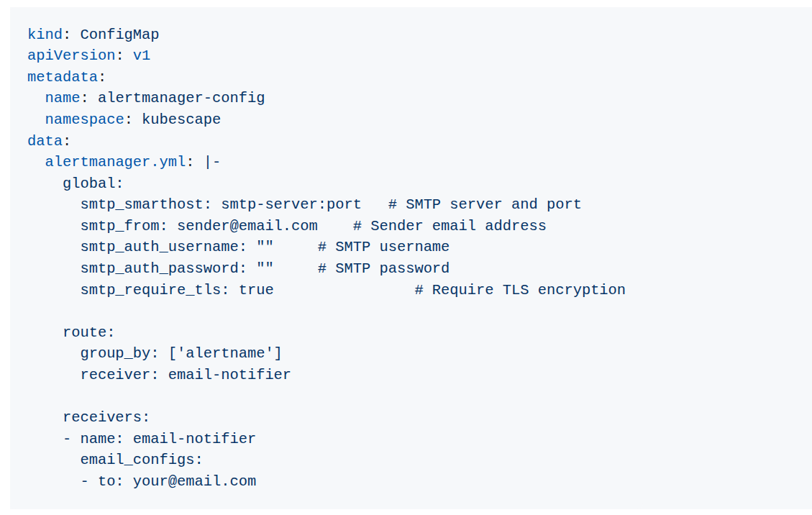
Kubeenforcer Configs

Slide 23
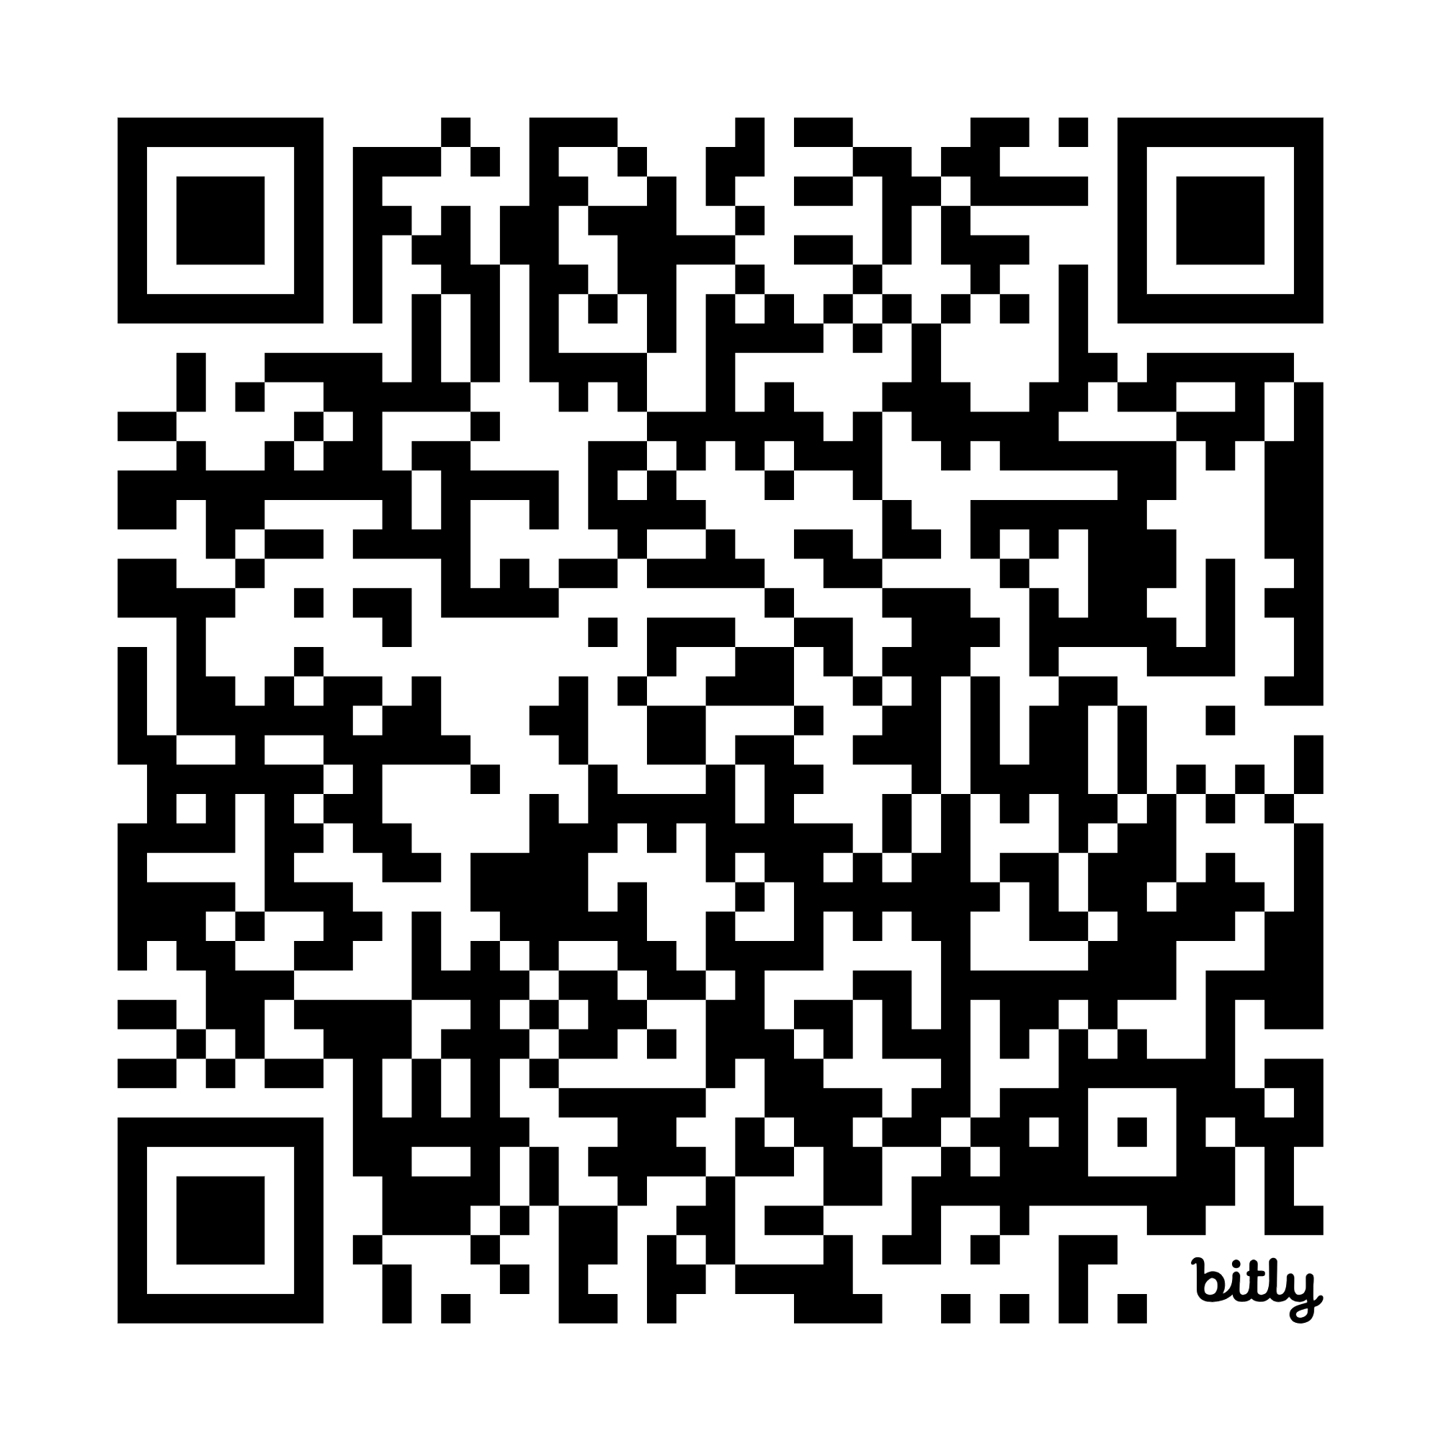
Demo
https://bit.ly/cncf-almaty-2026-meetup-kubescape

