Slide 1
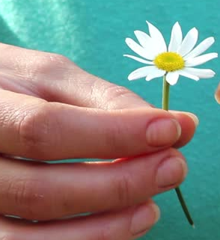



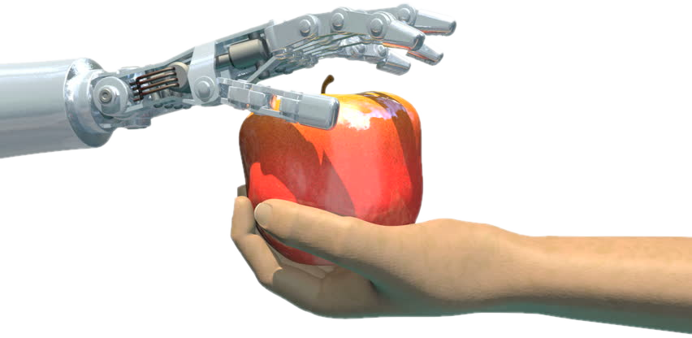

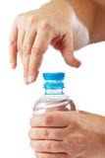
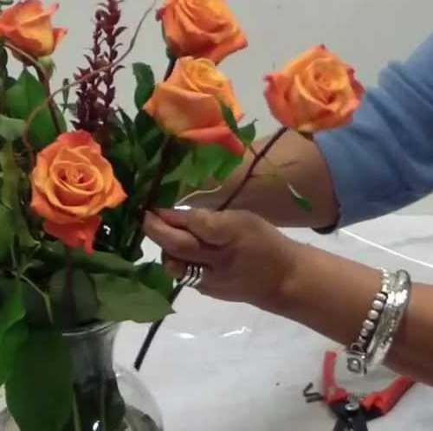
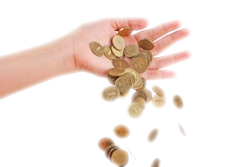
Pick flower
Grasp object
Approach target (shelf, table,
human, flowerbed)
Move robot
Give object to human
Drink
Open bottle
Arrange flower
Drop/Place object

Slide 2
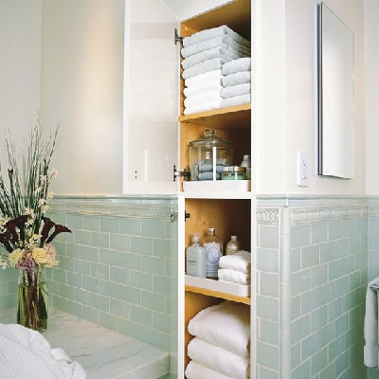

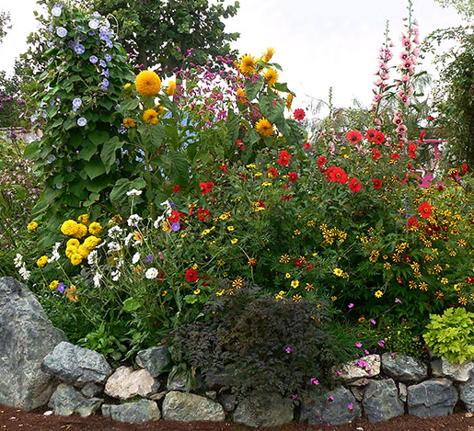

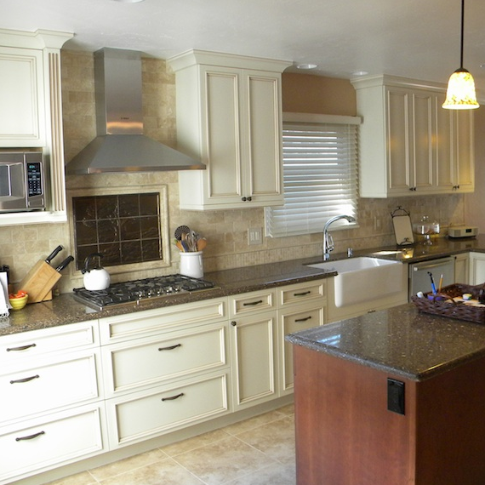
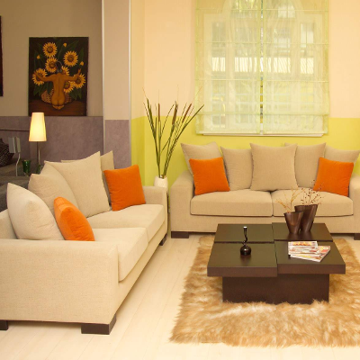
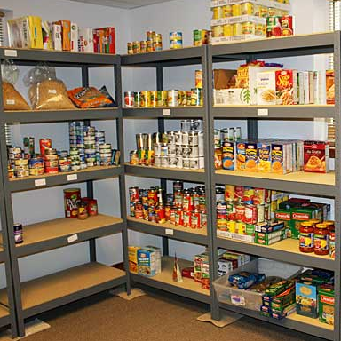
Bathroom
Friend
Garden
Me
Kitchen
Arbitrary: Select an arbitrary object
for the current parameter
Get other attribute: Give me another
attribute to choose from (e.g., instead of
asking me about the position of the
glass ask me for the shape)
Control:
Up/Down: move up or down
Enter: select the current item
Left: Go back
Living room
Pantry

Slide 3
