Slide 1
CommuteRoutes
Members:
Shui Cheung
Steven Denton
Sam Saarinen

Slide 2
Presentation Outline

Slide 3
Introduction
Problem Definition
Requirements
Overview

Slide 4
Problem definition
Client – Dr. Judy Goldsmith
Research lab at UK
Computational models of human preferences
Participant’s preference of route taken while commuting
Data collection
Security over data transfer and database

Slide 5
Requirements
User types
Collect varies type of data
App interacts with user in determining features
Data is anonymized
Data is uploaded and stored on a server
Client user interface security, settings, and notifications
Data is accessible to researchers
Battery Consumption is Limited

Slide 6
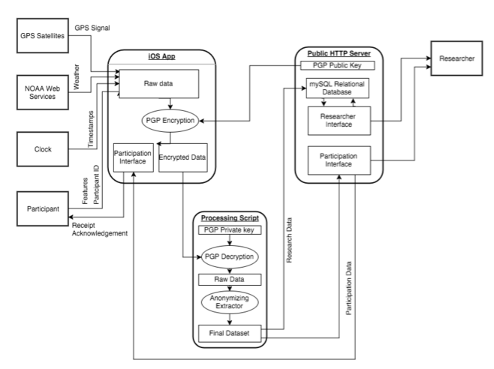
Overview

Slide 7
Mobile application
Collecting GPS data
Live demo
Secure upload

Slide 8
Feature Collection
Automated
GPS data on route (feature extraction later)
NOAA weather data
Timestamp data
Traffic data
Holidays (I.e. is July 4th a nationally recognized holiday?)
Relative travel time and relative travel distance
Queried
User Identified features of the route
Mood
Detours
Restaurant and other business stops

Slide 9
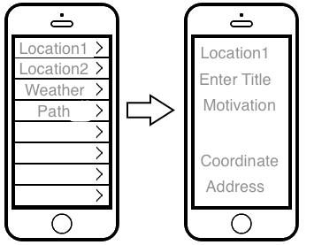
Mockup/Demo

Slide 10
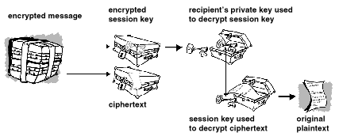
Secure Upload
Using PGP for data encryption over public networks
Researchers host their public key on official servers for verification
Clients poll public database of cryptographically hashed userids to confirm receipt.

Slide 11
Data processing
Feature Extraction
App Feedback

Slide 12
Feature Extraction
Identify Paths
Test Locations and Paths Against Those Stored
Process New Locations; Store Route

Slide 13
Identify Paths
IsRoute?:
Regress the GPS latitude vs. time and longitude vs. time.
Test whether correlation test statistic is significant.
Identify Paths:
With each point as a center
Do a binary search over a symmetric range to maximize the number of points included such than the subsequence is not a route.
Use a statistical test to determine whether end points (due to off-by-one error possibility due to symmetric collection of points) belong to the subsequence or not.
Reconcile the identified subsequences to separate locations and paths.
Runtime Estimate: O(n logn * m³) where n is the number of points, and m is the maximum number of points collected in a single location.
Identify Paths

Slide 14
Feature Extraction
Test Locations and Paths Against Those Stored
Locations are Stored as (Center, Radius)
Paths are Stored as (Start Location, End Location, Average Latitude, Average Longitude, Length)
New Locations or Paths are compared against those stored with some tolerances of comparison.

Slide 15
Feature Extraction
If new locations were identified:
Store the locations and give them generated labels.
Identify a feature corresponding to visiting a location
If new paths were identified:
Store the new paths and give them generated labels.
If multiple paths between the same locations exist:
Identify a feature corresponding to choice of path.
Store the abstracted route data in the database
Process New Locations; Store Route

Slide 16
Posted Log
Populate webpages with individually encrypted content that the app can poll to verify:
Successful Data Uploads
Feature Identification

Slide 17
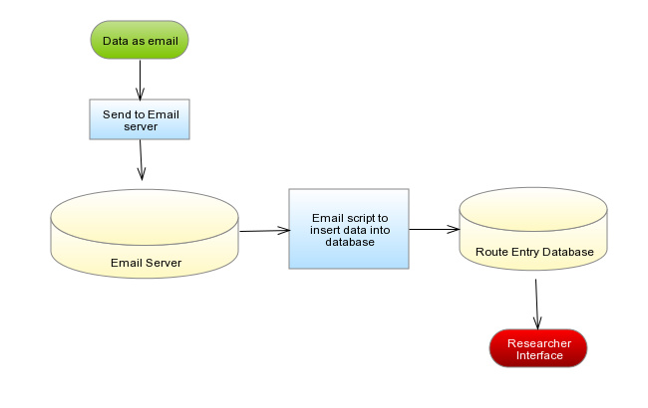
Database
Participation
Route data
Email script

Slide 18
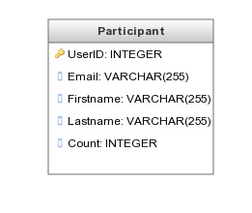
Participation
User information – name, email
Route upload count

Slide 19
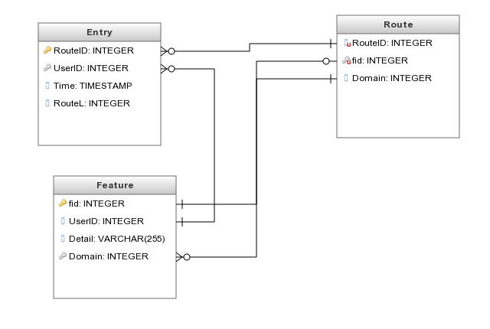
Route data

Slide 20
Email script
Python
Schedule processing event
Insert new data into database
Keep the database server and email server separate
Security purpose

Slide 21
Future Steps/ Problems Overcome
Increase accuracy and automation of feature extraction
Optimize the User Interface and Experience
Expand automated tracking beyond the model of routes between two static locations
Algorithmic Refinement
Advanced statistical analysis included in Research UI

Slide 22
Q&A

