Slide 1
BrainTrainer

Slide 2
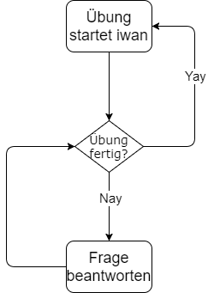
Idee
Längere Zeit am PC
Fragen werden gestellt
Fragen werden beantwortet
Weitermachen

Slide 3
Konzept

Slide 4
Technologien
CycleJS
NodeJS
Express
MongoDB
mongoose

Slide 5

CycleJS
A functional and reactive JavaScript framework for predictable code
https://cycle.js.org/
https://cycle.js.org/img/cyclejs_logo.svg

Slide 6

NodeJS
Node.js® is a JavaScript runtime built on Chrome's V8 JavaScript engine. Node.js uses an event-driven, non-blocking I/O model that makes it lightweight and efficient. Node.js' package ecosystem, npm, is the largest ecosystem of open source libraries in the world.
https://nodejs.org/en/
https://nodejs.org/static/images/logos/nodejs-new-pantone-black.png

Slide 7

Express
Fast, unopinionated, minimalist web framework for Node.js
https://expressjs.com/
https://i.cloudup.com/zfY6lL7eFa-3000x3000.png

Slide 8

MongoDB
In unserer vom digitalen Wandel und disruptiven Technologien geprägten Zeit hängt der Unternehmenserfolg von der Fähigkeit ab, sich ständig wandelnden Umständen anzupassen.
https://www.mongodb.com/de/mongodb-3.4
https://webassets.mongodb.com/_com_assets/cms/mongodb-logo-rgb-j6w271g1xn.jpg

Slide 9

mongoose
elegant mongodb object modeling for node.js
Let's face it, writing MongoDB validation, casting and business logic boilerplate is a drag. That's why we wrote Mongoose.
http://mongoosejs.com/
http://mongodb-tools.com/img/mongoose.png

Slide 10
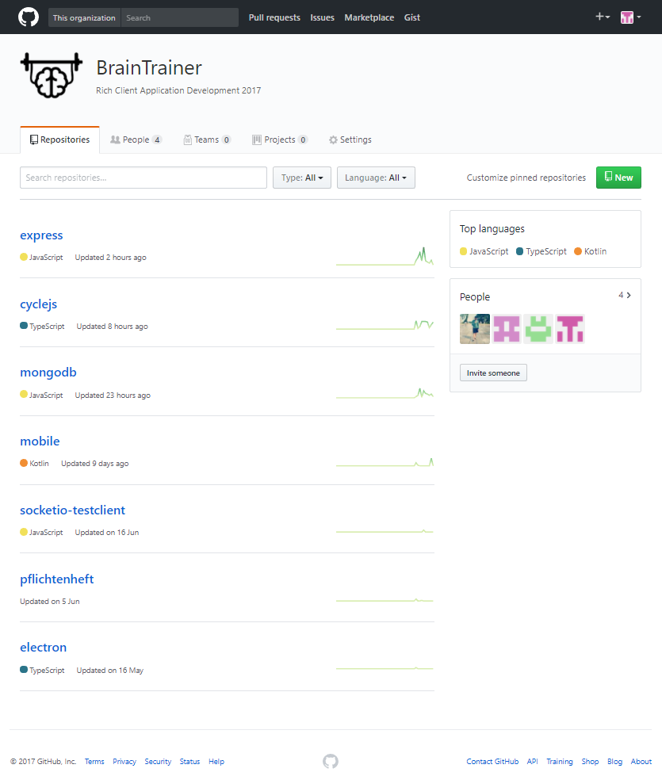
GitHub Struktur

Slide 11
Sourcecode

Slide 12
Frontend

Slide 13
Backend

Slide 14
Model

Slide 15
Tests

Slide 16
Softwaredemo

Slide 17
Pflichtenheft

Slide 18
Fazit

