Slide 1
Driver installation

Slide 2
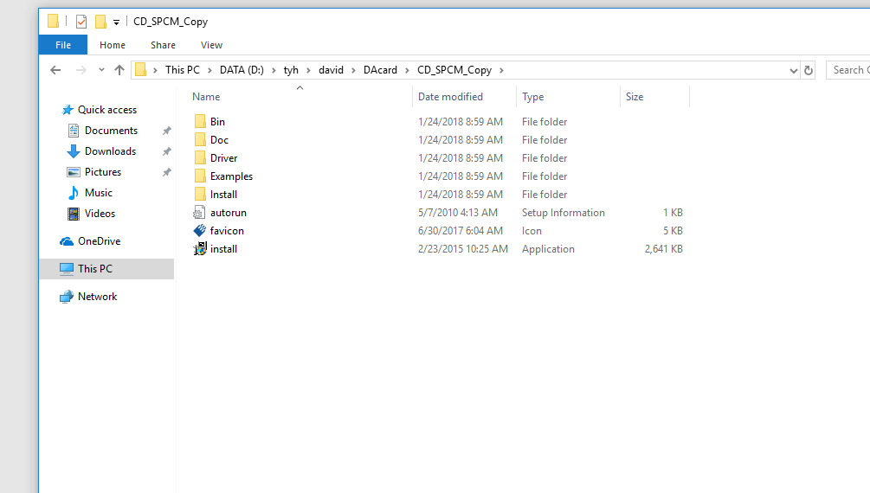
Install files’s path
Run the ‘install’ file

Slide 3
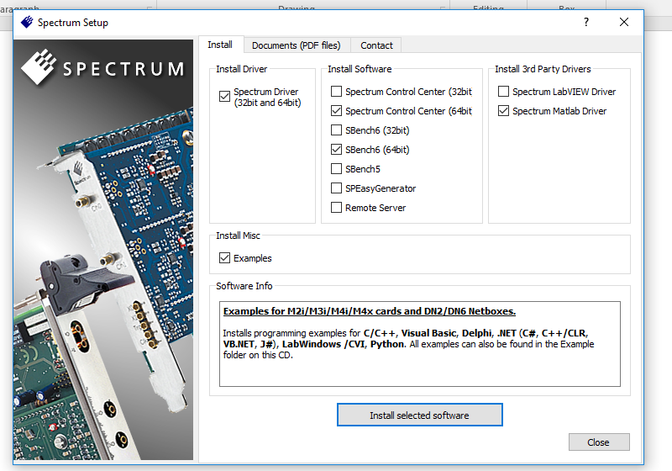
Notice the selection

Slide 4
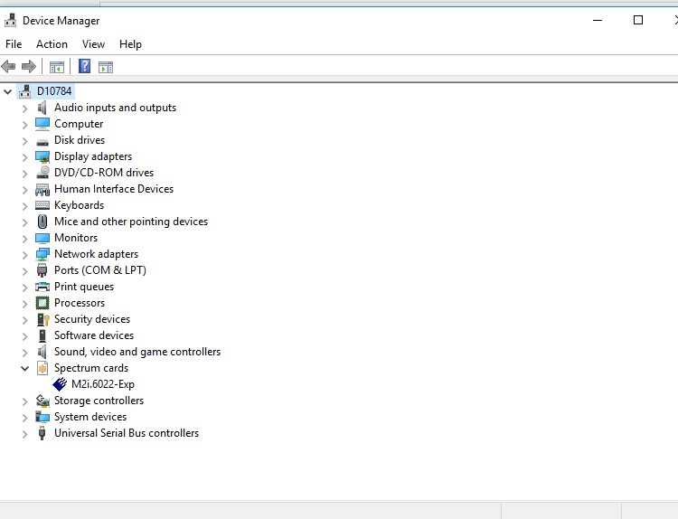
It proves the driver is installed successfully

Slide 5
Matlab environment setup

Slide 6
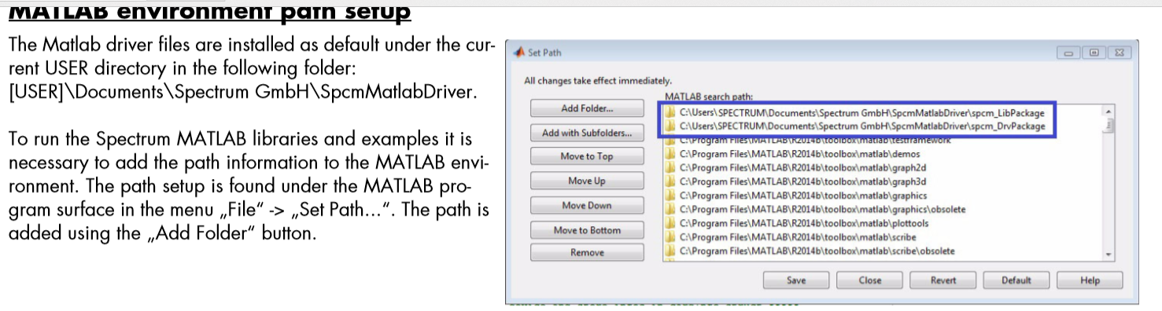
In this computer, the path is:
C:\Users\yhtian-adm\Documents\Spectrum GmbH\SpcmMatlabDriver

