Slide 1
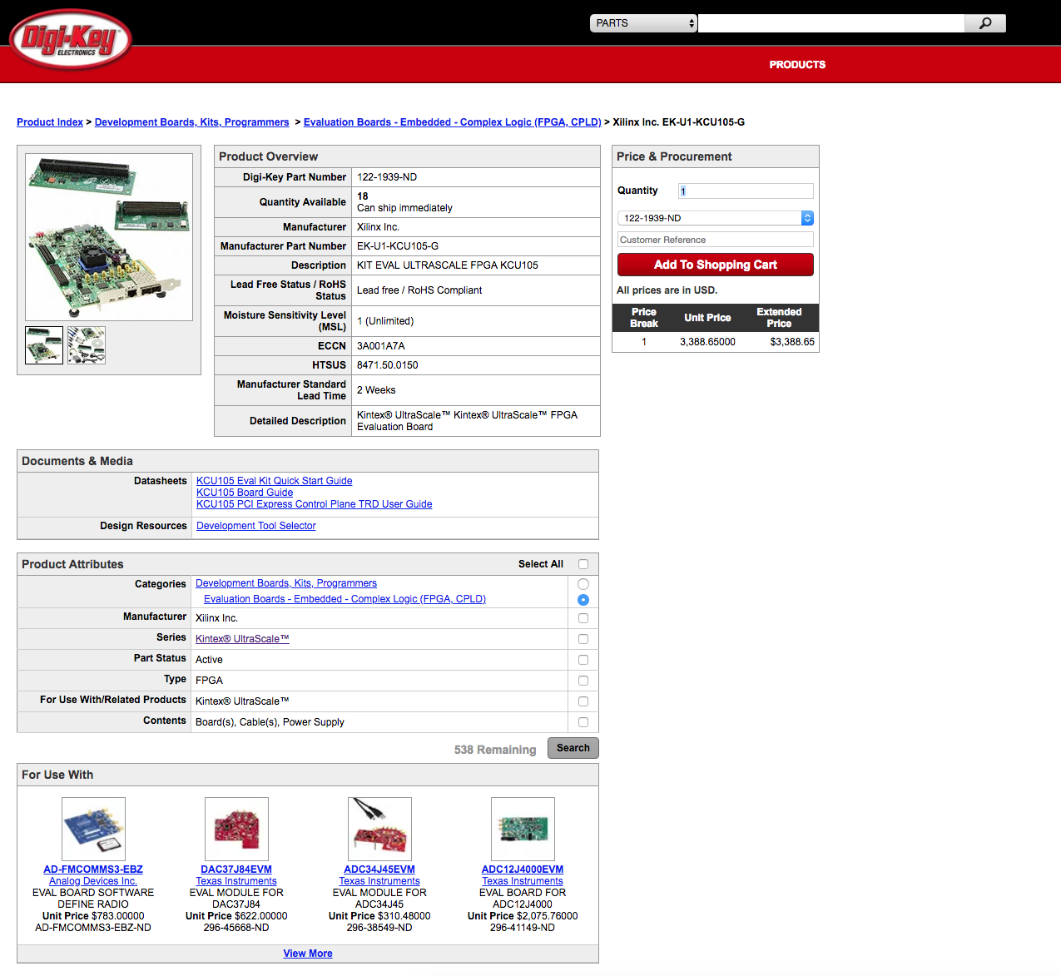
Xilinx Kintex UltraScale FPGA Evaluation Kit

Slide 2
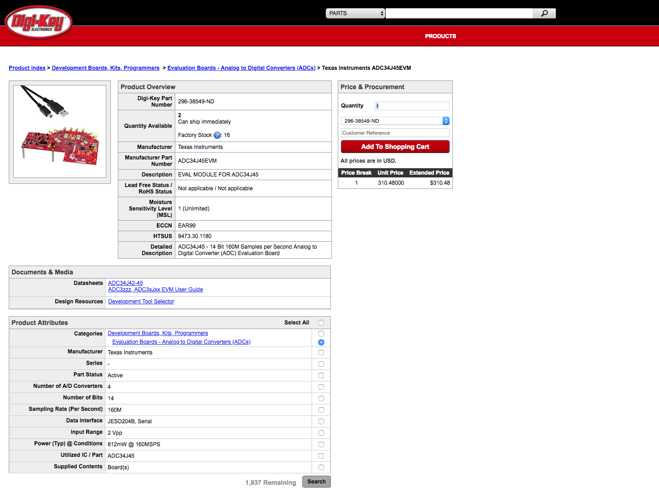
ADC34J45 Evaluation Module

Slide 3
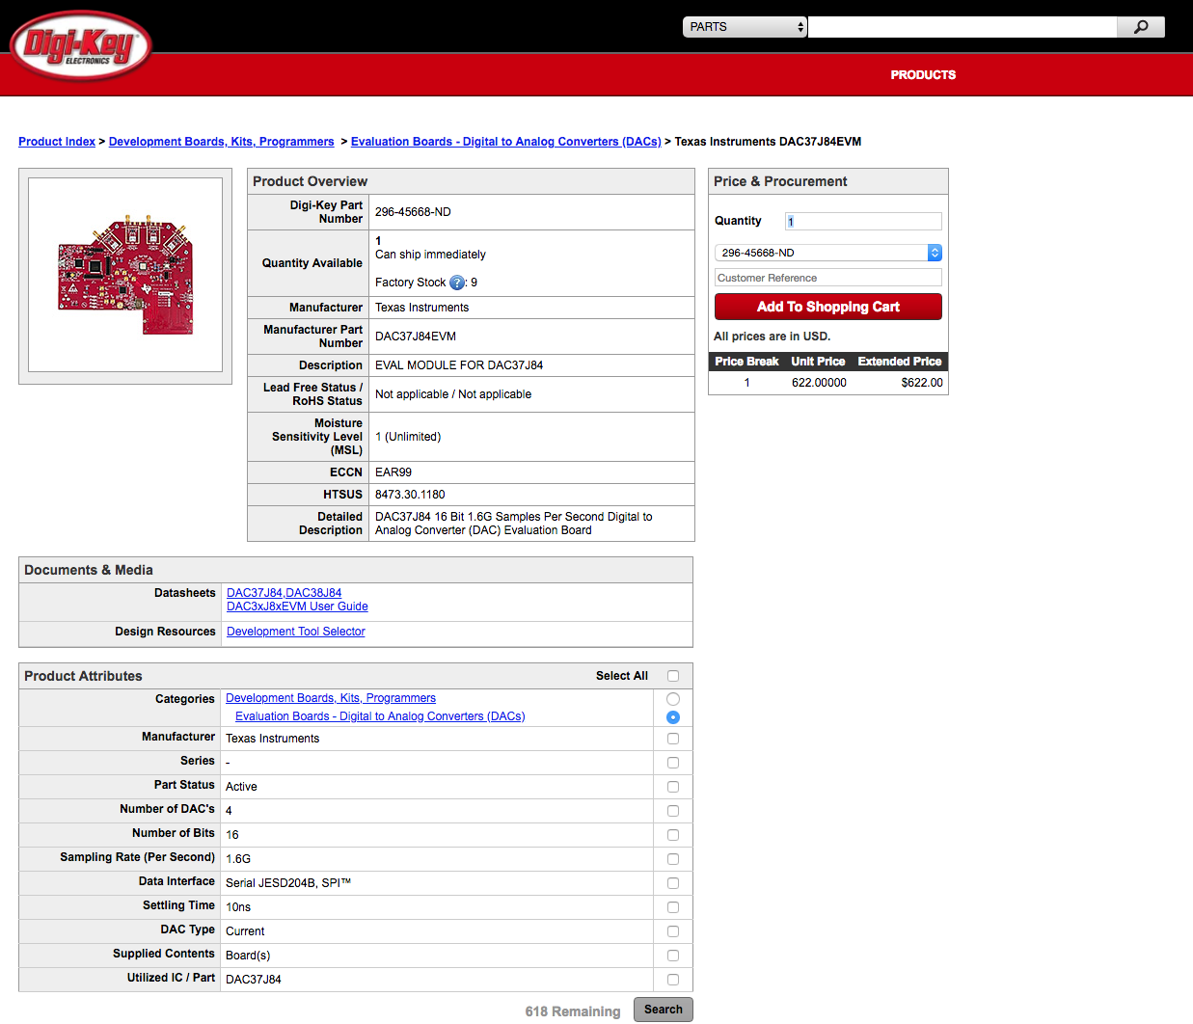
DAC Evaluation Module

Slide 4
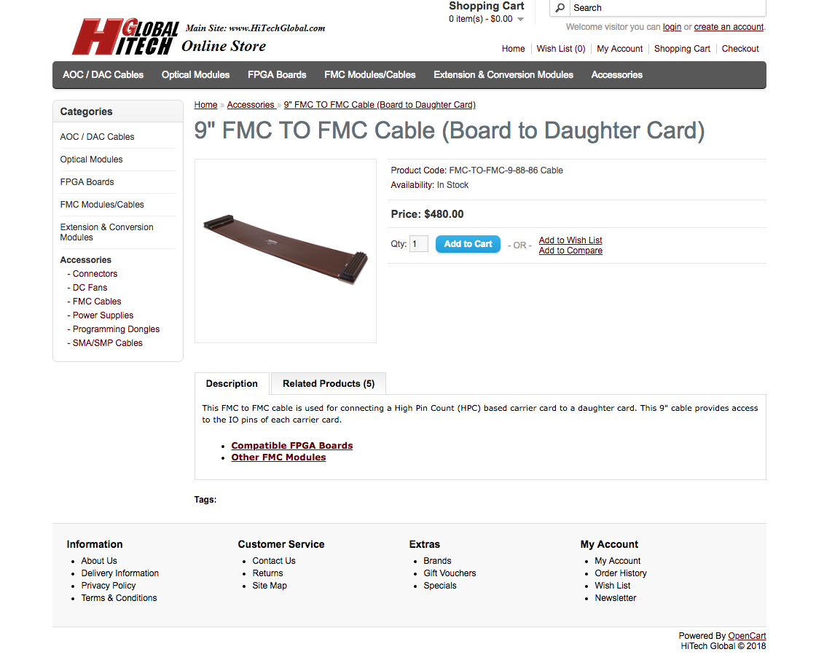
FMC Cable

Slide 5
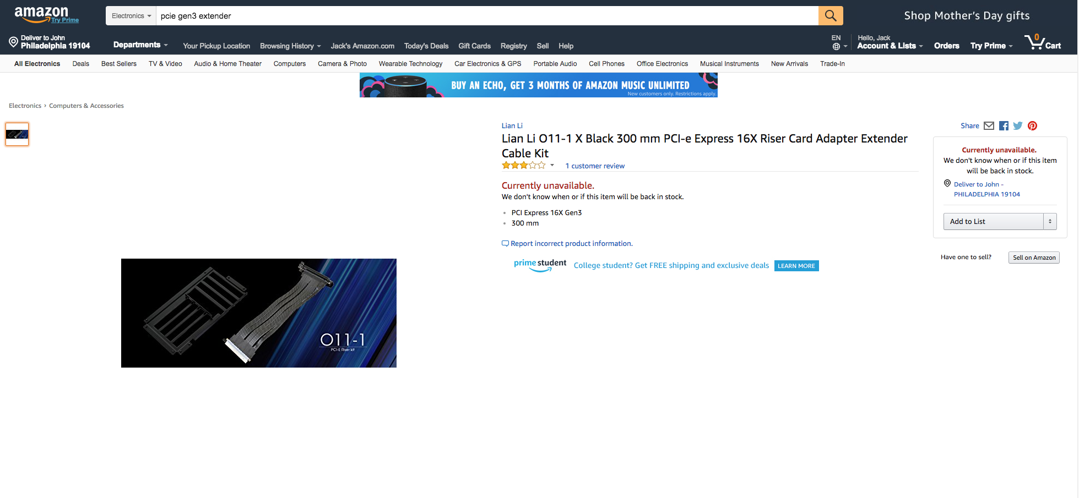
Link to the manufacturer page: http://www.lian-li.com/product/pw-pci-e30-1/

