Slide 1
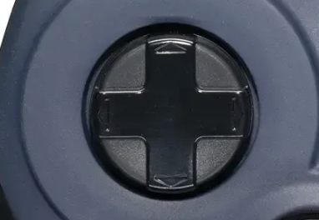
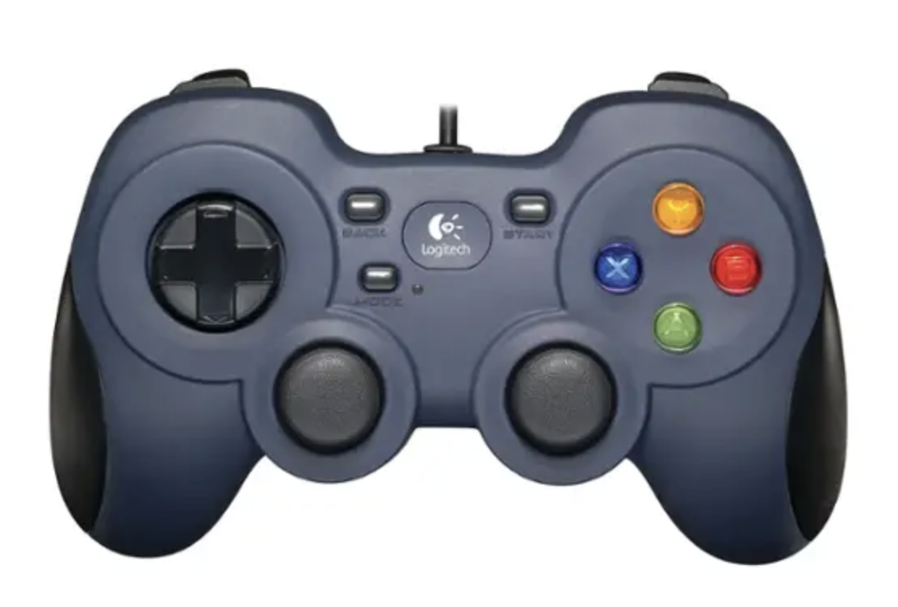

Increase Y
Quit
Accept and Save Match
Greener
Redder
Decrease Y
Bigger Y Step
Smaller
R/G Step
Bigger
R/G Step
Smaller Y Step

