Slide 1
ENIGMA Wrapper Scripts Structural MRI – Subcortical and Cortical Protocols
Welcome to ENIGMA! Here, we’ve packaged some of the ENIGMA structural MRI analysis protocols with several wrapper scripts to facilitate the easiest data processing possible. These wrappers scripts were developed by Eric Kan, Julia Anglin, and Sook-Lei Liew to implement all of the excellent scripts written by the ENIGMA team. Many thanks to NPNL lab members and Michael Borich for great beta testing and feedback.
Thanks for doing this - we look forward to a productive collaboration!
Any troubleshooting issues with these scripts can be directed to both Sook-Lei Liew (sliew@usc.edu) and the Neural Plasticity and Neurorehabilitation Laboratory (npnl@usc.edu).

Slide 2
TABLE OF CONTENTS
Getting Started ………….…………. Pages 3 – 7
1. Project Directory Setup ……………………………………... Page 3
2. Organizing Data ……………………………………………… Page 4
3. Installing Software ………………..……………………..…… Page 5
4. Setting Freesurfer Path ……….……..…..……………..…… Page 6
5. Make Scripts Executable …....………………………..…….. Page 7
Running the Scripts ...………...….. Pages 8 – 10
6. Run Freesurfer ………………..……………………………... Page 8
7. Extract Data and Quality Checks (subcortical) ……….….. Page 9
8. Extract Data and Quality Checks (cortical)….……..……… Page 9
Additional Tips …......………...…….…... Page 10
Page 2

Slide 3
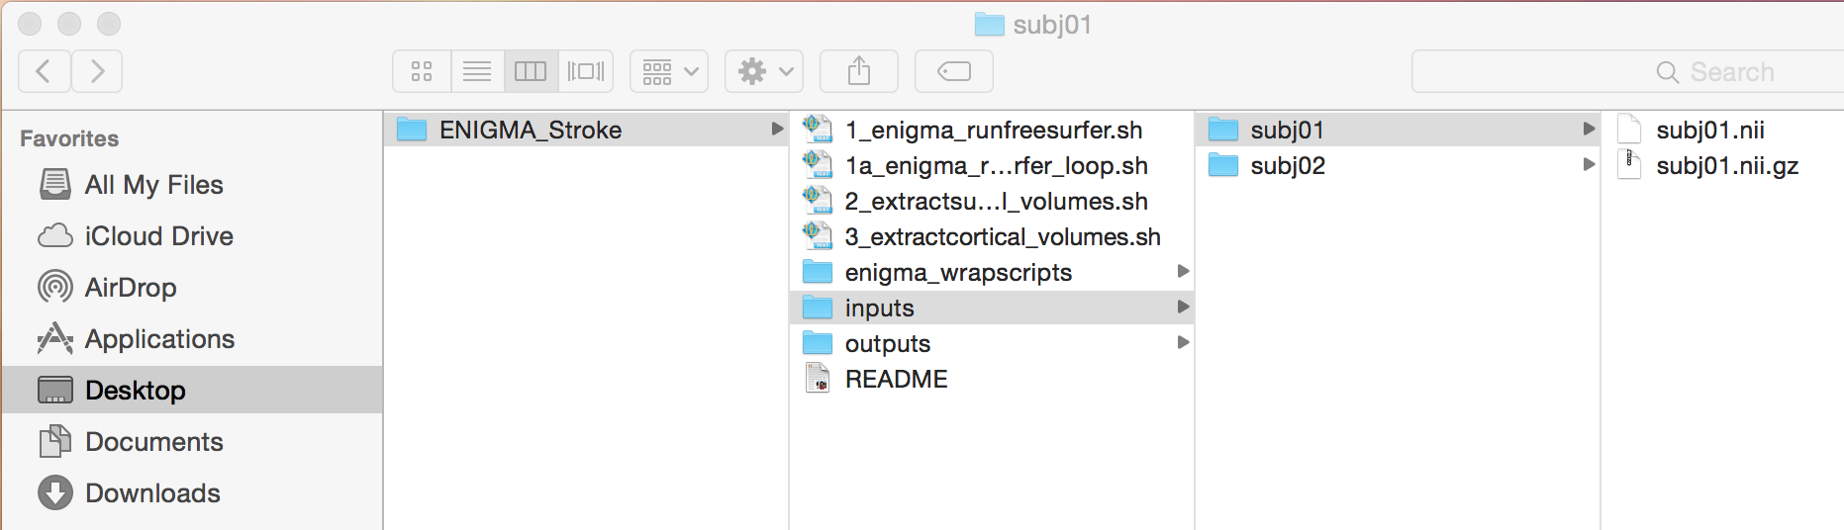
GETTING STARTED
Before you start running the scripts, please make sure that the following steps are completed to organize your data.
1. Project Directory Setup
The project directory should be built as follows:
ENIGMA_parent_directory/
-> inputs/ (anatomicals, 1 per subject)
-> subj01 (within this folder should be subj01.nii.gz)
-> subj02 (within this folder should be subj02.nii.gz)
..
-> outputs/
-> enigma_wrapscripts/
-> bash
-> Matlab
-> R
Here is an example of how the directories should appear:
This structure is set up in the zip folder you downloaded. All you should have to do is add your subjects’ folders and .nii.gz images into the inputs folder. If your subject data does not have the string ‘sub’ at the beginning of your subject names, follow the steps for item 2 (Organizing Your Data) on the Page 4 to reorganize your data.
Page 3

Slide 4
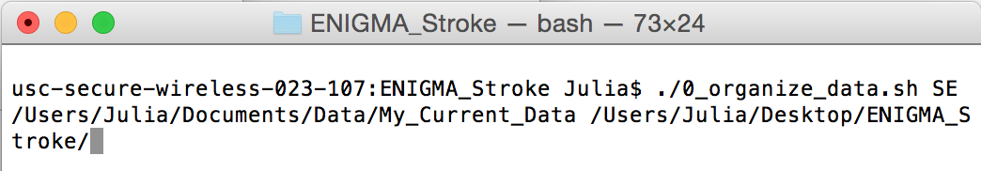
2. Organizing your data
The enigma wrapper scripts assume that the string ‘sub’ is at the beginning of your subject names and that you have a subject folder with a single .nii.gz anatomical with the same subject name inside the subject folder. If your data is not organized this way, run the 0_organize_data.sh script to reorganize your anatomical data into the ENIGMA inputs folder.
Before running this script (and to use all future scripts), make sure you are in the directory for which the script is in. If you do not know how to change your directory, please see tip (1) on Page 10.
To use this script, type the following into the terminal, making sure to replace what is in the <> with the given information:
./0_organize_data.sh <subject data header> <directory of current data> <directory for enigma project>
For example:
If you do not know what the directory you are currently in is, type pwd in the terminal. If you are unclear about a directory of another file, follow tip (2) on page 11.
Note 1: This script assumes your anatomical data are all directly within /My_Current_Data or whatever folder you put as your directory of current data - if not your data is not all within this folder, minor edits will be needed; please contact npnl@usc.edu and sliew@usc.edu.
Note 2: If you receive an error that says “Access Denied”, please refer to the section titled ‘Make Scripts Executable’ on Page 7.
Page 4

Slide 5
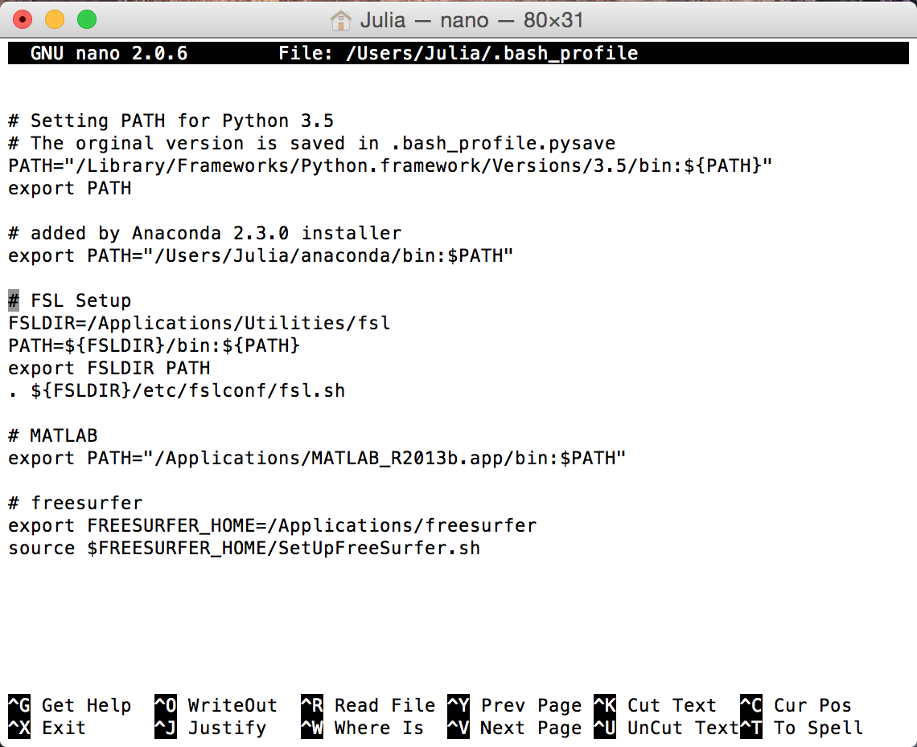
3. Installing Software
FSL, Freesurfer, R and Matlab must be installed on your computer. You also need a bash terminal.
The executables of FSL, Freesurfer, and R each need to be in the user's PATH environment (most times this is already setup if the programs are already installed on the machine). For Mac/Linux users, to see if this is set up, type:
nano ~/.bash_profile
(or .bash_rc or other equivalent profile) in the terminal (this file may be a different name/path). If this is not set up for a given program, you will need to manually type the following in:
export PATH=“<directory>/<program>/bin:$PATH”
(but replace <directory>/<program> with your specific path to the program - for instance, for Matlab 2013b, you might use the following line:
export PATH="/Applications/MATLAB_R2013b.app/bin:$PATH"
You should have these three PATH environments, similarly structured, in your bash profile:
Page 5

Slide 6
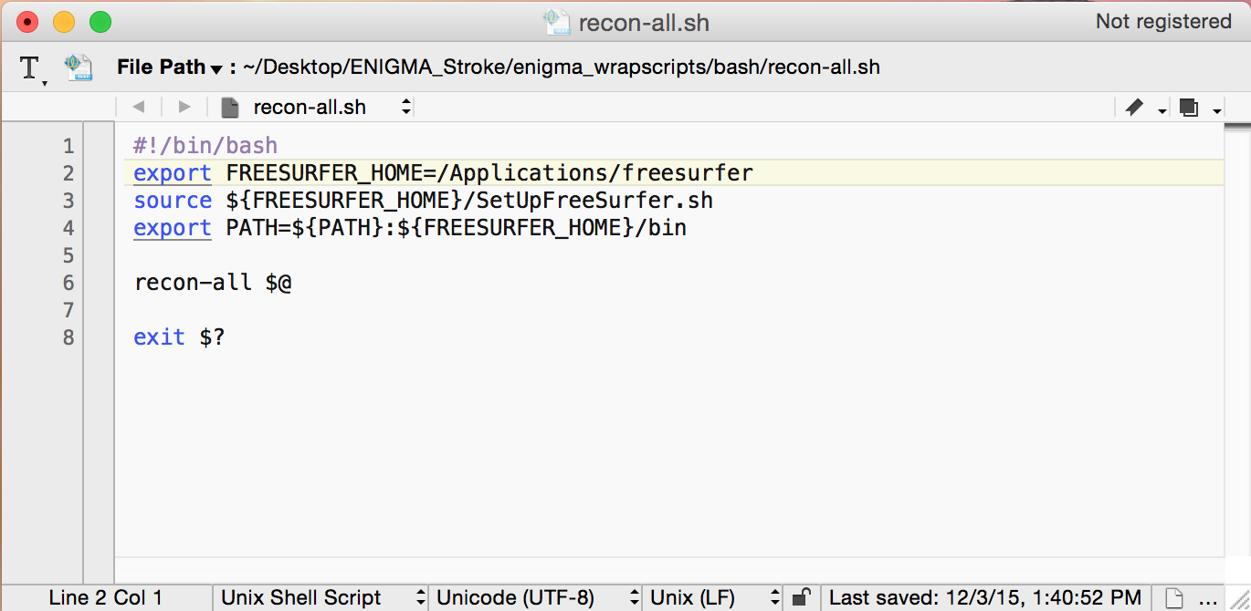
4. Set Freesurfer Path
You will need to edit your Freesurfer Path in the recon-all.sh script. The recon-all.sh script is found in enigma_wrapscripts/bash/.
In the recon-all.sh script, line 2 needs to be modified to point where the Freesurfer program has been installed (i.e. replace <PATH TO FREESURFER INSTALLATION> with /Applications/freesurfer or wherever you have installed freesurfer).
Page 6

Slide 7
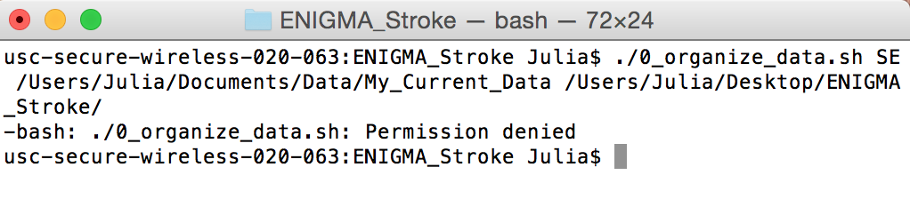
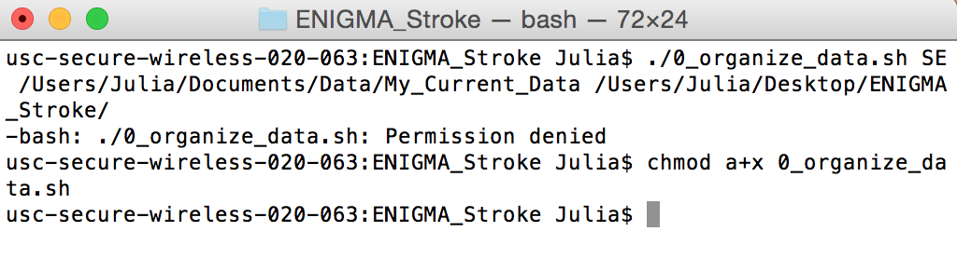
5. Make Scripts Executable
All bash and applications scripts in the parent directory must be executable.
If when running scripts, you receive an error that looks like this:
It usually means that your script is not executable.
To make the scripts executable, use the chmod command, with a+x arguments. For instance:
Page 7

Slide 8
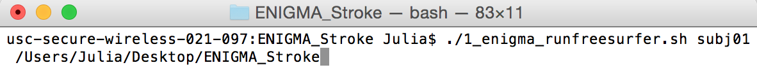
RUNNING THE SCRIPTS
When GETTING STARTED steps are complete, you can run the 3 wrapper scripts, which means just running 3 lines of code.
6. Run Freesurfer
This will take some time to run (~12-16 hours per subject, depending on your computer)!
To run freesurfer for a single subject, type the following into the terminal making sure to replace what is in the <> with the given information:
./1_enigma_runfreesurfer.sh <subject number> <path to parent project directory>
To run freesurfer for more than one subject, use the script 1a_enigma_runfreesurfer_loop.sh:
./1a_enigma_runfreesurfer_loop.sh <path to parent project directory>
Page 8

Slide 9
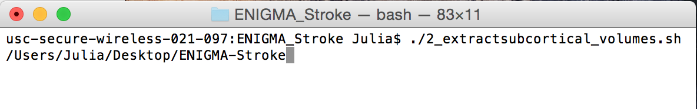
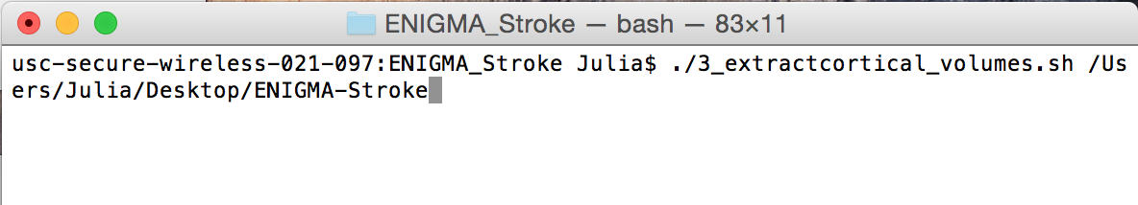
7. EXTRACT DATA AND QUALITY CHECKS (SUBCORTICAL)
To extract all the data into a csv file and run the quality checks for subcortical analysis, type the following into the terminal making sure to replace what is in the <> with the given information :
./2_extractsubcortical_volumes.sh <path to parent project directory>
Estimated run time: ~30 min for 27 subjects
8. EXTRACT DATA AND QUALITY CHECKS (CORTICAL)
To extract all the data into a csv file and run the quality checks for cortical analyses, type the following into the terminal making sure to replace what is in the <> with the given information :
./3_extractcortical_volumes.sh <path to parent project directory>
Estimated run time: ~30 min for 27 subjects
Page 9

Slide 10
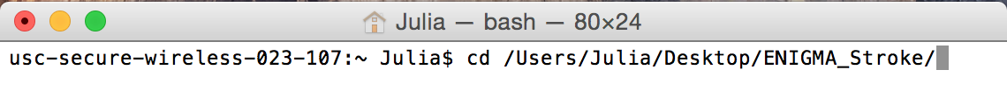
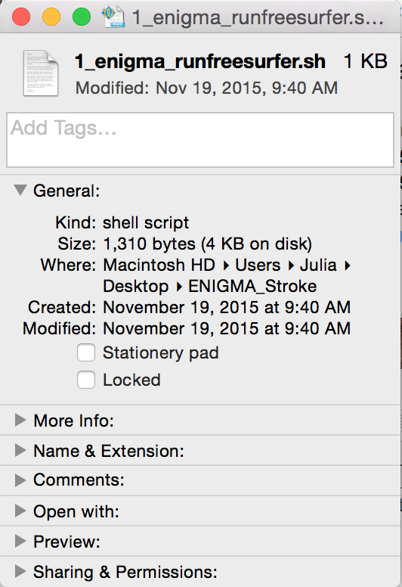
Additional Tips
Tip (1): To change directories, use the command “cd” followed by the directory you want to move to
Tip (2): To locate the directory path of a given file from the Finder on a Mac, right click on the file and click “Get Info”. The portion in the red box is the path. You may highlight this and copy and paste it into the terminal. Make sure folders are separated by ‘/” – e.g., Users/Julia/Desktop/ENIGMA_Stroke
Page 10

