Slide 1
Microsoft Azure Training Day: Migrating Applications to the Cloud

Slide 2
(DO NOT SHOW) Deploying your application faster and safer
Baseline Event | Microsoft Azure Training Day: Migrating applications to the cloud
Recommended Speaker Roles | Field Technical Roles: Regional CDA’/CSA’s, PFE, GBB’s, MVP, MTC TSP’s
Audience | 70% Developers 30% Architects
Length & Version | 60min
Content Level | 200
Deck Contacts | Mark Winters
Training Resources | Session Video -Video 3 Github resource to run the demo’s-Session 3
Accessibility checker | (done)
CHANGE TRACKER
Date | Slide | Description of Update

Slide 3
Deploying your Application Faster and Safer
Speaker name
Title

Slide 4
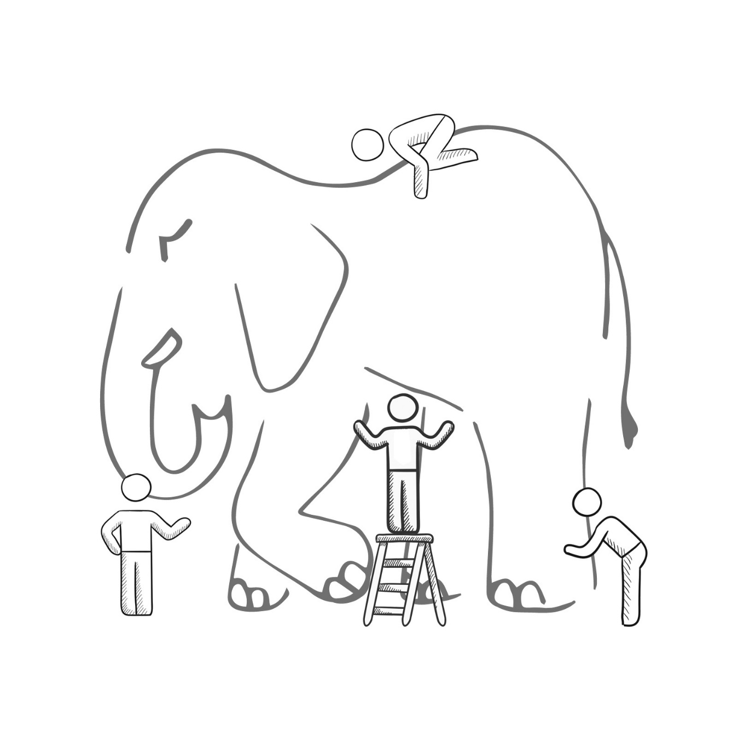
What is DevOps?
It’s a job title
It’s automation
It’s Development and Operations collaboration
It means faster and smaller releases
Notes:
Now I've mentioned DevOps a lot, but what exactly is DevOps. I bet if I ask 10 people in this room what DevOps is, we will get 10 different responses. And I'm not saying anyone elses definition is wrong. But in order to frame this conversation we are having, let me give you Microsoft's Definintion of DevOps

Slide 5

DevOps is the union of people, process, and products to enable continuous delivery of value to our end users.
- Donovan Brown
http://bit.ly/WhatIs-DevOps
Notes:
At Microsoft, DevOps is something very specific. Devops is the union of people, process and products to enable the continous delivery of value to our end users. Now notice I said that super carefully. I didn't say continously deliver code. Because what will that give us, just piples and piles of code that's no use to our end users. And notice, I didn't even say continously deliver features. Because we could be delivering feature after feature, but if we are not delivering value, we are just wasting time!

Slide 6
Why is DevOps important?
Your competition is already doing this
Increase velocity
Reduce downtime
Reduce human error
Notes:
Now why is this important? Why do should we care about DevOps. The speed of business today is SO fast, that we must adopt DevOps best practices just to keep up. If we don't, our competitors either have or they will adopt DevOps best practices. And whey they do, they WILL out innovate us and they WILL render us obsolete. And no one wants to be rendered obsolete.

Slide 7


High Performance DevOps Companies Achieve…
46x Deployment
Frequency
2,555x Faster Lead
Time For Changes
Faster
Time to Market
DevOps
$
Increased
Revenue
7x Lower Change
Failure Rate
2,604x Faster Mean
Time to Recover
Source: 2018 Accelerate: State of DevOps: Strategies for a New Economy." N. Forsgren, J. Humble, G. Kim. DevOps Research and Assessment (DORA)
Notes:
This isn't just theory anymore. We now have the cold hard imperical facts that cleary demonstrate this. Adopting DevOps best practices means you are faster to market, you have lower failure rates. Much faster lead time for changes and much faster Mean time to recover. And what does all of this translate into? INCREASED REVENUE!

Slide 8
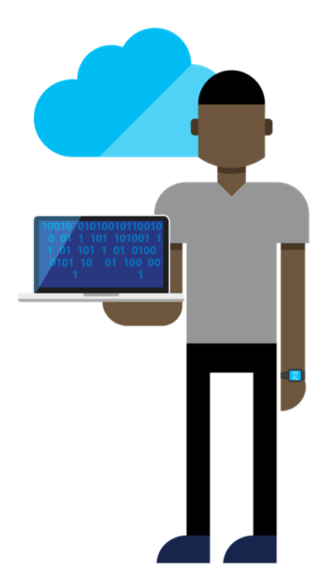
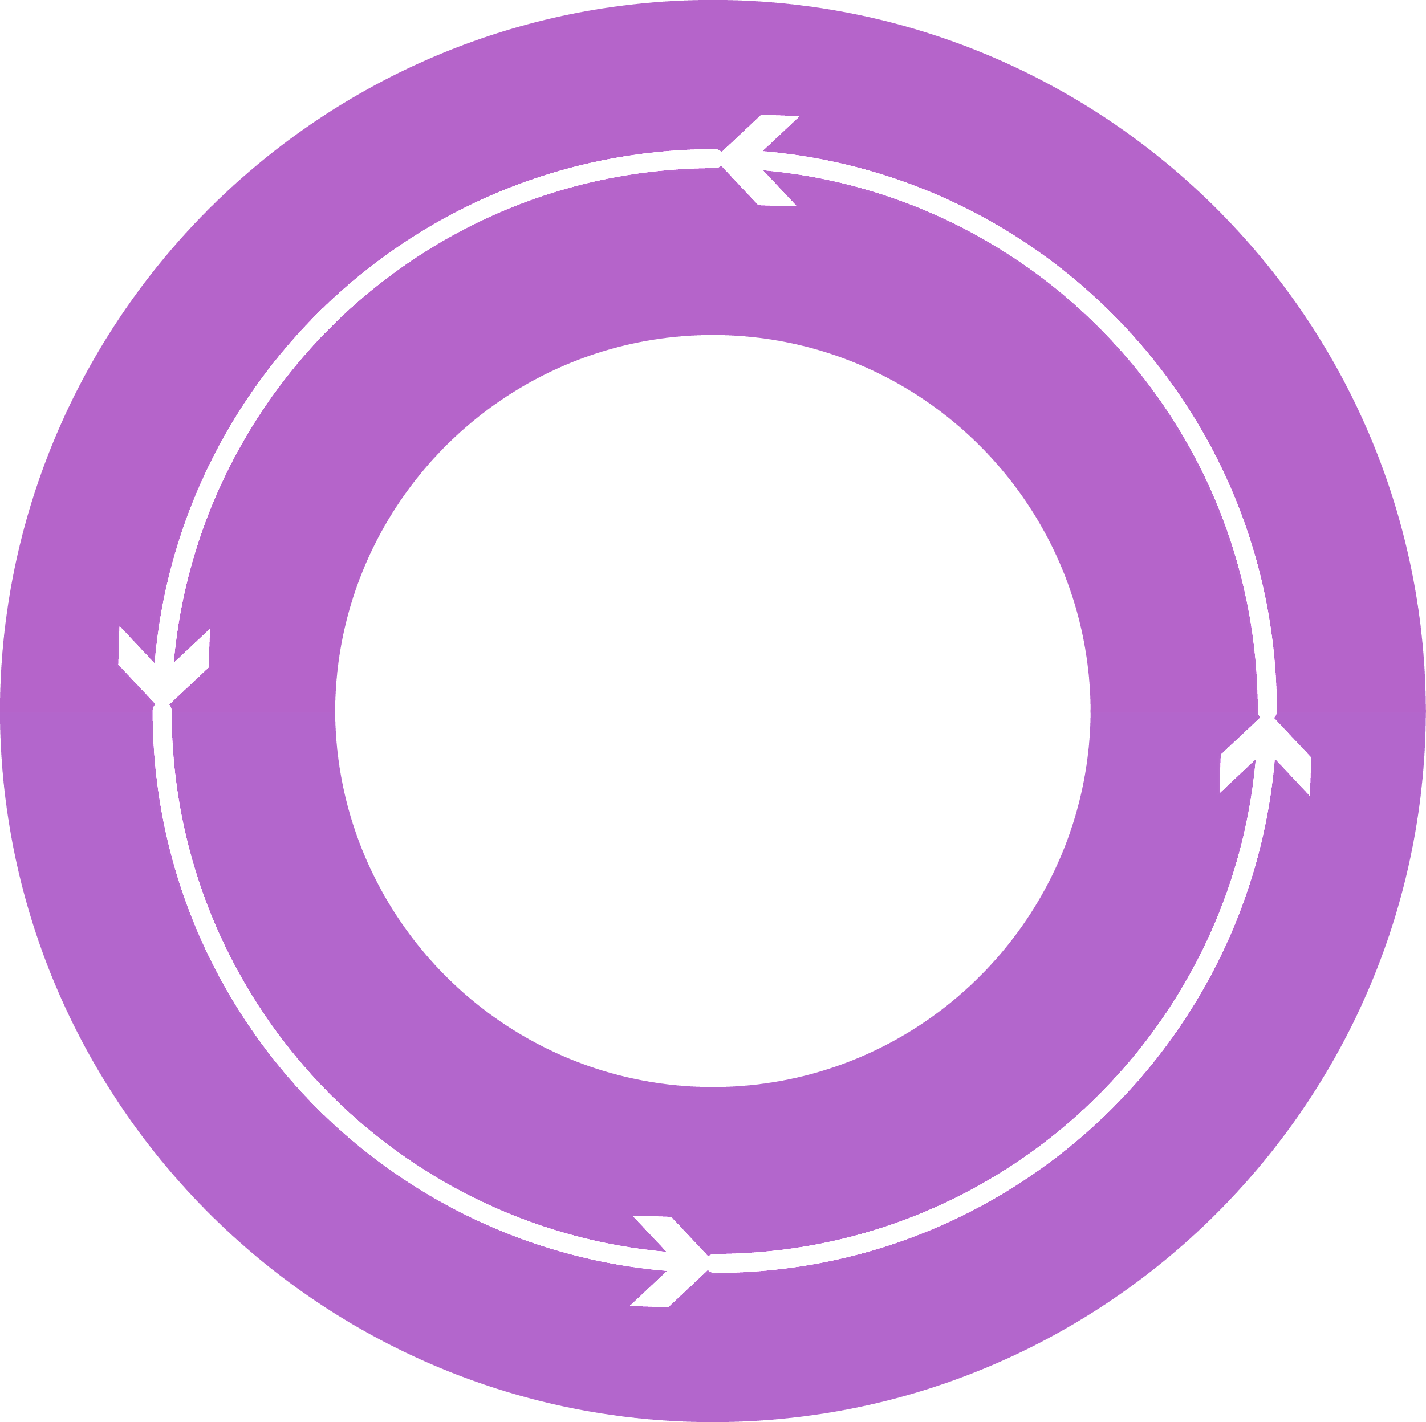




DevOps: the three stage conversation
DEV
OPS
1
People
2
Process
3
Products
Notes:
To implement DevOps successfully, you have to attack all three pillars when writing software. You must address the People, the Process and the Products

Slide 9

People
DEV
OPS
Notes:
For the people portion, that's the toughest change to make. This is a cultural shift that needs to take place in the organization. Where everybody from the top down all become hyperfocused on continuously delivering value. I don't want to hear, well, that's how we always do things from anyone. Everyone needs to focus on continuously delivering vaue.

Slide 10
Process
1
4
Plan
Monitor + Learn
Development
Production
2
3
Develop + Test
Release
Notes:
For the process, we need to have a process that will let us interate fast enough, yet still deliver code of high enough quality. So what does that mean? I need to be able to plan my sprints, and I need to be able to check my code in and out while tracking against the work I'm doing. And as I'm checking code in and out? Builds need to kick off. Automated Tests need to be run. Security scans need to happen. And if the build are good, an automated system needs to pick up my bits and deploy them into my Dev, QA, UAT all the way out in to production. And why does this need to be automated? Potentially, this can happen many times a day! So we need to make sure the process is consistent and repeatable. Every single time like clock work. And once the code reaches production, it doesn't end there. We still need to be able to monitor our code in production. We need to know things like, is my app up or down, is my app performing well, and what are users really doing in my app? Because answers to those questions let me know if I'm delivering vaue to my end users. And if I am, we can double down on those types of activities in the next sprint. And if we aren't, then we can quickly reprioritize our backlog and course correct.

Slide 11
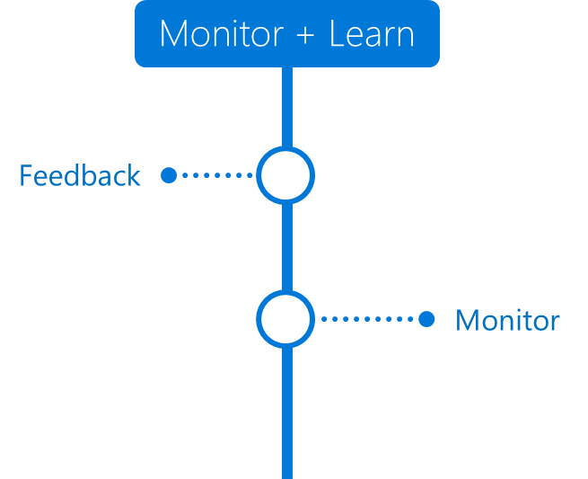
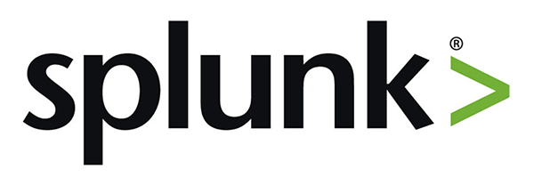
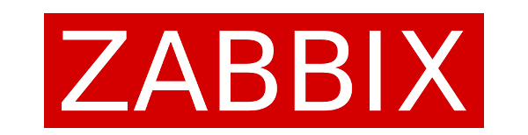
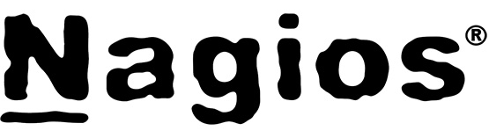

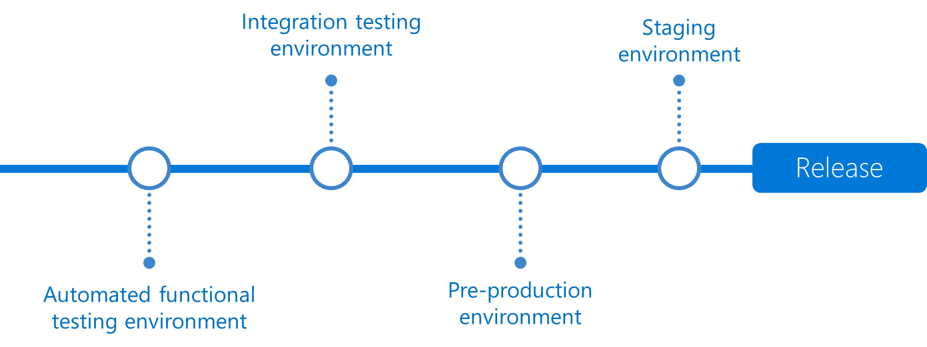
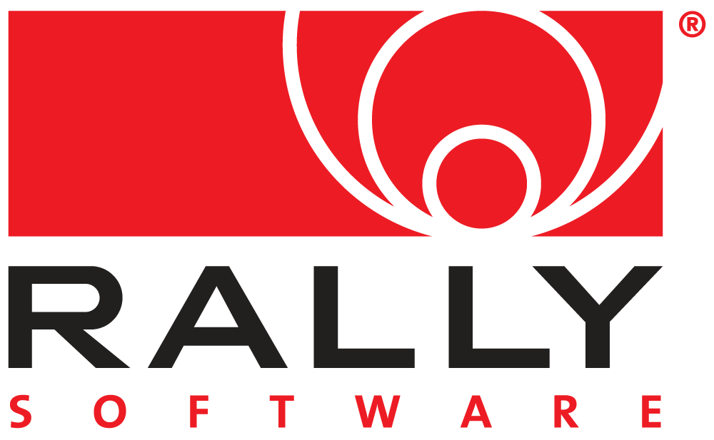
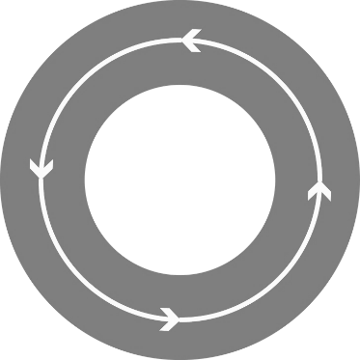

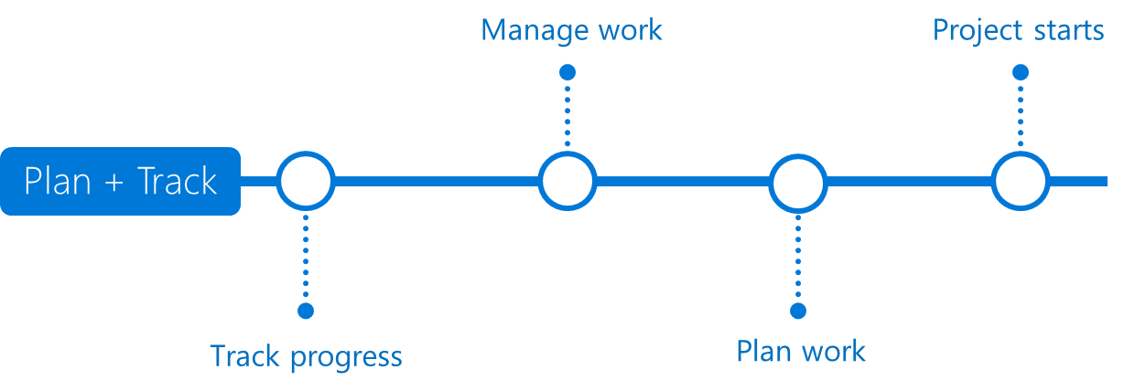

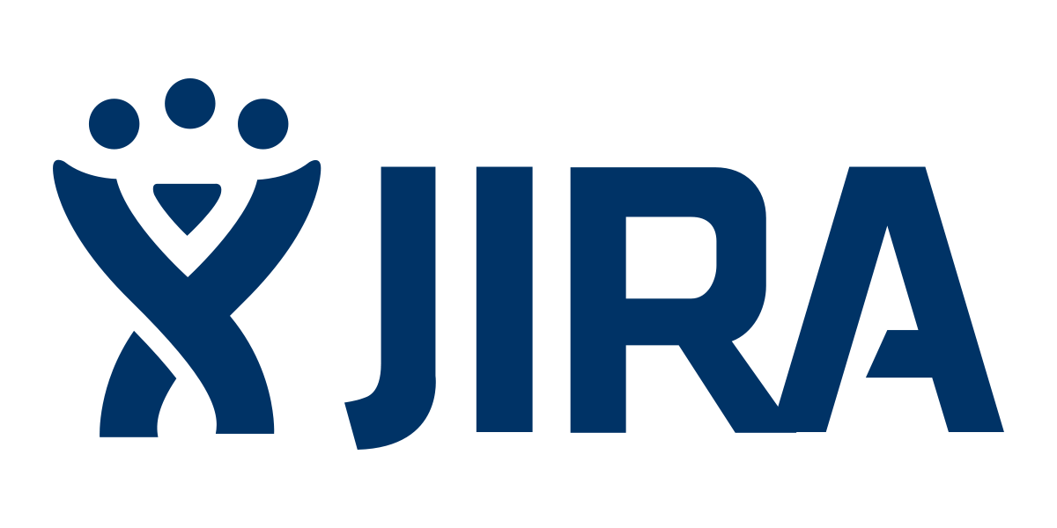
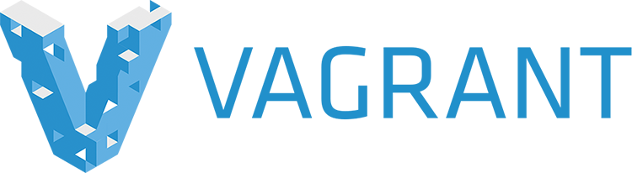


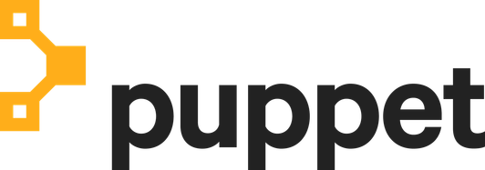
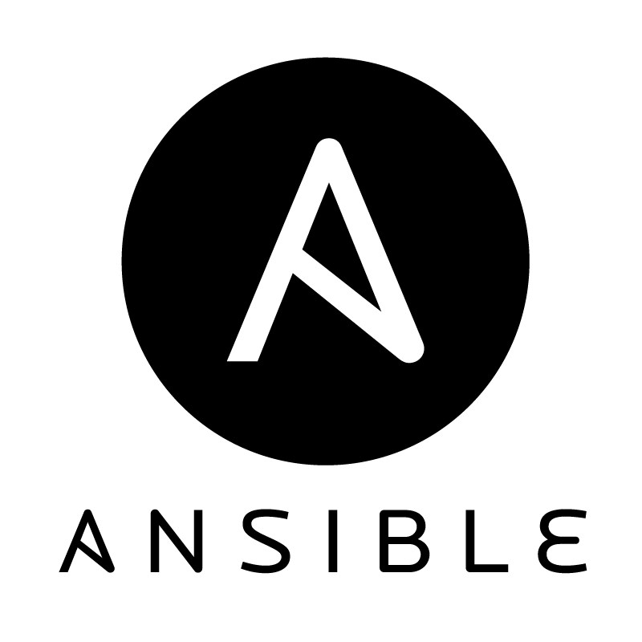

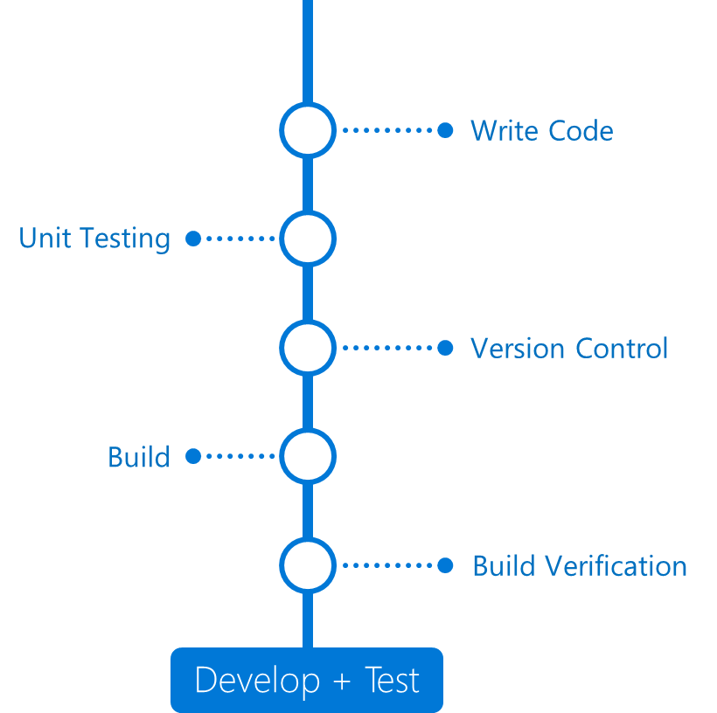
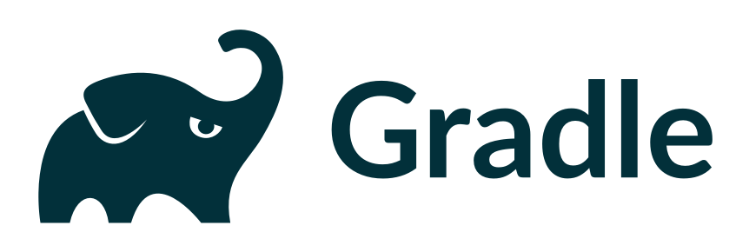
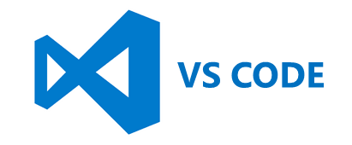
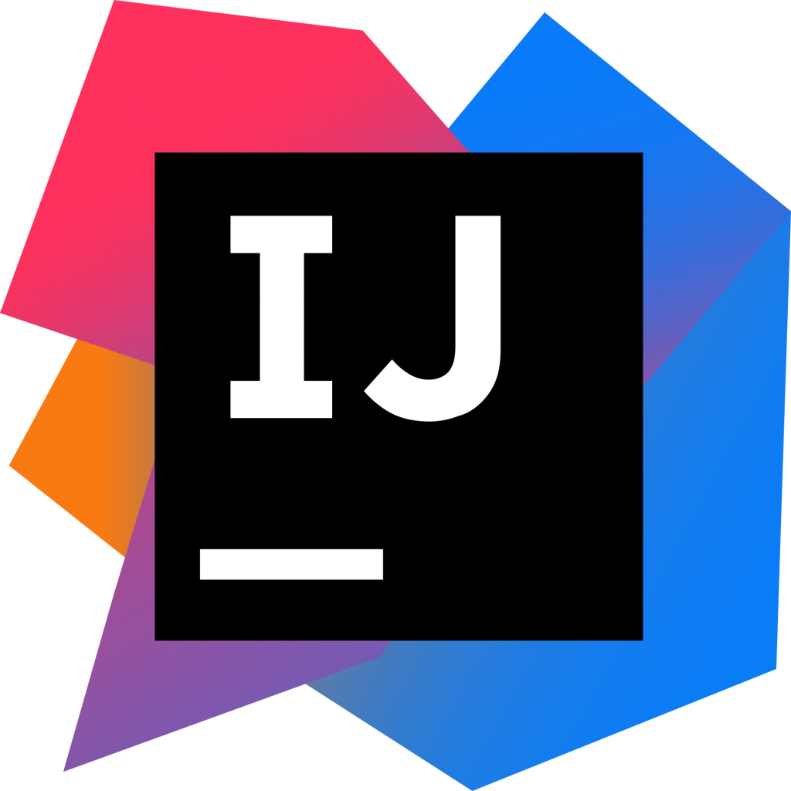
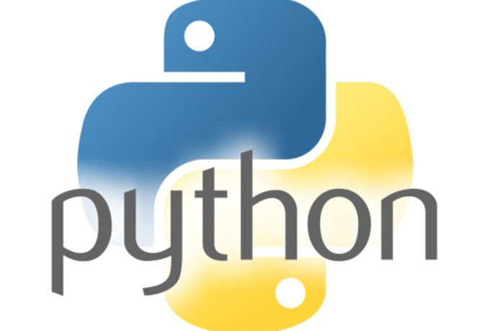
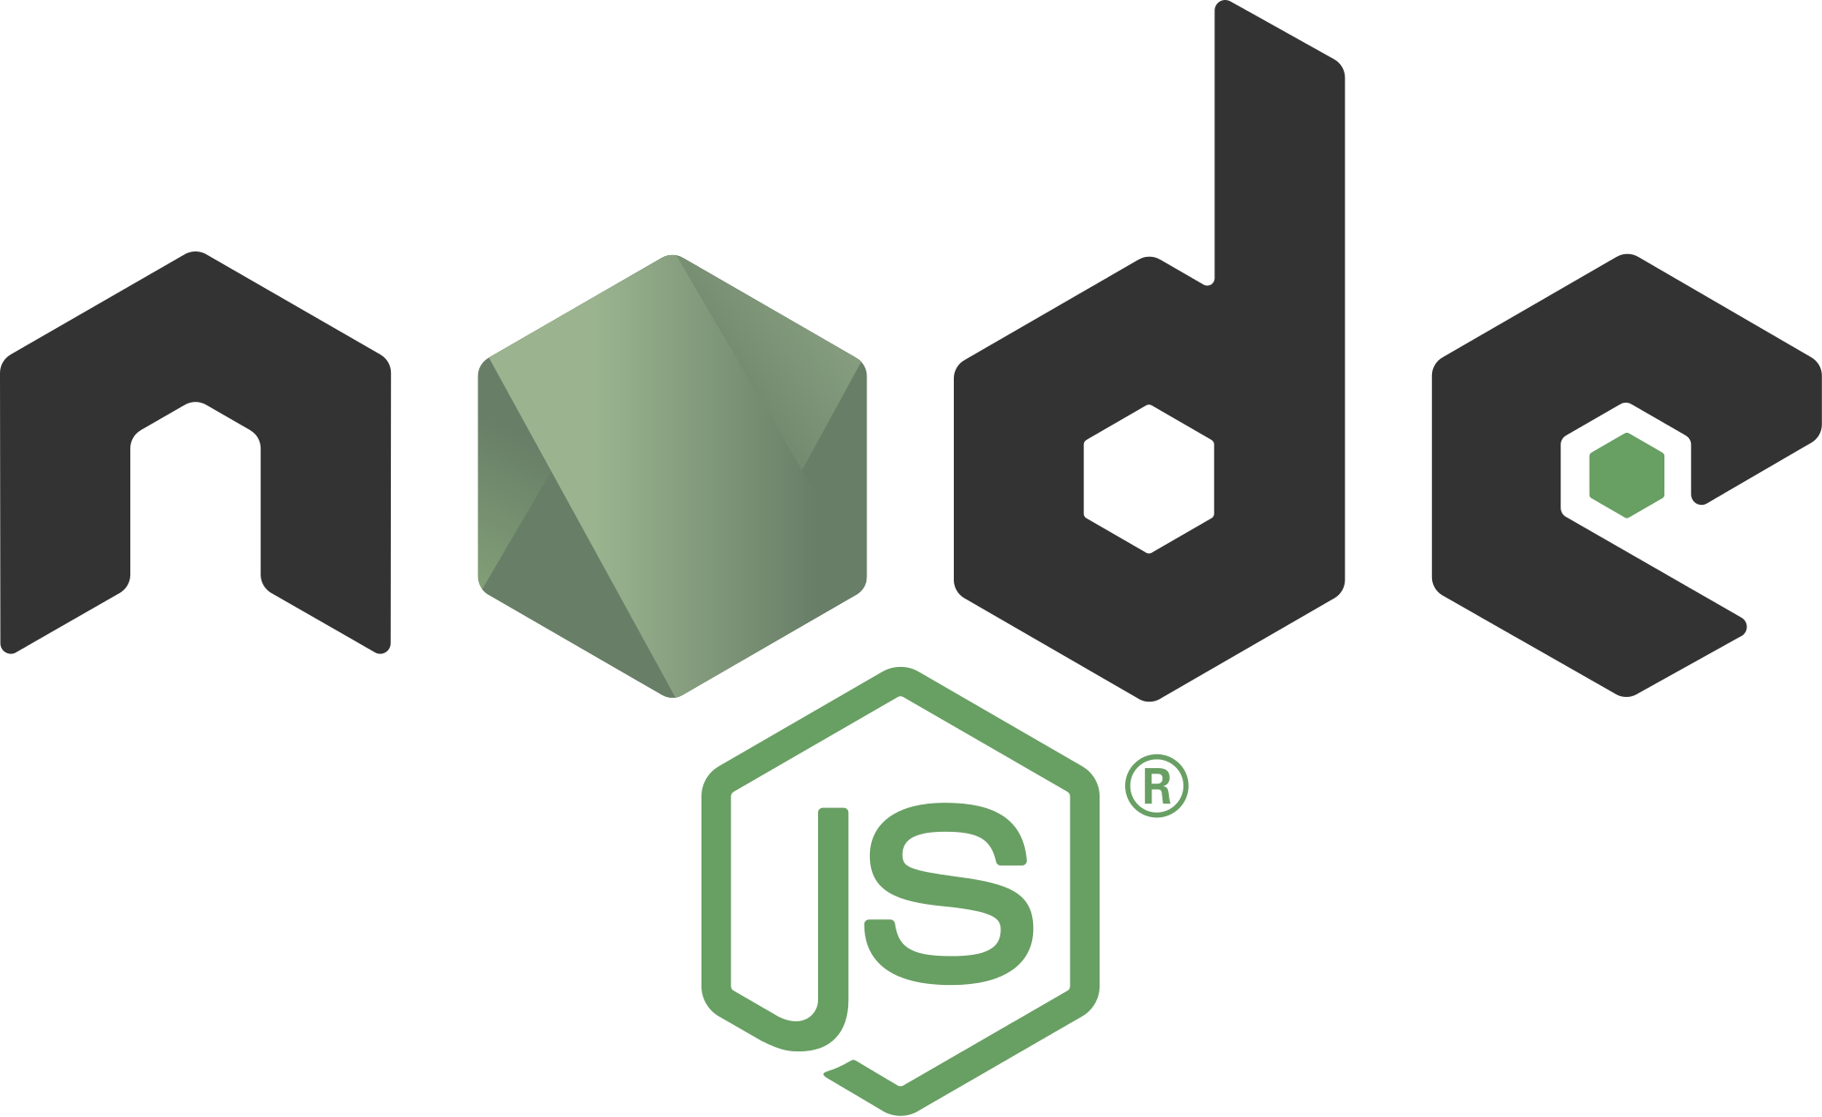
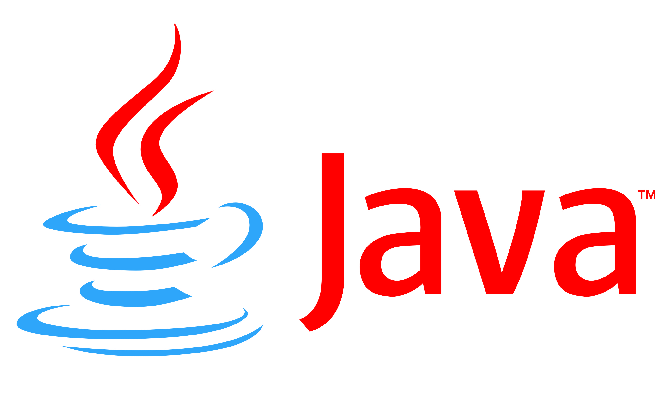

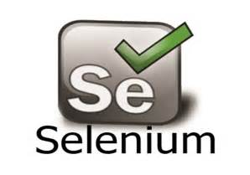
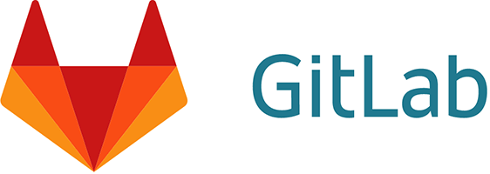

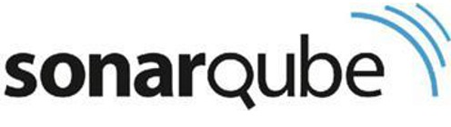
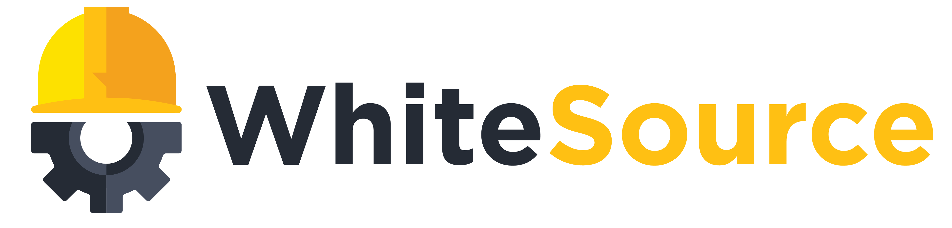
Any Language
Any Platform
DevOps
DevOps
Notes:
Now all of this requires the right products and tools to help enable all of this. So we need tools that will let us track our work throughout our sprint. We need source control systems that can corrolate our work to our checkins. We need automated build and release systems that can build on everycheckin, run all of our unit tests and automate deployment all the way to production. And we need systems in place to monitor our app in production.
Out there in the world, there are all sorts of tools that do these things. And Azure is an open system, which means you can keep using all of the DevOps tools you are most familiar with.
However, you can replace ALL of them with just one product. Azure DevOps

Slide 12





Introducing Azure DevOps
Azure Boards
Azure Pipelines
Azure Repos
Deliver value to your users faster using proven agile tools to plan, track, and discuss work across your teams.
Build, test, and deploy with CI/CD that works with any language, platform, and cloud. Connect to GitHub or any other Git provider and deploy continuously.
Get unlimited, cloud-hosted private Git repos and collaborate to build better code with pull requests and advanced file management.
Azure Test Plans
Azure Artifacts
➔
Test and ship with confidence using manual and exploratory testing tools.
Create, host, and share packages with your team, and add artifacts to your CI/CD pipelines with a single click.
https://azure.com/devops
Notes:
Azure DevOps is literally everything you need to take an idea and turn that idea into a working piece of software in the hands of your end users, for ANY language targeting ANY platform. Azure DevOps is a suite of 5 sepparate products that work SEAMLESSLY together. There's a work item tracking product called Azure Boards, where you can track any unit of work in your software project with visual tools to help you manage all of your work. There is Azure Pipelines, where you can build yout your CI/CD pipelines for any language targeting any platform. There is Azure Repos where you can host your own Git repo or a centralized version control system. There is Azure Test Plans for you to create, plan and run all of your manual tests. And finally there is Azure Artifacts, where you can host your package management systems, whethere they be nuget, maven or even generic packages.

Slide 13

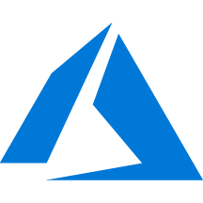
Azure DevOps + Azure
Notes:
In today's session, we will be concentrating on Azure Pipelines, where we will deploy our code faster yet safer!

Slide 14
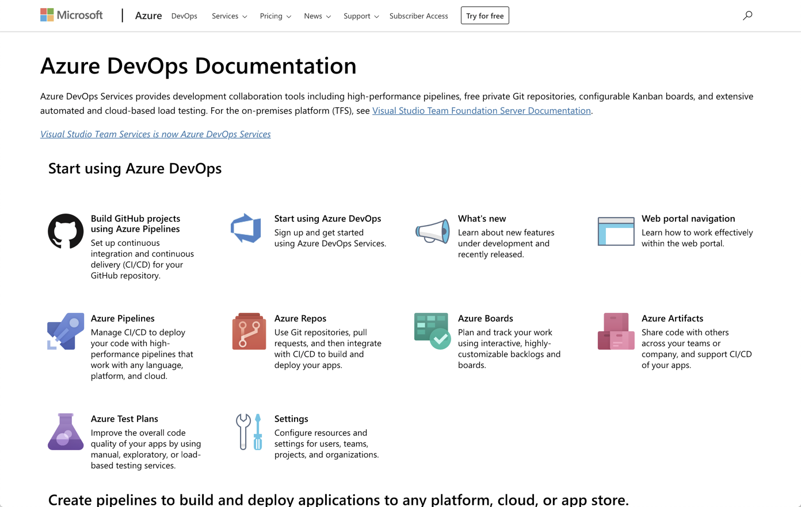
/Docs alert
Azure DevOps documentation has quickstarts and all the reference material you could need
https://aka.ms/AzureDevOpsDocs

Slide 15
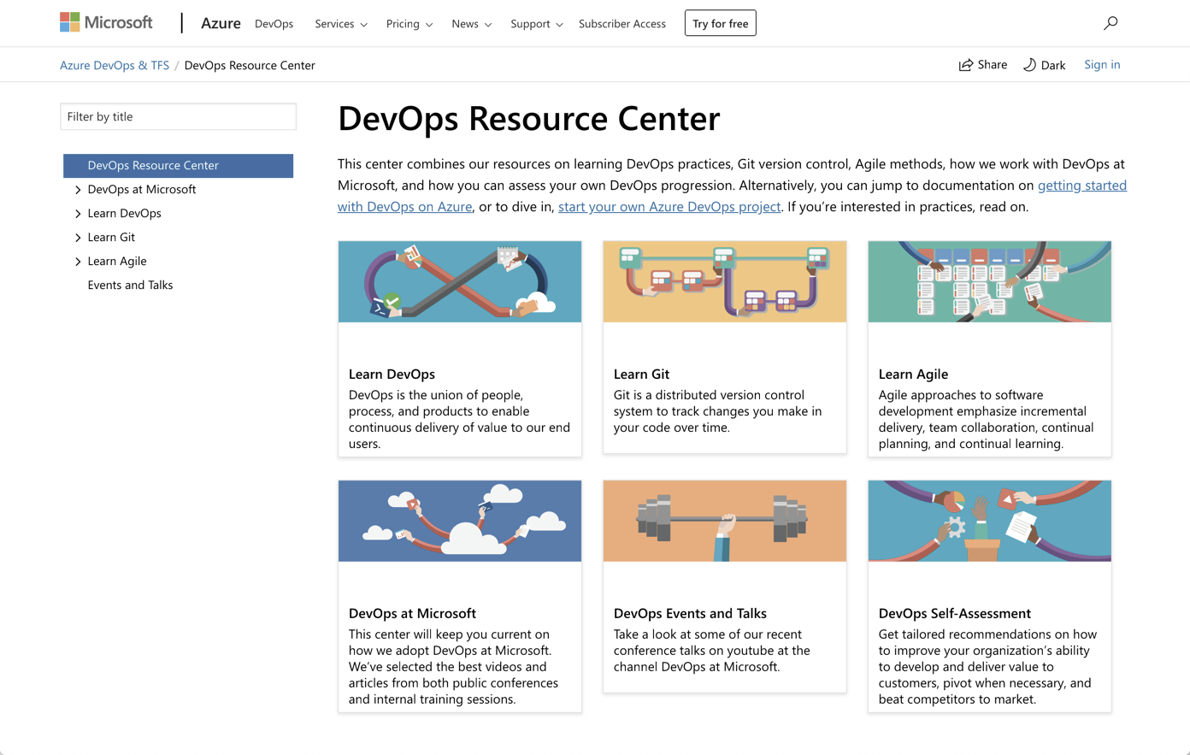
/Docs alert
The DevOps Resource Center is a great starting point for everything DevOps at Microsoft
https://aka.ms/DevOpsResourceCenter

