Slide 1
Microsoft Azure Training Day: Migrating Applications to the Cloud

Slide 2
(DO NOT SHOW) Consolidating infrastructure with Azure Kubernates service
Baseline Event | Microsoft Azure Training Day: Migrating applications to the cloud
Recommended Speaker Roles | Field Technical Roles: Regional CDA’/CSA’s, PFE, GBB’s, MVP, MTC TSP’s
Audience | 70% Developers 30% Architects
Length & Version | 60min
Content Level | 300
Deck Contacts | Mark Winters
Training Resources | Session Video -Video 5 Github resource to run the demo’s-Session 5
Accessibility checker | (date)
CHANGE TRACKER
Date | Slide | Description of Update

Slide 3
Consolidating infrastructure with Azure Kubernetes Service
Speaker name
Title

Slide 4
Goals for this session.
Discover Azure's options for containers
Learn how to deploy a Kubernetes cluster with AKS
Learn to deploy your services to Kubernetes
Learn options for high-availability and redundancy.

Slide 5
Mission control
Your mission, should you choose to accept it…

Slide 6
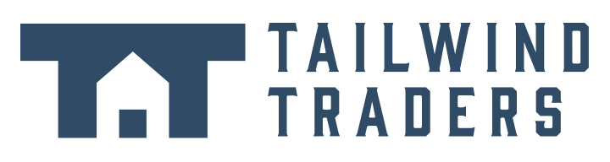
THE DAILY NEWS
theuselessweb.com
THE WORLD’S MOST MEH NEWSPAPER
- Since 5 seconds ago
Tailwind Traders Acquires Northwind
REDMOND, WA - Tailwind Traders, Inc announced that it has agreed to acquire Northwind Traders, the venerable "old guard" international foods company, in an effort to bolster its virtual hardware offerings with some international culinary flare. Tailwind agreed to acquire Northwind for an undisclosed sum and is assuming control of all of Northwind's virtual assets, not excluding the company's flagship product: Aniseed Syrup/
"This is a profoundly wonderful development for
for all involved, and will help to bring our food products to a whole new sector of the market" stated Nancy Daviolo, Executive Vice President of Operations. "We really couldn't be happier with the arrangement". The recently-promoted Daviolo will join the Tailwind executive team along with two of her close associates, Margaret Peacock and Michael Suyama. Daviolo took over Northwind’s company sales operations in 2012 after Andrew Fuller was
Notes:
Many of you are familiar with the Global company Northwind Traders, we’ve been working with them for a LONG time at Microsoft.
As we saw in LP2S4, Northwind initially moved onto the cloud with Azure App Service, under Tailwind's technical direction
They were able to adopt containers but didn't yet commit to a full-on container orchestration system
Today, they're going to make the next step and move to an orchestration system
Let's go recap what they learned about containers

Slide 7
Containers
A refresher
Notes:
We learned all about containers in LP2S4, so let's do a brief refresh here

Slide 8
What Containers Are
Fully packaged applications
Resource isolation without overhead
Ready to deploy with a standard API call
Better resource utilization
Standard image format
Notes:
Fully packaged applications, including dependencies like shared libraries, required tools, etc...
Resource isolation without the VM overhead
The standard API allows portability
Better resource utilization than VMs because you can share a kernel
Everything a container needs is stored in an image, which has a standard format, so it's portable

Slide 9
What Containers Aren't
Virtual Machines
No hardware virtualization
No hard security boundary
Notes:
Containers don't provide each running process its own complete view of a machine
Containers share underlying OS kernel, so no hardware virtualization
Some resource restriction and isolation mechanisms, but kernel exploits and misconfigurations can allow attackers to break out of container

Slide 10
Moving from VMs to Containers
Now is the best time to move
More cost effective, efficient and reliable
Dramatic deployment and resilience benefits
Notes:
We've seen the benefits and limitations of container technologies
Containers and their related tools have been battle tested over decades, and new, open tooling have democratized everything
We'll detail cost savings, reliability and security in the following slides

Slide 11
Cost Savings
Far more granular compute units
Use only what you need
Dramatic utilization improvement
Azure has per-second billing
Notes:
Containers work more efficiently on a single machine because they can share an underlying OS and are not virtualized
Azure has products that let you take advantage of the efficiencies that containers provide
Northwind will use these products to keep costs down

Slide 12
Reliability
Standard, robust monitoring APIs
Battle tested monitoring and orchestration tools
Incredible launch / restart / stop times
Notes:
Containers have several standards around them
There are battle tested tools that take advantage of these standards to deploy, run, monitor, and restart containers
Northwind will combine several of these tools with Azure services to make their site highly available and improve its redundancy across cloud regions

Slide 13
Security Wins
Fine-grained "sandbox" per-process
Principle of least privilege for processes
Quickly react to vulnerabilities, etc...
Easily build a new image with patch
Open technologies get constant audits
Notes:
Northwind is accustomed to patching their operating systems and tools to ensure their site is secure
But, on a few occasions they haven't been able to react fast enough and were exposed to exploits for too long
Containers allow them to automatically and constantly scan for vulnerabilities automatically, and react immediately when they find any

Slide 14
Azure Container Products:
Which option is right for me?
Notes:
In LP2S4, Northwind used Azure App Service for Linux
But Azure offers additional services that Northwind may want to use in their next technical evolution

Slide 15
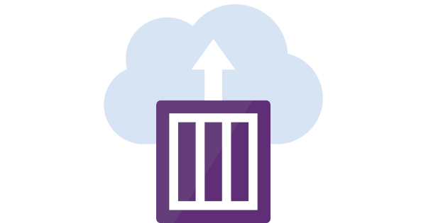
Azure Container Instances
Containers on demand
Per-second billing (!)
Integrations with other Azure services
No need to provision VM’s or clusters
Hypervisor level isolation
Public IP
Persistent Storage
Supports both Linux and Windows containers
Notes:
Containers as a service – a new take on serverless
… with VM quality isolation
The same as 'docker run' but in the cloud

Slide 16
Azure Container Instances
$ az container create
--resource-group myrg \
--name aci-helloworld \
--image microsoft/aci-helloworld \
--dns-name-label aci-demo \
--ports 80
Notes:
This command is equivalent to a 'docker run' that Northwind engineers are used to
It launches a container in the cloud, with a public IP address and DNS name
Since it's on Azure, you can integrate with other Azure cloud services as well

Slide 17

Azure App Services for Linux
Fully managed PaaS for containers
Support for many workflows
Advanced features for webapps
Notes:
Northwind is already using App Services
Workflows: everything from CLI to FTP to VS deployments
Advanced features for webapps: logging, SSL, etc...

Slide 18
Azure App Services for Linux
$ az webapp create \
-g myrg \
-n nginx \
--plan my-appservice-plan \
--deployment-container-image-name 'nginx'
Notes:
CLI deployment
Git Push deployment
VS Code Deployment
FTP Deployment

Slide 19
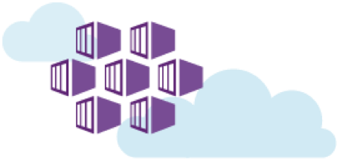
Azure Kubernetes Service
Azure's managed Kubernetes Product
Notes:
The last container offering is AKS, which we’re going to focus on today
Northwind has chosen to move forward with AKS for their container orchestrator
Their technical team will need to become familiar with Kubernetes before they adopt AKS and its related technologies
in order to understand the benefits of AKS, we first need to understand what Kubernetes and Container Orchestrators are.

Slide 20
What is Kubernetes?

Slide 21
What is Kubernetes?
Kubernetes is an open-source system for automating deployment, scaling, and management of containerized applications.
Container Orchestrator
Modular and pluggable
Self-healing
Designed by Google based on the system they use to run billions of containers per week.
Over 2,300 contributors
Including contributions from companies like Google, Microsoft, Red Hat, Intel, Huawei, CoreOS, IBM, Mesosphere, and many more)

Slide 22
What is Container Orchestration?
Decouple SRE teams from what’s inside the box
Notes:
Decouple SRE teams, separation of concerns from what’s inside the box (the app code), and the infrastructure that runs it.

Slide 23
What is container orchestration?
Scheduling
Affinity / Anti-Affinity
Health Monitoring
Failover
Scaling
Networking
Service Discovery
Notes:
Tons of content in here, so this is a good place to engage the audience (i.e. "who knows what 'scheduling' means for orchestrators")
Otherwise, here are all the definitions:
Scheduling: Find a suitable machine on which to run the container.
(Anti-)Affinity: Specify that a set of containers should run nearby each other (for performance) or sufficiently far apart (for availability)
Health monitoring: Watch for container failures and automatically reschedule them.
Failover: Watch for container failures and automatically reschedule them, keep track of what is running on each machine and reschedule containers from failed machines to healthy nodes.
(Auto-)Scaling: Add or remove container instances to match demand, either manually or automatically
Networking: Provide an overlay network for coordinating containers to communicate across multiple host machines
Service Discovery: Enable containers to locate each other automatically even as they move between host machines and change IP addresses

Slide 24
How does Kubernetes work?

Slide 25
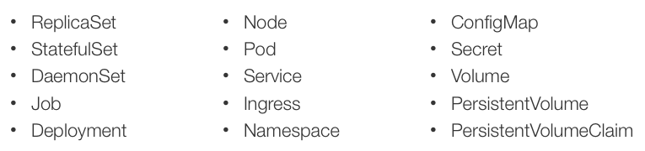
Kubernetes Objects

Slide 26
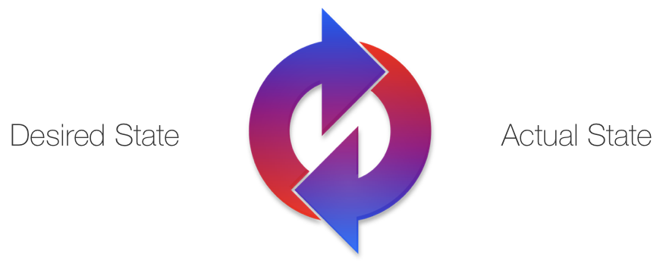
Reconciliation
Notes:
Kubernetes is a series of reconciliation loops that are constantly trying to reconcile the actual state toward the desired state specified by the declarative API

Slide 27
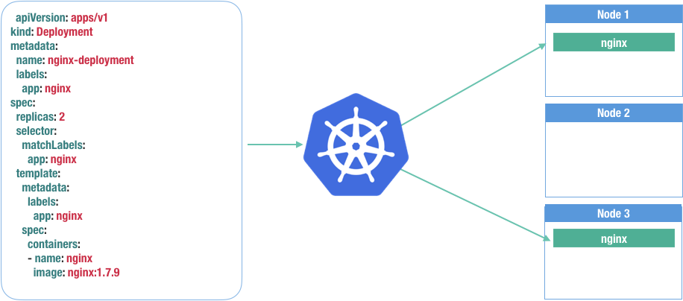
Reconciliation

Slide 28
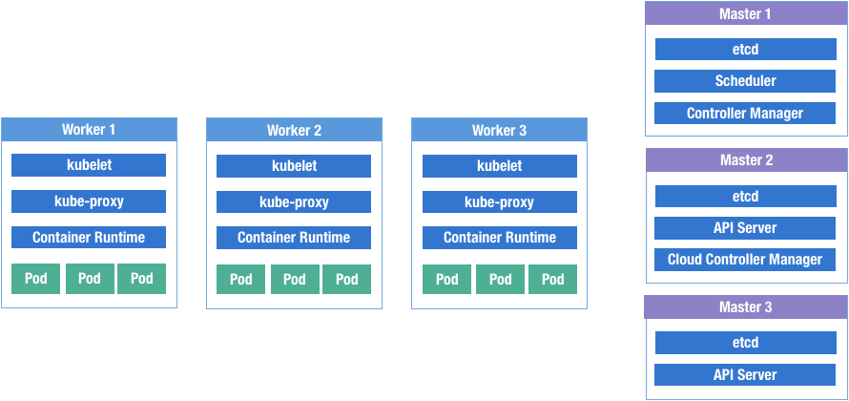
Control Plane
Notes:
Kubernetes has a series of control plane components that run on the agents and the master nodes
Kubelet – Responsible for pulling, running and monitoring images scheduled to it
Container Runtime – Docker, application that actually runs the container (called by kubelet)
Kube-Proxy – This makes service object real and routable by containers in the cluster
Etcd – Distributed database that stores all the Kubernetes data and leverages extensively by the control plane to monitor and save state
API Server – All components of the control plane, and tooling ran (kubectl) communicate with the API Server. Which fetches or writes the data to etcd.
Controller Manager – Runs many reconciliation loops to ensure that API objects are reconciled (ReplicationController, Node Status, etc)
Cloud Controller Manager – Reconciles API objects with a cloud provider (Service types of Load Balancer, Storage, etc)

Slide 29
AKS
Azure Kubernetes Service
Notes:
So that brings us back to AKS. why would we want to use AKS to run our Kubernetes clusters for us?

Slide 30
Azure Kubernetes Service
Kubernetes architecture is complex
Azure manages all of it for you
Full upstream Kubernetes code
Control plane (Kube API) is free, you pay for the workers VMs
And you have full access & ownership over the VMs you use
Cross-region and cross-cloud support
Notes:
Northwind explored deploying a Kubernetes cluster directly on Azure Virtual Machines
They were able to do it, but realized they'd have to scale up their operations team to maintain cluster health over the long term
They've chosen to use AKS, Azure's managed option, which effectively outsources the cluster operations to Azure without additional charge

Slide 31
Kubernetes Setup
az aks create \
--resource-group myResourceGroup \
--name myAKSCluster \
--node-count 5 \
--enable-addons monitoring,http_application_routing \
--generate-ssh-keys
Notes:
We’re not running this as part of the demo because of startup time of the cluster

Slide 32
Kubernetes Setup
az aks install-cli
Install kubectl tool to manage the cluster
az aks get-credentials
Configure kubectl to securely connect
Notes:
Install and configure local kubernetes administration tool “kubectl”

Slide 33
Kubernetes Upgrade
az aks get-upgrades \
--name myAKSCluster \
--resource-group myResourceGroup \
--output table
Name ResourceGroup MasterVersion NodePoolVersion Upgrades
------- ----------------- ---------------- ------------------- -----------
default myResourceGroup 1.8.10 1.8.10 1.9.1, 1.9.2, 1.9.6

Slide 34
Kubernetes Upgrade
az aks upgrade \
--name myAKSCluster \
--resource-group myResourceGroup \
--kubernetes-version 1.9.6

Slide 35
Kubernetes Scaling
az aks scale \
--name myAKSCluster\
--resource-group myResourceGroup \
--node-count 10
*Completely automate with Cluster Autoscaler

Slide 36
Helm
The Kubernetes Package Manager
Notes:
Make setup before talk, create databases, resource group,etc first
Make acr next – create the registry
Make aks

Slide 37
Helm
Another cloud native tool
“The Kubernetes Package Manager”
Simplifies deployment of applications
https://helm.sh
Notes:
Northwind has three microservices right now
Previously, they deployed each with a separate script. This was brittle because when an app changed, the script had to change and there was no way to test that
With Helm, they'll be able to describe how each microservice should be deployed and test everything out before they deploy to production

Slide 38
Helm Charts
Recipes for application deployment
You provide a few configuration values
Helm installs complex applications, all as one unit
Notes:
Helm charts are how they'll organize each microservice
The Docker image describes how the app should run, the chart describes how the app should be deployed to Kubernetes

Slide 39
Helm Chart Structure
Chart.yaml - metadata
values.yaml - variables
templates/ - Kubernetes deployment templates
service.yaml
deployment.yaml
ingress.yaml
Notes:
The Kube templates are similar to ARM templates
Explanation of each template:
service.yaml - a stable cluster-internal IP for the app. Kubernetes lets you make this a public IP too
deployment.yaml - the running app. Kubernetes allows you to scale up or down the number of replicas
ingress.yaml - routing rules from the public internet to your app

Slide 40
Helm Setup
Create cluster admin account for helm
helm init --service-account tiller
Installs “tiller” - the in-cluster component
Notes:
About Tiller:
Accepts requests from helm (e.g. helm list, helm install, etc....)
Manages the Kubernetes API based on the incoming chart and the request

Slide 41
Demo
Helm Deployment
Notes:
make acrbuild
make helm

Slide 42
Front Door
Geographical Load Balancing
Notes:
Now that Northwind has their services deployed to AKS, they'll need to turn their focus toward incoming traffic to their website

Slide 43
Front Door
Fully managed Layer 7 (HTTP) global load balancer
Battle tested by Microsoft's own apps
Modern features and standards built in
DDoS protection, edge SSL termination, intelligent caching, robust monitoring, ...
Notes:
Front Door is how they'll route their global website traffic to their AKS cluster
It provides several critical features they need to run an industrial grade, highly available web property
And it gives them flexibility to grow their deployment

Slide 44
Front Door
We'll show:
Creating a Front Door frontend
Finding / creating a backend pool
Creating powerful routing rules
Instant SSL certificate provisioning

Slide 45
Demo
Azure Front Door Basics
Notes:
make setup-fd

Slide 46
Multi Region
High availability during catastrophic failure.

Slide 47
Front Door with AKS
AKS ingress creates a public IP, routes inside the cluster
No SSL, caching, etc... out of the box
Layer Front Door on top
Notes:
Northwind can now take full advantage of Azure Front Door by putting it "in front" of their AKS cluster
That means that Front Door will serve all of their web traffic while forwarding appropriate requests on to their AKS cluster, and caching the rest
They'll gain enormous cost savings, network traffic reduction, and more with FD
And they'll also give themselves flexibility to grow their infrastructure
Note if needed: There is an experimental OSS project to support front door from within AKS: https://github.com/lawrencegripper/azurefrontdooringress

Slide 48
Multi-Region Redundancy
An entire region is offline, what do you do?
Notes:
As we've seen, Northwind is a global company and needs to be highly available everywhere, not just in the same region as their AKS cluster

Slide 49
Multi-Region Redundancy
Identical AKS clusters in different regions
Deploy to each with a strategy
One Front Door for everything
Notes:
Front Door is a global service in Azure – it has no region
Northwind's redundancy strategy will be simply to create multiple AKS clusters in different regions
Each AKS cluster will have a single public IP
So they'll use Front Door to route to each AKS cluster – called a backend

Slide 50
What About the Data?
Multi-region compute needs data replication
Cosmos DB is already global
SQL databases have replication
Notes:
Northwind has a robust strategy on how to route incoming web traffic to their clusters, but each cluster needs access to the same data
They'll need a data replication strategy or their redundancy strategy will be limited

Slide 51
Front Door & Data Replication with AKS
We'll show:
A second AKS cluster, a second LB
Seamless failover to the second LB to Front Door

Slide 52
Demo
Failover via Front Door for AKS

Slide 53
Putting it All Together
Benefits of containers on Azure
And all the options you have
Deploying to AKS with a click
How Azure Front Door fits in
Front Door & multiple AKS clusters with data replication
Notes:
Northwind was able to evolve their container strategy to a cloud native strategy
They moved from App Services to Kubernetes, AKS and Helm
They were able then to take advantage of Azure Front Door to begin implementing their global redundancy strategy
This gave them not only a global ingress point for their site, they also got advanced L7 features like SSL/HTTPS termination, caching, DDoS protection and more
They then used Azure CosmosDB global replication and SQL Server data replication to run their app in multiple AKS clusters around the world, but still operate on the same data
Northwind's move to cloud native, along with Azure services allowed them to quickly create a highly available planet-scale application and easily run, monitor and deploy it going forward

